Slide 1


Chapter 1
What is React JS?
Giảng viên: Từ Thị Xuân Hiền
Notes:
NOTE:
To change the image on this slide, select the picture and delete it. Then click the Pictures icon in the placeholder to insert your own image.

Slide 2
1.1 INTRODUCTION TO REACT JS

Slide 3
What is React JS?
React is a free and open-source front-end JavaScript library for building user interfaces (UIs) on the web.
React is a declarative, component-based library that allows developers to build reusable UI components and It follows the Virtual DOM (Document Object Model) approach, which optimizes rendering performance by minimizing DOM updates.
React is fast and works well with other tools and libraries.

Slide 4
Key Features
Virtual DOM: Minimizes direct DOM manipulation for faster updates.
JSX (JavaScript XML): Syntax extension that looks like HTML and integrates seamlessly with JavaScript, making code more readable and structured.
Component-Based Architecture: Encourages the creation of small, reusable components that can be composed into complex UIs.
Unidirectional Data Flow: Data flows from parent to child components, making data management predictable and easier to debug.
Notes:
Virtual DOM: Giảm thiểu thao tác DOM trực tiếp để cập nhật nhanh hơn.
JSX (JavaScript XML): Tiện ích mở rộng cú pháp trông giống HTML và tích hợp liền mạch với JavaScript, giúp mã dễ đọc và có cấu trúc hơn.
Kiến trúc dựa trên thành phần: Khuyến khích tạo các thành phần nhỏ, có thể tái sử dụng, có thể được kết hợp thành UI phức tạp.
Luồng dữ liệu đơn hướng: Dữ liệu chảy từ thành phần cha sang thành phần con, giúp quản lý dữ liệu có thể dự đoán được và dễ gỡ lỗi hơn.

Slide 5
Fundamental Concepts
Components: Building blocks of a React application, can be functional or class-based.
State and Props: State manages component data, while props are used to pass data from one component to another.
Lifecycle Methods: Class components have lifecycle methods (like componentDidMount, componentWillUnmount) that manage component behavior at different stages.
Hooks: Introduced in React 16.8, hooks (like useState, useEffect) allow functional components to manage state and side effects, making functional components more powerful.

Slide 6
React Native vs. React JS
React and React Native are developed by Facebook.
React Native is a React JS-based framework for designing mobile apps
React js | React native
React is a JavaScript library of reusable components designed to create skeletons of apps | React Native is designed to build native mobile apps with reusable components.
React is used to build the user interface for web applications | React Native is used for developing a mobile application for Android, iOS and Windows.
React utilizes HTML, CSS, and JavaScript to create interactive user interfaces | React Native utilizes APIs and native UI components to build mobile applications.

Slide 7
React Native vs. React JS
React js | React native
React.js used a virtual DOM to render browser code in React | React Native uses Native API to render components for mobile applications
React has a steep learning curve as it requires knowledge of libraries, | React Native is easier to understand with basic knowledge of React and JavaScript.
React is an open-source JS library for building the UIs for web applications | React Native is used to build rich mobile UI from declarative components using only JavaScript.

Slide 8
Setting up a development environment
Requirements:
Editor and Terminal: text editor (e.g. Sublime Text) and a command line tool (e.g. item). Using an IDE, for example Visual Studio Code, CodeSandbox is a great tool for sharing code online
Node and NPM: Both are used to manage libraries (node packages) that you will need along the way. Node.js is essential as it runs JavaScript code outside browsers, while NPM helps in managing packages needed for your projects
Notes:
Node.js rất cần thiết vì nó chạy mã JavaScript bên ngoài trình duyệt, trong khi NPM giúp quản lý các gói cần thiết cho các dự án của bạn

Slide 9
Setting up a development environment
Install Node.js and npm (Node Package Manager)
​​Download the Node.js installer from the official Node.js website.
Run the installer and follow the on-screen instructions. Make sure to check the box to install npm during the setup process.
After installation, confirm the installation: Open cmd and run the following commands
node -v
npm -v
Notes:
Node.js is a runtime that allows you to run JavaScript code.
npm is the package manager for Node.js, which helps install and manage libraries.

Slide 10
Setting up a development environment
Install Create React App
What it does: Create React App is a command-line tool that helps you create a new React project with the necessary build configurations.
Steps:
Open Command Prompt and run the following command to install Create React App globally
npm create vite@latest my-app

Slide 11
Setting up a development environment
Create a New React Project
What it does: Creates a new directory with the necessary setup for a React project.
Steps:
Navigate to the directory where you want to create your React app.
Run the following command to create a new React app
Replace my-app with your preferred project name.
This will create a new folder named my-app and set up the project structure and dependencies.
npx create-react-app my-app

Slide 12
Setting up a development environment
Navigate into the Project Folder
What to do: After the project is created, go to the project directory to begin working on your app.
Steps:
Run the following command
cd my-app
npm install
npm run dev

Slide 13
Setting up a development environment
Start the Development Server
What it does: Runs the development server and opens the app in your browser at http://localhost:5173/.
Steps:
Inside your project folder, run the following command
The app will open in your default browser, and you’ll see a React page running locally
npm run dev

Slide 14
Setting up a development environment
Project Structure Overview
What files are generated:
node_modules/: Contains installed libraries.
public/: Contains static files like index.html.
src/: Contains React components and JavaScript files.
package.json: Manages project dependencies, scripts, and metadata.

Slide 15
Setting up a development environment
Next Steps
Start editing the files in the src/ directory to build your app.
Add new components, styles, and any features needed for your React project.

Slide 16
Overview of React JS architecture
React is like a toolbox for building websites. It's made up of different parts that help developers create interactive and user-friendly web pages.
The way these parts are organized and work together is what we call React architecture.
React architecture is a collection of components responsible for building a software’s User Interface (UI). You can also see it as an organization of your codebase that helps you build your unique project.

Slide 17
Overview of React JS architecture
React Architecture Important in Web Development
Easy to Fix and Update: With a good React architecture, it's easier to figure out what's broken and fix it.
Can Grow with the Website: As websites get bigger and more complex, a solid React architecture allows them to grow smoothly.
Reuse What You Already Have: React lets developers reuse components of code.
Make Websites Faster: A well-organized React architecture helps websites load quickly and respond fast to user actions.
Work Together Better: When developers collaborate on building a website, having a clear React architecture helps everyone understand how things fit together.

Slide 18
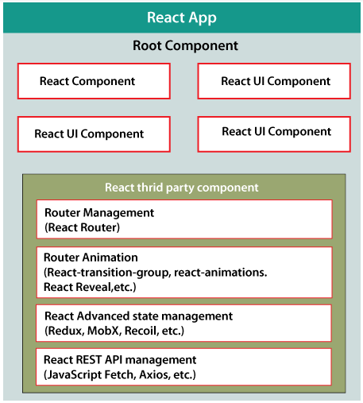
Overview of React JS architecture

Slide 19
Overview of React JS architecture
React library is just UI library and it does not enforce any particular pattern to write a complex application. Developers are free to choose the design pattern of their choice.
One of the patterns is Flux pattern. React library also provides lot of concepts like Higher Order component, Context, Render props, Refs etc., to write better code.
React Hooks is evolving concept to do state management in big projects.

Slide 20
Overview of React JS architecture
Components:
Building blocks of a React application.
Can be functional (stateless) or class-based (stateful).
JSX: Syntax for embedding HTML-like code in JavaScript.
State and Props:
Props: Data passed from parent to child components.
State: Data managed within a component.
Virtual DOM: Optimized for rendering changes.Visual: A diagram of a React app's structure with arrows showing data flow.

Slide 21
Overview of React JS architecture
Component-Based Architecture
Functional and Class Components:
Functional Components are stateless and primarily concerned with rendering UI.
Example:
Class Components are stateful and can hold and manage state. They provide more features and lifecycle methods, allowing for more complex functionality
Example
const Greeting = (props) => { return <h1>Hello, {props.name}!</h1>; };
class Greeting extends React.Component { render() { return <h1>Hello, {this.props.name}!</h1>; } }

Slide 22
Overview of React JS architecture
Component-Based Architecture
Hooks: Introduced in React 16.8, hooks are functions like useState, useEffect, and useContext that allow functional components to have state and side effects, making them more powerful and capable of handling most of the functionality that was previously available only in class components.

Slide 23
Overview of React JS architecture
Virtual DOM: React uses a Virtual DOM, which is a lightweight representation of the real DOM.
Workflow:
React creates a Virtual DOM tree whenever the state or props change.
It calculates the differences (diffing) between the new and old Virtual DOM trees.
Efficiently updates the actual DOM only with the changes.

Slide 24
Overview of React JS architecture
JSX (JavaScript XML)
React uses JSX, which is a syntax extension for JavaScript. It looks similar to HTML but can include JavaScript expressions. JSX is compiled into regular JavaScript at runtime.
JSX allows developers to define the UI structure directly in the component, making it easier to visualize the layout of the UI within the code.
Notes:
JSX (JavaScript XML)
React sử dụng JSX, là phần mở rộng cú pháp cho JavaScript. Nó trông giống HTML nhưng có thể bao gồm các biểu thức JavaScript. JSX được biên dịch thành JavaScript thông thường khi chạy.
JSX cho phép các nhà phát triển xác định cấu trúc UI trực tiếp trong thành phần, giúp dễ hình dung bố cục của UI trong mã hơn.

Slide 25
Overview of React JS architecture
State and Props
State: Each React component can maintain its own state. State represents the internal data of the component that can change over time and trigger re-rendering of the component.
Props: "Props" (short for properties) are how data is passed from parent components to child components. Props are immutable, meaning a component cannot change its own props directly, but it can pass them down to child components.

Slide 26
Overview of React JS architecture
Unidirectional Data Flow
React follows a unidirectional data flow. This means that data flows from parent components down to child components via props.
When a user interacts with the UI (e.g., clicking a button or entering text), an event handler in a component updates its state, which in turn causes a re-render and updates the UI.
React Router
React Router is a popular library for handling routing in single-page applications (SPAs). It allows navigation between different views or pages within the application without triggering a full page reload

Slide 27
Overview of React JS architecture
React Lifecycle:
React class components have lifecycle methods that allow developers to run code at specific points in the component’s lifecycle. In functional components, these lifecycle methods are replaced by hooks such as useEffect.
Common lifecycle methods include:
componentDidMount()
componentDidUpdate()
componentWillUnmount()
useEffect() for functional components.

Slide 28
Overview of React JS architecture
Hooks
Hooks allow you to "hook into" React features like state, lifecycle methods, and context in functional components. Common hooks include:
useState: For state management
useEffect: For side effects (e.g., data fetching, subscriptions).
useContext: For accessing context values.
useReducer: For managing more complex state logic.

Slide 29
Overview of React JS architecture
Context API
The Context API provides a way to pass data through the component tree without having to manually pass props down at every level. It is particularly useful for global state management, like theming or user authentication status.
React DevTools
React DevTools is a browser extension that allows developers to inspect and debug React applications. It provides features such as inspecting the component tree, viewing props and state, and measuring component performance.

Slide 30
Overview of React JS architecture
Bundling and Compilation
React applications are typically bundled using tools like Webpack or Vite. JSX code is compiled into JavaScript during the build process, and ES6+ features are transpiled into compatible JavaScript using Babel.
Redux (optional)
While React itself does not provide a built-in state management solution for large applications, Redux is often used in large-scale React applications for managing global state. It uses a single immutable state tree and allows for predictable state updates via actions and reducers.

Slide 31
Visual Studio Code development environment
1. Install Visual Studio Code
2. Install Node.js and npm
3. Install Create React App (Optional)
Create React App is a tool to quickly set up a new React project with a good default configuration.
Once installed, you can create a new React project
npm create vite@latest my-app

Slide 32
Visual Studio Code development environment
Open the React Project in VS Code
Open the VS Code editor.
Use File > Open Folder to open the folder containing your React project (e.g., the folder where you created your app using create-react-app).
Alternatively, from the terminal/command prompt, you can navigate to the project folder and open it directly in VS Code by running:

Slide 33
Visual Studio Code development environment
Install Essential VS Code Extensions:
ES7 React/Redux/GraphQL/React-Native snippets: This extension provides many useful code snippets for React, Redux, and GraphQL.
Install it from the VS Code Extensions Marketplace.
Prettier - Code formatter: Helps format your code automatically for better readability and consistency.
ESLint: A linter for JavaScript and JSX that can help enforce code quality and style.
Bracket Pair Colorizer: This extension adds color-coding to matching brackets, which is particularly helpful in React with complex JSX.
Path Intellisense: Provides autocompletion for file paths when importing components and assets in your React project.
Reactjs code snippets: Offers more advanced React-specific snippets for faster development.
GitLens: Enhances VS Code's built-in Git capabilities, providing a deeper insight into Git history, blame annotations, and more.

Slide 34
Visual Studio Code development environment
Configure ESLint and Prettier
ESLint helps you maintain code quality by identifying potential issues, while Prettier automatically formats your code according to a standard style.
You can install them in your React project.
Create an ESLint configuration file (.eslintrc.json) and a Prettier configuration file (.prettierrc) at the root of your project.
npm install --save-dev eslint prettier eslint-plugin-react eslint-config-prettier eslint-plugin-prettier

Slide 35
Visual Studio Code development environment
Example .eslintrc.json:
{
"extends": [
"eslint:recommended",
"plugin:react/recommended",
"plugin:prettier/recommended"
],
"parser": "babel-eslint",
"plugins": ["react", "prettier"],
"env": {
"browser": true,
"es2021": true
},
"rules": {
"prettier/prettier": "error",
"react/prop-types": "off"
}
}

Slide 36
Visual Studio Code development environment
Configure Debugging: VS Code has built-in debugging support. To configure it for React development:
Go to the Run and Debug sidebar (click the play icon with a bug on the left).
Click create a launch.json file, then select Chrome (or another browser if you prefer).
Add the following configuration to your launch.json:

Slide 37
Visual Studio Code development environment
Configure Debugging
{
"version": "0.2.0",
"configurations": [
{
"name": "Launch Chrome against localhost",
"type": "chrome",
"request": "launch",
"url": "http://localhost:3000",
"webRoot": "${workspaceFolder}"
}
]
}

Slide 38
Visual Studio Code development environment
Version Control with Git
Git integration is built into VS Code, allowing you to manage version control and collaborate with others. Make sure Git is installed on your system.
You can check if Git is installed by running
git --version

Slide 39
Visual Studio Code development environment
Run and Build the React Application
To run the React app, open a terminal inside VS Code (press Ctrl + or go to Terminal > New Terminal).
In the terminal, run:
npm run dev

Slide 40
Visual Studio Code development environment
Additional Tips for React Development in VS Code
Auto-save: Enable auto-save in VS Code to automatically save your files after a short delay. Go to File > Preferences > Settings and search for "Auto Save".
Code Navigation: Use Ctrl+P to quickly navigate to files in your project and Ctrl+Shift+O to navigate to symbols in the current file.
Live Server: If you want to preview static files or non-React content, use the Live Server extension, which auto-refreshes the page on file changes.

Slide 41
1.2 Basic concepts of React JS
Components: Components are independent and reusable bits of code. They serve the same purpose as JavaScript functions, but work in isolation and return HTML.
Components come in two types
Class components.
Function components.

Slide 42
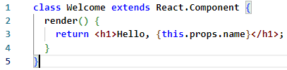
Basic concepts of React JS
Class Component: must include the extends React.Component statement. This statement creates an inheritance to React.Component, and gives your component access to React.Component's functions.
The component also requires a render() method, this method returns HTML.
Notes:
When creating a React component, the component's name MUST start with an upper case letter.
Các Class components là những class ES6. Chúng phức tạp hơn functional components ở chỗ nó còn có: phương thức khởi tạo, life-cycle, hàm render() và quản lý state (data).
Vì vậy, một React class component là:
là một class ES6, nó sẽ là một component khi nó "kế thừa" React component.
có thể nhận props (trong hàm khởi tạo) nếu cần.
có thể maintain data của nó với state
phải có 1 method render() trả về 1 React element (JSX), or null

Slide 43

Basic concepts of React JS
A Function component also returns HTML, and behaves much the same way as a Class component, but Function components can be written using much less code, are easier to understand, and will be preferred in this tutorial.
Example
Notes:
1 functional component là một hàm Javascript (hoặc ES6) trả về 1 phần tử/1 element React. Theo official docs của React,
Functional components cũng được nói với một cái tên là stateless components bởi vì chúng ta không thể làm nhiều thứ phức tạp như quản lý React State (data) hoặc phương thức life-cycle trong functional components.
Vậy 1 React Functional Component là:
một function Javascript / ES6 function
phải trả về 1 React element
nhận props làm tham số nếu cần

Slide 44
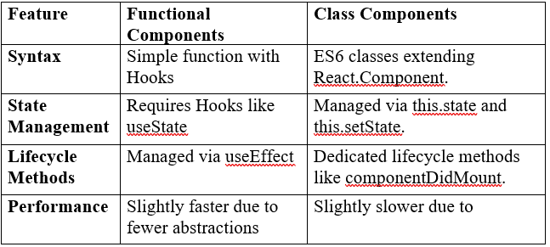
React Functional vs. Class Components

Slide 45
State and Props
State in React:
State in ReactJS refers to an object that stores a component’s dynamic data and determines how the component behaves.
It is an instance of the React Component Class that can be defined as an object of a set of observable properties that control the behavior of the component.
React components has a built-in state object.
The state object is where you store property values that belong to the component.
When the state object changes, the component re-renders

Slide 46
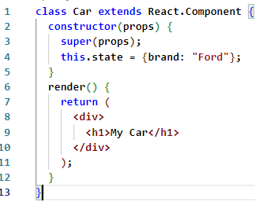
State and Props
Creating the state Object: The state object is initialized in the constructor: Specify the state object in the constructor method

Slide 47
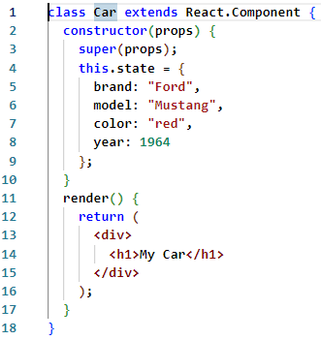
State and Props
The state object can contain as many properties as you like:

Slide 48
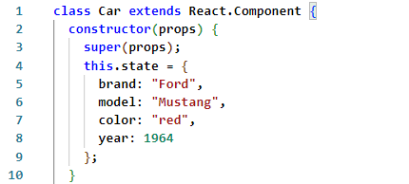
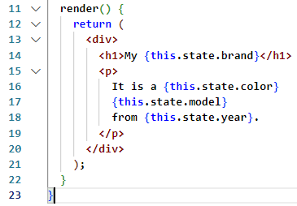
State and Props
Using the state Object: Refer to the state object anywhere in the component by using the this.state.propertyname syntax
Example: Refer to the state object in the render() method:

Slide 49
State and Props
Changing the state Object To change a value in the state object, use the this.setState() method.
When a value in the state object changes, the component will re-render, meaning that the output will change according to the new value(s).
Example
Add a button with an onClick event that will change the color property:

Slide 50
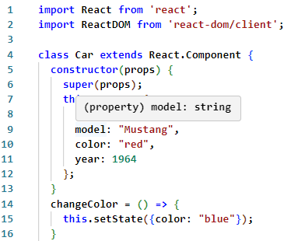
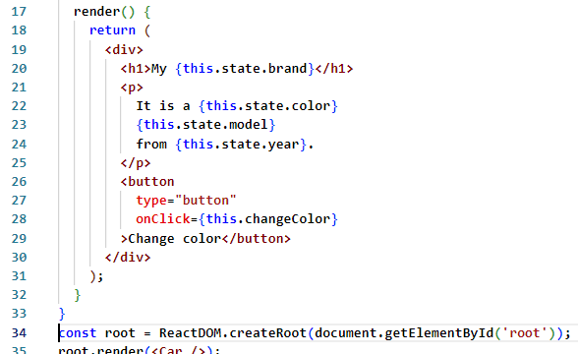
State and Props
Changing the state Object:

Slide 51
State and Props
Props in React:
Props are arguments passed into React components.
Props are objects which can be used inside a component.
React Props are like function arguments in JavaScript and attributes in HTML.
To send props into a component, use the same syntax as HTML attributes:
Example: Add a "brand" attribute to the Car element:

Slide 52

State and Props
Props in React:
The component receives the argument as a props object: For Example, Use the brand attribute in the component:

Slide 53
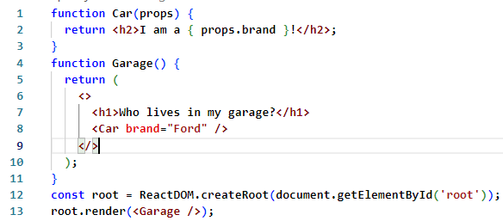
State and Props
Pass Data: Props are also how you pass data from one component to another, as parameters.
Example: Send the "brand" property from the Garage component to the Car component:

Slide 54
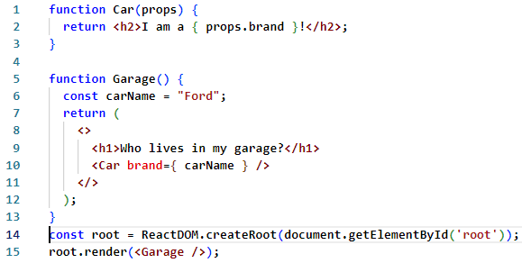
State and Props
Pass Data: If you have a variable to send, and not a string as in the example above, you just put the variable name inside curly brackets
Example: Create a variable named carName and send it to the Car component:

Slide 55
Event handling
React Events: Just like HTML DOM events, React can perform actions based on user events. React has the same events as HTML: click, change, mouseover etc.
Adding Events: React events are written in camelCase syntax:
onClick instead of onclick.
React event handlers are written inside curly braces:
onClick={shoot} instead of onclick="shoot()".

Slide 56
Event handling
React Events
Example:
React
HTML:

Slide 57
Styling components
Styling React Using CSS: There are many ways to style React with CSS:
Inline styling
CSS stylesheets
CSS Modules

Slide 58
Styling components
Using Inline Styles: Inline styles in React are defined using the style prop, which accepts an object.
The keys in the object are written in camelCase, and the values are the corresponding CSS values.
Syntax: assign inline styles to CSS elements is mentioned below

Slide 59
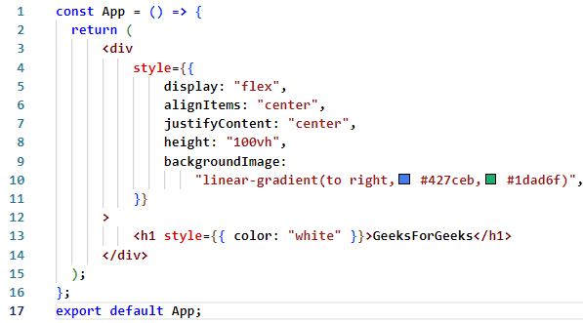
Styling components
Using Inline Styles:
Example: add inline styling to the React elements.

Slide 60
Styling components
Using CSS File: To style elements using a traditional CSS file, you can create a CSS file and import it into your React component.
Syntax: assign the classes to the className prop .

Slide 61
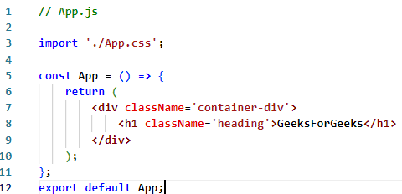
Styling components
Using CSS File
Example:

Slide 62
Styling components
Using CSS Modules: CSS Modules allow you to locally scope CSS by generating unique class names.
To use CSS Modules, create a file with the .module.css extension and import it into your component.
Syntax:

Slide 63

Styling components
Using CSS Modules:
assign the classes to the className properties

Slide 64
Styling components
Using CSS Modules:
Example :The content of App.js and App.css files demonstrating the use of CSS modules to style the React element
/*App.modules.css*/
.container - div {
display: flex;
align - items: center;
justify - content: center;
height: 100vh;
background - image: linear - gradient(
to right, #427ceb, #1dad6f);
}
.heading { color: white;}

Slide 65
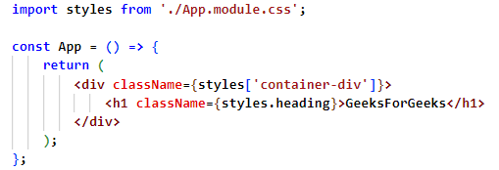
Styling components
Using CSS Modules:
Example(tt)

Slide 66
Styling components
Using Styled-Components:
styled-components is a popular library for writing component-level styles in JavaScript. It allows you to create styled components with a combination of CSS and JavaScript.
Module Installation: In order to use the styled-components you must first install it as a dependency using the following command from the command line
npm install styled-components

Slide 67

Styling components
Using Styled-Components:
Syntax: create a styled component

Slide 68
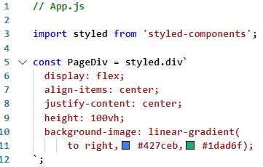
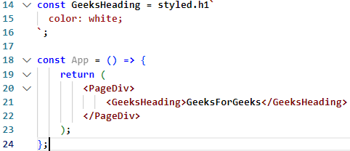
Styling components
Using Styled-Components:
Example

