Slide 1


Chương 2.
Components
Giảng viên: Từ Thị Xuân Hiền
Notes:
NOTE:
To change the image on this slide, select the picture and delete it. Then click the Pictures icon in the placeholder to insert your own image.

Slide 2
Class Components
Basic Concepts
Props & State
Lifecycle Methods
Mini Project (Todo App – Class Component)

Slide 3
Function Component
Function Component Basics
useState Hook
useEffect Hook
Advanced Hooks
Mini Project (Todo App – Hooks)

Slide 4
Class Component

Slide 5
Why do we still need Class Components?
Many legacy projects still use class components
Understanding lifecycle fundamentals
Easier maintenance and refactoring of old code

Slide 6
Function vs Class (Quick Comparison)
Function: Hooks (useState, useEffect)
Class: state, setState, lifecycle methods

Slide 7
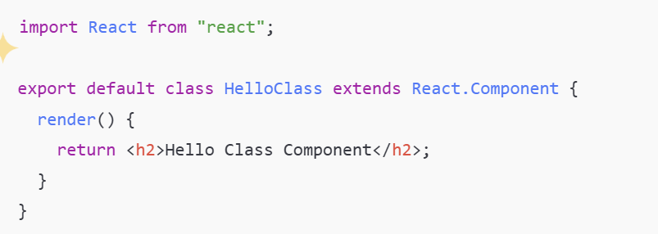
Minimal Class Component Syntax

Slide 8
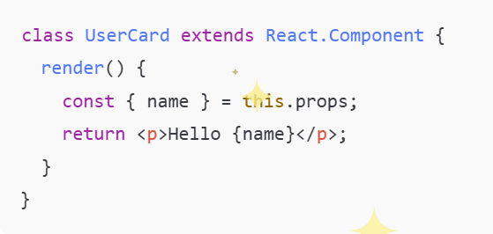
Props in Class Components

Slide 9
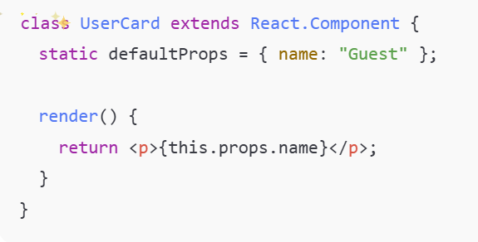
Default Props

Slide 10
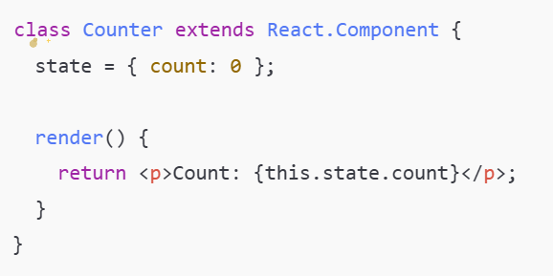
State: Definition & Initialization

Slide 11
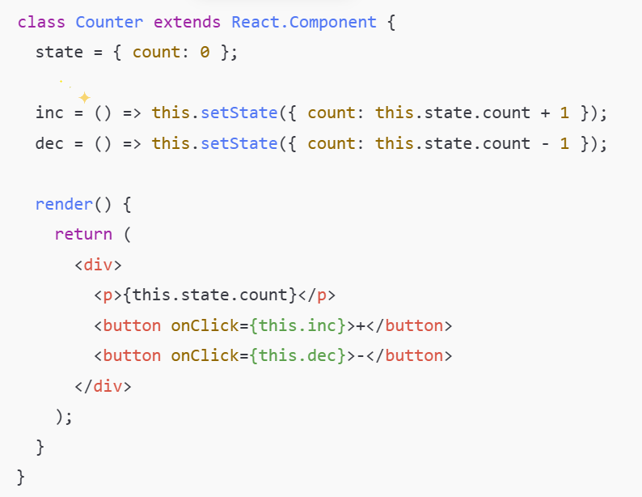
Updating State with setState

Slide 12

Correct setState Usage
Safe when state depends on previous state.

Slide 13
Event Handlers & this
Use arrow functions to avoid losing this

Slide 14
Lifecycle Overview
componentDidMount
componentDidUpdate
componentWillUnmount

Slide 15
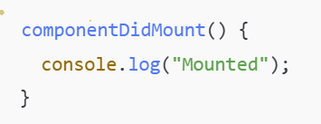
componentDidMount
Fetching data
Initializing timers
Subscriptions

Slide 16
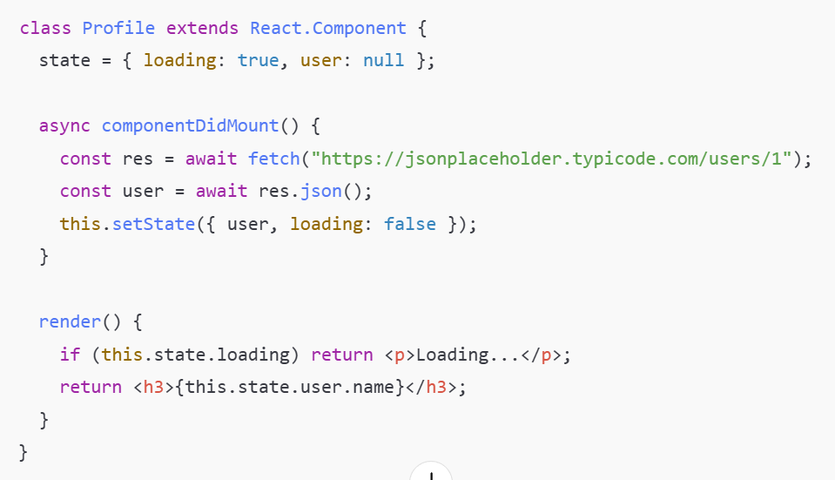
Example: Fetch Data on Mount

Slide 17
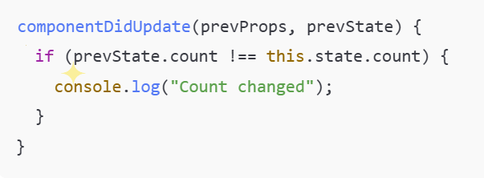
componentDidUpdate

Slide 18
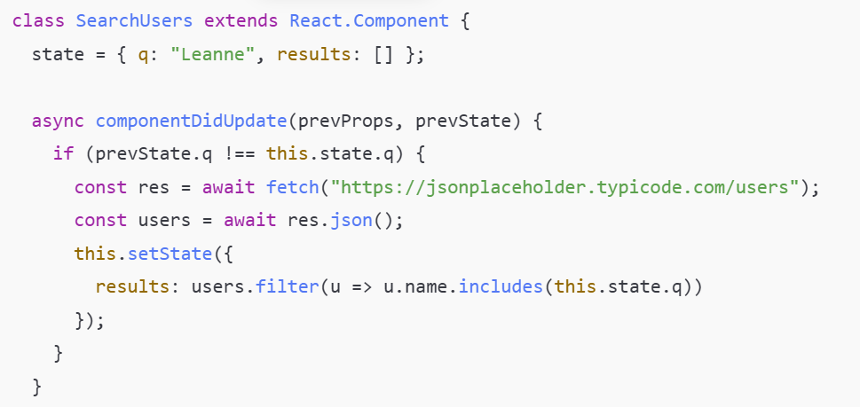
Example: Reacting to State Change

Slide 19
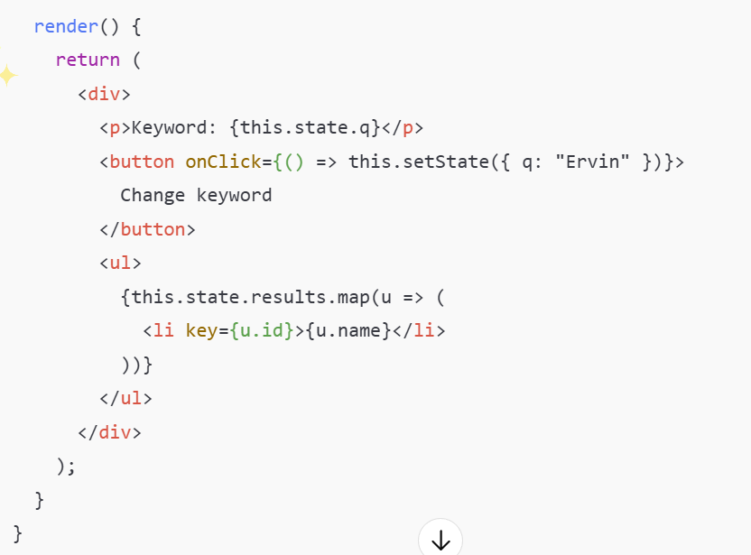
Example: Reacting to State Change

Slide 20
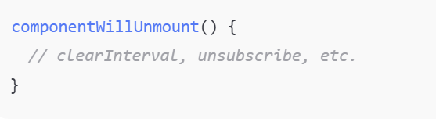
componentWillUnmount

Slide 21
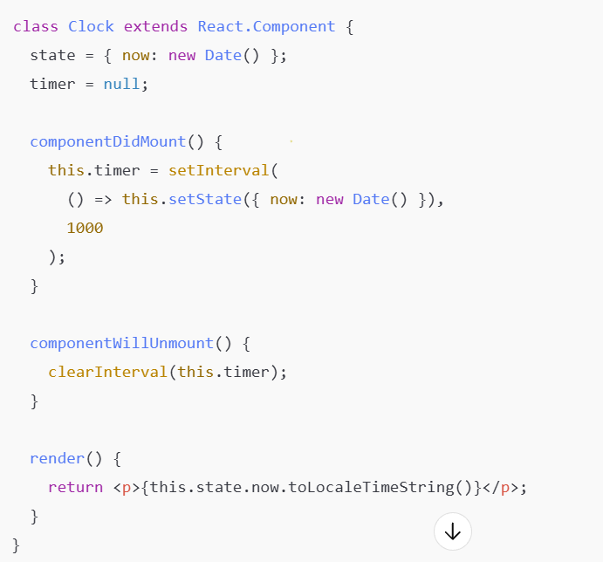
Example: Timer with Cleanup

Slide 22
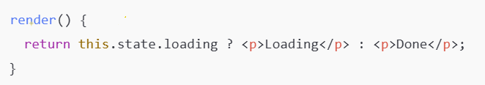
Conditional Rendering

Slide 23
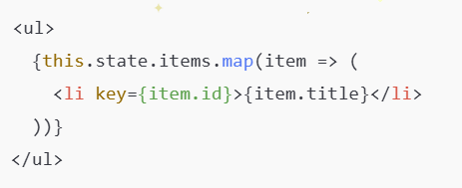
Rendering Lists

Slide 24
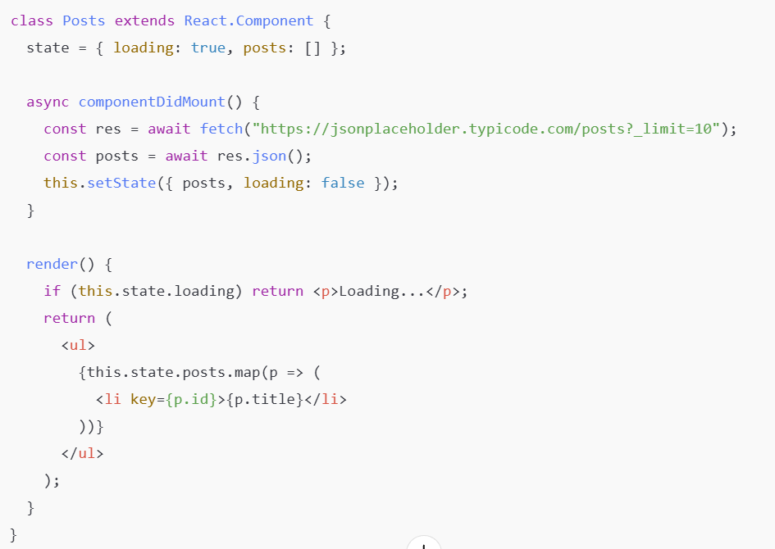
Example: Fetch & Render Posts

Slide 25
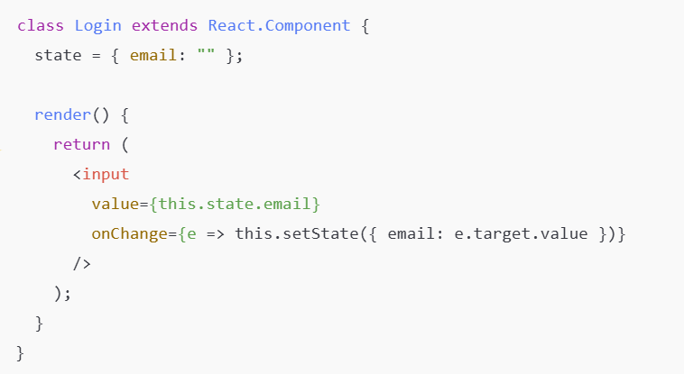
Controlled Input (Forms)

Slide 26
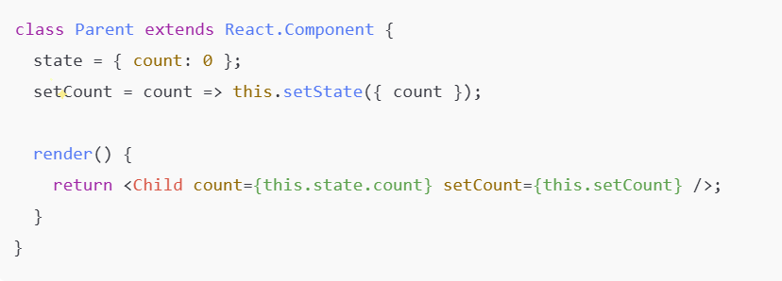
Lifting State Up

Slide 27
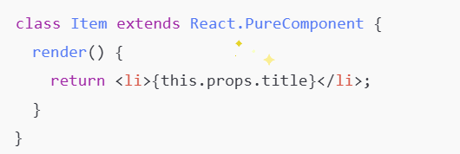
Performance: PureComponent

Slide 28
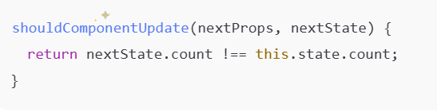
shouldComponentUpdate

Slide 29
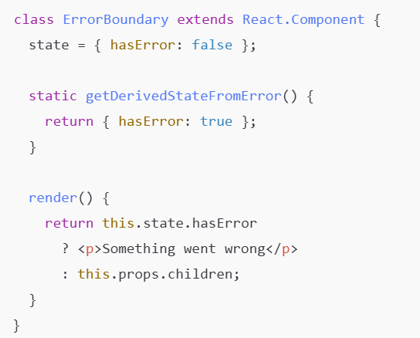
Error Boundary (Class Only)

Slide 30
Function Component

Slide 31
Why Function Components?
Cleaner syntax
Easier reuse with hooks
Official recommendation by React

Slide 32
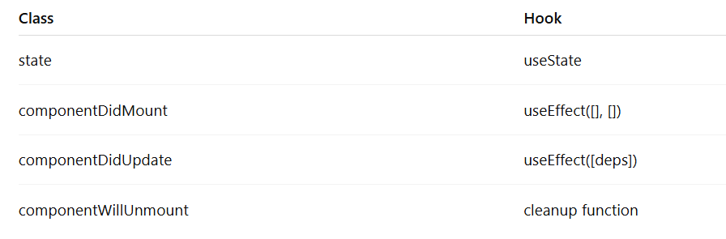
Lifecycle Mapping

Slide 33
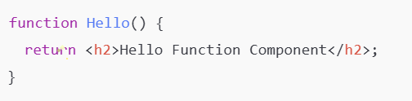
Minimal Function Component

Slide 34
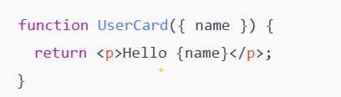
Props in Function Components

Slide 35
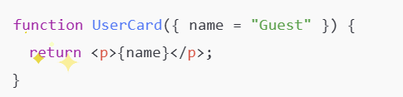
Default Props via Parameters

Slide 36

useState Basics

Slide 37

Updating State

Slide 38

Functional State Update

Slide 39

useState with Objects

Slide 40
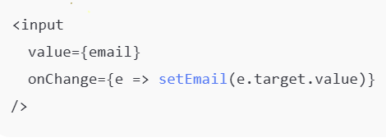
Controlled Input

Slide 41

Rendering Lists

Slide 42

Conditional Rendering

Slide 43
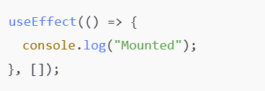
useEffect: componentDidMount

Slide 44
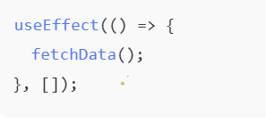
Fetch Data on Mount

Slide 45
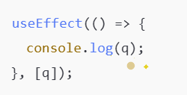
useEffect with Dependencies

Slide 46
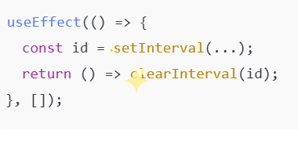
Cleanup (Unmount)

Slide 47
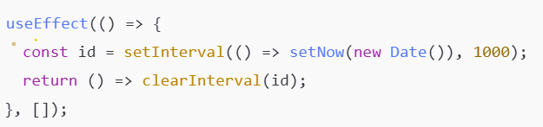
Clock Example

Slide 48

useRef (No Re-render)

Slide 49

useRef with DOM

Slide 50

Lifting State Up

Slide 51
Final Summary
Hooks replace lifecycle
Function components are default choice
Understand both for real-world projects

