Slide 1


Chương 2.
Components
Giảng viên: Từ Thị Xuân Hiền
Notes:
NOTE:
To change the image on this slide, select the picture and delete it. Then click the Pictures icon in the placeholder to insert your own image.

Slide 2
Core Components and APIs
Giảng viên: Từ Thị Xuân Hiền

Slide 3
Components
Components are independent and reusable bits of code. They serve the same purpose as JavaScript functions, but work in isolation and return HTML.
Types of Components in React: In React, we mainly have two types of components:
Functional Components
Class based Components

Slide 4
Components
Functional Component in React
Functional components are just like JavaScript functions that accept properties and return a React element.
We can create a functional component in React by writing a JavaScript function. These functions may or may not receive data as parameters
Syntax:
function demoComponent() { return (<h1> Welcome Message! </h1>);
}

Slide 5

Components
Example: Create a function component called welcome.

Slide 6
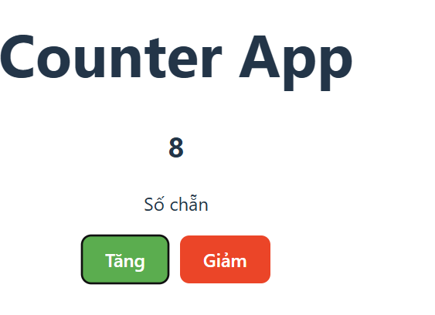
Components
Example: tạo một ứng dụng Counter App, sử dụng function component

Slide 7
Components
Class Component in React
The class components are a little more complex than the functional components. A class component can show inheritance and access data of other components.
Class Component must include the line “extends React.Component” to pass data from one class component to another class component.
Syntax:
class Democomponent extends React.Component { render() { return <h1>Welcome Message!</h1>; } }

Slide 8
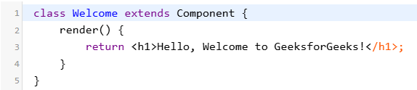
Components
Example

Slide 9
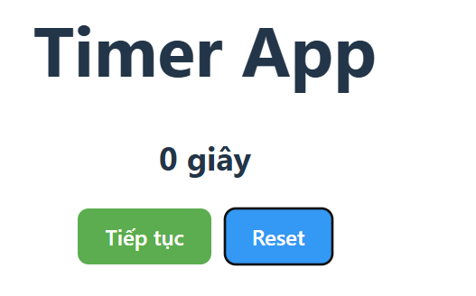
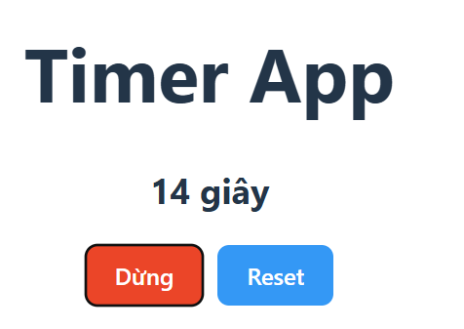
Components
Example: Xây dựng một Timer App, sử dụng class component

Slide 10
Components
Functional Component vs Class Component:
A functional component is best suited for cases where the component doesn’t need to interact with other components or manage complex states. Functional components are ideal for presenting static UI elements or composing multiple simple components together under a single parent component.
Class-based components can achieve the same result, they are generally less efficient compared to functional components. Therefore, it’s recommended to not use class components for general use.
Notes:
Một functional component phù hợp nhất cho các trường hợp mà thành phần không cần tương tác với các thành phần khác hoặc quản lý các trạng thái phức tạp. Các thành phần chức năng lý tưởng để trình bày các thành phần UI tĩnh hoặc kết hợp nhiều thành phần đơn giản lại với nhau dưới một thành phần cha duy nhất.
Các class component có thể đạt được kết quả tương tự, chúng thường kém hiệu quả hơn so với các thành phần chức năng. Do đó, không nên sử dụng các thành phần lớp cho mục đích sử dụng chung.

Slide 11
Rendering React Components
Rendering Components means turning your component code into the UI that users see on the screen.
React is capable of rendering user-defined components.
To render a component in React we can initialize an element with a user-defined component and pass this element as the first parameter to ReactDOM.render() or directly pass the component as the first argument to the ReactDOM.render() method.
Syntax:
The componentname is the name of the user-defined component
const elementName = <ComponentName />;
Notes:
Note: The name of a component should always start with a capital letter. This is done to differentiate a component tag from an HTML tag.

Slide 12
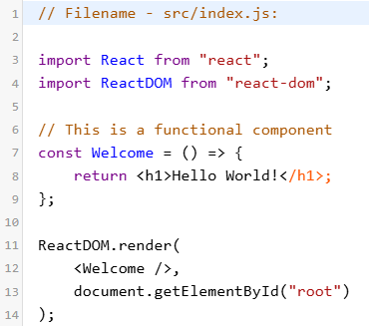

Rendering React Components
Example
Output: This output will be visible on the http://localhost:3000/ on the browser window.

Slide 13
Rendering React Components
Explanation:
Call the ReactDOM.render() as the first parameter.
React then calls the component Welcome, which returns <h1>Hello World!</h1>; as the result.
Then the ReactDOM efficiently updates the DOM to match with the returned element and renders that element to the DOM element with id as “root”.

Slide 14
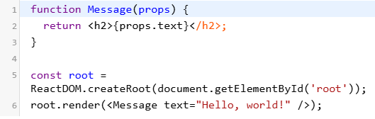
Rendering React Components
Props: (short for properties) are a way to pass data from the parent component to the child component.
Props are like function arguments, you can use them as attributes in components.
Example:

Slide 15
Rendering React Components
Example: tạo project
npm create vite@latest my-react-app --template react
cd my-react-app
npm install
npm run dev
Tạo hai file:
App.jsx (parent component)
Child.jsx (child component)

Slide 16
Rendering React Components
File App.jsx (Parent Component) là component cha, nơi dữ liệu được định nghĩa và truyền xuống cho component con qua Props.

Slide 17
Rendering React Components
import React from 'react’;
import Child from './Child';
function App() {
const parentMessage = "Hello from Parent! 👋";
const parentNumber = 42;
return (
<div>
<h1>Parent Component</h1>
<Child message={parentMessage} number={parentNumber} />
</div>
);
}
export default App;

Slide 18
Rendering React Components
File Child.jsx (Child Component)
import React from 'react';
function Child({ message, number }) {
return (
<div>
<h2>Child Component</h2>
<p>Message from Parent: {message}</p>
<p>Number from Parent: {number}</p>
</div>
);
}
export default Child;
Notes:
Truyền dữ liệu từ parent đến child:
Trong App.jsx, props message và number được truyền cho Child bằng cách sử dụng cú pháp:jsx
CopyEdit
<Child message={parentMessage} number={parentNumber} />
Nhận dữ liệu trong child:
Trong Child.jsx, dữ liệu được nhận qua tham số props và destructuring:jsx
CopyEdit
function Child({ message, number }) {
Hiển thị dữ liệu:
Child hiển thị dữ liệu nhận được từ parent bằng cách truy cập giá trị từ props.

Slide 19
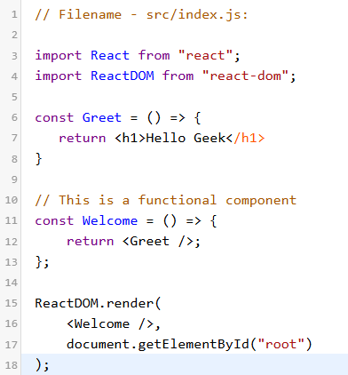
Components in Components
We can call components inside another component
Example:

Slide 20
Core Components
Core components are ready-to-use components available from React Native, which include <View>, <Text>, <Image>, <ScrollView>, <Button>, and <TextInput>.
Importing Core Components: You can import core components into your Expo project from the react-native package.

Slide 21
Core Components
Core Components Optional Functionality:
Core components may have more optional functionality, which you can configure through the props.

Slide 22
Core Components
<View> Component
The <View> component is a generic “visible” container without any semantic meaning or noticeable performance impact, best translated as <div> from web.
<TextInput> Component
The <TextInput> component can capture alphanumeric input from the user. Its behavior can be modified with the onChangeText prop, which accepts a function.

Slide 23
Core Components
<ScrollView> Component
The <ScrollView> component is a generic “visible” container with scrolling, but it’s less performant than <View>, making it less suitable for simple styling and short lines of text.
<Text> Component
The <Text> component is the only way to display text in React Native. These components can be nested to inherit and modify styling.

Slide 24
Learn to Work with API- JavaScript
What is an API (Application Programming Interface)?
APIs are mechanisms that enable two software components to communicate with each other using a set of definitions and protocols.
For example, the weather bureau’s software system contains daily weather data. The weather app on your phone “talks” to this system via APIs and shows you daily weather updates on your phone.
Notes:
API là cơ chế cho phép hai thành phần phần mềm giao tiếp với nhau bằng một tập hợp các định nghĩa và giao thức.
Ví dụ, hệ thống phần mềm của cơ quan thời tiết chứa dữ liệu thời tiết hàng ngày. Ứng dụng thời tiết trên điện thoại của bạn "giao tiếp" với hệ thống này thông qua API và hiển thị cho bạn thông tin cập nhật thời tiết hàng ngày trên điện thoại.

Slide 25
Learn to Work with API- JavaScript
What is an API (Application Programming Interface)?
Common Uses:
Fetching data (e.g., weather, stock prices)
Sending data (e.g., form submissions, payments)
Integration with third-party services
Types of APIs
Web APIs: REST, GraphQL
Browser APIs: DOM, Geolocation, Fetch
Third-party APIs: Social media, Payment gateways

Slide 26
HTTP Basics for APIs
HTTP Methods:
GET: Retrieve data
POST: Submit data
PUT/PATCH: Update data
DELETE: Remove data
Status Codes:
200: Success
404: Not Found
500: Server Error

Slide 27
JavaScript Tools for API Work
Fetch API: Built-in for making HTTP requests.
Axios: A popular library for advanced use cases.
Promises and Async/Await: Handle asynchronous operations.

Slide 28
Fetch API
A modern interface for making HTTP requests in JavaScript.
Replaces XMLHttpRequest for cleaner and more powerful code.
Part of the browser's native JavaScript environment.

Slide 29
Fetch API
Key Features of Fetch API:
Uses Promises for handling asynchronous tasks.
Supports HTTP methods: GET, POST, PUT, DELETE, etc.
Handles JSON and other content types seamlessly.
Provides more flexible request/response handling.
Notes:
Sử dụng Promises để xử lý các tác vụ không đồng bộ.
Hỗ trợ các phương thức HTTP: GET, POST, PUT, DELETE, v.v.
Xử lý JSON và các loại nội dung khác một cách liền mạch.
Cung cấp khả năng xử lý yêu cầu/phản hồi linh hoạt hơn.

Slide 30
Fetch API
Basic Syntax:
url: The endpoint of the request.options:
Optional configurations (method, headers, body, etc.).
fetch(url, options)
.then(response => {
// Process the response
})
.catch(error => {
// Handle errors
});

Slide 31
Fetch API
Example: GET Request
response.json(): Parses the JSON response.
Handles errors with .catch().
fetch('https://api.example.com/data')
.then(response => response.json())
.then(data => console.log(data))
.catch(error => console.error('Error:', error));

Slide 32
Fetch API
Example: POST Request
fetch('https://api.example.com/data', {
method: 'POST',
headers: {
'Content-Type': 'application/json',
},
body: JSON.stringify({ key: 'value' }),
})
.then(response => response.json())
.then(data => console.log('Success:', data))
.catch(error => console.error('Error:', error));
Notes:
method: Specifies POST.headers: Defines the content type.body: The data to send (converted to JSON)

Slide 33
Fetch API
Error Handling:
Use .catch() to catch network or runtime errors.
Check response.ok for HTTP status codes.
fetch('https://api.example.com/data')
.then(response => {
if (!response.ok) {
throw new Error('Network response was not ok');
}
return response.json();
})
.catch(error => console.error('There was a problem with the fetch operation:', error));

Slide 34
Fetch API
Fetch API vs. XMLHttpRequest
Feature | Fetch API | XMLHttpRequest
Syntax | Cleaner, Promise-based | Callback-based
Native JSON Parsing | Yes | No
Streaming Responses | Supported | Not Supported
Modern Standards | Yes | Outdated

Slide 35
Fetch API
Advanced Features
Streaming Responses: Fetch supports reading large responses in chunks.
AbortController: Allows you to cancel ongoing requests.
Notes:
Streaming Responses: Fetch hỗ trợ đọc các phản hồi lớn theo từng phần.
AbortController: Cho phép bạn hủy các yêu cầu đang diễn ra.

Slide 36
Fetch API
Example
const controller = new AbortController();
const signal = controller.signal;
fetch('https://api.example.com/data', { signal })
.then(response => response.json())
.then(data => console.log(data))
.catch(err => {
if (err.name === 'AbortError') {
console.log('Request was aborted');
} else {
console.error(err);
}
});
controller.abort(); // Cancels the fetch

Slide 37
Fetch API
Limitations of Fetch API
Doesn't support timeout natively (requires custom implementation).
HTTP errors (like 404, 500) do not reject the Promise.
Limited browser support in older versions.
Notes:
Không hỗ trợ thời gian chờ gốc (yêu cầu triển khai tùy chỉnh).
Lỗi HTTP (như 404, 500) không từ chối Promise.
Hỗ trợ trình duyệt hạn chế trong các phiên bản cũ hơn.

Slide 38
Axios
Axios is a JavaScript library that allows developers to make HTTP requests to servers to fetch data.
It is based on Promises and works both in the browser and Node.js.
Provides a simple API for sending asynchronous requests to APIs and handling responses.
Supports modern JavaScript features and integrates easily with frameworks like React, Vue, and Angular.
Notes:
Nó dựa trên Promises và hoạt động trên cả trình duyệt và Node.js.
Cung cấp API đơn giản để gửi các yêu cầu không đồng bộ đến API và xử lý phản hồi.
Hỗ trợ các tính năng JavaScript hiện đại và tích hợp dễ dàng với các khung như React, Vue và Angular.

Slide 39
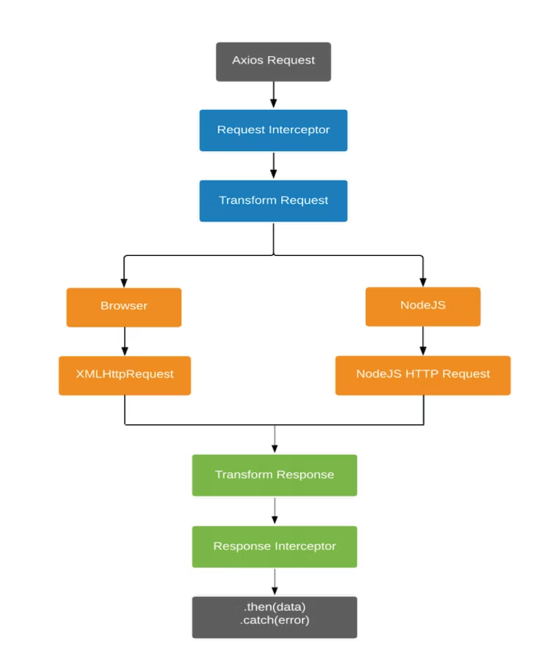
Axios
This diagram represents how Axios interacts with an application

Slide 40
Axios
Features of Axios
Easy to use: Simplified syntax compared to traditional XMLHttpRequest or fetch.
Supports request cancellation using tokens.
Intercept requests and responses for error handling or token updates.
Automatically transforms request/response data to JSON.
Works with timeout configurations.
Supports both GET, POST, PUT, DELETE, and other HTTP methods.
Supports cross-site requests (CORS).

Slide 41
Axios
Installing Axios
Using npm:
Using yarn:
Include via CDN:
npm install axios
yarn add axios
<script src="https://cdn.jsdelivr.net/npm/axios/dist/axios.min.js">
</script>

Slide 42
Axios
Making a Simple Request with Axios
// Import Axios
const axios = require('axios');
// Send a GET request
axios.get('https://api.example.com/data')
.then(response => {
console.log(response.data); // Process the data
})
.catch(error => {
console.error('Error:', error); // Handle errors
});
Notes:
Explanation:get method is used to fetch data.
response.data contains the fetched data.
Handles both success and error cases.

Slide 43
Axios
Axios with Async/Await: Using Axios with Async/Await
async function fetchData() {
try {
const response = await axios.get('https://api.example.com/data');
console.log(response.data);
} catch (error) {
console.error('Error:', error);
}
}
fetchData();
Notes:
Explanation:Async/Await syntax provides cleaner and more readable code for asynchronous requests.

Slide 44
Axios
Axios Configuration: Configuring Axios Requests
const config = {
method: 'post',
url: 'https://api.example.com/data',
data: { key: 'value' },
headers: { 'Authorization': 'Bearer token' },
};
axios(config)
.then(response => console.log(response.data))
.catch(error => console.error('Error:', error));

Slide 45
Axios
Interceptors in Axios: Using Axios Interceptors
axios.interceptors.request.use(config => {
console.log('Request sent:', config);
return config;
}, error => {
return Promise.reject(error);
});
axios.interceptors.response.use(response => {
console.log('Response received:', response);
return response;
}, error => {
return Promise.reject(error);
});
Notes:
Explanation:Interceptors allow modification or logging of requests/responses before they are processed.

Slide 46
Axios
Error Handling in Axios
axios.get('https://api.example.com/data')
.then(response => console.log(response.data))
.catch(error => {
if (error.response) {
console.error('Response error:', error.response.status);
} else if (error.request) {
console.error('No response received:', error.request);
} else {
console.error('Request setup error:', error.message);
}
});

Slide 47
Axios
Advanced Features of Axios
Cancel Tokens: Cancel ongoing requests to save resources.Instance Creation: Create custom Axios instances with pre-configured settings
const api = axios.create({
baseURL: 'https://api.example.com/',
timeout: 1000,
});

