Slide 1
Homework 4
Nguyen Anh Tien

Slide 2
Exercise 01
Build a distance transform program
bw = zeros(5,5);
bw(2,2) = 1;
bw(4,4) = 1;
0 | 0 | 0 | 0 | 0
0 | 1 | 0 | 0 | 0
0 | 0 | 0 | 0 | 0
0 | 0 | 0 | 1 | 0
0 | 0 | 0 | 0 | 0

Slide 3
Exercise 01
[D, IDX] = bwdist(bw)
1.4142 | 1.0000 | 1.4142 | 2.2361 | 3.1623
1.0000 | 0 | 1.0000 | 2.0000 | 2.2361
1.4142 | 1.0000 | 1.4142 | 1.0000 | 1.4142
2.2361 | 2.0000 | 1.0000 | 0 | 1.0000
3.1623 | 2.2361 | 1.4142 | 1.0000 | 1.4142
D =

Slide 4
Exercise 01
[D, IDX] = bwdist(bw)
7 | 7 | 7 | 7 | 7
7 | 7 | 7 | 7 | 19
7 | 7 | 7 | 19 | 19
7 | 7 | 19 | 19 | 19
7 | 19 | 19 | 19 | 19
IDX =

Slide 5
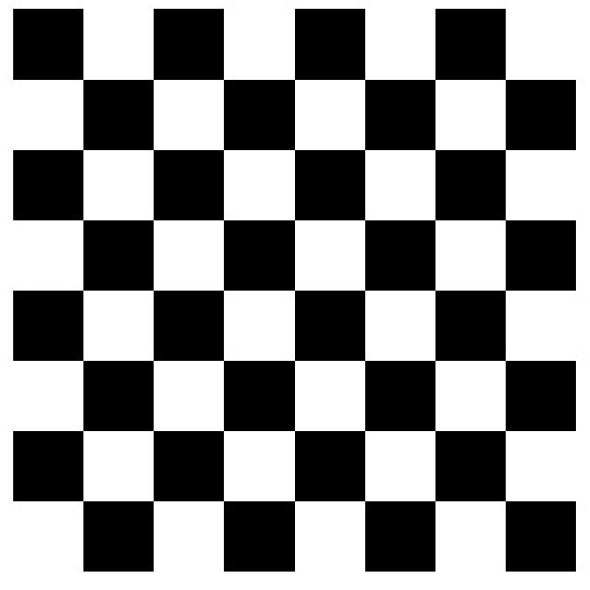
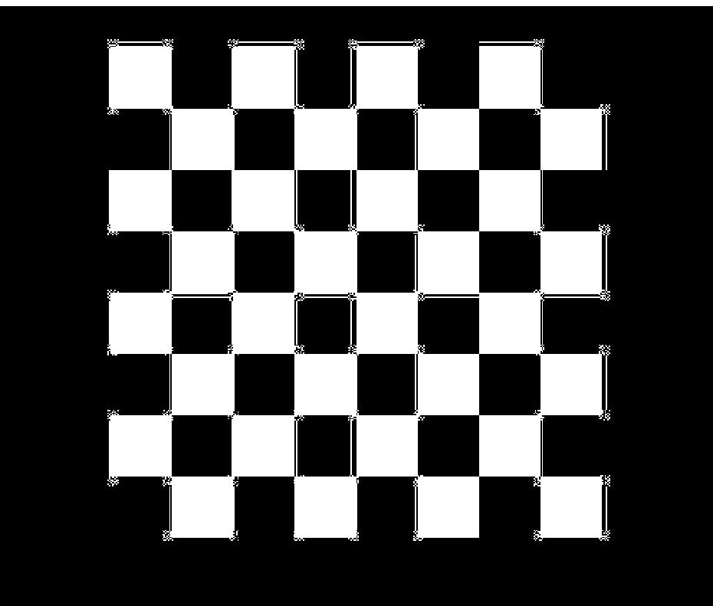
Exercise 01

Slide 6
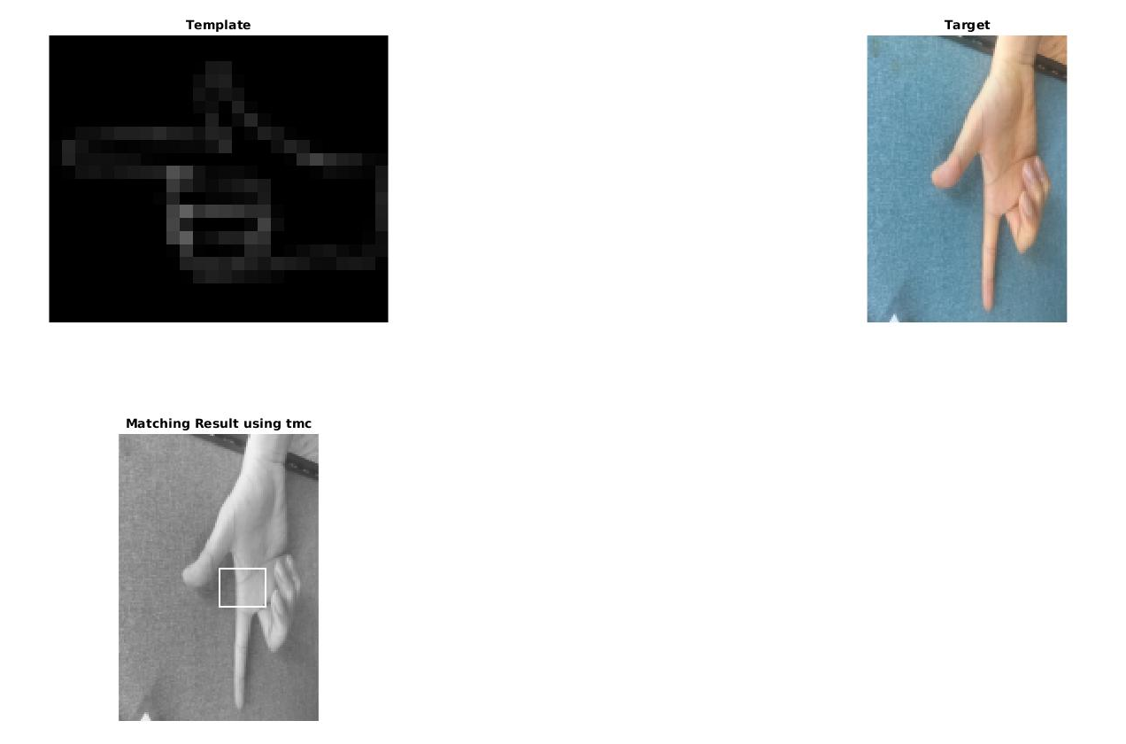
Exercise 02
Chamfer
matching

Slide 7
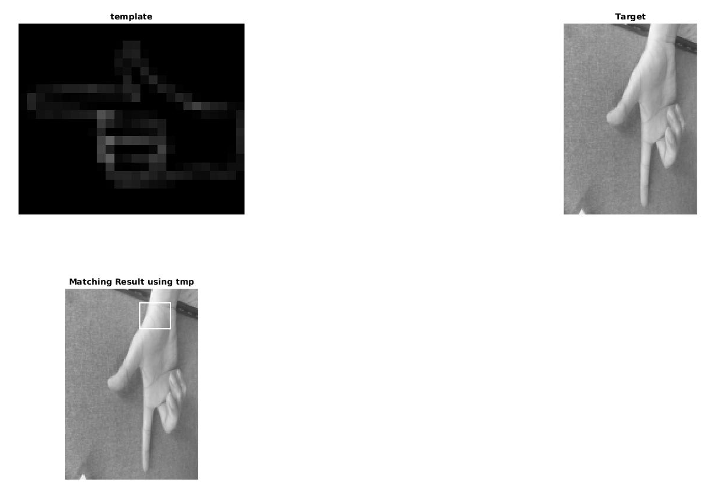
Exercise 03
Hausdorff
matching

Slide 8
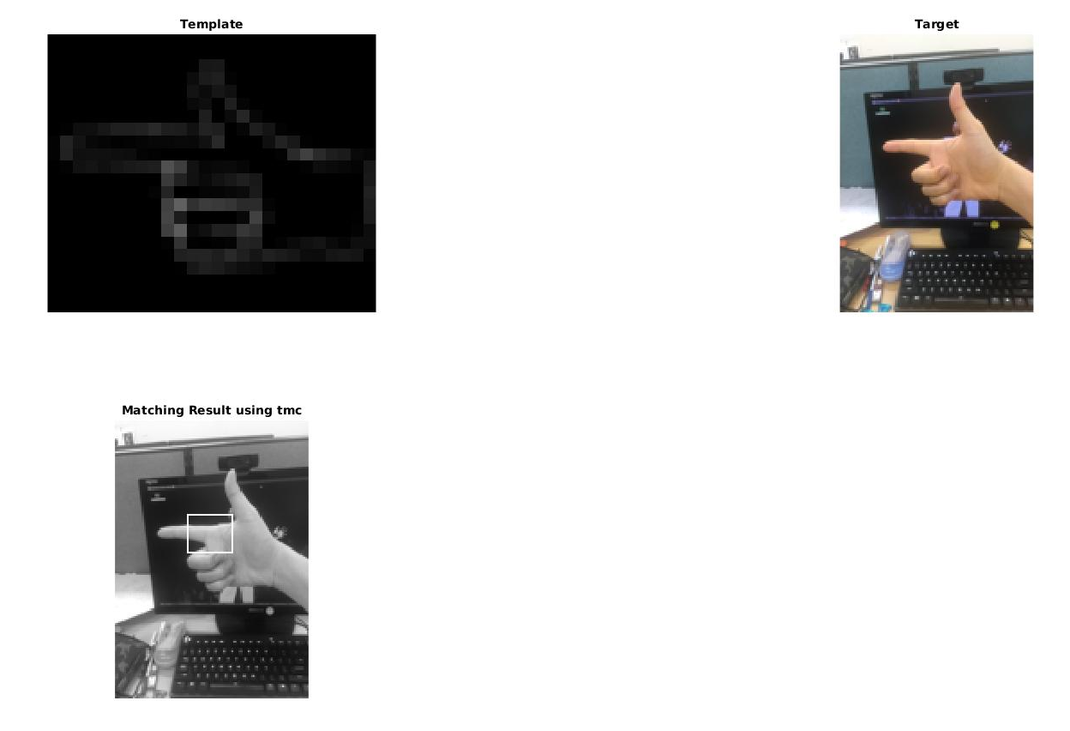
Chamfer vs Hausdorff
Chamfer
matching

Slide 9
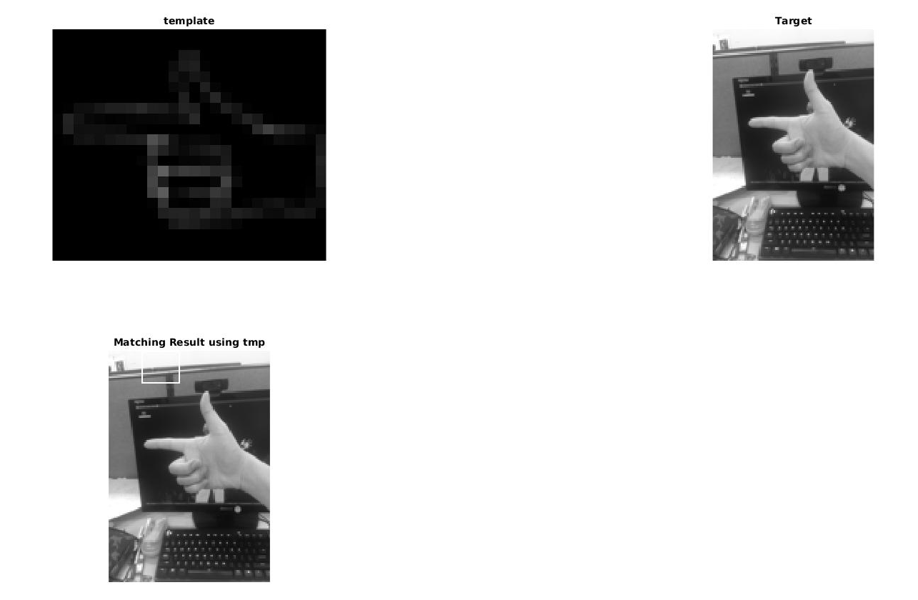
Chamfer vs Hausdorff
Hausdorff
matching

Slide 10
Chamfer vs Hausdorff
Chamfer matching had a better performance than Hausdorff matching in a complex background picture.
The performance of both method depends on the template picture.
The chamfer matching provided a suitable performance with low computing cost.

