Slide 1



Powerapps Project
NGUYEN Auguste Duc-Liem Kim

Slide 2


Chess Analyser Database
Notes:
Problem and Solution:
Problem: Chess players need to analyze games and improve their skills.
Solution: A PowerApps-based Chess Analyzer that automates the analysis and provides move suggestions.

Slide 3
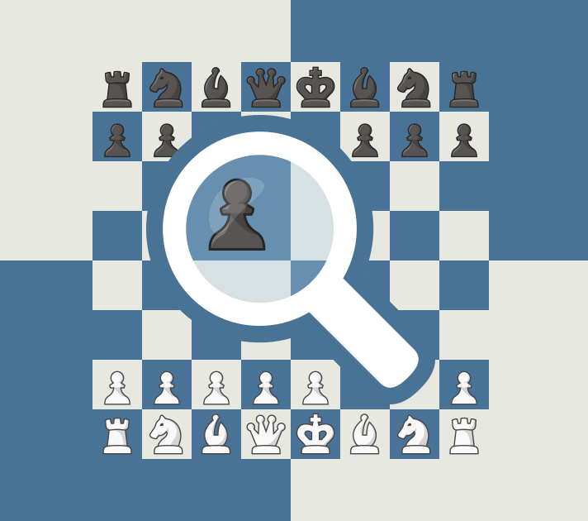
Objectives
With PowerAutomate get an AI-driven move suggestions from an integrated chess engine (e.g., Stockfish or Lichess API).
Play from that position by generating a link to online chess platforms (e.g., Lichess, Chess.com).
Upload a chess game position (through a screenshot or taking a picture).

Slide 4
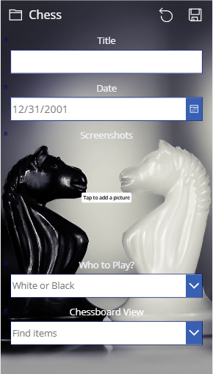
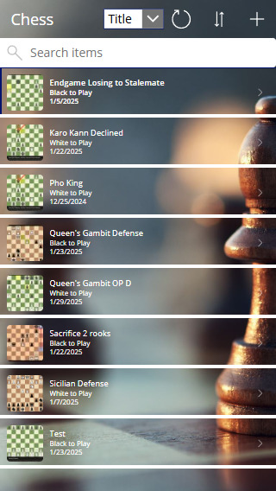
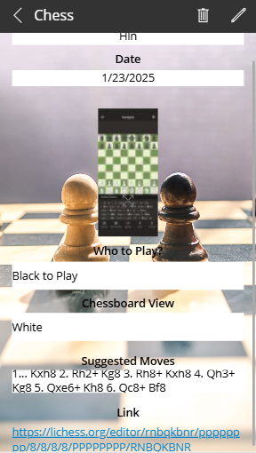
Application Features

Slide 5
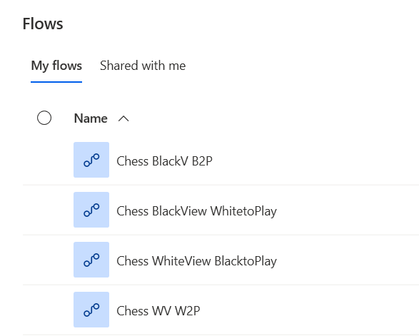
PowerAutomate Feature
Notes:
Power Automate: Explain how Power Automate connects SharePoint to the app and triggers automatic processes, like extracting data or sending links.

Slide 6
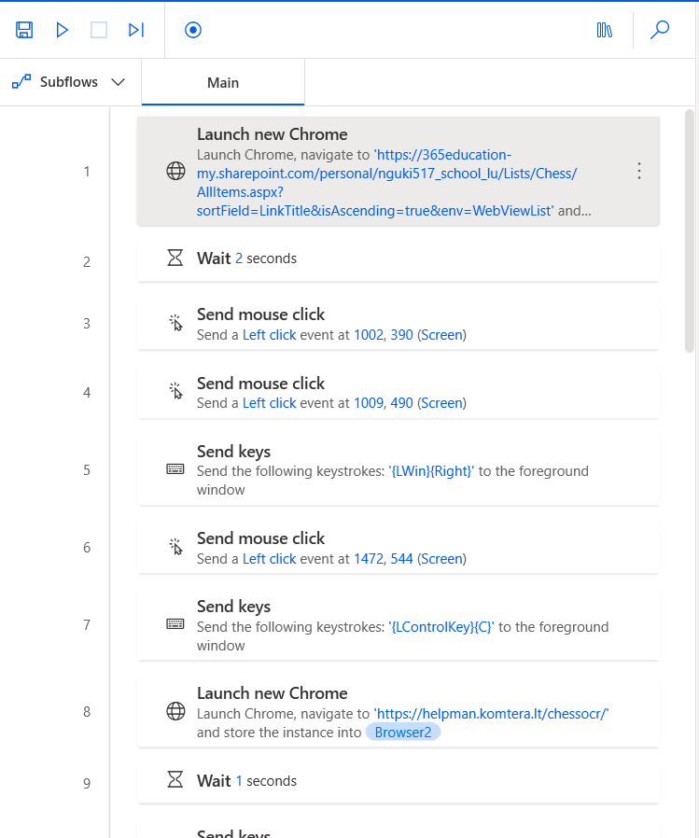
PowerAutomate Feature
Notes:
Power Automate: Explain how Power Automate connects SharePoint to the app and triggers automatic processes, like extracting data or sending links.

Slide 7
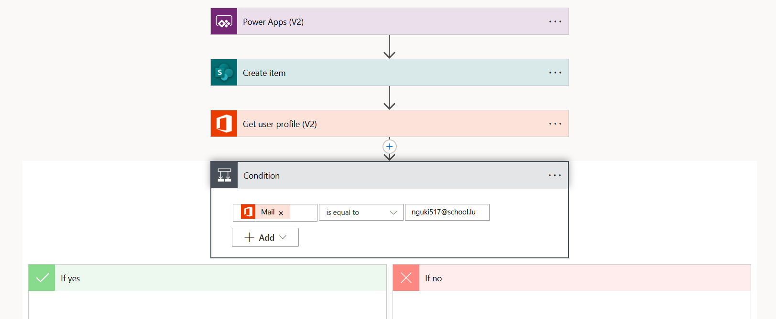
PowerAutomate Feature
Notes:
Power Automate: Explain how Power Automate connects SharePoint to the app and triggers automatic processes, like extracting data or sending links.

Slide 8
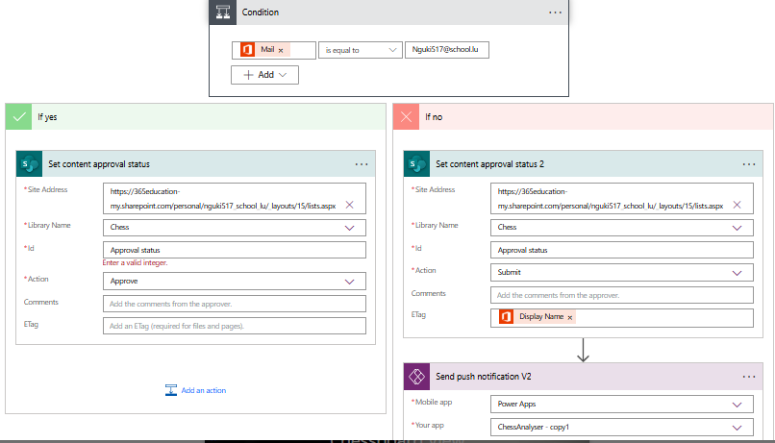
PowerAutomate Feature
Notes:
Power Automate: Explain how Power Automate connects SharePoint to the app and triggers automatic processes, like extracting data or sending links.

Slide 9
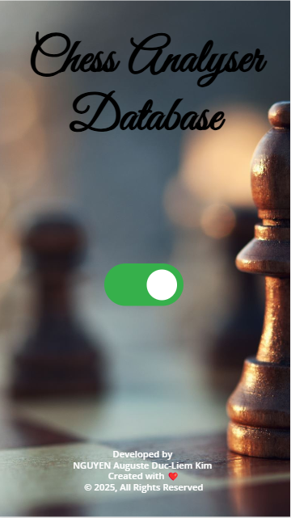
Live Demo

Slide 10
Thank you

