Slide 1

Phân Tích Kỹ Thuật RFM
Nhóm 1
Nguyễn Văn Vinh
Nguyễn Thị Phương Trinh
Trương Huỳnh Kim Yến
Huỳnh Thanh Hoàng
Môn: Phân Tích Định Lượng
GVHD: Huỳnh Nam
Lớp: DHHTTT17B

Slide 2

Nhóm 1
Nguyễn Văn Vinh
Nguyễn Thị Phương Trinh
Trương Huỳnh Kim Yến
Huỳnh Thanh Hoàng

Slide 3

Chương I. To introduce
Chương II. RFM analysis :
I. What is RFM analysis?
Nội Dung
II.How does RFM work
III.Benefits of RFM analysis
IV. Application of RFM in various fields
V.Advantages And Disadvantages Of RFM
VI.Why is RFM analysis important?
VII.Customer segmentation

Slide 4

Overview of the topic
In today's business environment, understanding customers plays an important role in the success of every business. To capture this, our topic focuses on "RFM Analysis" (Recency, Frequency, Monetary) - an important method in understanding customer behavior and optimizing marketing strategy.
Chương I. To introduce
2. The goal of the topic
The main objective of this topic is to identify and analyze important elements in RFM Analysis, thereby better understanding how customers interact with our products or services. We also set a goal to create methods and strategies to optimize customer management and marketing based on RFM data.

Slide 5
3. Scope of the topic
The scope of the topic includes the study and application of RFM Analysis to a specific set of customer data. We will focus on data collection, RFM analysis, and thereby determine how to optimize marketing strategy and customer management based on the results of the analysis.
4. The urgent nature of the topic
The urgent nature of this topic is undeniable in the current context when data is becoming increasingly important to every business. Better understanding customer behavior through RFM Analytics helps businesses improve marketing performance, optimize customer management, and create new business opportunities. This is especially urgent in the context of fierce competition and rapid market transformation.

Slide 6

Chương II. : RFM Analysis

Slide 7
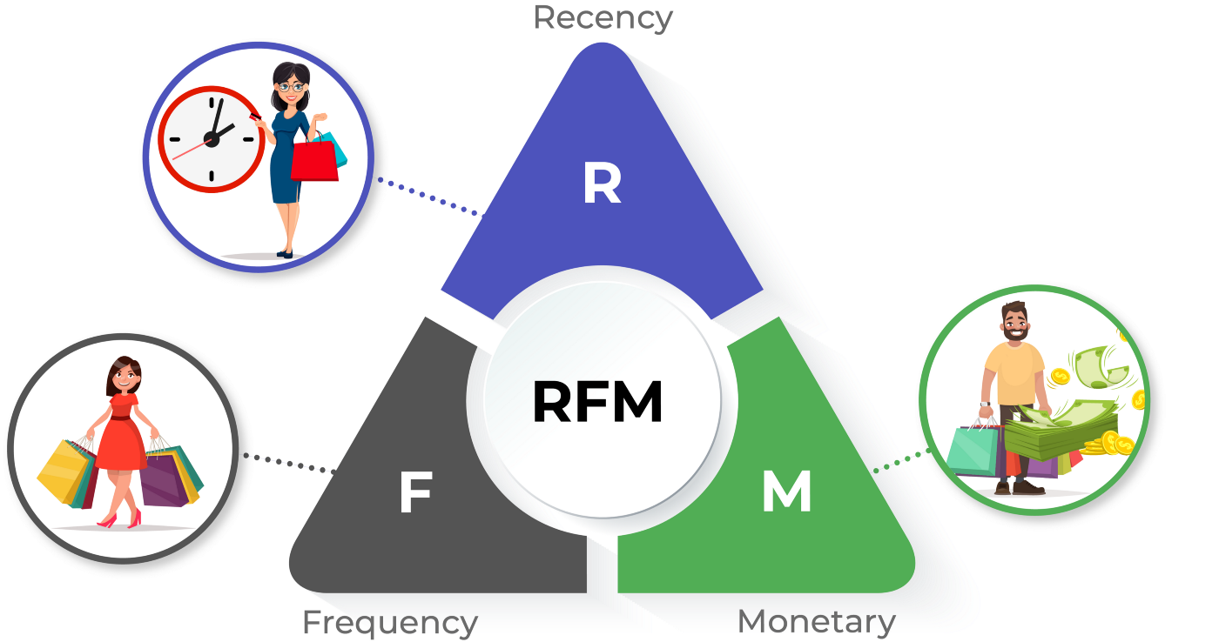
I.What is RFM analysis?
RFM analysis is a customer segmentation technique based on past customer trading behavior.

Slide 8
II.How does RFM work?
RFM model structure:
RFM is made up of three factors (points for each index from 1 to 5) but usually a business will use 2 out of these 3 factors. For example RF, RM, FM.
R (Recency):
The period of time that customers make the most recent purchase. We will set points for the group of customers whose most recent purchase time is 5 points until the group for a long time has not purchased 1 point. *Note: Depending on each type of business, the scale can be arranged accordingly. For example:
Last purchase in about 3 days ago: 5 VND
Last purchase in about 1 week ago: 4 VND
Last purchase in about 2 weeks ago: 3d
Last purchase in about 1 month ago: 2 VND
Last purchase in about 3 months ago: 1d

Slide 9
F (Frequency):
Customer's purchase frequency. This index is often of interest to businesses with services and products with low profit value (M), because they can only exist if customers use their services regularly, e.g. order Grab car, buy a bottle of drinking water. Similar to the above, we will divide the frequency of purchases, use customer services into groups, and then set scores for each group. Example: (As above, each business will have a different way of dividing and calculating points)
Twice a week: 5 VND
Once a week: 4 VND
Once/ 2 weeks: 3 VND
1 time/ 1 month: 2 VND
1 time/ 6 months: 1 VND
M (Monetary Value):
What is the value of each purchase. This index is used to calculate the material value that businesses have every time customers use the service. The types of businesses that pay a lot of attention to this indicator are service companies that customers do not use often, but each time they use it, they have to spend a decent amount of money. For example: Tourism services, hotels, real estate,..

Slide 10
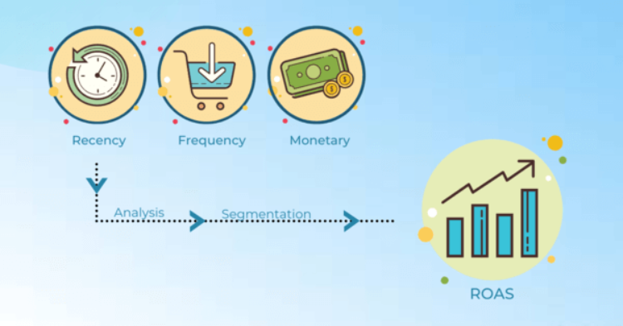
III.Benefits of RFM analysis:
Increase customer retention rate.
Speed up customer feedback
Increase the rate of revenue from customers.
It is based on the marketing axiom that 80% of your business revenue comes from 20% of your customers. RFM helps identify customers who are more likely to respond to promotions by segmenting them into different categories.
Notes:
III.Lợi ích của phân tích RFM:
• Tăng tỷ lệ giữ chân khách hàng.
• Tăng tốc độ phản hồi từ khách hàng.
• Tăng tỷ lệ doanh thu từ khách hàng.
Nó dựa trên tiên đề tiếp thị rằng 80% doanh thu doanh nghiệp của bạn đến từ 20% khách hàng của bạn. RFM giúp xác định những khách hàng có nhiều khả năng phản hồi các chương trình khuyến mãi hơn bằng cách phân khúc họ thành các danh mục khác nhau.

Slide 11
IV. Application of RFM in various fields.
-RFM analysis can be applied in many different areas to optimize customer management and marketing strategy.
-E-commerce: Online shopping sites use RFM Analytics to evaluate and manage customer relationships, with a focus on offering custom marketing and offers to further motivate shopping.
-Retail: Retail stores use RFM to classifddy customers into groups based on purchase behavior, helping them adjust store structure and promotions.
-Financial Services: The financial company uses RFM Analysis to assess the risk and solvency of its customers, thereby determining the appropriate structure of financial products and services.
-Tourism and hospitality: In the tourism industry, understanding customer RFM helps manage bookings and promotions to optimize profits.

Slide 12
-Health and medical services: Medical organizations can use RFM to monitor and manage relationships with patients, ensure that they receive appropriate service, and manage medical records effectively.
-Public services: In this area, RFM can be used to manage and optimize relations with government agencies and organizations.
-Hotels and restaurants: The hotel and restaurant industry uses RFM to manage reservations, market, and provide better services to customers.
-Banking: Banking institutions use RFM Analysis to track customer financial behavior and recommend appropriate financial products.

Slide 13
V.Advantages And Disadvantages Of RFM
1. Advantage
-RFM can be applied to different types of business
-It can lead to reduced marketing costs by helping you target the right customers
-Data can be a good source for loyalty programs
-It can be combined with other analytical tools to better understand
-It can help you identify your best customers
2. Weak point
-Calculating RFM scores can be difficult
-RFM analysis depends on historical data and not future prospects
-This analysis may not be appropriate if you only sell one product

Slide 14
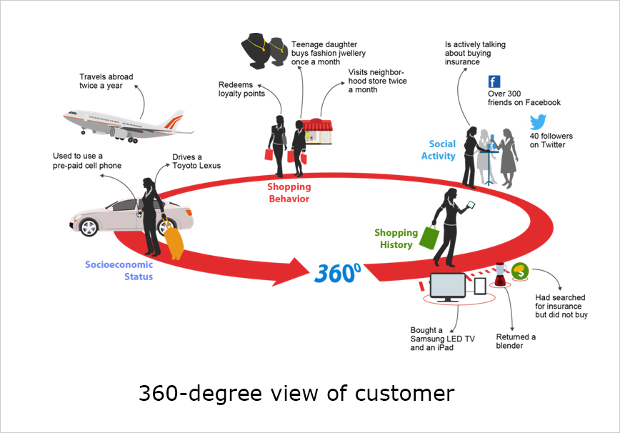
VI.Why is RFM analysis important?
RFM analysis provides businesses with a comprehensive picture of customer buying behaviors, helping them better understand customer purchase frequency, value, and recent frequency. This helps businesses:
1. Understand customer groups and groups
RFM analysis helps businesses categorize customers into groups based on their buying behavior. These groups may include 'lead customers,' 'loyal customers,' or 'compassion customers.' This customer classification helps businesses focus on each customer group to come up with appropriate marketing strategies.

Slide 15
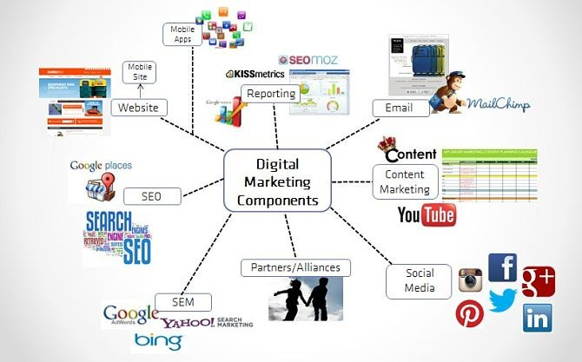
2. Business strategy optimizations
RFM analysis helps businesses optimize business strategy through focusing on the most important customers. Enterprises can use information from RFM analysis to assess whether the current business strategy is effective and make improvements.
3. Increase conversion rate
RFM analysis helps businesses increase conversion rates by focusing on more important customers. By understanding the buying behavior of customer groups, businesses can design appropriate marketing strategies to increase conversion rates for each customer group.

Slide 16
VII.Customer segmentation

Slide 17

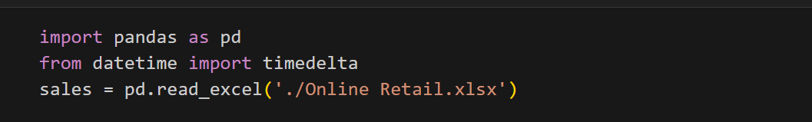
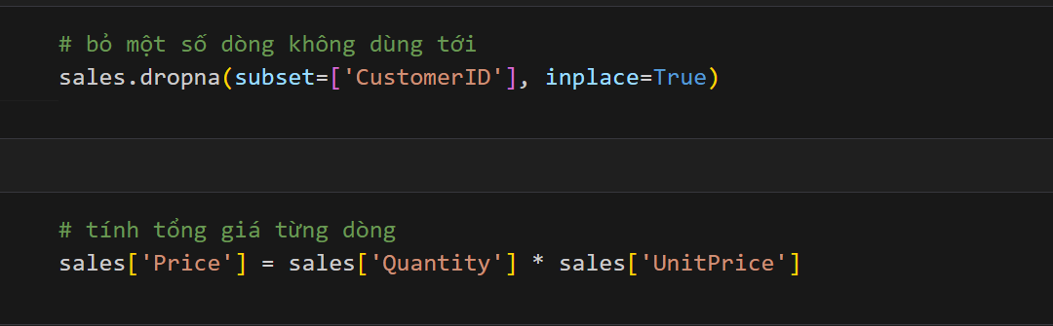
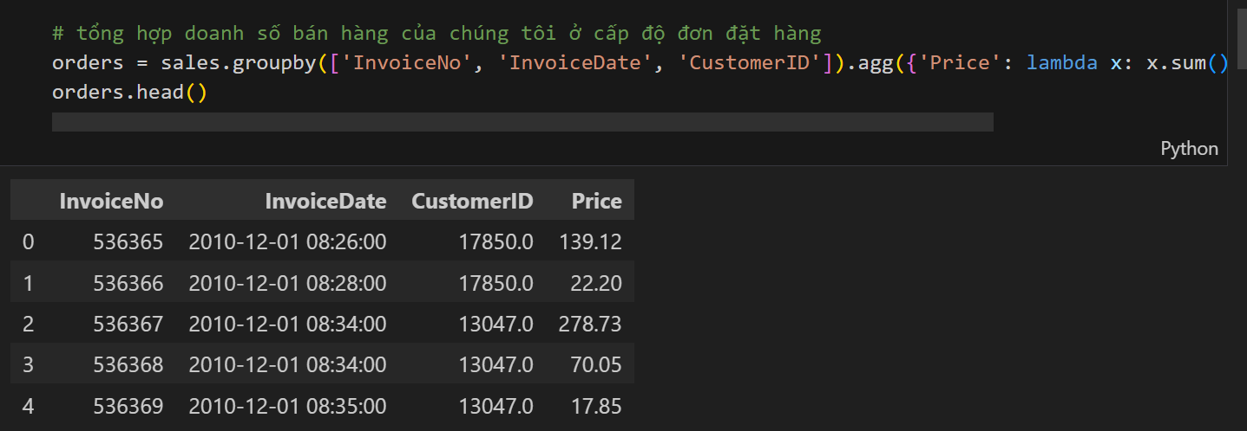
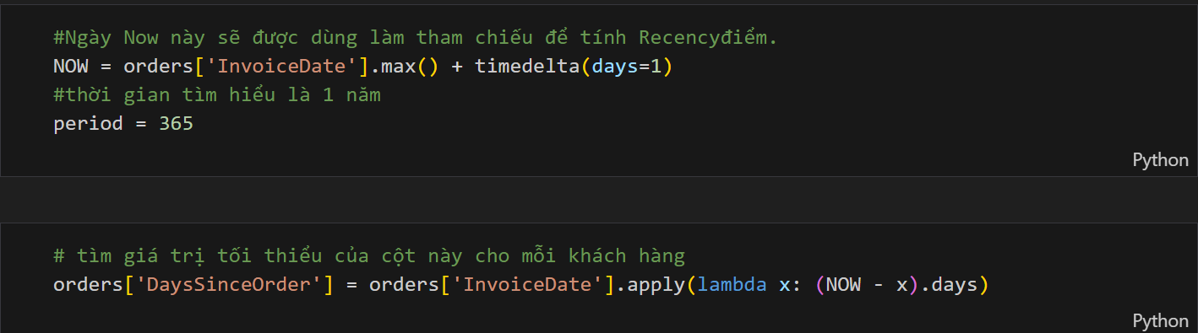

Slide 18
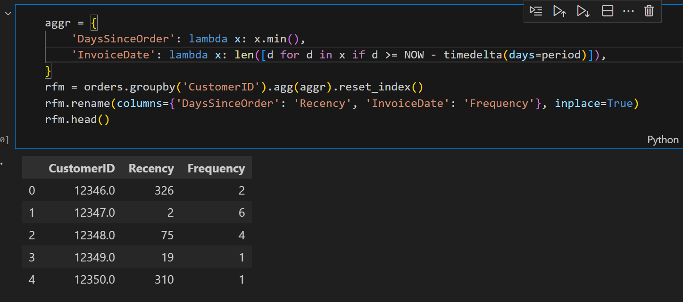
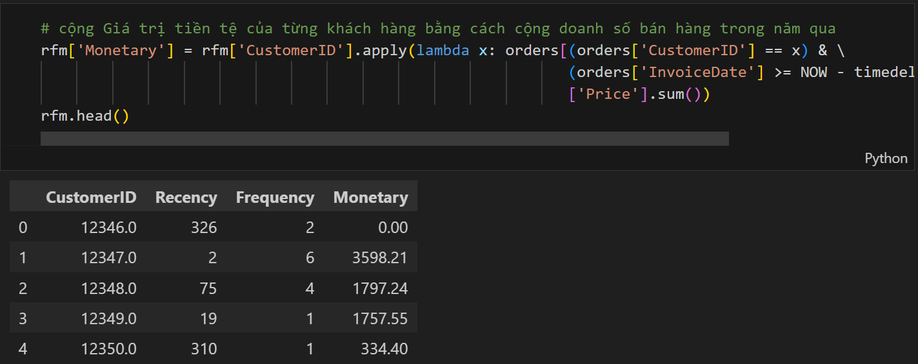
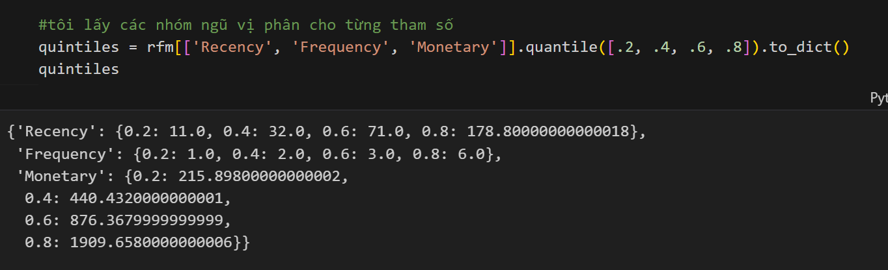

Slide 19
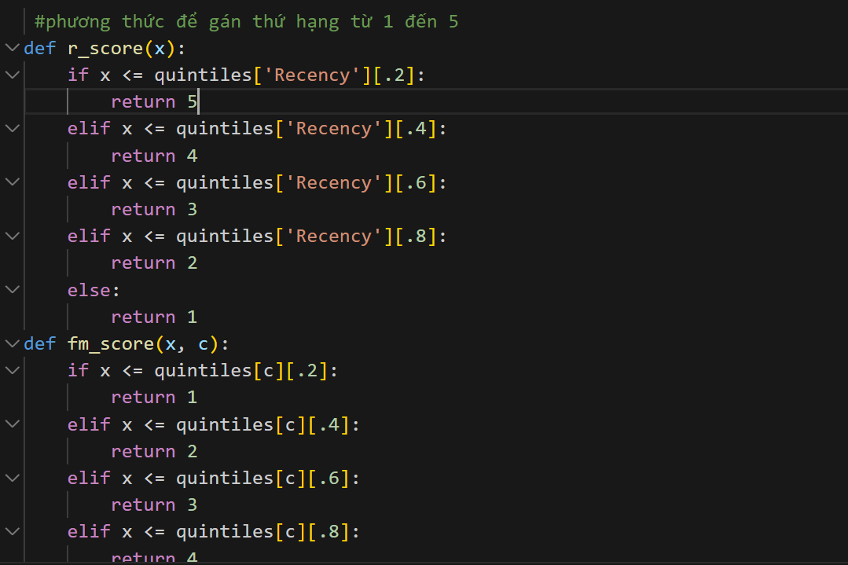
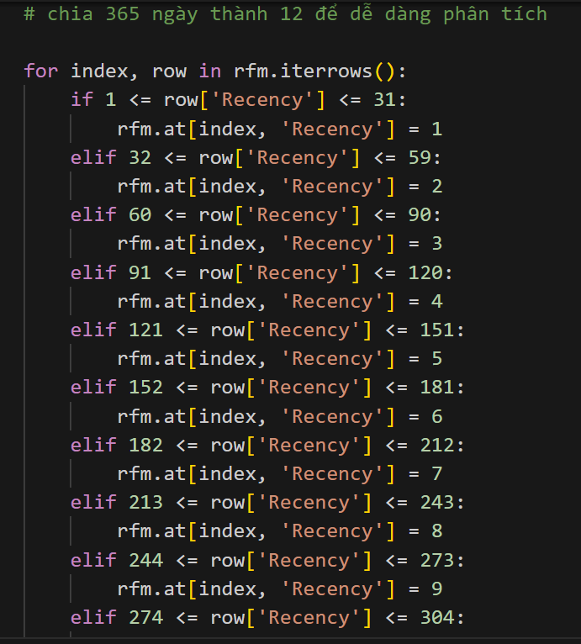
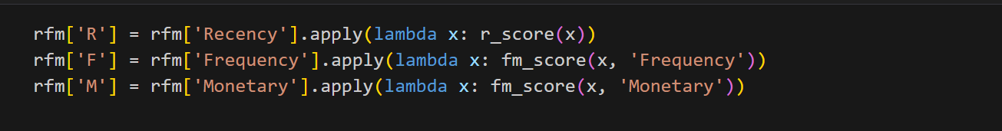

Slide 20
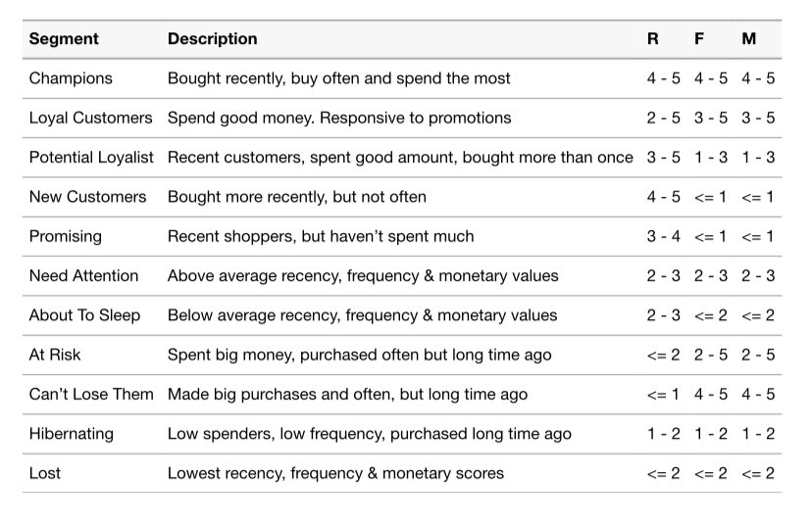

Slide 21
In the context of increasingly competitive markets and continuous changes in customer behavior, the topic "RFM Analysis" has brought a deeper understanding of how to manage customers and market more effectively than ever. time is over. RFM analytics has provided businesses with a powerful tool to identify and classify customers, thereby creating customized marketing strategies, optimizing customer relationships and enhancing profits.
conclude
This technique not only contributes to a better understanding of customer behavior, but also helps businesses predict future behavior, manage resources effectively, and create better customer experiences. From applying RFM Analytics, businesses have learned how to optimize relationships and create real value for customers.
With the increasing importance of understanding and interacting with customers, the topic "RFM Analysis" is not only meaningful in the research environment but also in business practice, helping to create competition. and succeed in the ever-changing world of business

Slide 22
CẢM ƠN THẦY VÀ CÁC BẠN ĐÃ LẮNG NGHE

