Slide 1
Network Security and Cryptography
Topic 8:
Access Control
Notes:
NCC Education - Title Master

Slide 2
Network Security and Cryptography
Topic 8 – Lecture 1:
Packet Filters & Access Control Lists
Notes:
NCC Education - Title Master

Slide 3
Scope and Coverage
This topic will cover:
  Packet filtering
  Access control lists
  NAT
  IDS
Notes:
NCC Education - Slide Master

Slide 4
Learning Outcomes
By the end of this topic students will be able to:
  Configure access control mechanisms
  Apply and manage port forwarding rules

Slide 5
Access Control
  Network traffic is in the form of IP/TCP/UDP packets
  The headers of these packets contain information as to source and destination of the packets
  Routing devices uses the source and destination addresses to route traffic through the network
  These addresses can be used to create access control rules
  We will examine methods for determining if traffic is allowed on a network or section of a network

Slide 6
Packet Filtering
  Routing devices examine a packet's destination address and decide where to send it
  Packet filtering adds an extra layer to this process
  First the destination address is examined
  If the router determines that it should process the packet it then applies a set of rules to determine what happens to it
  Can apply these rules to both incoming and outgoing packets

Slide 7
Filtering Rules
  Implement security policies as services that are allowed or disallowed
  Examples:
    Packets for particular machines can be blocked
    Specific types of packets can be blocked
    Packets going out of your network can be blocked
  Packet filtering rules can be very general or can be applied to specific machines or ports

Slide 8
Use of Packet Filtering
  Commonly used to protect a network from attack from machines outside of the network
  Most routing devices have packet filtering capabilities
  An inexpensive option as no extra equipment required
  Very powerful tool
  Does not provide full protection

Slide 9
Packet Filtering Possibilities
  Can be applied to:
    Machines
    Ports
    Combinations of machines and ports
  Examples:
    Block all traffic to machine A
    Block all traffic to port 80 (http)
    Block all traffic to port 80 except on machine A

Slide 10
Stateless Filtering - 1
  Simple rules
  Easy to implement
  Not flexible
  For example:
    If all traffic to port 80 is blocked a static filter will block all http traffic
    It cannot be set to block all traffic to port 80 except that from http://campus.nccedu.com in a single rule

Slide 11
Stateless Filtering - 2
  Filtering process is “dumb”
    Applies a set of static rules to every packet
    Does not store any results from previous packets
    No intelligence or learning built into the filtering system
  The set of rules is an Access Control List (ACL)
    Rules are checked in a specific order
    The first matching rule found is applied to the packet
    If there are no rules matching the packet is blocked

Slide 12
Stateful Filtering
  Also known as Dynamic Packet Filtering
  Uses a state table that stores detail of legitimate traffic requests:
    IP addresses
    Ports
    Handshake status
    Route/Time
  Compare packets with previous valid traffic
  Allows traffic based upon connections

Slide 13
Configuring Static Packet Filters
  There are three main steps to correctly configuring static packet filters
  Decide what traffic to permit and what traffic to block
    Determined by nature of business and assessment of security risks
  Define this as a set of rules that includes IP addresses and port numbers
  Translate these rules into a language that the router or other device understands
    May be vendor specific so we do not cover this

Slide 14
What is Permitted?
  This is done at a conceptual level
    Is internet access allowed
    Can individual machines accept email from the Internet or will it all come through a central mail server
    Are all messages from a specific location blocked
  A good general rule is to block all packets except those that have been specifically allowed
    Default is to block all packets not processed by the rule list

Slide 15
Access Control Lists - 1
  A simple tabular template should be used that has one rule for each line of the table
  The following columns should be included:
    Source IP address
    Source port
    Destination IP address
    Destination port
    Action (block/allow)
    Comments (allow a brief text explanation)
  Protocol can be included in this

Slide 16
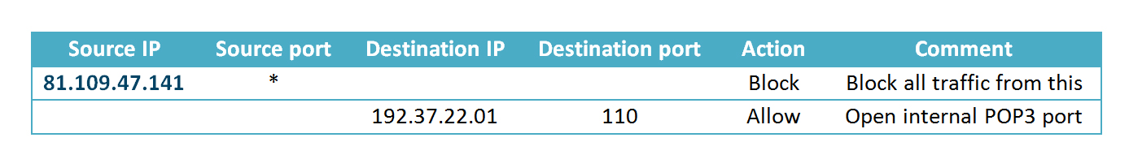
Access Control Lists - 2
  The order of the rules is important
  The first rule that matches with the packet being inspected will be implemented
  All remaining rules will be ignored

Slide 17
Access Control Lists - 3
  What happens when 81.109.47.141 sends an email message to 192.37.22.01?
  What happens if 81.109.47.142 sends an email message to 192.37.22.01?
  What happens if 81.109.47.142 sends a telnet message to 192.37.22.01?
  What if the rule order is swapped?

Slide 18
Network Security and Cryptography
Topic 8 – Lecture 2:
NAT and IDS
Notes:
NCC Education - Title Master

Slide 19
Network Address Translation
  NAT provides a means to connect multiple computers to an IP network using only one IP address
  Three reasons this is useful:
    Shortage of IP addresses (under IPv4)
    Security
    Flexible network administration

Slide 20
The Number of IP Addresses
  A typical IP address is written as dotted quad
    E.g. 81.109.47.141
  In IPv4 there was theoretical limit on the number of available IP addresses
    4 bytes = 2³² = 4,294,967,296 possible addresses
  Method was required to create “extra” IP addresses or the Internet would reach capacity
  The main reason for the use of NAT originally was to create “extra” IP addresses

Slide 21
The IP Address
  An IP address has two parts:
    a network number
    a host number
  Computers on one physical network have the same network number
    Think street name in a postal address
  The rest of the IP address defines an individual computer
    Think house number in a postal address

Slide 22
IP Address Classes - 1
  The network size determines the class of IP address
  There is a network and host part in each IP address
  IP addresses come in 4 classes (A, B, C and D)
  Each class suits a different network size

Slide 23
IP Address Classes - 2
  Network addresses with first byte between 1 and 126 are class A with approx.17 million hosts each
  Network addresses with first byte between 128 and 191 are class B with approx. 65000 hosts each
  Network addresses with first byte between 192 and 223 are class C with 256 hosts
  All other networks are class D, used for special functions, or class E which is reserved

Slide 24
Dynamically Assigning Addresses
  Internet Service Providers (ISPs) usually allocate a single address to a single customer
  This is assigned dynamically
    every time a client connects to the ISP a different address is provided
  Large companies can buy several addresses
  It is more economic for small businesses to use a single address

Slide 25
Connecting Multiple Computers
  In theory one IP address means only one computer can connect to the Internet
  By using a NAT gateway running on a single computer, multiple local computers can connect using the single IP address
  To the Internet this appears as a single computer
  End-to-end connections are not created and this can prevent some protocols from working

Slide 26
Dynamic NAT
  A small number of public IP addresses are dynamically assigned to a large number of private IP addresses
  Port Address Translation (PAT) is a variant of NAT:
    Allows one or more private networks to share a single public IP address
    Commonly used in small businesses
    Remaps both source and destination addresses and source and destination ports of packets

Slide 27
NAT and Security
  NAT only allows connections that come from inside the network
  Internal servers can allow connections from outside via inbound mapping
    Specific ports are mapped to specific internal addresses
    Makes services such as FTP or the Internet available but in a highly controlled way
  NATs use their own protocol stack not that of the host machine
    Protects against some attacks

Slide 28
NAT and Network Administration
  Can aid network administration in several ways:
    May contain a dynamic host configuration protocol (DHCP) server
    Provide methods for restricting Internet access
    Have traffic logging capabilities
    Can divide a network into sub-networks

Slide 29
NAT Operation
  Changes the source address on every outgoing packet to the single public address
  Renumbers source ports to be unique
    Used to keep track of each client connection
  Has a port mapping table to record ports for each client computer
    Relates real local IP address and source port to translated port number, destination address and port
    Allows the process to be reversed for incoming packets so they are routed to the correct client

Slide 30
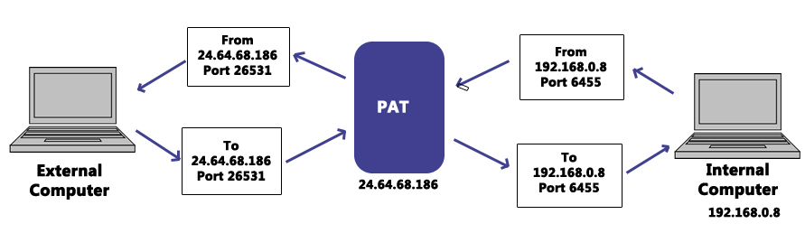
PAT Operation
  An example of how IP and port are changed

Slide 31
Intrusion Detection Systems (IDS)
  Monitors network traffic for suspicious activity
  Alerts the network administrator if suspicious activity discovered
  May also respond to suspicious traffic by:
    blocking the user from accessing the network
    blocking the IP address from accessing the network
  Different types that use different methods to detect suspicious activity

Slide 32
IDS Types
  Network based intrusion detection systems (NIDS)
  Host based intrusion detection systems (HIDS)
  IDS that look for signatures of known threats
  IDS that compare traffic patterns against a network baseline and look for anomalies in the patterns

Slide 33
NIDS
  Positioned in strategic locations in the network
  Monitor all traffic to and from network devices
  In a perfect world all traffic would be monitored
  This would create a bottleneck in the network with a huge processing overhead
    It would deteriorate network speed

Slide 34
HIDS
  Operate on individual hosts or network devices
  Monitors all inbound and outbound packets but only to and from the device it operates on
  If suspicious activity is detected it usually alerts the user and/or network administrator of that activity

Slide 35
Signature-based IDS
  Monitors packets on the network
  Compare packets against a stored database of known malicious threats
    Similar to the operation of antivirus software
  When a new threat appears there is a period of time before this is added to the database
  Any new threat is undetected until such time as the database is updated to include this threat
    Similar to the operation of antivirus software

Slide 36
Anomaly-based IDS
  Monitors network traffic
  Compare network traffic with a baseline
  Baseline is “normal” traffic for that network:
    Bandwidth
    Protocols
    Ports
    Devices
  User and/or network administrator is alerted if there is a significant change from the baseline

Slide 37
IDS Overview
  Ideal for monitoring and protecting a network
  Can be prone to false alarms
  Must be correctly set up to recognize what is normal traffic on the network
  Network administrators and users must:
    Understand the alerts
    Know the most effective course of action upon receiving an alert

Slide 38
References
  Scambrey, J., McClure, S. and Kurtz, J. (2001). Hacking Exposed: Network Security Secrets & Solutions. 2nd Edition. McGraw Hill.

Slide 39
Topic 8 – Access Control
Any Questions?
Notes:
NCC Education - End Slide Master

