Slide 1
Network Security and Cryptography
Topic 9:
Firewalls
Notes:
NCC Education - Title Master

Slide 2
Network Security and Cryptography
Topic 9 – Lecture 1:
Firewall Operation
Notes:
NCC Education - Title Master

Slide 3
Scope and Coverage
This topic will cover:
  Firewall architectures and their limitations
  The DMZ firewall and its limitations
Notes:
NCC Education - Slide Master

Slide 4
Learning Outcomes
By the end of this topic students will be able to:
  Describe the components of a firewall
  Configure a DMZ firewall
  Evaluate the limitations of firewalls

Slide 5
Network Firewall
  A firewall is the first line of defence for your network
  The purpose of a firewall is to keep intruders from gaining access to your network
  Usually placed at the perimeter of network to act as a gatekeeper for incoming and outgoing traffic
  It protects your computer from Internet threats by erecting a virtual barrier between your network or computer and the Internet

Slide 6
How Does a Firewall Work?
  Examines the traffic sent between two networks
    e.g. examines the traffic being sent between your network and the Internet
  Data is examined to see if it appears legitimate:
    if so the data is allowed to pass through
    If not, the data is blocked
  A firewall allows you to establish certain rules to determine what traffic should be allowed in or out of your private network

Slide 7
Creating Rules
  Traffic blocking rules can be based upon:
    Words or phrases
    Domain names
    IP addresses
    Ports
    Protocols (e.g. FTP)
  While firewalls are essential, they can block legitimate transmission of data and programs

Slide 8
Common Firewall Types
  In general there are software firewalls and hardware firewalls
    Even in home networks
  Hardware firewalls are typically found in routers, which distribute incoming traffic from an Internet connection to computers
  Software firewalls reside in individual computers
  Ideally a network has both

Slide 9
Software Firewall
  Protect only the computer on which they are installed
  Provide excellent protection against threats (viruses, worms, etc.)
  Have a user-friendly interface
  Have flexible configuration

Slide 10
Router Firewall
  Protect your entire network or part of a network
  Located on your router
  Protect network hardware which cannot have a software firewall installed on it
  Allows the creation of network-wide rules that govern all computers on the network

Slide 11
Firewall Operation
  Can be divided into three main methods:
    Packet filters (see last topic)
    Application gateways
    Packet inspection
  Individual vendors of firewalls may provide additional features
    You should look at their products for details

Slide 12
Application Gateways
  Application-layer firewalls can understand the traffic flowing through them and allow or deny traffic based on the content
  Host-based firewalls designed to block objectionable Web content based on keywords are a form of application-layer firewall
  Application-layer firewalls can inspect packets bound for an internal Web server to ensure the request isn’t really an attack in disguise

Slide 13
Advantages of Application Gateways
  Provide a buffer from port scans and application attacks
    if an attacker finds a vulnerability in an application, the attacker would have to compromise the application/proxy firewall before attacking devices behind the firewall
  Can be patched quickly in the event of a vulnerability being discovered
    This may not be true for patching all the internal devices

Slide 14
Disadvantages
  Needs to know how to handle traffic to and from your specific application
    If you have an application that's unique, your application layer firewall may not be able to support it without making some significant modifications
  Application firewalls are generally much slower than packet-filtering or packet-inspection firewalls
    They run applications, maintain state for both the client and server, and also perform inspection of traffic

Slide 15
Packet Inspection Firewalls
  Examine the session information between devices:
    Protocol
    New or existing connection
    Source IP address
    Destination IP address
    Port numbers
    IP checksum
    Sequence numbers
    Application-specific information

Slide 16
Outbound Internet Traffic
  Client initiates connection to IP address of the web server destined for port 80 (HTTP)
  Firewall determines whether that packet is allowed through the firewall based on the current rule-set
  Firewall looks into the data portion of the IP packet and determine whether it is legitimate HTTP traffic
  If all the requirements are met, a flow entry is created in the firewall based on the session information, and that packet is allowed to pass

Slide 17
Inbound Internet Traffic
  Web server receives the packet and responds
  Return traffic is received by the firewall
  Firewall determines if return traffic is allowed by comparing the session information with the information contained in the local translation table
  If return traffic matches the previous requirements, payload is inspected to validate appropriate HTTP
  Then it is forwarded to the client

Slide 18
Advantages
  Generally much faster than application firewalls
    They are not required to host client applications
  Most of the packet-inspection firewalls today also offer deep-packet inspection
    The firewall can dig into the data portion of the packet and also:
    Match on protocol compliance
    Scan for viruses
    Still operate very quickly

Slide 19
Disadvantages
  Open to certain denial-of-service attacks
  These can be used to fill the connection tables with illegitimate connections

Slide 20
Network Security and Cryptography
Topic 9 – Lecture 2:
Firewall Architecture
Notes:
NCC Education - Title Master

Slide 21
Firewall Architecture
  Firewalls are used to protect the perimeter of a network and the perimeter of sections of networks
  A key question for a network administrator is where firewalls should be located
  The positioning of firewalls in relation to other network elements is the firewall architecture
  We will only look at the position of firewalls and the consequences of this
    Other security devices should also be used

Slide 22
Firewall Architecture
  The following are common firewall architectures:
    Screening router
    Screened host
    Dual homed host
    Screened subnet
    Screened subnet with multiple DMZs
    Dual firewall

Slide 23
Screening Router
  Simplest of firewall architectures
  Traffic is screened by a router
    Packet filtering
    Using ACLs
  Traffic is screened according to:
    Source or destination IP address
    Transport layer protocol
    Services requested

Slide 24
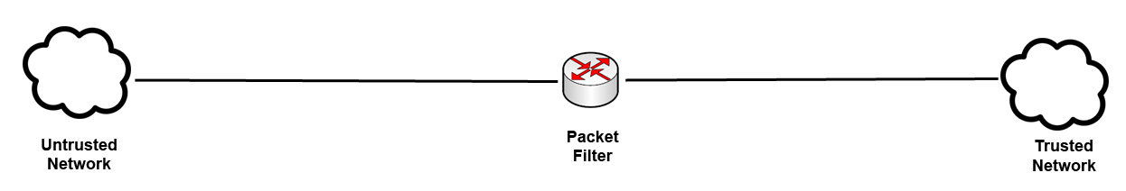
Screening Router
  Usually deployed at the perimeter of the network
  May be used to control access to a Demilitarized Zone (DMZ) – see later
  More often used in conjunction with other firewall technologies

Slide 25
Advantages & Disadvantages
  Advantages
    Simple
    Cheap
  Disadvantages
    No logging
    No user authentication
    Difficult to hide internal network structure

Slide 26
Demilitarised Zones (DMZ)
  A DMZ is part of the internal network but separated from the rest of the internal network
  Traffic moving between the DMZ and other interfaces on the protected side of the firewall still goes through the firewall
  This traffic has firewall protection policies applied
  Common to put public-facing servers on the DMZ:
    Web servers
    Email servers

Slide 27
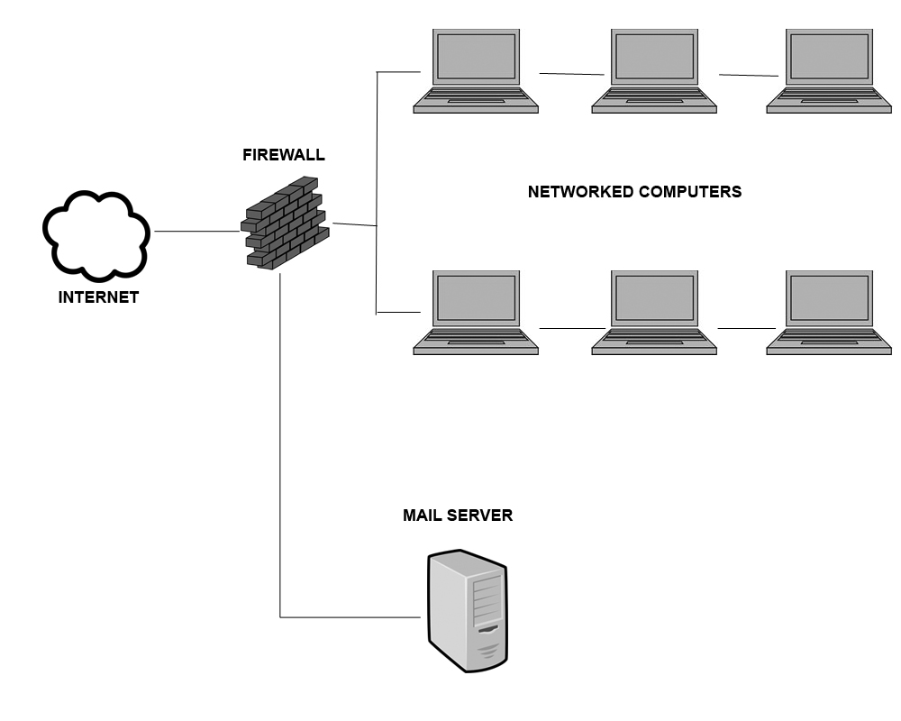
Demilitarised Zones (DMZ)

Slide 28
Screened Host Firewall
  Adds an extra layer of protection in comparison to a screening router
  Has a Bastion Host/Firewall between networks
  Bastion Host/Firewall has two NICs
  Bastion Host/Firewall connects the trusted network to the untrusted network
    Stateful and proxy technologies are used to filter traffic up to the application layer

Slide 29
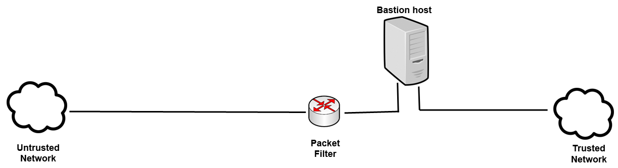
Bastion Host
  A special purpose computer specifically designed and configured to withstand attacks
  The router is the first line of defence
    packet filtering/access control is carried out at the router
  The bastion host is the server that connects to the unsecure network through the router

Slide 30
Advantages & Disadvantages
  Advantages
    Security is distributed between two points
    Greater security than screening router
    Transparent outbound access/restricted inbound access
  Disadvantages
    Difficult to hide internal structure
    There is a single point of failure in the network

Slide 31
Dual-Homed Host
  A Bastion Host/Firewall is surrounded with packet filtering routers
    Dual-homed - outside world and protected network
    Multi-homed - outside world and multiple protected networks
  Routers filter traffic to the Bastion Host
  Bastion Host adds additional filtering capabilities
  Bastion Host has no routing capabilities

Slide 32
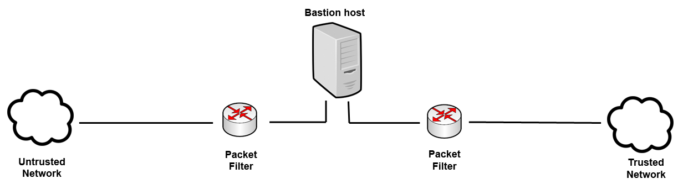
Advantages & Disadvantages
  Advantages
    Hides internal network structure
  Disadvantages
    Requires users to log onto bastion host or the use of proxy servers

Slide 33
Screened Subnet DMZ
  Bastion Host is surrounded with packet filtering routers
  These control traffic into and out of the trusted and untrusted network sections
  Has an extra layer of functionality with a DMZ
  Traffic from DMZ to trusted network must go through Bastion Host and packet filtering router

Slide 34
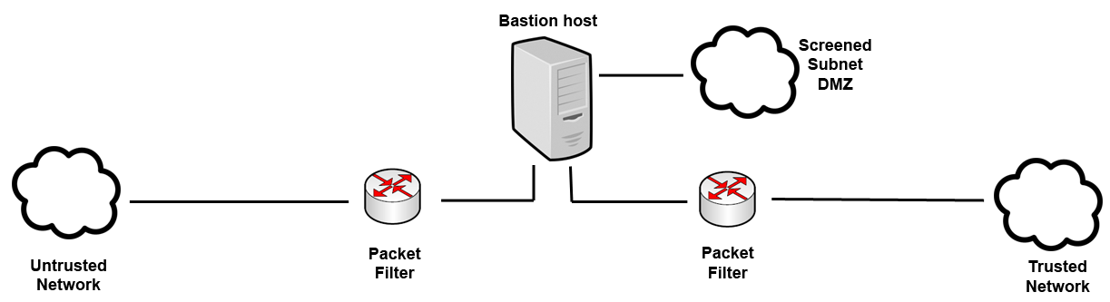
Advantages & Disadvantages
  Advantages
    Provides services to outside without compromising inside
    Internal network hidden
  Disadvantages
    Single point of failure

Slide 35
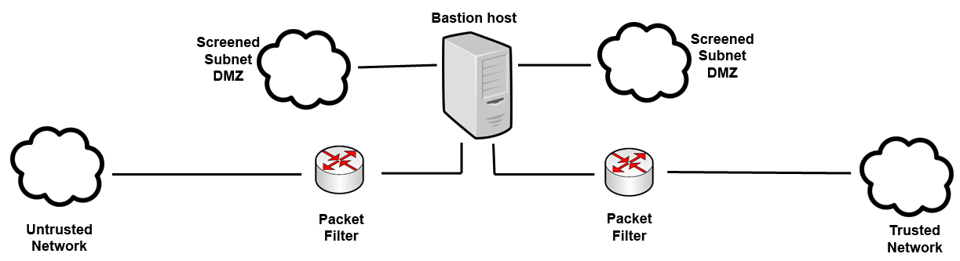
Screened Subnet Multiple DMZs
  Allows configuration of varying levels of security between:
    DMZs and the untrusted network
    Different DMZs
    DMZs and the trusted network

Slide 36
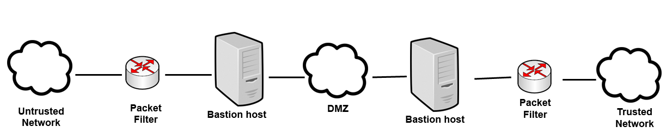
Dual Firewall Architecture
  Using two or more firewalls enhances security
  Can be used to create DMZs
  Using technology from multiple vendors can enhance security

Slide 37
References
  Scambrey, J., McClure, S. and Kurtz, J. (2001). Hacking Exposed: Network Security Secrets & Solutions, 2nd Edition. McGraw Hill.
  Zwicky, E.D. (2000). Building Internet Firewalls, 2nd Edition. O’Reilly Media.

Slide 38
Topic 9 – Firewalls
Any Questions?
Notes:
NCC Education - End Slide Master

