Slide 1
Kiến trúc Microservice. Và so sánh với Monolith
Nhóm 5

Slide 2
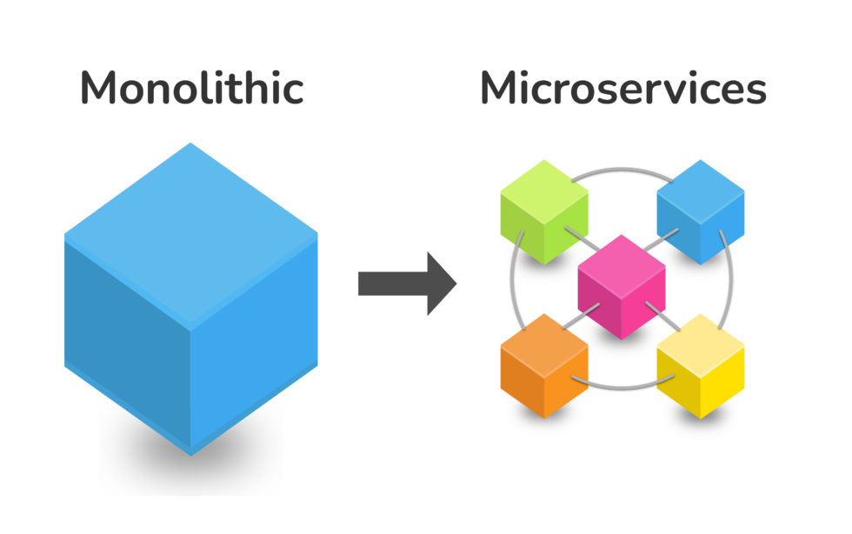
Table of contents
01
02
03
04
What is Monolith Architechture?
Challenges and why Microservice?
What are Microservice Architecture?
Benefits and Best Practices

Slide 3
Table of contents
05
06
Challenges of Microservices
Communication between Microservices

Slide 4
01
Monolith & it’s downsides

Slide 5
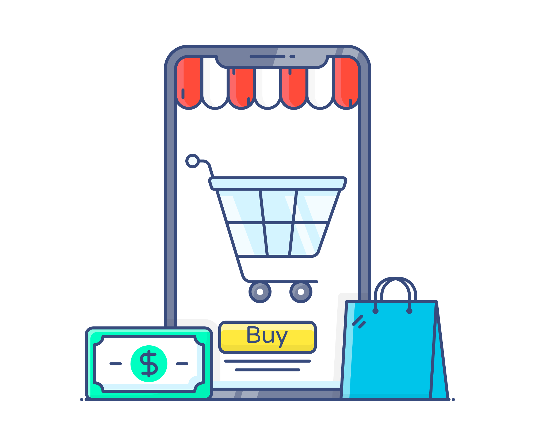
Monolith
MONOLITHIC
Before microservices, a monolithic architecture was the standard.
All components are part of a single unit
In 1 codebase
User-auth
Product-Catalog
Everything is developed, deployed and scaled as 1 unit
Shopping-cart
Notification
Payment

Slide 6

Monolith
App must be written with 1 main language, with 1 tech stack and a single runtime.
MONOLITHIC
User-auth
Product-Catalog
Teams need to coordinate and be careful to not effect each other’s work.
1 single artifact, so you must redeploy the entire application on each update.
Shopping-cart
Notification

Slide 7
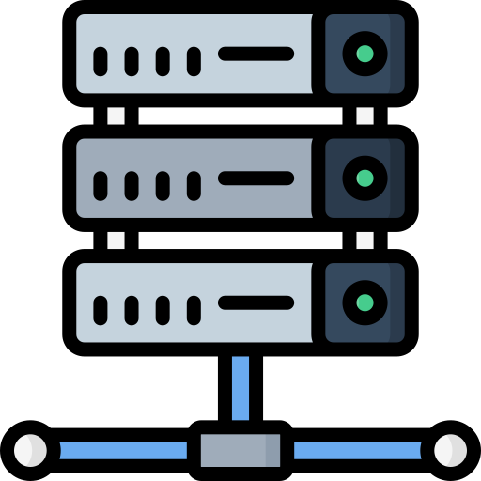
Chanllenges of monolithic architecture
MONOLITHIC
Shopping-cart
Product-Catalog
Application grow larger and more complex.
User-auth
Notification
Parts are more tangled into each other.
The coordination between teams became more difficult.
You can only scale the entire app, instead of a specific service.
ELASTIC SERVER

Slide 8
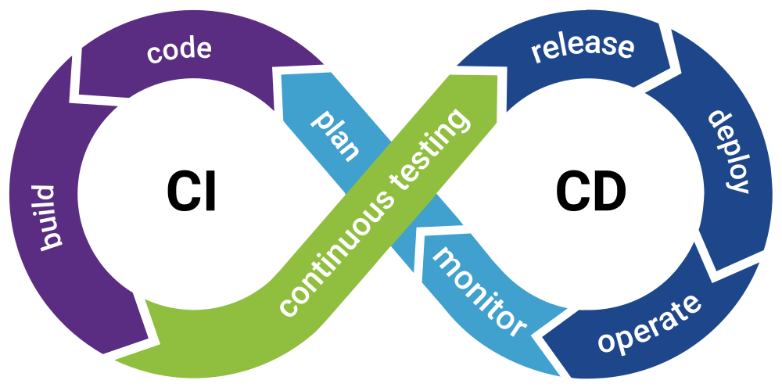
Chanllenges of monolithic architecture
Difficulty if services need different dependency versions.
Payment
Release process takes longer. Because:
3rd : v1.8
3rd : v1.7
On every change, the entire application needs to be tested.
Entire application needs to be built and deployed.
Notification
Bug in any module can potentially bring down the entire application.

Slide 9
The answer: Microservice Architecture

Slide 10
02
What is microservies ?

Slide 11

Microservies Architecture
Monolithic
Application
Split application into smaller, independent services.
How to break down application ?
How big/small should they be?
Service A
Service B
What code goes where ?
How do they communicate?
Service C
Service D
How many services do we creates

Slide 12

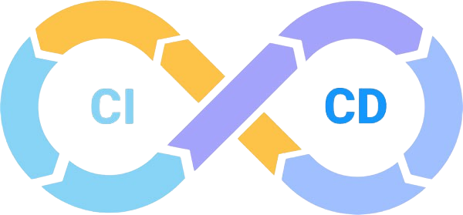


Microservies Architecture
products
shopping-cart
shopping-cart
shopping-cart
checkout
Split based on business fuctionalities
Service A
Service B
Separation of concerns: 1 service for 1 specific job
user
checkout
Service C
Service D
products
shopping-cart
Self-contained & Independent
…
shopping-cart checkout
payment
checkout
Meaning each service can developed, deployed and scaled separately
Apps should be loosely coupled

Slide 13

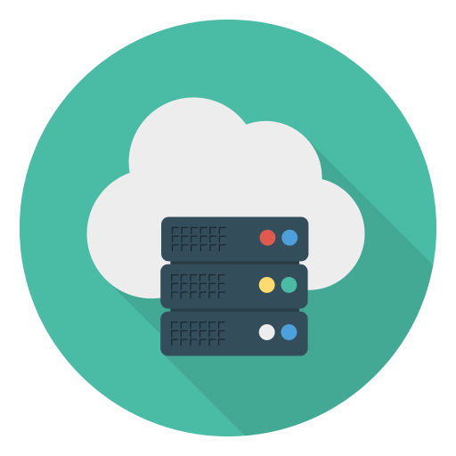

Microservies Architecture
Services can be built and deployed separately
Each microservice has its own version
v2.2
v2.0
products
shopping-cart
payment
checkout
v5.1
v5.5

Slide 14
03
Communication between microservices

Slide 15

Commmunication between microservices
/user/123
/shopping-cart/2454
products
shopping-cart
1) Communication via API Calls
HTTP
Response
HTTP
Request
HTTP
Response
HTTP
Request
payment
checkout
/payment/..
/checkout/24/order/12
Each service has it’s own API and an endpoint on which it except request form other services
This is Synchronous communication
Where 1 service send request to another service and wait for the response
They can talk to each other, by sending HTTP requests to the respective API endpoint

Slide 16

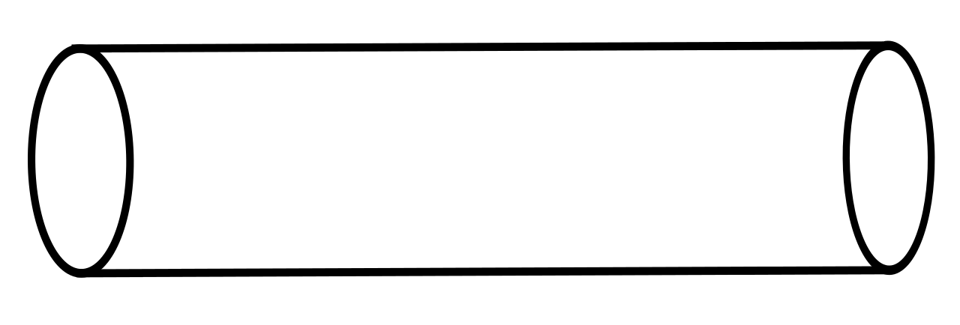
Commmunication between microservices
2) Communication via Message Broker
payment
Message Broker
Subscriber
Queue 1
user-account
Queue 2
checkout
publish
Publisher
Asynchronous communication
Services first send message to message broker, like RabbitMQ
Communication via messages
Common distribution patterns: Publish/subscribe and point-to-point messaging
Then message broker forward message to the respective service

Slide 17


Commmunication between microservices
products
shopping-cart
3) Communication via Service Mesh
payment
checkout
With service mesh we have a helper service which take over the complete communication logic so you don’t have to code this login into microservices

Slide 18
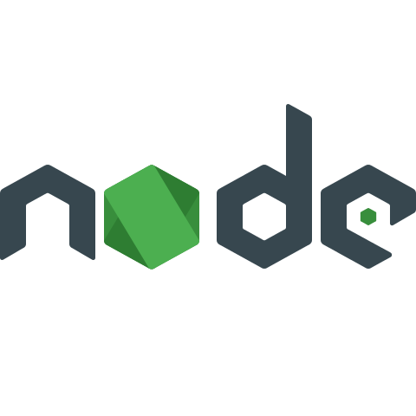




Advantages of Microservices
shopping-cart
shopping-cart
payment
checkout
Each microservice team can choose it own tech stack
Each team can develop the service independently, without effecting others

Slide 19
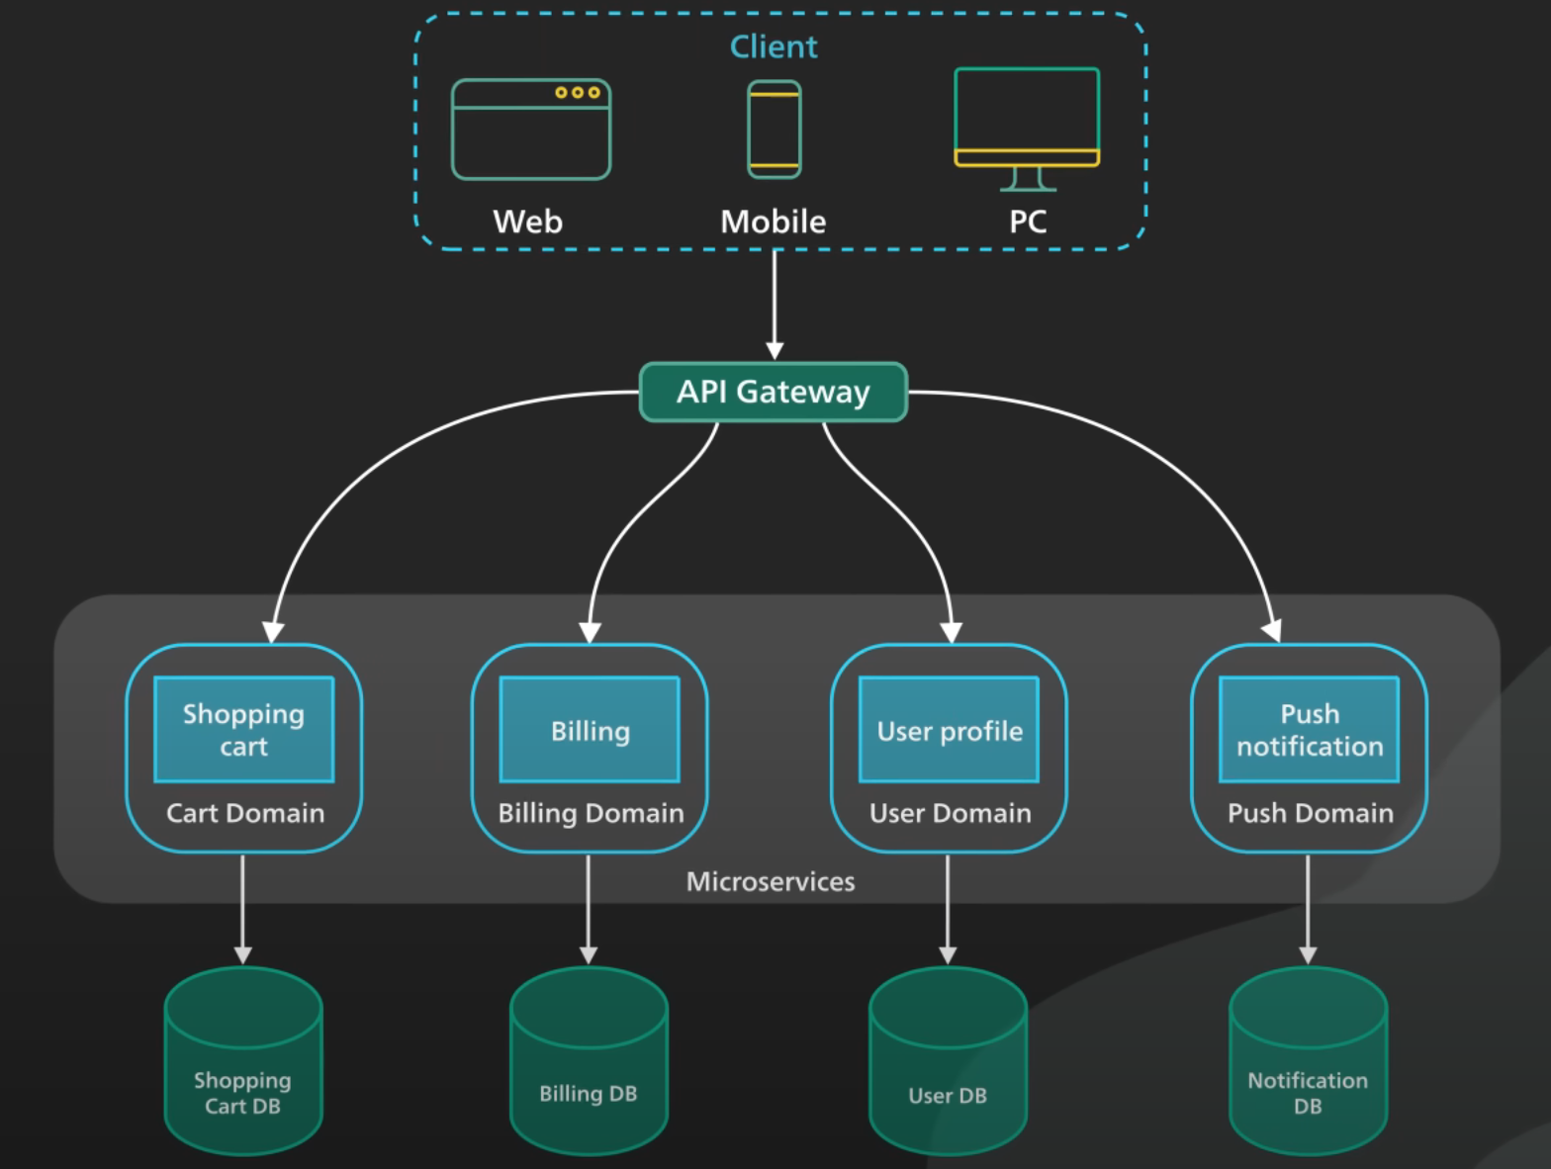
Application implement using microservices

Slide 20
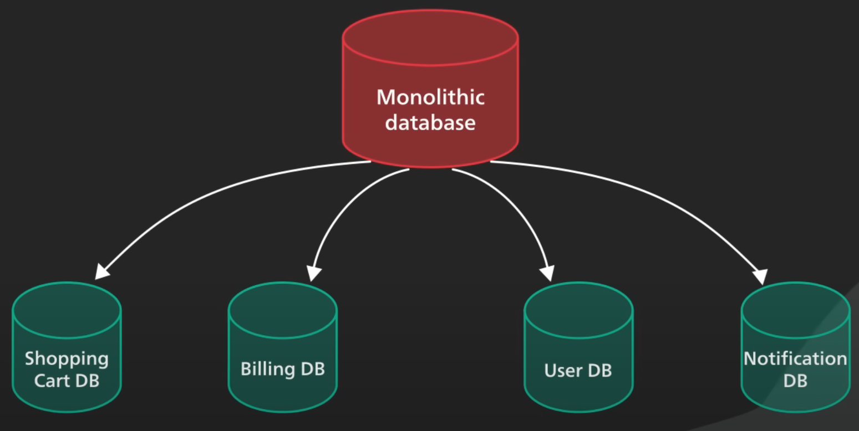
Strong information hiding
This often mean braking up a monolithic database into it’s logical component and keeping it logical component well hidden inside it corresponding microservice.

Slide 21
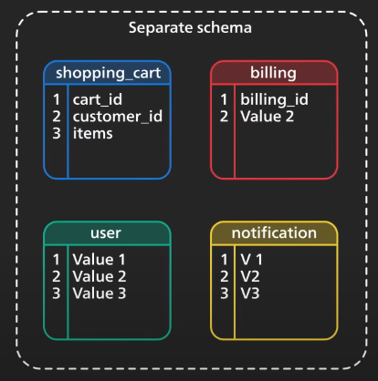
Strong information hiding
By logical component, it could mean a separated schema within a database cluster or an entirely separated database.

Slide 22
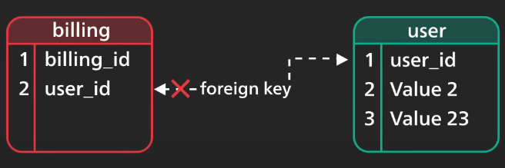
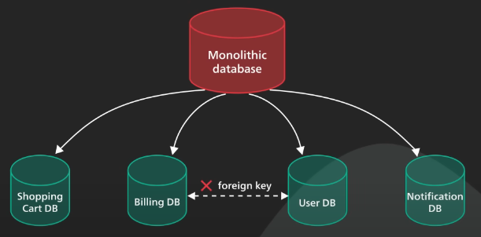
Strong information hiding
We can no longer maintain the foreign key relationship in database.
The burden of maintaining data integrity is moved to application layer.

Slide 23
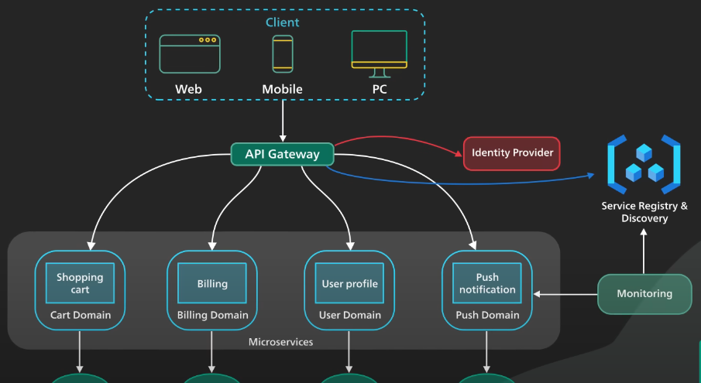
API Getway

Slide 24
04
Downsides of Microservices

Slide 25
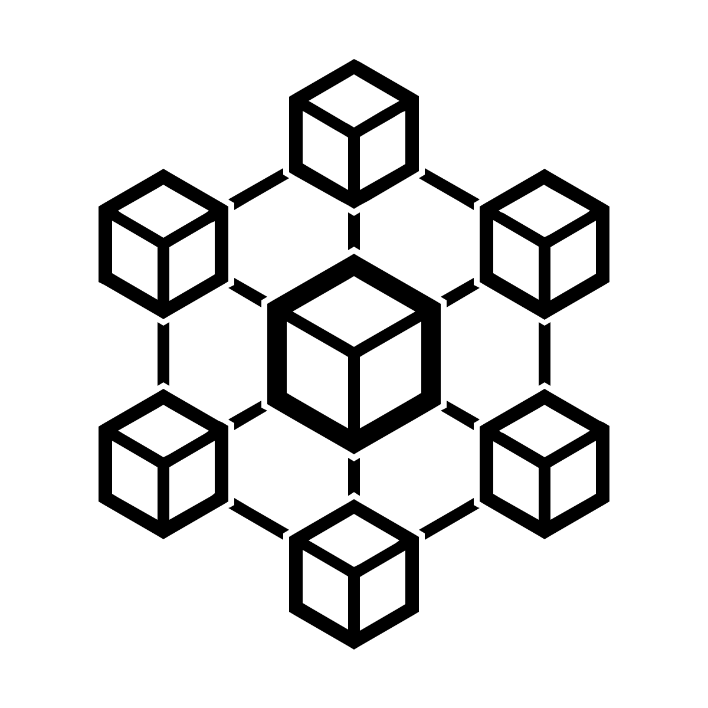


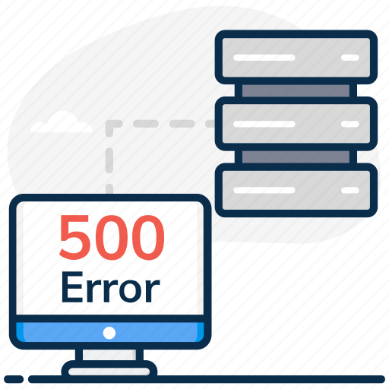

Downsides of Microservices
Added complexity just by the fact that a microservices application is a distributed system
Configure the communication between services
shopping-cart
More difficult to monitor with multiple instances of each service distributed across server
payment

Slide 26
Thanks!
Do you have any questions?

