Slide 1
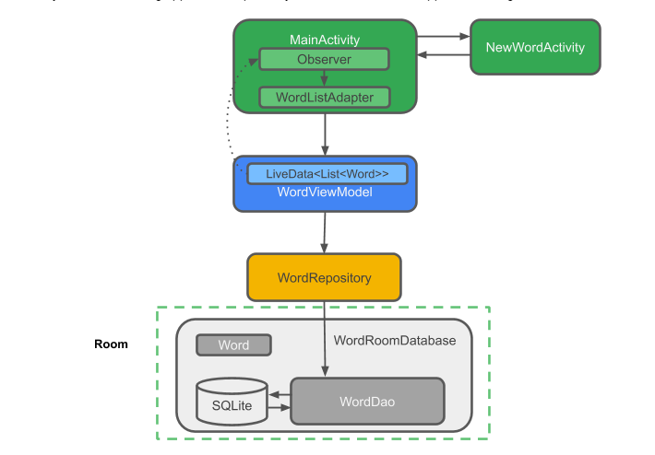
Room can’t run in main thread so it use only background(Coroutines Kotlin)
Main Activity
ViewModel
Observer data changed
Update data to UI
New Word
ViewModel
Add word
Data change
Repository
Insert
DAO
Insert SQLite
Room with View - Kotlin

Slide 2
Use:
Coroutines kotlin(Thread – use with Room)
LiveData – ViewModel(Observer and update UI when data changed)
DAO (only interface or abstract)
Room(communitcate with SQLite)
LiveData-VM
(application-context)
Respository
Constructer(DAO)
LiveData-VM

