Slide 1

Big Data Analytics
Personalized Healthcare Analytics with Wearable Data
Nguyen Dong Hai-24072183
Notes:
Hello everyone, my name is Nguyen Dong Hai – 24072183. Today I’m presenting my Big Data Analytics project titled: “Personalized Healthcare Analytics with Wearable Data.” This project focuses on analyzing Fitbit data to uncover user health patterns through clustering and anomaly detection, all visualized via an interactive dashboard.

Slide 2
Table of contents
01
02
03
04
05
Objectives
Methodology
System Architecture
Results
Conclusion
Notes:
Here's an overview of my presentation. I’ll briefly go through the project’s objectives, methodology, and system architecture. Then, I’ll demonstrate the live results using my Streamlit dashboard, and finally, share the key conclusions and future improvements.

Slide 3
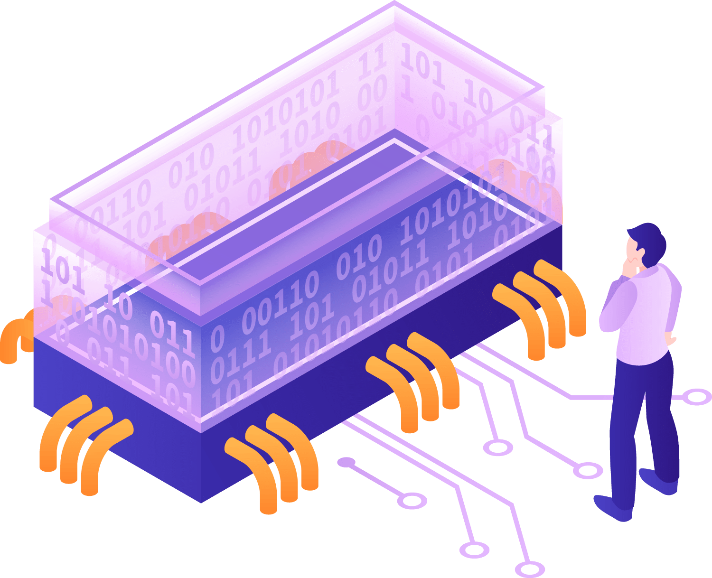
01
Objectives
of the project
Notes:
The goal of the project is to turn raw Fitbit data into meaningful, personalized health insights. I had four main objectives:
Analyze user activity data such as steps and calories.
Segment users into activity groups using clustering.
Detect outlier behaviors that may signal health anomalies.
Present this information through an interactive dashboard for easier understanding.

Slide 4

Objectives
The goal
Analyze Fitbit data for health insights
Cluster users based on activity levels
Detect behavioral anomalies
Build an interactive visualization dashboard
Notes:
The goal of the project is to turn raw Fitbit data into meaningful, personalized health insights. I had four main objectives:
Analyze user activity data such as steps and calories.
Segment users into activity groups using clustering.
Detect outlier behaviors that may signal health anomalies.
Present this information through an interactive dashboard for easier understanding.

Slide 5
02
Methodologyof the project
Notes:
Here’s an overview of the techniques I used.
Data preprocessing with Pandas to clean and transform the Fitbit data.
KMeans clustering to classify user-days into three activity levels: Low, Moderate, and High.
Anomaly detection using the IQR method to flag unusually high or low step counts.
Dashboard development in Streamlit to display the insights in a user-friendly way.

Slide 6
Key Techniques Used
Preprocessing with Pandas
Clustering using KMeans
Anomaly Detection with IQR method
Dashboard built with Streamlit
Cleaned, transformed, and prepared Fitbit data for analysis
Grouped users into Low, Moderate, and High activity levels
Flagged unusually high or low daily step counts
Interactive web app for visualizing personalized health trends
Notes:
Here’s an overview of the techniques I used.
Data preprocessing with Pandas to clean and transform the Fitbit data.
KMeans clustering to classify user-days into three activity levels: Low, Moderate, and High.
Anomaly detection using the IQR method to flag unusually high or low step counts.
Dashboard development in Streamlit to display the insights in a user-friendly way.

Slide 7
03
System Architectureof the project
Notes:
This slide shows the overall flow of the system, from raw data to dashboard.
First, I load a Fitbit dataset from Kaggle, which contains daily step counts, calories, and activity minutes.
I clean and format the data using Pandas: convert dates, remove duplicates, and select relevant features.
Then I apply KMeans clustering on features like TotalSteps and Calories to group users into 3 activity segments.
To detect anomalies, I use the IQR method — anything outside the 5th and 95th percentile of TotalSteps is considered unusual.
All of these results are visualized in a Streamlit web app that allows users to explore their personal health trends interactively.
I’ll show you how this works in the live demo next.

Slide 8
Architecture-Flow of data
Raw Fitbit CSV
Preprocessing
Collected from a publicly available dataset on Kaggle
Includes daily metrics: steps, calories, active minutes, and more
Converted ActivityDate to datetime format
Removed duplicates and missing values
Selected relevant columns for analysis
Feature Engineering
Clustering (KMeans)
Focused on key variables: TotalSteps, Calories, VeryActiveMinutes, SedentaryMinutes
Scaled and transformed features for clustering
Applied KMeans algorithm with k=3 to identify:
Low Activity
Moderate Activity
High Activity
Assigned cluster labels to each user-day
Notes:
This slide shows the overall flow of the system, from raw data to dashboard.
First, I load a Fitbit dataset from Kaggle, which contains daily step counts, calories, and activity minutes.
I clean and format the data using Pandas: convert dates, remove duplicates, and select relevant features.
Then I apply KMeans clustering on features like TotalSteps and Calories to group users into 3 activity segments.
To detect anomalies, I use the IQR method — anything outside the 5th and 95th percentile of TotalSteps is considered unusual.
All of these results are visualized in a Streamlit web app that allows users to explore their personal health trends interactively.
I’ll show you how this works in the live demo next.

Slide 9
Architecture-Flow of data
Anomaly Detection (IQR)
Visualization (Streamlit)
Computed 5th and 95th percentiles of TotalSteps
Flagged outlier days as anomalies
Helps detect unusual user behavior or sensor errors
Built a clean and interactive web app
Enables user-level data exploration and trend analysis
Tabs: Overview, Trends, Segmentation, Anomalies
Notes:
This slide shows the overall flow of the system, from raw data to dashboard.
First, I load a Fitbit dataset from Kaggle, which contains daily step counts, calories, and activity minutes.
I clean and format the data using Pandas: convert dates, remove duplicates, and select relevant features.
Then I apply KMeans clustering on features like TotalSteps and Calories to group users into 3 activity segments.
To detect anomalies, I use the IQR method — anything outside the 5th and 95th percentile of TotalSteps is considered unusual.
All of these results are visualized in a Streamlit web app that allows users to explore their personal health trends interactively.
I’ll show you how this works in the live demo next.

Slide 10
04
Result of the project
Notes:
On the sidebar, users can choose their User ID to view personal metrics.
The Overview tab shows the average steps, calories, and active minutes — very useful for summarizing lifestyle habits.
The Trends tab visualizes step counts, calories, and activity patterns over time.
In Segmentation, you’ll see how users are grouped into clusters like Low, Moderate, and High Activity based on daily behavior.
Lastly, the Anomalies tab shows days with very high or very low steps, detected using the IQR method — these may indicate errors, missed days, or intense workouts.
The dashboard is designed to be interactive and intuitive, helping users understand their behavior at a glance.

Slide 11
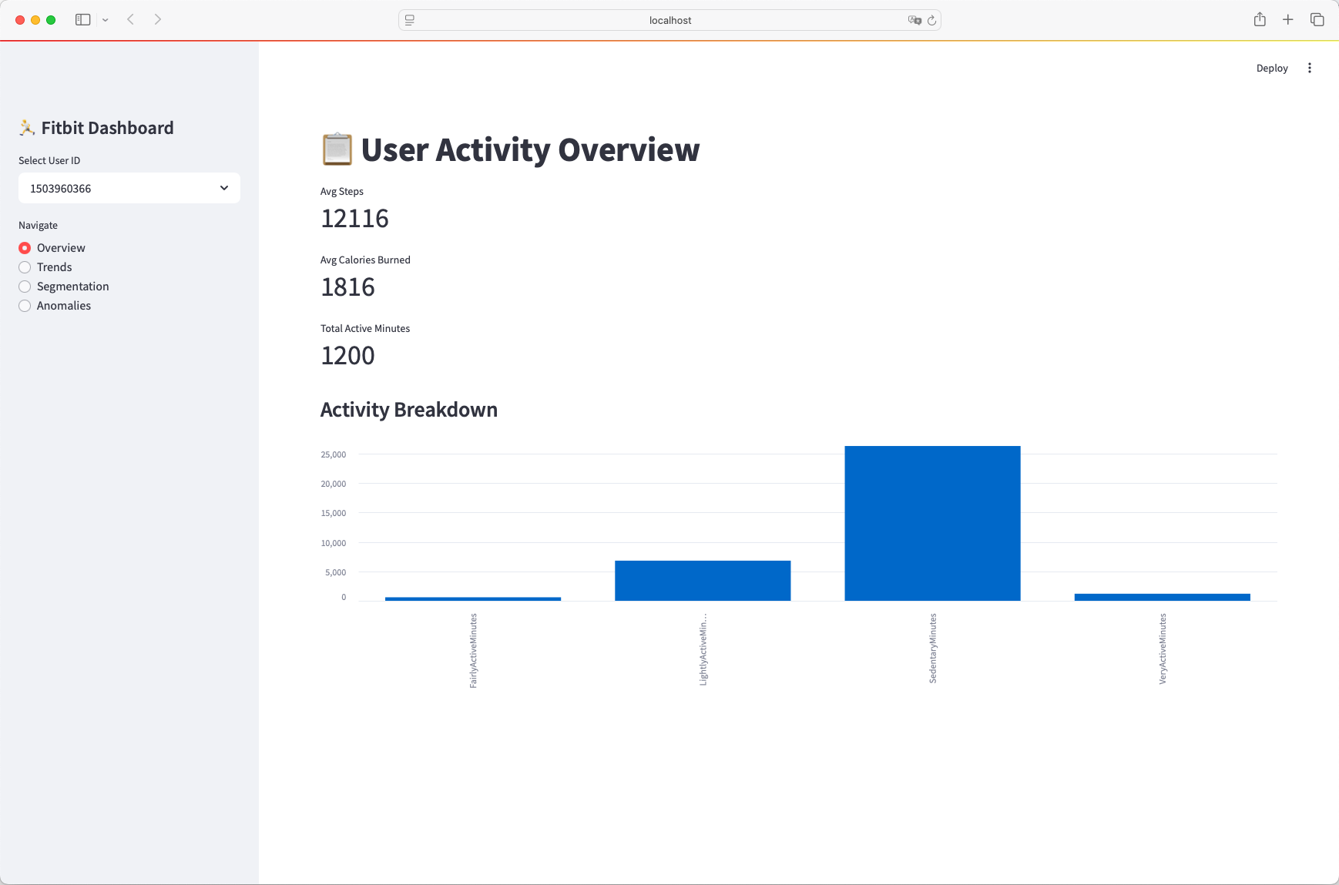
Notes:
On the sidebar, users can choose their User ID to view personal metrics.
The Overview tab shows the average steps, calories, and active minutes — very useful for summarizing lifestyle habits.
The Trends tab visualizes step counts, calories, and activity patterns over time.
In Segmentation, you’ll see how users are grouped into clusters like Low, Moderate, and High Activity based on daily behavior.
Lastly, the Anomalies tab shows days with very high or very low steps, detected using the IQR method — these may indicate errors, missed days, or intense workouts.
The dashboard is designed to be interactive and intuitive, helping users understand their behavior at a glance.

Slide 12
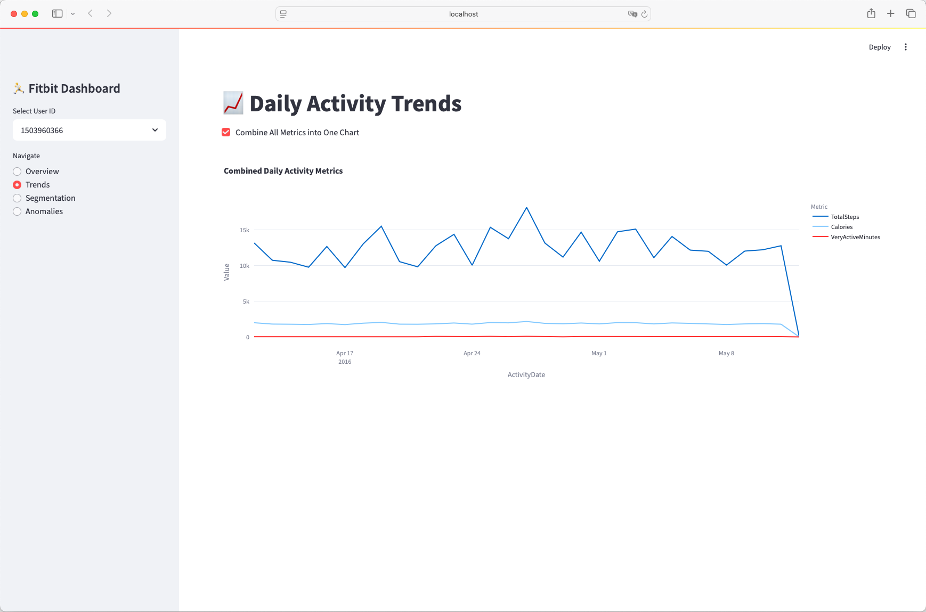
Notes:
On the sidebar, users can choose their User ID to view personal metrics.
The Overview tab shows the average steps, calories, and active minutes — very useful for summarizing lifestyle habits.
The Trends tab visualizes step counts, calories, and activity patterns over time.
In Segmentation, you’ll see how users are grouped into clusters like Low, Moderate, and High Activity based on daily behavior.
Lastly, the Anomalies tab shows days with very high or very low steps, detected using the IQR method — these may indicate errors, missed days, or intense workouts.
The dashboard is designed to be interactive and intuitive, helping users understand their behavior at a glance.

Slide 13
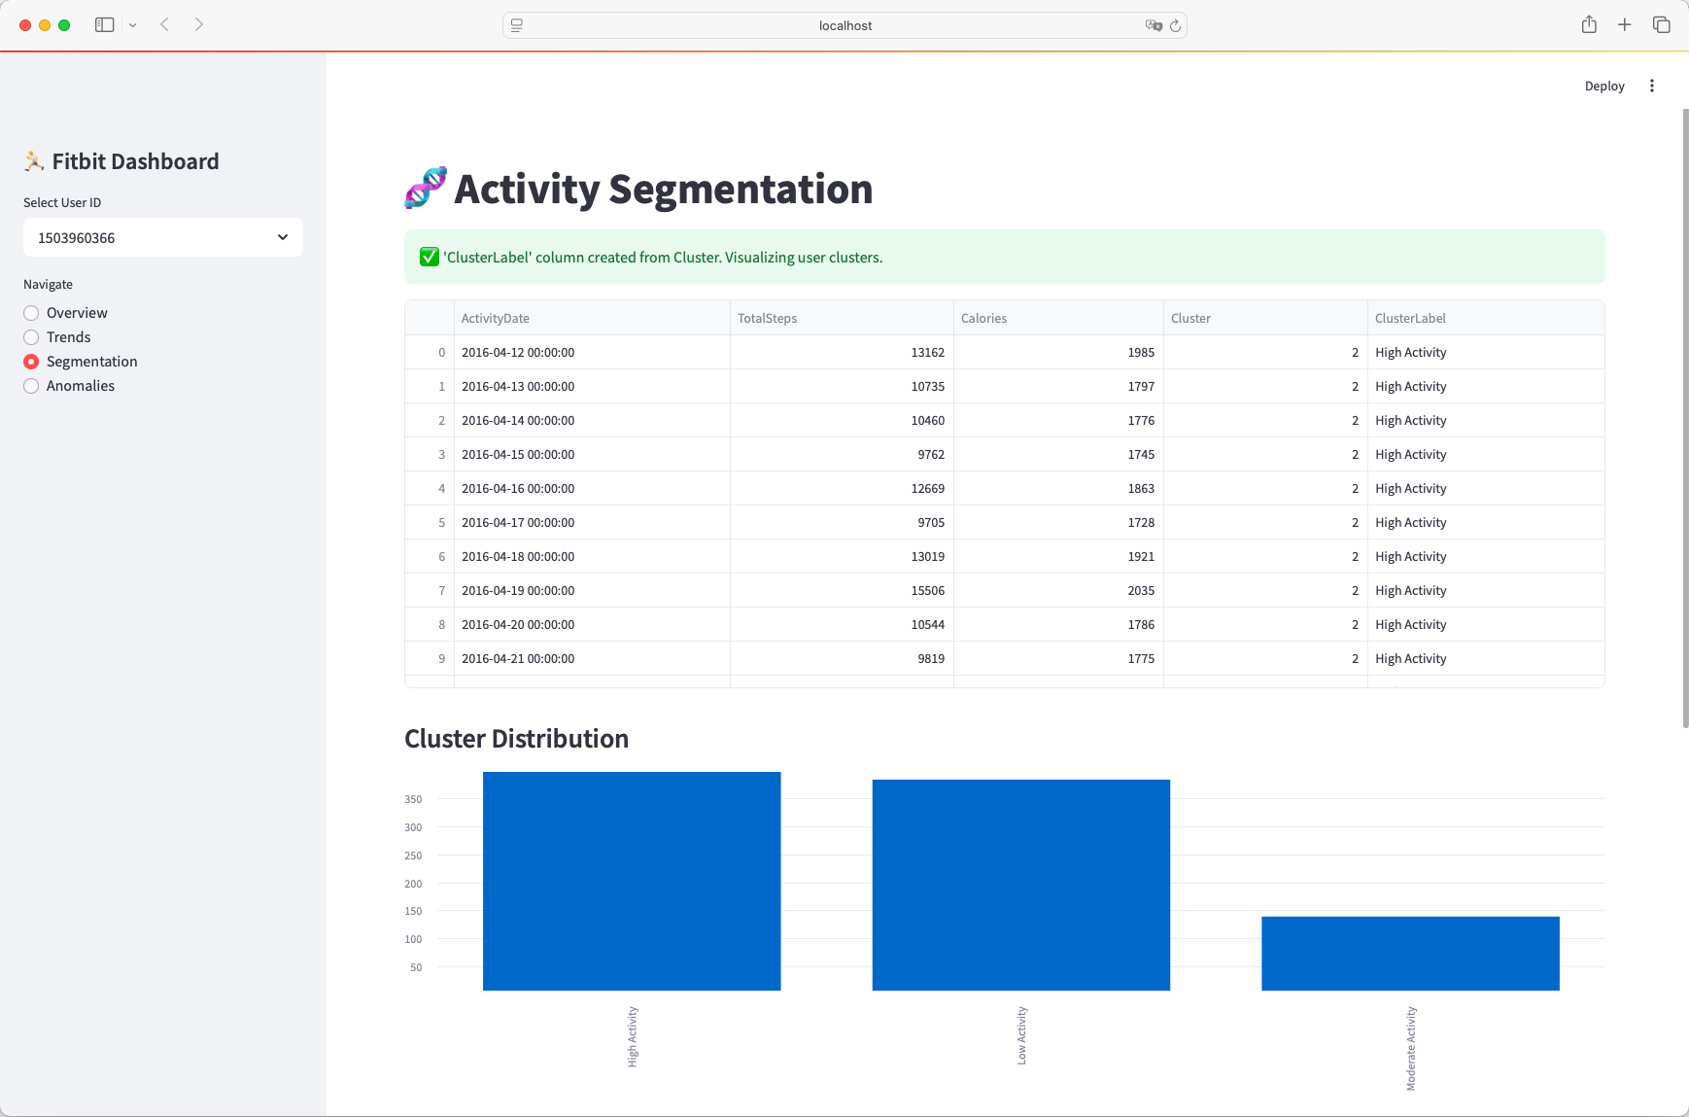
Notes:
On the sidebar, users can choose their User ID to view personal metrics.
The Overview tab shows the average steps, calories, and active minutes — very useful for summarizing lifestyle habits.
The Trends tab visualizes step counts, calories, and activity patterns over time.
In Segmentation, you’ll see how users are grouped into clusters like Low, Moderate, and High Activity based on daily behavior.
Lastly, the Anomalies tab shows days with very high or very low steps, detected using the IQR method — these may indicate errors, missed days, or intense workouts.
The dashboard is designed to be interactive and intuitive, helping users understand their behavior at a glance.

Slide 14
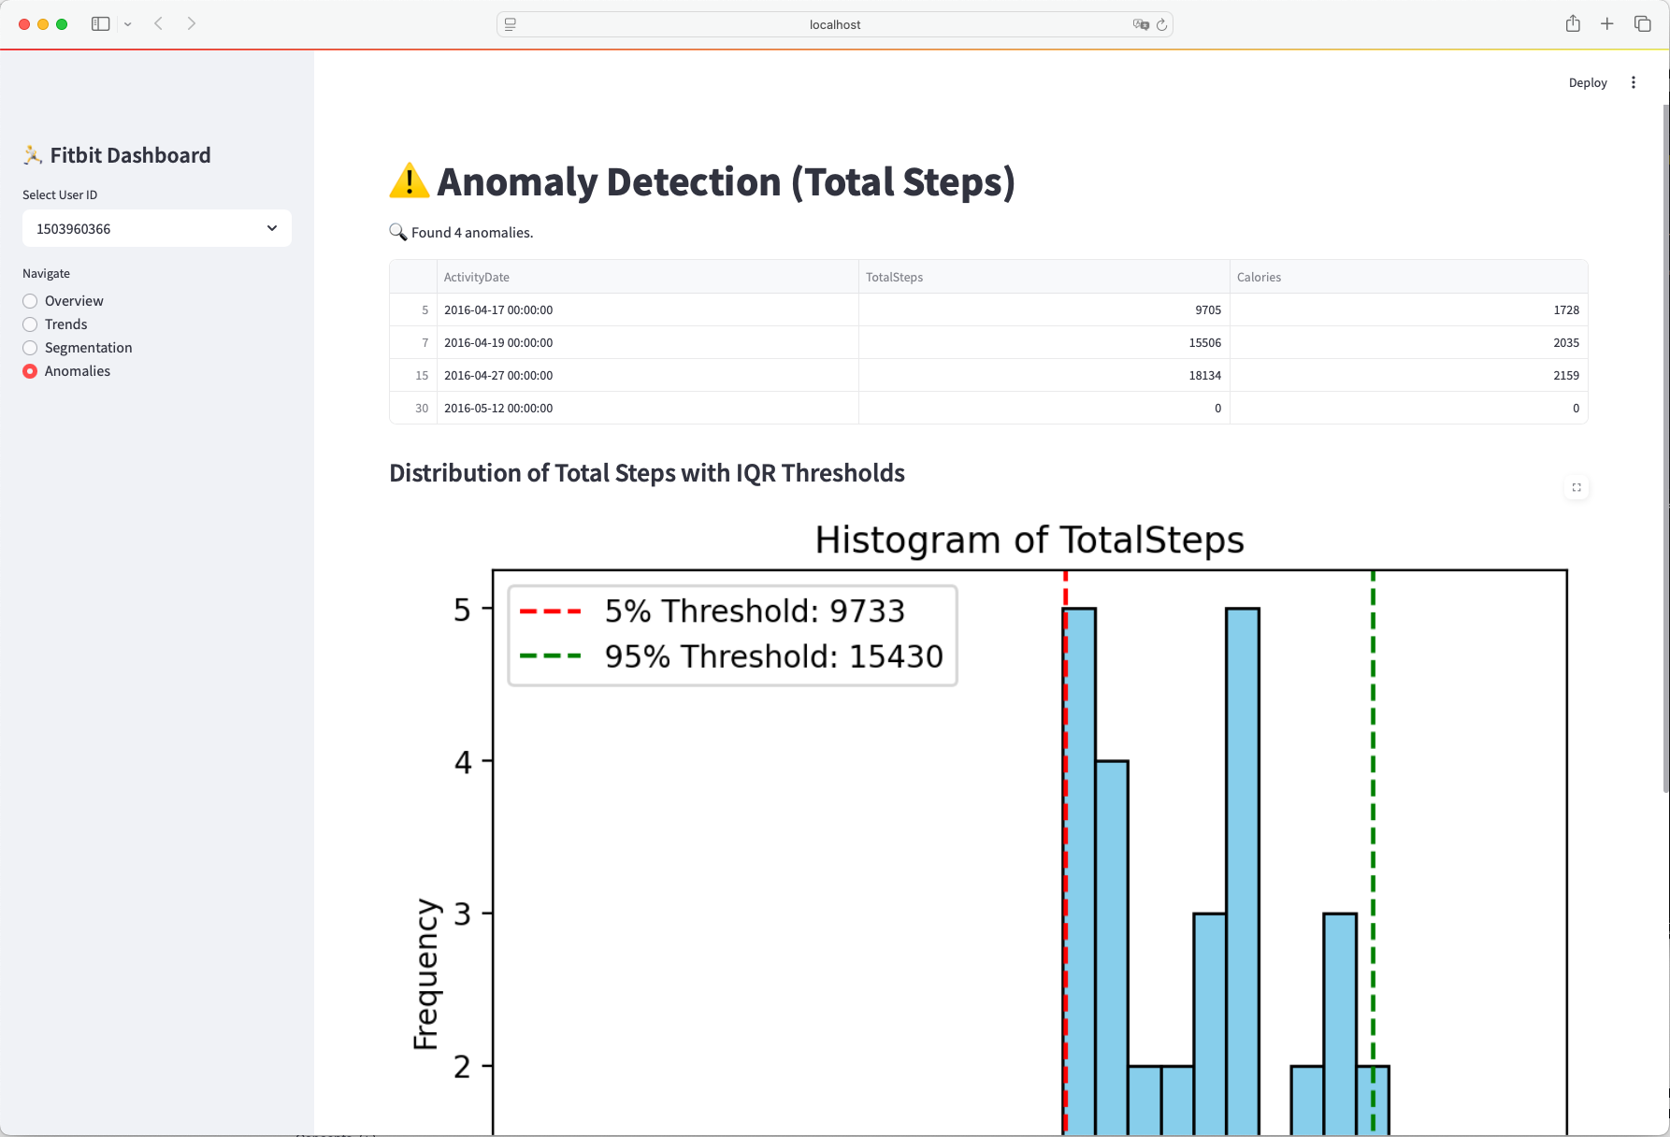
Notes:
On the sidebar, users can choose their User ID to view personal metrics.
The Overview tab shows the average steps, calories, and active minutes — very useful for summarizing lifestyle habits.
The Trends tab visualizes step counts, calories, and activity patterns over time.
In Segmentation, you’ll see how users are grouped into clusters like Low, Moderate, and High Activity based on daily behavior.
Lastly, the Anomalies tab shows days with very high or very low steps, detected using the IQR method — these may indicate errors, missed days, or intense workouts.
The dashboard is designed to be interactive and intuitive, helping users understand their behavior at a glance.

Slide 15
05
Conclusion of the project
Notes:
In conclusion, this project successfully:
Segmented user activity levels using clustering,
Detected abnormal patterns using statistical thresholds,
And delivered the findings through an interactive Streamlit dashboard.
Through this project, I learned the importance of data preprocessing, model tuning, and effective visualization in Big Data Analytics. For future work, I’d like to integrate more data types — such as heart rate or sleep — and deploy the dashboard online for public use.

Slide 16
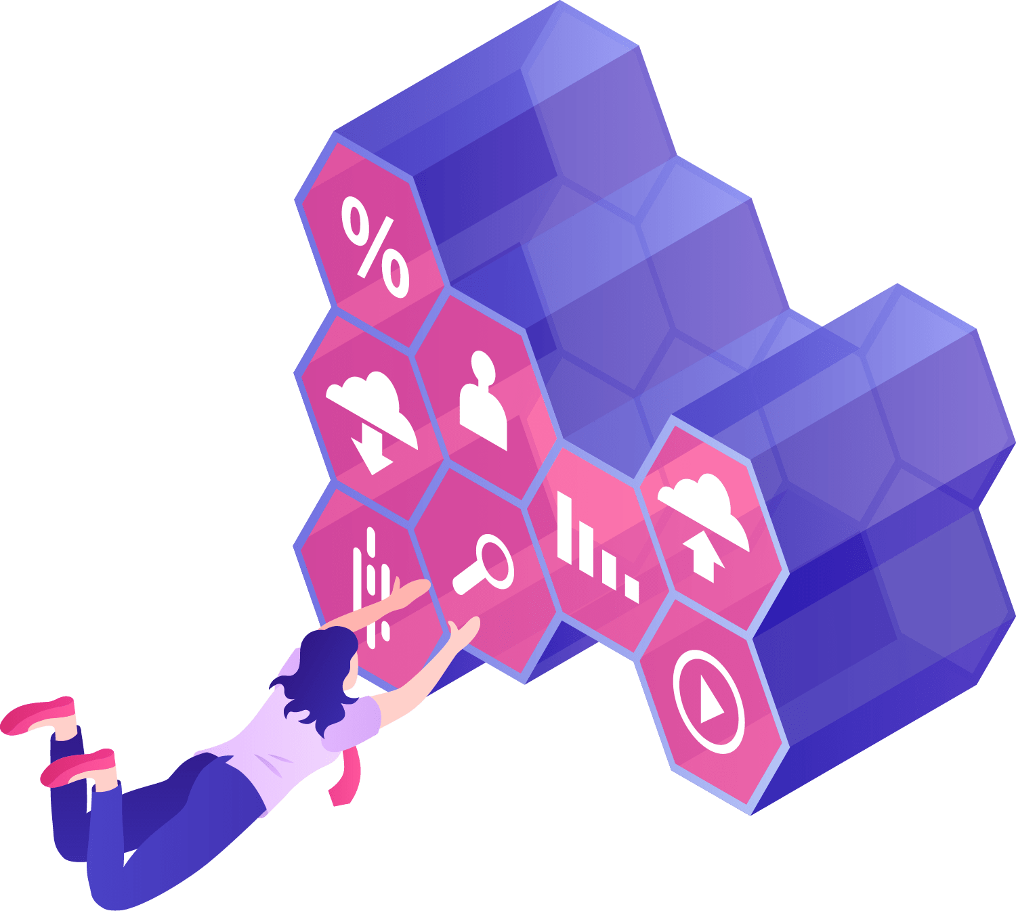
Thanks!
Do you have any questions?
Please keep this slide for attribution

