Slide 1

JS Framework training

Slide 2
Contents
01
Introduction
02
Required knowledge
03
Create React project
04
React Component
05
Component State & Props
06
Component Life Cycle

Slide 3
1. Introduction
React is a library for building user interfaces
Declarative
Component-based
Learn Once, write anywhere

Slide 4
2. Required
Knowledge
Javascript basic
ES6+ syntax
HTML/CSS basic
Environment
NodeJS v8+
Visual Studio Code
Google Chrome with React extension
ESLint extension for Visual Studio Code (optional)

Slide 5
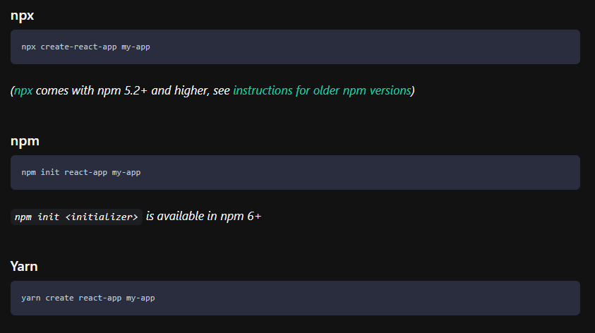
3. Create React project

Slide 6
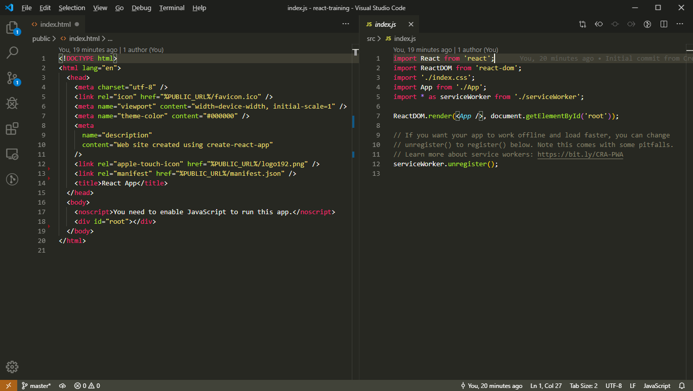
3. Create React project
2 most important files

Slide 7
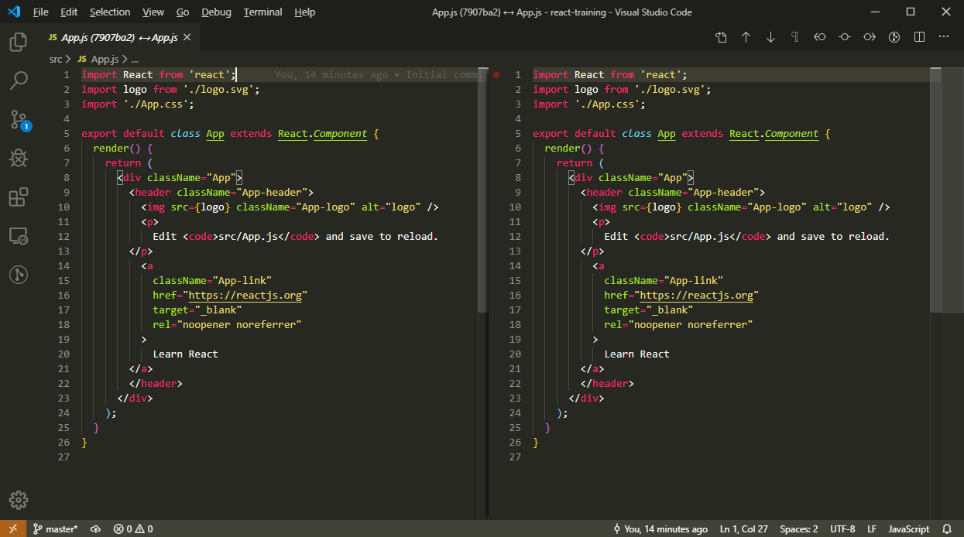
4. React Component
There are 2 kinds of React Component
Functional Component
Class Component

Slide 8
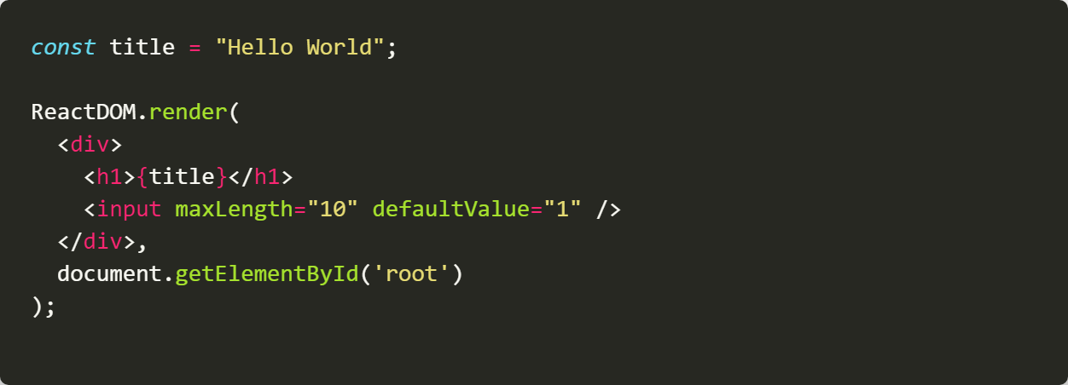
4. React Component - JSX
React use JSX to describe HTML template
JSX stands for JavaScript XML.
JSX allows us to write HTML in React.
JSX makes it easier to write and add HTML in React.
Difference from standard HTML
Attributes must be wrote in camelCase
Use className instead of class, forHTML instead of for
Data binding must be put inside curly brace { }
All components must be self-close or have closing tag

Slide 9
5. Component State
Create
Create state Object
Update state
Avoid directly mutate state Object

Slide 10
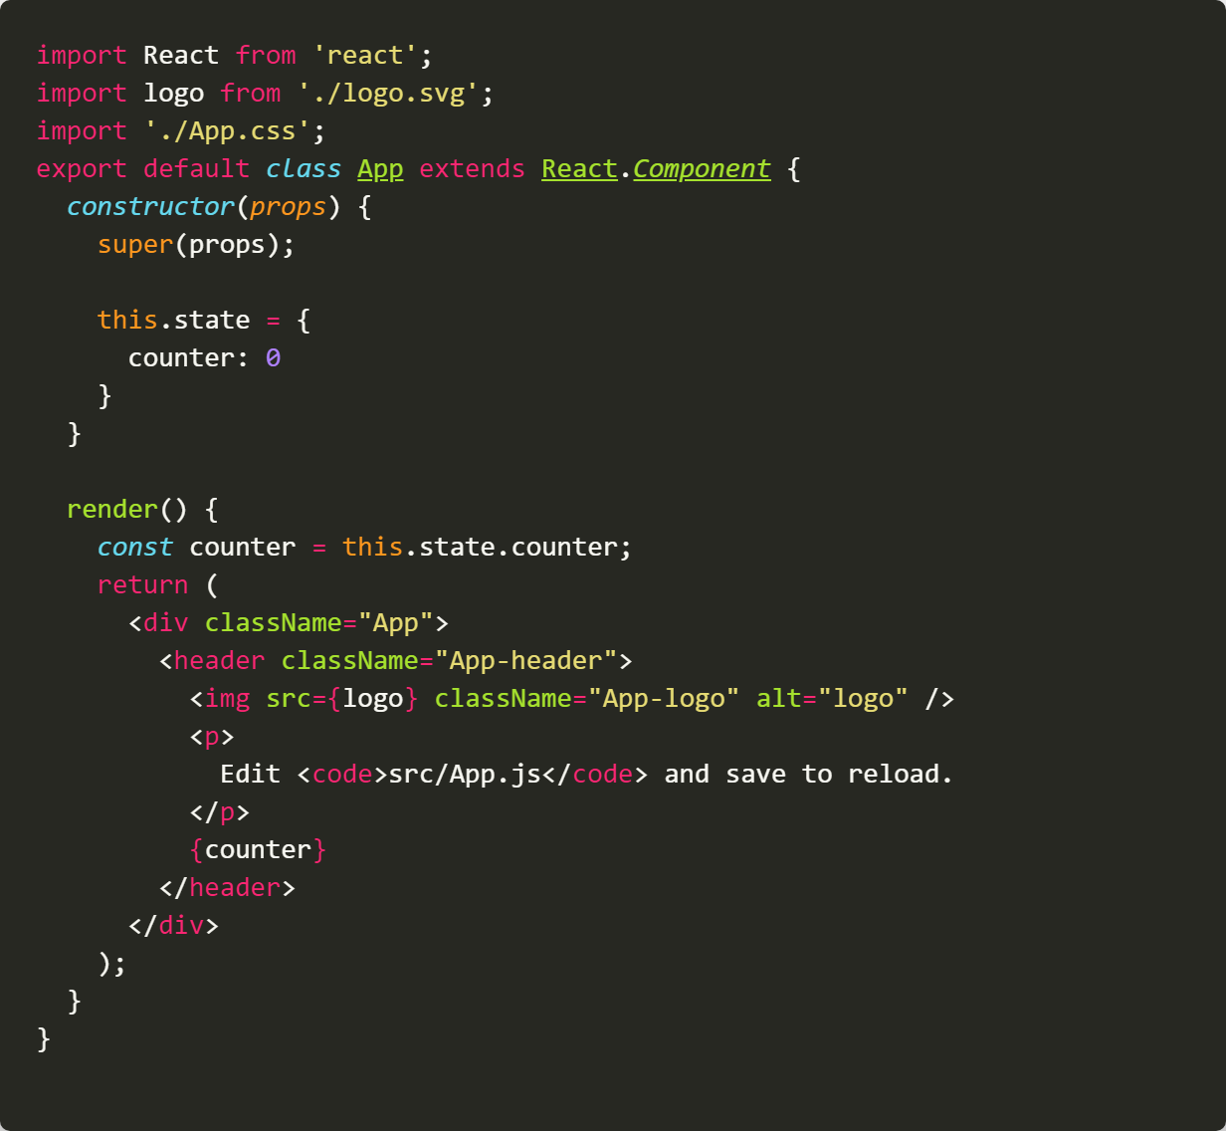
5. Component State
Create state Object
Property name must be state
It must be an Object

Slide 11
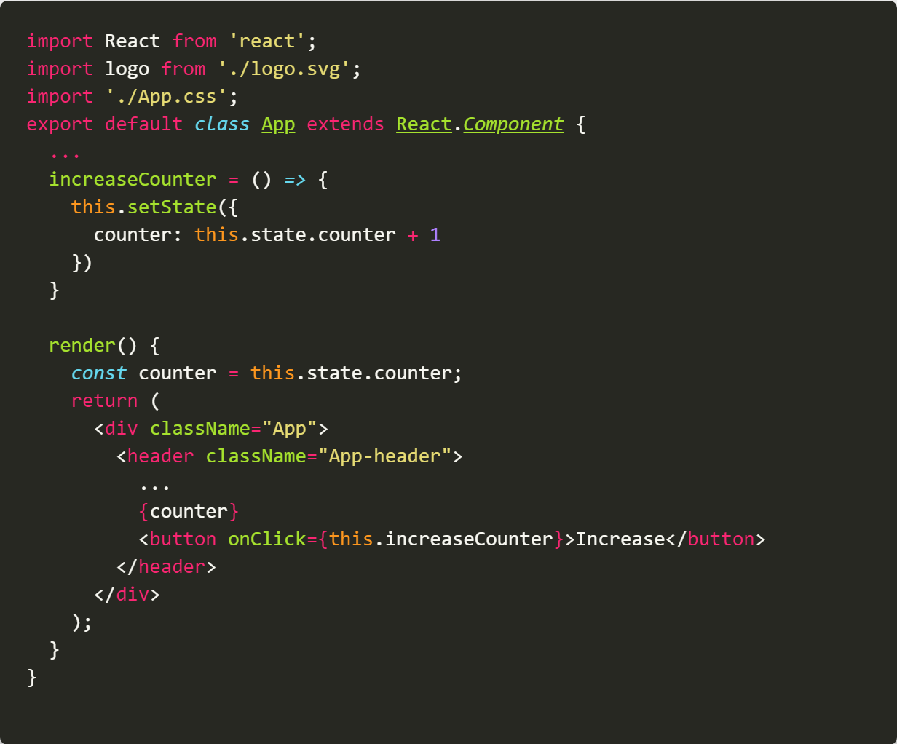
5. Component State
Update state
Use setState to update state Object

Slide 12
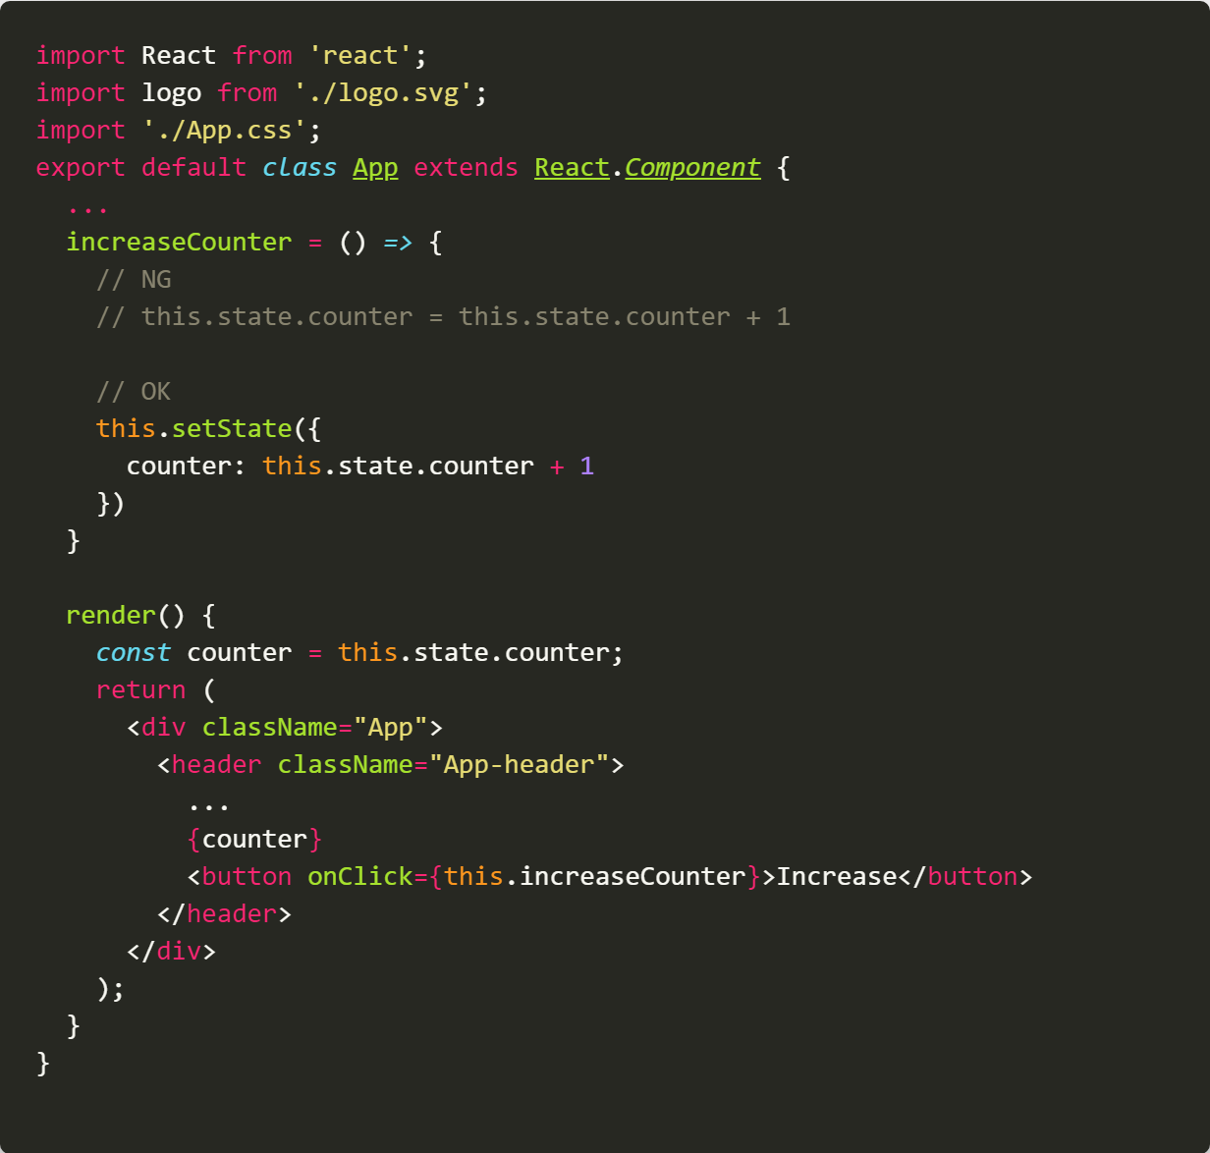
5. Component State
NEVER directly mutate state Object!!!

Slide 13
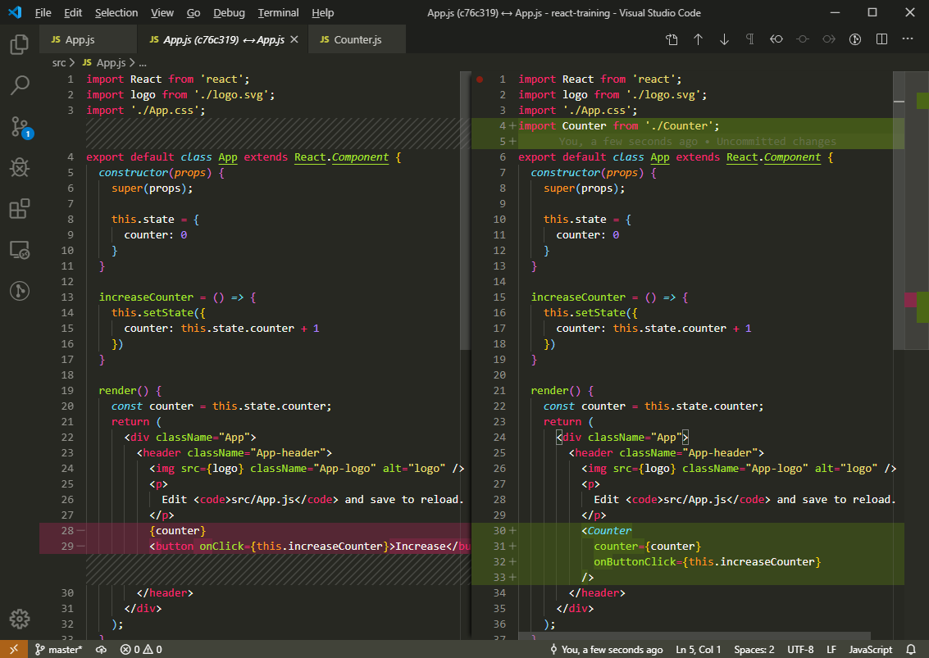
6. Component Props
React Component Props
Described similar with HTML attribute (but not need to use camelCase)
Value must be put inside “ ” or {}
Value type could be anything: String, Number, Boolean, Array, Object, Function, Symbol
Notes:
- Use “ ” when prop is string or number
Use { } when it is not string, number or an expression
Boolean value “true” can be omitted

Slide 14
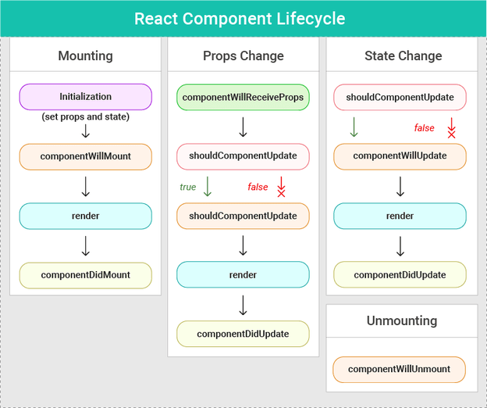
7. Component Life Cycle
React Component support these life cycle hooks

Slide 15
7. Component Life Cycle
When we need to use life cycle hook?
Control html outside mouting node
Imperative action
Integrate non-React 3rd libraries
Optimize performance by control when component update
Attention!!!
If you start a timer, register event handlers or init 3rd library, you need to un-doing it in componentWillUnmount to avoid memory leak.
Notes:
Set document title
Set timeout
Integrate datepicker, chart library

Slide 16
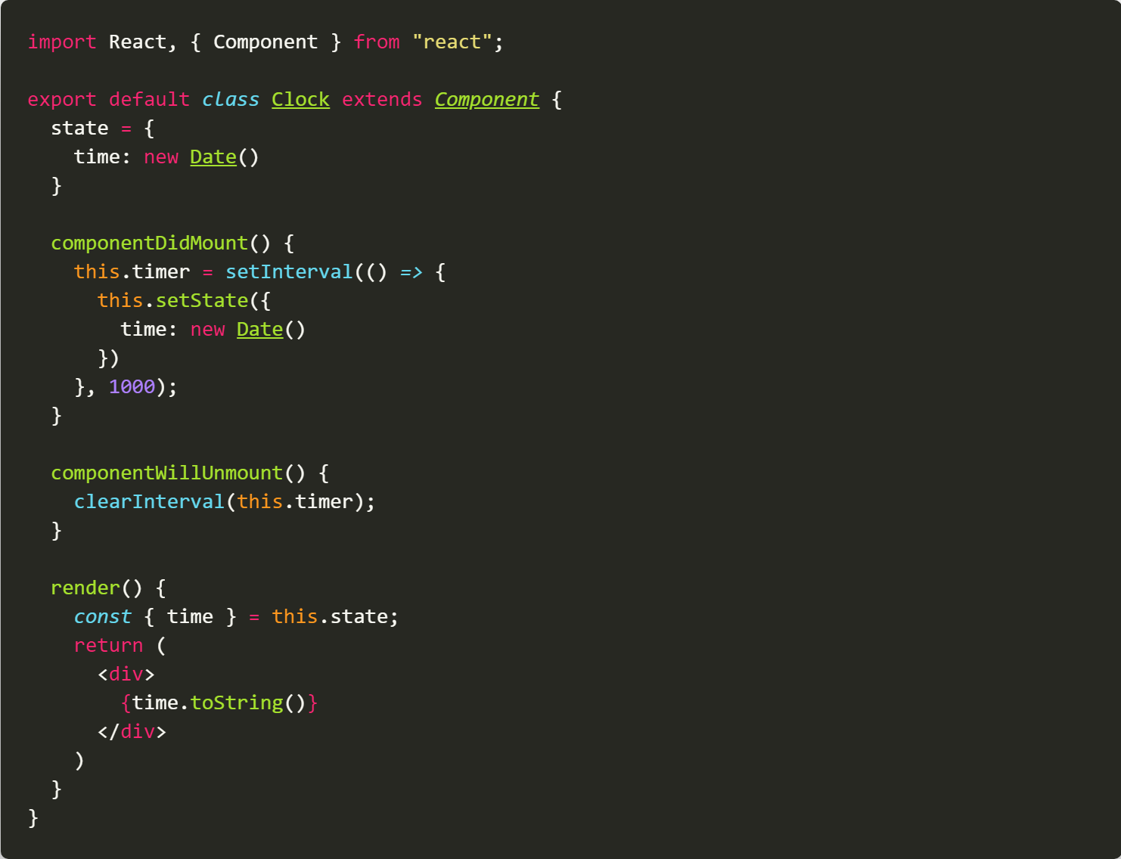
7. Component Life Cycle
Example: Clock component
Notes:
Set document title
Set timeout
Integrate datepicker, chart library

Slide 17
8. QnAs

Slide 18
9. Homework
If counter1 reach over 20, Increase button will be change to Decrease button. Then click decrease 1 to 0 then change to increase
If counter2 reach under 20, Increase button will be disabled.
AutoFocusInput: normal input, auto focus to input when created
Mail: quoctoan907@gmail.com
Note: delete node_modules before zipping
Subject: React training – Bai 1

