Slide 1

JS Framework training – React & Redux

Slide 2
Contents
01
Introduce Redux
02
Actions
03
Reducers
04
Middleware
05
Container
06
Development tools

Slide 3
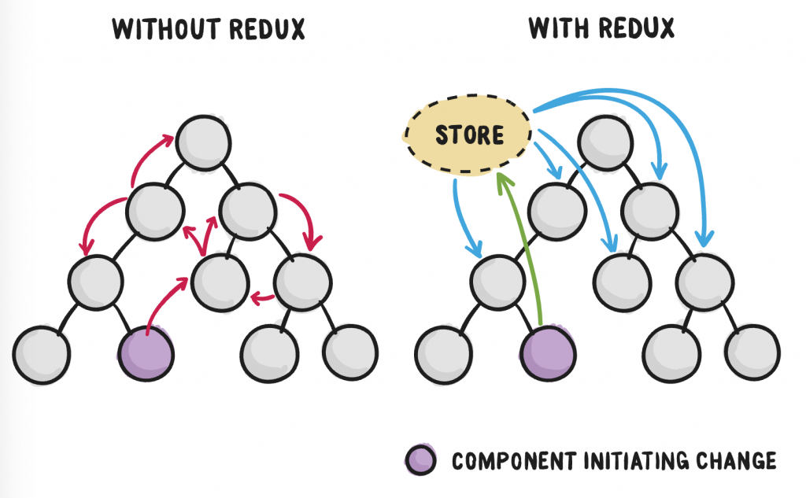
1. Introduce Redux
Most libraries like React, Angular, etc. are built with a way for components to internally manage their state without any need for an external library or tool. It does well for applications with few components but as the application grows bigger, managing states shared across components becomes a chore.
In an app where data is shared among components, it might be confusing to actually know where a state should live. Ideally, the data in a component should live in just one component. So sharing data among sibling components becomes difficult.
It’s clear that state management gets messy as the app gets complex. This is why you need a state management tool like Redux that makes it easier to maintain these states.
Using Redux store in React application come with some extra features:
Separate GUI layer (React) and State logic (Redux), it help developers thinking in a more modular way and implement each part faster.
Split State logic into smaller reducers, atomic but simply at the same time.
Enforce application structure: Redux application may have too many boilerplates, but in large size application it help developers can understand any part of application even they do not develop that part.
Notes:
Redux are commonly use with React, however it could work with any JS Framework, or even with vanillaJS
NgRx for Angular or Vuex for Vue are state management libraries strongly inspired by Redux.

Slide 4
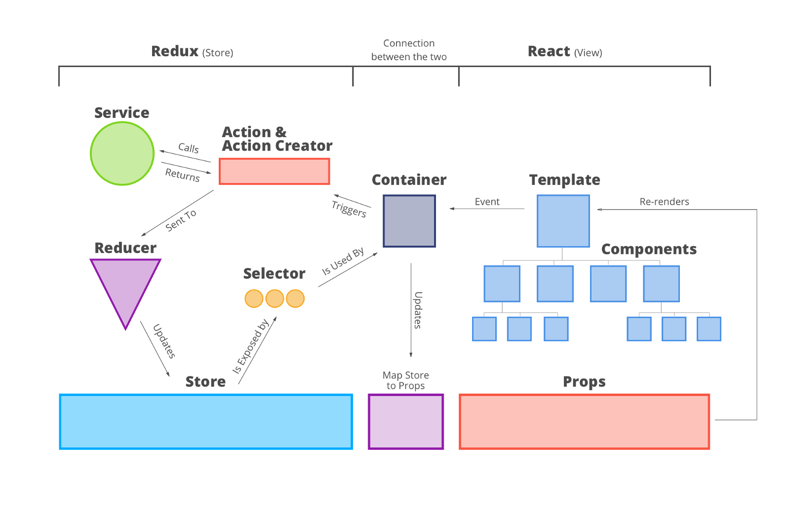
1. Introduce Redux

Slide 5
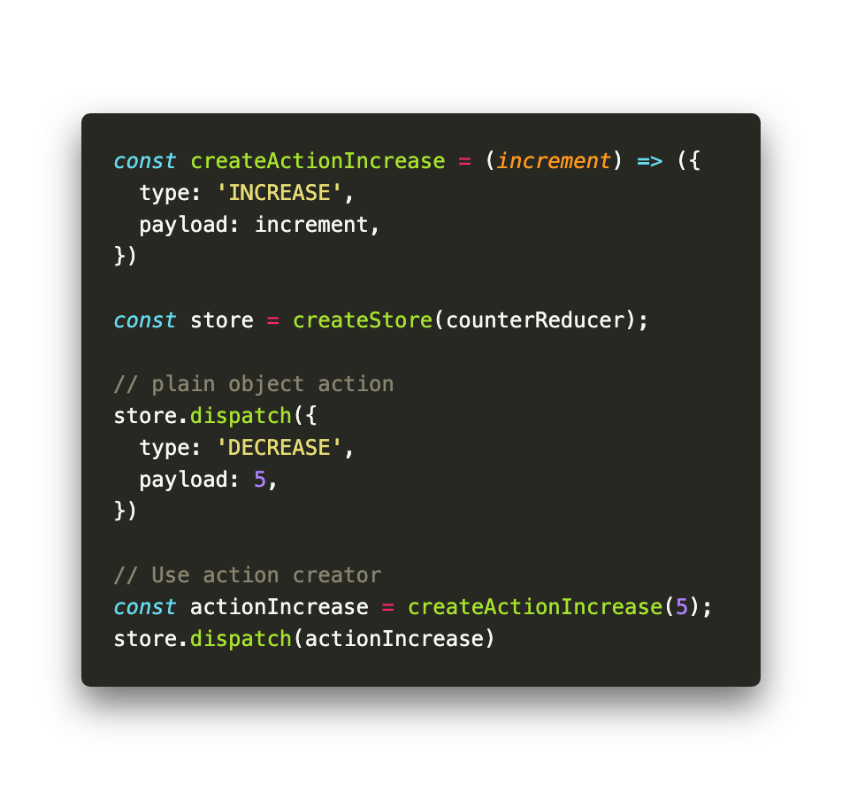
2. Actions
Action in Redux is a plain Javascript Object with mandatory .type property, any other property is optional and can be decided by developer. Action .type must be a string.
Actions are usually created via an action creator
Dispatch an action is the only way to change state.

Slide 6
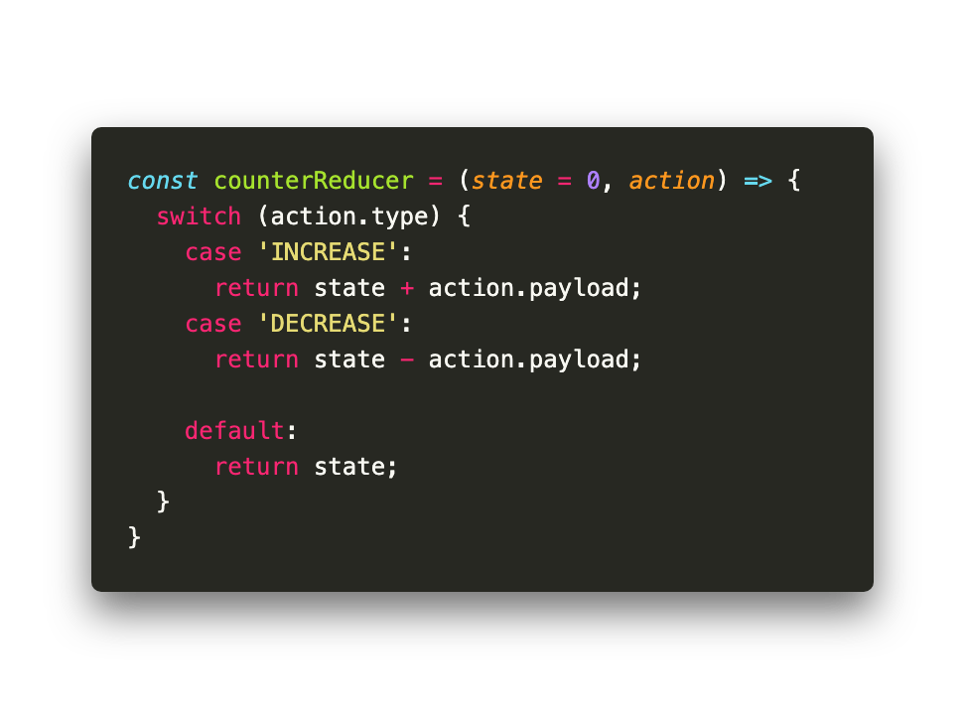
2. Reducers
Reducers are pure functions that take the current state of an application, perform an action and returns a new state.
As pure functions, they do not change the data in the object passed to it or perform any side effect in the application. Given the same object, it should always produce the same result.
Note for reducer:
NEVER mutate state object!!! Must return a new state base on old state and action.
ALWAYS return state for default case.

Slide 7
3. Middleware
Normally Redux Store only support synchronous. But asynchronous actions are very common in real life project, for example API request to server is asynchronous action.
To handle asynchronous action, we need to use middleware. There are many middlewares support asynchronous action, these are 2 most popular middlewares:
Redux Thunk
Redux Saga

Slide 8
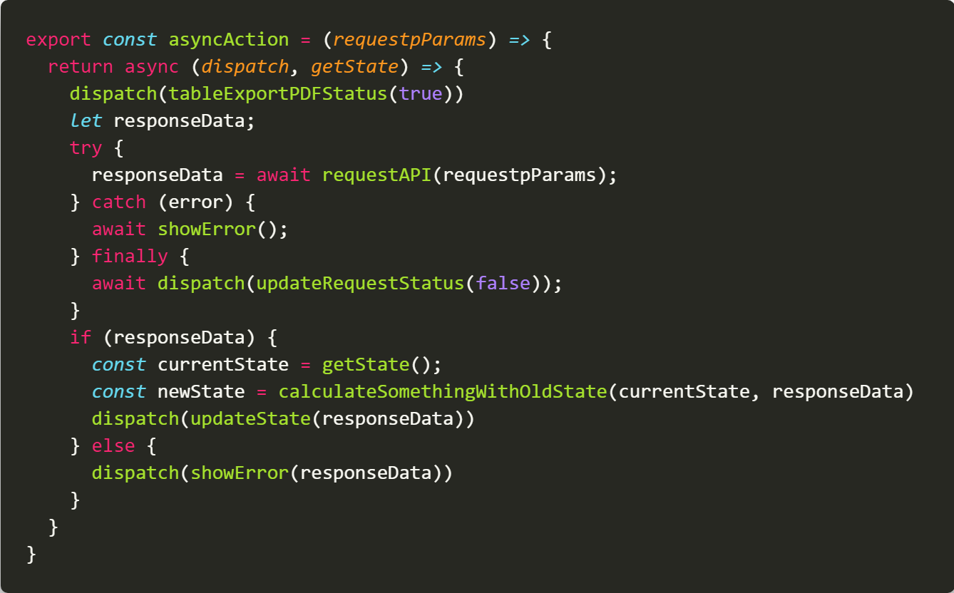
3. Middleware
Redux Thunk
The idea of redux thunk is very simple, instead of creating plain Object action, we create an action as a function with dispatch as parameter.

Slide 9
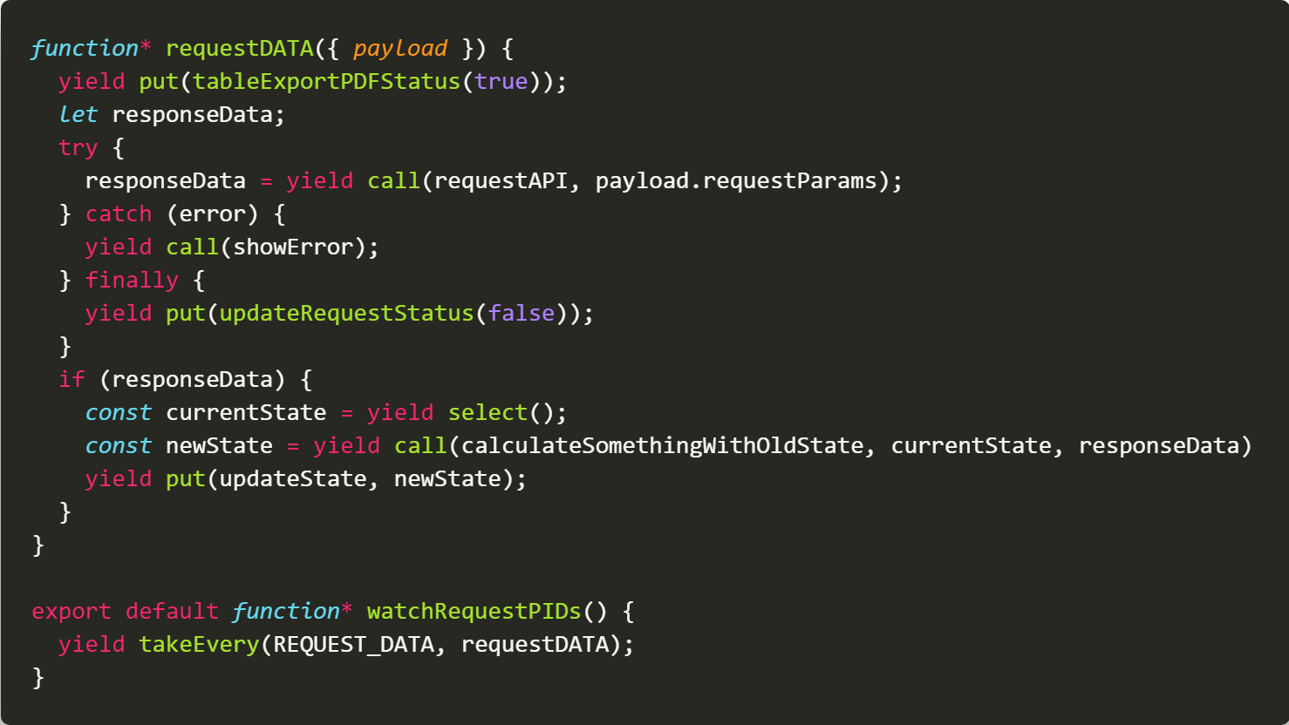
3. Middleware
Redux Saga
For more complex use case, Redux Thunk might not be enough to handle. Redux Thunk is also not support unit test. For these cases, I recommend to use Saga middleware.
Redux Saga support many effects like: takeEvery, takeLatest, race,… which very hard to implement in Thunk
Redux Saga working principle based on generator function, the syntax is very similar with async/await with some notices:
Instead of dispatch, use yield put
Instead of getState, use yield select
Instead of call function directly, use with yield call
Notes:
you still could call function directly but you cannot write unit test for that

Slide 10
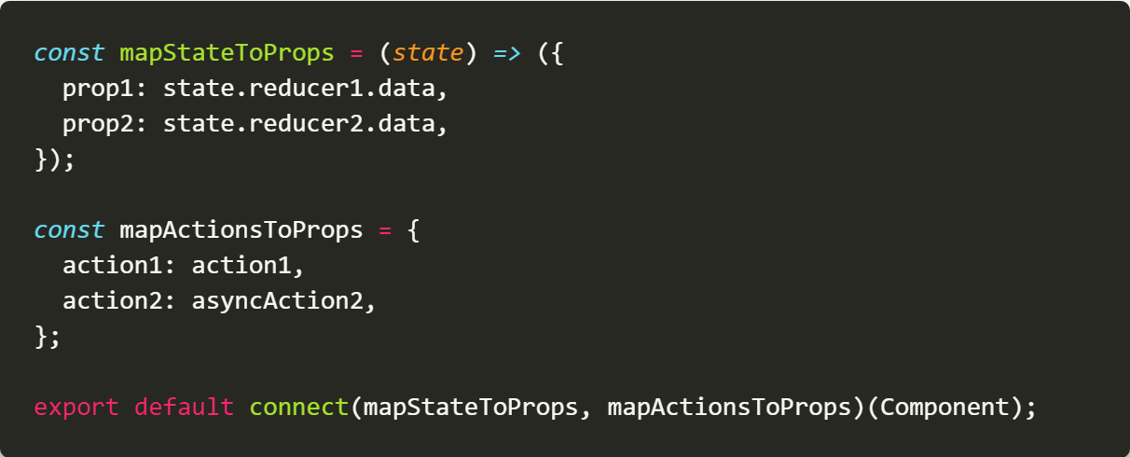
4. Container
As design, React-Redux architecture based idea is separate GUI layer and Stateful logic. So, for them to working together in an application, we need a connector between theme. In React-Redux, we use a component type called Container to do that
We use connect function from react-redux library to create connection between Redux Store and React Component. This function accept 2 main parameters:
mapStateToProps: get some part of Redux store and pass as props to Component. NOTE: you should only map what you need, no more.
mapActionsToProps: get and binding actions from Action Creator to Component props

Slide 11
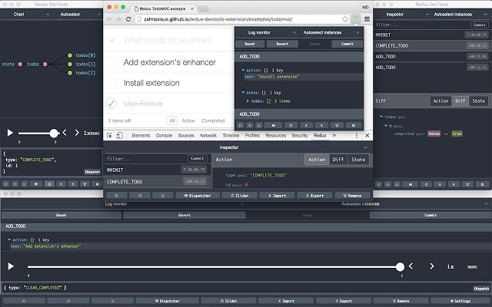
5. Dev tools
Redux provide a very powerful Development Tools, it come as extension for Chrome or Firefox
Show all action dispatch to Store
Show what difference action made to State.
Visualize State Tree
Generate Unit Test Code
Manually dispatch action
Time Travel Debugging
…

Slide 12
6. QnAs

