Slide 1

JS Framework training

Slide 2
Contents
01
PropTypes
02
Event, Ref, Key, Form
03
React Router
04
HTTP Request
05
React Hooks

Slide 3
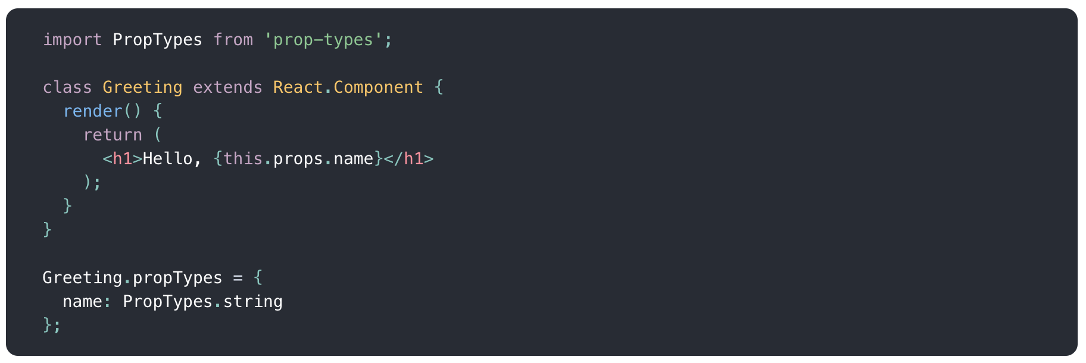
1. PropTypes
As your app grows, you can catch a lot of bugs with typechecking. For some applications, you can use JavaScript extensions like Flow or TypeScript to typecheck your whole application. But even if you don’t use those, React has some built-in typechecking abilities. To run typechecking on the props for a component, you can assign the special propTypes property.
PropTypes exports a range of validators that can be used to make sure the data you receive is valid. In this example, we’re using PropTypes.string. When an invalid value is provided for a prop, a warning will be shown in the JavaScript console. For performance reasons, propTypes is only checked in development mode.

Slide 4
2.1. Events
Handling events with React elements has some syntactic differences:
React event handlers are named using camelCase, rather than lowercase.
With JSX you pass a function as the event handler, rather than a string.
Event handler context need to be bound.
Notes:
Set document title
Set timeout
Integrate datepicker, chart library

Slide 5
2.2 Refs
Create ref by using React.createRef()
React supports a special attribute that you can attach to any component.
If attach to a standard HTML element, it will refer to JS instance of that element.
If attach to a React Class Component, it will refer to instance of that class.
You cannot directly attach ref to a Functional Component, use React.forwardRef in this case.
Ref usually use in some case you need to do something in imperative way.
Notes:
Set document title
Set timeout
Integrate datepicker, chart library

Slide 6
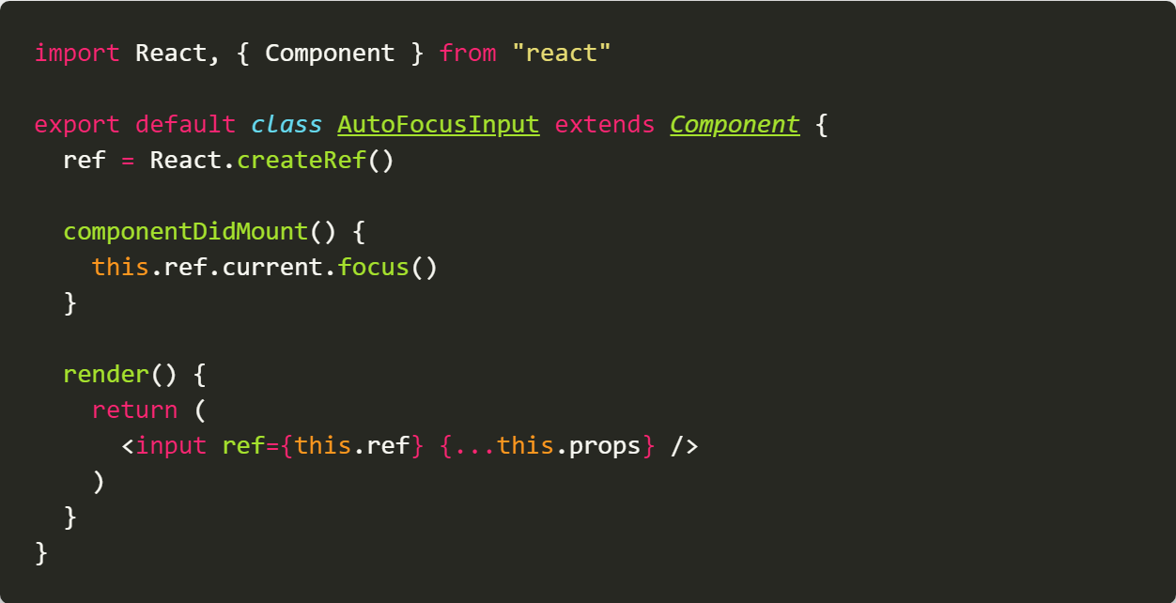
2.2 Refs
Attach ref to standard HTML

Slide 7
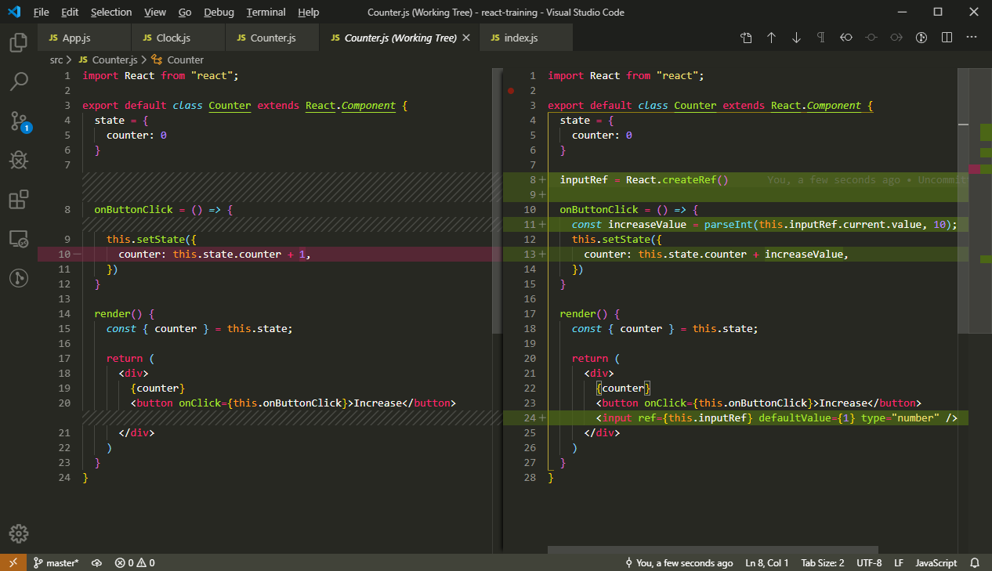
2.2 Refs
Attach ref to standard HTML

Slide 8
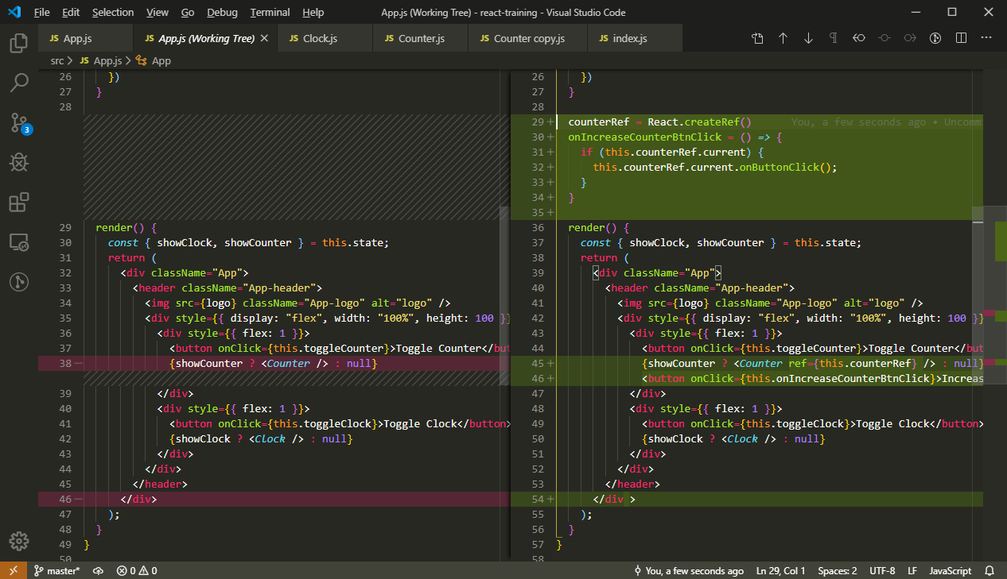
2.2 Refs
Attach ref to React Class Component

Slide 9
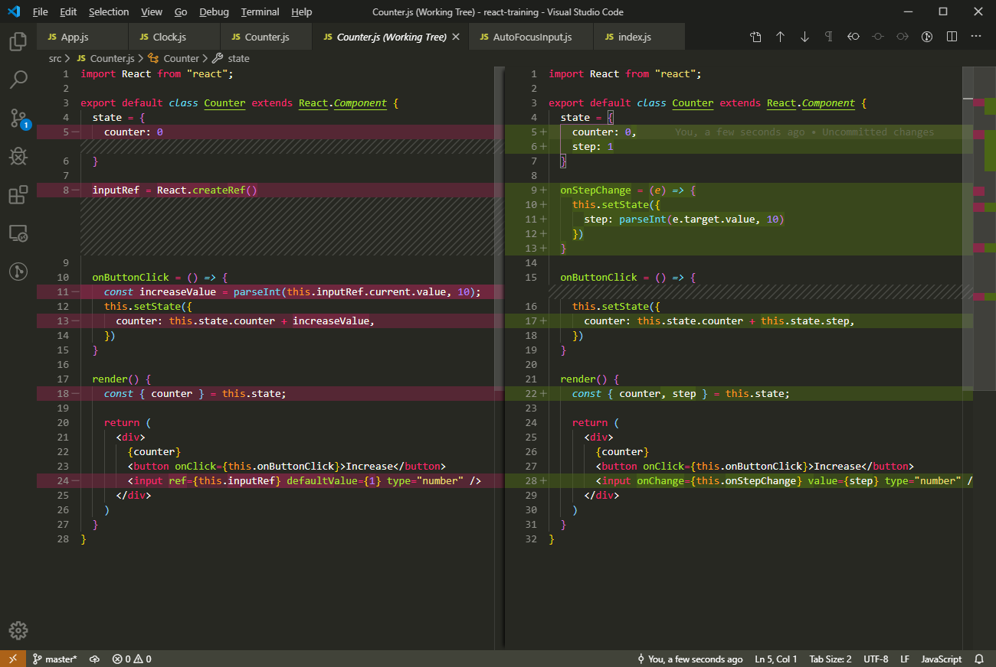
2.3 Form
There are 2 kinds of form components in React
Controlled Components.
Uncontrolled Components.

Slide 10
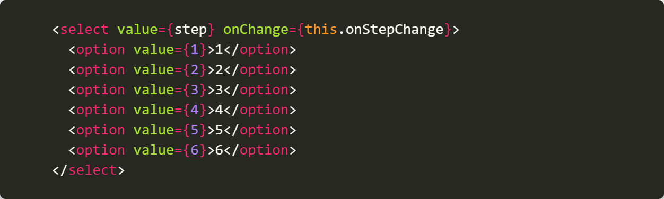
2.3 Form
<select> component has some difference from standard HTML <select>

Slide 11
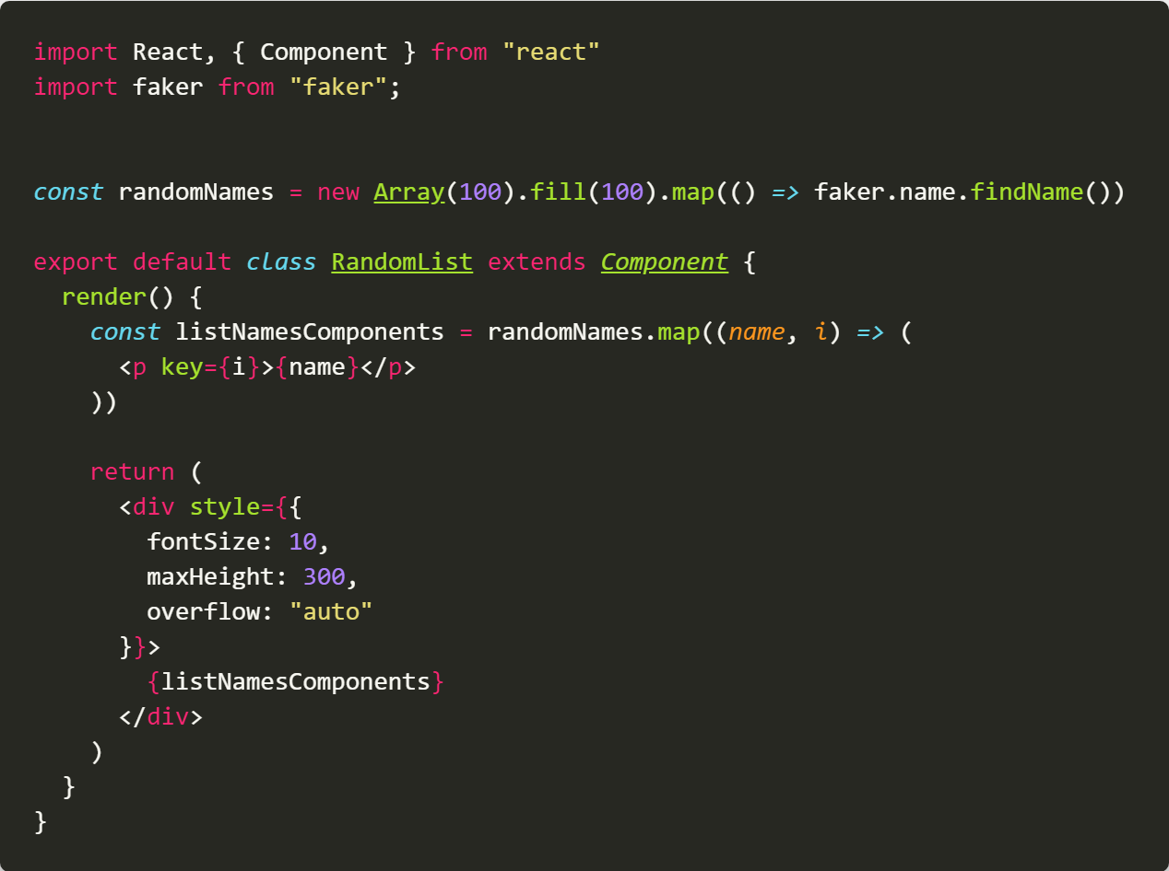
2.4 Lists and Keys
When rendering a list in React, you need to provide each child an unique and stable key

Slide 12
2.4 Lists and Keys
Key can be set to any component, not just list children. When key change, React will destroy old component and create a new one. So we could use key to control component life cycle in some case.
Only use indexes as key in case you cannot get unique id from data.
Key could be used when you want to make a 3rd library controllable

Slide 13
3. HTTP Request
React does not offer any library for HTTP Request, but there are many 3rd JS libraries for that, feel free to use them in your React project:
ES6+ fetch API
Axios
Request
JQuery Ajax
…
I personally recommend to use Axios for some reasons:
It use promise syntax
It support all major browsers include IE9+ and NodeJS for fullstack Application
Auto transform JSON data
Support Buffer data (which means you can upload/download file)
Support cancel request
Support upload/download progress

Slide 14
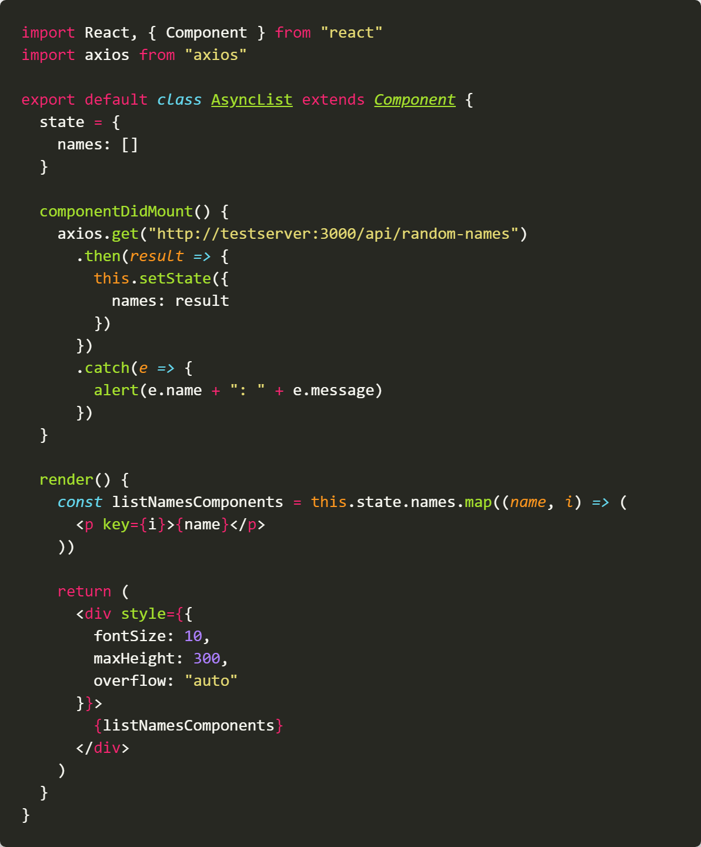
3. HTTP Request
HTTP Request must be put into componentDidMount or componentDidUpdate.
Good practice: Show a loading indicator when requeting data and show error when request has problem.

Slide 15
4. React Router
Like HTTP Request, React doesn’t come with a Routing solution, but luckily, we have a very good 3rd library which almost all React developer use for routing.
- Unlike Server Routing solutions, React is client side framework, so it use Client Routing solution, which means when you change URL, browser does not make request to server and only some part of GUI is re-render.
- React Router allow developer setup routing using Component based like any normal React Component.

Slide 16
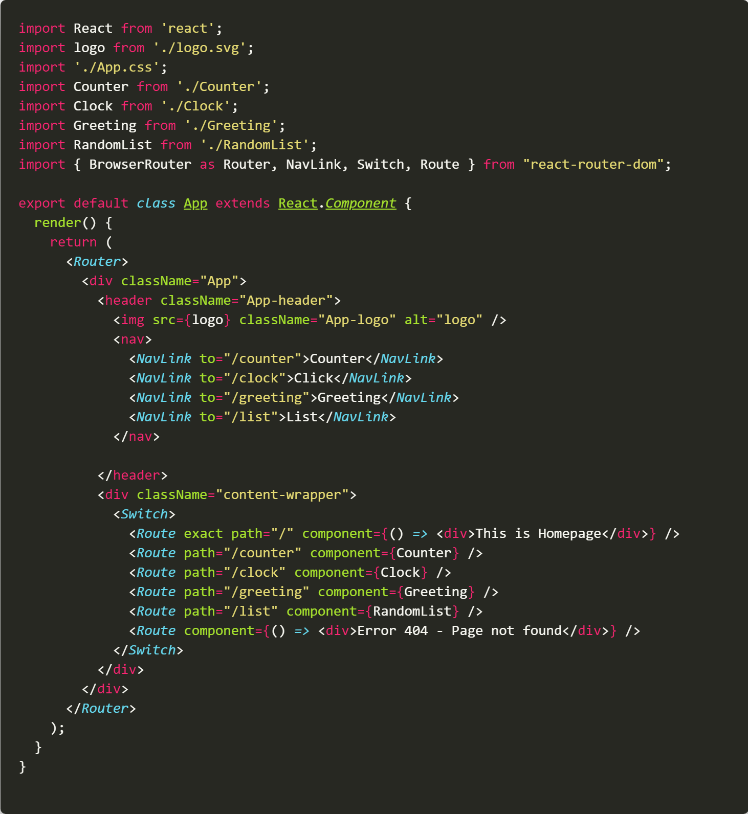
4. React Router
Notes:
If you use BrowserRouter, server must support Single Page Application.

Slide 17
5. React Hooks
Hooks are a new addition in React 16.8. They let you use state and other React features without writing a class.
Before we continue, note that Hooks are:
Completely opt-in. You can try Hooks in a few components without rewriting any existing code. But you don’t have to learn or use Hooks right now if you don’t want to.
100% backwards-compatible. Hooks don’t contain any breaking changes.
Not need to rewrite: There are no plan to remove Class Component from React
Hooks don’t replace your knowledge of React concepts. Instead, Hooks provide a more direct API to the React concepts you already know: props, state, context, refs, and lifecycle. As we will show later, Hooks also offer a new powerful way to combine them.
Why use Hooks?
Easier to reuse stateful logic
Easier to understand complex component
Normally Functional Components with Hooks have better performance than Class Component.

Slide 18
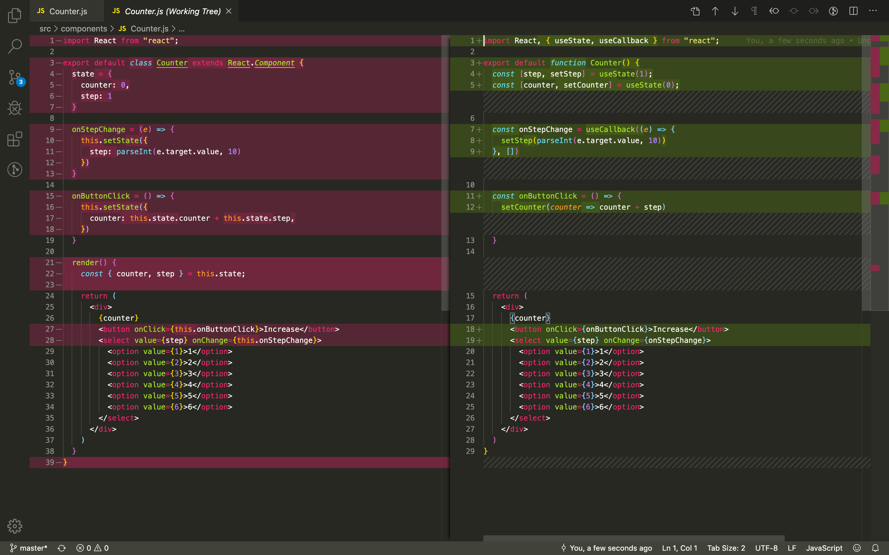
5. React Hooks - State
useState will be use instead of state Object
Notes:
Unlike setState in class component, you need to pass full state to setState parameter
setState could receive a function as parameter like setState of class component
If you pass a function to useState, it will be execute once and the result will be default state.

Slide 19
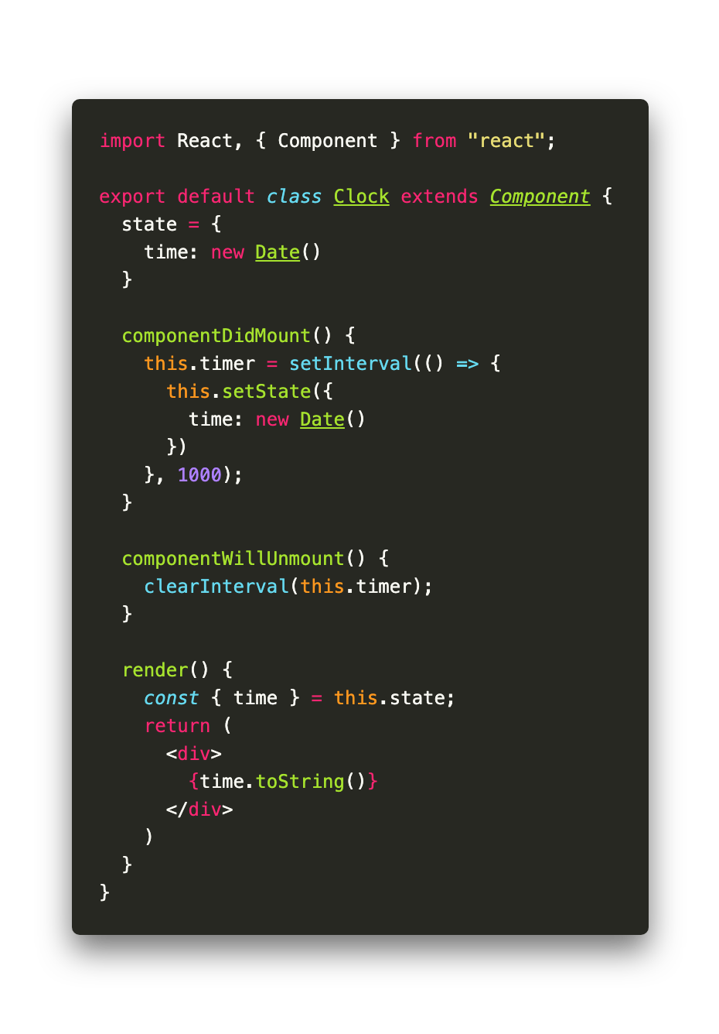
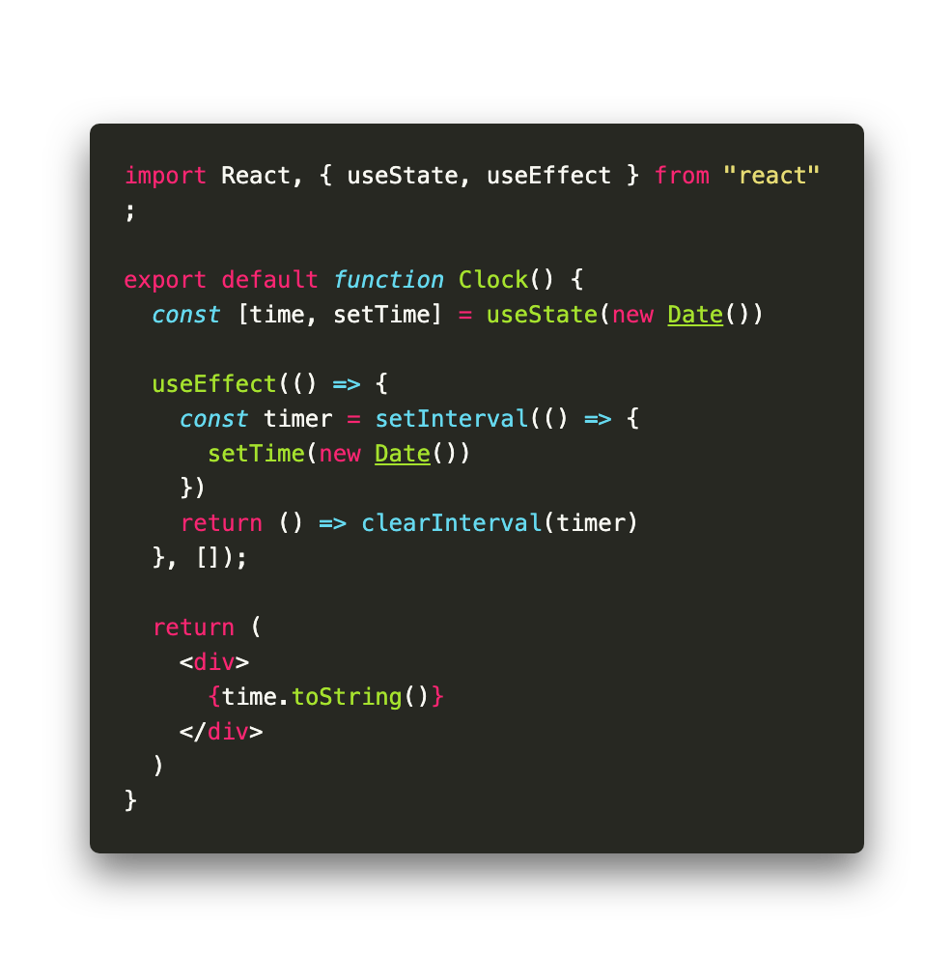
5. React Hooks – Effect hook
The Effect Hook lets you perform side effects in function components
It replace componentDidMount, componentDidUpdate and componentWillUnmount in Class Component:
Without deps, it same as componentDidMount
With deps, it same as componentDidUpdate
If return a function, it will be run when componentWillUnmount

Slide 20
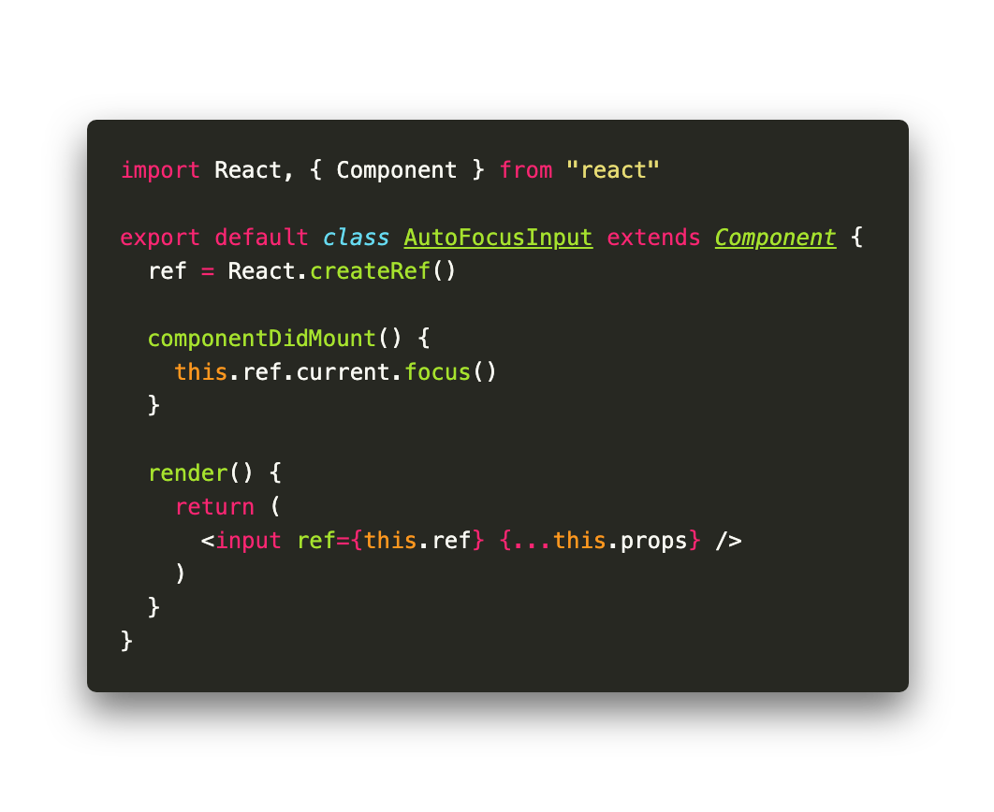
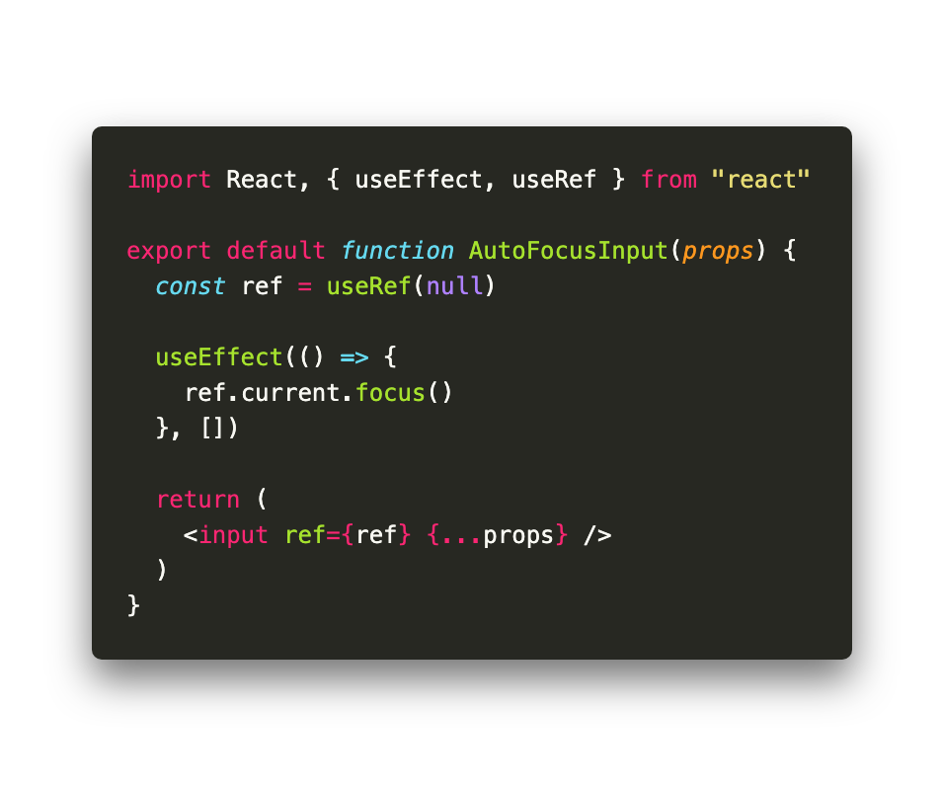
5. React Hooks – Ref hook
useRef returns a mutable ref object whose .current property is initialized to the passed argument (initialValue). The returned object will persist for the full lifetime of the component.
useRef commonly use to replace React.createRef() in Class Component. But actually it much more powerful than that.
NOTE: unlike React.createRef(), with useRef(), you can manually assign .current property of ref.

Slide 21
5. React Hooks – memo and callback hook
useMemo
Returns a memoized value.
Pass a “create” function and an array of dependencies. useMemo will only recompute the memoized value when one of the dependencies has changed. This optimization helps to avoid expensive calculations on every render.
If no array is provided, a new value will be computed on every render.
useCallback
useCallback(fn, deps) is equivalent to useMemo(() => fn, deps).

Slide 22
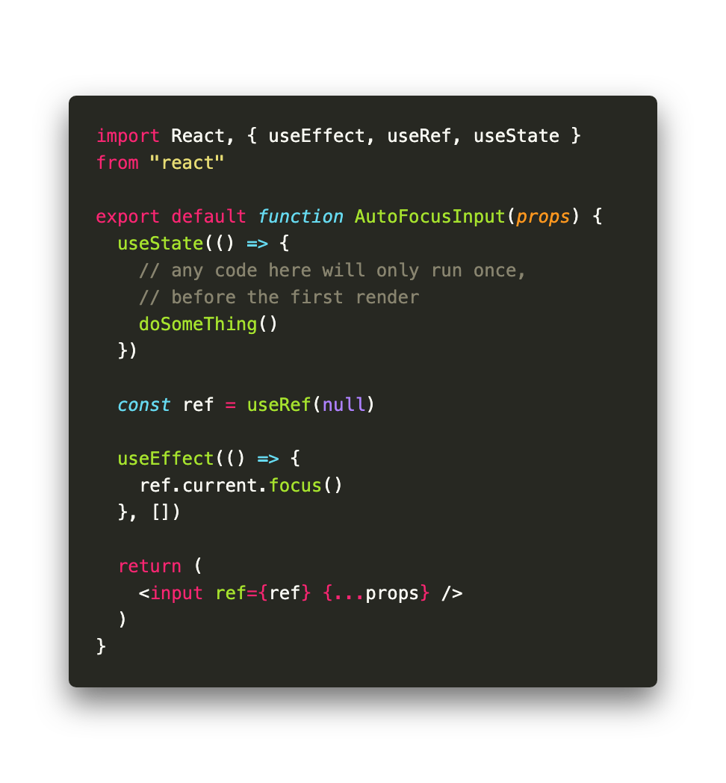
5. React Hooks – contructor trick
Sometime, you want to initialize some value even before the first render of component. In Class Component, you will simply put it in the constructor of class. But in Functional Component, there isn’t any Hook specific for this use case.
If you still want to write a Functional Component for this case, there is a trick: write anything you would write in the constructor and pass it as parameter of useState()

Slide 23
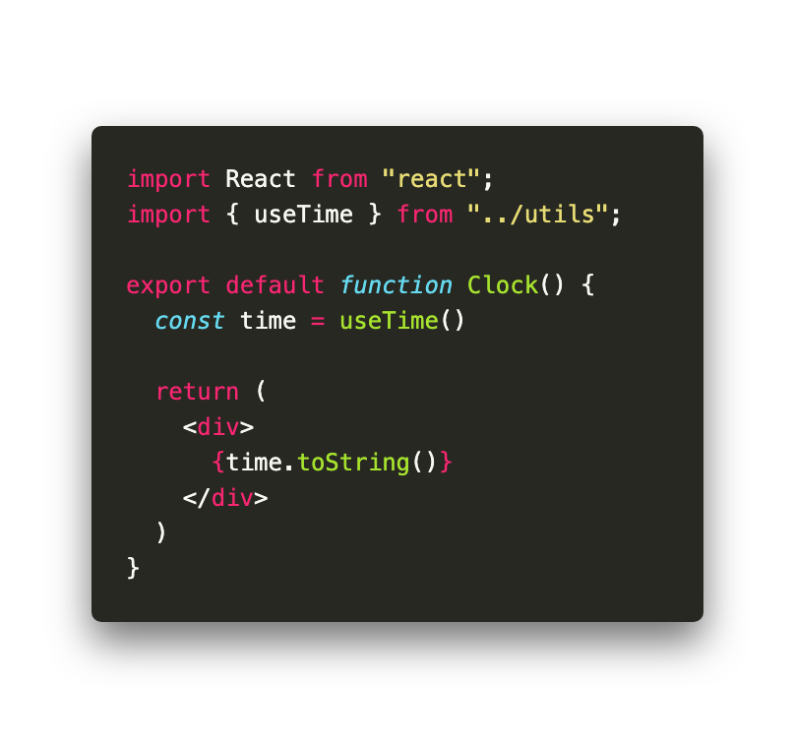
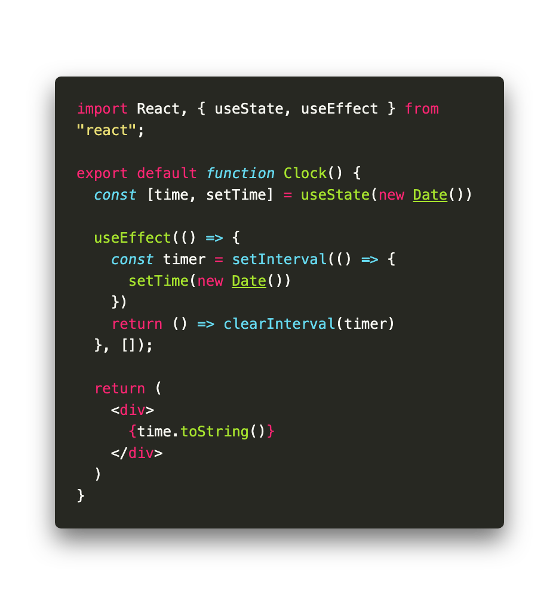
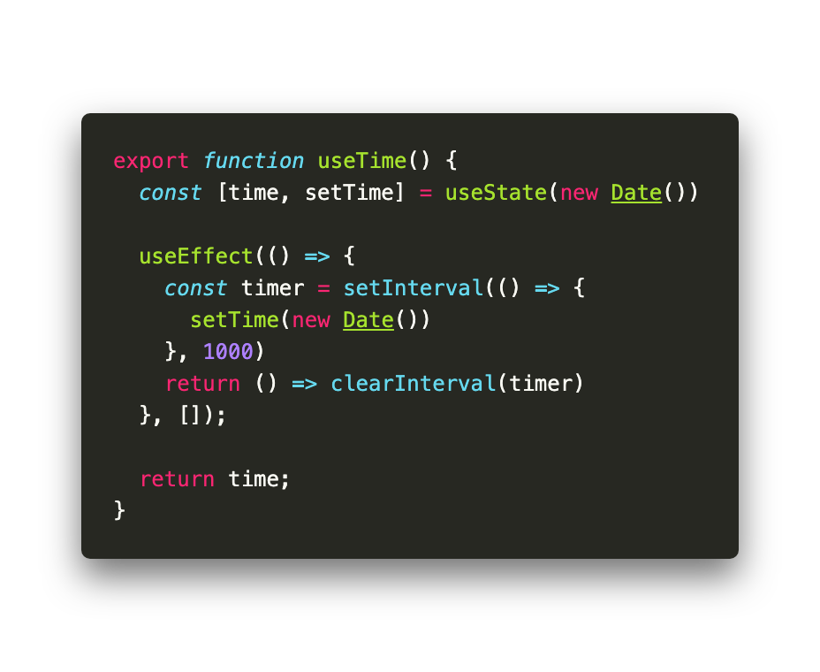
5. React Hooks – Reuse hook (custom hook)
By writing custom hooks, you can reuse stateful logic in Function Component which very hard or sometime impossible in Class Component

Slide 24
5. QnAs

Slide 25
8. Homework
From Random List screen, create a nested page for each item in the list.
Re-write every component in project to Function Component

