Slide 1


CONCURRENCY PROGRAMMING
By : Nguyen Ho (Eddy)

Slide 2

WHAT IS CONCURRENCY?
Concurrency is the ability of a system to execute multiple tasks during overlapping time periods by interleaving their.
Tasks do not need to run at the exact same time
The CPU switches rapidly between tasks
Each task makes progress over time

Slide 3
WHY CONCURRENCY?
01
02
03
Handles multiple tasks efficiently
Improves performance
Enhances responsiveness

Slide 4
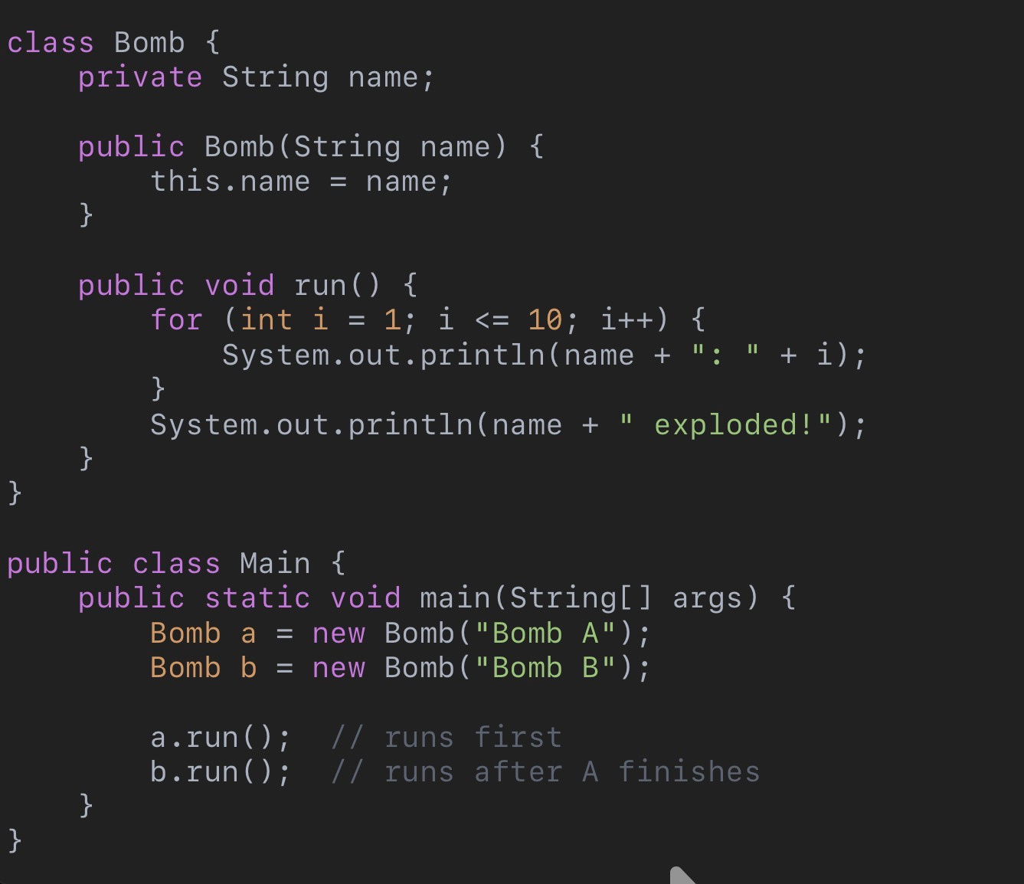
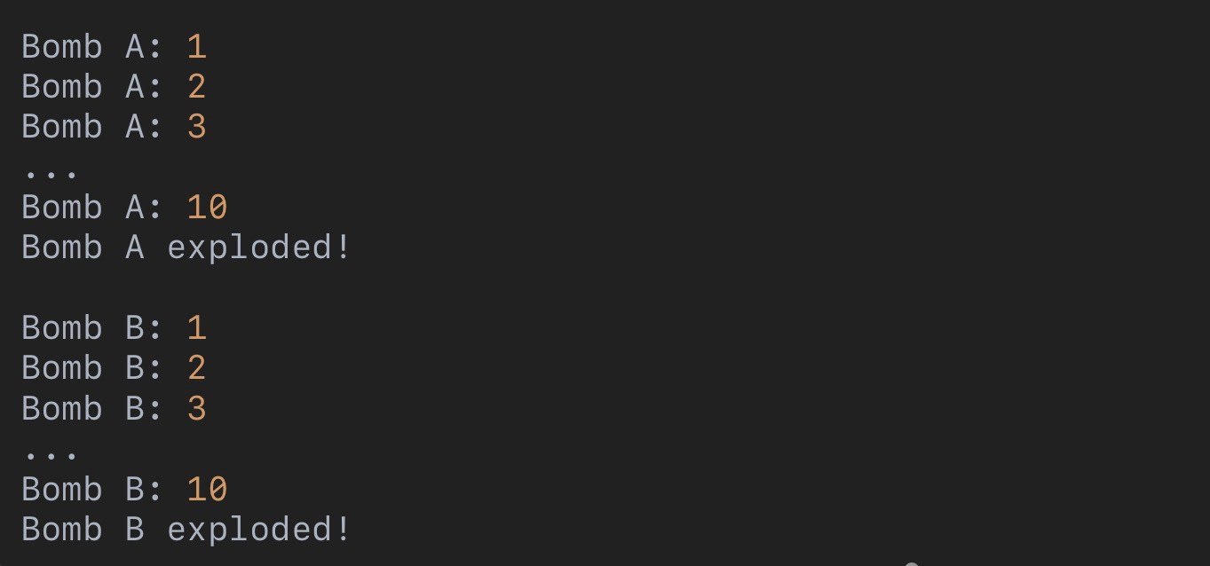
SEQUENTIAL EXECUTION

Slide 5
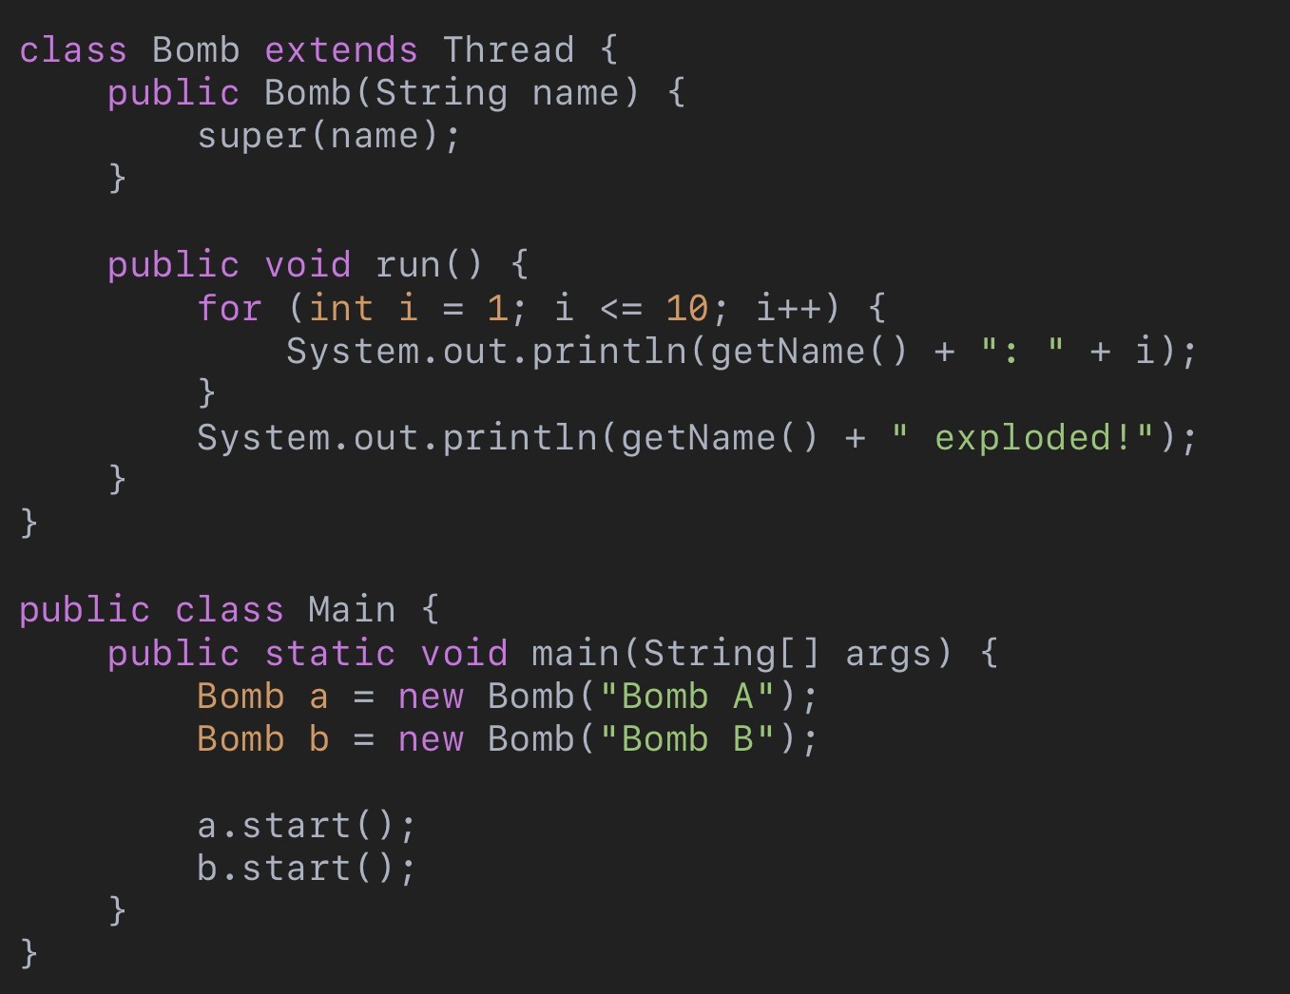
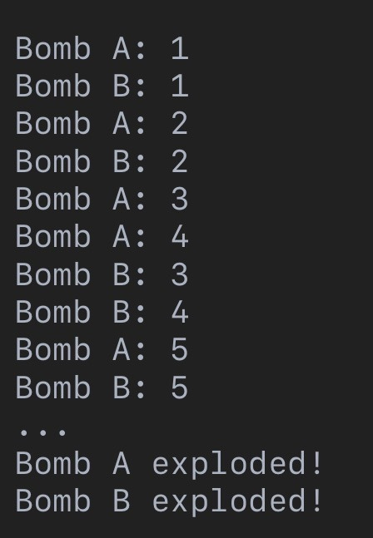
CONCURRENT EXCUTION

Slide 6
Feature | Sequential Execution | Concurrent Execution
Execution | One task at a time | Multiple tasks overlap
Speed | Slower | Faster (in many cases)
Complexity | Simple | More complex
Output | Predictable | May be interleaved
Resource Usage | Low | Better utilization
Time (Big-O) | O(n + m) | O(max(n, m)) (ideal)

Slide 7
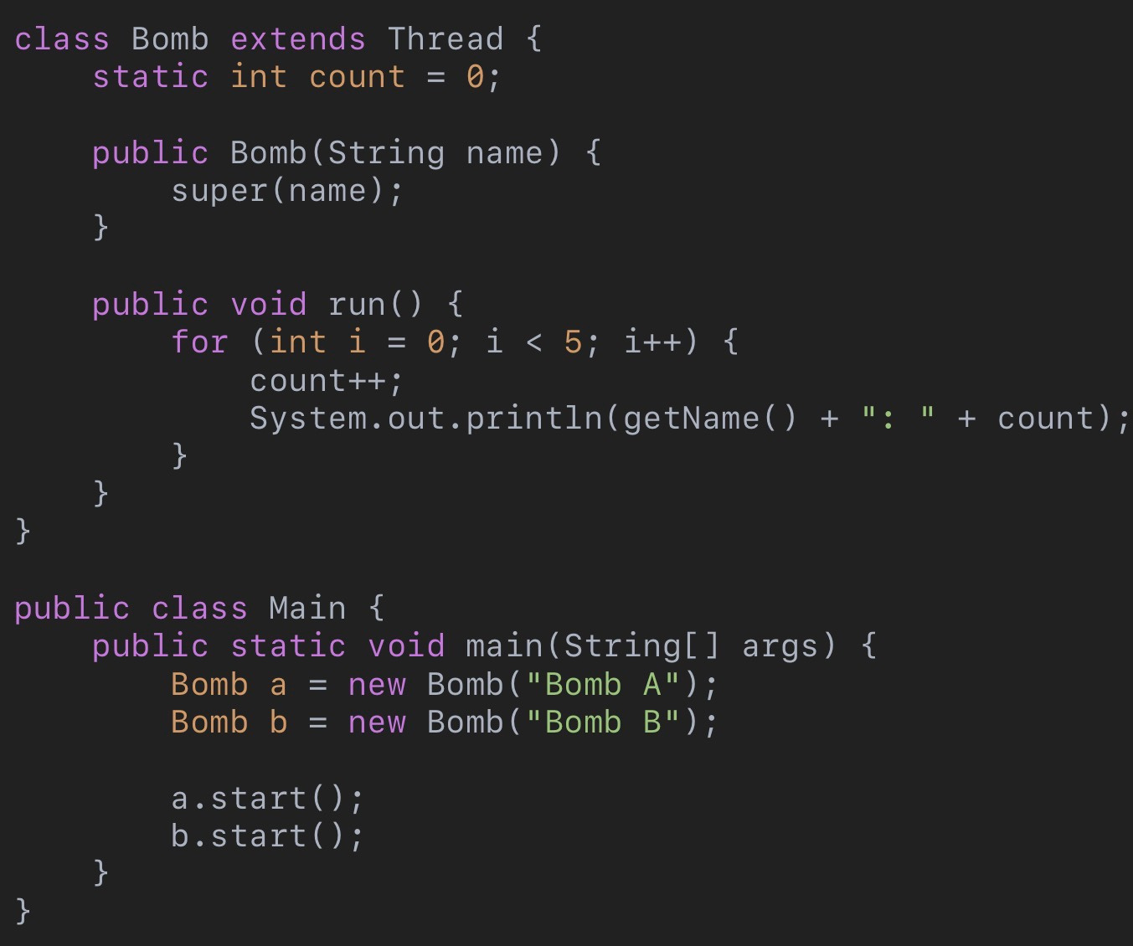
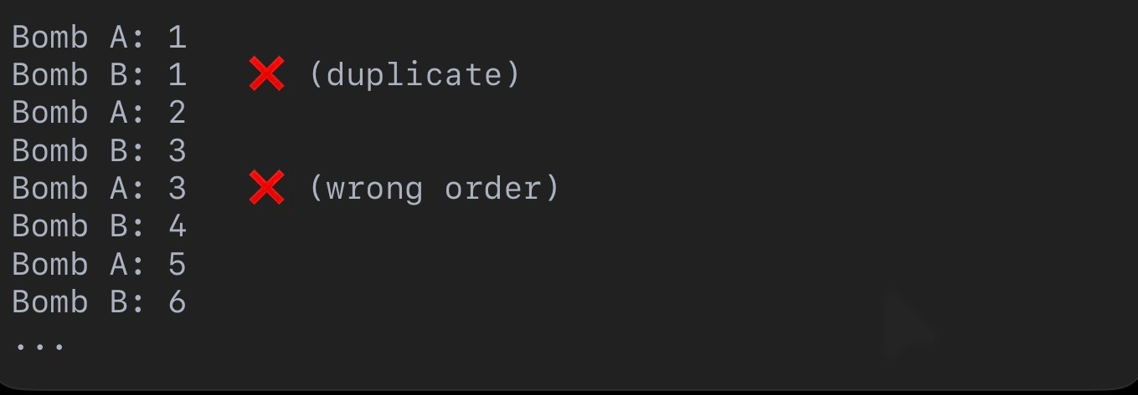
RACE CONDITION

Slide 8
RACE CONDITION
A race condition occurs when multiple threads access and modify shared data at the same time, leading to unpredictable results.
Using Our Bomb Example:
Bomb A and Bomb B share the same counter
Both try to update it at the same time
The result becomes incorrect

Slide 9
SYNCHRONIZATION
Synchronization is used to control access to shared data, allowing only one thread to execute a critical section at a time.
Back to Bomb Example
Bomb A and Bomb B share the same counter
We lock the counter when updating
Only one thread can update at a time

Slide 10
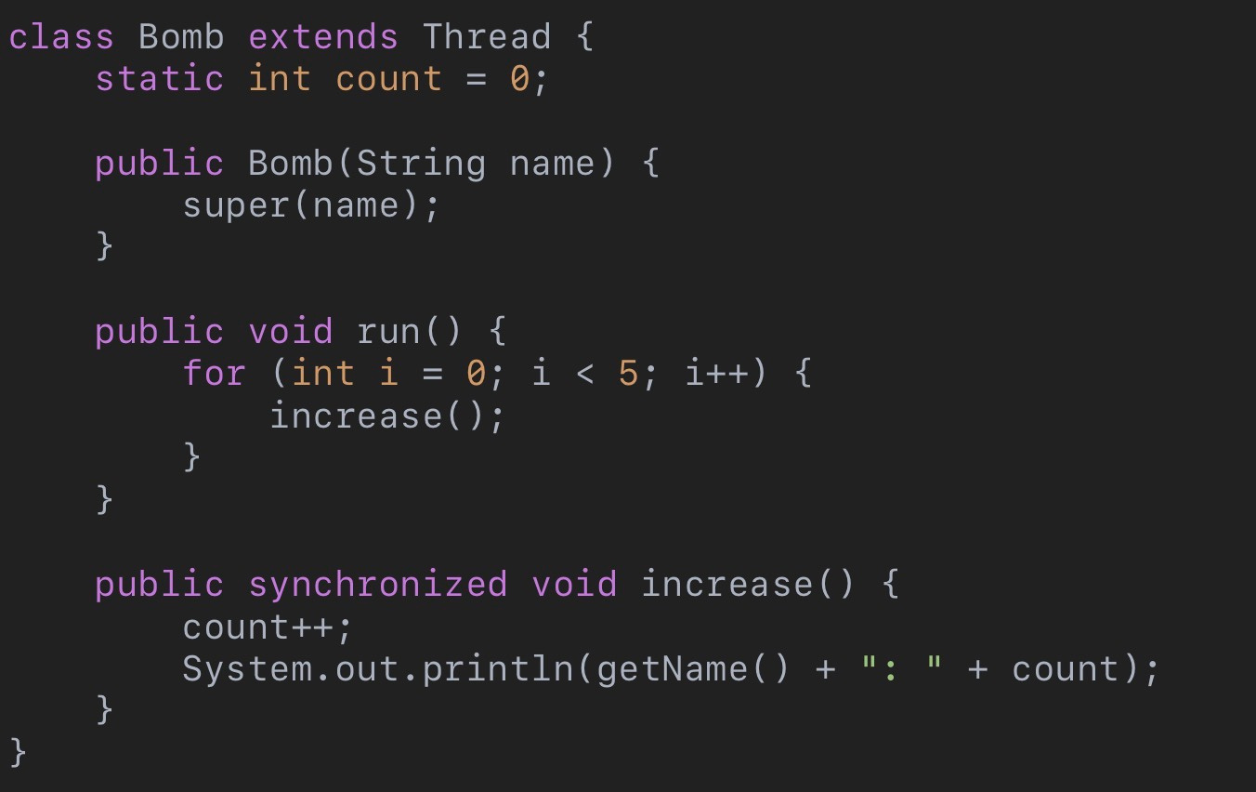
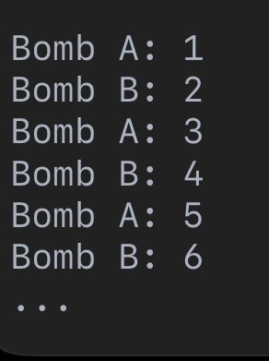

Slide 11
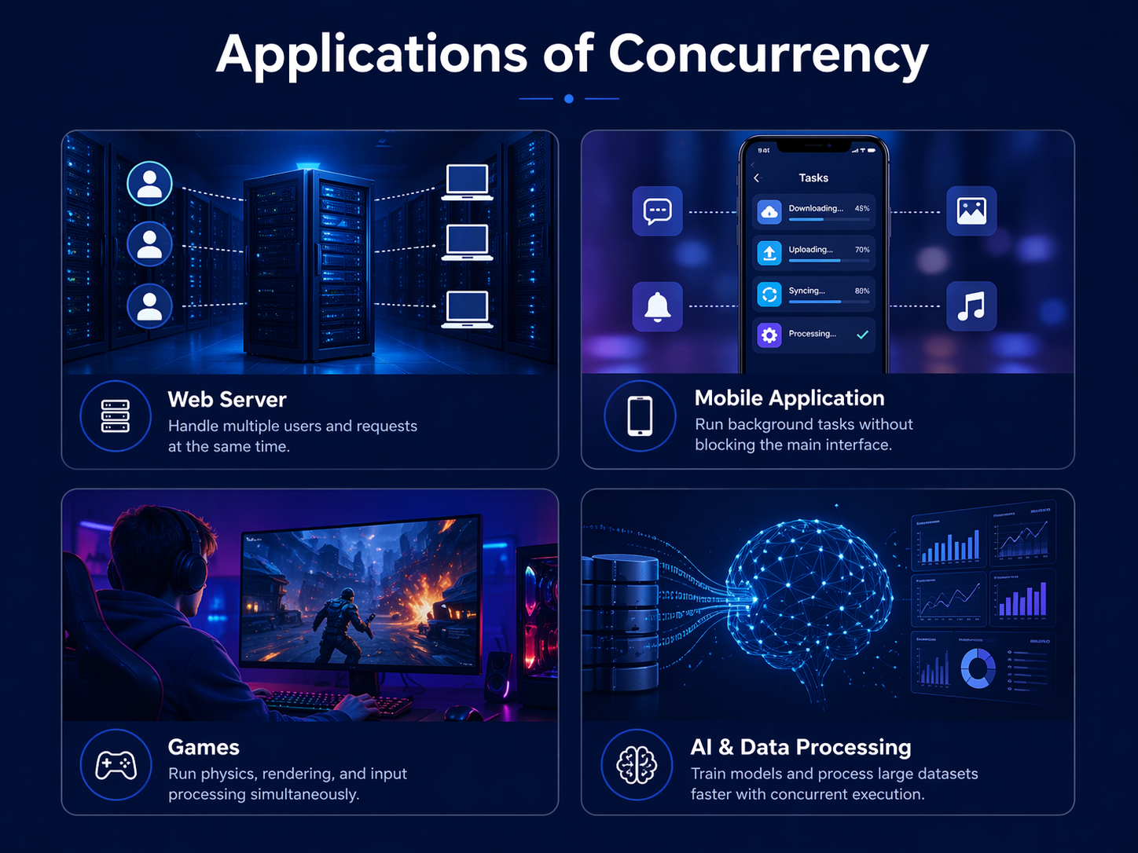

Slide 12
CONCLUSION
Key Takeaways
Concurrency allows multiple tasks to run efficiently
It improves performance and responsiveness
But it introduces challenges like race conditions
Synchronization is needed to ensure correctness

Slide 13
THANK YOU

