Slide 1
Simple Waves Business Plan Basic Template
Here is where your presentation begins

Slide 2
Table of contents
01
Overview
06
HTML Comment Tag
02
HTML Head
07
HTML Link
03
HTML Heading
08
HTML List
04
HTML Paragraph
09
HTML Table
05
10
HTML Text Formatting
Select Tag
11
HTML Form and Input

Slide 3
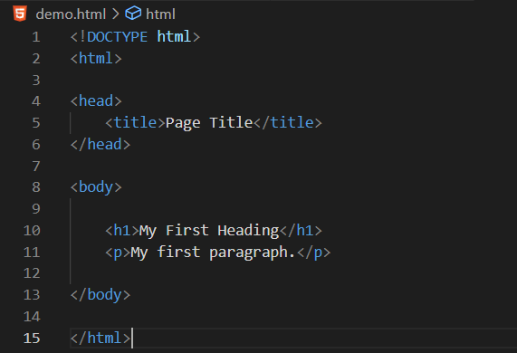
01
Overview
HTML stands for Hyper Text Markup Language.
HTML is the standard markup language for creating Web pages.
HTML describes the structure of a Web Page.

Slide 4
HTML Head
02
The HTML <head> element is a container for the following elements: <title>, <style>, <meta>, <link>, <script>, and <base>.
Tag | Description
<head> | Defines information about the document
<title> | Defines the title of a document
<base> | Defines a default address or a default target for all links on a page
<link> | Defines the relationship between a document and an external resource
<meta> | Defines metadata about an HTML document
<script> | Defines a client-side script
<style> | Defines style information for a document

Slide 5
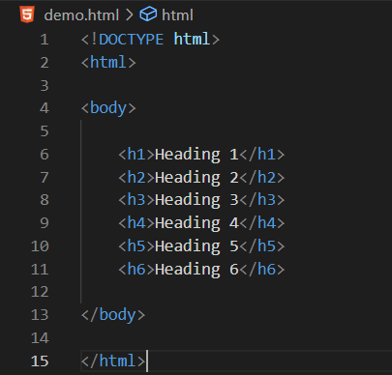
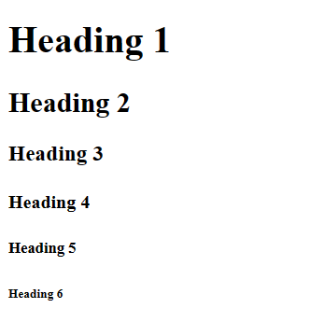
HTML Heading
03
HTML headings are defined with the <h1> to <h6> tags.
<h1> defines the most important heading. <h6> defines the least important heading.

Slide 6
HTML Paragraph
04
The HTML <p> element defines a paragraph.
A paragraph always starts on a new line, and browsers automatically add some white space (a margin) before and after a paragraph.
Tag | Description
<p> | Defines a paragraph
<hr> | Defines a thematic change in the content
<br> | Inserts a single line break
<pre> | Defines pre-formatted text

Slide 7
HTML Text Formatting
05
Tag | Description
<b> | Defines bold text
<em> | Defines emphasized text
<i> | Defines a part of text in an alternate voice or mood
<small> | Defines smaller text
<strong> | Defines important text
<sub> | Defines subscripted text
<sup> | Defines superscripted text
<ins> | Defines inserted text
<del> | Defines deleted text
<mark> | Defines marked/highlighted text

Slide 8
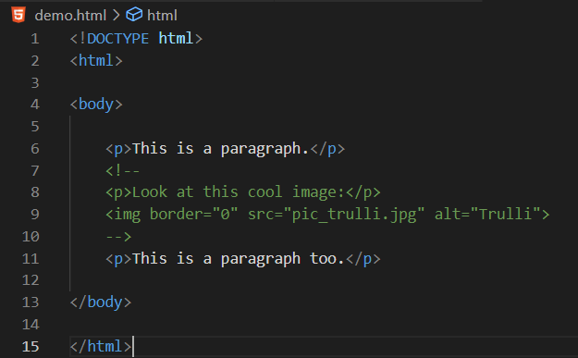
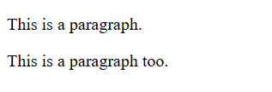
HTML Comment Tag
06
HTML comments are not displayed in the browser, but they can help document your HTML source code.

Slide 9
HTML Link
07
Links are found in nearly all web pages. Links allow users to click their way from page to page.
HTML links are hyperlinks.
You can click on a link and jump to another document.
When you move the mouse over a link, the mouse arrow will turn into a little hand.
Tag | Description
<a> | Define a link
href | Define the link address
target | Define where to open the linked document
<img>(inside <a>) | Use an image as a link
mailto | Create a link that opens the user's email program

Slide 10
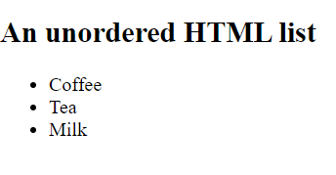
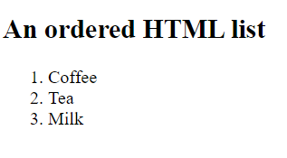
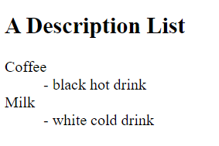
HTML List
08
HTML lists allow web developers to group a set of related items in lists.
Tag | Description
<ul> | Defines an unordered list
<ol> | Defines an ordered list
<li> | Defines a list item
<dl> | Defines a description list
<dt> | Defines a term in a description list
<dd> | Describes the term in a description list

Slide 11
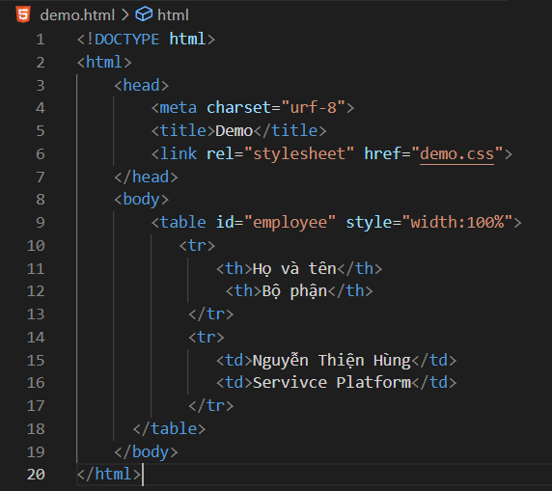
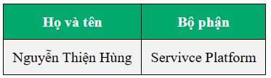
HTML Table
09
HTML tables allow web developers to arrange data into rows and columns.

Slide 12
Tag | Description
<table> | Defines a table
<th> | Defines a header cell in a table
<tr> | Defines a row in a table
<td> | Defines a cell in a table
<caption> | Defines a table caption
<colgroup> | Specifies a group of one or more columns in a table for formatting
<col> | Specifies column properties for each column within a <colgroup> element
<thead> | Groups the header content in a table
<tbody> | Groups the body content in a table
<tfoot> | Groups the footer content in a table

Slide 13
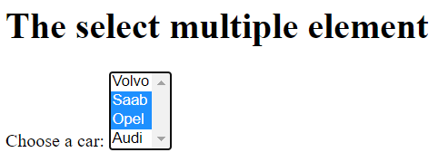
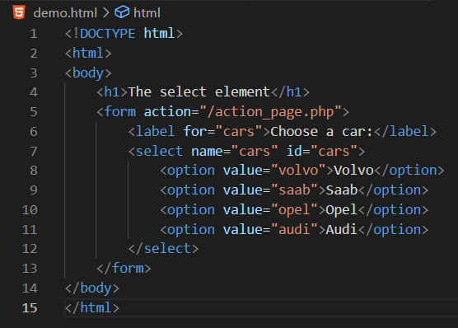
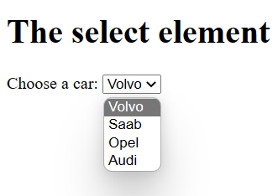
Select Tag
10
Create a drop-down list

Slide 14
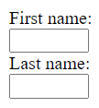
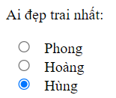

Form and Input
11
An HTML form is used to collect user input
The user input is most often sent to a server for processing
Type | Description
<input type="text"> | Displays a single-line text input field
<input type="radio"> | Displays a radio button (for selecting one of many choices)
<input type="checkbox"> | Displays a checkbox (for selecting zero or more of many choices)
<input type="submit"> | Displays a submit button (for submitting the form)
<input type="button"> | Displays a clickable button

Slide 15
Thanks
Do you have any questions?
youremail@freepik.com / +34 654 321 432 / yourwebsite.com
Please keep this slide for attribution

