Slide 1
Simple Waves Business Plan Basic Template
Here is where your presentation begins

Slide 2
HTML

Slide 3
01
Overview
06
HTML Comment Tag
02
HTML Head
07
HTML Link
03
HTML Heading
08
HTML List
04
HTML Paragraph
09
HTML Table
05
10
HTML Text Formatting
Select Tag
11
HTML Form and Input

Slide 4
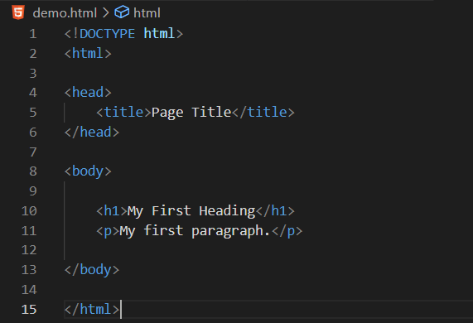
01
Overview
HTML stands for Hyper Text Markup Language.
HTML is the standard markup language for creating Web pages.
HTML describes the structure of a Web Page.

Slide 5
HTML Head
02
The HTML <head> element is a container for the following elements: <title>, <style>, <meta>, <link>, <script>, and <base>.
Tag | Description
<head> | Defines information about the document
<title> | Defines the title of a document
<base> | Defines a default address or a default target for all links on a page
<link> | Defines the relationship between a document and an external resource
<meta> | Defines metadata about an HTML document
<script> | Defines a client-side script
<style> | Defines style information for a document

Slide 6
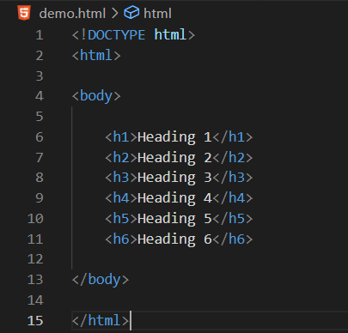
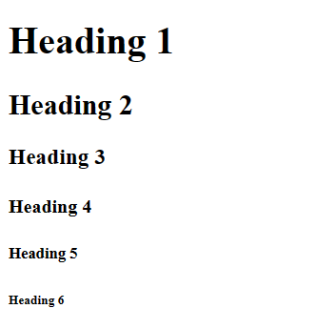
HTML Heading
03
HTML headings are defined with the <h1> to <h6> tags.
<h1> defines the most important heading. <h6> defines the least important heading.

Slide 7
HTML Paragraph
04
The HTML <p> element defines a paragraph.
A paragraph always starts on a new line, and browsers automatically add some white space (a margin) before and after a paragraph.
Tag | Description
<p> | Defines a paragraph
<hr> | Defines a thematic change in the content
<br> | Inserts a single line break
<pre> | Defines pre-formatted text

Slide 8
HTML Text Formatting
05
Tag | Description
<b> | Defines bold text
<em> | Defines emphasized text
<i> | Defines a part of text in an alternate voice or mood
<small> | Defines smaller text
<strong> | Defines important text
<sub> | Defines subscripted text
<sup> | Defines superscripted text
<ins> | Defines inserted text
<del> | Defines deleted text
<mark> | Defines marked/highlighted text

Slide 9
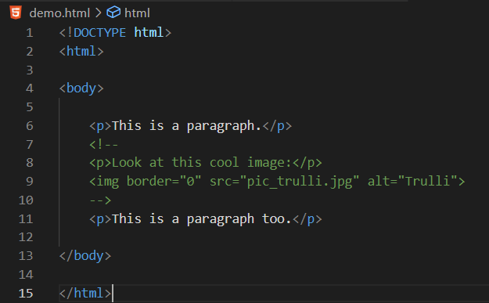
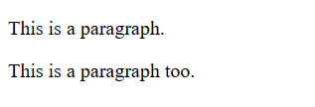
HTML Comment Tag
06
HTML comments are not displayed in the browser, but they can help document your HTML source code.

Slide 10
HTML Link
07
Links are found in nearly all web pages. Links allow users to click their way from page to page.
HTML links are hyperlinks.
You can click on a link and jump to another document.
When you move the mouse over a link, the mouse arrow will turn into a little hand.
Tag | Description
<a> | Define a link
href | Define the link address
target | Define where to open the linked document
<img>(inside <a>) | Use an image as a link
mailto | Create a link that opens the user's email program

Slide 11
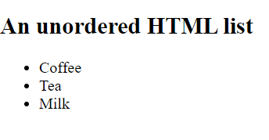
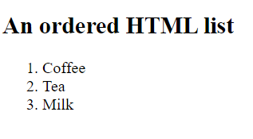
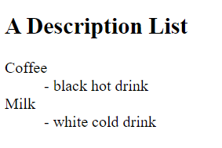
HTML List
08
HTML lists allow web developers to group a set of related items in lists.
Tag | Description
<ul> | Defines an unordered list
<ol> | Defines an ordered list
<li> | Defines a list item
<dl> | Defines a description list
<dt> | Defines a term in a description list
<dd> | Describes the term in a description list

Slide 12
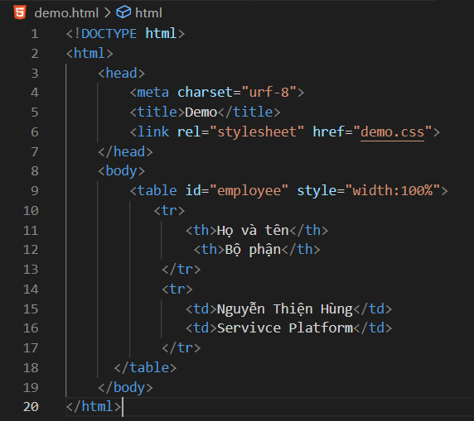
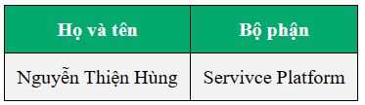
HTML Table
09
HTML tables allow web developers to arrange data into rows and columns.

Slide 13
Tag | Description
<table> | Defines a table
<th> | Defines a header cell in a table
<tr> | Defines a row in a table
<td> | Defines a cell in a table
<caption> | Defines a table caption
<colgroup> | Specifies a group of one or more columns in a table for formatting
<col> | Specifies column properties for each column within a <colgroup> element
<thead> | Groups the header content in a table
<tbody> | Groups the body content in a table
<tfoot> | Groups the footer content in a table

Slide 14
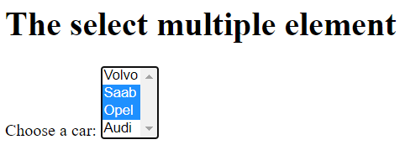
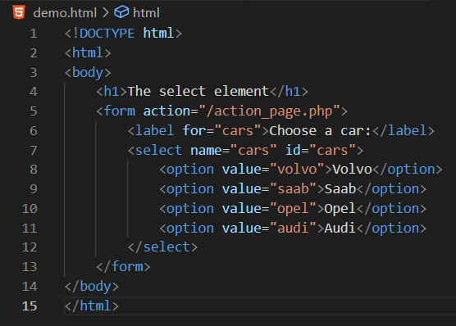
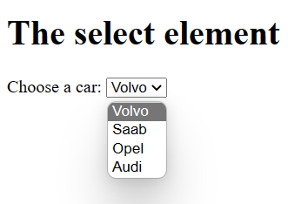
Select Tag
10
Create a drop-down list

Slide 15
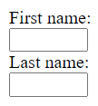
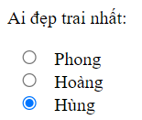

Form and Input
11
An HTML form is used to collect user input
The user input is most often sent to a server for processing
Type | Description
<input type="text"> | Displays a single-line text input field
<input type="radio"> | Displays a radio button (for selecting one of many choices)
<input type="checkbox"> | Displays a checkbox (for selecting zero or more of many choices)
<input type="submit"> | Displays a submit button (for submitting the form)
<input type="button"> | Displays a clickable button

Slide 16
CSS

Slide 17
01
Overview
08
CSS Overflow
02
CSS How To Use
09
CSS Float
03
CSS Selector
10
CSS Clear
04
CSS Background and Color
11
CSS Links
05
CSS Box Model
12
CSS Display
06
CSS Margin and Padding
13
CSS Website Layout
07
CSS Position

Slide 18
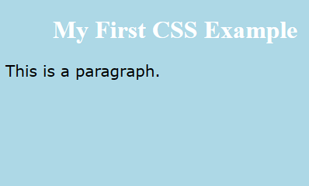
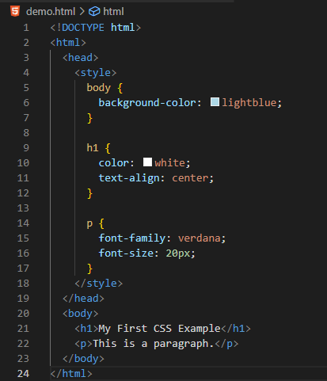
Overview
01
CSS stands for Cascading Style Sheets
CSS describes how HTML elements are to be displayed on screen, paper, or in other media
CSS saves a lot of work. It can control the layout of multiple web pages all at once
External stylesheets are stored in CSS files

Slide 19
CSS How To Use
02
There are three ways of inserting a style sheet:
External CSS
Internal CSS
Inline CSS

Slide 20
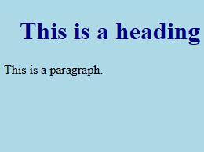
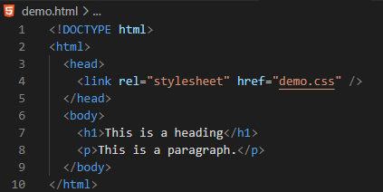
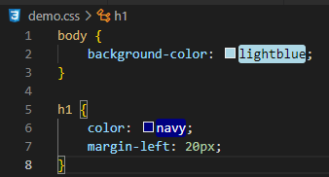
External CSS

Slide 21
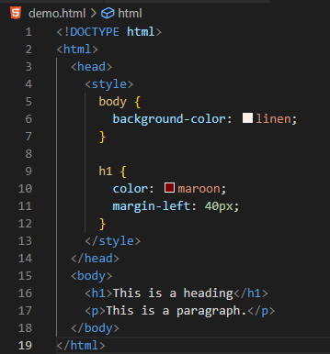
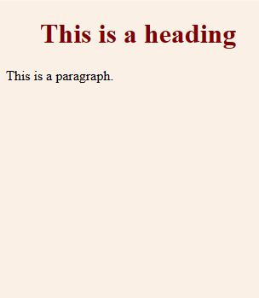
Internal CSS

Slide 22
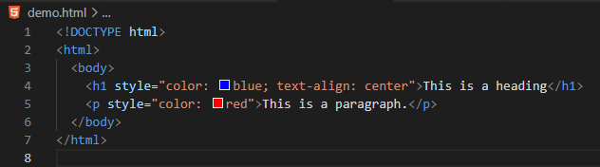
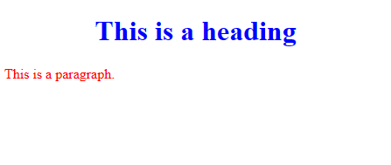
Inline CSS

Slide 23
CSS Selector
03
A CSS selector selects the HTML element(s) you want to style.
Selector | Example | Example description
#id | #firstname | Selects the element with id="firstname"
.class | .intro | Selects all elements with class="intro"
element.class | p.intro | Selects only <p> elements with class="intro"
* | * | Selects all elements
element | p | Selects all <p> elements
element,element,.. | div, p | Selects all <div> elements and all <p> elements

Slide 24
CSS Background and Color
04

Slide 25

CSS Box Model
05
Content - The content of the box, where text and images appear
Padding - Clears an area around the content. The padding is transparent
Border - A border that goes around the padding and content
Margin - Clears an area outside the border. The margin is transparent

Slide 26
CSS Margin and Padding
06
Margins are used to create space around elements, outside of any defined borders.
Padding is used to create space around an element's content, inside of any defined borders.
Property | Description
margin | A shorthand property for setting all the margin properties in one declaration
margin-bottom | Sets the bottom margin of an element
margin-left | Sets the left margin of an element
margin-right | Sets the right margin of an element
margin-top | Sets the top margin of an element
Property | Description
padding | A shorthand property for setting all the padding properties in one declaration
padding-bottom | Sets the bottom padding of an element
padding-left | Sets the left padding of an element
padding-right | Sets the right padding of an element
padding-top | Sets the top padding of an element

Slide 27
CSS Position
07

Slide 28
CSS Overflow
08
The CSS overflow property controls what happens to content that is too big to fit into an area.

Slide 29
CSS Float
09
The float property is used for positioning and formatting content

Slide 30
CSS Clear
10

Slide 31
CSS Links
11

Slide 32
CSS Display
12

Slide 33
CSS Website Layout
13

Slide 34
Thanks
Do you have any questions?
youremail@freepik.com / +34 654 321 432 / yourwebsite.com
Please keep this slide for attribution

