Slide 1
WEEK 4 • GROUP 9
GeekBrain AI Assistant.
RAG + Tool Calling + Memory
Le Hoang Trung Kien • Tran Dinh Bao Long • Nguyen Duc Chinh • Nguyen Huu Dinh
Truong Thi My Quyen • Tran Van Duc • Hoang Trong Tan • Le Duy Khanh
Mentor: Anh Quang Phung (QA Lead, TechX)
LLM: DeepSeek V3.2 via Amazon Bedrock • Framework: Bedrock Agents

Slide 2
AGENDA
What we'll cover.
01 Architecture
02 Individual Q&A
03 Live Demo
04 Lessons Learned
System diagram, key decisions, data flow through the pipeline.
Random members explain how the system works internally.
L1 → L2 → L3 → L4 progressive demonstration.
Hardest level and what we would change.

Slide 3
01
PART 01
System Architecture.
How requests flow through Bedrock Agent, Knowledge Base, and Tools — all on AWS with no NAT Gateway.

Slide 4
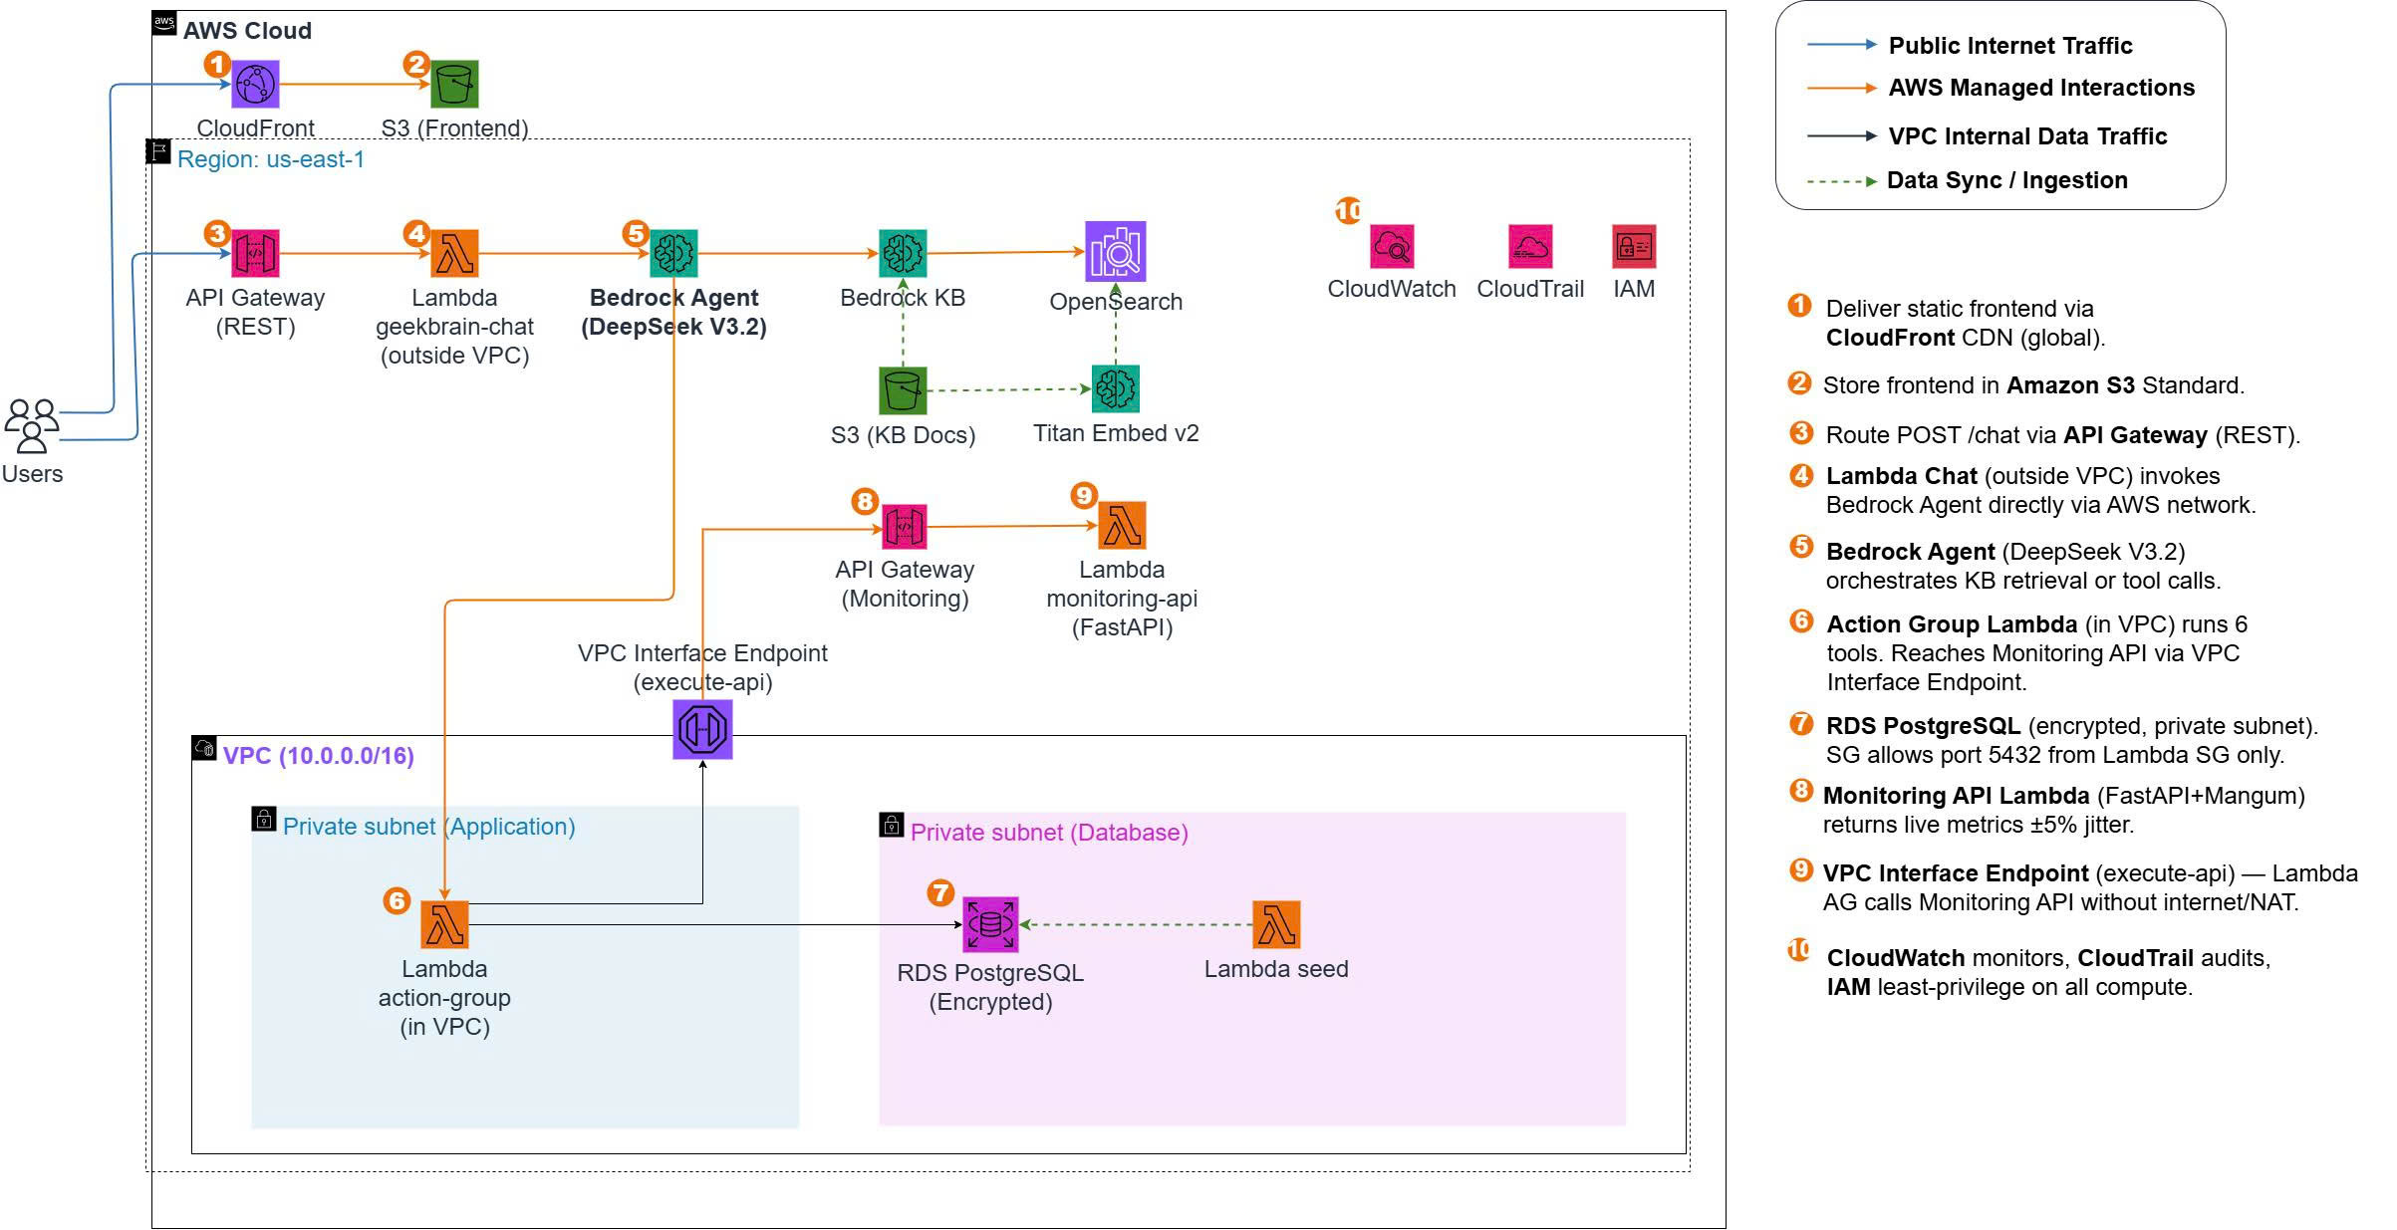
01 • ARCHITECTURE
System Architecture.

Slide 5
01 • DECISIONS
Key Technical Decisions.
Bedrock Agents vs Custom Pipeline
VPC Interface Endpoint (No NAT)
Managed orchestration. Agent handles KB retrieval + tool routing automatically. Less control, faster to production.
VPC Endpoint for execute-api. Traffic stays on AWS backbone. No NAT Gateway needed — saves cost.
Lambda Chat Outside VPC
What Didn't Work
No vpc_config — calls Bedrock via AWS internal network. Avoids cold start ENI delays (5-10s).
DeepSeek V3.2 via Terraform foundation_model param failed. Fix: lifecycle { ignore_changes } + manual console config.

Slide 6
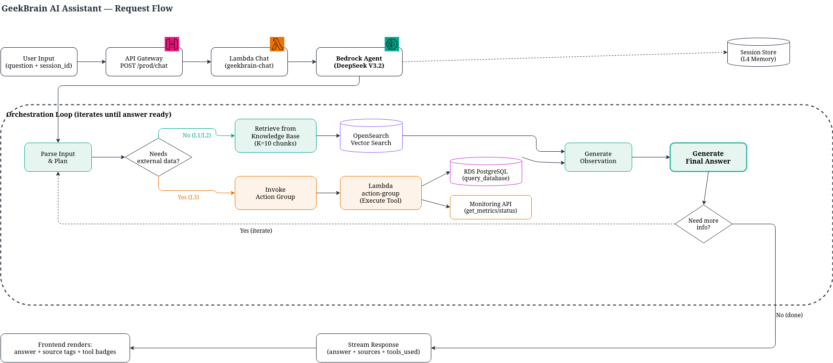
01 • DATA FLOW
Request Flow & Orchestration Loop.

Slide 7
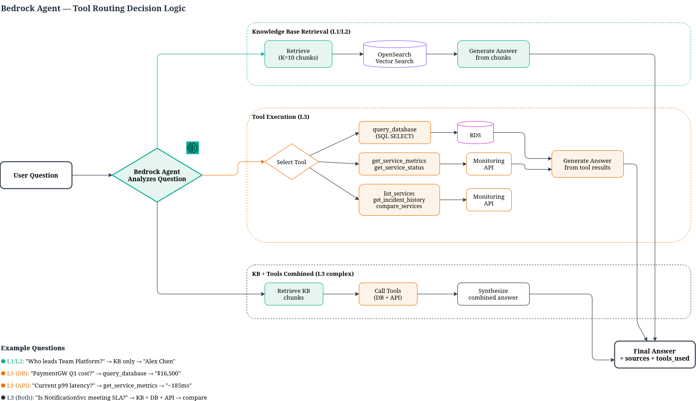
01 • TOOL ROUTING
Agent Decision Logic — KB vs Tools.

Slide 8
03
PART 03
Live Demo.
L1 → L2 → L3 → L4 — progressive levels of AI capability.

Slide 9
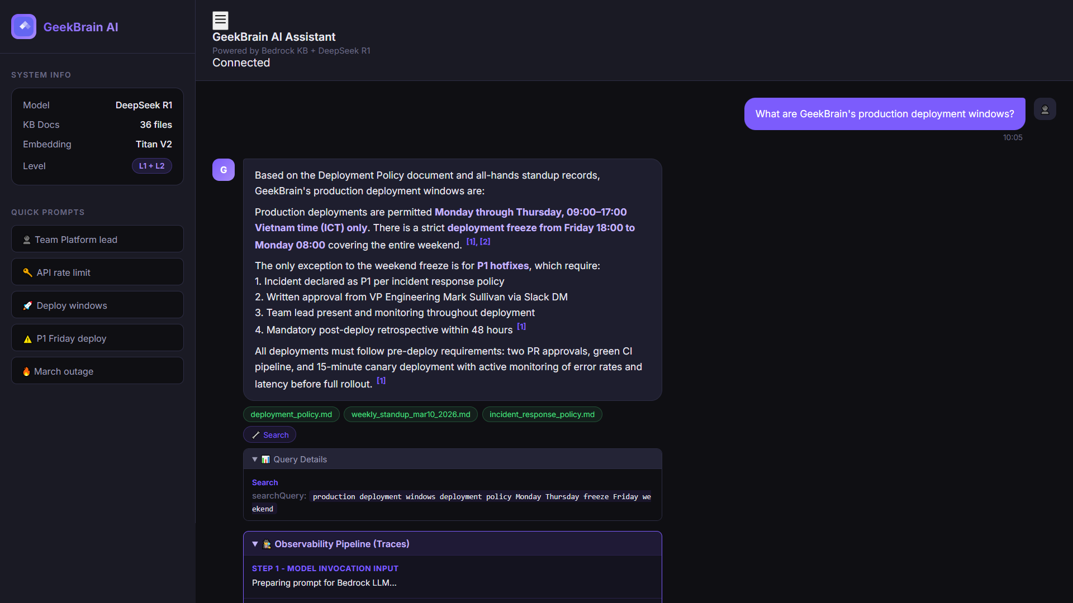
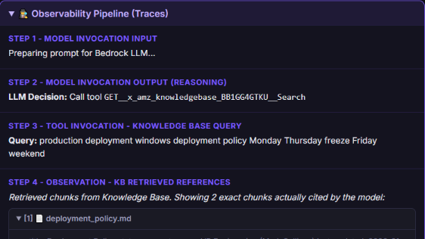
L1 • RAG
L1 — Simple RAG (Retrieval).
36 markdown docs → Titan Embed v2 (1024d) → OpenSearch Serverless → top-K chunks → answer + source citation

Slide 10
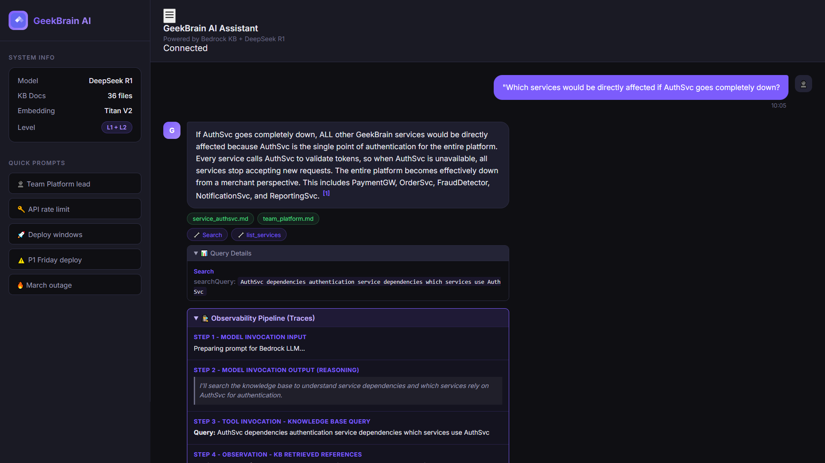
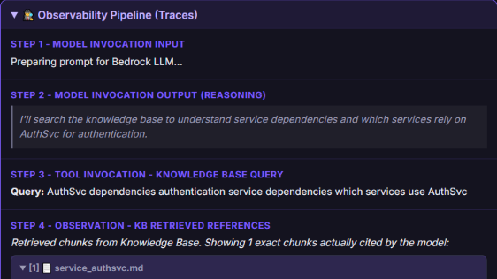
L2 • MULTI-SOURCE
L2 — Multi-Source Retrieval.
Multi-doc synthesis & conflict resolution. Agent prefers most recent version (status='current' over 'archived')

Slide 11
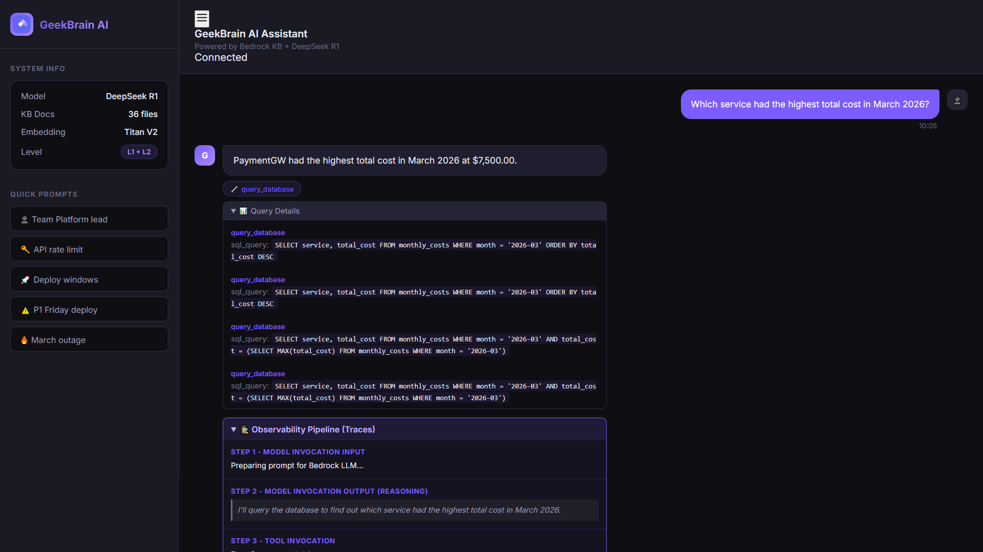
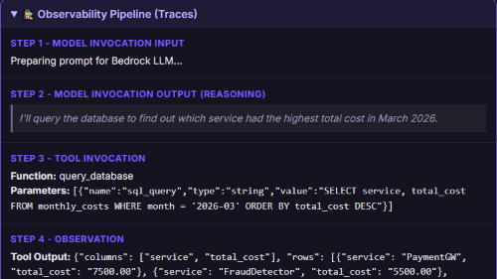
L3 • TOOLS
L3 — Tool-Augmented RAG.
6 tools: query_database, get_service_metrics, get_service_status, list_services, get_incident_history, compare_services

Slide 12
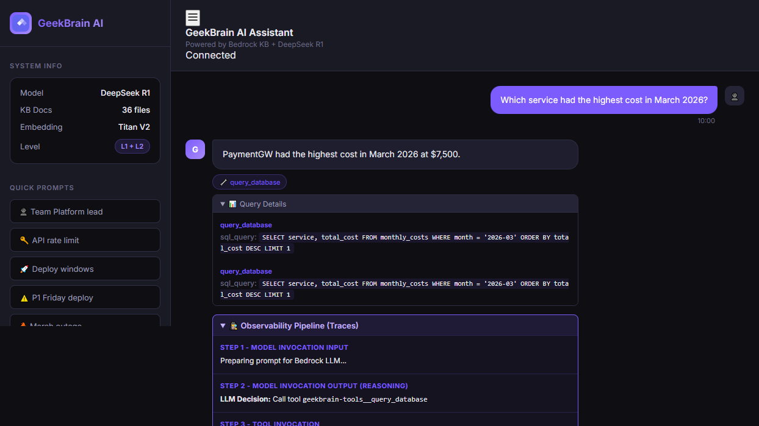
L4 • MEMORY
L4 — Memory (Multi-turn).
Bedrock Agent sessionId (TTL: 1800s). Pronouns like "its costs" and "that service" resolved across turns.

Slide 13
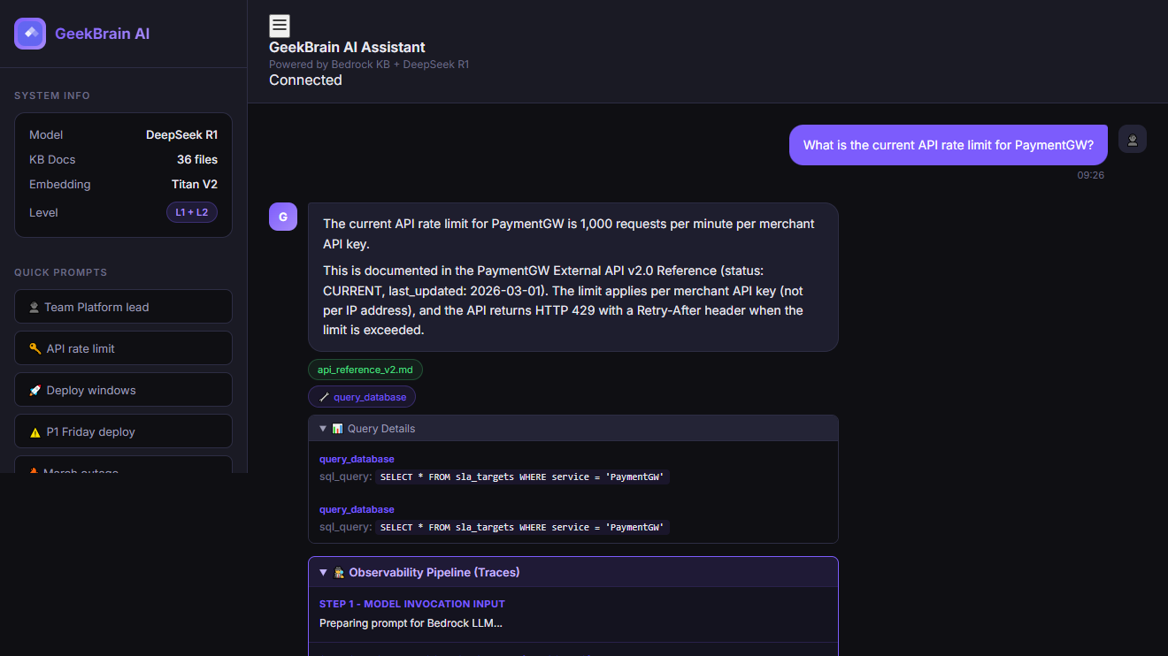
BONUS A • OBSERVABILITY
Observability Dashboard (+0.5)
Pipeline internals: source tags (green), tool badges (purple), query details, full orchestration trace.

Slide 14
BONUS C • KB SYNC
Knowledge Base Auto-Sync (+0.5)
01 Detect Change
02 Start Ingestion
03 Poll Complete
MD5 hash trigger detects .md file updates in S3.
null_resource.kb_sync runs aws bedrock-agent start-ingestion-job
Polls until COMPLETE. Timeout: 10 min. Fully automated via Terraform.
Evidence: terraform/modules/ai_engine/main.tf — kb_sync resource

Slide 15
04 • REFLECTION
Lessons Learned.
Hardest Level: L3
What we'd do differently
Tool descriptions must be extremely precise. "Gets data" → useless. "Returns CURRENT live metrics; for HISTORICAL data use query_database" → works. Iterated multiple times before agent routed correctly.
• Add query rewriting for L4 (pronouns → explicit references) • Automated testing with question JSON files • Fallback error messages when Monitoring API is unreachable

Slide 16
Thank You!
Group 9 — GeekBrain AI Assistant
Evidence Pack: docs/W4_evidence.md
Repo: github.com/hoang-trong-tan/G9-W4
Questions?

