Slide 1
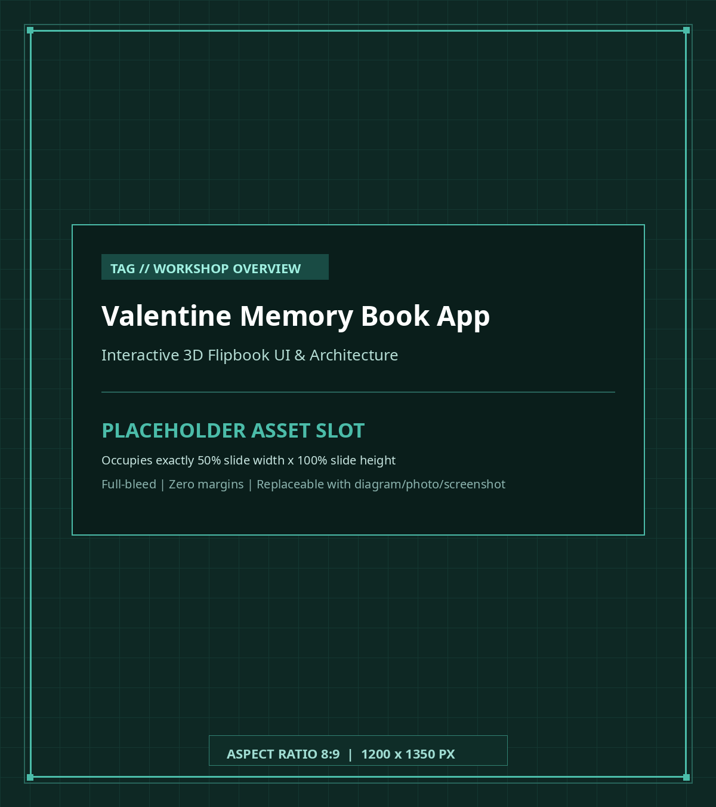
WORKSHOP KICKOFF
Valentine Memory Book
• Project Scope: A full-stack digital memory archival web application featuring interactive 3D flipbook simulation.
• Tech Stack: Next.js 16 (App Router), React 19, Supabase (PostgreSQL + Storage), Tailwind CSS v4 & Vercel.
• Key Features: Collection curation, realistic dual-page page turning, photo attachments, real-time search & multi-sort.
• Workshop Goal: Set up project from scratch locally and complete 8 modular coding tasks step-by-step.

Slide 2
ROADMAP
Table of Contents & Learning Path
A comprehensive 4-stage journey from empty terminal to production cloud deployment
PART 1: SETUP
PART 2: TECH STACK
PART 3: TASKS 1-4
PART 4: TASKS 5-8 & DEPLOY
• GitHub Account: Account creation & repository cloning
• Dependencies: Node.js v20+, pnpm v11 & React 19
• Supabase Local: Docker engine & Supabase CLI startup
• Environment: .env.local configuration & API keys
• Dev Server: Local verification on :3000
• Next.js 16: Server Components & Server Actions
• Supabase: Postgres database, RLS & Storage
• Vercel: Hosting platform & Edge infrastructure
• Architecture: 3-Tier Client -> Server -> DB flow
• Task Blueprint: Directory structure & component bindings
• Task 1: Create collection server action
• Task 2: Edit collection & state merge
• Task 3: Create memory page in flipbook
• Task 4: Edit memory narrative & order index
• Form Flow: React Hook Form to parent UI update
• Task 5: Real-time client search filter
• Task 6: Multi-attribute collection sort
• Task 7: Collection poster upload/removal
• Task 8: Memory photo upload/removal
• Cloud Release: Deploying to Vercel with Cloud Supabase

Slide 3
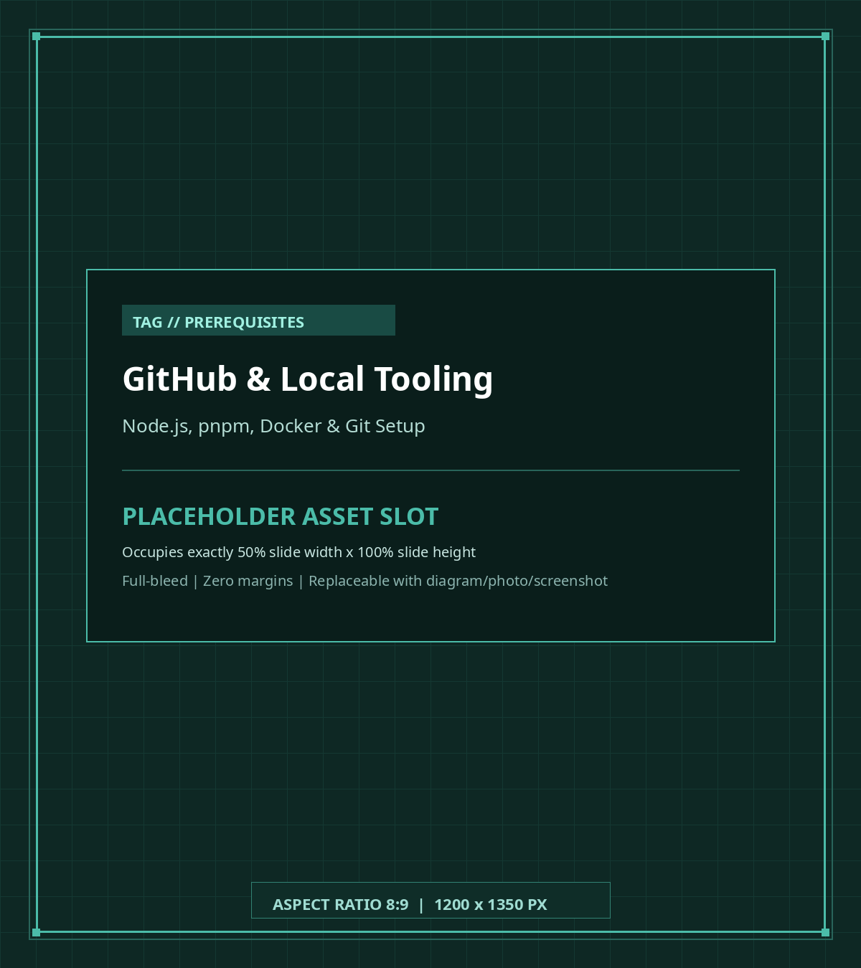
PREREQUISITES
Tooling & GitHub Setup
• GitHub Account: Create an account at github.com and configure SSH keys or Personal Access Token (PAT).
• Node.js Runtime: Install Node.js v20.x or higher (LTS recommended) for modern JavaScript APIs.
• Package Manager: Install pnpm (v9 or v11 recommended) for disk-efficient package management: npm i -g pnpm.
• Docker Desktop: Required to orchestrate local Supabase containers (PostgreSQL, Storage, Inbucket & Studio).
• Git CLI: Verify git is configured locally with your user name and email address.

Slide 4
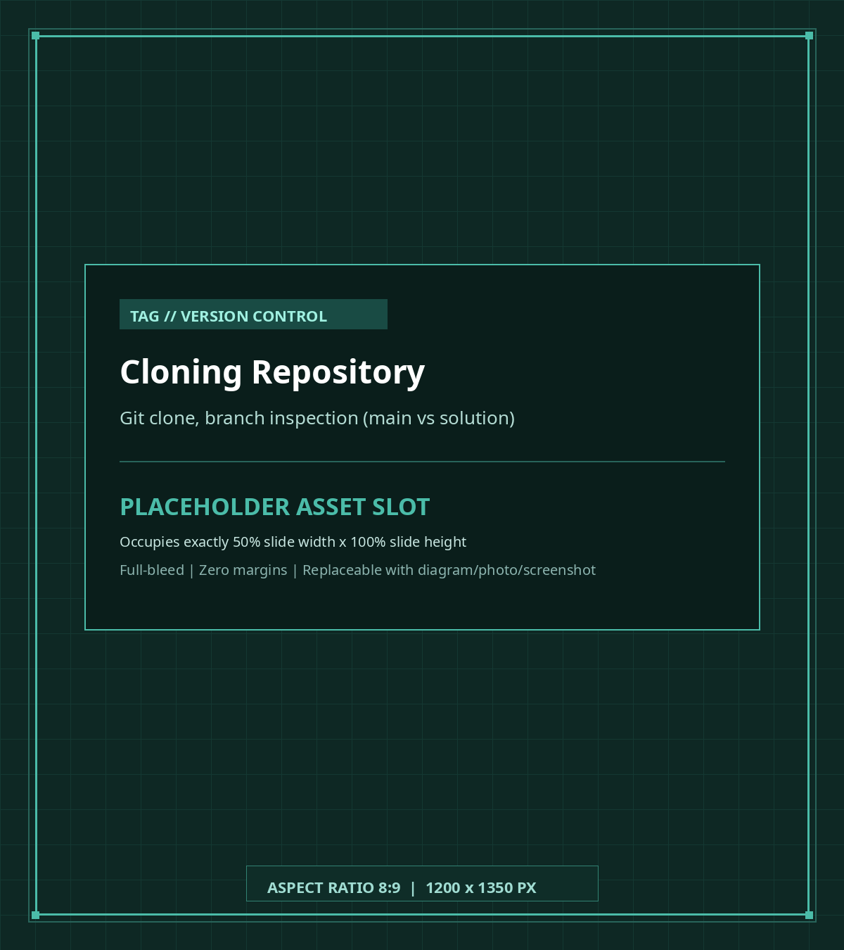
GIT SETUP
Cloning the Repository
• Repository URL: https://github.com/NguyenKhangPhuc/valentine-workshop.git
• Clone Command: Run `git clone <repo-url> && cd valentine-workshop` in your terminal.
• Starter Branch (`main`): Contains the initial application with TODO markers inside tasks/ — this is your workspace.
• Solution Branch (`solution`): Contains the completed, verified reference implementation for all 8 workshop tasks.
• Branch Inspection: Execute `git branch -a` to inspect all local and remote branches.

Slide 5
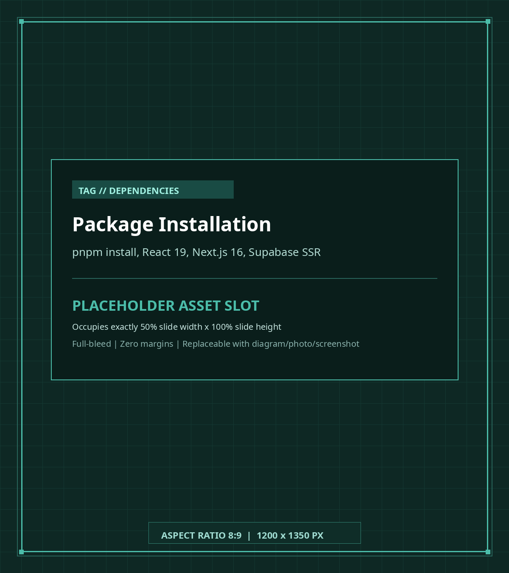
DEPENDENCIES
Installing Project Packages
• Install Command: Execute `pnpm install` in the repository root directory.
• Next.js 16.3.4: App Router framework with built-in React Server Components and Server Actions.
• React 19.2.8: Latest React release powering client components and concurrent state updates.
• Supabase SDK: @supabase/supabase-js & @supabase/ssr for server/client isomorphic communication.
• 3D Flipbook & UI: react-pageflip for page-turning physics and framer-motion for smooth transitions.

Slide 6
LOCAL BACKEND
Setting Up Supabase Local Development
Run an entire isolated Supabase cloud backend locally inside Docker containers with zero cost
1. CLI INSTALLATION
2. STARTING CONTAINERS
3. LOCAL ENDPOINTS & PORTS
• Global Installation: Run `npm install -g supabase`
• CLI Verification: Execute `supabase --version`
• Docker Check: Ensure Docker engine is active (`docker ps`)
• Configuration: Managed via `supabase/config.toml`
• Start Command: Run `supabase start` in root
• Container Stack: PostgreSQL 17, Storage API, Studio, Inbucket
• Status Command: Run `supabase status` to view keys
• Stop Command: Run `supabase stop` when done
• API URL: http://127.0.0.1:54321
• Studio Web Dashboard: http://127.0.0.1:54323
• PostgreSQL Port: 127.0.0.1:54322 (postgres / postgres)
• Inbucket Email Port: http://127.0.0.1:54324

Slide 7
DATABASE & STORAGE
Database Schema Migrations & Storage Bucket
Provision the relational schema and configure the image storage bucket
1. SCHEMA RESET & MIGRATIONS
2. RELATIONAL ARCHITECTURE
3. STORAGE BUCKET SETUP
• Reset Command: Run `supabase db reset`
• Automated Migrations: Executes SQL files in `supabase/migrations/`
• 20260902081732_...: Creates collections & collection_items tables
• 20260924081300_...: Grants CRUD permissions to the anon role
• `collections` Table: Primary album records (id, name, dates, poster_url)
• `collection_items` Table: Memory page records nested under collection_id
• Cascade Delete: Deleting an album cascades and deletes all pages
• RLS Security: Row Level Security policies active on both tables
• Studio Access: Open `http://127.0.0.1:54323` in browser
• Storage Section: Click 'Storage' in the left navigation sidebar
• Create Bucket: Click 'New Bucket' and name it `attachments`
• Public Policy: IMPORTANT: Check 'Public bucket' to enable photo URLs

Slide 8
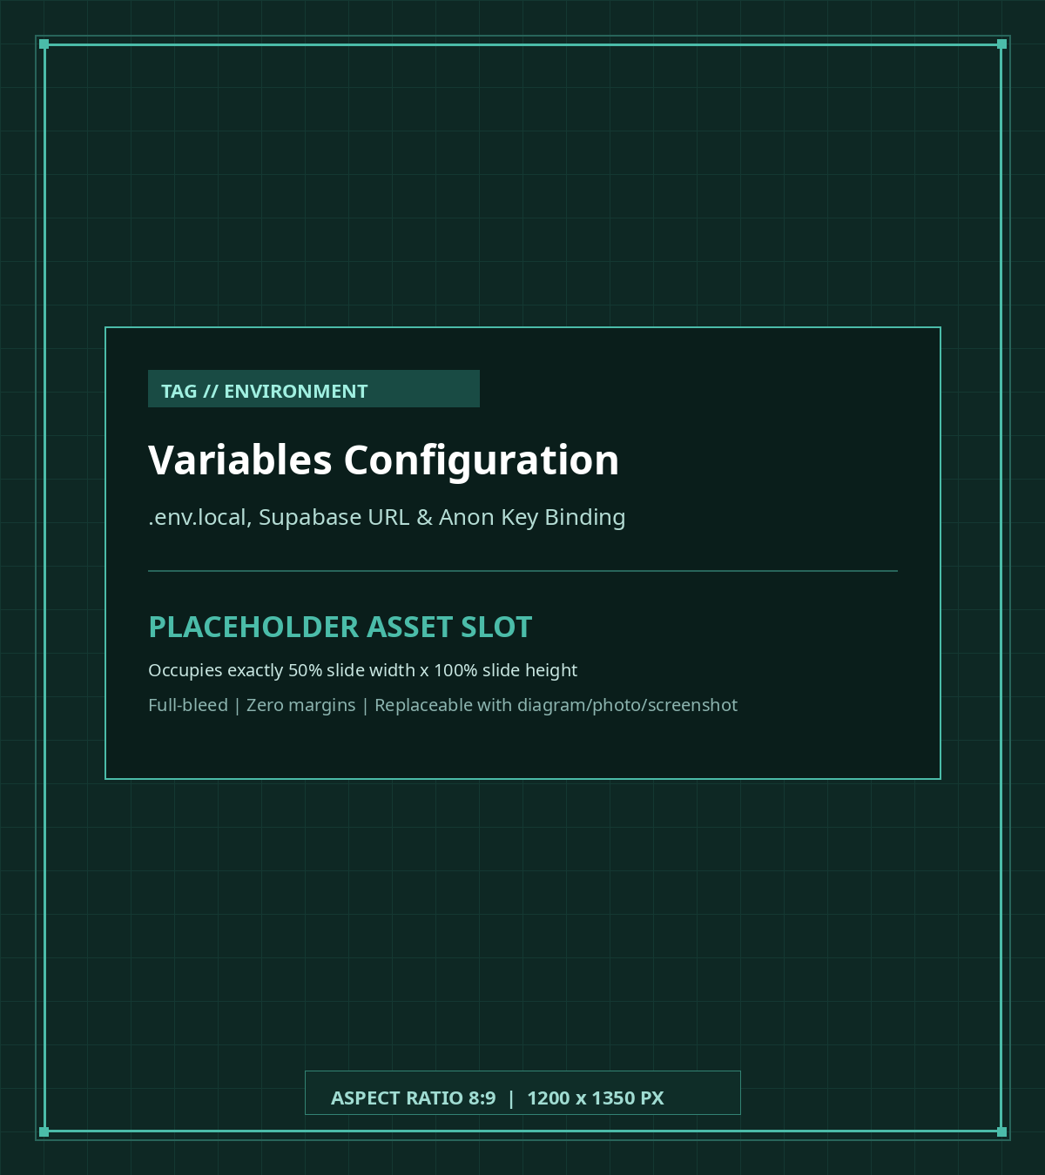
CONFIGURATION
Environment Variables (.env.local)
• File Creation: Create `.env.local` in your root folder: `touch .env.local`.
• Supabase Local URL: NEXT_PUBLIC_SUPABASE_URL=http://127.0.0.1:54321
• Publishable Anon Key: NEXT_PUBLIC_SUPABASE_PUBLISHABLE_KEY=sb_publishable_... (from `supabase start`).
• Client Binding: `app/utils/supabase/client.ts` uses `createBrowserClient` with these keys.
• Server Binding: `app/utils/supabase/server.ts` uses `createServerClient` for Server Actions.

Slide 9
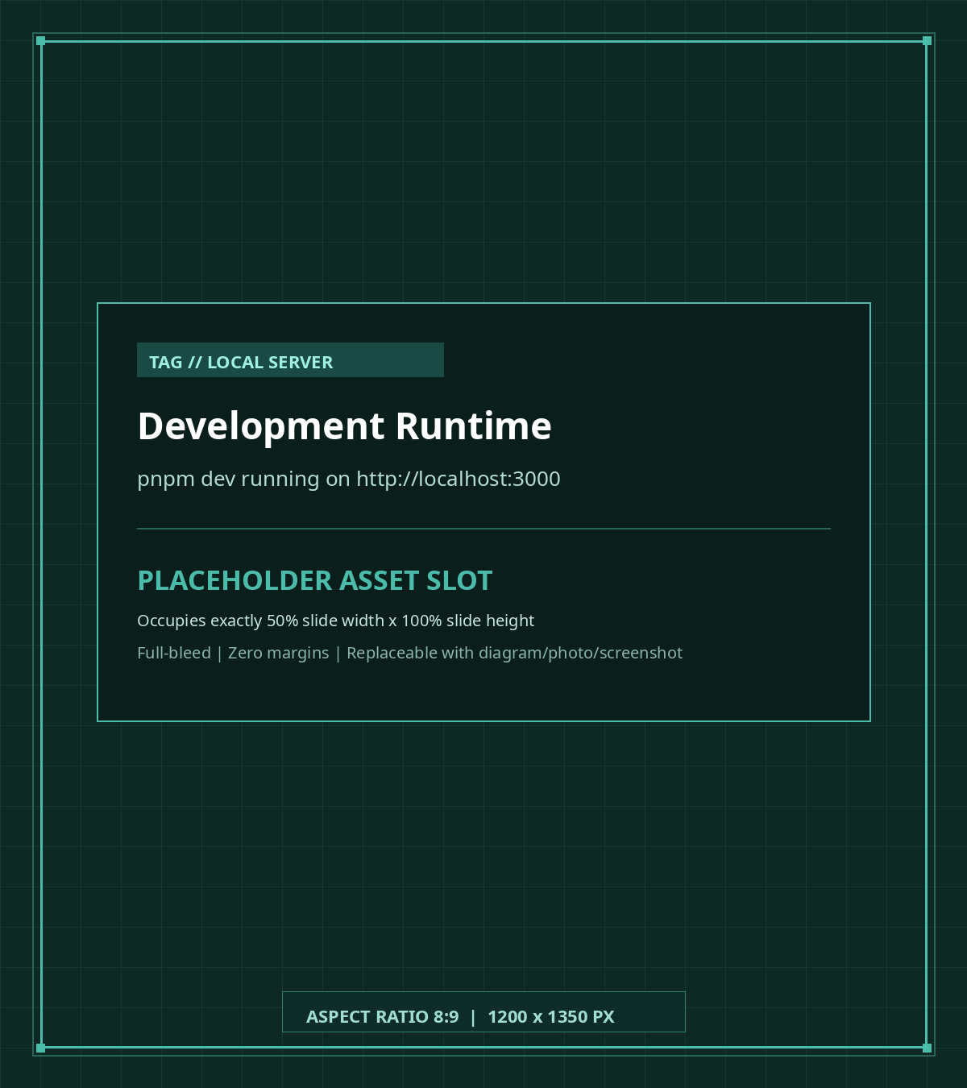
DEV SERVER
Launching Local Dev Server
• Launch Command: Execute `pnpm dev` in your terminal to start Next.js.
• Local Port: Application serves on `http://localhost:3000` with Fast Refresh enabled.
• Browser Verification: Navigate to `http://localhost:3000` to verify the Memory Book landing page.
• Live Reloading: Any changes saved inside `app/components/tasks/` will instantly update the UI.
• Keep Running: Keep this terminal running in the background during the entire workshop.

Slide 10
ARCHITECTURE
Core Tech Stack: Architectural Overview
Three distinct layers orchestrating modern full-stack web capabilities
LAYER 1: CLIENT BROWSER
LAYER 2: NEXT.JS SERVER
LAYER 3: SUPABASE BACKEND
• React 19 Components: Stateful cards, modals, search & sorting toolbar
• 3D Flipbook Viewer: react-pageflip engine with hardcover and page-turning physics
• Task Implementations: app/components/tasks/task-1.ts to task-8.ts
• Client State: Optimistic state updates for instant user feedback
• App Router: React Server Components for fast initial data prefetching
• Server Actions: app/actions/collection.ts & collection_items.ts RPC endpoints
• SSR Client: @supabase/ssr manages secure authenticated requests
• Zero REST Boilerplate: No manual fetch endpoints or express servers required
• PostgreSQL 17: High-performance relational persistence with foreign keys
• Row Level Security: Declarative authorization policies directly in database
• Supabase Storage: attachments S3 bucket storing collection posters & photos
• Supabase Studio: Real-time inspection dashboard on port 54323

Slide 11
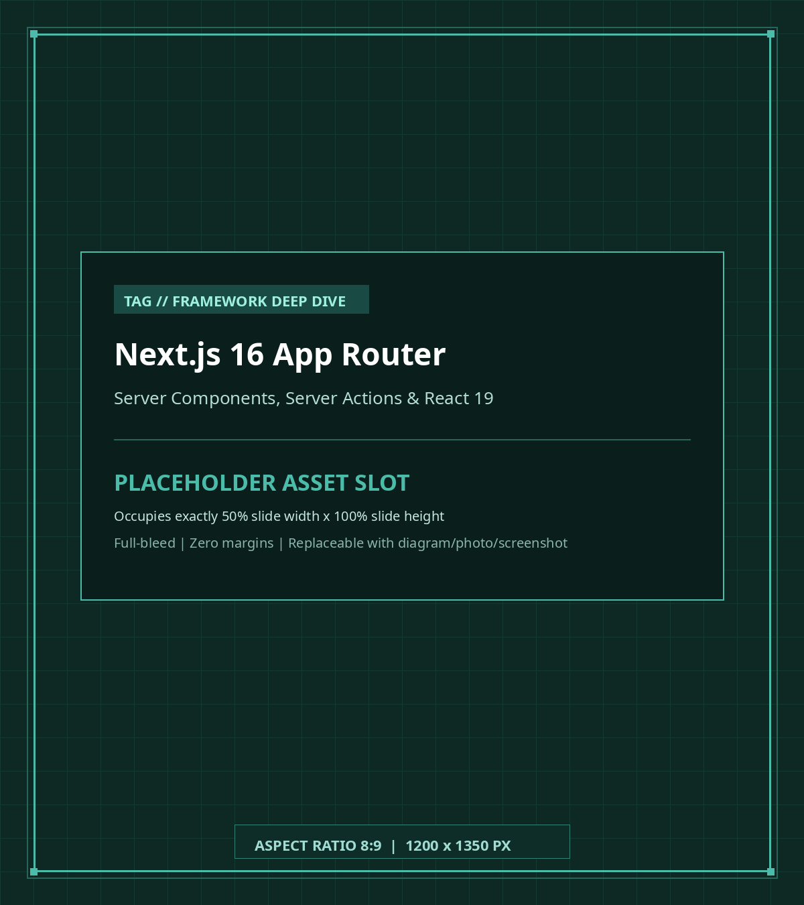
FRAMEWORK DEEP DIVE
Next.js 16 (App Router)
• React Server Components (RSC): Execute on the server (`page.tsx`), fetching database records before page render.
• Client Components (`'use client'`): Power interactive UI components, 3D flipbook page turning, and form modals.
• Server Actions (`'use server'`): Async functions running on the server; invoked directly from frontend handlers.
• Full Type Safety: Shared TypeScript types guarantee contract synchronization from DB to UI.
• Fast Iteration: Modern bundling with Turbopack for near-instant hot module replacement.

Slide 12
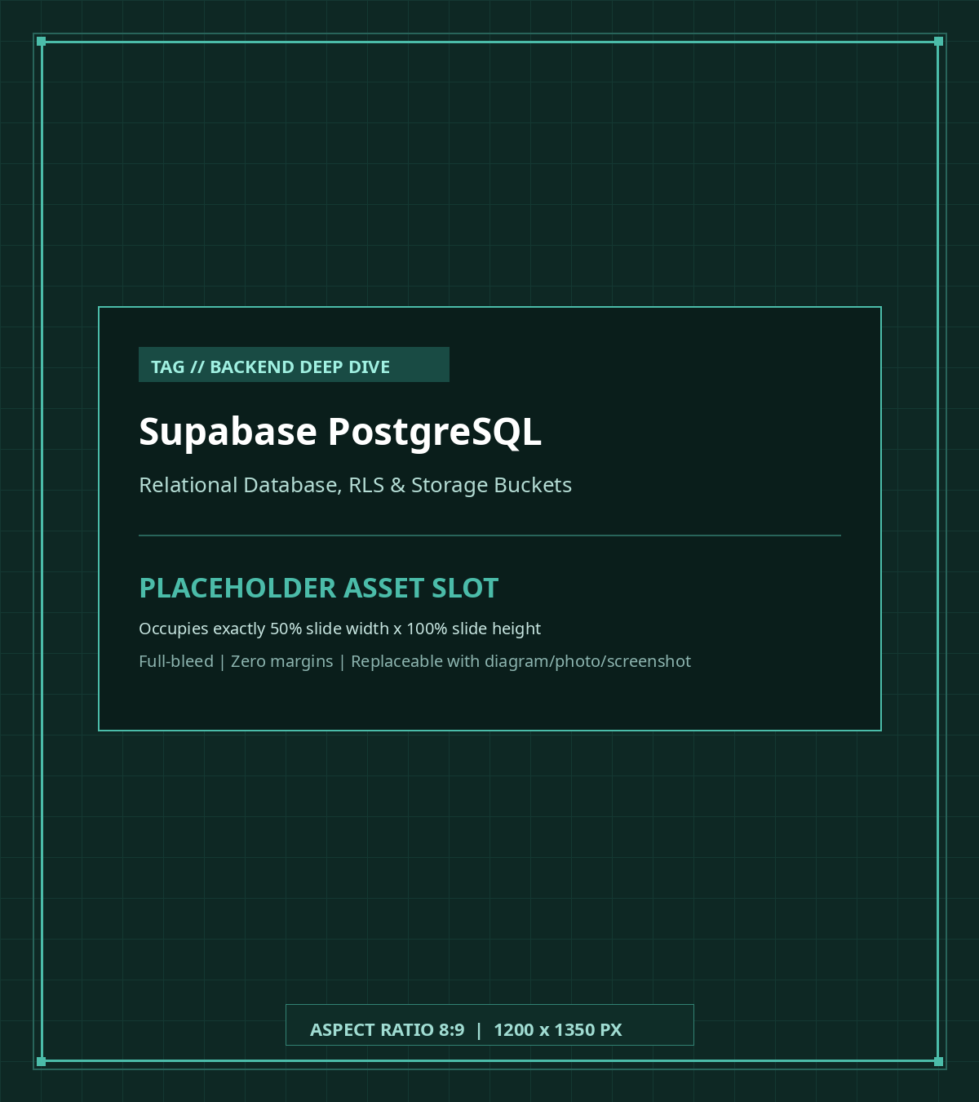
BACKEND DEEP DIVE
Supabase (Postgres & Storage)
• PostgreSQL Database: Robust relational engine storing albums and nested memory entries.
• Foreign Key Cascades: Deleting a collection automatically cascades and cleans up child memory rows.
• Row Level Security (RLS): Database-level policy enforcement ensuring secure access control.
• Storage API: Public image bucket storing covers and photos under structured folder paths.
• TypeScript Codegen: `pnpm generate:types` extracts exact TypeScript schema types from Postgres.

Slide 13
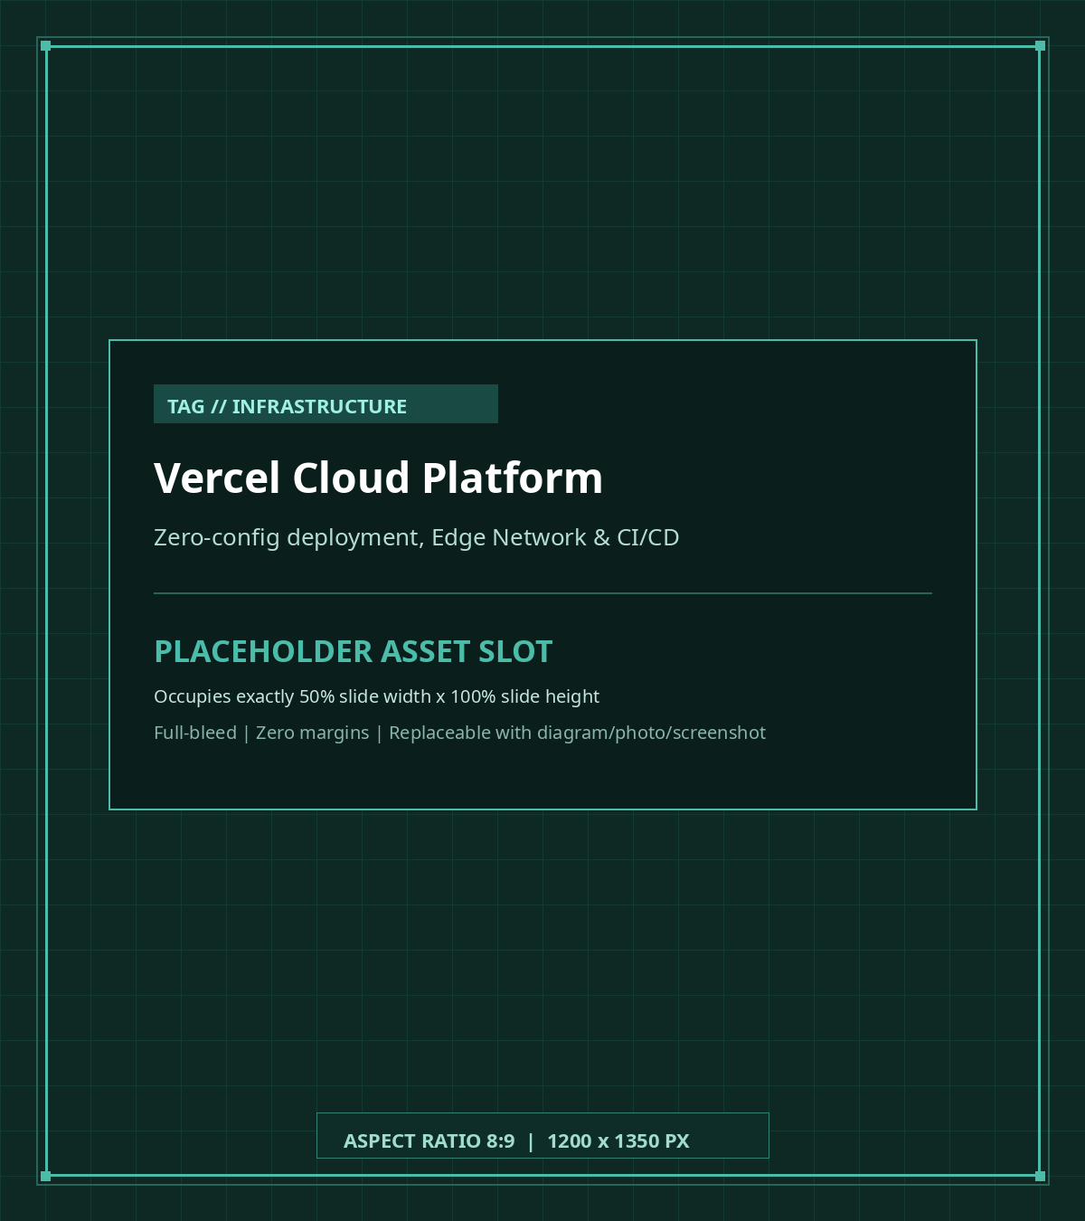
INFRASTRUCTURE
Vercel Cloud Platform
• First-Class Next.js Host: Built and maintained by the creators of Next.js for maximum performance.
• Automated CI/CD: Every git push to GitHub automatically triggers a preview build and deployment.
• Serverless Execution: Server Actions run inside lightweight serverless functions that scale instantly.
• Global Edge Network: Static pages and optimized assets cached globally for millisecond responses.
• Environment Secrets: Centralized dashboard for staging and production Supabase keys.

Slide 14
CODE STRUCTURE
Codebase Architecture & Tasks Blueprint
Where workshop tasks live and how they connect to UI modals and Server Actions
1. APPLICATION PATHS
2. WORKSHOP TASKS FOLDER
3. TASK EXECUTION PATTERN
• `app/page.tsx`: Home page prefetching collection list on server
• `app/actions/`: Server actions: collection.ts & collection_items.ts
• `app/components/`: Cards, modals, flipbook, navbar & search toolbar
• `app/types/`: database.types.ts, collection.ts, collection_item.ts
• `app/components/tasks/`: Central directory containing all 8 workshop tasks
• `index.ts`: Barrel export entry point for all task functions
• `task-1.ts` to `task-4.ts`: CRUD handlers for collections & memory items
• `task-5.ts` to `task-8.ts`: Search filter, multi-sorting & image uploaders
• User Action: User submits a modal form or clicks a toolbar option
• Task Function: UI calls exported task function with validated inputs
• Server Action: Task executes Server Action to mutate Supabase DB
• Parent Notification: Task triggers `onSuccess` callback to update React state

Slide 15
TASK 1 OF 8
Task 1: Creating a Memory Collection
Implement collection insertion in app/components/tasks/task-1.ts
FILE & UI
• File: app/components/tasks/task-1.ts
• UI Trigger: CreateCollectionModal.tsx
IMPLEMENTATION STEPS
• Step 1: Map `data` fields to `CollectionInsert` payload
• Fallback: Convert empty/undefined strings to `null`
• Step 2: Invoke `createNewCollection(payload)` server action
• Step 3: Attach `collection_items: []` and return object
VERIFICATION
• Action: Click '+ Create Collection' in navigation bar
• Test Inputs: Name: 'Helsinki Trip', Start: '2026-06-01'
• Expected: Success toast appears; new card renders in grid
TYPESCRIPT IMPLEMENTATION
// Step 1: Map form inputs to database payload
const payload: CollectionInsert = {
name: data.name,
description: data.description || null,
start_time: data.start_time || null,
end_time: data.end_time || null,
poster_url: null,
}
// Step 2: Persist via Server Action
const res = await createNewCollection(payload)
if (res?.error) {
console.error('Failed to create collection:', res.error)
showNotification?.('Failed to create: ' + res.error)
throw new Error(res.error)
}
// Step 3: Attach items array & notify parent state
let createdCol: CollectionWithItems = {
...res.data,
collection_items: [],
}
showNotification?.('Collection created successfully!')
if (onCreated) onCreated(createdCol)
return createdCol

Slide 16
TASK 2 OF 8
Task 2: Editing a Memory Collection
Implement collection updates in app/components/tasks/task-2.ts
FILE & UI
• File: app/components/tasks/task-2.ts
• UI Trigger: EditCollectionModal.tsx
IMPLEMENTATION STEPS
• Step 1: Construct update payload targeting `collection.id`
• Step 2: Call server action `updateCollection(updatePayload)`
• Step 3: Merge updated fields with existing items & poster
• Step 4: Show success toast and call `onSuccess`
VERIFICATION
• Action: Click edit pencil icon on any collection card
• Test Change: Change title to 'Lapland Winter Journey'
• Expected: Card updates immediately with new title
TYPESCRIPT IMPLEMENTATION
// Step 1: Construct partial update payload
const updatePayload = {
id: collection.id,
name: data.name,
description: data.description || null,
start_time: data.start_time || null,
end_time: data.end_time || null,
}
// Step 2: Invoke Server Action
const res = await updateCollection(updatePayload)
if (res?.error) {
console.error('Failed to update collection:', res.error)
showNotification?.('Failed to update collection: ' + res.error)
throw new Error(res.error)
}
// Step 3: Merge state & preserve items array
const updatedCollection: CollectionWithItems = {
...collection,
...updatePayload,
poster_url: res.data?.poster_url ?? null,
collection_items: collection.collection_items ?? [],
}
showNotification?.('Collection updated successfully!')
if (onSuccess) onSuccess(updatedCollection)
return updatedCollection

Slide 17
TASK 3 OF 8
Task 3: Creating a Memory Item
Implement memory page creation in app/components/tasks/task-3.ts
FILE & UI
• File: app/components/tasks/task-3.ts
• UI Trigger: CreateMemoryItemModal.tsx inside Flipbook
IMPLEMENTATION STEPS
• Step 1: Store created item `res.data` from DB
• Step 2: Upload optional photo with `updateCollectionItemPoster`
• Step 3: Merge image URL into `newItem` object
• Step 4: Trigger success toast and invoke `onSuccess(newItem)`
VERIFICATION
• Action: Click 'Open Book' on a collection card
• Add Page: Click '+ Add Memory Page' inside the book viewer
• Test Inputs: Title: 'Northern Lights', Order: 1, select a photo
• Expected: Flipbook renders new dual-page spread with photo
TYPESCRIPT IMPLEMENTATION
// Step 1: Store newly created record from database
let newItem: CollectionItem = res.data
// Step 2: Upload photo attachment if provided
if (posterFile) {
const resPoster = await updateCollectionItemPoster(
newItem,
posterFile
)
if (resPoster?.data) {
newItem = resPoster.data
} else if (resPoster?.error) {
console.warn('Image upload failed:', resPoster.error)
}
}
// Step 3: Trigger toast and notify parent state
showNotification?.('Memory item created successfully!')
if (onSuccess) {
console.log(newItem)
onSuccess(newItem)
}
return newItem

Slide 18
TASK 4 OF 8
Task 4: Editing a Memory Item
Implement memory page updates in app/components/tasks/task-4.ts
FILE & UI
• File: app/components/tasks/task-4.ts
• UI Trigger: EditMemoryItemModal.tsx inside Flipbook
IMPLEMENTATION STEPS
• Step 1: Assemble update payload with `itemToEdit.id`
• Step 2: Map updated title, description, date, and order
• Step 3: Invoke `updateCollectionItem(payload)`
• Step 4: Merge fields safeguarding existing `image_url`
VERIFICATION
• Action: Flip to a memory page and click the Edit button
• Test Change: Update description narrative or page order
• Expected: Page re-renders with new narrative text immediately
TYPESCRIPT IMPLEMENTATION
// Step 1: Assemble partial update payload
const payload = {
id: itemToEdit.id,
name: data.name,
description: data.description || null,
memory_date: data.memory_date || null,
order: data.order,
}
// Step 2: Execute Server Action
const res = await updateCollectionItem(payload)
if (res?.error || !res?.data) {
const errorMsg = res?.error ?? 'Failed to update memory item.'
console.error(errorMsg)
showNotification?.(errorMsg)
throw new Error(errorMsg)
}
// Step 3: Merge fields preserving image_url
const updatedItem: CollectionItem = {
...res.data,
image_url: res.data.image_url,
}
showNotification?.('Memory item updated successfully!')
if (onSuccess) onSuccess(updatedItem, true)
return updatedItem

Slide 19
TASK 5 OF 8
Task 5: Real-Time Collection Search
Implement searchByTitleOrDescription in app/components/tasks/task-5.ts
FILE & UI
• File: app/components/tasks/task-5.ts
• UI Trigger: CollectionToolbar.tsx search input
IMPLEMENTATION STEPS
• Step 1: Fast exit: return `[]` if collections empty
• Step 2: Sanitize query with `.trim().toLowerCase()`
• Fast Path: Return unfiltered collections if query is empty
• Step 3: Filter matching name or description substring
VERIFICATION
• Action: Type query 'Finland' into search bar
• Filtering: Only albums with 'Finland' in name or note display
• Reset: Clear the search input; all collections restore
TYPESCRIPT IMPLEMENTATION
export function searchByTitleOrDescription(
collections: CollectionWithItems[],
query: string
): CollectionWithItems[] {
// 1. Guard against empty collection list
if (!collections || collections.length === 0) {
return []
}
// 2. Sanitize and normalize search query
const normalizedQuery = (query || '').trim().toLowerCase()
if (!normalizedQuery) {
return collections
}
// 3. Filter by title or description substring
return collections.filter((collection) => {
const nameMatch = collection.name
? collection.name.toLowerCase().includes(normalizedQuery)
: false
const descriptionMatch = collection.description
? collection.description.toLowerCase().includes(normalizedQuery)
: false
return nameMatch || descriptionMatch
})
}

Slide 20
TASK 6 OF 8
Task 6: Multi-Criteria Collection Sorting
Implement onSortChange and sortCollections in app/components/tasks/task-6.ts
FILE & UI
• File: app/components/tasks/task-6.ts
• UI Trigger: CollectionToolbar.tsx sort dropdown
IMPLEMENTATION STEPS
• Part 1: `onSortChange`: update sort state & reset page to 1
• Part 2: Pure immutable sorting returning a new sorted array
• Criteria: created_at (asc/desc), name (A-Z/Z-A), items, dates
• Null Safety: Safe comparison fallbacks for collections without dates
VERIFICATION
• Sort A-Z: Select 'Alphabetical (A - Z)' — verify alphabetical order
• Sort Items: Select 'Memory Count (Most Items)' — verify highest count
TYPESCRIPT IMPLEMENTATION
// Part 1: Sort change handler & pagination reset
export function onSortChange(newSort, setSortBy, setCurrentPage) {
setSortBy(newSort)
setCurrentPage(1)
}
// Part 2: Sorting switch cases (sortCollections)
case 'created_at_asc':
return (a.created_at ? new Date(a.created_at).getTime() : 0) -
(b.created_at ? new Date(b.created_at).getTime() : 0)
case 'name_asc':
return (a.name || '').localeCompare(b.name || '')
case 'items_desc':
return (b.collection_items?.length || 0) -
(a.collection_items?.length || 0)
case 'start_date_asc':
if (!a.start_time && !b.start_time) return 0
if (!a.start_time) return 1
if (!b.start_time) return -1
return new Date(a.start_time).getTime() -
new Date(b.start_time).getTime()

Slide 21
TASK 7 OF 8
Task 7: Collection Poster Upload & Removal
Implement editCollectionPoster in app/components/tasks/task-7.ts
FILE & UI
• File: app/components/tasks/task-7.ts
• UI Trigger: EditCollectionModal.tsx poster uploader
IMPLEMENTATION STEPS
• Case A (Upload): Invoke `updateCollectionPoster(collection, file)`
• Preview: Generate `URL.createObjectURL(file)` preview URL
• Case B (Delete): When `file === null`, call action to delete file
• State Reset: Set `poster_url: null` and notify parent state
VERIFICATION
• Upload Test: Upload PNG/JPG cover image on a collection
• Storage Check: Inspect bucket `attachments/<id>/...` in Studio
• Removal Test: Click 'Remove Poster'; confirm cover returns to default
TYPESCRIPT IMPLEMENTATION
if (file != null) {
// Case A: Upload or Replace Poster
const res = await updateCollectionPoster(collection, file)
if (res?.error) {
showNotification?.('Failed to update poster: ' + res.error)
throw new Error(res.error)
}
const previewUrl = URL.createObjectURL(file)
const updatedCollection = { ...collection, poster_url: previewUrl }
showNotification?.('Collection poster updated successfully!')
if (onSuccess) onSuccess(updatedCollection)
return updatedCollection
}
// Case B: Remove Poster (file is null)
const res = await updateCollectionPoster(collection, null)
if (res?.error) throw new Error(res.error)
const clearedCollection = { ...collection, poster_url: null }
showNotification?.('Collection poster removed successfully!')
if (onSuccess) onSuccess(clearedCollection)
return clearedCollection

Slide 22
TASK 8 OF 8
Task 8: Memory Photo Upload & Removal
Implement editMemoryPoster in app/components/tasks/task-8.ts
FILE & UI
• File: app/components/tasks/task-8.ts
• UI Trigger: EditMemoryItemModal.tsx & MemoryBookModal.tsx
IMPLEMENTATION STEPS
• MIME Check: Permit only: image/png, jpeg, jpg, webp
• Rejection: Throw error & display toast for unsupported files
• Case A (Upload): Invoke `updateCollectionItemPoster(item, file)`
• Case B (Remove): Delete photo from storage when `file === null`
VERIFICATION
• Valid Upload: Upload JPG photo; verify display on memory page
• Invalid Test: Upload a .pdf file; verify error toast rejection
• Removal Test: Remove photo; verify layout adjusts seamlessly
TYPESCRIPT IMPLEMENTATION
if (file != null) {
// 1. Validate MIME types
const validTypes = ['image/png', 'image/jpeg', 'image/jpg', 'image/webp']
if (!validTypes.includes(file.type.toLowerCase())) {
const errorMsg = 'Unsupported format. Please upload PNG, JPG, or WEBP.'
showNotification?.(errorMsg)
throw new Error(errorMsg)
}
// 2. Upload file via Server Action
const res = await updateCollectionItemPoster(item, file)
if (res?.error) throw new Error(res.error)
const previewUrl = URL.createObjectURL(file)
const updatedItem = { ...item, image_url: previewUrl }
showNotification?.('Memory photo updated successfully!')
if (onSuccess) onSuccess(updatedItem, true)
return updatedItem
}
// Case B: Remove photo attachment (file is null)
const res = await updateCollectionItemPoster(item, null)
if (res?.error) throw new Error(res.error)
const clearedItem = { ...item, image_url: null }
showNotification?.('Memory photo removed successfully!')
if (onSuccess) onSuccess(clearedItem, false)
return clearedItem

Slide 23
VERIFICATION & DEBUGGING
Verification, Troubleshooting & Solution Diff
Techniques for verifying your implementation and debugging common local issues
1. GIT SOLUTION DIFF
2. STORAGE & DATABASE ERRORS
3. DEV SERVER TROUBLESHOOTING
• Task Diff: git diff solution -- app/components/tasks/task-1.ts
• All Tasks Diff: git diff solution -- app/components/tasks/
• Reference Branch: Inspect full code: `git checkout solution`
• Return to Work: Return to your tasks: `git checkout main`
• Storage Upload Fails: Ensure bucket `attachments` exists & Public is checked
• RLS Policy Denied: Run `supabase db reset` to apply SQL permissions
• Port Conflicts: Run `supabase stop` then `supabase start`
• Inspect Tables: Open Studio at `http://127.0.0.1:54323`
• Missing Env Keys: Ensure `.env.local` contains `NEXT_PUBLIC_SUPABASE_URL`
• Fast Refresh Glitch: Restart server: `Ctrl+C` then `pnpm dev`
• TypeScript Check: Run `pnpm build` to catch type mismatches
• Browser Console: Inspect Network tab for Server Action responses

Slide 24
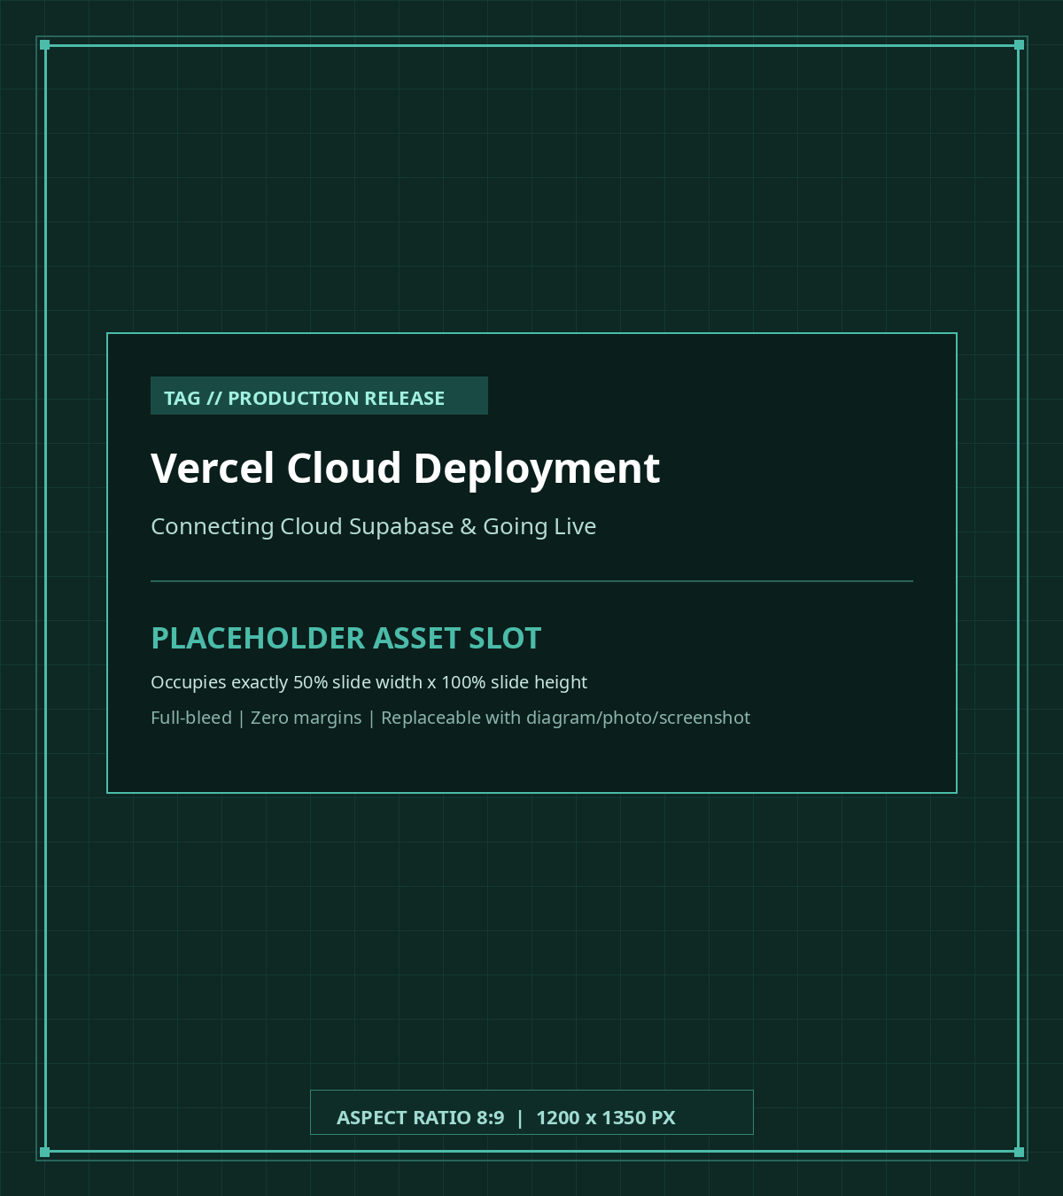
PRODUCTION RELEASE
Deploying to Vercel & Wrap-Up
• Step 1: Push Code: Commit your completed tasks: `git add . && git commit -m 'feat: complete tasks' && git push`.
• Step 2: Cloud Supabase: Create a free project at supabase.com, run migrations, and create the `attachments` public bucket.
• Step 3: Import into Vercel: Import your repo on vercel.com; add `NEXT_PUBLIC_SUPABASE_URL` & `NEXT_PUBLIC_SUPABASE_PUBLISHABLE_KEY`.
• Step 4: Live Release: Click Deploy; Vercel compiles the Next.js App Router and provisions edge networks.
• Congratulations!: Your Valentine Memory Book is live with 3D flipbook page turning, image uploads, and cloud persistence!

