Slide 1
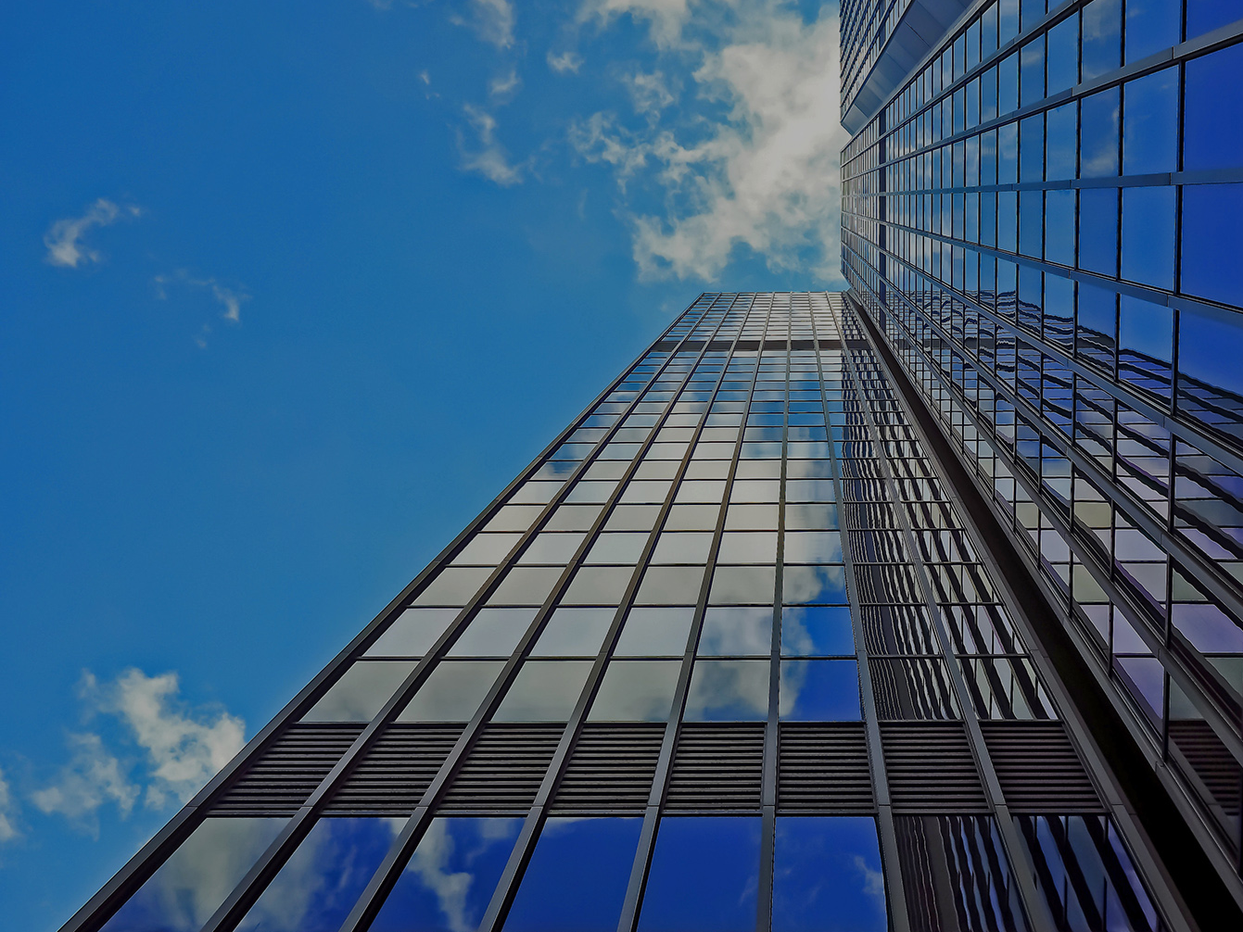
Software engineer final project
Introduce to Check the good application
519K0013-NguyenDinhMinhKhoi

Slide 2

Main topic
+ Architecture design
- Style
- Model
+ Design
- Database design
- Class diagram
- Sequence for each use case
+ Link to github
+ Purpose, Scope and product overview
+ Project plan manager:
- Organization
- SDLC
- Risk analysis of the project
- Deliverable and schedule
+ Requirement specification
- Use case
- Function & non functional requirements

Slide 3
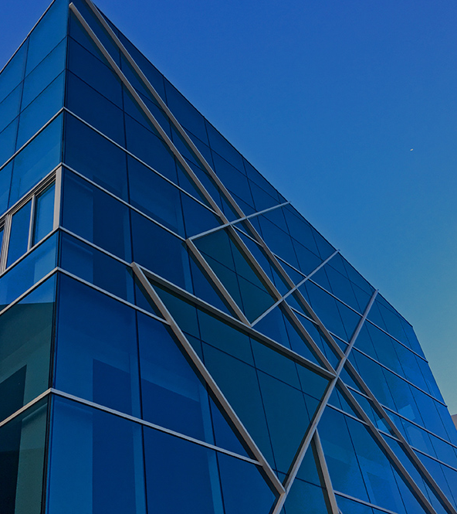
Purpose, scope and overview
Product scope Description | Check the good will develop and implement application with functionality to help the user can manage the goods better from importing to transferring (shipping) to online transaction for goods. Further, we also analyze and design goods for accountants by checking the review or the number of goods being import and sell in order to help accountants have a brief view of what should focus on.
Project Deliverables | Create useful function like view receipt, create note, view stock and revenue for accountant that use check the good application Make a website for online payment between accountants and agents. Intake the data of users and then recommend goods for users base on their often order Develop the review by gathering data of goods that being used most in each region and give it to accountants in order to push their sale.
Project Acceptance Criteria | Successful implement all function in check the good app Successful implement review table for accountant to see what most sale from Successful deploy a website for agent to make online transaction to accountants.
Project Exclusion | Since check good app is a useful app for accountants to manage goods. And website for online payment reduce a lot of user’s effort spending. Some work will be occurring: 5% cost reduction for 1 month with user use app 5 years Open community for all accountants and agents check information
Project Constraint | Check good app should help accountants easier work their job without reduce labor. Online payment need to be inside country and also globally Check good app should be done by the end of December 2021 with review and necessary notification in 2021 The budget must be done with no fee except huge amount of time All resource must be done from scratch but the idea can be come up when using internet or friend and family daily work. Personal limitations: time and knowledge is essential
Purpose of project is to provide application to help accountant manage good better
Check the good is targeting to accountants most to help accountants able to manage their good easily, it also has a connection to the warehouse employees and create communication between accountants and warehouse employees without saying anything, all the data accountants do in the app is the thing they want to say to those employees.
Check the good is an application make as window form application, it first has login account for each accountants, function print receipt so that accountants can print receipt when they import goods, function update order for accountants to update order when they shipping good to agents. function view stock to see the stock and revenue report.
Every accountant should use the product as soon as possible because it reduces a lot of effort, and every accountant can use this app everywhere, they just need to download it and connect to internet.
This app has so many reward for long use accountants, if they use the app about years, they get many discounts.

Slide 4
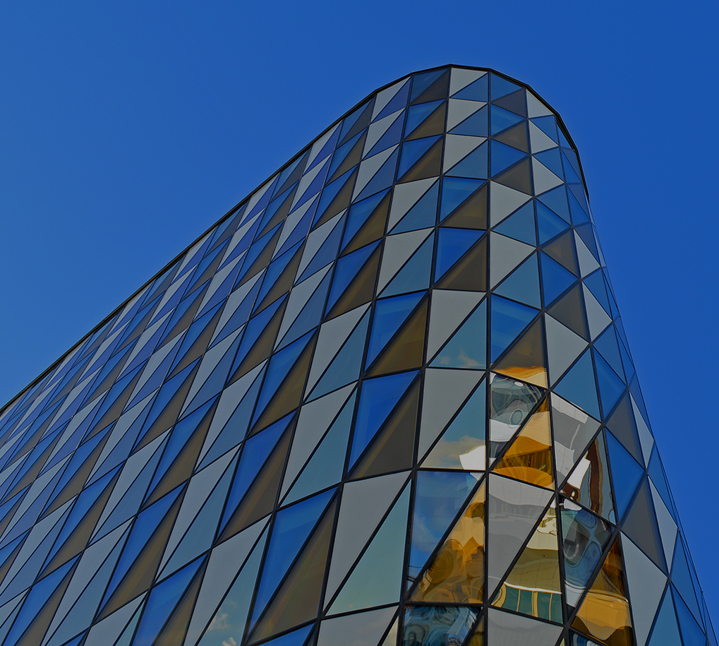
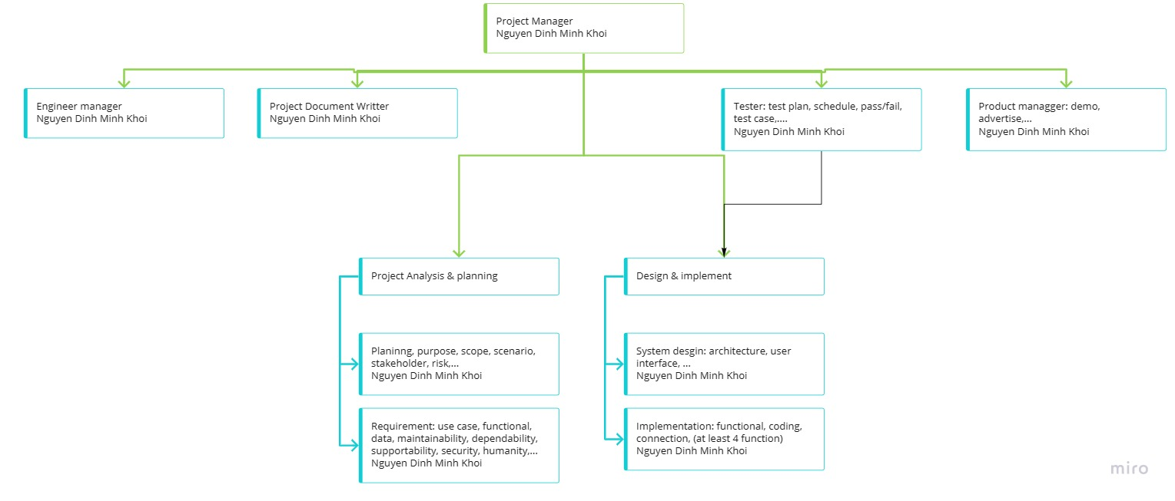
Project management
This project team was done by 1 person company so every member is this person name. This picture below was made with help of tools in miro.com.
Role | Employee Name
Project Manager | Nguyen Dinh Minh Khoi
Engineer Manager | Nguyen Dinh Minh Khoi
Project Document Writter | Nguyen Dinh Minh Khoi
Project Analysis & planning | Nguyen Dinh Minh Khoi
Design and implement | Nguyen Dinh Minh Khoi
Tester | Nguyen Dinh Minh Khoi
Demo & advertise | Nguyen Dinh Minh Khoi

Slide 5
Life cycle model use
Waterfall lifecycle model was used in this project.
Explanation about SDLC
Reason why I choose
The project follows to a specific software development lifecycle that is waterfall SDLC model. The project follows a sequential step-by-step process from planning -> analysis requirement ->…-> maintenance. Every section of the project is done carefully and also have well-defined for later step to use.
Using waterfall model for this project is to help team member easily understand and also can use effectively. Since this project was done by Nguyen Dinh Minh Khoi – university student so it is perfect because it suitable for inexperience member. Milestone can be easily understood and also the whole project is very easy to manage and control from planning to maintenance.
The reason why this project is using waterfall model but not other SLDC model:
requirement are well known and will not change.
product is stable and technology is understood.
waterfall work best for small project like Check the good.
I want to focus on quality rather than cost or schedule. Below is the picture of waterfall model that is being used in this project.

Slide 6
Risk
Quantity risk | Quality risk
Less function | Function is not effective (maybe require user action than automatic).
Less detailed document | Document is not effective for reader
More time needed to finish project | App design and Web design may have bad look
This project was done by only 1 person so there are many risks in this project.

Slide 7
Deliverables and schedule
No | Deliverables | Date | Status
1 | Project plan prepare | 16/12/2021 | Complete
2 | Requirement definition (functional and non functional) v1.0 | 18/12/2021 | Complete
3 | Software model (use case) v1.0 | 19/12/2021 | Complete
4 | Architecture design document | 19/12/2021 | Complete
5 | Design database and model | 20/12/2021 | Complete
6 | Coding function | 22/12/2021 | Complete
7 | Building web application | 24/12/2021 | Complete
8 | Do unit test and system test for function and web application | 26/12/2021 | Complete
9 | Link window form and web and API together and give final application | 26/12/2021 | Uncomplete
10 | Make a video demo of app and save source code by pushing to github last time | 27/12/2021 | Complete
11 | Complete report file | 27/12/2021 | Complete
All deliverables and the schedule is on the table.

Slide 8
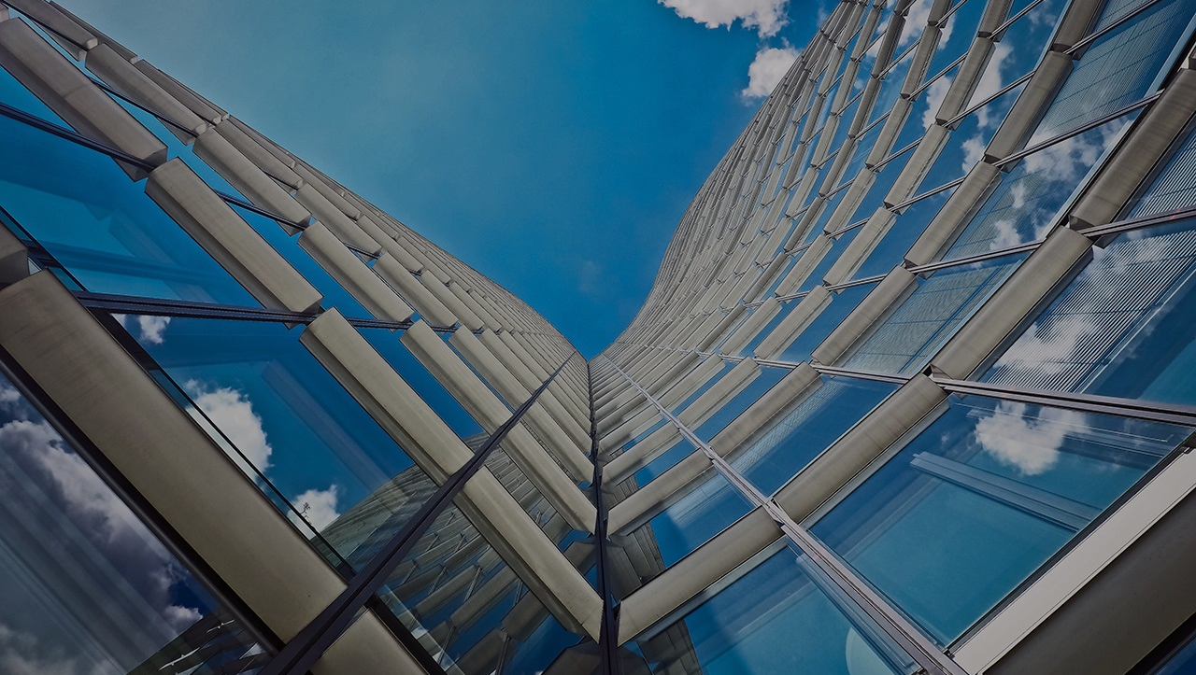
Professional standards
All acceptable and unacceptable behavior when doing this project
1 | Responsibility and standards. | - Accept full responsibility for this project. - Moderate the interests of the software engineer, the employer, the client and the users with the public good. (what public want) - Approve software only if they have a well-founded belief that it is safe, meets specifications, passes appropriate tests, and does not diminish quality of life, diminish privacy or harm the environment. The ultimate effect of the work should be to the public good. Provide service in their areas of competence, being honest and forthright about any limitations of experience and education. - Ensure that any document upon which they rely has been approved. - Offer fair payment for the work like good score in final project.
2 | Unaccepted behavior | - Not finish small target deadline on time and no announcement to others - Cut off content so and turn in just to make it on time and then make the whole project less quality - Not enough self-discipline to make the project as good as possible - Reason that can be accepted like (Chirstmas off, New year off, illness, family urgency,..)

Slide 9
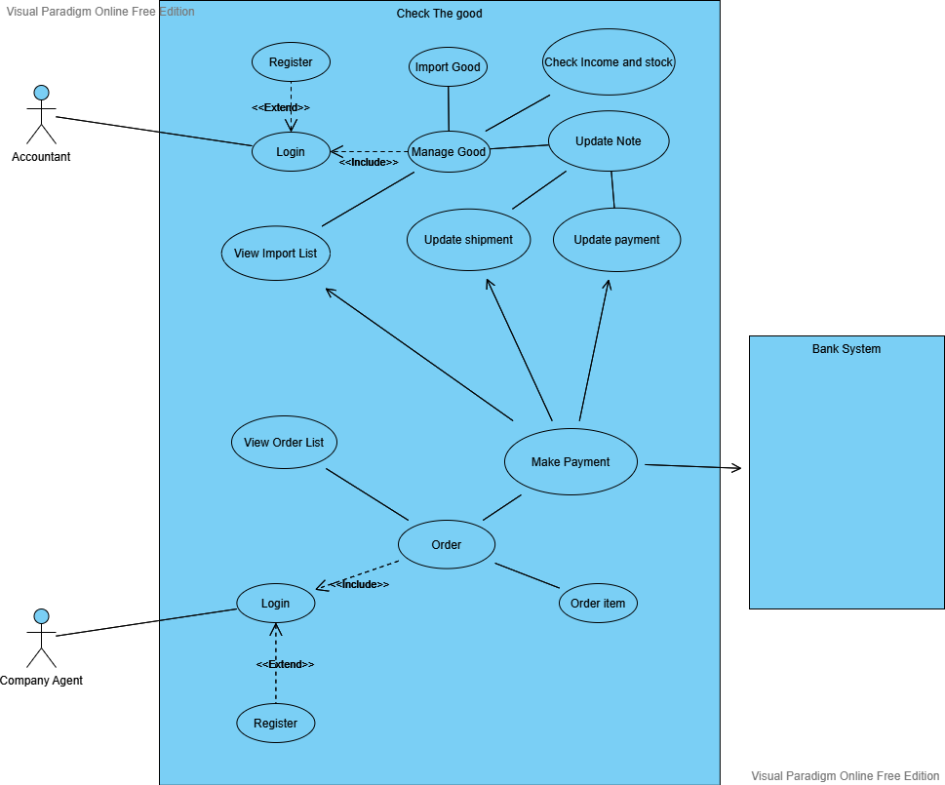
Use case diagram

Slide 10
Use case diagram
Textual Explain for each use case
- Login | There are 2 login use case one for company agent actor and 1 for Accountant actor because each type of account will have different UI to use and different functionality features. When user login they will have a different function to use. This is to separate the actor.
- Register: | This is extend use case of Login. If the users don’t have account or want to create new account they can register if not then they can login using their account.
Manage good | This is home manager page for accountant actor only to choose other functionality use case.
View Agent import list | This use case will show every single import from every single agents, may be different agents want to import. For example 2 agents may import item so the list will show all 2 agents and all of their import list including the import that they haven’t made payment or already paid.
Update transaction status | This use case is when agent they make a payment success the status will automatically updated or the Accountant can update manually if the agent pay directly. It first initialize at N (no payment yet) when agent import.
Update shipment status | This use case is when accountant want to update the delivery process goods to agents. It first initialize at Undelivered (no payment yet) when agent import.
View Stock and revenue | This use case is for accountant to see all money income and all stock that being imported by agents.
Import goods | This use case is for Accountant to choose goods and import them. After import => import list will update.
View import list | This use case for agents to check all import they make (they cannot see other agent import like account has view all agent import).
Make payment | This is when agent make online payment then view import list and view all agent import list updated and also transaction status updated automatically.

Slide 11
Functional and non functional requirements
Funtional requirements | Non- functional requirements
Authenticate of user when login | Show a username and password input place for user to type in
Create new user if they are new or demand for new account | Show a username and password and confirm user input place for user to type in.
The system allow the Accountant to manage the Note and Import list(upgrade, remove, edit). | The processing of each request should be done within 10 seconds
Agent can make online payment through a web with momo or zalo pay… | Show out a QR code for user to make payment and also make transaction in 10s
The system allow the administrator to back up and restore the information of customer in case of cyber attack or some physical damage to computer. | Friendly system, Image attractive and easy to use

Slide 12
Architecture design
Architecture style
The main style of this project architecture is layered architectures, where many layers are used. The different layers are defined in the architecture. It consists of outer and inner layer. The components of outer layer manage the user interface operations. All the components then execute the operating system interfacing at the inner layer. The inner layers are application layer, utility layer and the core layer. In many cases, It is possible that more than one pattern is suitable and the alternate architectural style can be designed and evaluated.
Because using layered architecture, the project is easily done base on the architecture where all the part is elaborated clearly. The good thing about check the good is that it is very simple to use, making all users navigate the application easily. Moreover, it has a considerable speed because it doesn’t use very complexity algorithm to run.
The layered design also help the project improve the image of presentation layer where most users see it at first. How ever with limited time, the image does not have a lot color which also make the image look not very well. But the good thing is the application will be updated time to time. Therefore, everything will be improved soon in time.

Slide 13
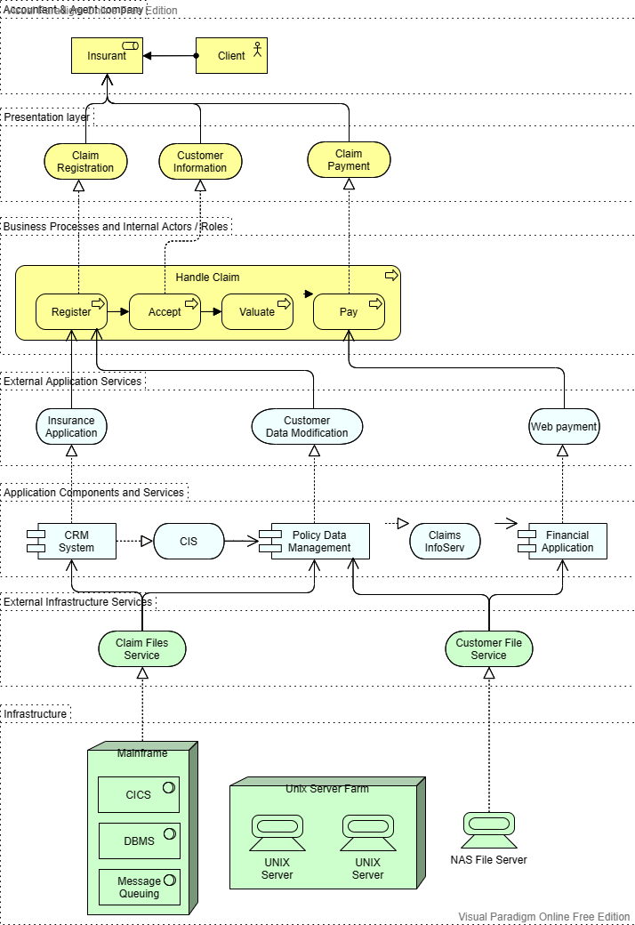
Architecture design
Architecture model

Slide 14
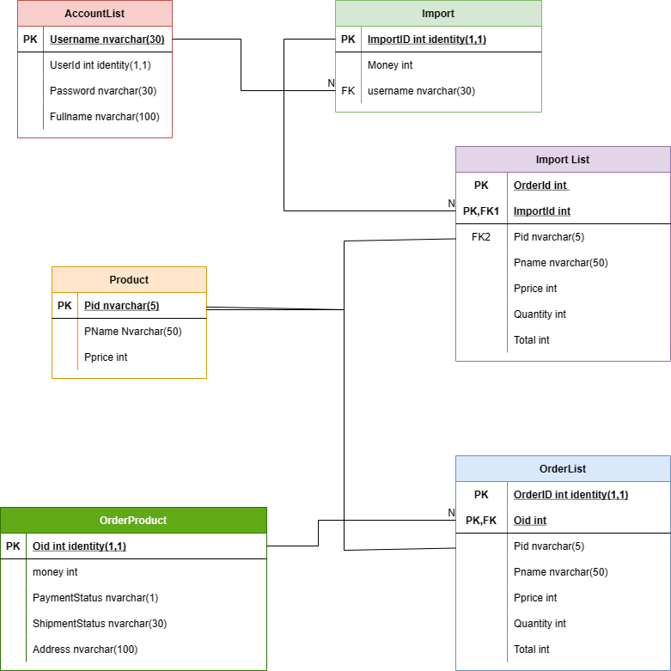
Design
Database design
The database contain 6 main table to store all user data. This diagram below will illustrate clearly the relationship between table.

Slide 15
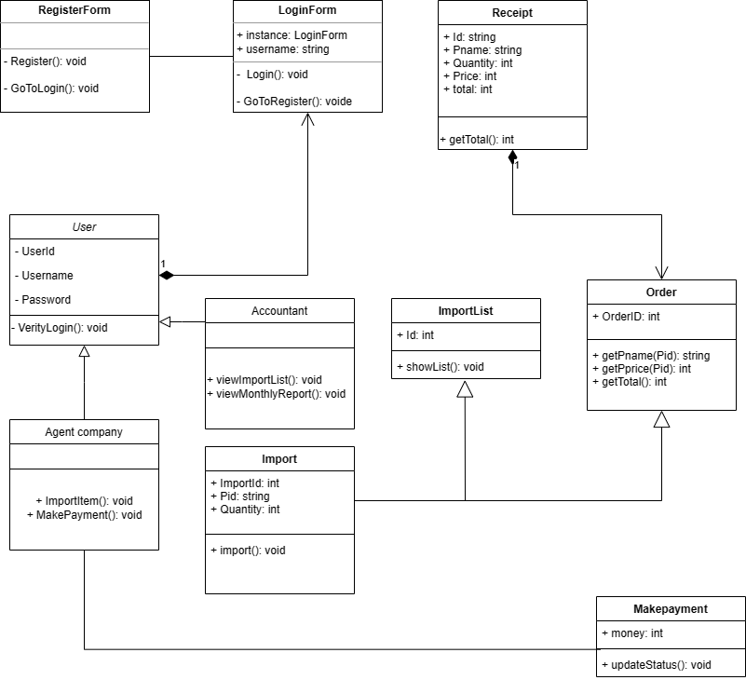
Design
Class diagram
Here is the whole application relationship between classes and database.

Slide 16
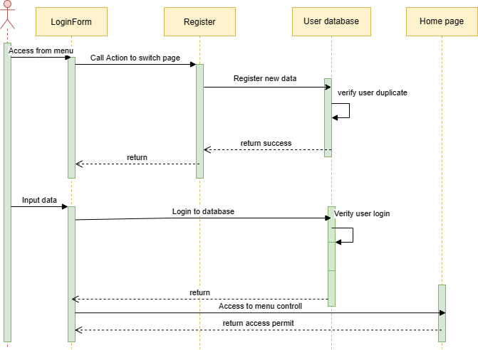
Design
Sequence diagram for usecase
Login usecase

Slide 17
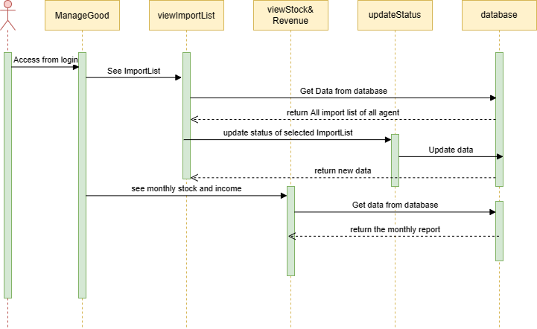
Design
Sequence diagram for usecase
Manage Good usecase

Slide 18
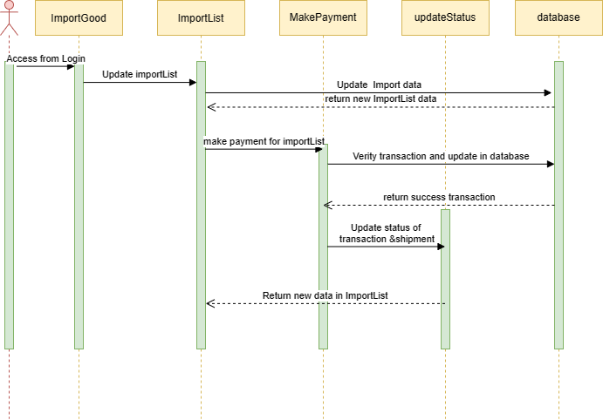
Design
Sequence diagram for usecase
Import Good use case

Slide 19
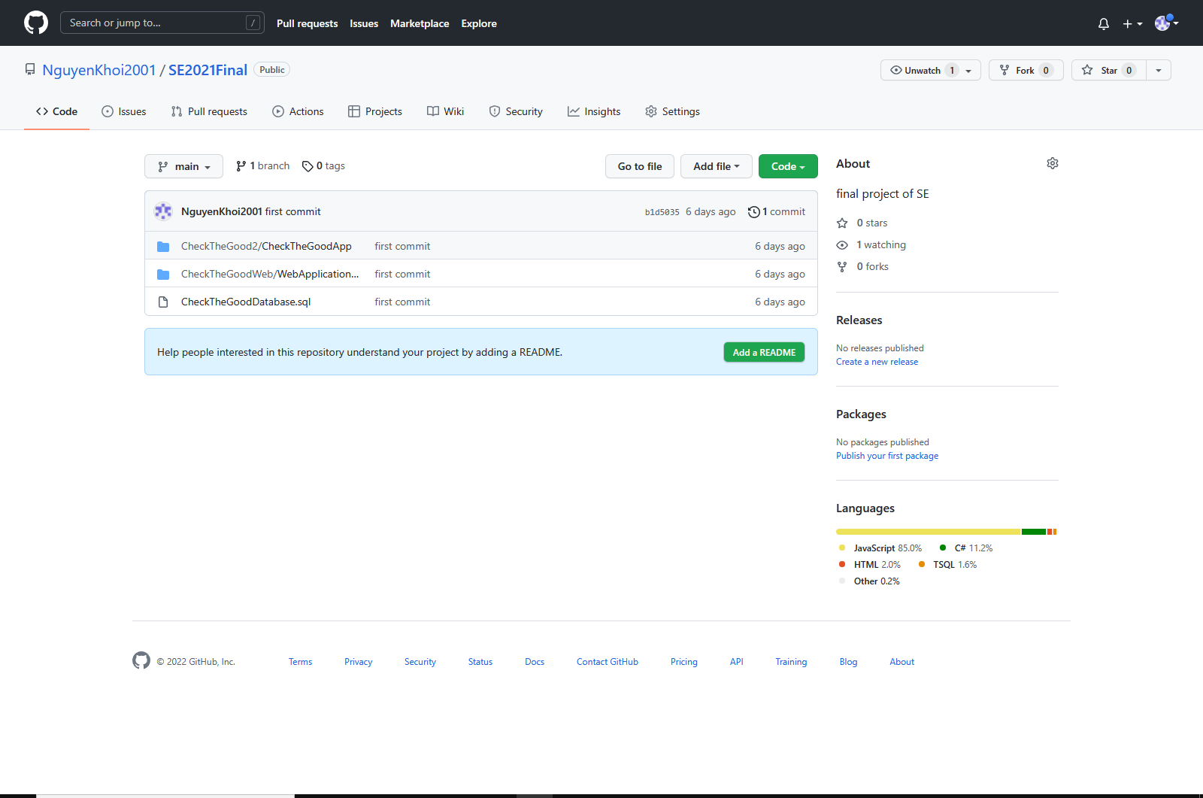
Github to Final
https://github.com/NguyenKhoi2001/SE2021Final

Slide 20
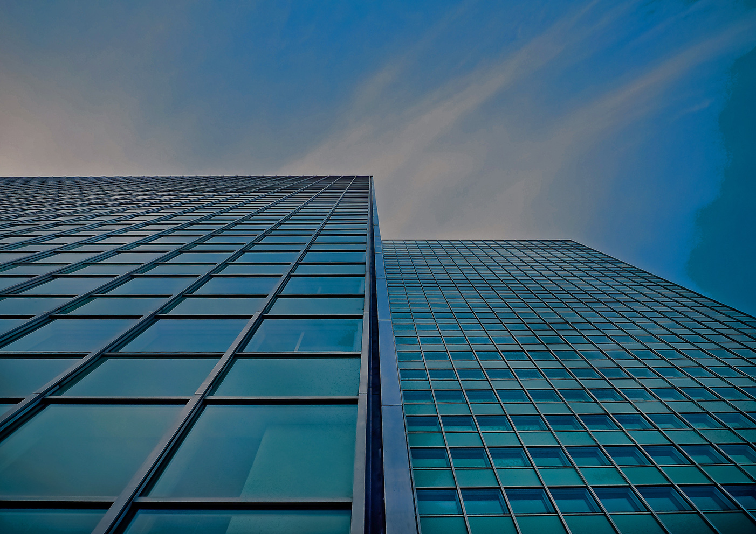
THANK YOU!
Alexander Martensson
Phone
678-555-0128
Email
martensson@example.com

Slide 21
Customize this Template
Template Editing Instructions and Feedback

