Slide 1


Android operating system

Slide 2

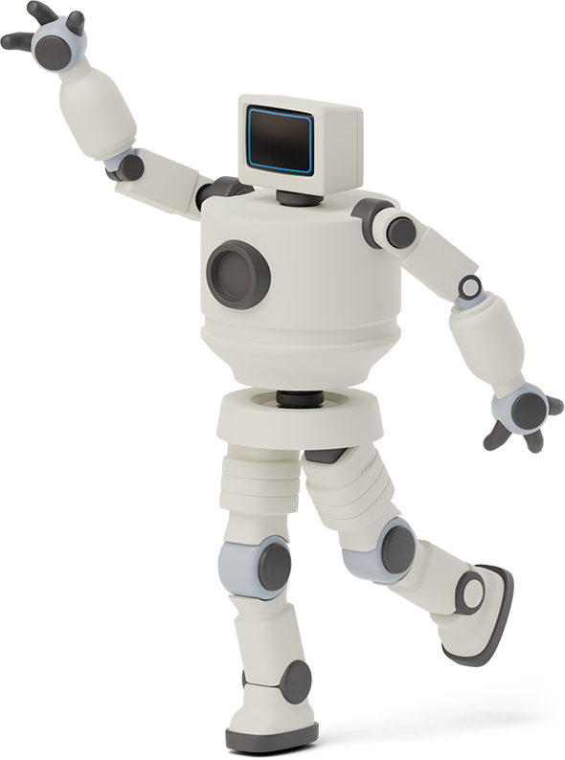

Hello!
I am Bao
I am here because I love to give presentations.
You can find me at nguyenlehb1808@gmail.com

Slide 3


Introductions
1
Let’s start with the first set of slides

Slide 4
Instructions- What is android
Android is a Linux based operating system designed primarily for mobile devices such as smartphones and tables
Android was first developed as a ADVANCE OPERATING SYSTEM for digital cameras
There are more than 4,000,000 apps in android market
And, android is open source

Slide 5
Instructions- What is operating system
An operating system, or “OS”, is a software that communicates with the hardware and allows other programs to run…
Common desktop operating systems include Windows, OS X, and Linux
Common mobile OS include Android, iOS, and Window Phone
Android OS consists of a shell and a kernel
Creator’s of android takes out the kernel from Linux OS 2.6 and rewrite the shell part using Java, that’s form android OS

Slide 6
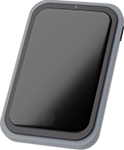
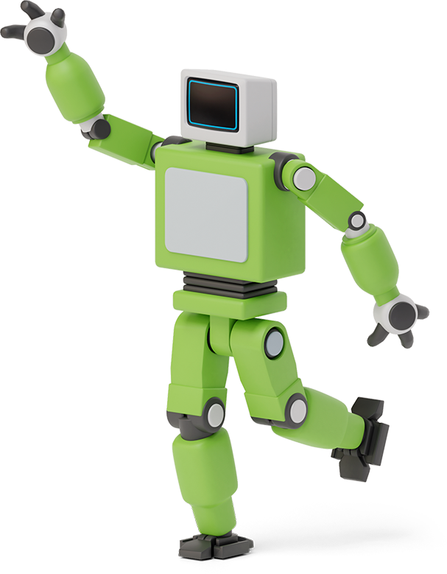

Origin of android
Android was founded in Palo Alto, California in October 2003 by Andy Rubin, Rich Miner, Nick Sears and Chris White
Android was purchased by Google in August, 2005 for 50 millions $

Slide 7

Features

Slide 8

Android support wireless communication
Open source
Built in services like GPS, browser and maps
Portability across current and future hardware

Slide 9

Android versions
Android Astro 1.0
Android Cupcake 1.5
Android Donut 1.6
Android Éclair 2.0
Android Froyo 2.2
Android Honeycomb 3.0
Android IceCream Sandwich 4.0
Android JellyBean 4.1
Android Kitkat 4.4
Android Gingerbread
Android Lollipop 5.0
Android Marshmallow 6.0
Android Nougat 7.0
Android Oreo 8.0

Slide 10
Architectuer
Architecture
Linus kernel
Application Framework
Libraries
Application Layer
Android Run Time

Slide 11

Why prefer android ?

Slide 12
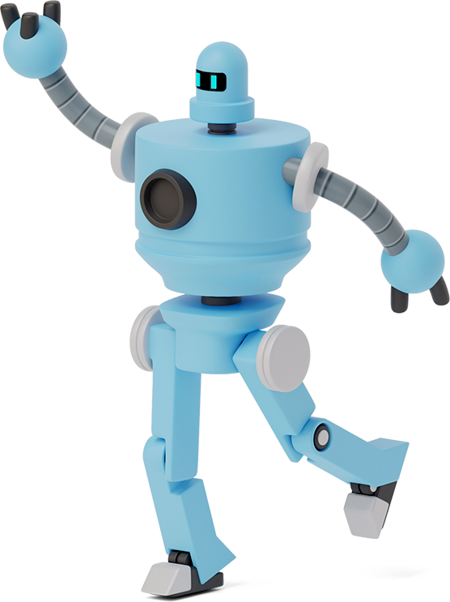
Why Android is better
CHEAPER THAN IPHONE
Android devices are cheaper than iPhone which is one of the main reason why Android phone sale is growing rapidly
03
Launchers
Android offers many cool launcher apps for customizing home screen’s style. While Apple do not allow users to customize their home screen and all the users have same home screen
01
02
Free apps and games
Android offers a lot of free games and application on google play, whereas iPhone have mostly paid Apps on App Store

Slide 13
Limitations
First
Making source code available to everyone inevitably invites the attention of hackers
Second
Android operating system uses more amount of battery as compared to normal mobile phones
Third
It has been seen that it has security related issues.
Finally
As we call Android is world of applications we continuously need to connected with the internet which is not possible for all the users.

Slide 14

Credits
Special thanks to all everybody

