Slide 1
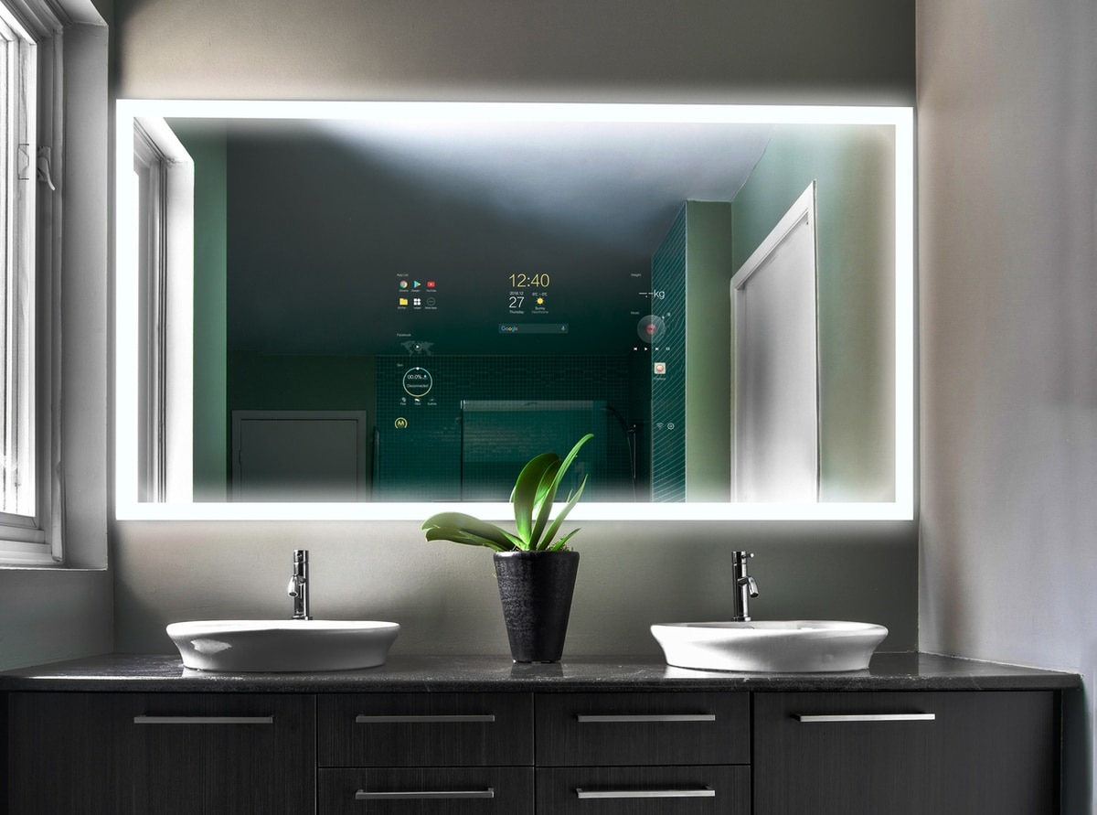
SMART MIRROR
2016

Slide 2
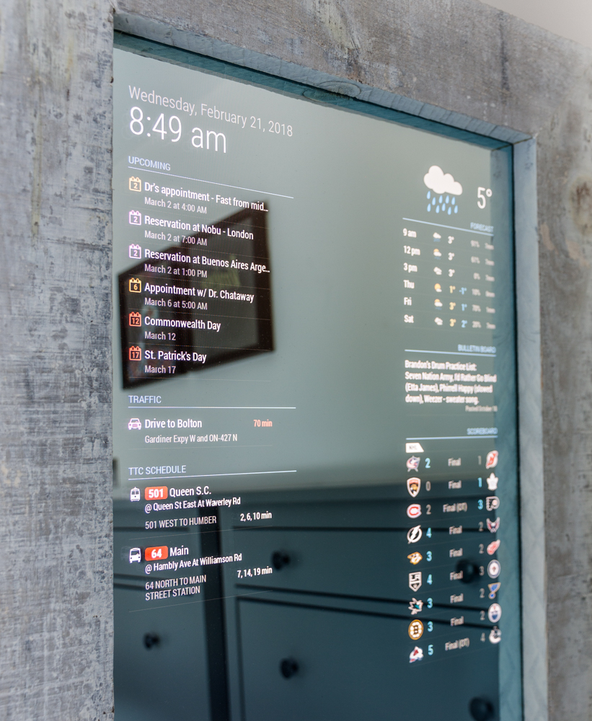


PURPOSE
BASIC APPLICATIONS
CLOCK
DATE
NEWS
WEATHER FORECAST
ALARM
,..
ADVANCED APPLICATIONS
MUSIC
GOOGLE ASSISTANT
TOUCHSCREEN
API EXTENSION
COMPUTER VISION
,..

Slide 3
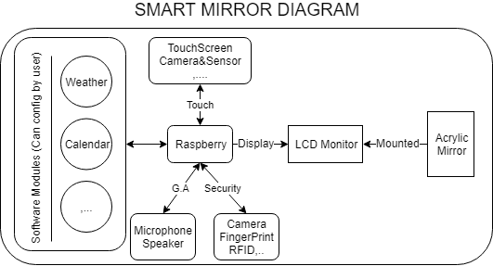

Slide 4
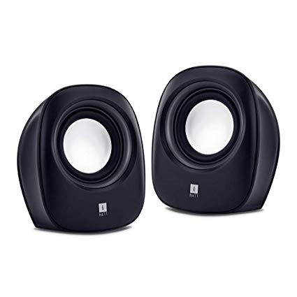
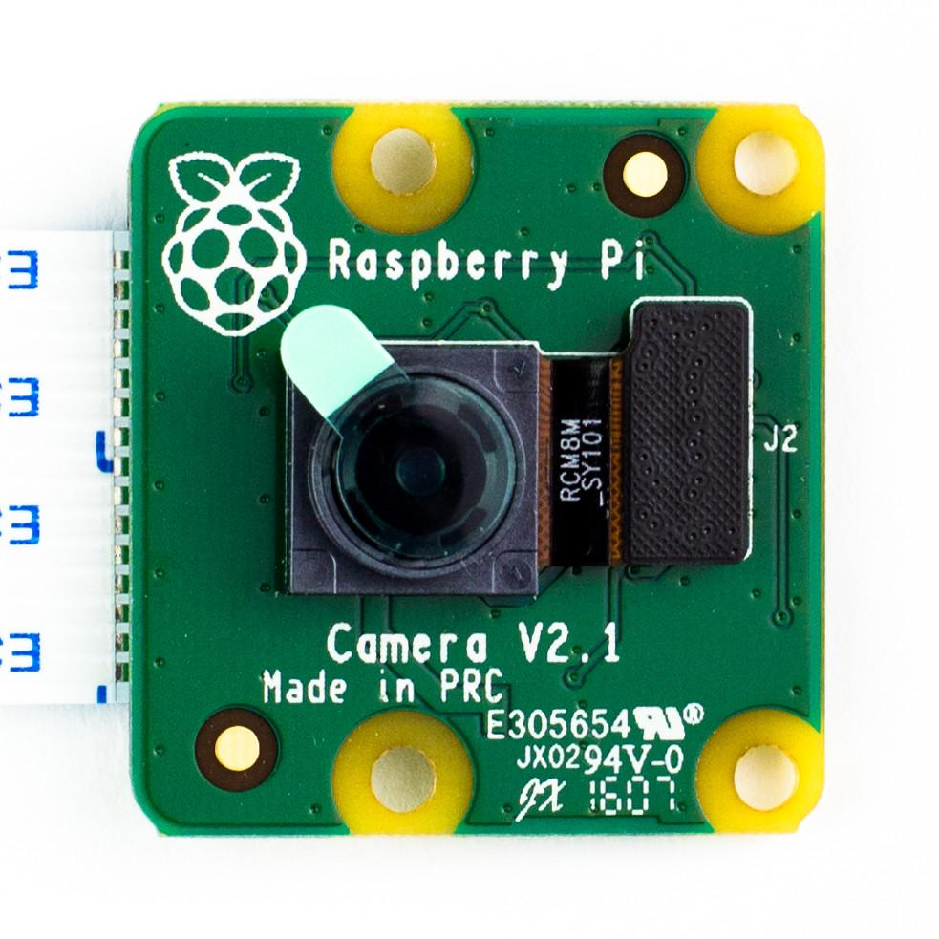
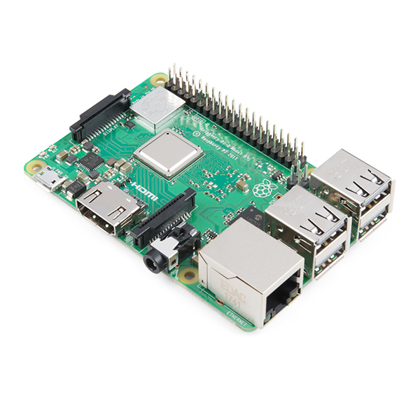
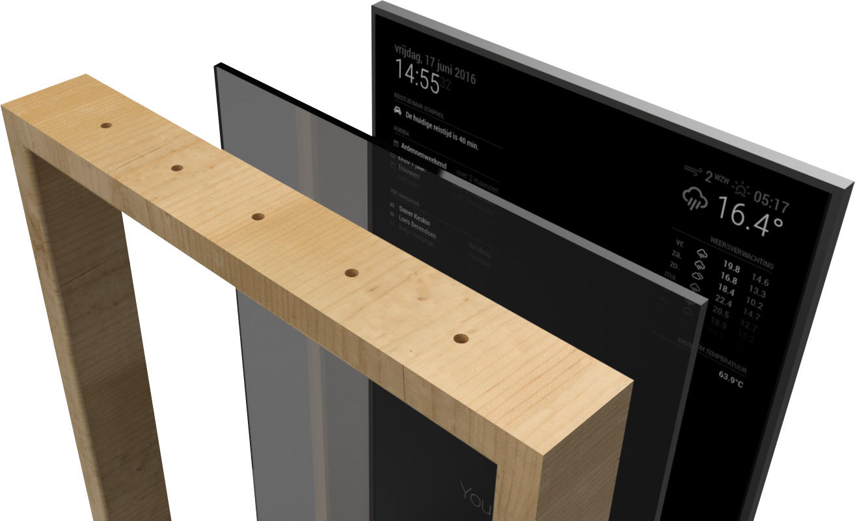
HARDWARE

Slide 5
SOFTWARE
SMART MIRROR | COMPUTER VISION | API EXTENTION
SMART MIRROR PACKAGE | PYTHON | APACHE
NODEJS | OPENCV | MARIA DB
GIT | MACHINE LEARNING
GOOGLE ASSISTANT
THIRD PACKAGES

Slide 6
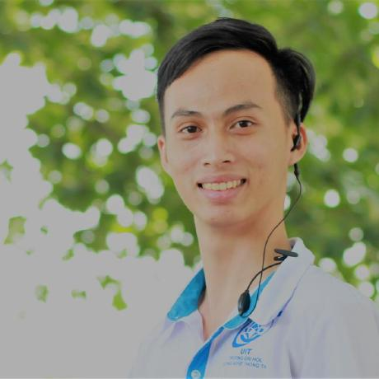
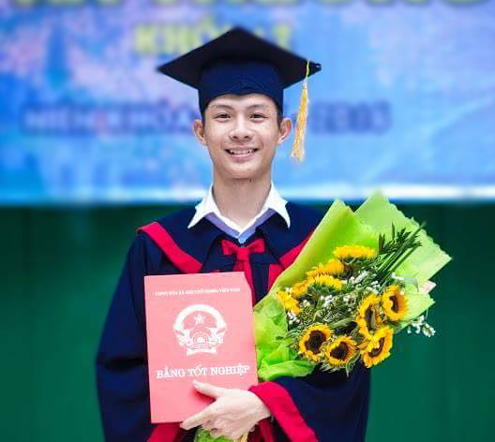
THE TEAM
Nguyen Luong Duy Khanh
Tong Anh Quan
16520584
16520985

Slide 7
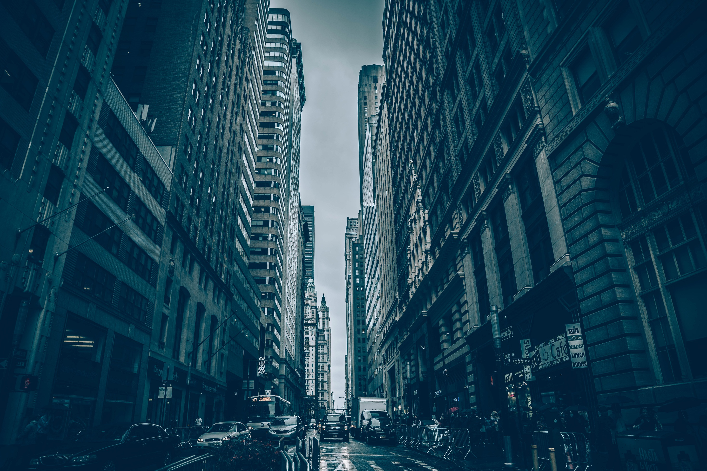
THANK YOU!

