Slide 1
Chipathon Design Specification
Block ORCA_TOP
Cuong Truong, Thuc Nguyen
Monday, July 01, 2025

Slide 3
List Of Documents
Library Information
Design Specifications
Flow Usage Guideline
Implementation Guideline
Requirements

Slide 4
1. Library Information
SAED 32/28nm Educational Design Kits

Slide 5

Introduction
The libraries used in this project is SAED32/28nm - The Synopsys Generic Library.
This library enable students to master advanced design methods, for low power, IoT, and automotive applications using the latest Synopsys EDA tools. The generic library is designed for educational and training purposes only and not for fabrication. Each library includes digital and I/O standard cell libraries, memories, phase-locked loops, technology kits and some sample designs. The libraries are also compatible with ARM® Cortex®-M0 DesignStart™ Processor, and OpenSPARC T1.

Slide 6
Library General Information

Slide 7
Library General Information

Slide 8
2. Design Specification
Block ORCA_TOP

Slide 9
Design Statistics

Slide 10
Design Clocks

Slide 11
Design Clocks

Slide 12
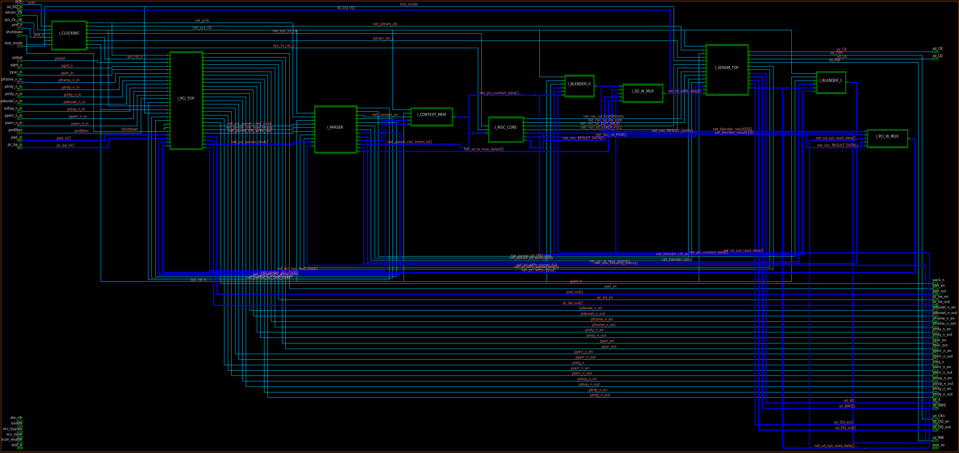
Block Diagram

Slide 13
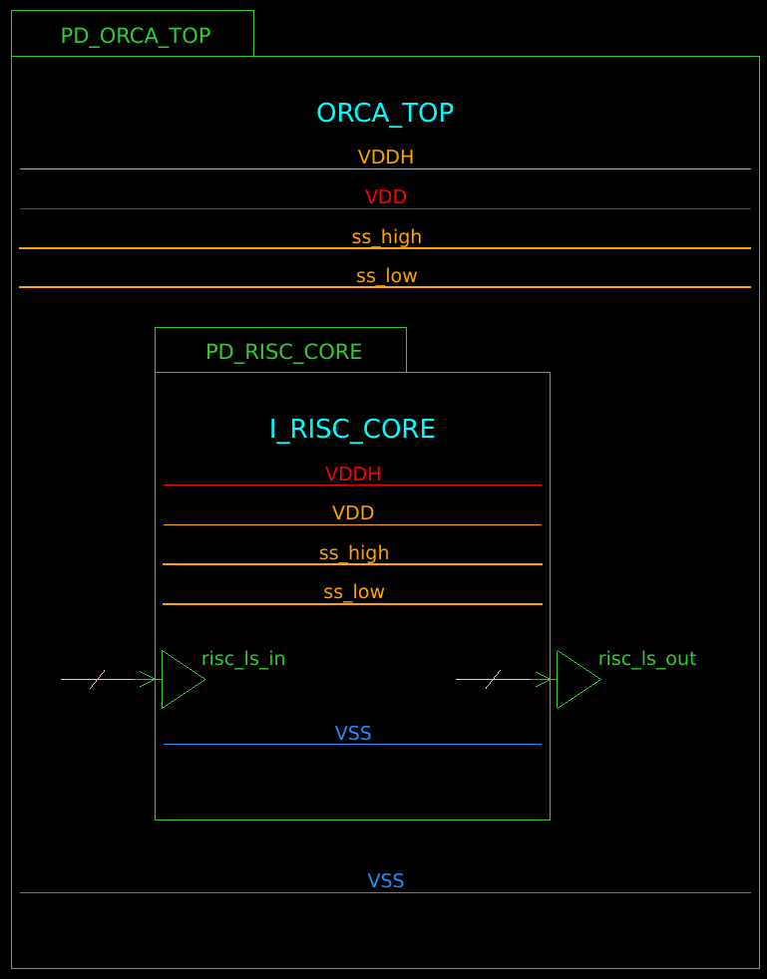
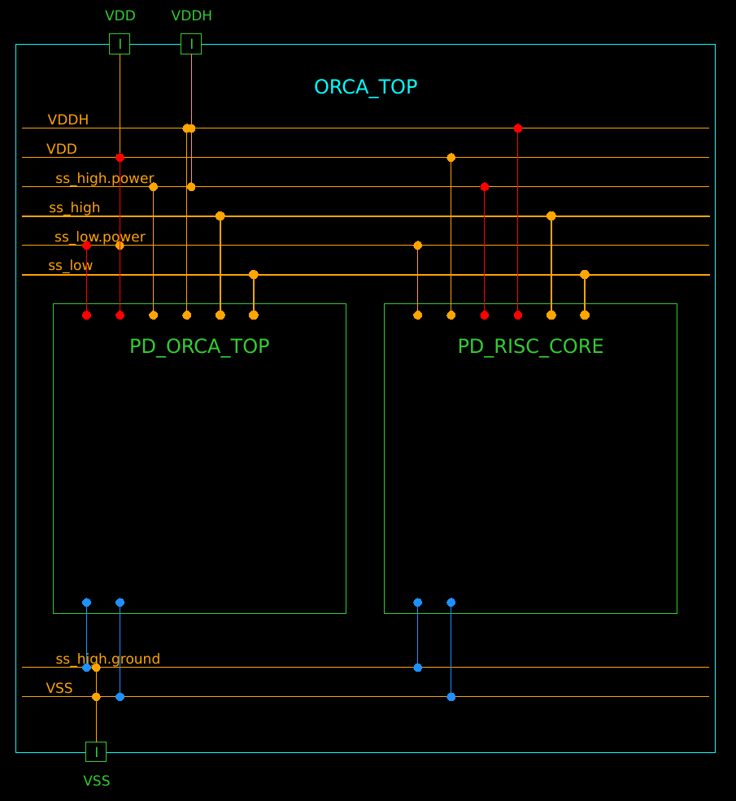
Power Diagram

Slide 14
3. Flow Usage Guideline
Flow ITP25_Custom0.1

Slide 15
Flow Structure
Workspace
Main Directory
Lab_Data_Ver*
Inputs Storage
Run Directory No. 1
Trial 1
Run Directory No. 2
Trial 2
Run Directory No. <n>
Trial <n>
…
run.csh
main run script
<index><step>
sub_dir for every steps

Slide 16
Flow Structure
<index><step>
Sub-Directory
reports
Report Dir
logs
Log Dir
outputs
Output Dir
nlib
Design Library
main script
<step>.tcl
proc script
user_proc_define.tcl
Note:
The main Script will be sourced into tool execution terminal. Example: place_opt.tcl
The Proc Script defines the procs called inside the Main Script for settings or optimization purpose.

Slide 17
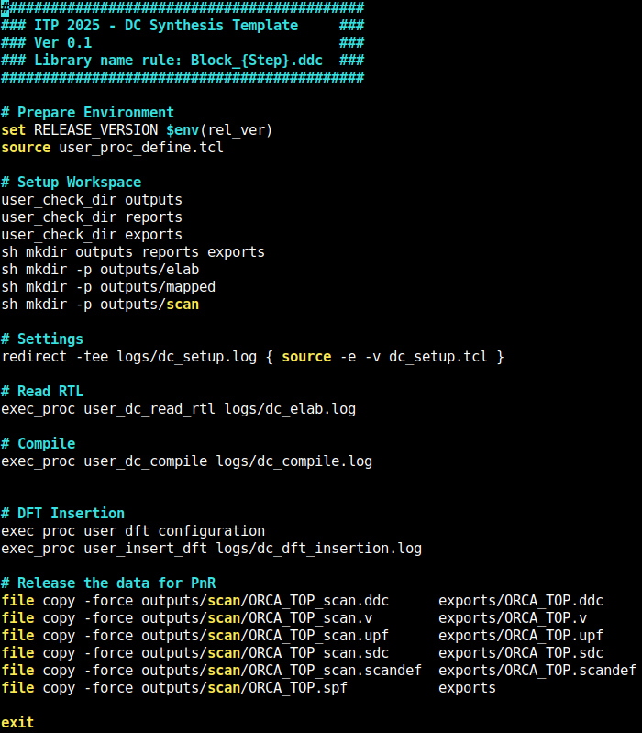
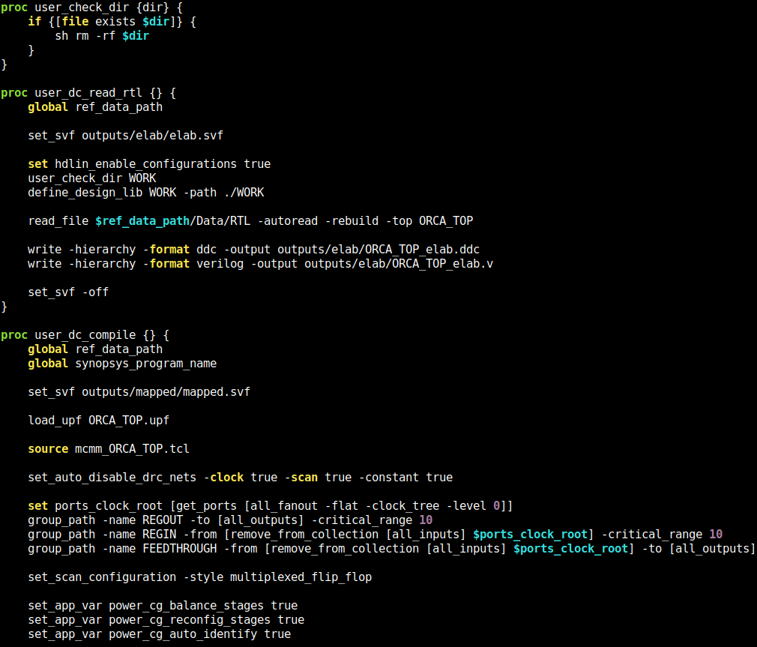
Script Structure
Main Script
Proc Script
Script Header
Script Body
Script Footer

Slide 18
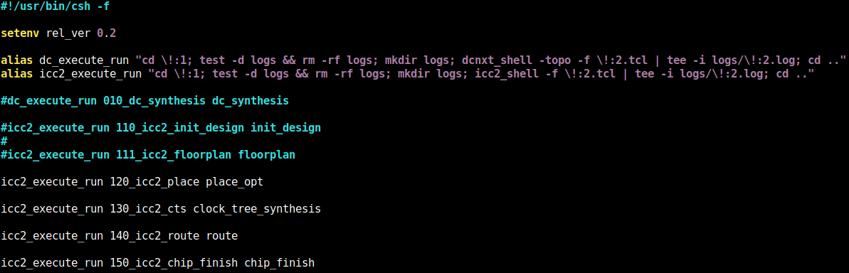
Run Multiple Steps
run.csh
Select which steps need to be executed
In Unix, execute ./run.csh

Slide 19
4. PnR Guideline
Guideline for setting to implement block ORCA_TOP

Slide 20
Routing Rules

Slide 21
Non-Default Rules For CTS

Slide 22
Placement Guideline – place_opt
Scenarios: test.ss_125c; func.ss_125c; func.ss_m40c
Using lib cells */TIE* for optimization
Don’t touch nets: sd_DQ_out[*]; sd_CK*
Don’t touch cells: I_SDRAM_TOP/I_SDRAM_IF/sd_mux_*
Bound: create a hard bound size 50x100 for snps_OCC_controller cell

Slide 23
CTS Guideline – clock_opt
Scenarios: All
CTS Lib Cells: */NBUFF*LVT; */NBUFF*RVT; */INVX*_LVT; */INVX*_RVT; */CG*; */AOBUFX*_LVT; */AOINV*; */*DFF*
Don’t use Lib Cells: */DFFARX*_HVT; */DFFNARX*_HVT; */SDFFARX*_HVT; */SDFFNARX*_HVT
Don’t touch cells: I_SDRAM_TOP/I_SDRAM_IF/sd_mux_*; I_CLOCKING/sys_clk_in_reg
Set driving cell for ports ate_clk by lib cell NBUFFX16_RVT

Slide 24
CTS Guideline – clock_opt
Scenarios:
CTS Lib Cells: */NBUFF*LVT; */NBUFF*RVT; */INVX*_LVT; */INVX*_RVT; */CG*; */AOBUFX*_LVT; */AOINV*; */*DFF*
Don’t use Lib Cells: */DFFARX*_HVT; */DFFNARX*_HVT; */SDFFARX*_HVT; */SDFFNARX*_HVT
Don’t touch cells: I_SDRAM_TOP/I_SDRAM_IF/sd_mux_*; I_CLOCKING/sys_clk_in_reg
Set driving cell for ports ate_clk by lib cell NBUFFX16_RVT

Slide 25
5. Requirements
List of requirements for this project

Slide 26
Requirements need to complete by block owner

