Slide 2

Prediction of football player’s value
Group 14
Nguyễn Nho Trung – 20204894
Hồ Minh Khôi – 20204917
Trương Quang Bình – 20200068

Slide 3


I.Introduction
Aim of our project
This project aims to help managers estimate player prices based on statistics about attributes of player and their performance in the 2021-2022 season.

Slide 4
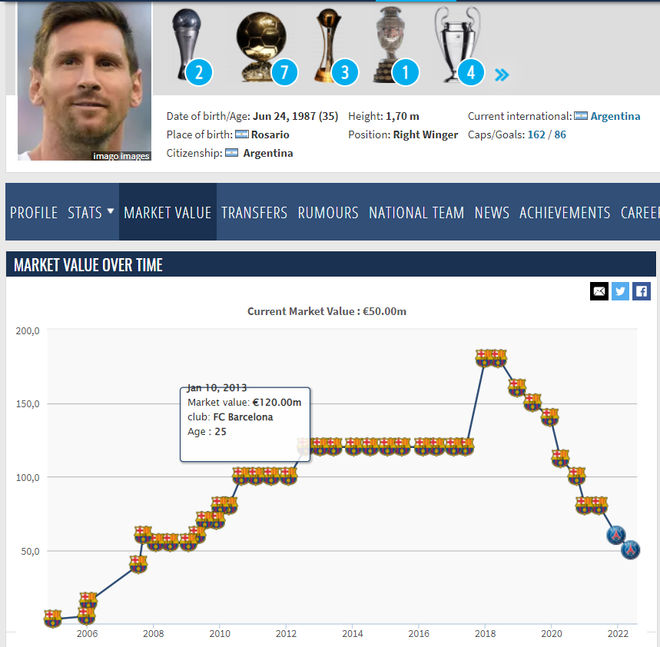
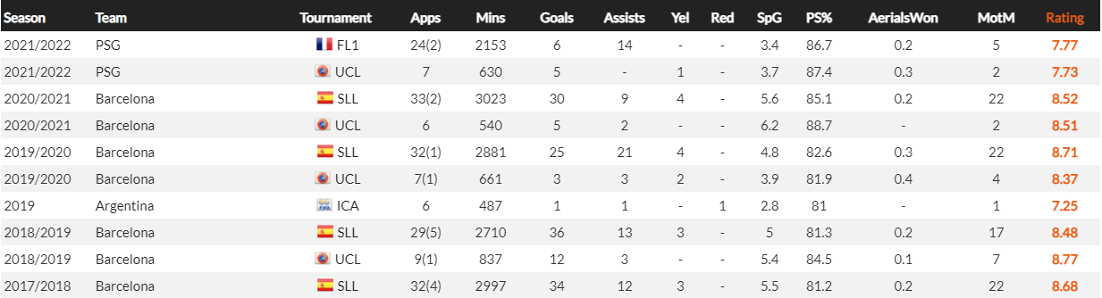
II.Dataset
First dataset: Combination of 2 sub-datasets:
- General data of players’ transfer value from past seasons, crawled from Transfermarkt, available on Kaggle
Detailed history of player performance, crawled using Selenium on Whoscored.
In total: 13891 records with 20 attributes
Main attributes are from Whoscored crawl data

Slide 5
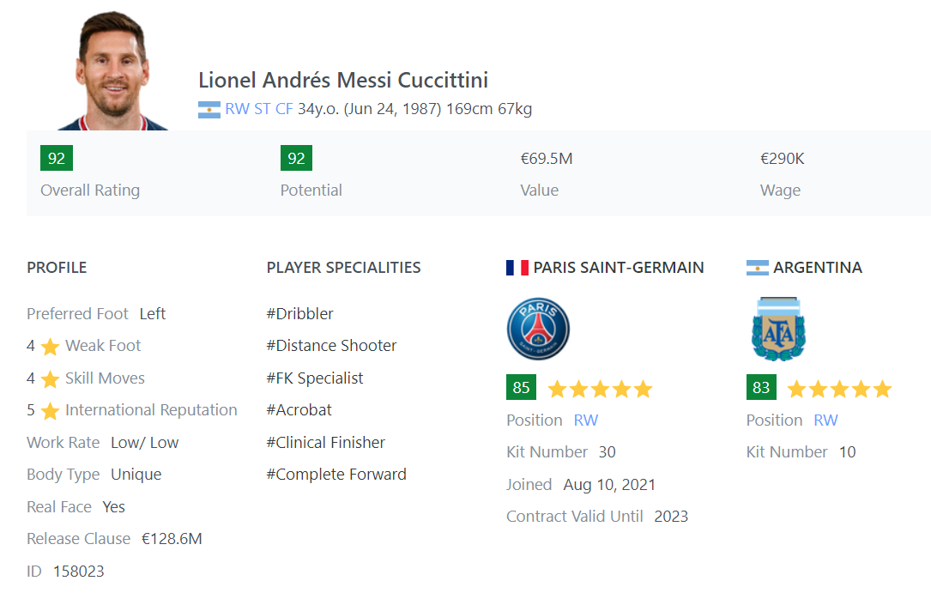
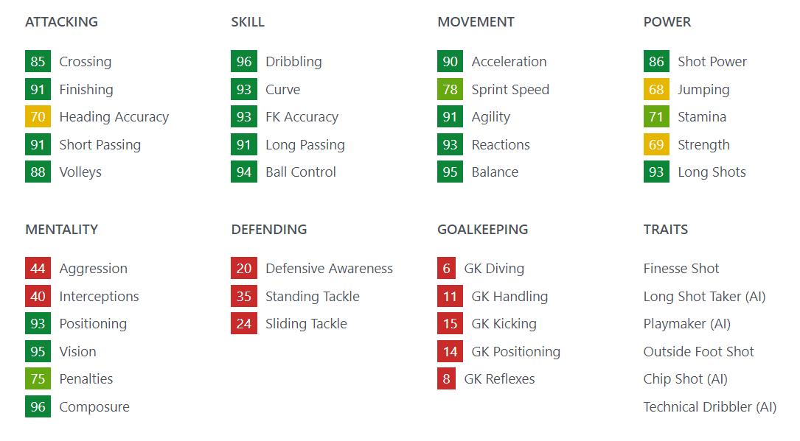
II.Dataset
Second dataset: It is also combined by 2 sub-dataset
- First sub-dataset: includes the attributes of each player. It includes name, overall, position, potential, preferred_foot, value, wage, club, best_position, age, volleys, vision, strength, standing_tackle, stamina, Sprint_Speed, Sliding_Tackle, Skill_Moves, Shot_Power, Short_Passing, Reactions, Positioning, Penalties, Marking, Long_Shots, Long_Passing, Jumping, ...
This dataset crawled from SoFIFA website using Scrapy.
- Second sub-dataset: It has many statistics about the performance of the players in the season 2021-2022 that important for model: Players, MP (Matches played), Min(Minutes played), Goals, Assists, CrdY, CrdR, Comp (name of league), Shots.
This dataset is available on Kaggle.

Slide 6
Integration data and data cleaning (1)
For sub-dataset from Transfermarkt on Kaggle:
- Firstly, we need to remove irrelevant data, keeping only players currently playing in the top 5 leagues.
- Since the Kaggle dataset is splitted into 7 tables, and our necessary data consists of 4 of them, we need to concatenate those 4.
- The value of each player is evaluated multiple times per year, thus we need to filter the value measured at the end of each season or summer break (usually from May to September).
For sub-dataset from Whoscored:
- Since the players’ statistics we crawled are divided into competitions, we need to sum them up into annual data.
- Format of the columns are string, so firstly they need to be numerically converted and replace null values by 0.
- Rating of the players are recalculated as average rating per match. Rating value is based on in-match performance of the player. Starting at 6.0, if a player performs a “good” action, for example scoring a goal, the rating increases and vice versa.
Two tables were joined by simplified form of players’ name

Slide 7

Integration data and data cleaning (2)
- Removed duplicated records in 2 datasets.
2 duplicated records removed in first dataset and 136 duplicated records removed in second dataset.
Join 2 tables based on player’s name in 2 tables: 2 full names taken from 2 tables are the same if: we have at least 2 similar words in any 2 full names of 2 tables, then those 2 full names are full name of a player.
Check missing values: Don’t have missing values.
Obtain LCB, CDM, LB, LM, LDM, RB, RCB, LS, LCM, RCM, RM, LWB, RDM, ST, CM, RW, RS, GK, CAM, RWB, RF, LF, CB, LAM, CF, LW, RAM positions.
we will convert these positions into 4 positions in common, including: goalkeeper, defender, midfielder, striker.
- Process with value and wage columns: These columns contain special characters
- Removed redundant columns that are not relevant in the predictive model. We obtained 2002 records.

Slide 8
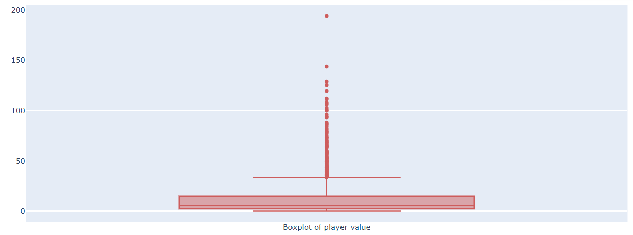
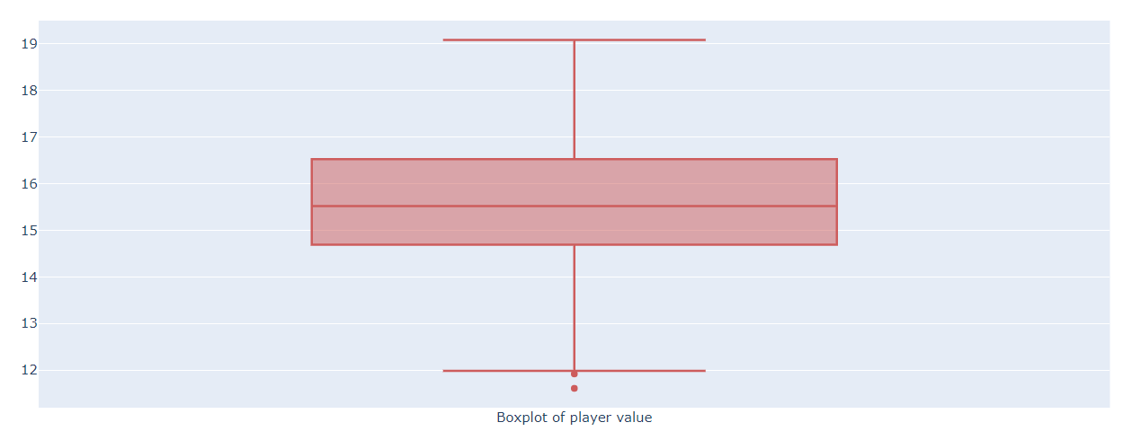

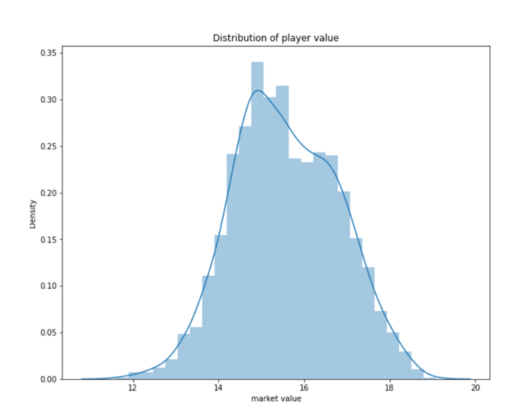
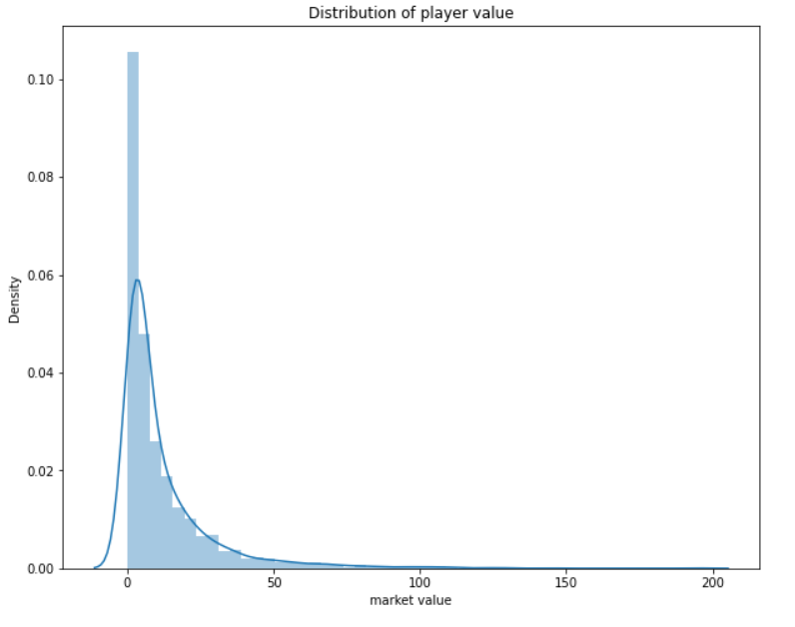
Exploratory data analysis (Market value)

Slide 9
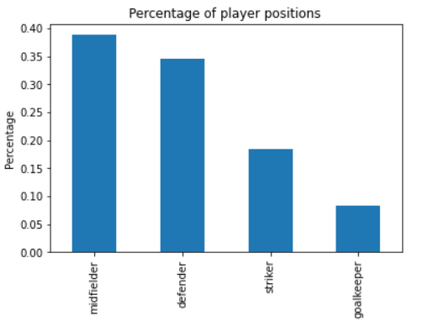
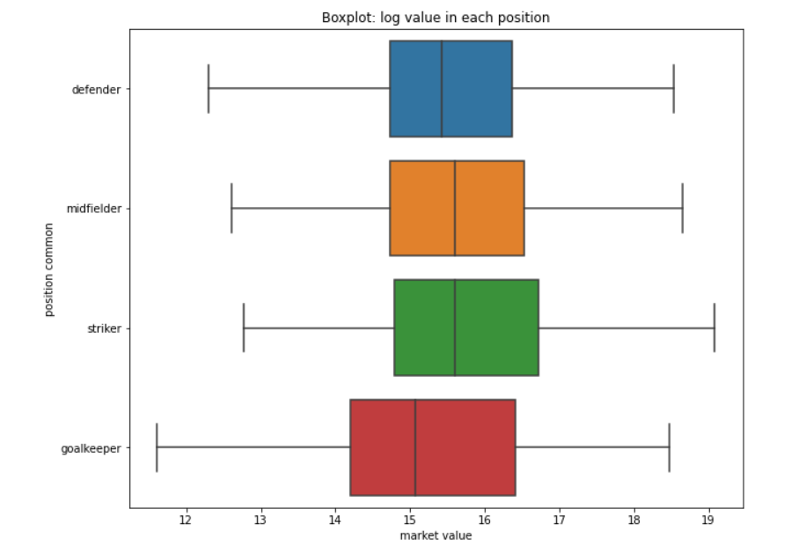
Exploratory data analysis (Position)

Slide 10
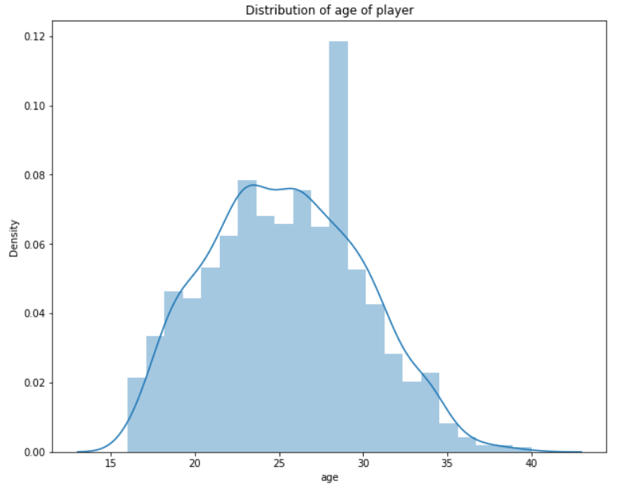
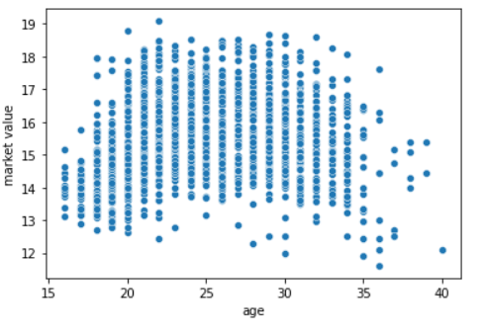
Exploratory data analysis (Age)

Slide 11
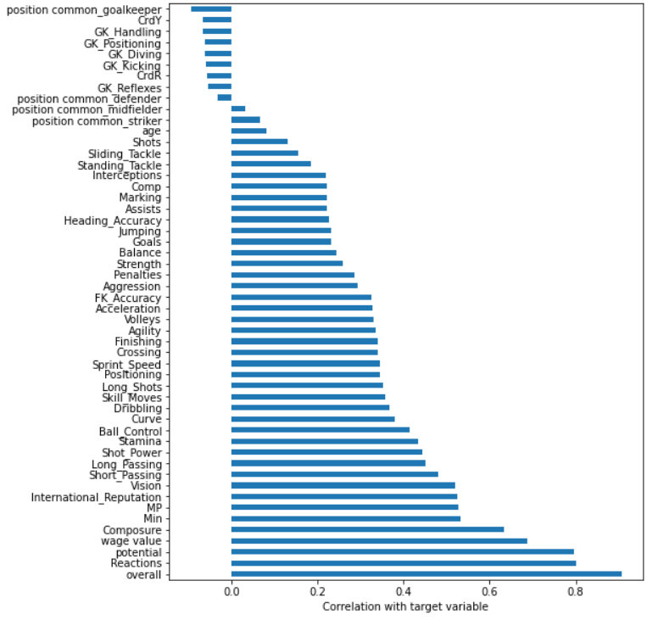
Exploratory data analysis (Correlation)
Correlation between independent variables and target variables:

Slide 12
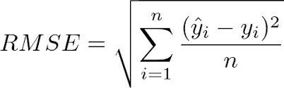
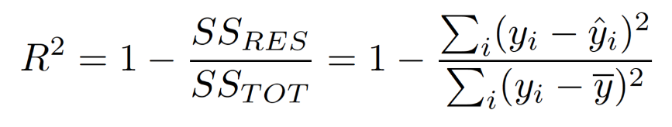
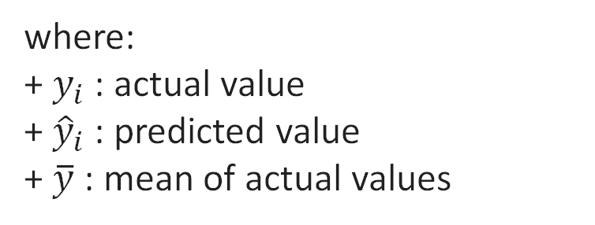
III. Metric for evaluation models
In this project, we use 2 metrics for evaluation models, namely root mean squared error and R2 score:
- Root mean squared error:
- R2 score:
where:
+ $y_{i}$ : actual value
+ ${\hat{y}}_{i}$ : predicted value
+ $\overline{y}$ : mean of actual values

Slide 13
IV. Pre-processing and Split Train- Test(First dataset)
Pre-processing:
Creating new features in the following pattern:
From number of appearances and minutes played, get a feature of how much a player is fully played
Number of goals/assists/MotM per match
Percentile of each feature in the whole dataset
For the hypothesis that a player’s prime age is 28, a feature also measure how far is that player from his prime
We then split the data set into 4 positions, and use Spearman Correlation to select the best features to our model.
Train- test split:
In each set, data is split into training set (¾) and test set (¼).

Slide 14
IV. Pre-processing and Split Train- Test(Second dataset)
Pre-processing:
Convert category columns into numeric columns:
+ Comp column (name of league) : use ordinal encoder
+ position common(it includes goalkeeper, defender, midfielder, striker): we use one-hot encoder.
- Drop columns that haven’t related in build model: name and preferred_foot columns.
- Feature scaling( just use for KNN – Lasso – Ridge) : use standardization for independent variables.
Train- test split:
2/3 dataset used for training ( 1336 records)
1/3 dataset used for testing (667 records)

Slide 15
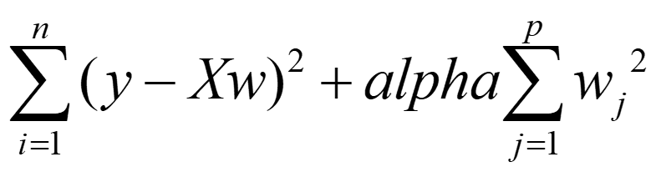
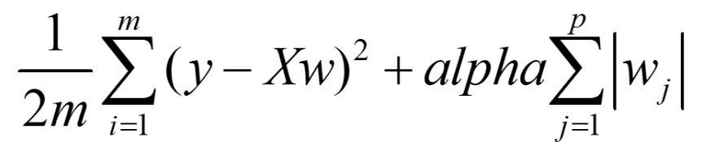


V.Building model (First dataset)
Ridge:
Lasso:
ElasticNet: combination of Ridge & Lasso
Regularization/penalty term:
+ Limits the size of w*
+ Helps us to trade off between the fitting of f on D and its generalization on future observations.

Slide 16
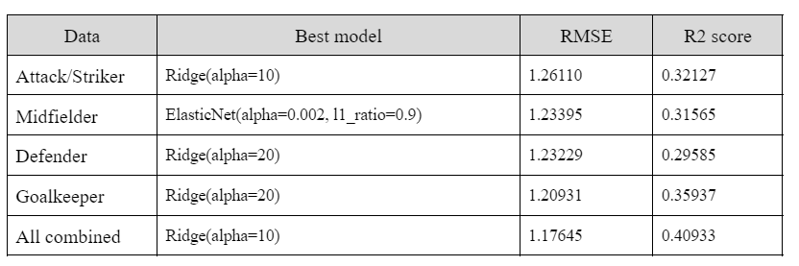
V.Building model (First dataset)
Results:

Slide 17
V.Building model (Second dataset)
K nearest neighbors:
Main idea: Prediction for x based on K nearest neighbors of x
Two key ingredients:
+ How many neighbors are enough?
+ Similarity measure: Minkowski, Manhattan, Euclidian, Chebyshev
Decision Tree:
To represent a function by using a tree.
Avoid overfitting:
+ Stop learning early: prevent the tree before it fits the training data perfectly.
+ Prune the full tree: grow the tree to its full size, and then post prune the tree.

Slide 18
V.Building model (Second dataset)
Random forest:
Main idea: Prediction is based on a combination of many decision trees, by taking the average of all individual predictions
Three basic ingredients:
- Randomization and no pruning:
+ For each tree and at each node, we select randomly a subset of attributes.
+ Find the best split, and then grow appropriate subtrees.
+ Every tree will be grown to its largest size without pruning.
- Combination: each prediction later is made by taking the average of all predictions of individual trees.
- Bagging: the training set for each tree is generated by sampling (with replacement) from the original data.

Slide 19




V.Building model (Second dataset)
Ridge:
Lasso:
K nearest neighbors:
Decision Tree:
Random forest

Slide 20
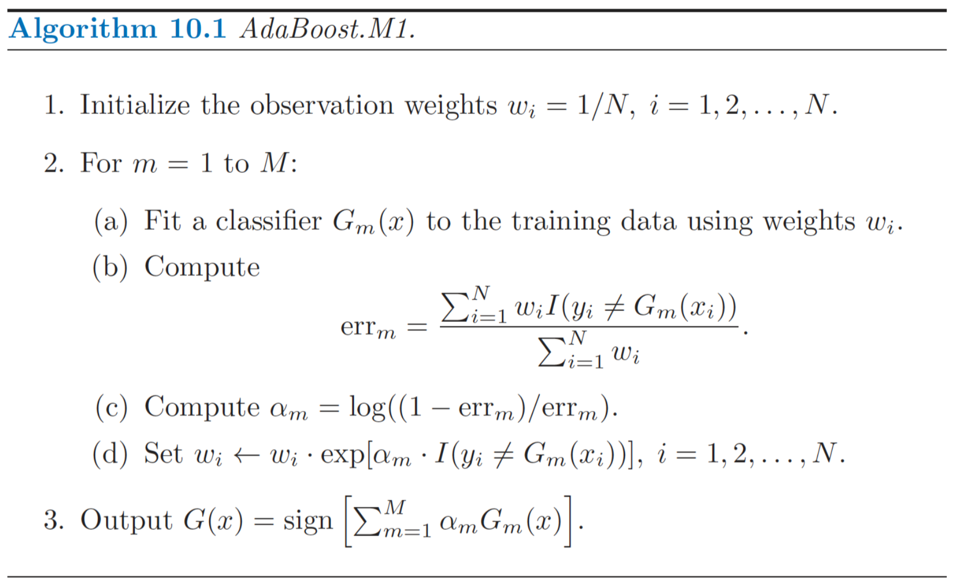

V.Building model(Second data)
AdaBoost:
=> Result:

Slide 21
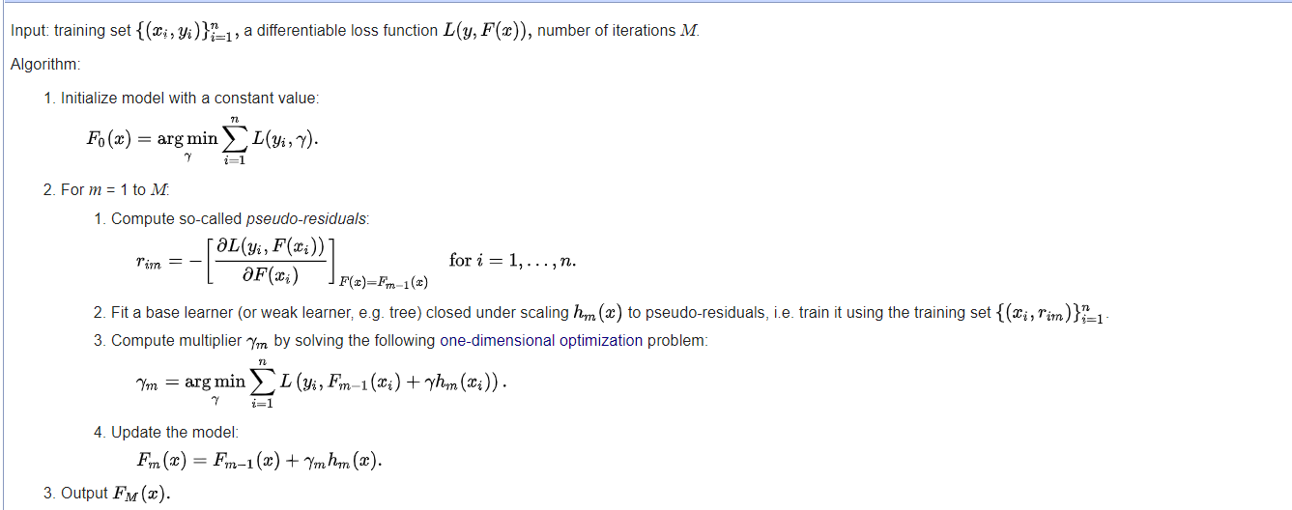
V.Building model(Second data)
Gradient Boosting:
- A gradient-boosted model is built in stage-wise fashion as in other boosting methods. But it generalizes the other methods by allowing optimization of an arbitrary differentiable loss function.
Generic gradient boosting method:

Slide 22


V.Building model(Second data)
XGBoost:
- XGBoost is an open-source software library which provides a regularizing gradient boosting.
- Many great features: Clever penalization of trees, a proportional shrinking of leaf nodes, Newton Boosting, Extra randomization parameter, implementation on single, distributed systems, and out-of-core computation, automatic feature selection.
=> Result :
LightGBM:
LightGBM doesn’t grow a tree level-wise , instead of it grows trees leaf-wise. It chooses leaf that will yield the largest decrease in loss.
The LightGBM algorithm utilizes two novel techniques called Gradient-Based One-Side Sampling (GOSS) and Exclusive Feature Bundling (EFB) which allow the algorithm to run faster while maintaining a high level of accuracy
=> Result :

Slide 23
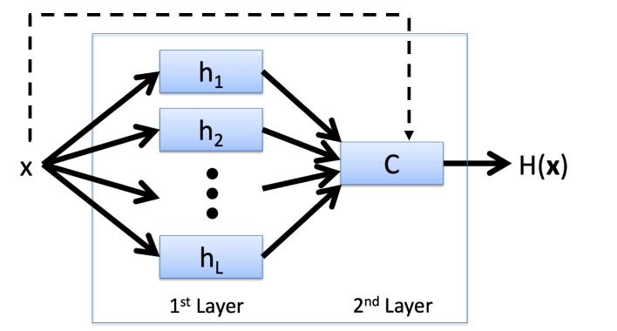

V.Building model(Second data)
Stacking:
Layer 1: Lasso, Ridge, Decision Tree, Random Forest.
Layer 2: XGBoost for hyperparameter tuning
Result:

Slide 24
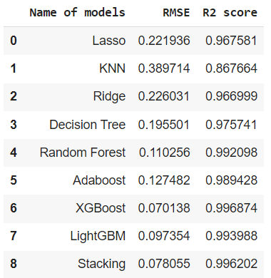
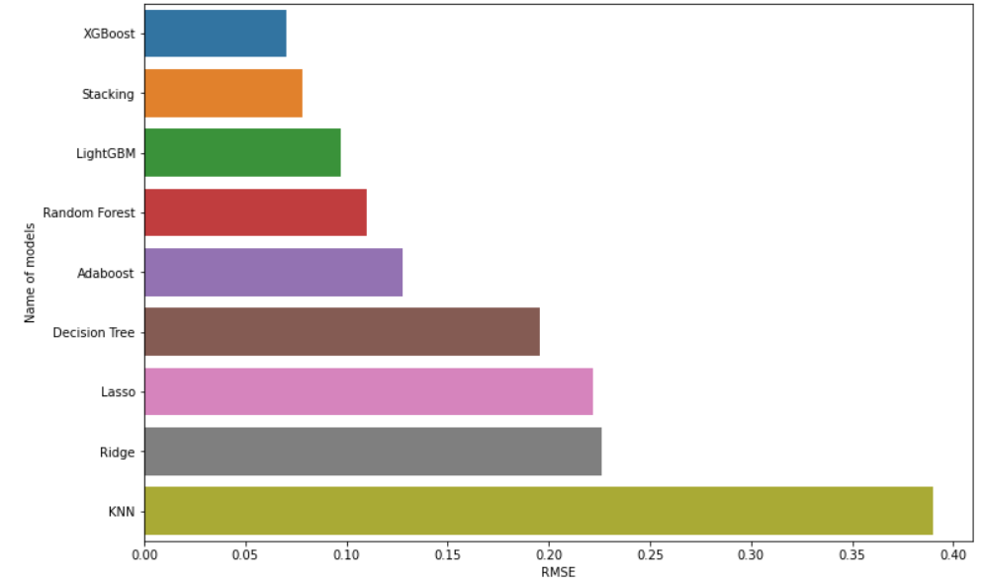
VI.Summary results

Slide 25

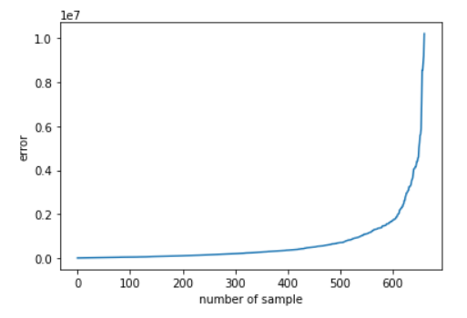
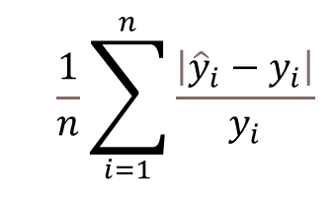
VII.Analysis with best model: XGBoost
Because we used log transformation technique for market value variables, we need to evaluate actual values with best model.
Result:
Plot error:
New metric: calculate the percentage of error of player prices:
Result:
If a player is really worth 100 million euros, our best model would predict that player's value between 100 - 5.4 million euros to 100 + 5.4 million euros.

Slide 26

VIII.Future
Apply our models to data for all players in the world, not just the top 5 European leagues.
More accurate models
More features should be considered in the model and data, such as contract deadline, contract fee, advertisement of players, players’ fame…
The model should be extended to other sports, such as basketball

Slide 27
THANK YOU !

