Slide 1
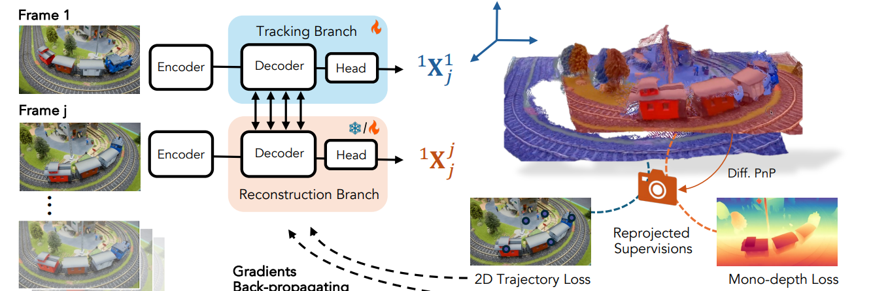
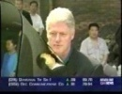
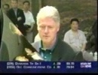




























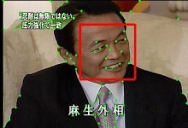
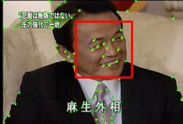
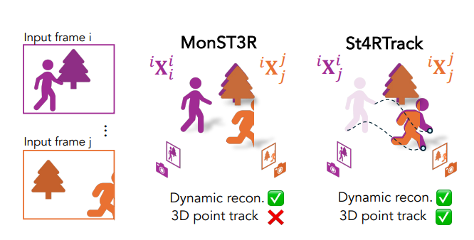
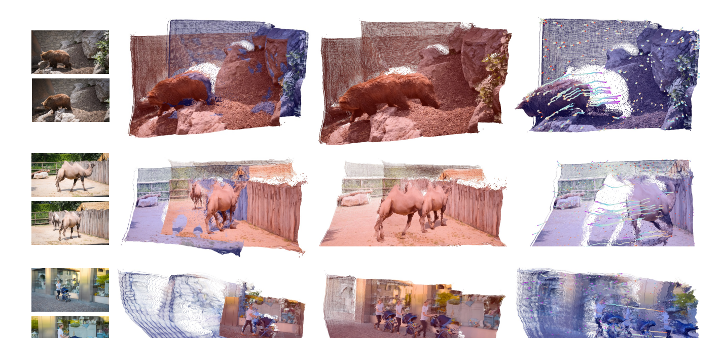
















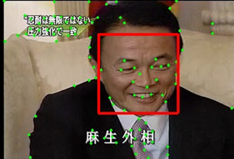
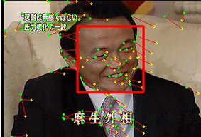
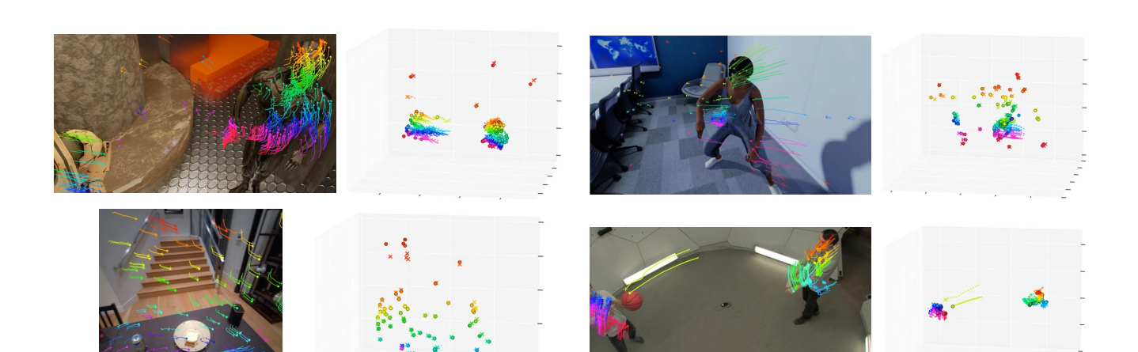




St4RTrack: Tái tạo & theo dõi 3D
Nguyễn Phạm Phương Nam
Hồ Ngọc Luật
University of Information Technology
HCMC, VietNam
What?
Why?
• Feed-forward: nhận (Frame 1, Frame j) ⇒ 2 pointmap.
• Tracking: X¹ⱼ = điểm Frame 1 tại thời điểm j.
• Recon: Xʲⱼ = hình học Frame j tại thời điểm j.
• Ghép theo j ⇒ world-frame 3D tracks dài hạn.
• Cảnh động ⇒ khó tách camera/scene motion.
• World-frame tracking: tách camera motion vs scene motion.
• Adapt video thật (không nhãn 4D): PnP khả vi + reprojection
(2D tracks + mono-depth + 3D consistency).
Overview of St4RTrack
Face Detection
Face-Track Extraction
Face-Track Matching
Face-Track X
Face-Track X and Z belong to one person
Face-Track Y
Face-Track Z
Details & Results
1) Biểu diễn 4D thống nhất
2) Học & thích nghi (không nhãn 4D)
3) Kết quả
1. Face Detection
2. Face-Track Extraction
Frame 3014
Frame 3015
Frame 3016
Pointmap có thêm yếu tố thời gian:
ᵃXᵇ_t = nội dung frame b tại thời điểm t,
trong hệ toạ độ của frame a.
Dự đoán: (X¹ⱼ, Xʲⱼ).
We used Kanade–Lucas–Tomasi (KLT) method to create and track key/interest points between frames.
The face detector implemented in OpenCV based on Viola method was used for detecting frontal views of faces in every frame of our video sequences.
Pretrain (synthetic 4D):
• Tracking: mesh vertices (world).
• Recon: depth + camera GT.
Suy ra camera frame j:
• K (DUSt3R), pose (Rⱼ,Tⱼ) bằng PnP+RANSAC (khả vi).
TTA / self-supervision (video thật):
• L_traj: reprojection khớp 2D tracks (CoTracker).
• L_depth: khớp mono-depth (MoGe), scale-invariant.
• L_align: consistency 3D giữa X¹ⱼ và Xʲⱼ.
Khi test: thường chỉ fine-tune tracking branch.
A high threshold was used to reduce the number of false positives.
The number of key points that pass through pairs of faces in consecutive frames was computed to make decision on grouping faces into face-tracks.
Input:
- Pair of consecutive frames.
- Face detection.
- List of key points.
UPDATE
Several treatments are proposed to handle tracking traps in news video.
Remove
flash-frames
Track
points
Group faces
into face-tracks
Re-generate
lost points
Flash-frame detector.
Adaptively generating key points.
Khác MonST3R: dự đoán “điểm frame 1 ở thời điểm j”
⇒ có correspondence theo thời gian (3D tracks)
⇒ world-frame tracking dài hạn.
Face
Track
Face-Track X
Định tính: tích luỹ reconstruction/tracking
⇒ track dày đặc dài hạn trong world frame.
Face-Track Z
Face-Track Y
Figure 2. Process-flow of face tracker.
Min-Min
distance
Figure 1. Detection results with a high threshold.
3. Face-Track Matching
Face-track matching is done by applying similarity estimation methods (e.g. Min-Min distance) on the feature space.
^{Feature Space}
Figure 3. Key/Interest points (plotted as green dots) in the left frame are tracked in the right frame. Small lines from green dots are motion of these points. Two faces in these frames share 22/23 points.
Figure 4. Apply Min-Min method for face-track matching.
Notes:
1

