Slide 1
MCU Modeling - Gitlab CI/CD
MAR 2023 – PHAM NHAT TRUONG

Slide 2
Agenda
I. Overview CI/CD
What is CI/CD ?
Why is CI/CD necessary ?
CI/CD tools
Gitlab CI/CD
II. CI/CD pipeline
What is a CI/CD pipeline ?
III. Gitlab CI/CD
What is a Gitlab CI/CD ?
Why use Gitlab CI/CD ?
What should you need to use Gitlab CI/CD ?
How to write a YAML file ?
How to connect Gitlab with Node ?
Register Gitlab Runner
Gitlab CI/CD of ETVPF Project
IV. Building a CI/CD pipeline
Create .gitlab-ci.yml file in Gitlab source
Run pipeline
Build job
V. Demo build a CI/CD pipeline

Slide 3
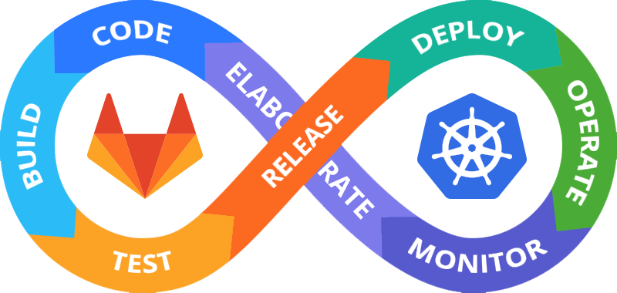
I. Overview CI/CD
What is CI/CD ?
Continuous integration, delivery, and deployment is known collectively as CI/CD.
CI/CD essentially involves continuously building, testing, and deploying code changes at every small iteration, reducing the chance of developing new code based on bugged or failed previous versions.

Slide 4
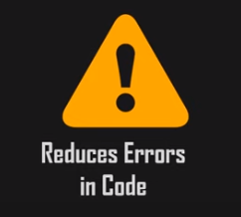

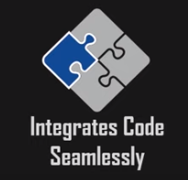
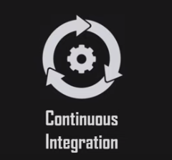
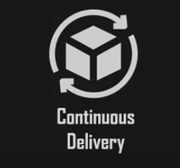
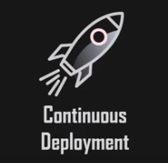
I. Overview CI/CD
What is CI/CD ?
Continuous integration, delivery, and deployment is known collectively as CI/CD.
CI/CD essentially involves continuously building, testing, and deploying code changes at every small iteration, reducing the chance of developing new code based on bugged or failed previous versions.

Slide 5
I. Overview CI/CD
2. Why is CI/CD necessary ?
Increase Speed of Operation
Easier detection of Errors
Communication between Teams
Quicker Recovery
Regular Feedback
Better Efficiency
Frequent Development Cycles

Slide 6




I. Overview CI/CD
3. CI/CD tools

Slide 7
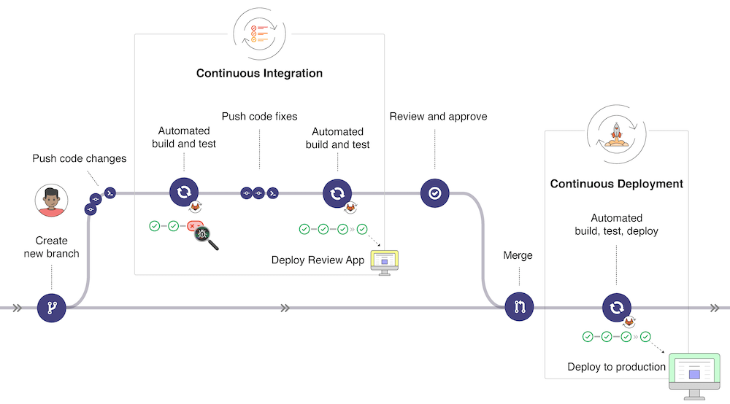
I. Overview CI/CD
4. Gitlab CI/CD

Slide 8

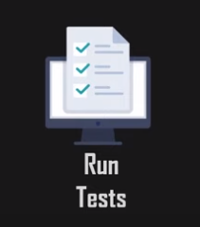
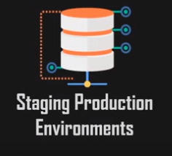
II. CI/CD Pipeline
1. What is a CI/CD pipeline ?
A pipeline automates a series of steps or stages in your development process such as initiating code builds, running tests, deploying and staging production environments, etc. It provides a more standardized approach to feedback loops, reducing errors and paces up iterations of development.

Slide 9
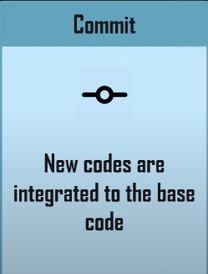
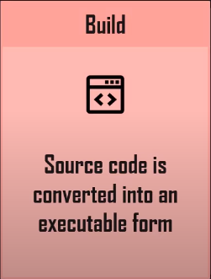
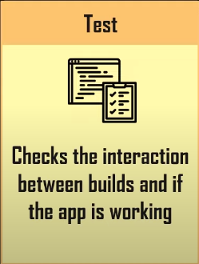
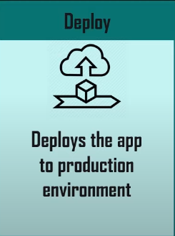
II. CI/CD Pipeline

Slide 10
III. Gitlab CI/CD
1. What is a Gitlab CI/CD ?
Gitlab CI/CD is a powerful tool build into Gitlab that allows you to apply Continuous Integration, Continuous Delivery, and Continuous Deployment to your software with no third-party application or integration needed.

Slide 11
III. Gitlab CI/CD
2. Why use Gitlab CI/CD ?
Higher Visibility
Wholesome CI-CD Solution
Easy Rollback of Changes
Automated Triggers

Slide 12
III. Gitlab CI/CD
3. What should you need to use Gitlab CI/CD ?
Application codebase hosted on Git
Sequentially defined scripts in a YAML file
YAML file in the root path of your Repo
Name of the file: .gitlab-ci.yml

Slide 13
III. Gitlab CI/CD
4. How to write a YAML file ?
What should the YAML file determine ?
Structure of the Pipeline
What steps to execute
Decisions to Conditions

Slide 14
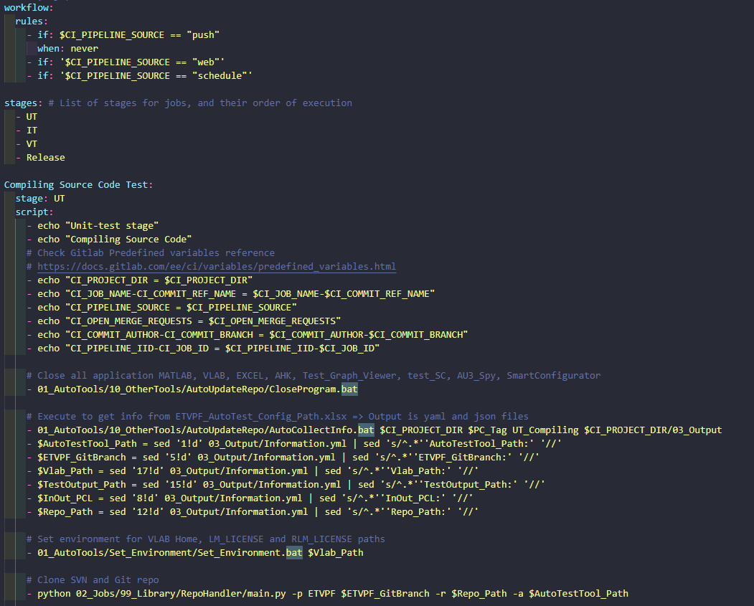
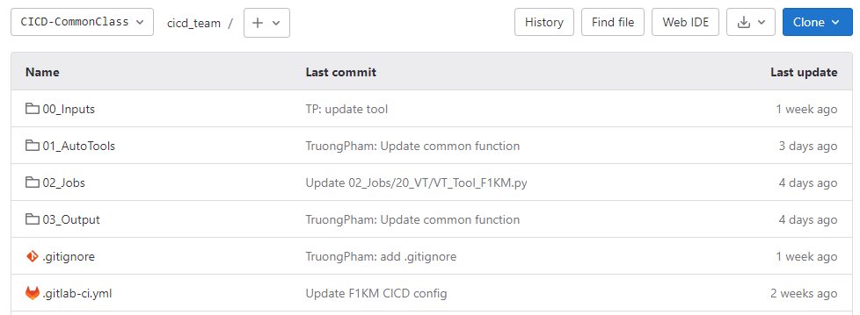
III. Gitlab CI/CD
4. How to write a YAML file ?
Gitlab CI/CD source code
File .gitlab-ci.yml

Slide 15
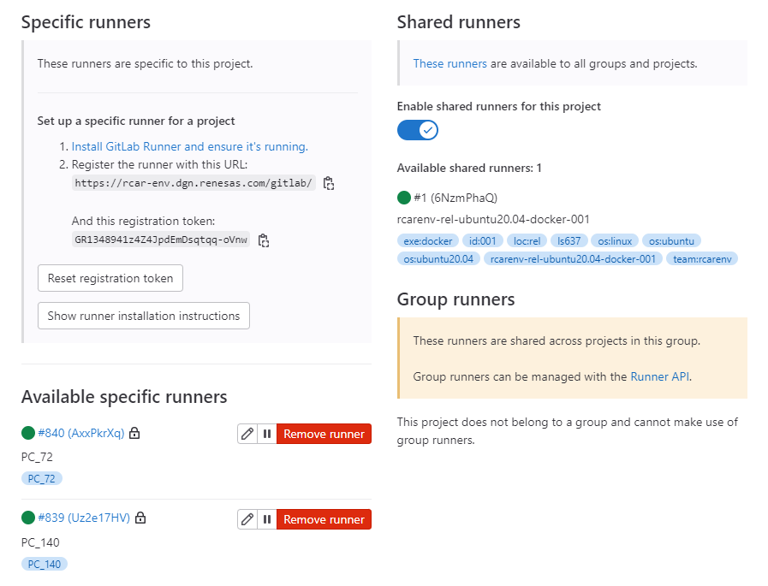
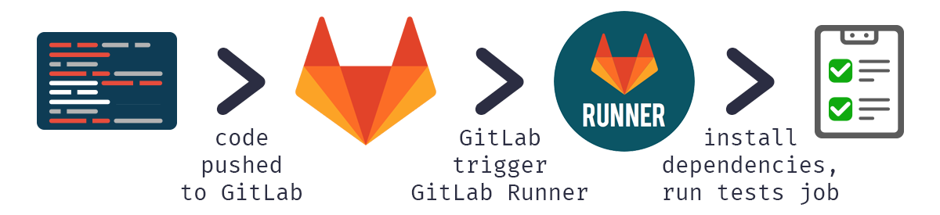
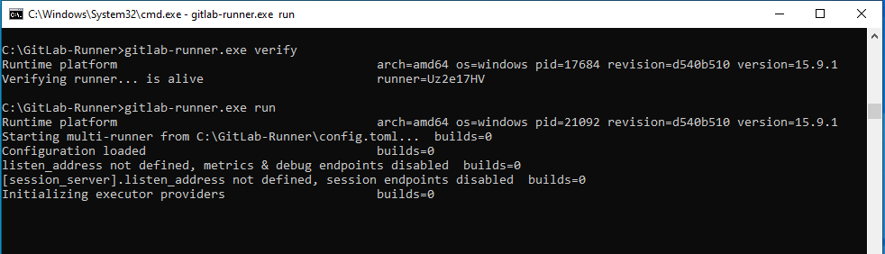
III. Gitlab CI/CD
5. How to connect Gitlab with Node ?
➔ Using Gitlab Runner

Slide 16
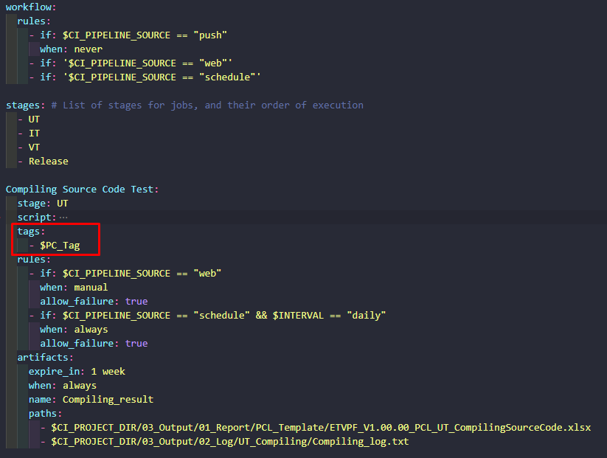
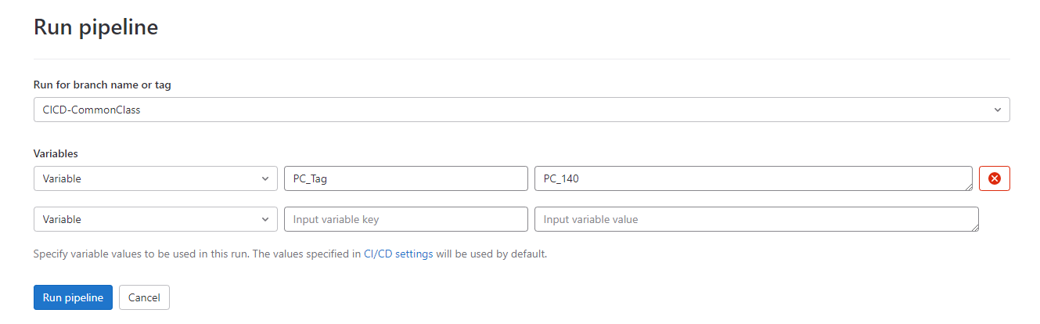
III. Gitlab CI/CD
5. How to connect Gitlab with Node ?
➔ In .gitlab-ci.yml file, using tags to connect with Gitlab Runner
Note:
With PC_Tag is Variables from user.
You can assign PC_140 in .gitlab-ci.yml instead of $PC_Tag

Slide 17
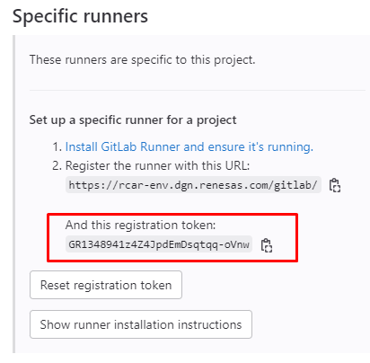
III. Gitlab CI/CD
6. Register Gitlab Runner
1. Run the following a command:
.\gitlab-runner.exe register
2. Enter your Gitlab instance URL (ex: https://rcar-env.dgn.renesas.com/gitlab/)
3. Enter the token you obtained to register the runner
4. Enter a description for runner. You can change this value in Gitlab user interface.
5. Enter the tags associated with the runner. You can change this value in Gitlab user interface.
6. Enter any optional maintenance note for the runner.
7. Provide the runner executor. For most use cases, enter shell
After that, you can run gitlab runner following a command:
.\gitlab-runner.exe run

Slide 18
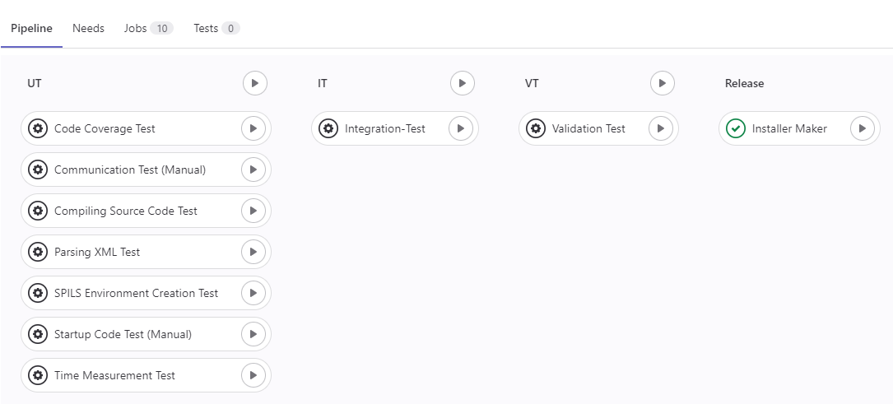
III. Gitlab CI/CD
7. Gitlab CI/CD of ETVPF Project
CI/CD of ETVPF Project: Pipeline

Slide 19
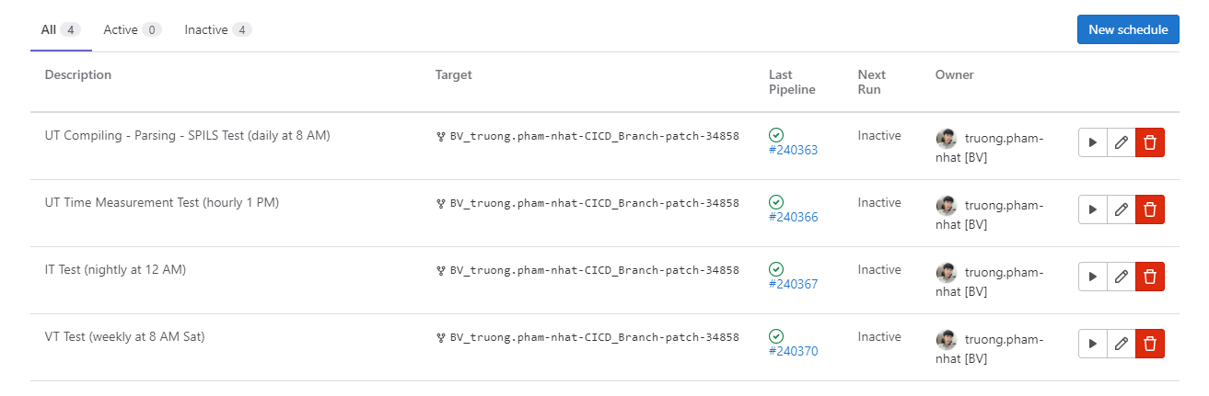
III. Gitlab CI/CD
7. Gitlab CI/CD of ETVPF Project
CI/CD of ETVPF Project: Schedules

Slide 20
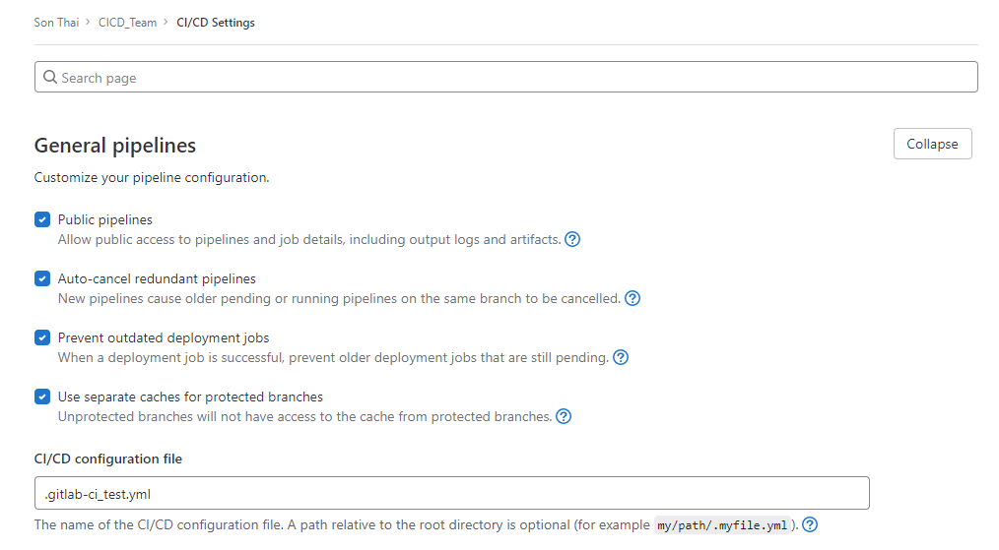
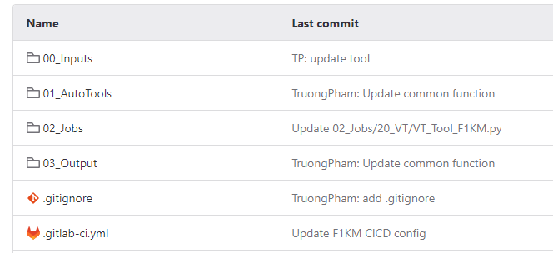
IV. Building a CI/CD pipeline
1. Create .gitlab1-ci.yml file in Gitlab source
Note:
.gitlab-ci.yml must be created in Gitlab project (same folder as .git file)
You can use another name for .gitlab-ci.yml by change CI/CD configuration file in Settings CI/CD

Slide 21
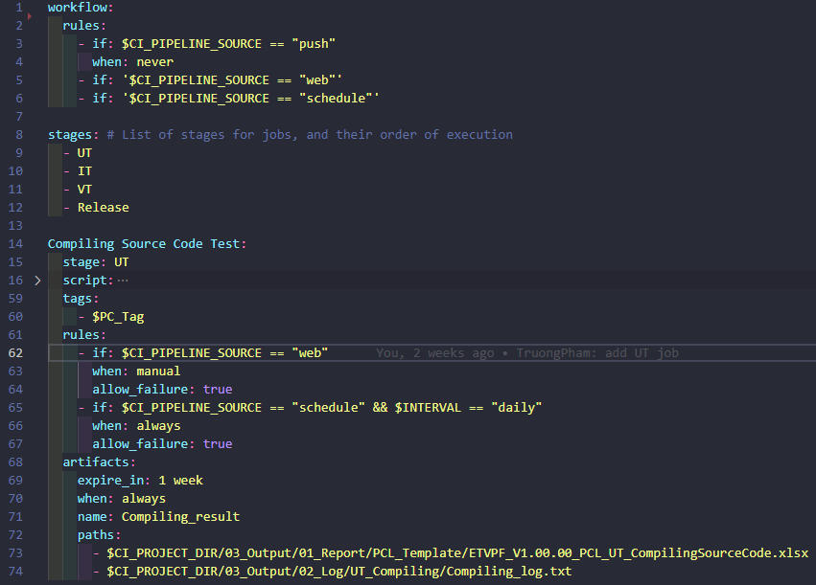
IV. Building a CI/CD pipeline
1. Create .gitlab-ci.yml file in Gitlab source
To develop .gitlab-ci.yml, please refer at https://docs.gitlab.com/ee/ci/yaml/

Slide 22
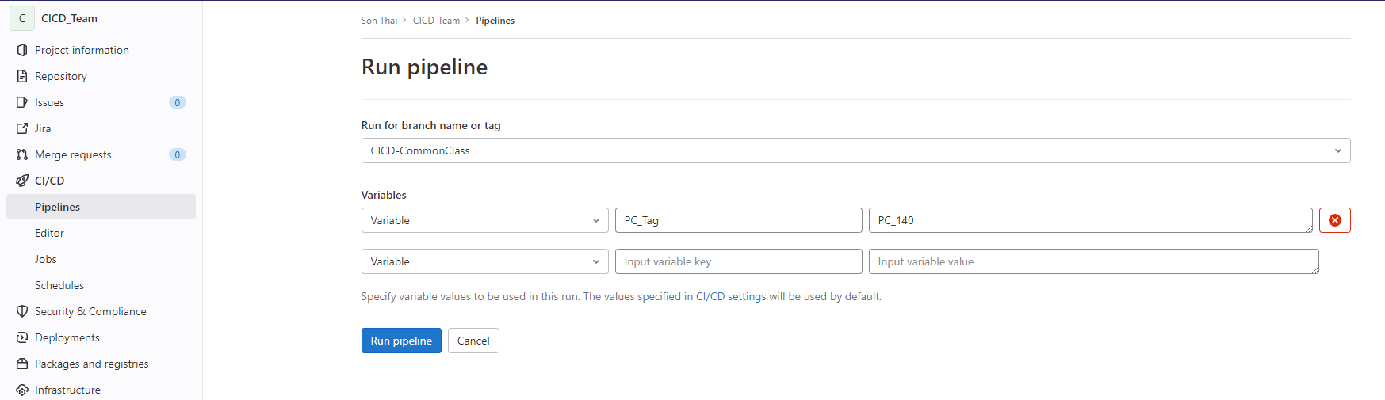
IV. Building a CI/CD pipeline
2. Run pipeline
1
2
3
4

Slide 23
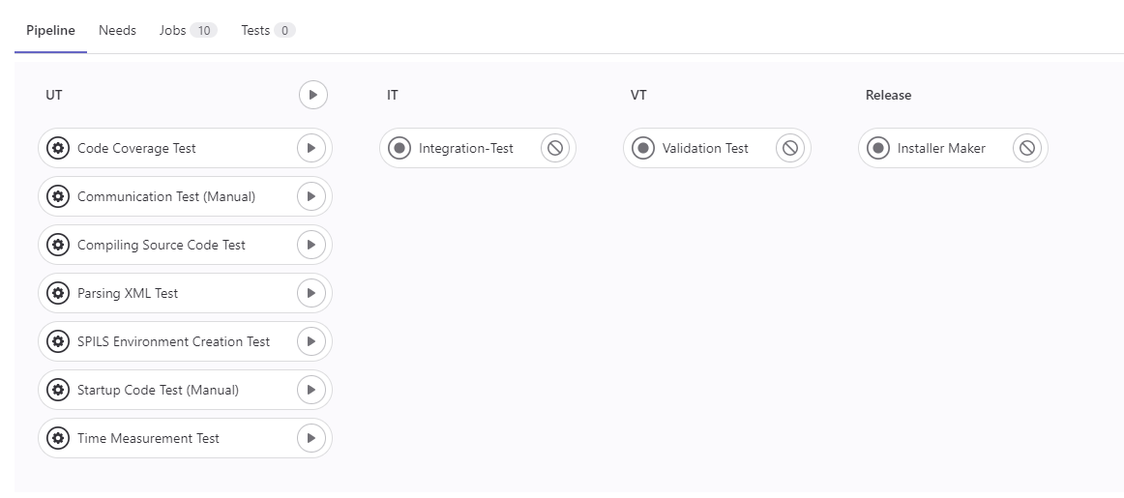
IV. Building a CI/CD pipeline
3. Build job
Choose job that want to run

Slide 24
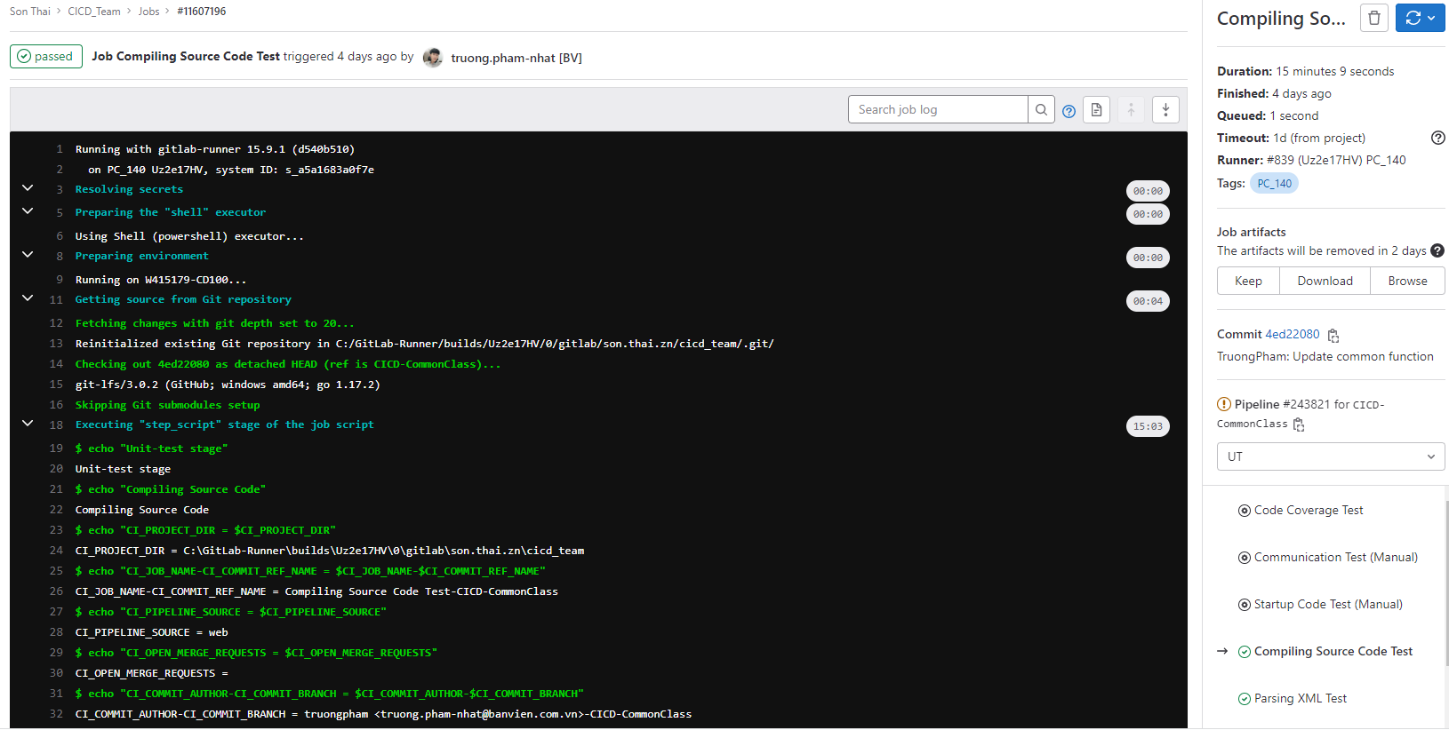
IV. Building a CI/CD pipeline
3. Build job

Slide 25
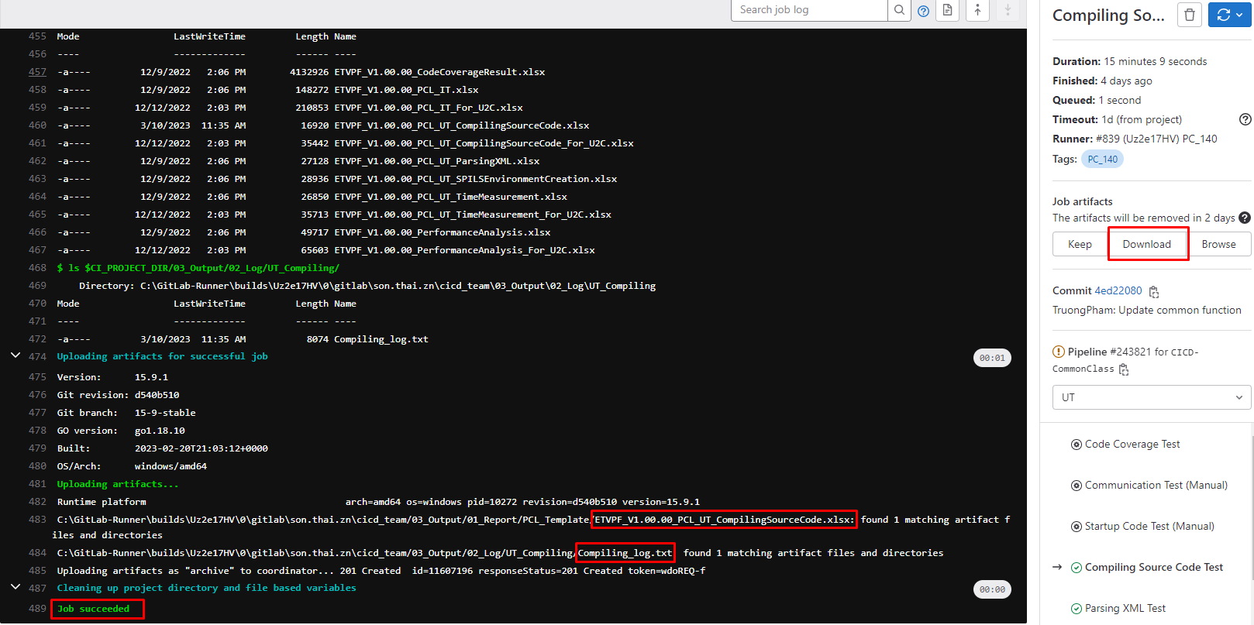
IV. Building a CI/CD pipeline
3. Build job

Slide 26
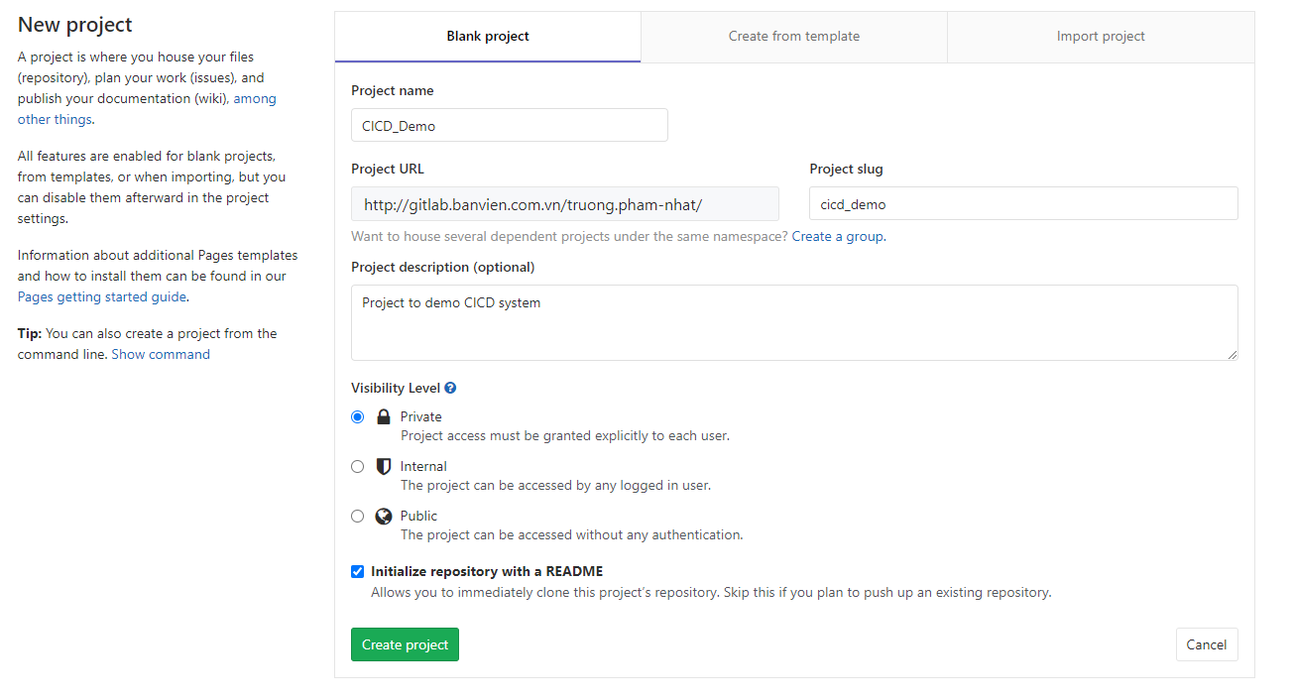
V. Demo build a CI/CD pipeline
1. Create project
This step to create Gitlab project. If you already have a project, you can skip this step
After fill information for project, press Create project to complete this step

Slide 27
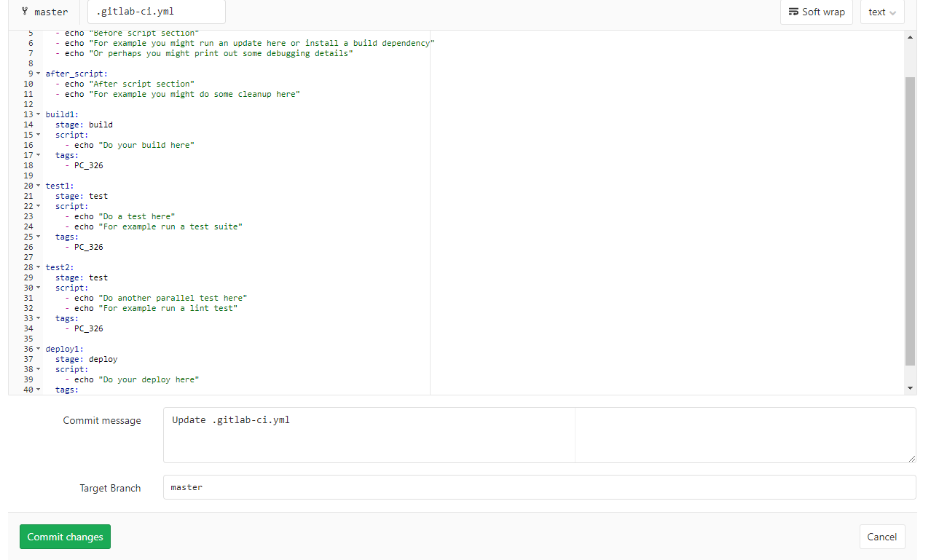
V. Demo build a CI/CD pipeline
2. Create .gitlab-ci.yml file
Press Commit changes to commit .gitlab-ci.yml file to master branch
You can change .gitlab-ci.yml to others name and reconfig as IV.1

Slide 28
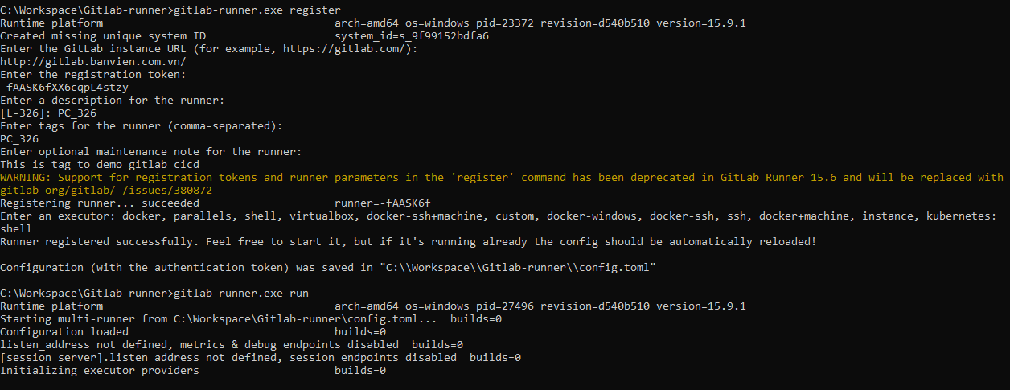
V. Demo build a CI/CD pipeline
3. Register gitlab-runner
Dowload gitlab-runner at https://gitlab-runner-downloads.s3.amazonaws.com/latest/binaries/gitlab-runner-windows-amd64.exe
Put gitlab-runner.exe file on local and enter command line:
gitlab-runner.exe register
Enter information as III.6 and gitlab-runner.exe run

Slide 29
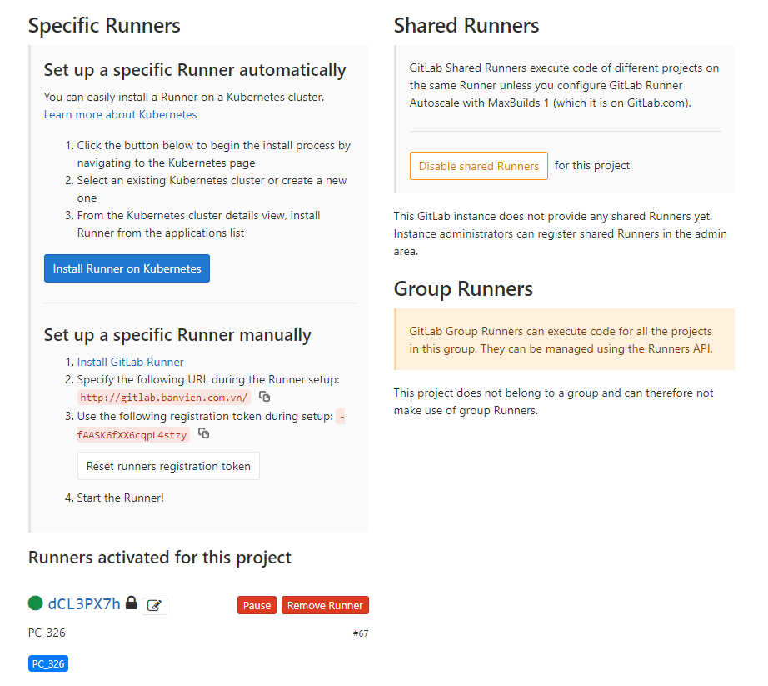
V. Demo build a CI/CD pipeline
3. Register gitlab-runner
Gitlab runner activated.
You can check at Settings CICD

Slide 30
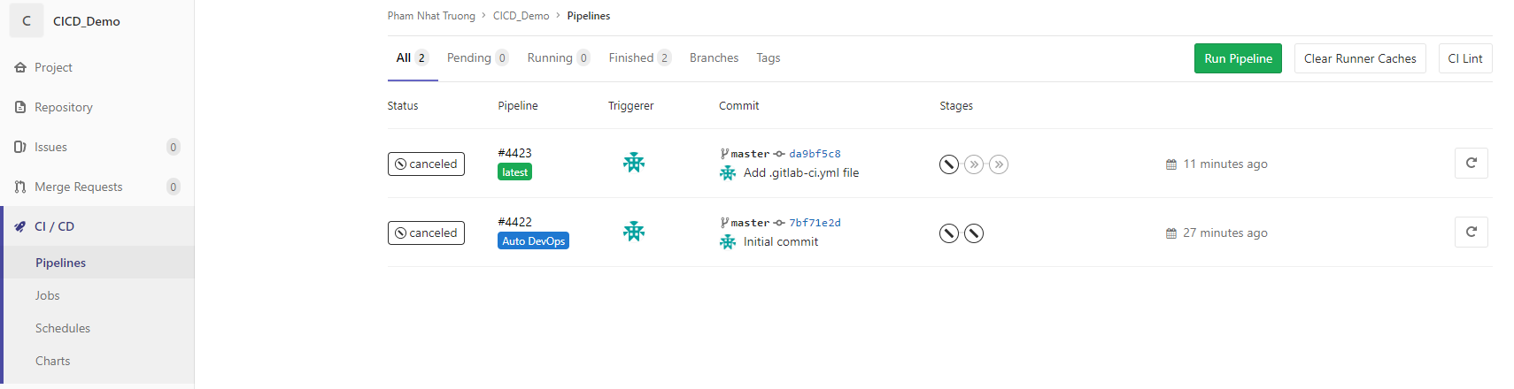
V. Demo build a CI/CD pipeline
4. Build pipeline
1. Choose Run Pipeline

Slide 31
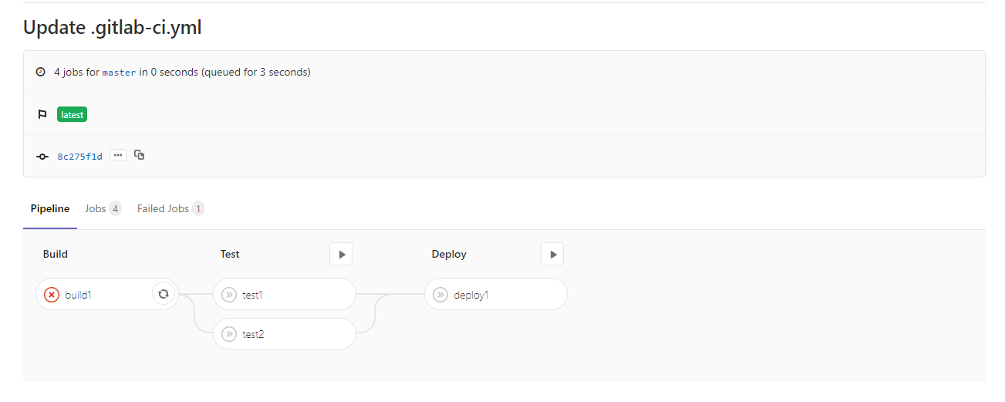
V. Demo build a CI/CD pipeline
5. Run job
2. Trigger job that want to build. In below picture, I choose build build1 job in Build stage

Slide 32
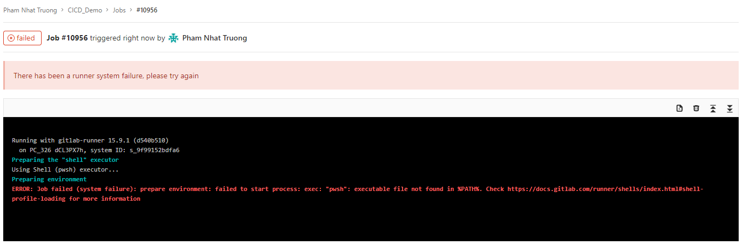
V. Demo build a CI/CD pipeline
5. Run job
If you get error as above picture, you have to update config.toml file of Gitlab-runner as below and rerun gitlab-runner.exe

Slide 33
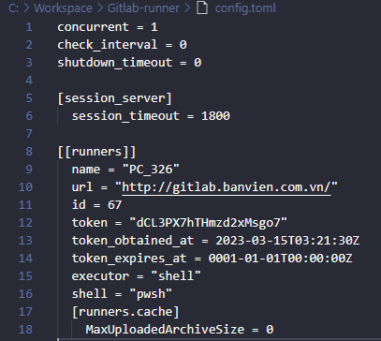
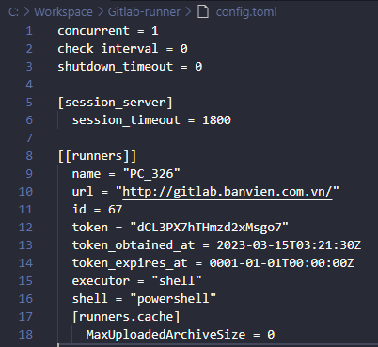
V. Demo build a CI/CD pipeline
5. Run job
Change “pwsh” to “powershell” in LOC 16 and rerun gitlab-runner.exe

Slide 34
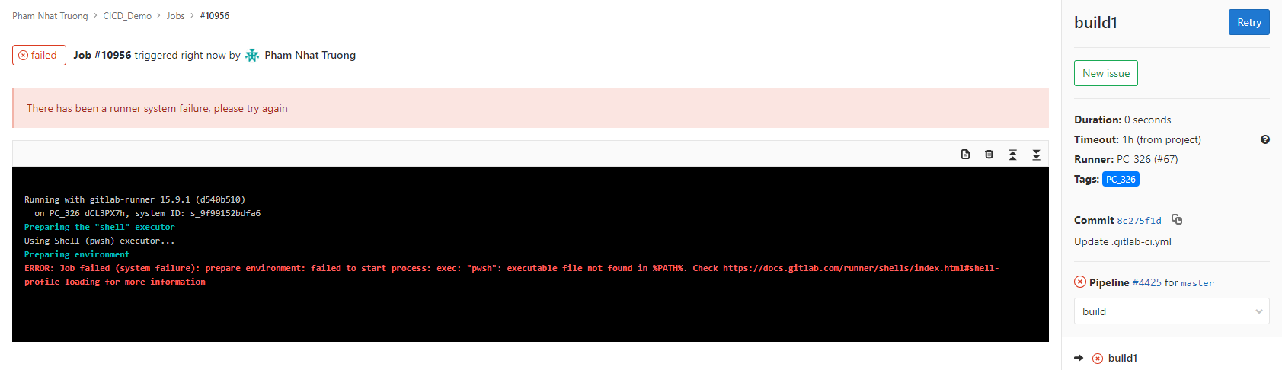
V. Demo build a CI/CD pipeline
5. Run job
After that, you can retry job or run new pipeline

Slide 35
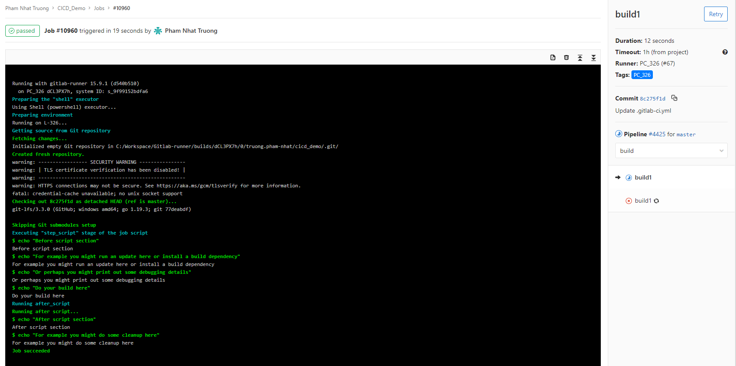
V. Demo build a CI/CD pipeline
5. Run job
That is result of build1 job

Slide 36
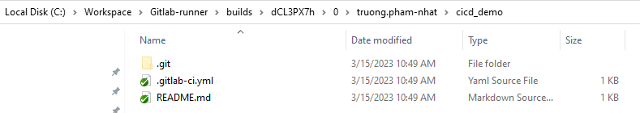
V. Demo build a CI/CD pipeline
5. Run job
Gitlab repo will be checked out at C:\Workspace\Gitlab-runner\builds\dCL3PX7h\0\truong.pham-nhat\cicd_demo on local

Slide 37
Refer
1. https://docs.gitlab.com/ee/ci/

Slide 38
THANK YOU!!!

