Slide 1
C/C++ Programming Language
Compilation process Apr, 2020

Slide 2
Contents
How the Compilation Process Works
Preprocessing
Compiling
Assembly
Linking
Example

Slide 3
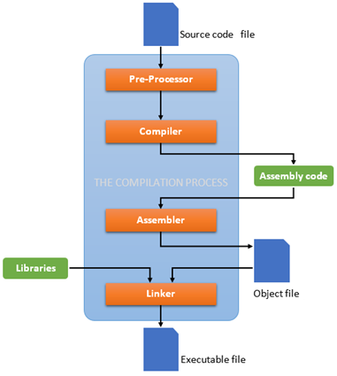
How the Compilation Process Works
Compilation is the process of converting a code in a programming language to machine code. In this process, the code goes through different steps depending upon the compiler and language.
The compilation process has four different steps in compiling a C/ C++ code :
The preprocessing
The compiling
The assembling
The linking

Slide 4
Preprocessing
The main function of preprocessor:
Remove comments from the source code.
Expanding macros.
Expanding included header files.
Here's an example code(sample.c):
#include <stdio.h>
#define PI 3.14
int main(void){
printf("Value of PI: %f\n", PI); // Output
return 0;
}

Slide 5
Preprocessing
Since, it inserts contents of header files to our source code file. Pre-processor generated file is larger than the original source file.
The output of this step will be stored in a file with a “.i” extension. The end of this file should look like
extern int ftrylockfile (FILE *__stream) __attribute__ ((__nothrow__ , __leaf__)) ;
extern void funlockfile (FILE *__stream) __attribute__ ((__nothrow__ , __leaf__));
# 868 "/usr/include/stdio.h" 3 4
# 2 "sample.c" 2
# 3 "sample.c"
int main(void){
printf("Value of PI: %f\n", 3.14);
return 0;
}
}
From “stdio.h”
PI is replaced by 3.14
“// Ouput” is removed

Slide 6
Compiling
Compiler accepts temporary pre-processed <file-name>.i file generated by the pre-processor and performs following tasks.
Check C program for syntax errors.
Translate the file into intermediate code “.i” extension in assembly language.
Optionally optimize the translated code for better performance.

Slide 7
Compiling
Our sample.s file should look like this:
.file "sample.c"
.text
.section .rodata
.LC1:
.string "Value of PI: %f\n"
.text
.globl main
.type main, @function
main:
.LFB0:
.cfi_startproc
....
.LC0:
.long 1374389535
.long 1074339512
.ident "GCC: (Ubuntu 7.5.0-3ubuntu1~18.04) 7.5.0"
.section .note.GNU-stack,"",@progbits

Slide 8
Compiling
If source code (c file) have an error. Example error_sample.c:
We will get an error when compiling it. The compilation process will stop in this step.
Our sample.s file should look like this.
// syntax error
#include <stdio.h>
#define PI 3.14
int main(void){
printf("Value of PI: %f\n", PI) // semicolon missed
return 0;
}
error_sample.c: In function ‘main’:
error_sample.c:6:3: error: expected ‘;’ before ‘return’
return 0;
^~~~~~
.file "error_sample.c"

Slide 9
Assembly
Assembler accepts the compiled source code (sample.s) and translates to low level machine code. After successful assembling it generates <file-name.o> (in Linux) or <file-name.obj> (in Windows) file known as object file. In our case it generates the sample.o file.
Our sample.o file should look like this:
7f45 4c46 0201 0100 0000 0000 0000 0000
0100 3e00 0100 0000 0000 0000 0000 0000
0000 0000 0000 0000 1003 0000 0000 0000
0000 0000 4000 0000 0000 4000 0d00 0c00
5548 89e5 4883 ec10 488b 0500 0000 0048
8945 f8f2 0f10 45f8 488d 3d00 0000 00b8
0100 0000 e800 0000 00b8 0000 0000 c9c3
5661 6c75 6520 6f66 2050 493a 2025 660a
0000 0000 0000 0000 1f85 eb51 b81e 0940
0047 4343 3a20 2855 6275 6e74 7520 372e

Slide 10
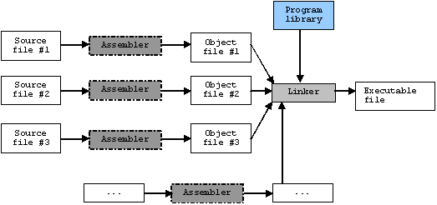
Linking
The job of the linker is to link together a bunch of object files (.o files) into a binary executable. Linking all the source files together, that is all the other object codes in the project.
This includes both the object files that the compiler created from your source code files as well as object files that have been pre-compiled for you and collected into library files. These files have names which end in .a or .lib

Slide 11
Linking
Our sample.out file should look like this:
You will notice that the size of sample.out executable is much larger than our object code code.o but the initial code is same. This is because the initial code is our actual code and the remaining code in a.out is the object code for the header file stdio.h for printf function.
7f45 4c46 0201 0100 0000 0000 0000 0000
0300 3e00 0100 0000 4005 0000 0000 0000
4000 0000 0000 0000 3019 0000 0000 0000
0000 0000 4000 3800 0900 4000 1d00 1c00
0600 0000 0400 0000 4000 0000 0000 0000
4000 0000 0000 0000 4000 0000 0000 0000
f801 0000 0000 0000 f801 0000 0000 0000
0800 0000 0000 0000 0300 0000 0400 0000
3802 0000 0000 0000 3802 0000 0000 0000
3802 0000 0000 0000 1c00 0000 0000 0000
1c00 0000 0000 0000 0100 0000 0000 0000

Slide 12
Example-Compiling with GCC compiler on linux
Simple file:
To compile the hello.c and run program:
To save all temporary files created during compilation:
// hello.c
#include <stdio.h>
int main()
{
printf("Hello World!\n");
return 0;
}
$ gcc -o hello hello.c
// Compile and link source hello.cpp into executable hello
$ ./hello
// Excute
$ gcc hello.c -save-temps -o hello

Slide 13
Example-Compiling with GCC compiler on linux
Multiple Files:
// main.c
extern void disp();
int main()
{
disp();
return 0;
}
// util.c
#include <stdio.h>
void disp()
{
printf("Hello World!\n");
}

Slide 14
Example-Compiling with GCC compiler on linux
To compile the hello.c and run program:
$ gcc -c main.c,
// generate main.o
$ gcc -c util.c
//generate util.o
$ gcc main.o util.o -o hello.e
//generate hello.e

Slide 15
Thank You!!

