Slide 1
MATLAB R-CarS4 R52
GPIO
Mar 2023
Notes:
Created by Hai Phan on Sep 5th 2018. This slide is used to help understand fundamental features and properties of Git ( a distributed version control system).

Slide 2
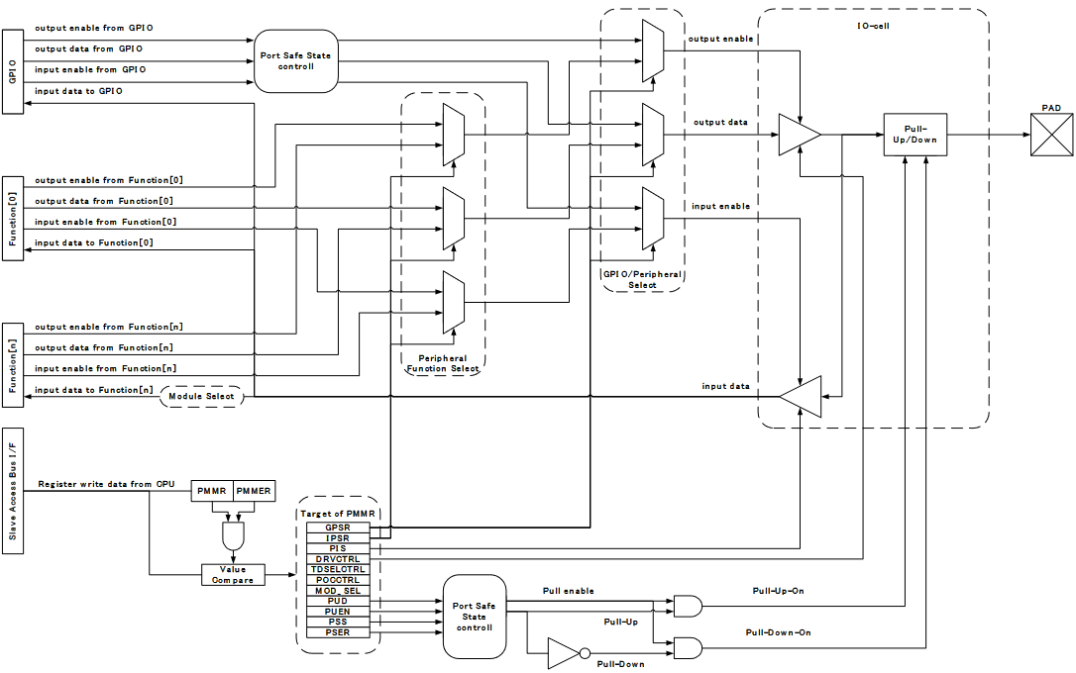
PFC Block Diagram

Slide 3
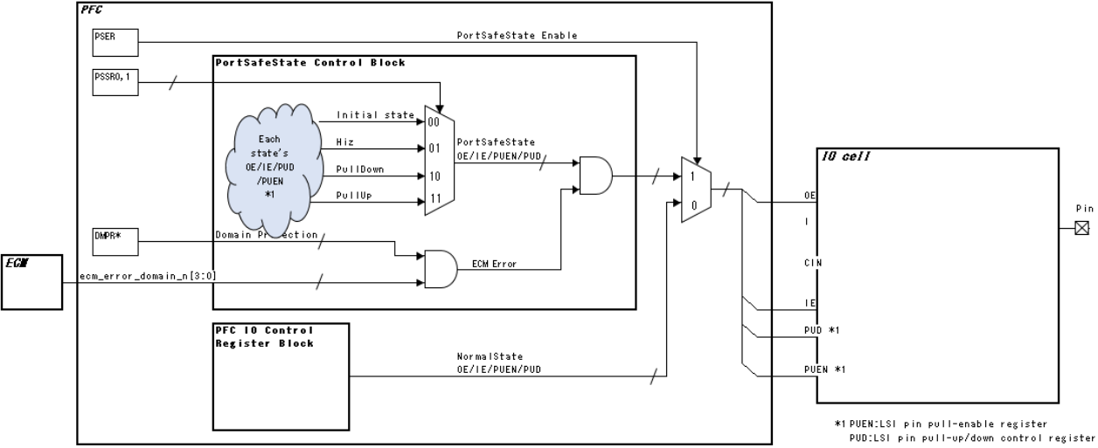
Port Safe State Block

Slide 4
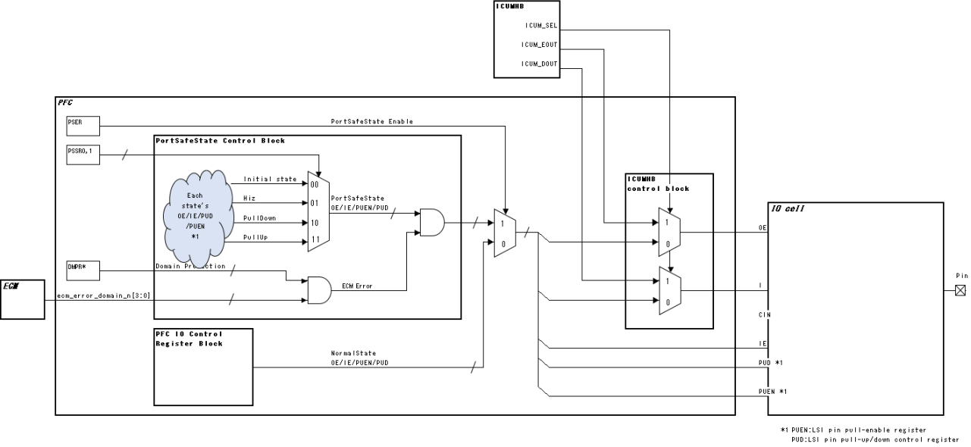
ICUMHB Select Function

Slide 5
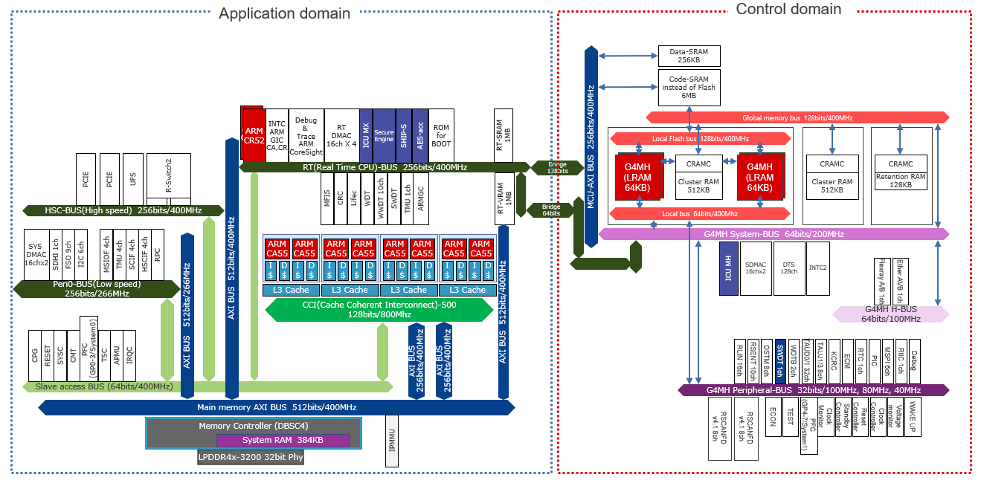
Bus Architecture

Slide 6
Initial value: Register value after a reset
- : Undefined value
R/W: Readable/writable. The written value can be read.
R: Read-only. The write value should always be 0.
W: Write-only. Reading this bit is prohibited. When the bit is reserved, the write value should always be 0. n: Number of GPIO Group, it’s value is in the range 0 to 7.
Register Description

Slide 7
Register Description
All the bits are active high unless otherwise specified, and deactivated on reset.
All access to registers is made in longword units.
The write value to a reserved bit should always be 0.
[Register access type and access mode]
Register access type is decoded by address offset, and selected by address check.
- R/W : Read-Write enabled register.
Offset: H’000
- SET : Controled per bit. Write case, applied bit is "1" then "1", or applied bit is "0" then keep value. Read case, return Reg value. (HWM described as WriteOnly)
Offset: H’200
- CLR : Controled per bit. Write case, applied bit is "1" then "0", or applied bit is "0" then keep value. Read case, return Reg value. (HWM described WriteOnly)
Offset: H’400
- Reserved:
Offset: H’600

Slide 8
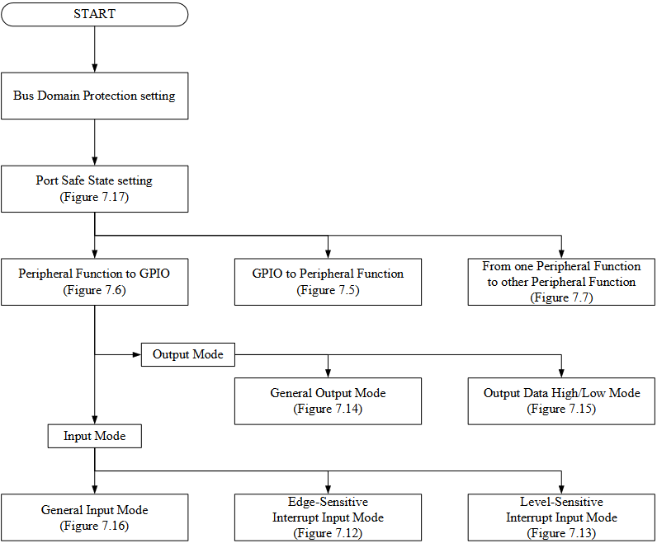
Recomendation of Pin Function setting flow

Slide 9
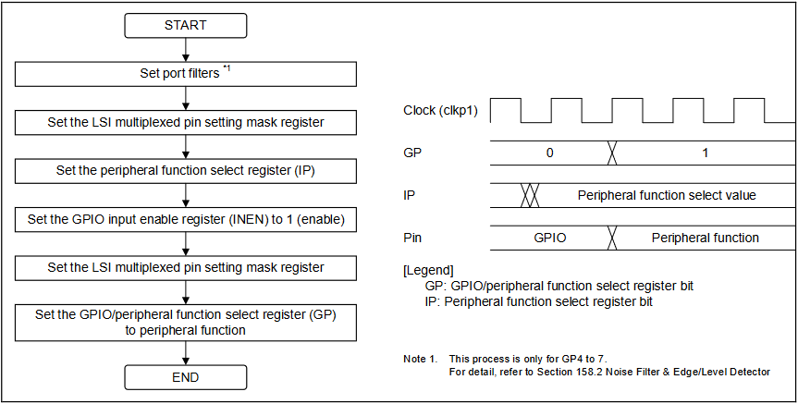
1. GPIO to Peripheral Function

Slide 10
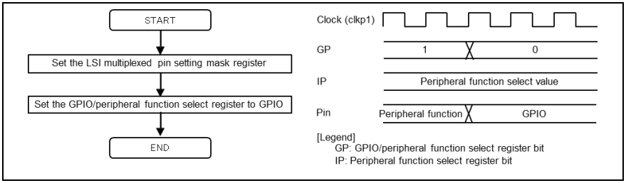
2. Peripheral Function to GPIO

Slide 11
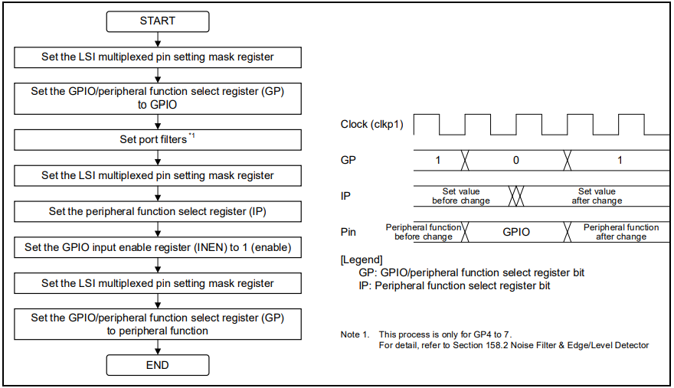
3. From one peripheral function to another peripheral function

Slide 12
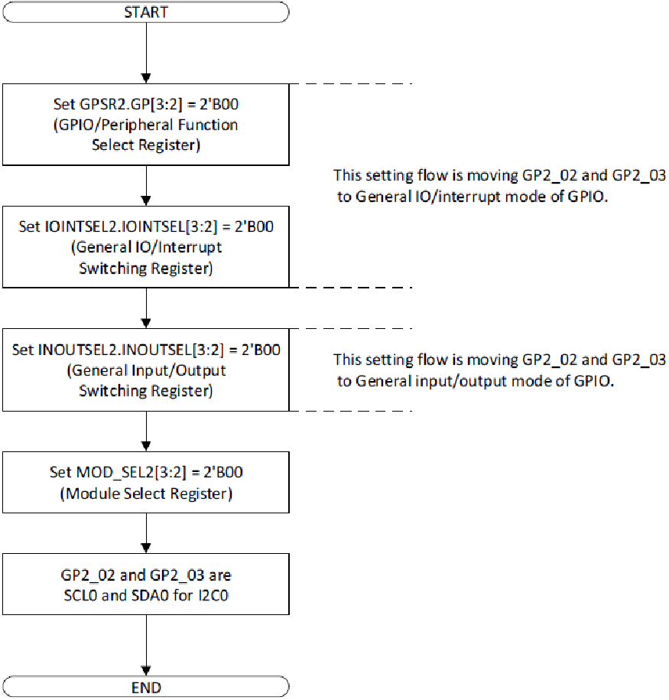
4. Switching GPIO to I2C

Slide 13
5. Operations in Each Mode
1. Mode Switching
2. General Input / Output Mode
3. Interrupt Input Mode

Slide 14
6. Handling of Input Signals on Port Pins
2. Input Signal Synchronization
1. Chattering

Slide 15
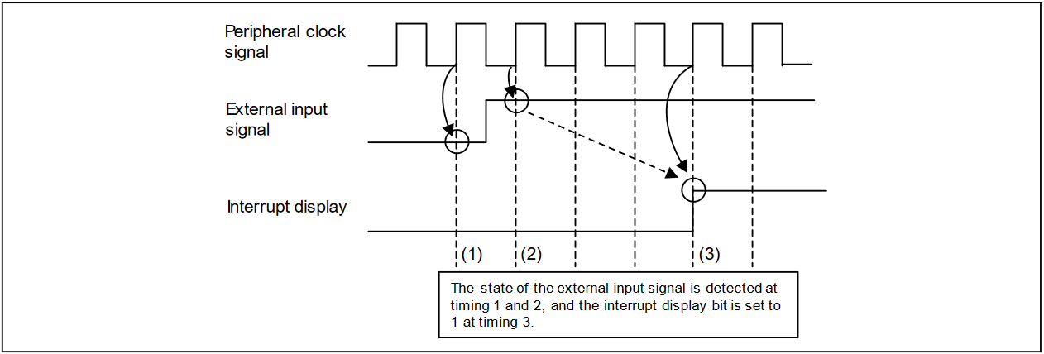
7. Interrupt Display Timing Charts

Slide 16
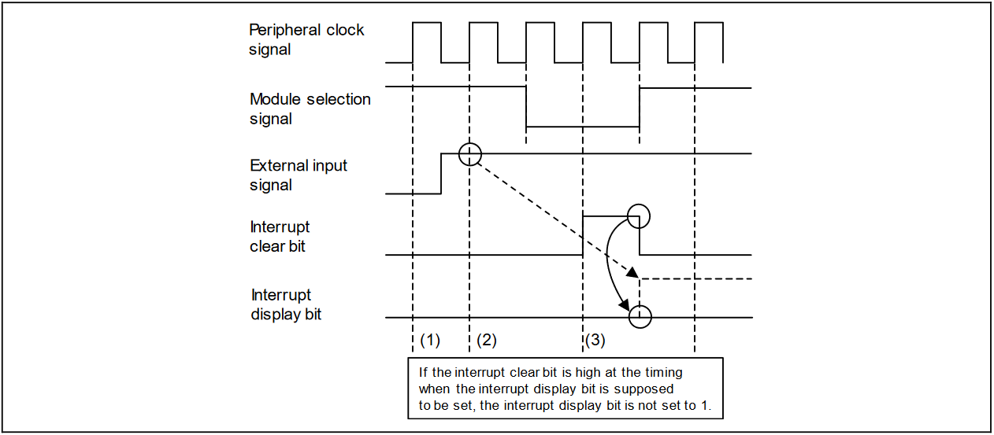
7. Interrupt Display Timing Charts

Slide 17
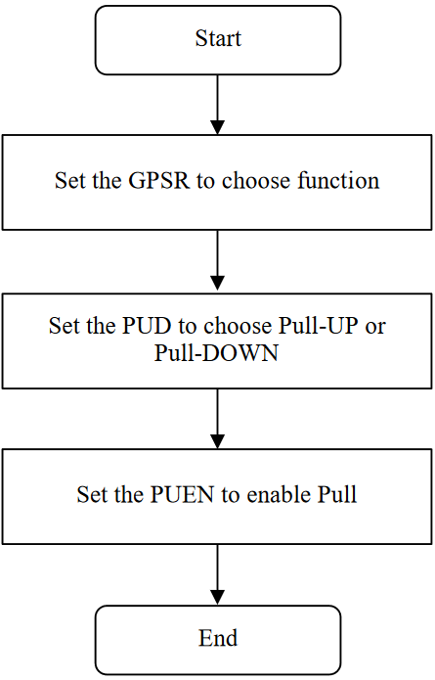
4. Setting Pull-Up / Down Resistors

Slide 18
THANK YOU!

