Slide 1
01
Project Overview
Current system:
Travel accessibility application featuring airport and airline information with a chatbot help functionality.
What we’re improving:
The AI Chatbot functionality in the application to give better and more detailed answers to users.
Who is the target audience of the app?
PRMs
(Passengers with reduced mobility)
What is the intended improved experience?
ChatGPT-like text response with supporting links/picture/information below the text response + service integration

Slide 2
02
Original Sprint 1 Plan: What we planned to deliver
Week 1: | Week 2: | Week 3:
Project repository and development environment setup | Client requirements clarification and prioritisation | Finalise MVP requirements and acceptance criteria
Establish application architecture and technology stack | Accessible traveller user journey analysis | Create accessible interface wireframes
Initial client requirements analysis | AI and third-party service research | Finalise API and data requirements
User needs and accessibility research | Initial travel assistant user flow | Sprint 1 review and client alignment
Project documentation and requirements coordination | Technical feasibility review | Finalise technical architecture and development environment

Slide 3
03
Actual Achievement: What we actually delivered - Part 1
Week 1: | Week 2: | Week 3:
Set up shared development environment | Review technical feasibility and constraints | Identify and prepare the development environment for Sprint 2 implementation
Research user needs and accessibility considerations | Create initial chatbot interaction wireframe | Refine chatbot interface design and accessibility features
Define technical architecture and technology stack | Reviewing existing chatbot implementation | Define sprint 2 technical implementation approach.
Analyse initial client requirements | Define MVP requirements and acceptance criteria | Establish possible user stories for chatbot testing
Create meeting template | Develop user interaction flow for the improved chatbot | Coordinate Sprint 1 findings and coordinate playback preparations
Coordinate Sprint 1 requirements and documentation

Slide 4
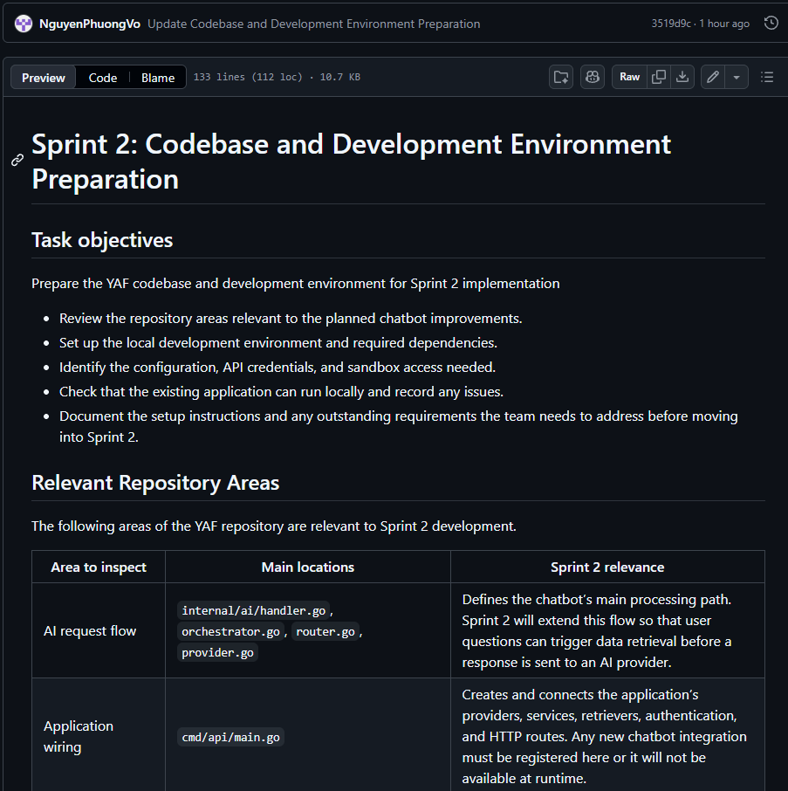
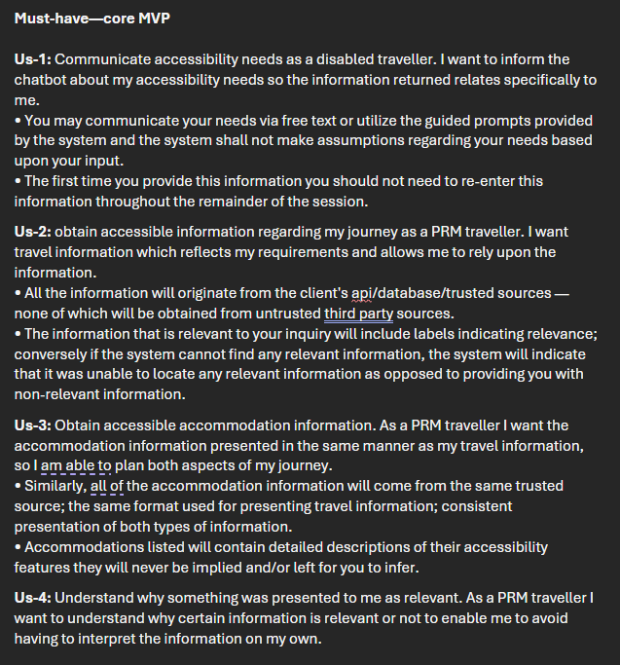
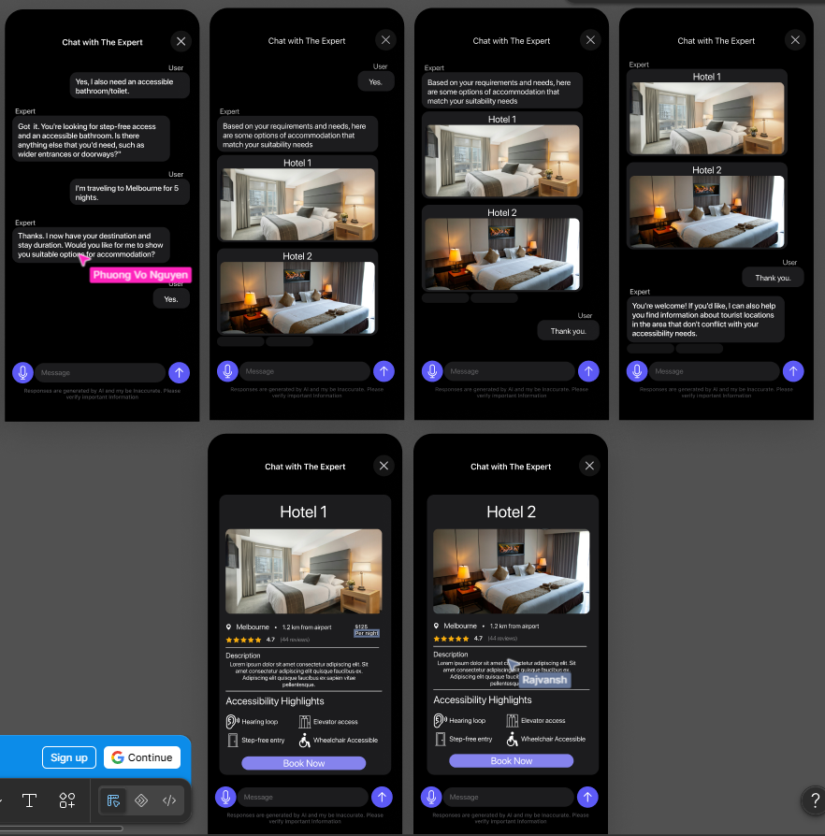
03
Actual Achievement: What we actually delivered - Part 2
Team environment in client repository
User stories to test chatbot against
Example Figma frames depicting chatbot interaction

Slide 5
04
Why It Matters
For the user:
More accessible interaction
Clearer information
More personalised assistance
For the client:
Improves existing functionality
Better support for their users
Clearer path to implementation
For the project:
Clearer foundation for development
Reduction of uncertainty before development
Priorities established for Sprint 2

Slide 6
05
Blockers & Open Questions
Hotel/Booking database:
Awaiting information - Team has identified this as important information to gather before starting Sprint 2.
We will inquire about this during our client meeting tomorrow.
Chat history retention:
Should chatbot conversations be stored? Or should they be temporary only?
We will also inquire about this during the client meeting tomorrow.

Slide 7
06
Task Allocation & Time Spent
Member: | Task(s): | Hours:
PM - Johanne Gutierrez | 3 | 9 (540min)
Dev - Sean Mojica | 3 | 10 (600min)
Dev - Nguyen Phuong | 3 | 10 (600min)
BA - Ethan Dalianis | 4 | 13 (720min)
UX - Rajvansh Padda | 3 | 9 (540min)

Slide 8
07
Timeline & Next Steps
Timeline:
Client meetings with YAF: 07/08, 14/08, 21/08, 11/09 - Fridays
Internal meetings: 05/08, 12/08, 19/08, 26/08, 09/09 - Every Wednesday
Supervisor meetings:
Tech w/Naresh - 17/08
Non-tech w/Leon - 27/08
Playback - 10/09
What’s happening next sprint:
Improvement of the chatbot functionality:
Text response with detailed information pertaining to user needs
Supporting information/links/pictures to give the user more to work with

Slide 9
Ethan Dalianis (BA)
Sprint 1 Weeks 1 & 2:
Reviewed and confirmed client requirements.
Defined the core problem: Improving accessibility for travel for disabled users.
Agreed on 10 functional requirements and 6 design requirements for the development team to utilise
Locked in technical restraints: Using the clients AI API and trusted database only.

Slide 10
Ethan Dalianis (BA)
Sprint 1 Week 3
Refined the MVP requirements into 12 prioritised user stories.
Clear acceptance criteria in the user stories.
Prioritised the user stories using MoSCoW style must have 6, Should have 2 and 4 could have.

Slide 11
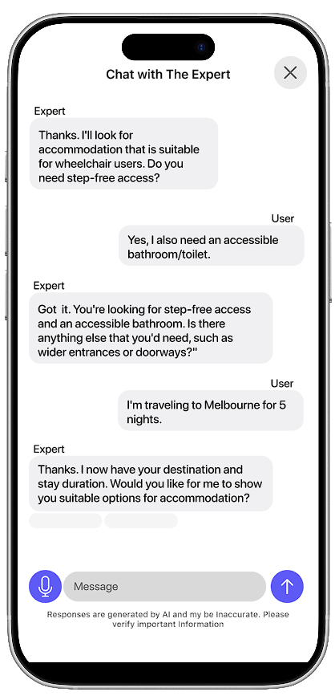
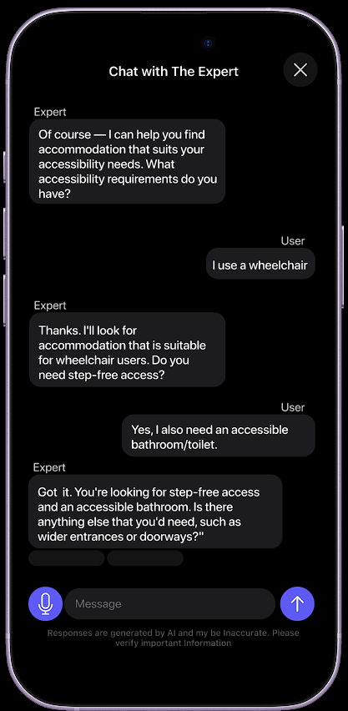
(UX)
Sprint 1: Week 1,2 & 3
Researched user needs and requirements for Persons with accessibility needs
Created Base Wireframes
Refined Wireframes according to changes
Created and documented Refined designs for chat bot
Created Working Prototype for Chat bot

Slide 12
(UX)
Figma Design
Completed Figma Design
Prototypes
Dark Mode
Light mode

Slide 13
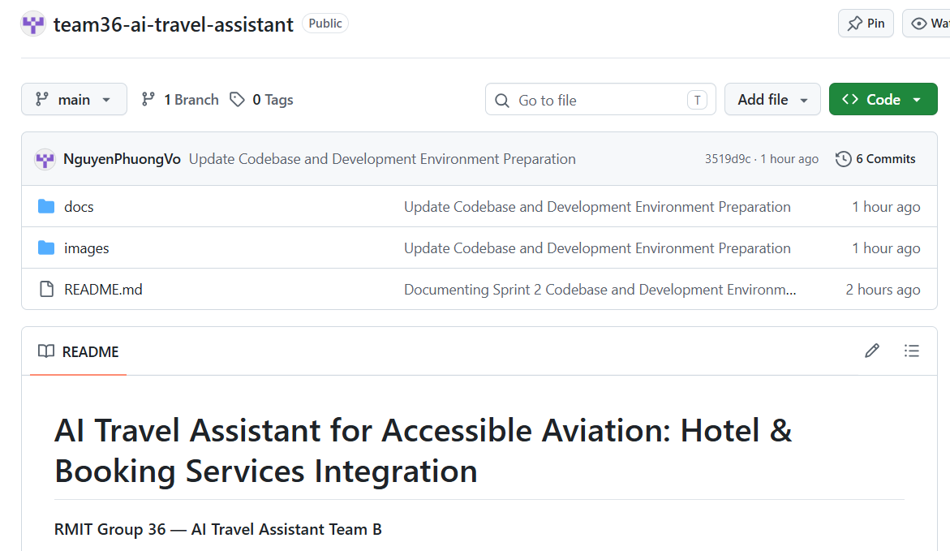
Nguyen Phuong Vo (Dev)
Sprint 1: Week 1 & 2
Set up repository and documented requirements
Reviewed YAF backend
Refined requirements and user flow
Identified technical risks and dependencies

Slide 14
Nguyen Phuong Vo (Dev)
Sprint 1: Week 3
Reviewed key YAF backend and AI components for Sprint 2
Verified dependencies and successfully ran the backend
Created the Team B integration branch
Documented remaining dependencies and confirmed local codebase readiness

Slide 15
Sean Renzo Mojica(Dev)
Sprint 1: Week 1 - 3
Set up document for technical architecture and technology stack
frontend using react and next.js with backend using node.js
Set up document for reviewing existing chatbot implementation
Multiple AI providers and PostgreSQL database
Set up document for Sprint 2 technical implementation approach
client-provided hotel or booking API
These documents are put in the github repository

