Slide 1


Slide 2
Using MEMO method on KDD99 dataset
Thay Generalized Block = nn.Linear(in_dim, 128) -> nn.Relu()
Thay Specialized Block = nn.Linear(128, 64) -> nn.Relu()
Top 1 accuracy:
[99.99, 99.87, 96.47, 99.01, 98.65]
Top 5 accuracy:
[100.0, 99.99, 99.78, 99.94, 99.95]

Slide 3
Build new dataset using Wireshark package capture
Using ping3, nmap to Python-Syn-Flood-Attack-Tool to DDoS from 2 Google Cloud Server and and PC to a Google Cloud Server
Using tcpdump to capture package and wireshark to export to CSV file
The CSV includes time, source IP, destination IP, Protocol, Length, Info

Slide 4
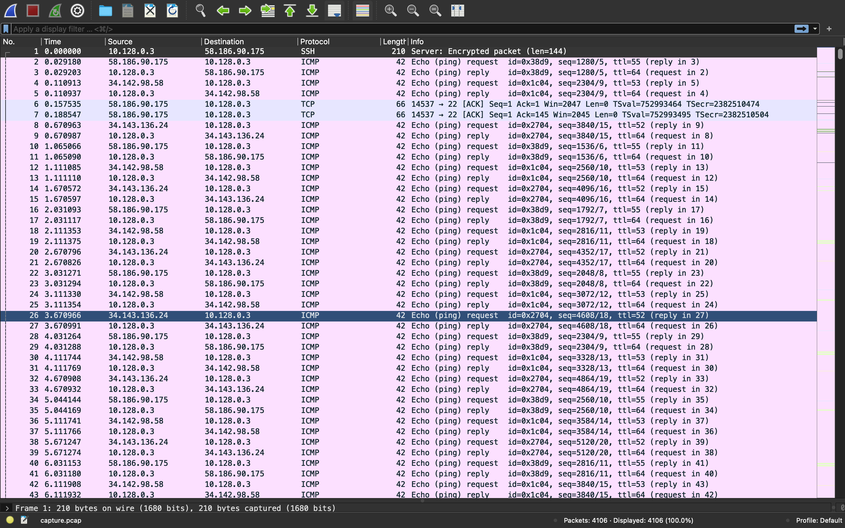

Slide 5
Problem with kdd99 dataset
The dataset is useless and completely broken.
https://www.kdnuggets.com/news/2007/n18/4i.html
Among the issues raised, the most important seemed to be that no validation was ever performed to show that the DARPA dataset actually looked like real network traffic. Indeed, even a cursory examination of the data showed that the data rates were far below what will be experienced in a real medium sized network. Nevertheless, IDS researchers continued to use the dataset (and the KDD Cup dataset that was derived from it) for lack of anything better.

Slide 6
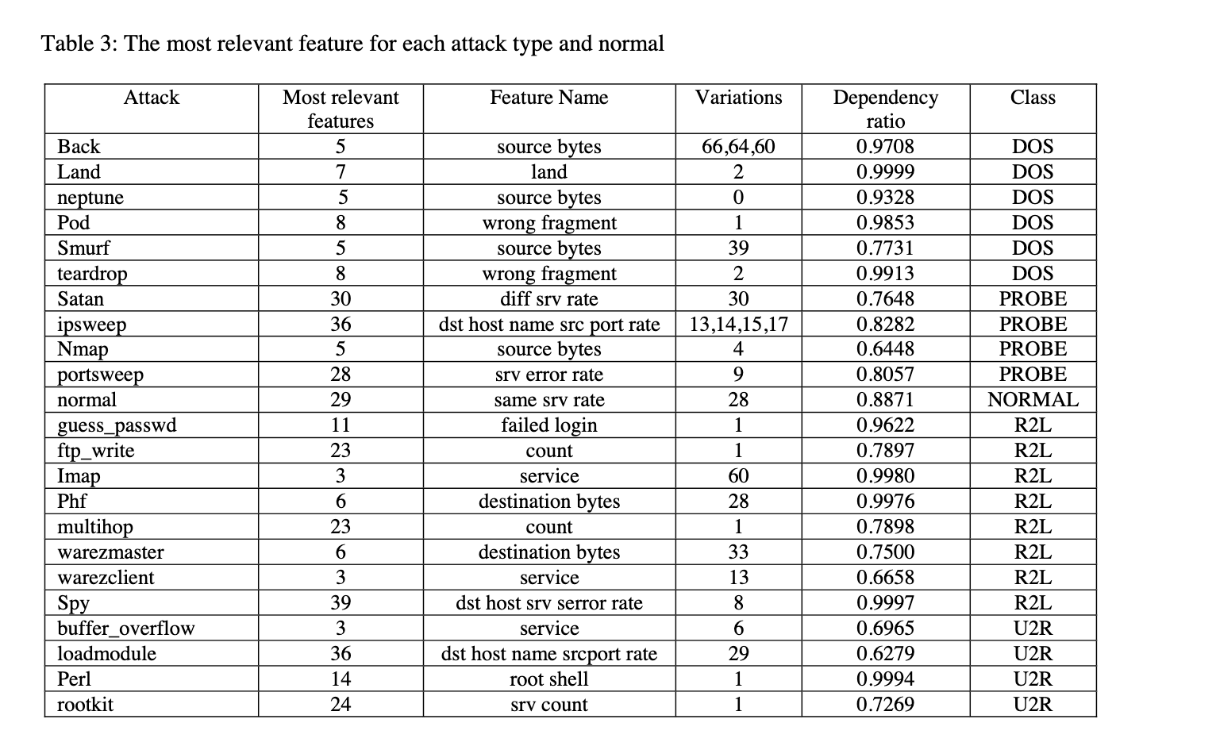
Problem with KDD99 dataset

Slide 7
Problem with KDD99 dataset
Back attack, Neptune attack and Smurf attack use Source bytes as the most relevant feature (with the dependant ratio > 98%).
But all the script perform the attack will generate the same source bytes.

Slide 8
A neptune attack can be distinguished from normal network traffic by looking for a number of simultaneous SYN packets destined for a particular machine that are coming from an unreachable host. A host-based intrusion detection system can monitor the size of the tcpd connection data structure and alert a user if this data structure nears its size limit.
The Smurf attack can be identified by an intrusion detection system that notices that there are a large number of 'echo replies' being sent to a particular victim machine from many different places, but no 'echo requests' originating from the victim machine.
An intrusion detection system looking for the Back attack needs to know that requests for documents with more than some number of front slashes in the URL should be considered an attack. Certainly, a request with 100 front slashes in the URL would be highly irregular on most systems. This threshold could be varied to find the desired balance between detection rate and false alarm rate.

Slide 9
