Slide 1


Slide 2
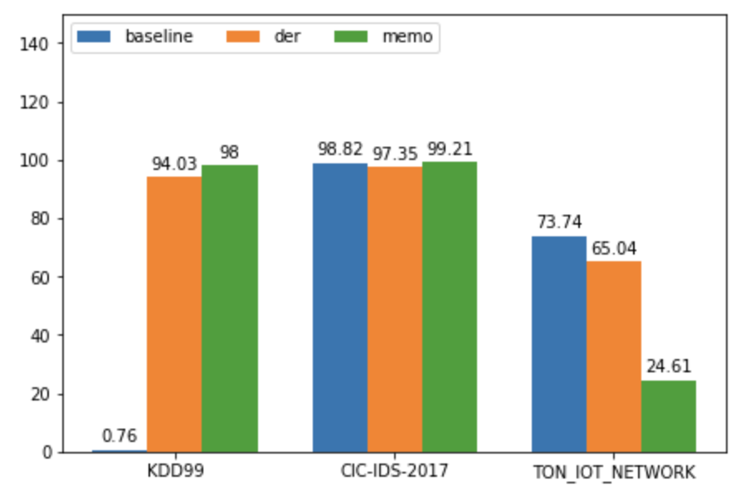
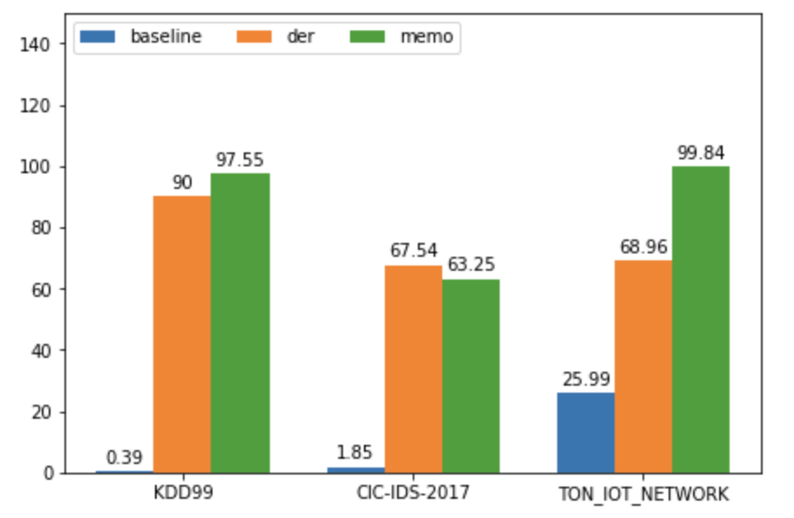
Base 5 Inc 5 (CIC-IDS-2017 Dos Only)
Base 2 Inc 2 (CIC- IDS-2017 Dos only, KDD drop class < 200 instances

Slide 3
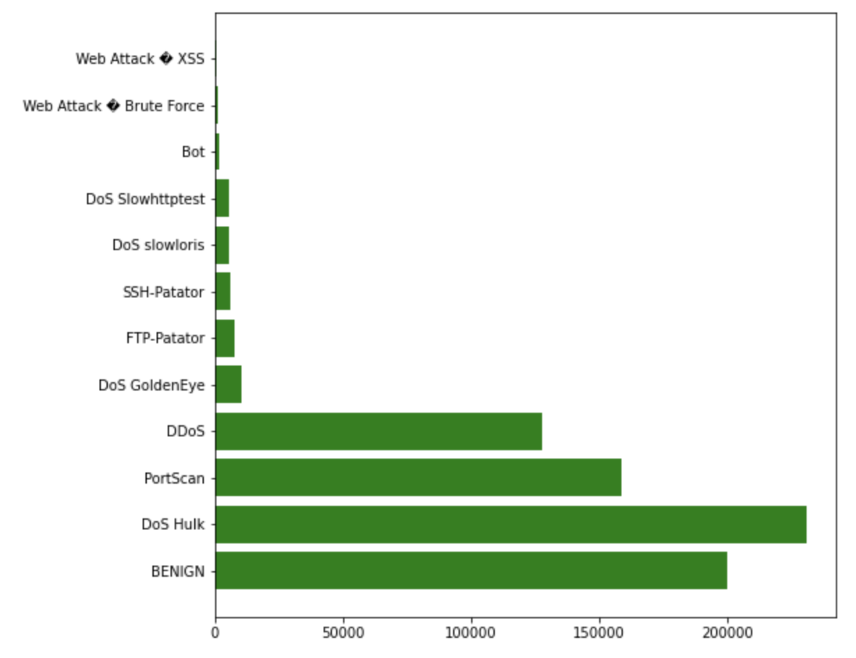
CIC-IDS-2017 Data Distribution
There are a total of 2.2 million records of BENIGN data. I only use 200000 records because of memory related problem when running on servers. I also drop classes has number of instances < 200.
Most instances: Dos Hulk – 231073 Least instances: Web attack XSS 652

Slide 4
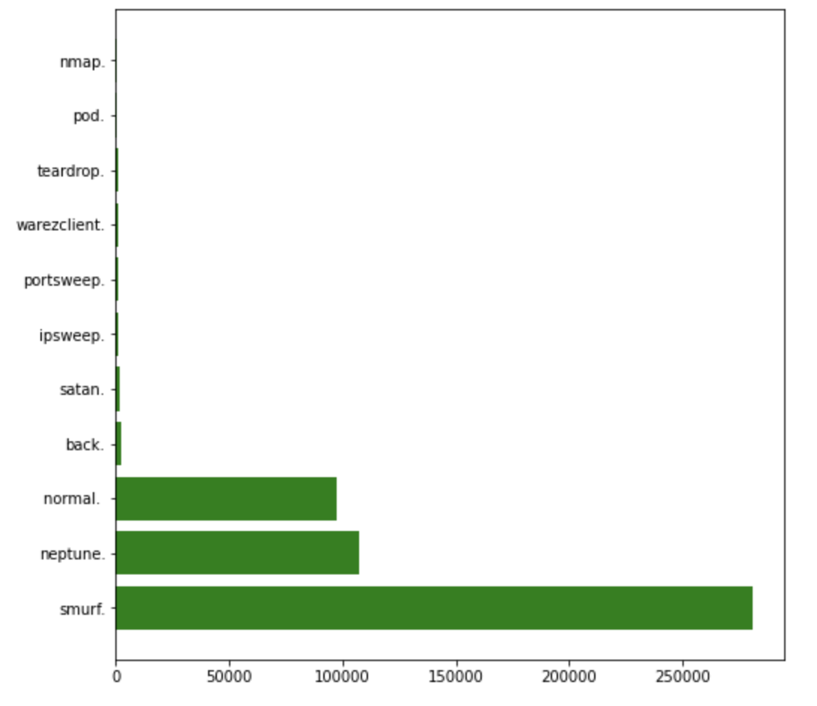
KDD99 Data Distribution
I drop all class that has < 200 instances.
Most instances: Smurf attack: 280790 Least instances: nmap 231

Slide 5
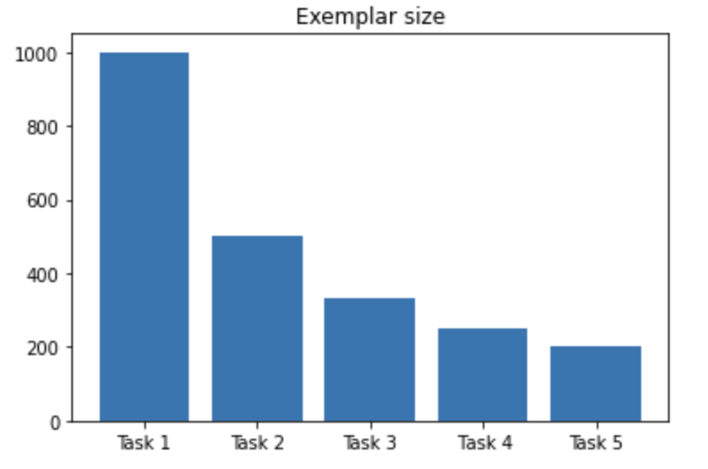
Setting
Zscore normalization + DropNA
Init epoch: 200
Consecutive epoch: 150
Batch size: 128
Exemplar size: 2000
Lr: 0.1

Slide 6
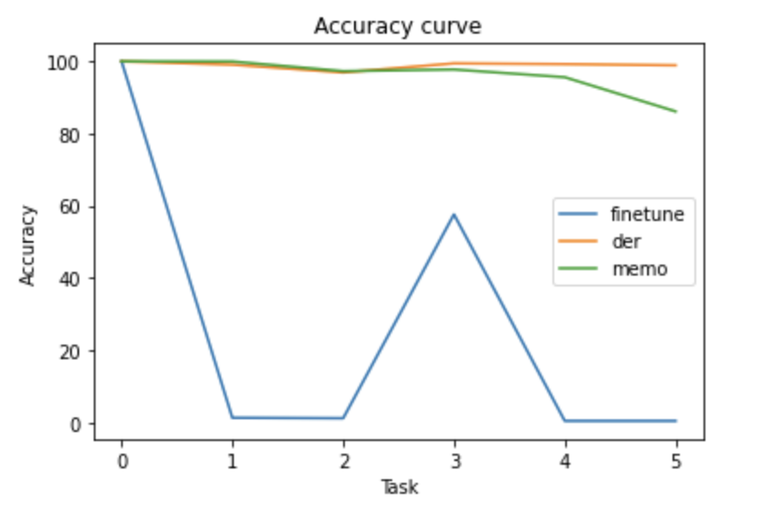
Result
KDD99 Accuracy Curve

Slide 7
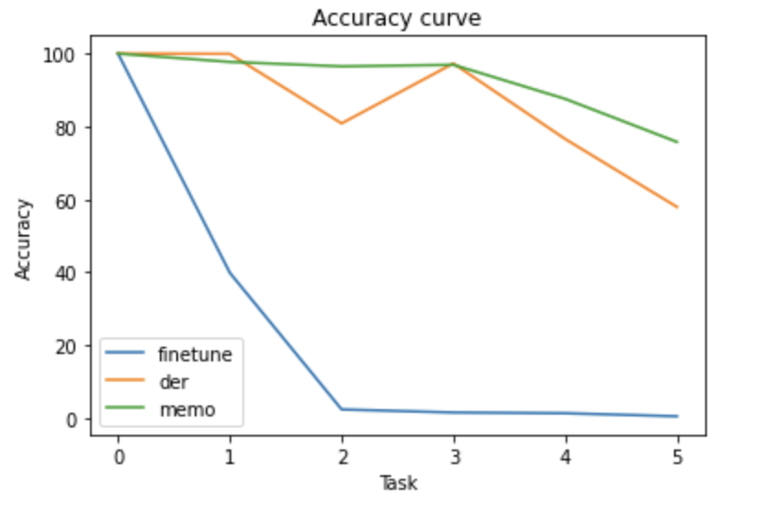
Result
CIC-IDS-2017 full dataset

Slide 8
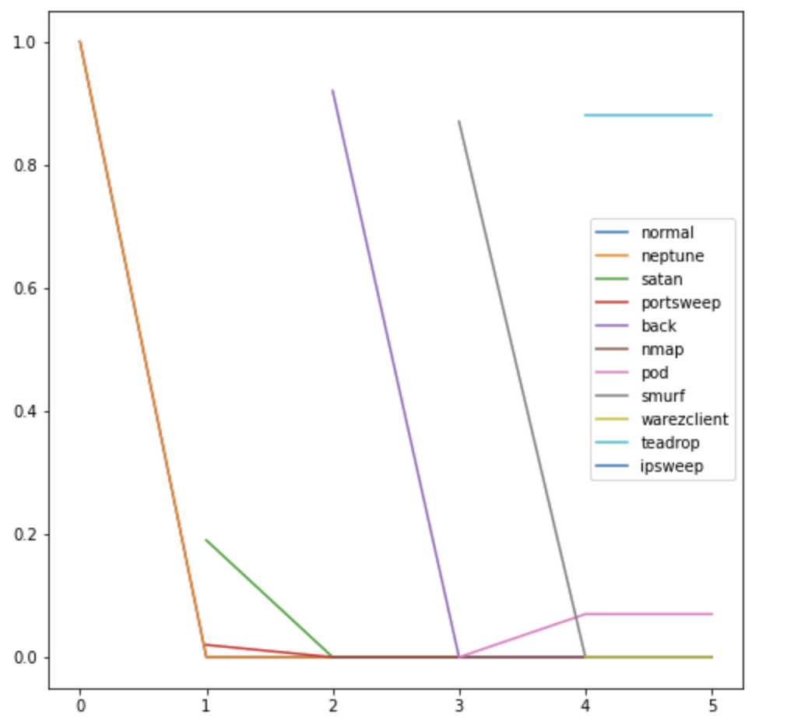
KDD99
Finetune Model
F1 score of each class

Slide 9
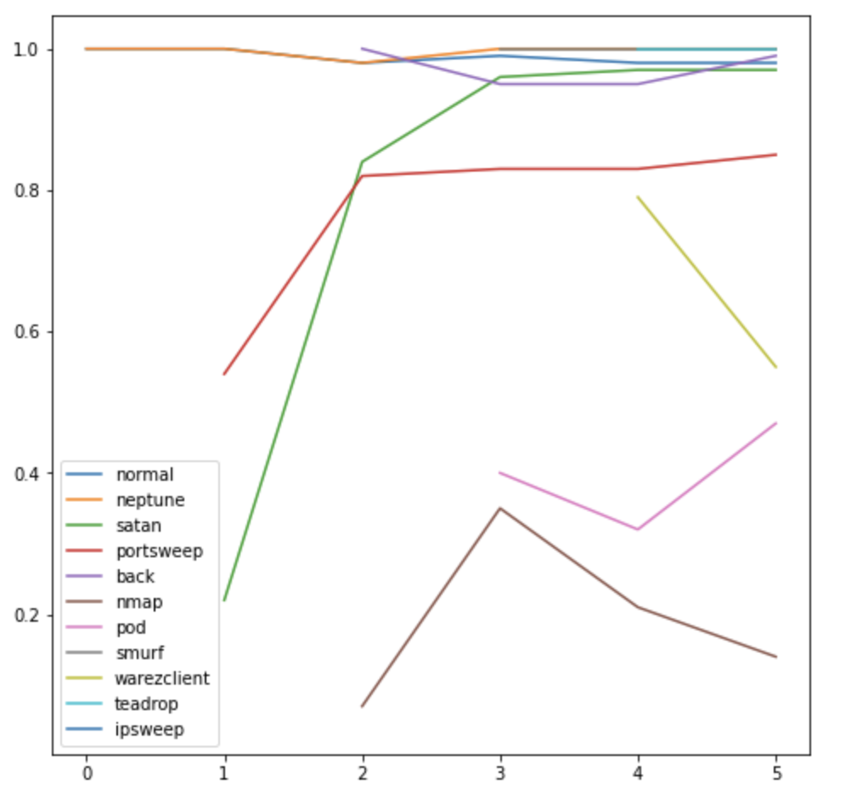
KDD99
Der Model
F1 score of each class

Slide 10
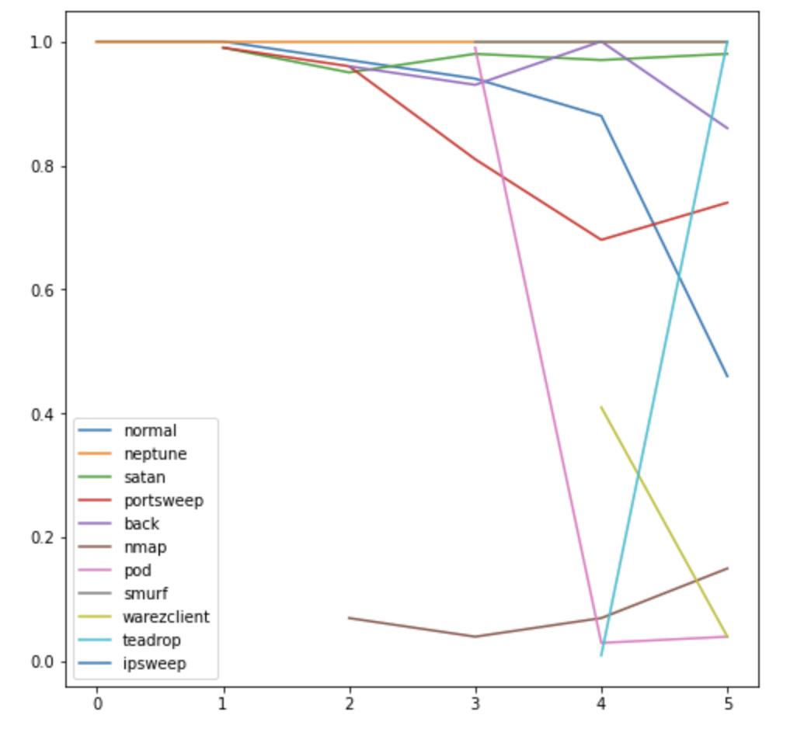
KDD99
MEMO Model
F1 score of each class

Slide 11
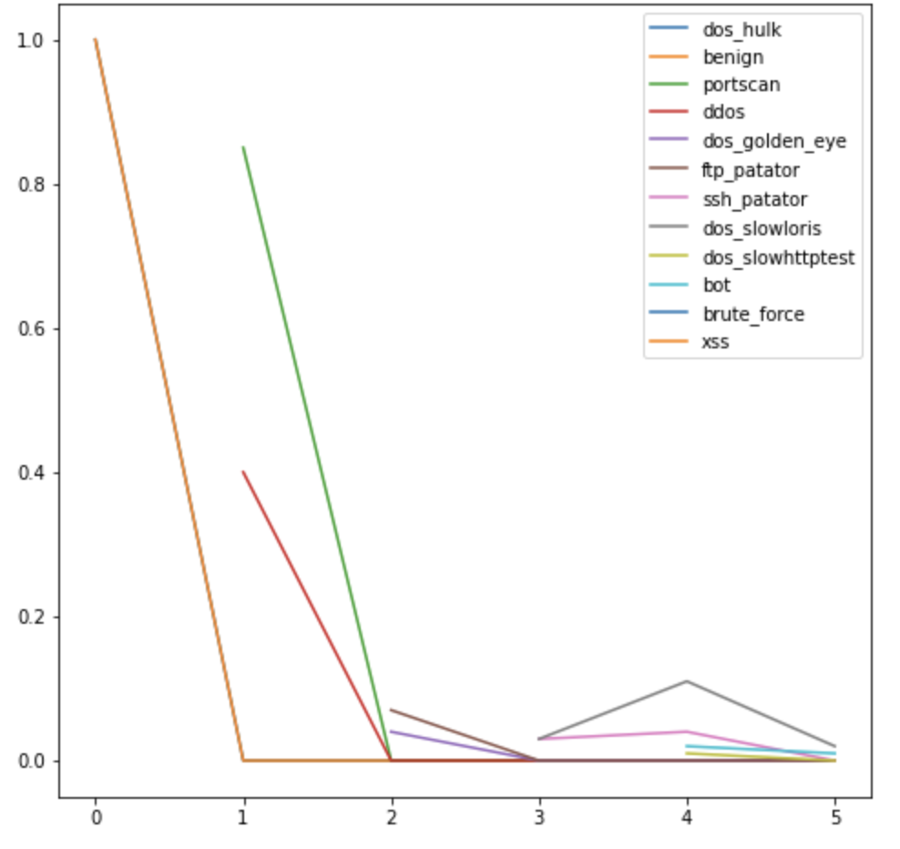
CIC-IDS
Finetune Model
F1 score of each class

Slide 12
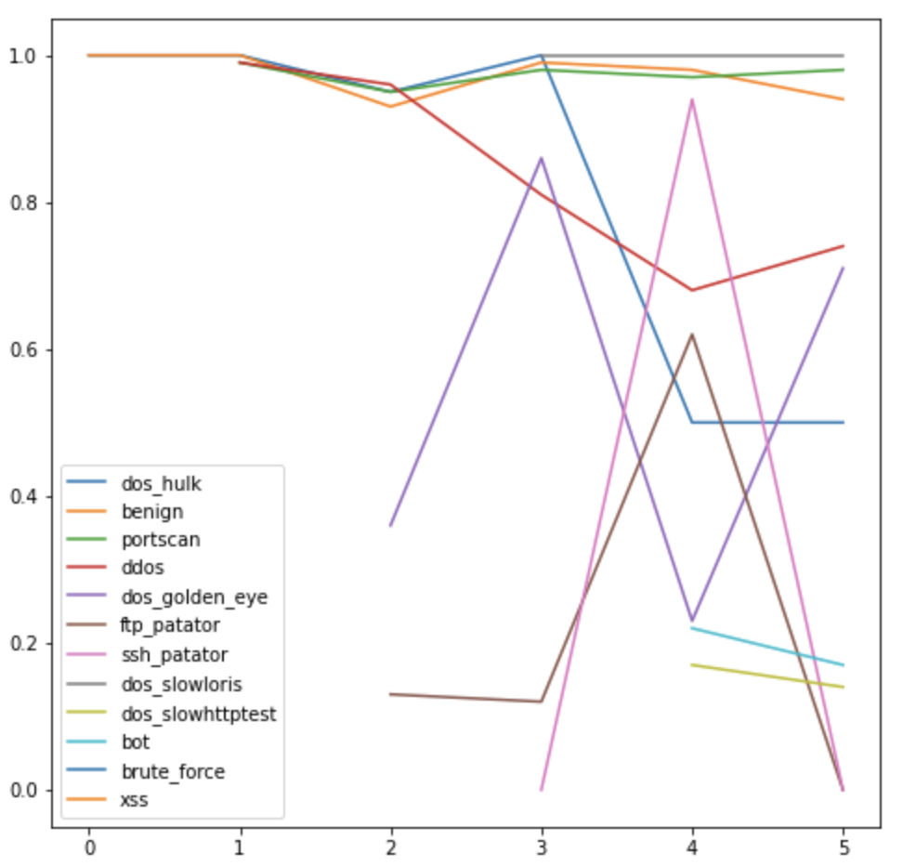
CIC-IDS
Der Model
F1 score of each class

Slide 13
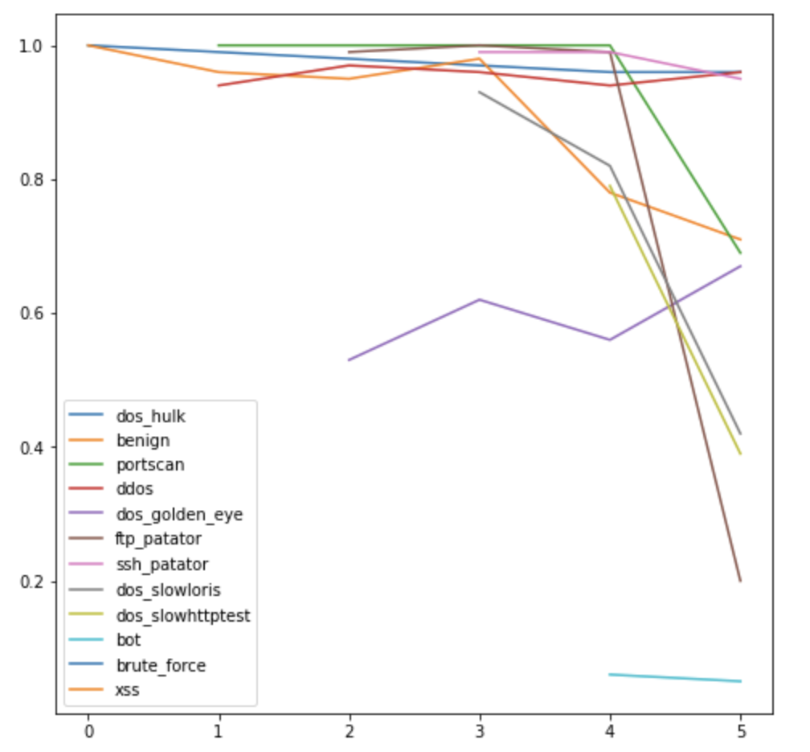
CIC-IDS
MEMO Model
F1 score of each class

Slide 14
Good news:
- DER Net and MEMO Net outperform Finetune Model completely in Incremetal Learning setup because Finetune Model was suffered from catastrophic forgetting.
Bad news:
- F1 score of each class widely different in both KDD99 dataset and CIC-IDS-2017 dataset.
- F1 score curve of each class does not decline. In the best scenario it should decline steadily. Only in MEMO Net using dataset CIC-IDS did the curve followed decline trend.

Slide 15
What could went wrong
- Number epochs and batch size does not cover all the training instances.
- Both KDD99 dataset and CIC-IDS-2017 are highly imbalanced.
- The exemplar size are few compared to dataset.
- Model size is too small.
- Data leaking (exists in KDD99 dataset), data complexity.

Slide 16
Data leaking in CIC-IDS-2017 dataset when testing on self-collected dataset
- I create a dataset by collecting network package from a server hosting my website while using another server running wrk command. Wrk is web server benchmark tool works by sending a load of HTTP requests to the web server.
The pcap file was parsed through tool CIC-Flow-Meter, and the results is a dataset with same features as CIC-IDS-2017 dataset.
CIC_IDS_Train worked well on CIC_IDS_Test, Wrk_Train worked well on Wrk_Test, but the prediction results of Wrk_Test is poorly given train data is CIC_IDS_Train.

Slide 17
Data leaking in CIC-IDS-2017 dataset when testing on self-collected dataset
All dataset is generated in a closed environment with a way to simulated real user data -> The dataset learn the characteristic of the environment. - > Low generalization
The dataset learned the essence of the attack script -> Low detection accuracy.

Slide 18
What’s next
- Validate the training process by inspecting the train accy, val accy, train losses, val losses, training batch. Re order the class order.
Data leak problems: Determine how much dependant of model predicts on features ( there are works on KDD dataset, but not on CIC-IDS-2017 dataset and ToN_IoT_Network dataset).
Use evaluation metrics other than accuracy for imbalance dataset.
Testing on other dataset and other approaches.

