Slide 3
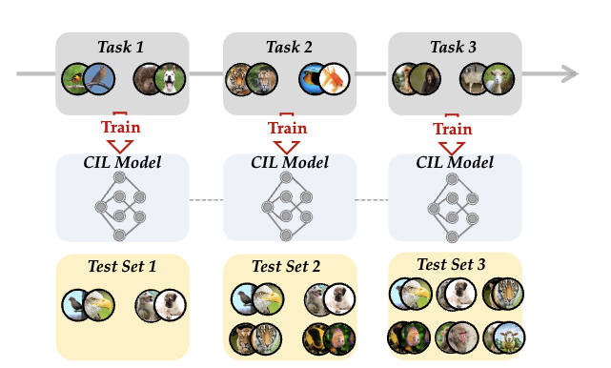
Class Incremental Learning
No overlapping classes
Model learn to classify incrementally
Model need to perform well on all classes (old and new)

Slide 4
CIL in Network Intrusion Detection
Learn to classify between normal and malicious connection using characteristics of network package
Label of malicious connections: scanning, dos, ddos, ransomeware, backdoor, injection, …
Characteristics used for detection: Connection duration, Package statistics, Flag Statistics, Protocol, Port, …
Dataset used for evaluation: UNSW-NB15, KDD99, CIC-IDS-2017, ToN_IoT_Network.

Slide 5
Dataset

Slide 6
Dataset

Slide 7
CIL Approaches
Model Centric: Concentrate on model evolution in the learning process. For example, dynamic network propose expanding the network when needed to enhance representation ability.
Algorithm Centric: Focus on designing algorithms to maintain the model’s knowledge in former tasks. For example, knowledge distilation build the mapping between old and new models and reflect the characteristics of the old model in the updating process

Slide 8
Implemented Methods
Model Centric Approach
DER (Dynamic Expandable Representation): Expanding a new backbone when facing new tasks and aggregates the features with a larger FC layer.
MeMO (Memory efficient Exapandable MOdel): Propose to decouple backbone in DER to generalized layers and specialized layers. Only expanding specialized layers
Algorithm Centric Approach
Lwf (Learning without Forgetting): Implement a Knowledge Distilation Loss to force the semantic relationship of the old model and new model to be the same and resist forgetting.

Slide 9
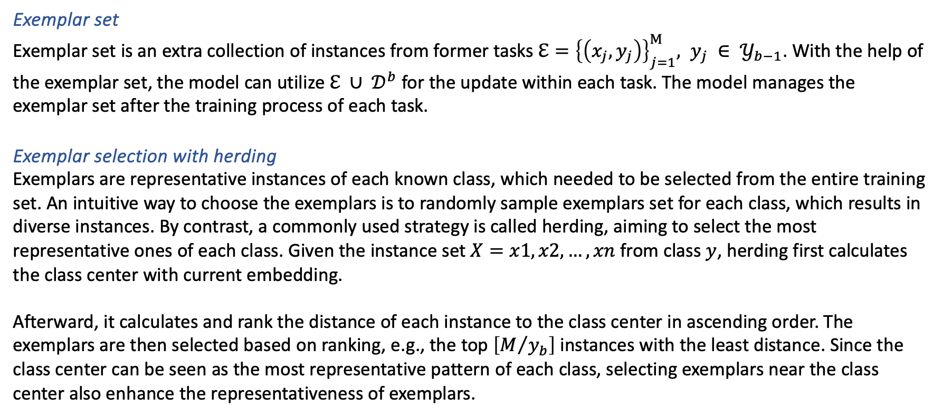
Definition
Exemplar set
Exemplar set is an extra collection of instances from former tasks $ℇ={\left\{\left(x_{j},y_{j}\right)\right\}}_{j=1}^{Μ}, y_{j} ∈ 𝒴_{b−1}$. With the help of the exemplar set, the model can utilize $ℇ ∪ 𝒟^{b}$ for the update within each task. The model manages the exemplar set after the training process of each task.
Exemplar selection with herding
Exemplars are representative instances of each known class, which needed to be selected from the entire training set. An intuitive way to choose the exemplars is to randomly sample exemplars set for each class, which results in diverse instances. By contrast, a commonly used strategy is called herding, aiming to select the most representative ones of each class. Given the instance set $X=x1,x2,…,xn$ from class $y$, herding first calculates the class center with current embedding.
Afterward, it calculates and rank the distance of each instance to the class center in ascending order. The exemplars are then selected based on ranking, e.g., the top $\left[M/{y_{b}}\right]$ instances with the least distance. Since the class center can be seen as the most representative pattern of each class, selecting exemplars near the class center also enhance the representativeness of exemplars.

Slide 10
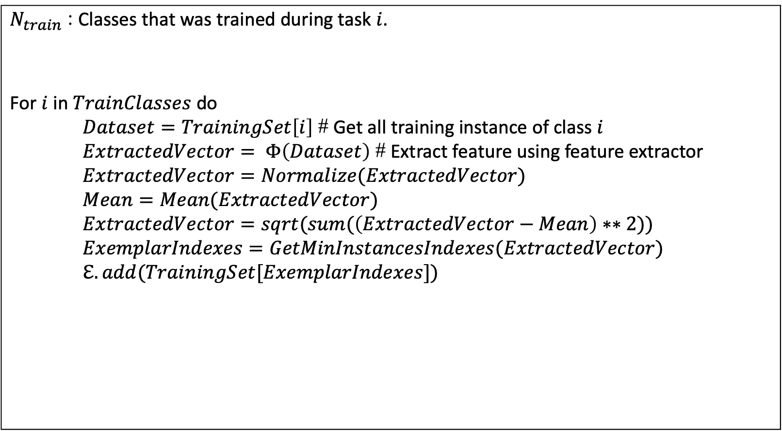
Herding Pseudocode
$N_{train}$ : Classes that was trained during task $i$. For $i$ in $TrainClasses$ do $Dataset=TrainingSet\left[i\right]$ # Get all training instance of class $i$ $ExtractedVector= Φ\left(Dataset\right)$ # Extract feature using feature extractor $ExtractedVector=Normalize(ExtractedVector)$ $Mean=Mean(ExtractedVector)$ $ExtractedVector=sqrt(sum(\left(ExtractedVector−Mean\right)∗∗2))$ $ExemplarIndexes=GetMinInstancesIndexes(ExtractedVector)$ $ℇ.add(TrainingSet[ExemplarIndexes])$

Slide 11
Task | Finetune | Lwf | Der | MeMO
Task 0 | Random Initialize Neural Net Random Initialize FC Train on class [0, 1] Loss: Cross Entropy Loss | Random Initialize Neural Net Random Initialize FC Train on class [0, 1] Loss: Cross Entropy Loss | Random Initialize Neural Net Random Initialize FC Train on class [0, 1] Loss: Cross Entropy Loss | Random Initialize Neural Net = Shallow Net + Deep Net Random Initialize FC Train on class [0, 1] Loss: Cross Entropy Loss
After task 0 | Generate new FC Copy weight from old FC to new FC | Generate new FC Copy weight from old FC to new FC Copy current model (Neural Net + FC) to old model. | Generate new FC Copy weight from old FC to new FC Generate new Neural Net Copy weight from old NN to new NN Freeze old NN weight Generate Exemplar Set E[0, 1] | Generate new FC Copy weight from old FC to new FC Generate new Deep Net Copy weight old Deep Net to new Deep Net Freeze old Deep Net weight Generate Exemplar Set E[0, 1]
Task 1 | Train on class [2, 3] Loss: Finetune Cross Entropy | Train on class [2, 3] Loss: Lwf (Base on old model and new model) Loss = lambda *CE_Loss + KD_Loss | Train on class [2, 3] U E[0, 1] Loss: Cross Entropy Loss | Train on class [2, 3] U E[0, 1] Loss: Cross Entropy Loss
After task 1 | Generate new FC Copy weight from old FC to new FC | Generate new FC Copy weight from old FC to new FC Copy current model (Neural Net + FC) to old model. | Generate new FC Copy weight from old FC to new FC Generate new Neural Net Copy weight from old NN to new NN Freeze old NN weight Generate Exemplar Set E[0, 1, 2, 3] | Generate new FC Copy weight from old FC to new FC Generate new Deep Net Copy weight from old Deep Net to new Deep Net Freeze old Deep Net weight Generate Exemplar Set E[0, 1, 2, 3]
Task 2 | Train on class [4, 5] Loss: Finetune Cross Entropy | Train on class [4, 5] Loss: Lwf (Base on old model and new model) Loss = lambda *CE_Loss + KD_Loss | Train on class [4, 5] U E[0, 1, 2, 3] Loss: Cross Entropy Loss | Train on class [4, 5] U E[0, 1, 2, 3] Loss: Cross Entropy Loss

Slide 12
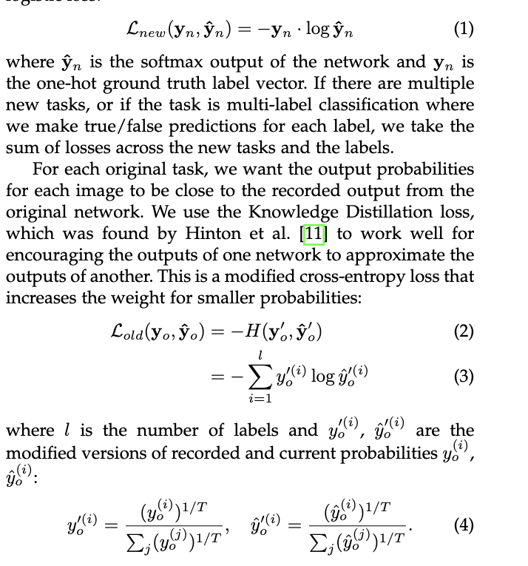
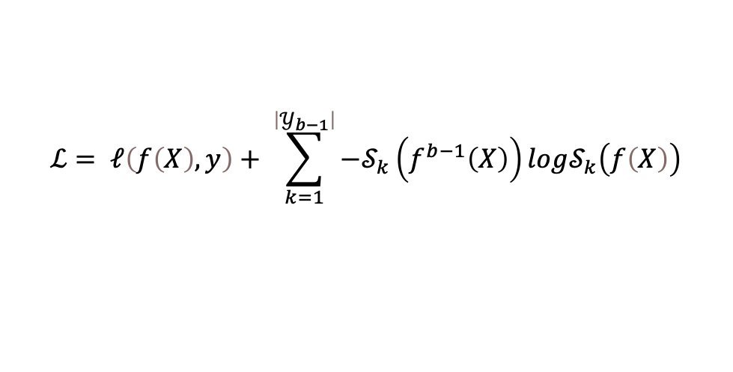
Lwf
$$ℒ= 𝓁\left(f\left(X\right), y\right)+ \sum_{k=1}^{\left|𝒴_{b−1}\right|}{−𝒮_{k}\left(f^{b−1}\left(X\right)\right)log𝒮_{k}\left(f\left(X\right)\right)}$$

Slide 13
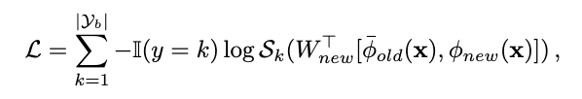
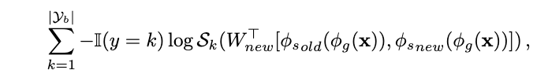
Der
MeMo

Slide 14

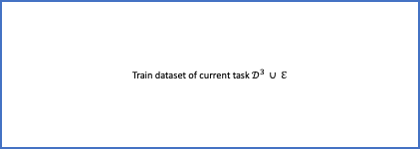

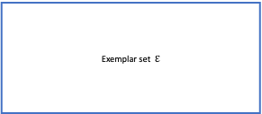



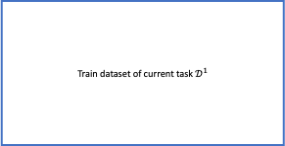









Der architecture
Train dataset of current task $𝒟^{1}$
Train dataset of current task $𝒟^{2} ∪ ℇ$
Train dataset of current task $𝒟^{3} ∪ ℇ$
$Φ_{1} = \left[ℱ_{1}\right]$
$Φ_{2} = \left[Φ_{1} , ℱ_{2}\right]$
$Φ_{3} = \left[Φ_{2} , ℱ_{2}\right]$
Feature extractor $ℱ_{1}$:
Random initilize
Feature extractor $Φ_{1}$
(Freeze)
Feature extractor $ℱ_{2}$:
Random initilize
Feature extractor $Φ_{2}$
(Freeze)
Feature extractor $ℱ_{2}$:
Random initilize
Classifier $H_{1}$:
Random initilize
Classifier $H_{2}$:
Random initilize
Classifier $H_{3}$:
Random initilize
Exemplar set $ℇ$
Exemplar set $ℇ$
Exemplar set $ℇ$

Slide 15
Loss Implementation in Pytorch
Finetune
logits = self._network(inputs)["logits"]
fake_targets = targets - self._known_classes
loss_clf = F.cross_entropy(logits[:, self._known_classes:], fake_targets)
loss = loss_clf
Der and MeMO
logits = self._network(inputs)["logits"]
loss = F.cross_entropy(logits, targets)

Slide 16
Loss Implementation
Lwf
logits = self._network(inputs)["logits"]
fake_targets = targets - self._known_classes
loss_clf = F.cross_entropy(
logits[:, self._known_classes:], fake_targets
)
loss_kd = _KD_loss(
pred=logits[:, : self._known_classes],
soft=self._old_network(inputs)["logits"],
T=T,
)
loss = lamda * loss_kd + loss_clf
def _KD_loss(pred, soft, T: int):
pred = torch.log_softmax(pred / T, dim=1)
soft = torch.softmax(soft / T, dim=1)
return -1 * torch.mul(soft, pred).sum() / pred.shape[0]

Slide 17
Training configuration
Init Epoch: 0.001
Batch_size: 128
Zscore Normalization for numeric
Dummy Encoding for category
3 layers ANN: Input -> nn.Linear(input_size -> 128) -> nn.Relu -> nn.Linear(128, 64) -> nn.Relu -> nn.FC -> SimpleLinear()
Exemplar size: 2000
KDD99 dataset: Drop all classes < 200 instances. Drop IP column, …
CIC-IDS-2017: Only use 200 / 2.2 billion normal connection due to memory problems

