Slide 1

Performance Analysis of Incremental Learning in Network Intrusion Detection
Student: Nguyễn Quang Minh 20194444
Supervisor: Dr. Trần Hải Anh

Slide 2
CONTENT
INTRODUCTION
PRELIMINARIES AND LITERATURE REVIEW
METHODOLOGY
NUMERICAL RESULTS
CONCLUSION

Slide 3
1. INTRODUCTION

Slide 4



Introduction
Network Intrusion Detection System (NIDS) monitors network traffic by analyzing data packets at network point to identify malicious actions.
Supervised neural network involves training a model on labeled dataset where the input data is associated with known labels.
Internet
NIDS
When new attacks emerge, the model failed to classify. => Incorporating Class Incremental Learning (CIL) to detect new attack types.
Notes:
NIDS use network traffic, collected via mirroring by network devices such as switches, routers to identify threats within network traffic.
The model learn patterns associated with different types of network traffic and classify new traffic accordingly.

Slide 5
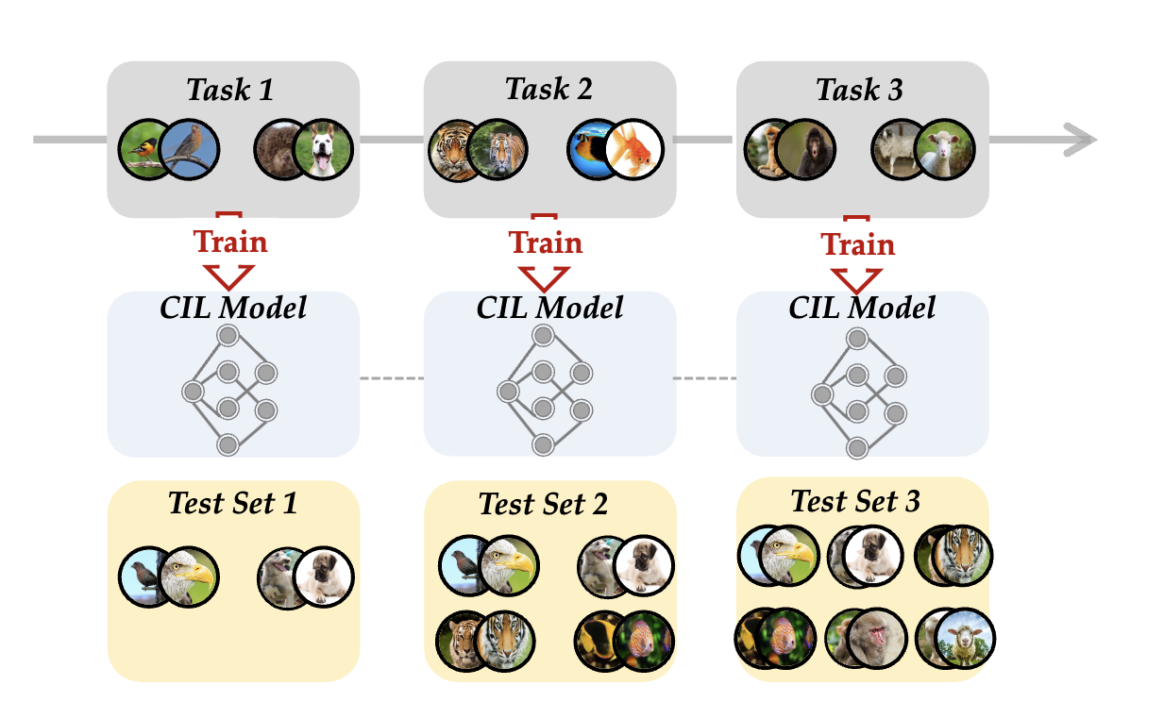
Class Incremental Learning
Stream of incoming new classes.
No overlapping classes.
Training data limited to current task.
Fig 1: Setting of CIL.
Source: Deep Class Incremental Learning: A survey

Slide 6
Class Incremental Learning
Benefits:
  Adaptability -> Allow NIDS to detect new attack classes
  Compute Resource Efficiency -> Reduce deployment time of NIDS
  Memory Efficient.
Challenges: Catastrophic forgetting
Catastrophic forgetting refers to the tendency of a neural network to completely previously learned information upon learning new data.
Notes:
The landscape of cyber threats is constantly evolving, with new attack techniques and patterns emerging regularly. Class incremental learning enables intrusion detection systems to adapt to these evolving threats by incorporating new attack classes or patterns without re- quiring a complete retraining of the model. This adaptability is crucial for maintaining the effectiveness of intrusion detection systems in detecting novel and sophisticated attacks.
Reduced Latency in Response: In network intrusion detection, timely detection and response to threats are critical to mitigate potential damages. Class incremental learning enables intrusion detection system to update their knowldge base rapidly with new attack signatures or patterns, leading to reduced latency in detecting and responding to emerging threats. This rapid response capability enhances the effectiveness of intrusion detection systems in mitigating the impact of cyber attacks

Slide 7
Contribution
Integration of Class Incremental Learning in Network Intrusion Detection System
Comparative Analysis of CIL methods:
  LWF: Learning Without Forgetting
  ICARL: Incremental Classifier and Representation Learning
  DER: Dynamic Expandable Representation
  MEMO: Memory Efficient Expandable Model
Evaluations on multiple NIDS datasets: KDD99, CIC-IDS-2017, UNSW-NB15, ToN-IoT-Network and a synthetic dataset.

Slide 8
2. PRELIMINARIES AND LITERATURE REVIEW

Slide 9
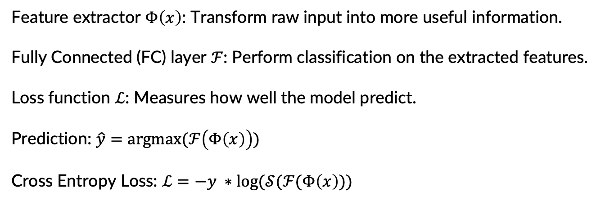
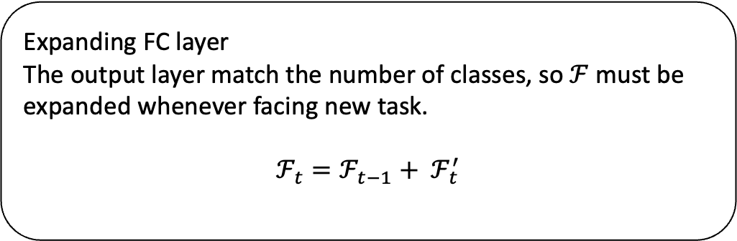
Preliminaries
Feature extractor $Φ\left(x\right)$: Transform raw input into more useful information.
Fully Connected (FC) layer $ℱ$: Perform classification on the extracted features.
Loss function $ℒ$: Measures how well the model predict.
Prediction: $\hat{y}=argmax(ℱ\left(Φ\left(x\right)\right))$
Cross Entropy Loss: $ℒ=−y ∗log⁡(𝒮(ℱ(Φ\left(x\right)))$
Expanding FC layer
The output layer match the number of classes, so $ℱ$ must be expanded whenever facing new task.
$$ℱ_{t}=ℱ_{t−1}+ ℱ_{t}^{′}$$
Notes:
With the help of the exemplar set, the model can utilize $ε ∪ D_{b}$ for the update within each task. The model manages the exemplar set after the training process of each task.

Slide 10
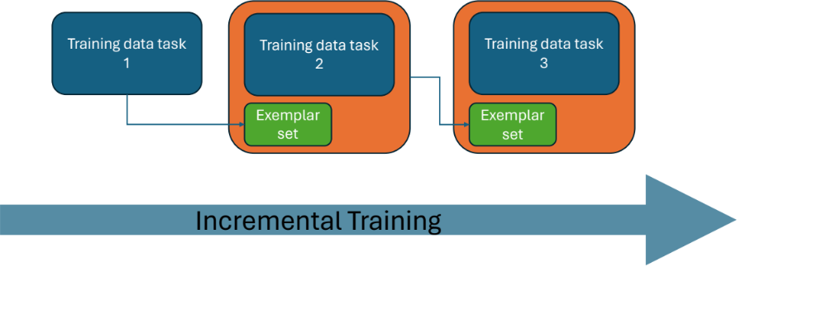
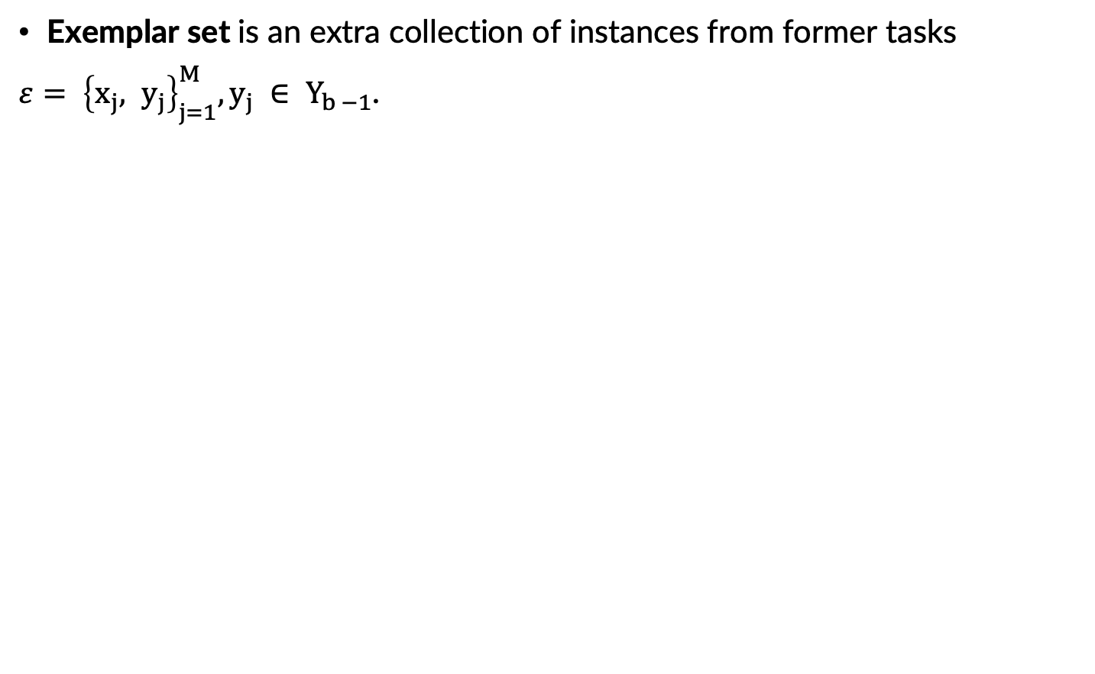
Preliminaries
Exemplar set is an extra collection of instances from former tasks
$ε= {\left\{x_{j}, y_{j}\right\}}_{j=1}^{M}, y_{j} ∈ Y_{b −1}$.
Notes:
With the help of the exemplar set, the model can utilize $ε ∪ D_{b}$ for the update within each task. The model manages the exemplar set after the training process of each task.

Slide 11
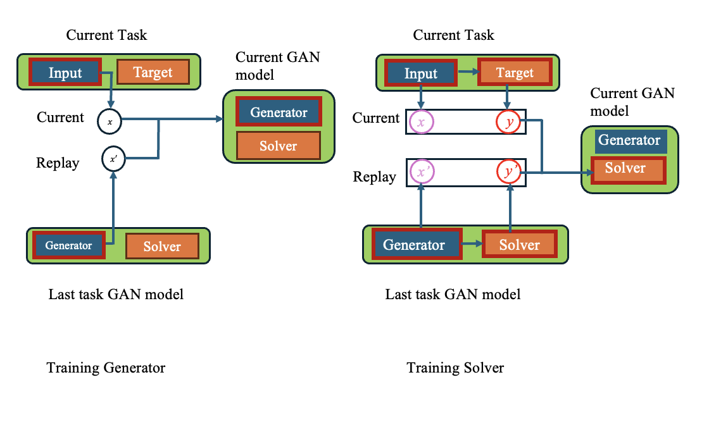
Related Works: Data Based Approach
Exemplar Based Methods: Selecting the most informative exemplars. [1] choose the most representative ones. [2] choose the most discriminative ones. [3] combines both of methods.
Generative Replays Methods:
[4] use generative model to create synthetic data that resemble previously learned classes.

Slide 12
Related Works: Model Based Approach
Network Expanding Methods: [5] [6] [7] Adjust the network architecture by adding new component to accommodate new task while preserving previously learned knowledge.
Knowledege Distilation Based Methods: [1] [8] Transfer knowledge of model from former task to current task model.
Regularization Based Methods: [9] Introduce constraints during the training process to prevent the model from significantly altering the weights asociated with previously learned classes.

Slide 13
3. METHODOLOGY

Slide 14
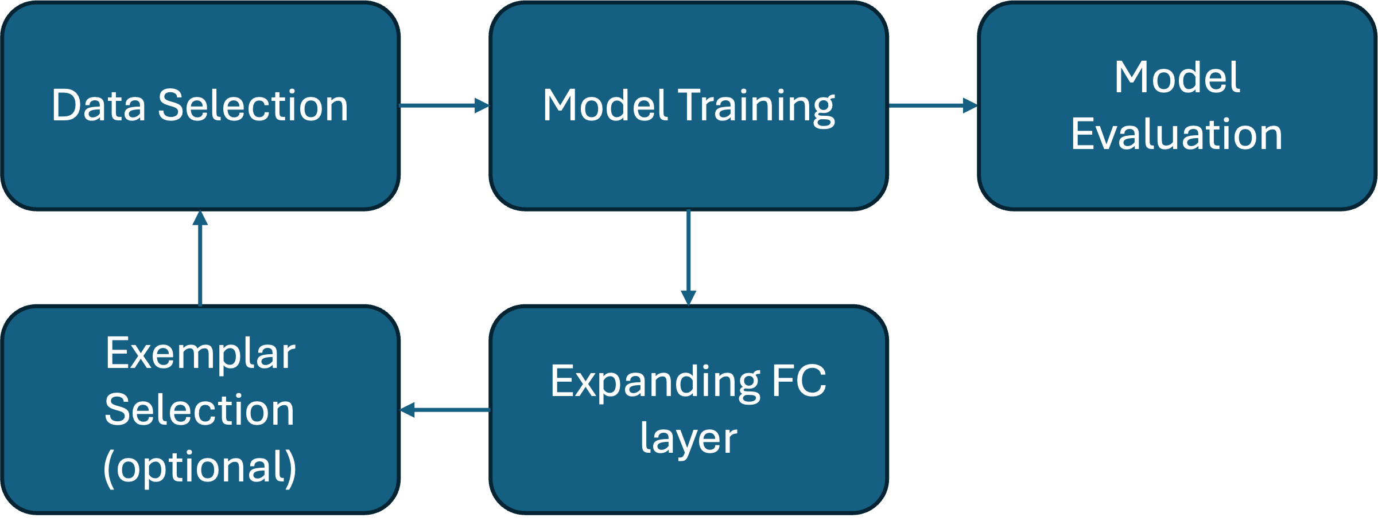
CIL Flow
The process is iterative, repeating whenever the model encounters a new task.

Slide 15
Benchmark Methods
The benchmark methods from 2 approaches:
Knowledge Distilation and Network Expanding.
 | Knowledge Distilation | Network Expanding | Exemplar Using
LWF | ✓ | ✗ | ✗
ICARL | ✓ | ✗ | ✓
DER | ✗ | Backbone Expand | ✓
MEMO | ✗ | Deep layer Expand | ✓

Slide 16
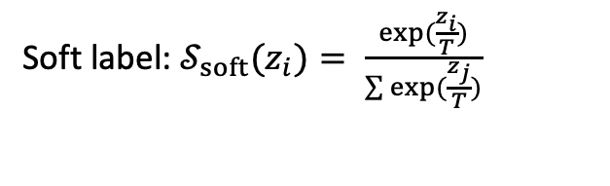
LWF: LEARNING WITHOUT FORGETTING
Soft label: $𝒮_{soft}(z_{i})= \frac{exp⁡(\frac{z_{i}}{T})}{\sum{exp⁡(\frac{z_{j}}{T})}}$
Distillation Loss: $ℒ_{old}=−𝒮_{soft}\left(ℱ_{teacher}\left(Φ_{teacher}\right)\right)∗Log(𝒮_{soft}\left(ℱ_{student}\left(Φ_{student}\right)\right))$
Ensemble of Models
Prediction
Dataset
Soft labels
Distillation Loss
Single Model
Prediction
Cross Entropy Loss
Actual labels

Slide 17
LWF: LEARNING WITHOUT FORGETTING
Soft label: $𝒮_{soft}(z_{i})= \frac{exp⁡(\frac{z_{i}}{T})}{\sum{exp⁡(\frac{z_{j}}{T})}}$
Distillation Loss: $ℒ_{old}=−𝒮_{soft}\left(\overline{ℱ_{t−1}}(\overline{Φ_{t−1}})\right)∗Log(𝒮_{soft}\left(ℱ_{t−1}\left(Φ_{t−1}\right)\right))$
Freeze model at task t - 1
Prediction
Dataset at task t
Soft labels
Distillation Loss
Model at task t
Prediction
Cross Entropy Loss
Actual labels

Slide 18
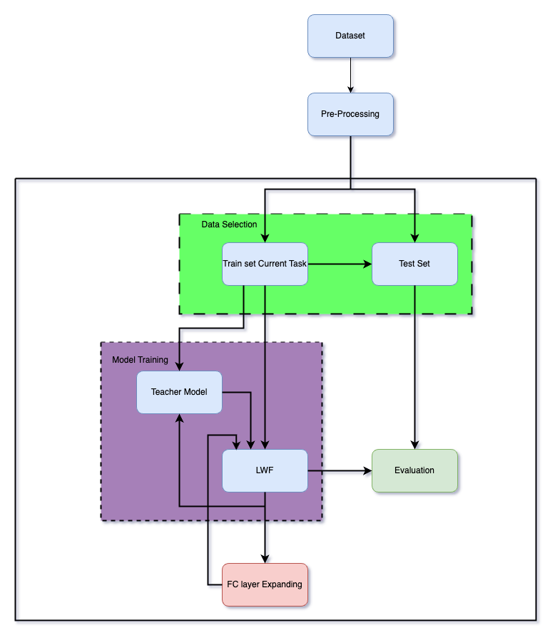
LWF Architecture

Slide 19
ICARL: Incremental Classification and Representation Learning
ICARL expands the work of LWF by proposing a combination of three key element:
Exemplar using.
Nearest-Mean-of-Exemplar (NME) classifier
Learning using Knowledge Distillation Loss (same as LWF).

Slide 20
Exemplar Using
ICARL suggests fixing total number of exemplar and employ herding for exemplar selection
Exemplar Management: ICARL proposes storing fixed $M$ number of total exemplars.
Training Task
Fix Exemplar Per Class
ICARL Fixed Number of total Exemplars
Notes:
Compared to fixed number of exemplar per class where it lead to linear increasing
memory, this approach maintains a constant memory size for the exemplar set.

Slide 21
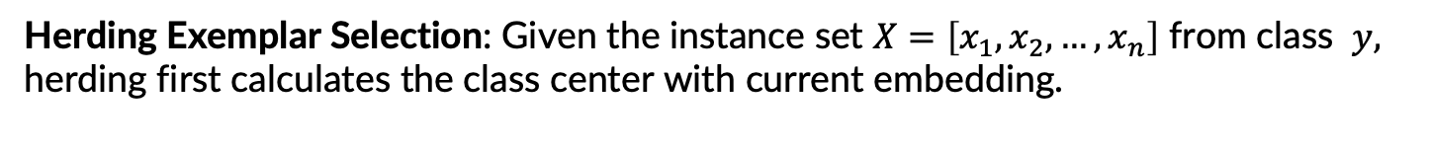
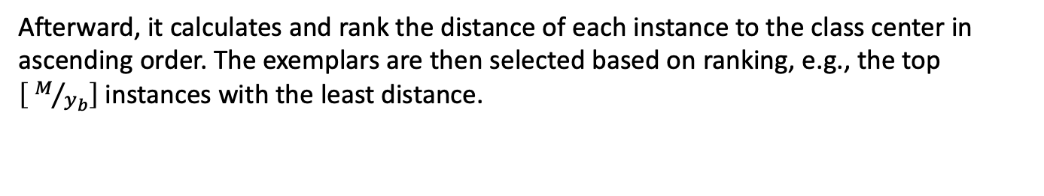
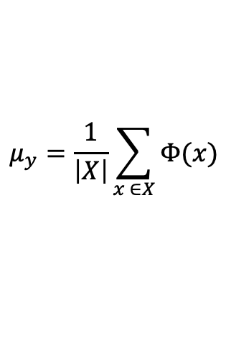
Exemplar Using
ICARL suggests fixing total number of exemplar and employ herding for exemplar selection
Herding Exemplar Selection: Given the instance set $X=\left[x_{1},x_{2},…,x_{n}\right]$ from class $y,$
herding first calculates the class center with current embedding.
$$μ_{y}=\frac{1}{\left|X\right|}\sum_{x ∈X}{Φ(x)}$$
Afterward, it calculates and rank the distance of each instance to the class center in ascending order. The exemplars are then selected based on ranking, e.g., the top $\left[ M/{y_{b}}\right]$instances with the least distance.
Notes:
:. This method prioritizes selecting the most representative data
points for each class, maximizing the information content stored within the limited
exemplar set. Since the class center can be seen as the most representative pattern of each class, selecting exemplars near the class center also enhance the representativeness of exemplars.

Slide 22
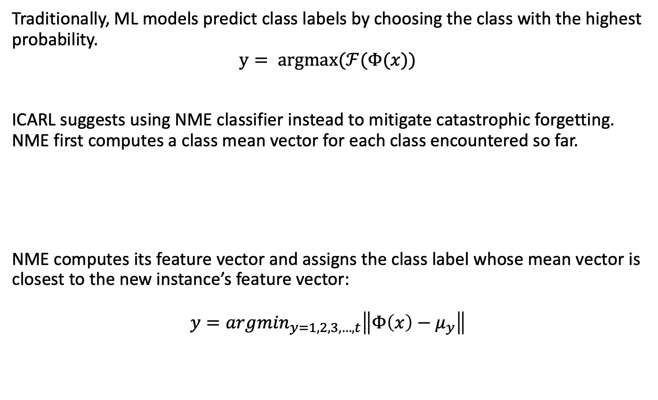
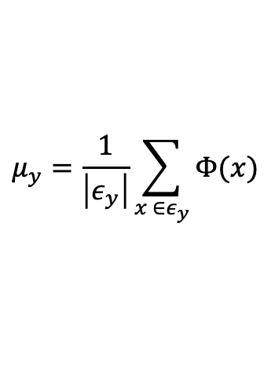
Nearest-Mean-of-Exemplar Classifier
Traditionally, ML models predict class labels by choosing the class with the highest probability.
$$y= argmax(ℱ(Φ(x))$$
ICARL suggests using NME classifier instead to mitigate catastrophic forgetting.
NME first computes a class mean vector for each class encountered so far.
NME computes its feature vector and assigns the class label whose mean vector is closest to the new instance’s feature vector:
$$y={argmin}_{y=1, 2,3, …, t}\left\|Φ\left(x\right)−μ_{y}\right\|$$
$$μ_{y}=\frac{1}{\left|ε_{y}\right|}\sum_{x ∈ε_{y}}{Φ(x)}$$
Notes:
where y is a class in the observed classes $1, 2, 3, …, t$. Then, for a new unseen instance,

Slide 23
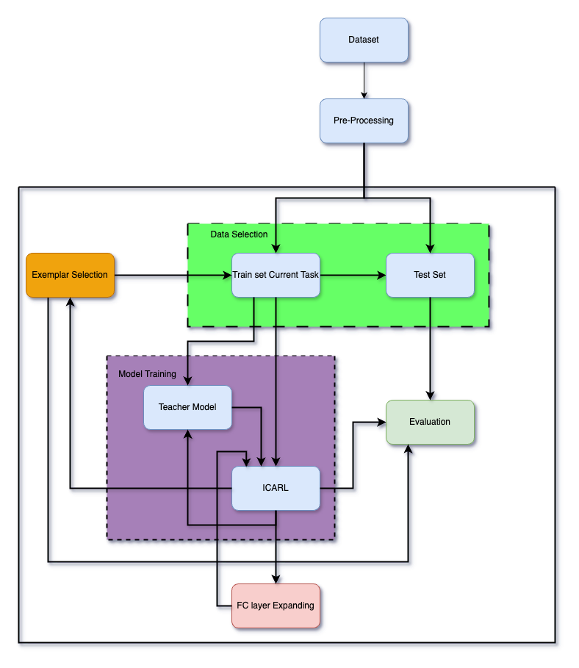
ICARL Architecture

Slide 24
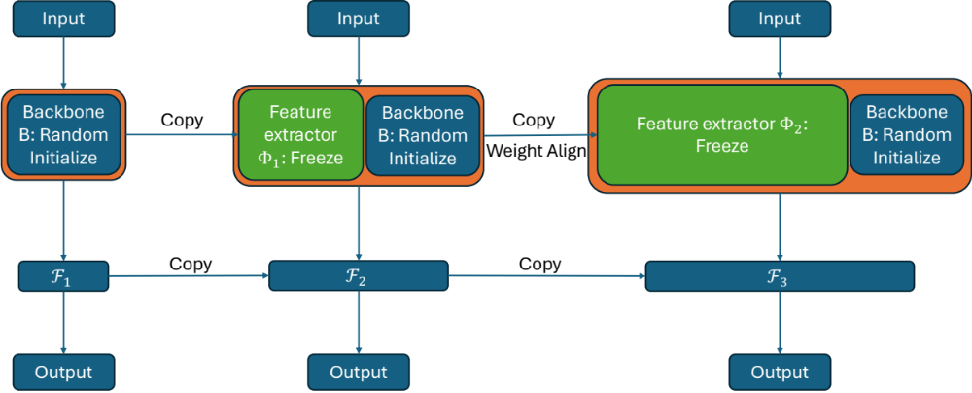
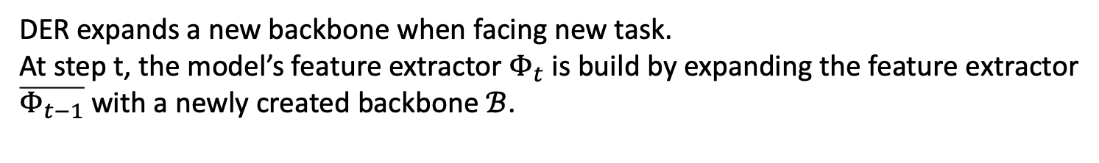

DER: Dynamic Expandable Representation
DER expands a new backbone when facing new task.
At step t, the model’s feature extractor $Φ_{t}$ is build by expanding the feature extractor
$\overline{Φ_{t−1}}$with a newly created backbone $ℬ$.
$$Φ_{t}\left(x\right)=\left[ \overline{Φ_{t−1}}\left(x\right), ℬ(x)\right]$$
Notes:
DER expands a new backbone when facing new task.
At step t, the model’s feature extractor Φt is build by expanding the feature extractor Φt−1 with a newly created backbone B.
To reduce model’s forgetting, the parameter of the last feature extractor Φt−1 is freeze. Since this component remains unchanged during subsequent learning stages, the features learned for previous tasks are preserved, preventing them from being overwritten by new information

Slide 25
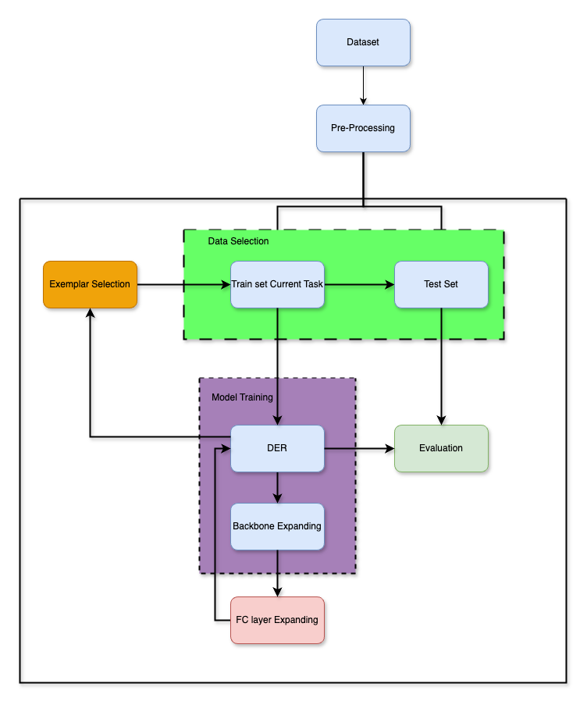
DER Architecture

Slide 26
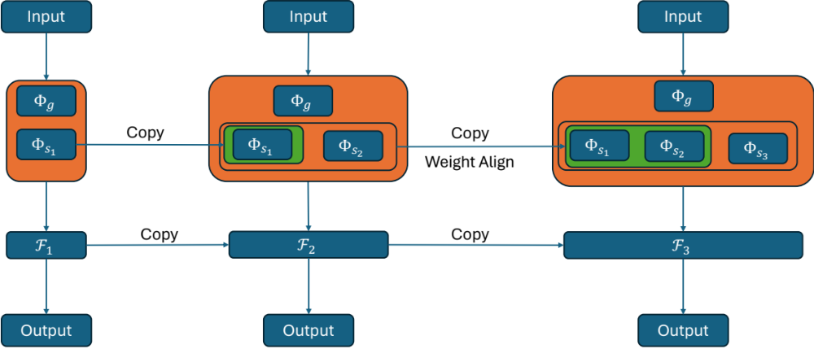
MEMO: Memory Efficient Expandable Model
Compared to DER, MEMO backbone was decomposing into specialized and generalized layers. MEMO only expand specialized layers.
Notes:
The model structure was redefined by decomposing the embedding layer module into specialized and generalized blocks. Specialized blocks correspond to the deep layers in the network, while generalized blocks correspond to the rest of the shallow layers. MEMO proposes to decouple the backbone at the middle level:

Slide 27
4. NUMERICAL RESULTS

Slide 28
Numerical results
The methods are tested on 5 datasets: KDD99, CIC-IDS-2017, UNSW-NB15, ToN-IoT-Network and a synthetic dataset.
The methods are evaluated using Last Accuracy and Average Accuracy.
  - Last Accuracy: evaluates the model’s accuracy on the most recent task it encountered during training.
  - Average Accuracy: The accuracy of the model on all tasks.

Slide 29
Data Preprocessing
Feature encoding
  One-Hot Encoding
  Min-Max Encoding
Feature Processing
  Duplicate removal
  Missing data removal
  Removing features with unique value and id feature.
Dataset Processing:
  Removing classes have less than 100 instances in CIC-IDS-2017 dataset and 200 instances in KDD99 dataset.

Slide 30
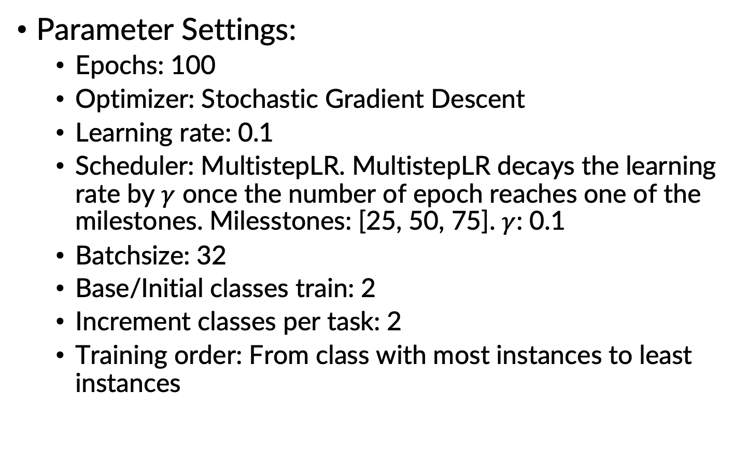
Implementation
Parameter Settings:
  Epochs: 100
  Optimizer: Stochastic Gradient Descent
  Learning rate: 0.1
  Scheduler: MultistepLR. MultistepLR decays the learning rate by $γ$ once the number of epoch reaches one of the milestones. Milesstones: [25, 50, 75]. $γ$: 0.1
  Batchsize: 32
  Base/Initial classes train: 2
  Increment classes per task: 2
  Training order: From class with most instances to least instances

Slide 31
Numerical Results
Evaluation on all datasets
 | Finetune | LWF | ICARL | DER | MEMO
KDD99 | 20,75 | 68,3 | 96,59 | 98,95 | 95,88
CIC-IDS-2017 | 22,03 | 13,15 | 49,93 | 32,27 | 25,96
ToN-IoT-Network | 38,26 | 52,06 | 66,24 | 40,25 | 38,32
UNSW-NB15 | 23,02 | 22,46 | 30,61 | 27,92 | 23,13
Synthetic | 45,9 | 50,21 | 99,99 | 100 | 99,88
Table 1: Average Accuracy of all methods on all datasets with exemplar size 2000
- LWF have better accuracy than Finetune in most case.
- Exemplar-based method (ICARL, DER, MEMO) outperforms exemplar-free method.
- ICARL gives competitive results in all datasets.

Slide 32
Numerical Results (2)
Evaluation on different exemplar size: [1000, 500, 250, 100]
Exemplar Size | ICARL | DER | MEMO
1000 | 99,99 | 99,96 | 99,84
500 | 99,99 | 100 | 99,88
250 | 96,13 | 99,82 | 79,84
100 | 69,25 | 96,3 | 64,1
Exemplar Size | ICARL | DER | MEMO
1000 | 96,39 | 94,57 | 94,5
500 | 80,43 | 93,02 | 58,74
250 | 62,86 | 51,59 | 21,02
100 | 67,11 | 33,73 | 20,75
Table 2: Averge Accuracy on Synthetic dataset
Table 3: Average Accuracy on KDD99 dataset
All methods performs equally well with sufficient exemplars (1000 and 500 exemplar on synthetic dataset and 1000 exemplar on KDD99 dataset.
All methods performances decreased when the size of exemplar decrease.
DER have better accuracy when exemplar size is large. For really small exemplar size, ICARL performs better.
DER performs better than MEMO in all exemplar size.

Slide 33
Numerical Results (3)
Evaluation of knowledge-distilation based methods with different temperature hyperparameter T = [0.25, 0.5, 1, 2, 4, 8]
T | LWF | ICARL
0,25 | 32,4 | 96,04
0,5 | 41,23 | 98,53
1 | 45,9 | 99,49
2 | 45,9 | 96,13
4 | 45,9 | 95,59
8 | 45,9 | 81,38
T | LWF | ICARL
0,25 | 20,38 | 98,42
0,5 | 20,52 | 97,03
1 | 20,75 | 96,17
2 | 20,75 | 96,39
4 | 20,75 | 96,17
8 | 20,75 | 95,93
Table 4: Averge Accuracy on Synthetic dataset 100
Table 5: Averge Accuracy on KDD99 dataset 500
- Temperature hyperparameter T have little effect on the performance of LWF.
- Higher T leads to decrease in the performance of ICARL in both datasets.

Slide 34
Numerical Results (4)
Evaluation of DER with NME classifier
Dataset | Normal Classifier | NME Classifier
KDD99 - 1000 | 94,57 | 97,88
CIC-IDS-2017 1000 | 27,38 | 71,83
ToN-IoT-Network 1000 | 38,26 | 95,19
UNSW-NB15 1000 | 24,32 | 31,37
Synthetic 100 | 96,3 | 99,77
Table 6: Averge Accuracy of DER with NME on all dataset, compared to normal DER
DER model with NME Classifier performs better than traditional DER in all datasets.

Slide 35
5. CONCLUSION

Slide 36
Conclusion
All benchmark methods perform better than the traditional model in incremental learning setup. However, their effectiveness heavily relies on the size of the exemplar set.
Soft label target is not effective in knowledge distillation approach.
NME classifier performs well in CIL compared to traditional classifier.
DER, combined with the NME classifier, achieve highest accuracy. However, DER is more resource expensive than other.

Slide 37
THANK YOU !

Slide 38
References
[1] S.-A. Rebuffi, A. Kolesnikov, G. Sperl, and C. H. Lampert, “Icarl: Incremental classifier and representation learning,”
[2] A. Chaudhry, P. K. Dokania, T. Ajanthan, and P. H. Torr, “Riemannian walk for incremental learning: Understanding forgetting and intransigence,”
[3] J. Bang, H. Kim, Y. Yoo, J.-W. Ha, and J. Choi, “Rainbow memory: Continual learning with a memory of diverse samples,”
[4] H. Shin, J. K. Lee, J. Kim, and J. Kim, “Continual learning with deep generative replay,”
[5] S. Yan, J. Xie, and X. He, “Der: Dynamically expandable representation for class incremental learning,”

Slide 39
References (2)
[6] F.-Y. Wang, D.-W. Zhou, H.-J. Ye, and D.-C. Zhan, “Foster: Feature boosting and compression for class-incremental learning,”
[7] D.-W. Zhou, Q.-W. Wang, H.-J. Ye, and D.-C. Zhan, “A model or 603 exemplars: Towards memory-efficient class-incremental learning,”
[8] Z. Li and D. Hoiem, “Learning without forgetting,”
[9] J. Kirkpatrick, R. Pascanu, N. Rabinowitz, et al., “Overcoming catastrophic forgetting in neural networks,”

Slide 40
APPENDIX

Slide 41
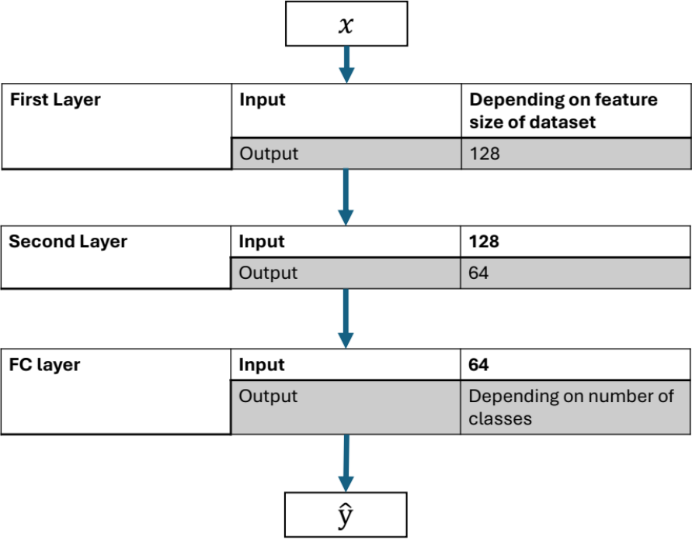
Backbone Architecture
LWF: Store 2 backbones at the time,
one for the model at the current task,
one for model from previous task
ICARL: Store 2 backbones at the time,
one for the model at the current task,
one for model from previous task
DER: Adding a backbone
whenever facing new task
MEMO: Adding second layer
whenever facing new task
Backbone Architecture

Slide 42
LWF: LEARNING WITHOUT FORGETTING
Dataset
Single Model
Prediction
Cross Entropy Loss
Actual labels
Idea: An ensemble of models predict better than a single model.
Knowledge distilation: Boost the accuracy of single model by transfer knowledge from an ensemble of models to the single model.

