Slide 1



An Phu Farm System
International School, Duy Tan University
CAPSTONE PROJECT 2
DIVINE TEAM
DN, 5/2016

Slide 2

DIVINE TEAM
Member:
Dang Doan Hai (Team Leader)
Chinh Nguyen Ba
Doan Le Dinh
Phuc Le Hoang
Mentor : MSc. Nguyen Minh Nhat

Slide 3
PROJECT OVERVIEW

Slide 4
Background
Nowadays, more and more hurtful food in market. An Phu Farm system, customer can have a live connect with An Phu Farm shop to search, booking fresh foods and another features.
An Phu Farm shop can increase competitive ability, grow the business performance and maximize the profits.
Additionally, the system will be developed with a Web Application to help user accessing anywhere, anytime.

Slide 5
Functions
Login
Show goods’s information
Show goods’s list
Shopping cart
News
Chat
Search by barcode
Online Payment

Slide 6
PROCESS DESCRIPTION

Slide 7
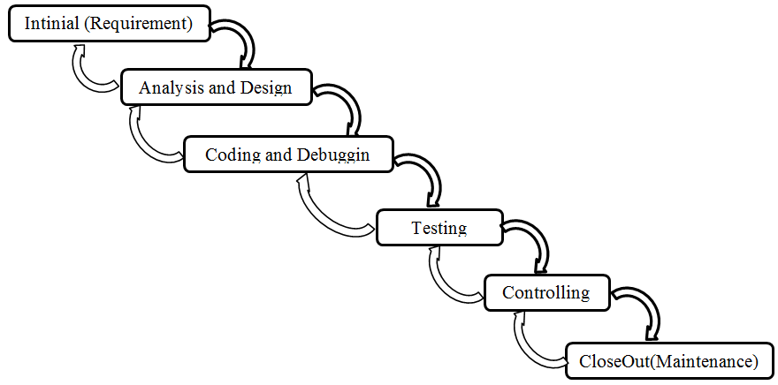
Waterfall Process

Slide 8
Advantages
  Simple easy to implement
  The amount of resources required to implement this model is very minimal
  documentation is produced at every stage of the waterfall model development. This makes the understanding of the product designing procedure simpler
  After every major stage of software coding, testing is done to check the correct running of the code

Slide 9
Disadvantages
  You cannot go back, if the design phase has gone wrong, things can get very complicated in the implementation phase.
  Many times, the customer does not specify exactly what they wanted in the software. Any changes that he mentions in between may cause a lot of confusion.

Slide 10
PROJECT PLAN
YOUR STYLE WEBSITE

Slide 11
Schedule
NO | TASK NAME | DURATION | START | FINISH
1 | Intinial | 13 days | 26/01/2016 | 21/02/2016
2 | Excution | 12 days | 22/02/2016 | 07/03/2016
 | Realization | 61 days | 08/03/2016 | 10/05/2016
3 | Testing & Controlling | 13 days | 02/05/2016 | 18/05/2016
4 | Closeout | 2 days | 19/05/2016 | 21/05/2016

Slide 12
Schedule
NO | TASK NAME | DURATION | START | FINISH
1 | Intinial | 13 days | 26/01/2016 | 21/02/2016
1.1 | Proposal Document Defining | 4 days | 26/01/2016 | 30/01/2016
1.2 | Project Plan Document Defining | 4 days | 30/01/2016 | 02/02/2016
1.3 | Process Description Document | 5 days | 17/02/2016 | 21/02/2016
2 | Excution | 12 days | 22/02/2016 | 07/03/2016
2.1 | SRS Document | 7 days | 22/02/2016 | 29/02/2016
2.2 | Detail Design Document | 5 days | 01/03/2016 | 5/03/2016
2.3 | Realization | 61 days | 08/03/2016 | 30/04/2016
2.3.1 | Release 1 Web | 40 days | 08/03/2016 | 30/4/2016
2.3.2 | Release 2 App | 21 days | 22/03/2016 | 18/04/2016
3 | Testing & Controlling | 13 days | 02/05/2016 | 18/05/2016
3.1 | Testing | 7 days | 02/05/2016 | 10/05/2016
3.2 | Training | 6 days | 11/05/2016 | 18/05/2016
4 | Closeout | 2 | 19/05/2016 | 21/05/2016

Slide 13
Total Cost Effort
Budget Cost Work Schedule
Resource Names | Duration (hrs) | Cost | January | February | March | April | May
Nguyen Ba Chinh | 208 | $312 | $2.25 | $20.25 | $129 | $108 | $52.50
Doan Hai Dang | 215.5 | $323.25 | $5.25 | $25.50 | $144 | $120 | $28.50
Le Hoang Phuc | 201.5 | $302.50 | $2.25 | $16.50 | $136.50 | $99 | $48
Le Dinh Doan | 197.5 | $296.25 | $2.25 | $16.50 | $129 | $99 | $49.50
Total | 822.5 | $1,234 | $12 | $78.75 | $538.50 | $426 | 178.5

Slide 14
REQUIREMENTS
YOUR STYLE WEBSITE

Slide 15
Software Requirement
User | Description
Customer | This user can search fresh food, booking, and contact with shop manager and another features
Shop Manager | This user can general manage product or category’s information and user’s information.

Slide 16
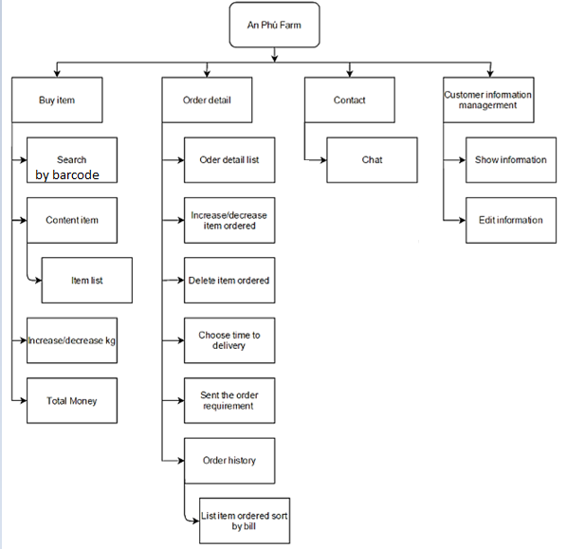
Work Break Down Structure

Slide 17
SYSTEM ARCHITECTURE

Slide 18
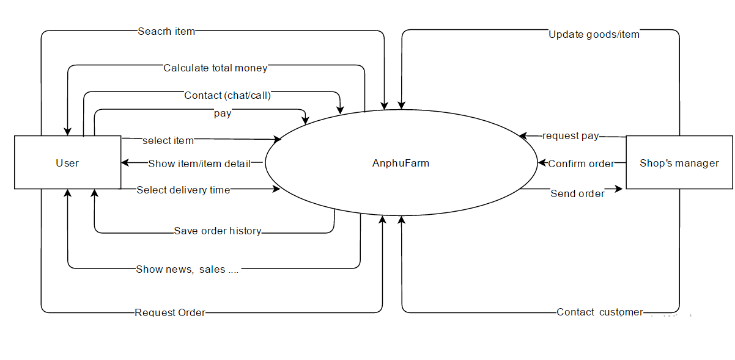
Context diagram

Slide 19
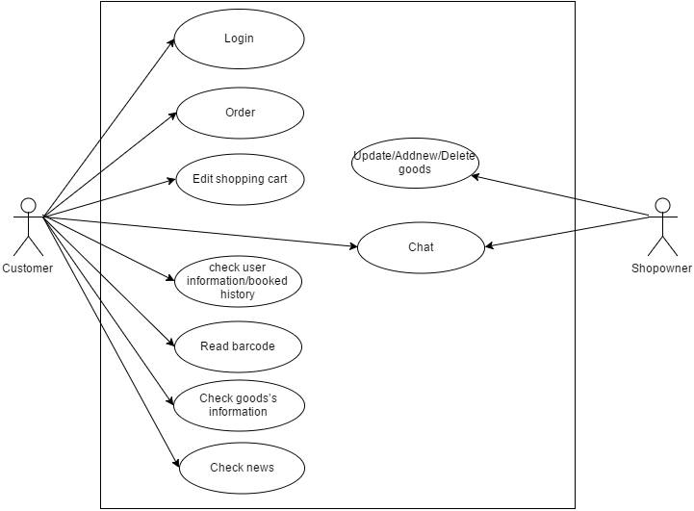
Use Case

Slide 20
Technology
Website: Spring Web MVC with JSTL.
Android: Using Eclipse with Spring tools and Android SDK.
Web service and input database: Spring Web service with json, Sqlite in Android.
Database System: MySQL 6.3, Sqlite browser.
Eclipse Database environment: Web service.
Other tools: draw.io, Microsoft Office, Microsoft Excel.

Slide 21
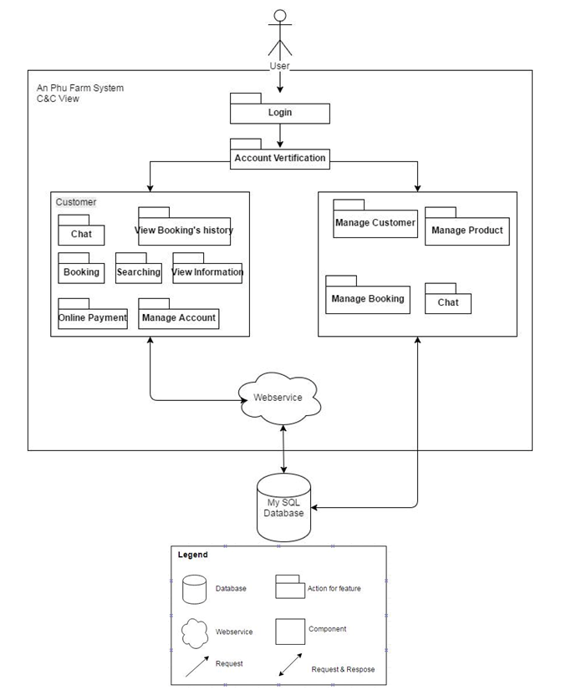
C&C View

Slide 22
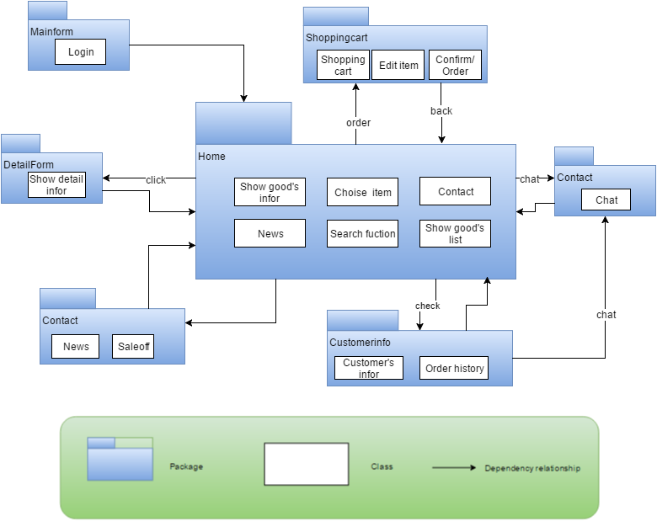
Module View

Slide 23
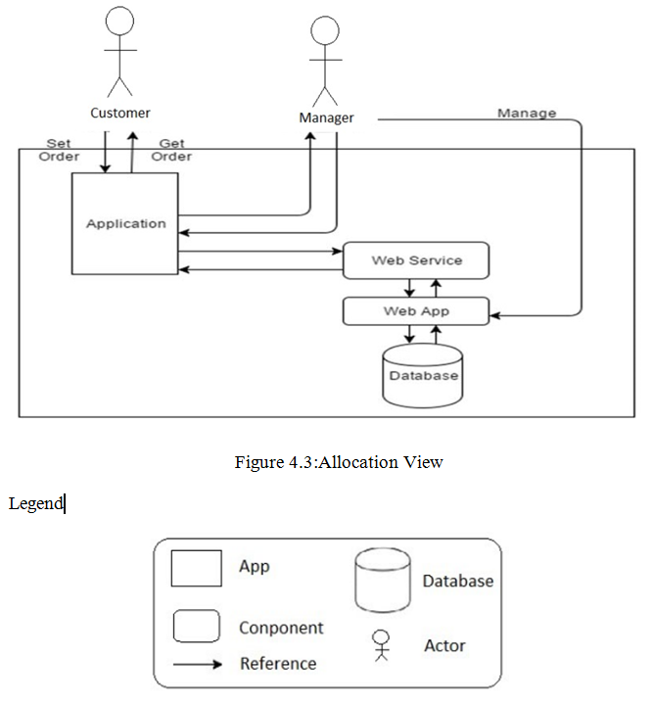
Allocation View

Slide 24
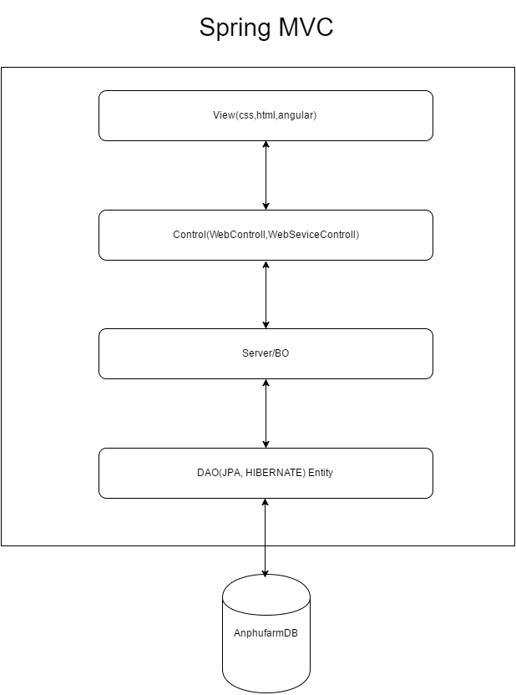
Framework Spring MVC

Slide 25
DATABASE

Slide 26
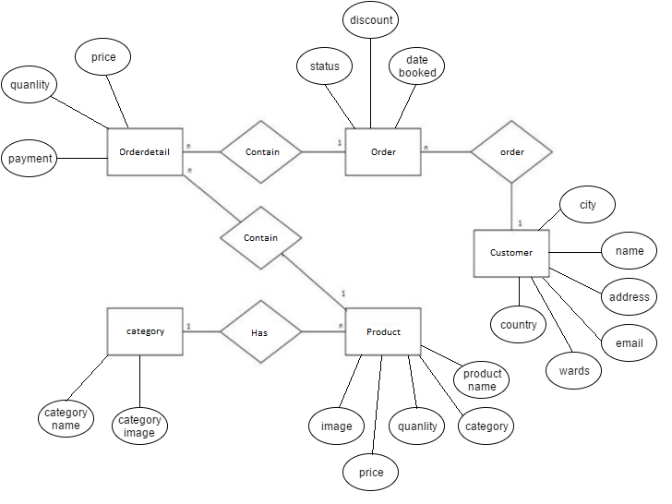
ERD

Slide 27
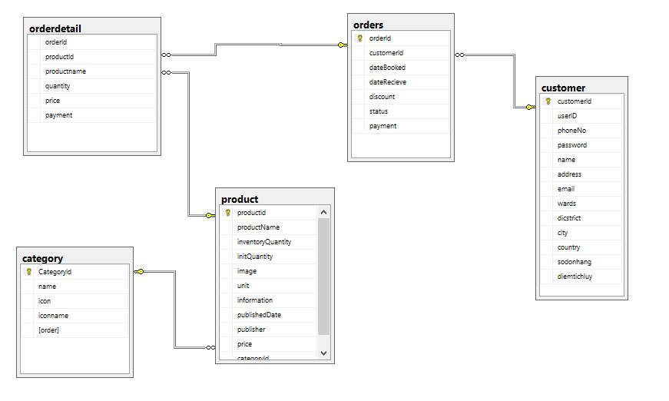
RDM

Slide 28
TESTING

Slide 29
Test Report
Test App
Total : 33
Pass : 27
Fail : 6
Test Web
  Total : 35
  Pass : 23
  Fail : 12

Slide 30
Earn Value
Budget At Completion | BAC | $1,023.28
Budgeted Cost of Work Scheduled | BCWS | $1,234.00
Budgeted Cost of Work Performed | BCWP | $1,234.00
Actual Cost of Work Performed | ACWP | $1,283.25
Cost Variance | CV= BCWP-ACWP | -$49.25
Schedule Variance | SV=BCWP-BCWS | $0.00
Cost Performance Index | CPI=BCWP/ACWP | $0.96
Schedule Performance Index | SPI= BCWP/BCWS | $1.00
Cost Schedule Index | CSI=CPI*SPI | $0.96

Slide 31
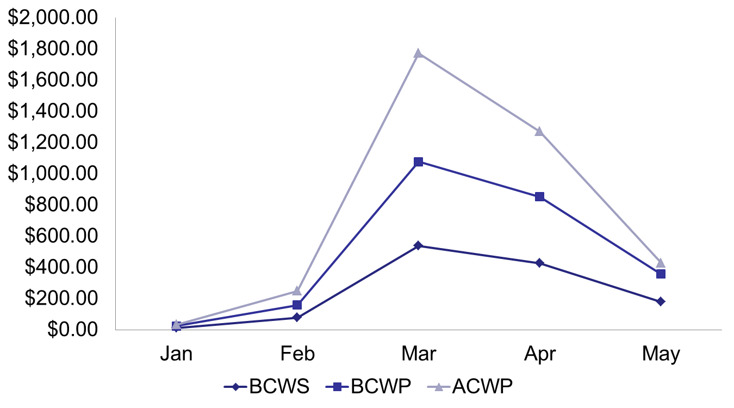
Earn Value

Slide 32
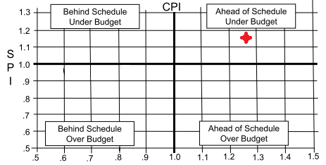
Earn Value

Slide 33
PROTOTYPE

Slide 34
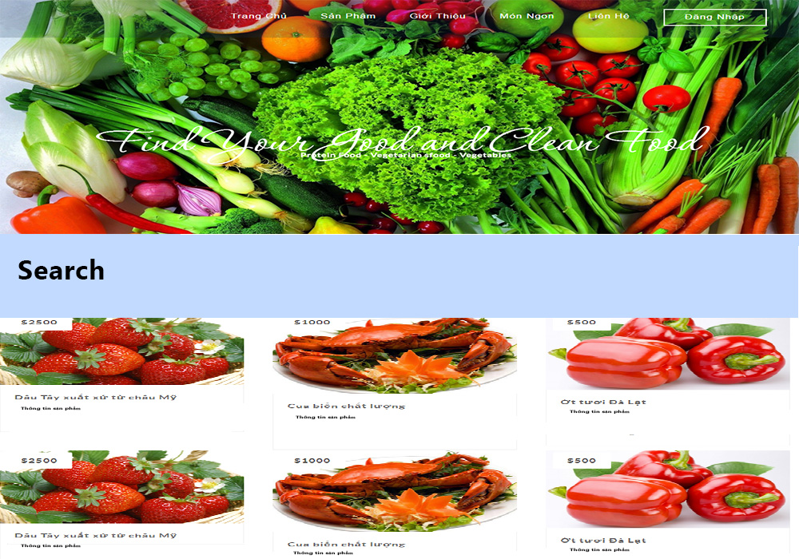
Web Homepage

Slide 35
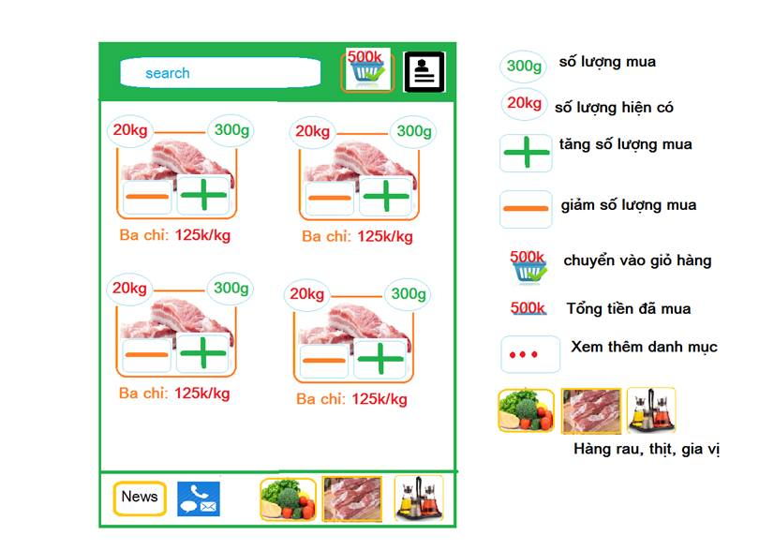
App

Slide 36
MANAGEMENT

Slide 37
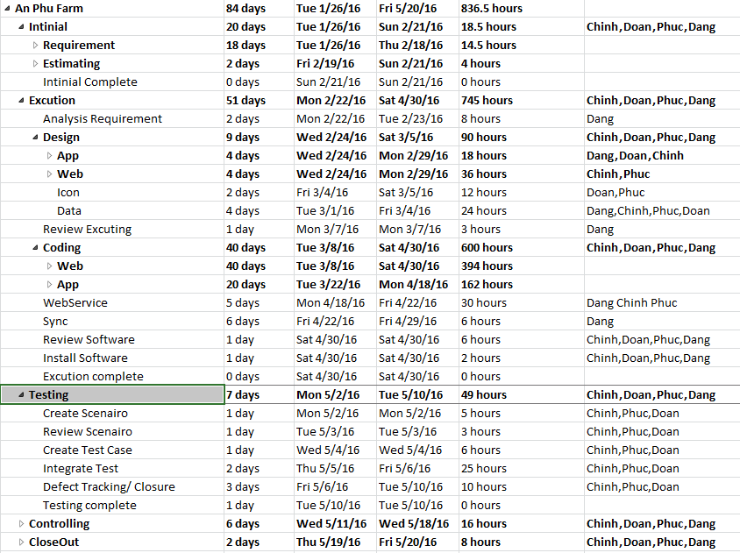
Master Plan

Slide 38
Management Tool
Team work
Google Driver
Facebook

Slide 39
Manage Code
Manage code by SVN

Slide 40
REFLECTION

Slide 41
Advantage
Waterfall has a perfect documents collection.
The documents support to manage project is full and really effective.
Mentor is very enthusiastic.
All members effort to complete project

Slide 42
Disadvantage
Communication with team member.
Team work.
Ability of each member.
Follow to customer’s requirement.
First time working with Spring Framework

Slide 43
Lessons From Project
Experiences.
Team-working.
Spring Framework.
Web development.
Communication

Slide 44
Thank you for your listening !

