Slide 1


AnPhuFarm System
DIVINE TEAM

Slide 2
Mentor : MSc. Nguyen Minh Nhat
Group name : Divine Team
Member:
+ Dang Doan Hai (Team Leader)
+ Chinh Nguyen Ba
+ Doan Le Dinh
+ Phuc Le Hoang

Slide 3
BACKGROUND
Nowadays, more and more hurtful food in market. An Phu Farm system, customer can have a live connect with An Phu Farm shop to search, booking fresh foods and another features.
An Phu Farm shop can increase competitive ability, grow the business performance and maximize the profits.
Additionally, the system will be developed with a web application to help user accessing anywhere, anytime.

Slide 4
VISION
For users who wish to order goods from ours website or from ours android application, the An Phu Farm System is an Internet-based application that will accept individual goods orders, process payments. Unlike the current telephone and manual ordering processes, users who use the An Phu Farm System will not have to go to the shop to get their goods, which will save them time and will increase the food choices available to them.

Slide 5
FUNCTION
FE-1: Show foods’s informations.
FE-2: Show foods’s images.
FE-3: Show foods’s price
FE-4: Online order.
FE-5: Search by bar code
FE-6: Online’s chat.
FE-7: Online’s payment.
FE-8: Show foods’s news.
FE-9: Show foods order‘s history.
FE-10: Food’s shopping cart

Slide 6
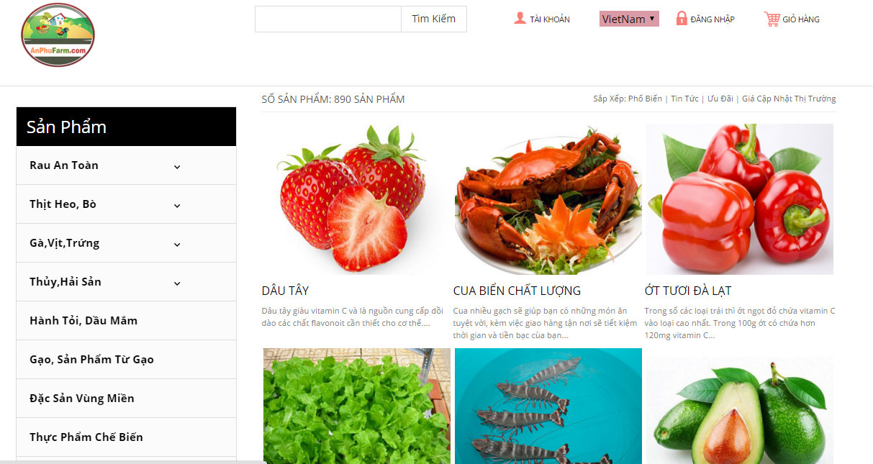
WEB INTERFACE

Slide 7
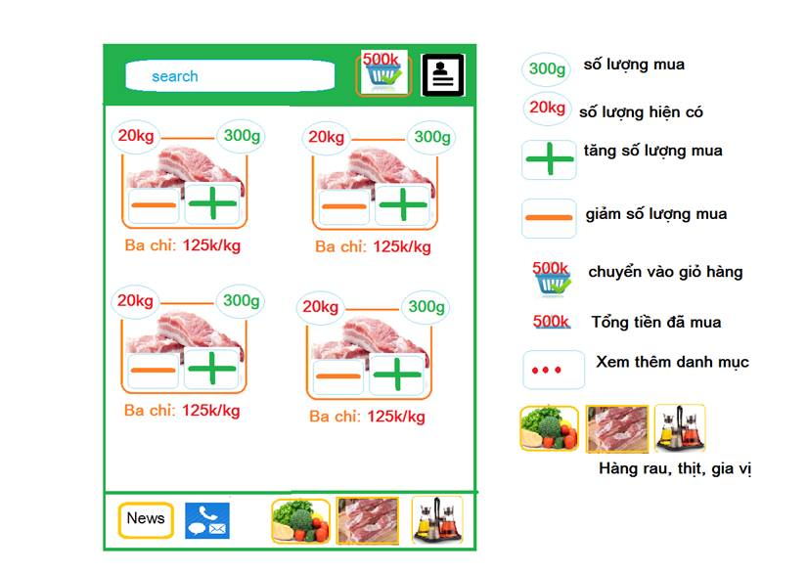
App Interface

Slide 8
ARCHITECTURE

Slide 9
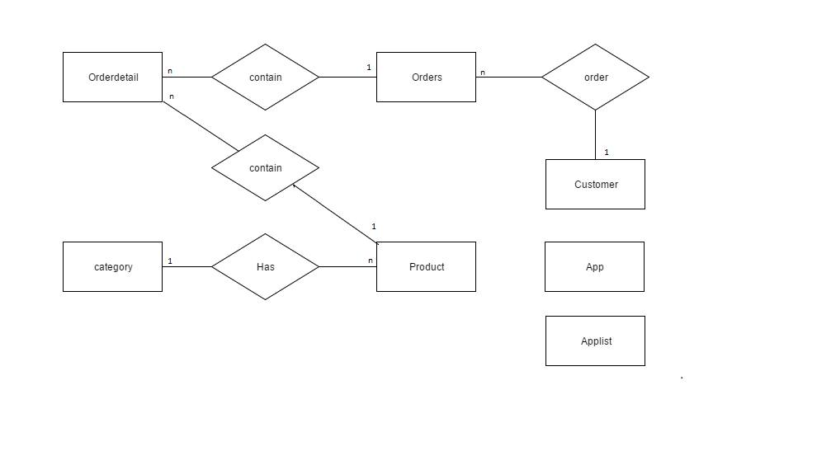
DATABASE ERD DIAGRAM

Slide 10
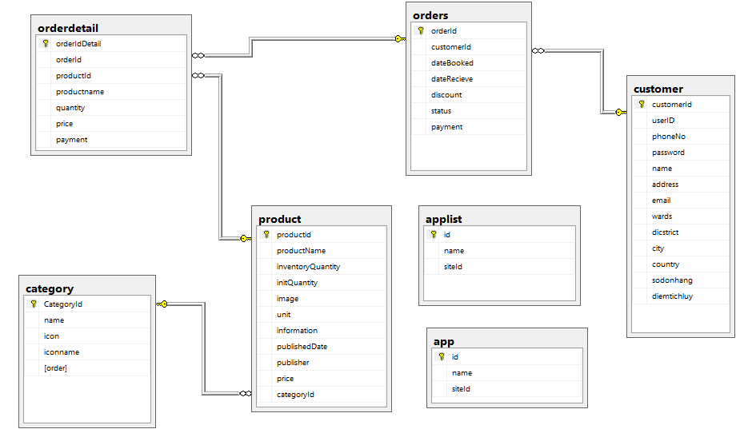
DATABSE RDM DIAGRAM

Slide 11
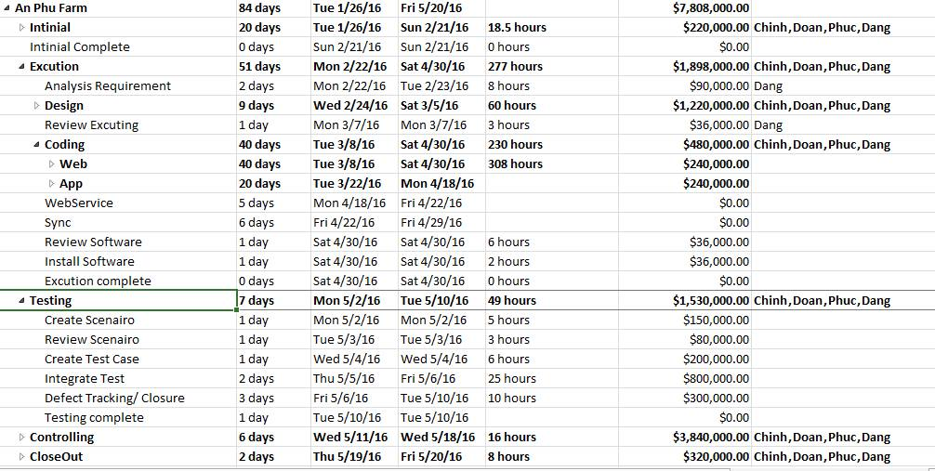
MANAGEMENT

Slide 12
MANAGEMENT TOOL
Teamwork
Google Drive
Facebook

Slide 13
Thank you for your listening !

