Slide 1

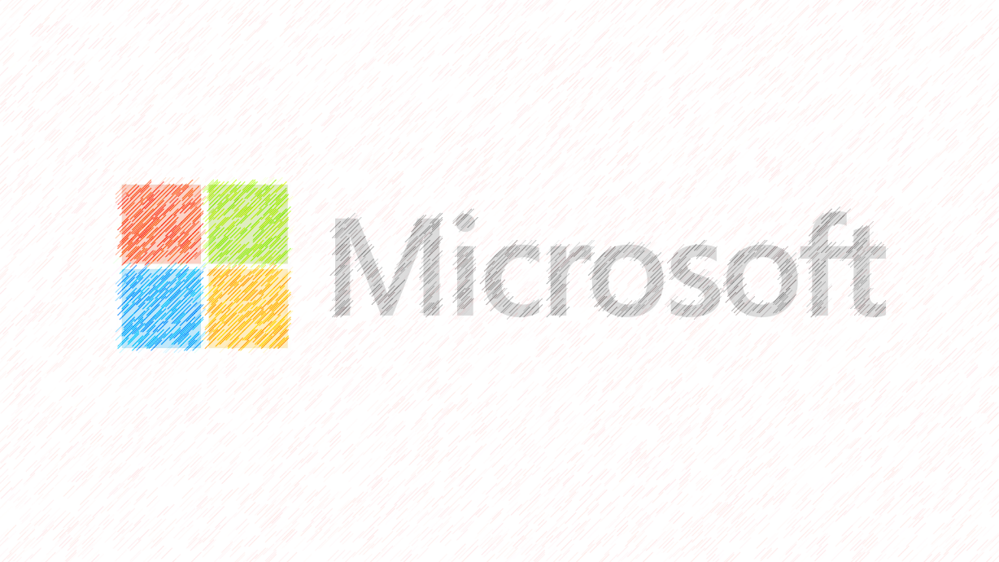
Microsoft:
1. What’s Microsoft.
2. Who founded Microsoft.
3. Their products.
4. A few of their achievements.

Slide 2
1. What’s Microsoft:
-Microsoft Corporation is an American multinational technology company with headquarters in Redmond, Washington.
-The word "Microsoft" is a portmanteau of "microcomputer" and "software”.
-(1)-It develops, manufactures, licenses, supports and sells computer software, consumer electronics, personal computers, and related services.
-(2) - Microsoft is ranked No. 30 in the 2018 Fortune 500 rankings of the largest United States corporations by total revenue.

Slide 3
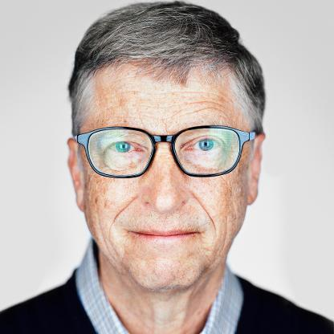
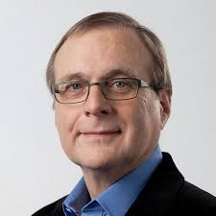
2. Who founded Microsoft
-Microsoft was founded by Bill Gates and Paul Allen on April 4, 1975, to develop and sell BASIC interpreters for the Altair 8800.
Bill Gates
Paul Gardner Allen
Born:
28 tháng 10, 1955 Seattle, Washington, US.
Born:
January 21, 1953
Seattle, Washington, U.S.
Died:
October 15, 2018 (aged 65) Seattle, Washington, U.S.
--Microsoft was founded by Bill Gates and Paul Allen on April 4, 1975, to develop and sell BASIC interpreters for the Altair 8800. It rose to dominate the personal computer operating system market with MS-DOS in the mid-1980s, followed by Microsoft Windows. The company's 1986 initial public offering (IPO), and subsequent rise in its share price, created three billionaires and an estimated 12,000 millionaires among Microsoft employees. Since the 1990s, it has increasingly diversified from the operating system market and has made a number of corporate acquisitions, their largest being the acquisition of LinkedIn for $26.2 billion in December 2016, followed by their acquisition of Skype Technologies for $8.5 billion in May 2011.
--As of 2015, Microsoft is market-dominant in the IBM PC compatible operating system market and the office software suite market, although it has lost the majority of the overall operating system market to Android. The company also produces a wide range of other consumer and enterprise software for desktops, laptops, tabs, gadgets, and servers.
--In 2018, Microsoft surpassed Apple Inc. as the most valuable publicly traded company in the world after being dethroned by the tech giant in 2010.[14] In April 2019, Microsoft reached the trillion-dollar market cap, becoming the third U.S. public company to be valued at over $1 trillion after Apple and Amazon respectively.

Slide 4
3. products
1985–1994: Windows and Office.
1995–2007: Foray into the Web, Windows 95, Windows XP, and Xbox.
2007–2011: Microsoft Azure, Windows Vista, Windows 7, and Microsoft Stores.
2011–2014: Windows 8/8.1, Xbox One, Outlook.com, and Surface devices.
2014–present: Windows 10, Microsoft Edge and HoloLens.

Slide 5
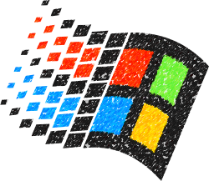
4. Achivements
--Windows 95(24th august,19950)
Codename Chicago, Windows 95 launched with $300 million marketing campaign with people such as Jay Leno and the Rolling Stones putting their weight behind the product. The software launch was made into a cultural event long before Apple and Google came to the forefront.
This was the software that cemented Microsoft as the operating systems for computers to be using at the time.

Slide 6
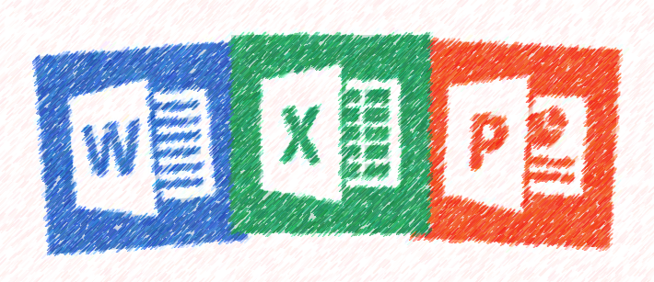
--Microsoft Office(19th November, 1990)
Microsoft Office can be seen as initially starting with it’s first Word processor for MS-DOS in 1983 that had two notable features. It could bold, italic, and underline formatting on-screen and it worked with a mouse. Things we take for granted today. Microsoft Office came into the picture as an application suite in 1990 with Word, Excel, and Powerpoint. While those programs continue to be the backbone of Office, Access, Outlook, and OneNote have all become major components as well, along with a host of other applications.
Today, Office dominates the productivity suite market. Competition from Apple software and Google Apps has arisen, but nothing has come close to the popularity of Office.

Slide 7
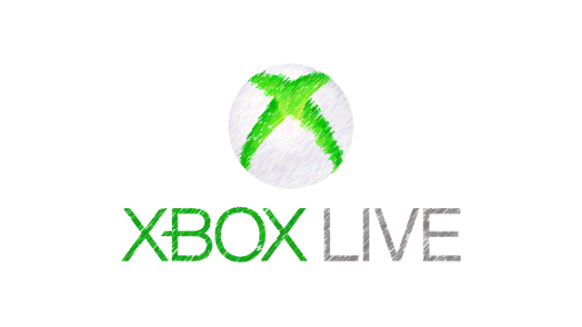
--Xbox Consoles
Xbox has had its ups and downs, primarily the Red Ring of Death fiasco that ended up costing the company over a billion dollars. Xbox 360s would easily overheat and die. Later models fixed the issue, but the damage was done. However, it’s also become a major player in the video game console market going head to head with Sony and Nintendo.
The Xbox 360 has sold over 77.2 million consoles worldwide. Xbox Live is widely the considered the most robust online platform and has over 48 million members.

Slide 8
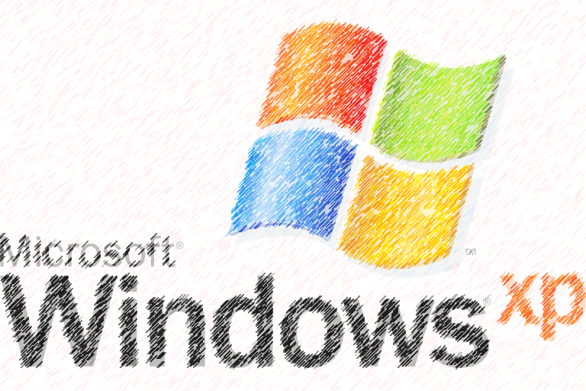
--Windows XP(25th October, 2001)
Windows XP launched in 2001 and had the best features of all of Microsoft’s past operating systems. An estimated 400 million copies of XP were sold globally in its first five years, and over a billion were sold by April 2014.
Windows XP had an extraordinary long life cycle, because of the poor reception for Vista. XP continued to be the primary operating software for many. It was the most widely used operating system until 2012 when Windows 7 surpassed it, meaning it was widely used for 11 years.

Slide 9

--Skype(august, 2003)
Skype was first released way back in 2003. Two years later it was acquired by eBay for $2.6 million. By the time Microsoft decided to buy, they had to pay $8.5 billion. The app was known as the primary method for video chatting and also offered messenger, file exchange, and other communications. The name comes from “Sky peer-to-peer.” It was then abbreviated to “Skyper,” but the domain names weren’t available, so the “r” was dropped and it became Skype.
Skype’s market share of international calls has gone from 13% to 34% since being acquired by Microsoft and its number of users has gone upwards of 50 million.

Slide 10
The end.

