Slide 1
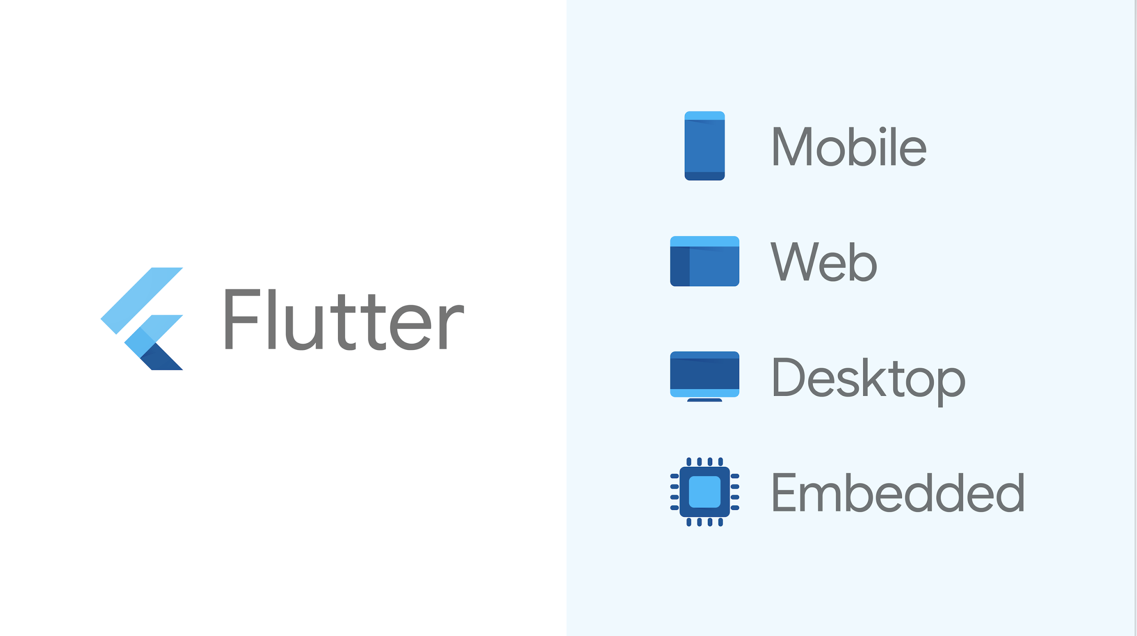

Slide 2

Introduce
Everything a Widget
Content
State, Stateful && Stateless
BuildContext, InheritedWidget

Slide 3




Introduce
WHAT IS FLUTTER ?
Fast Development
Expressive and Flexible UI
Native Performance

Slide 4
Introduce
What are the pros of Flutter?
What are the cons of Flutter?
• One codebase for IOS and Android
• Faster coding
• Great performance
• User Interface
• Open-source
• Perfect choice for MVP
• Young technology

Slide 5
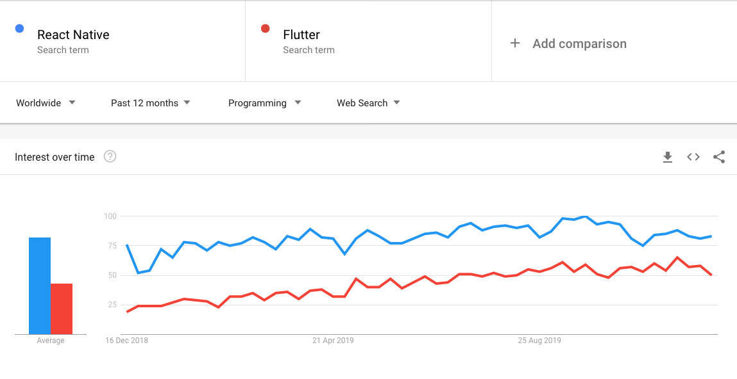
Introduce
Flutter vs React Native in 2019

Slide 6
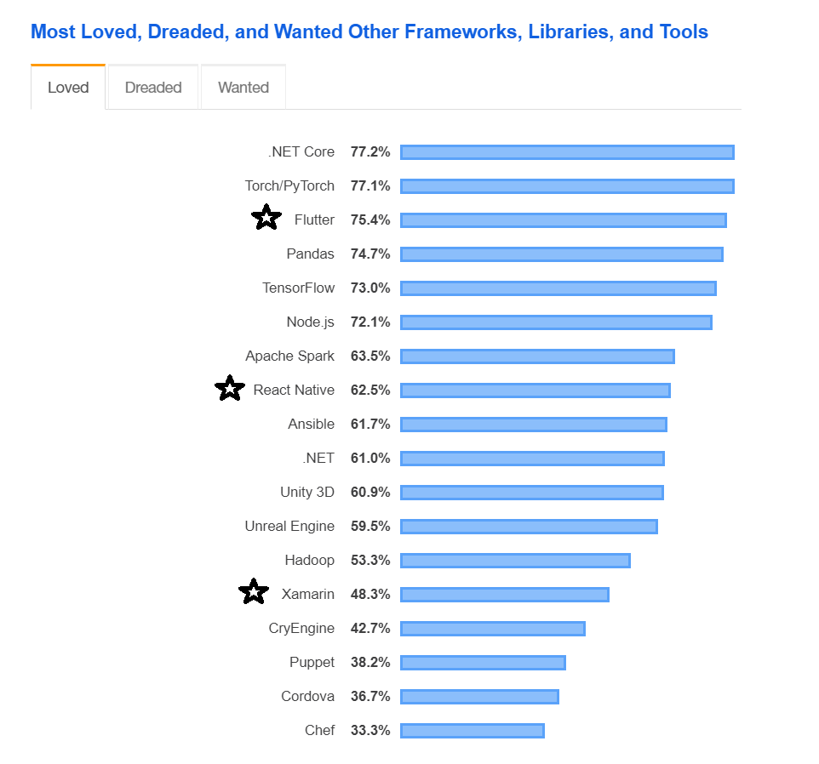
Introduce
Flutter vs React Native in 2019

Slide 7
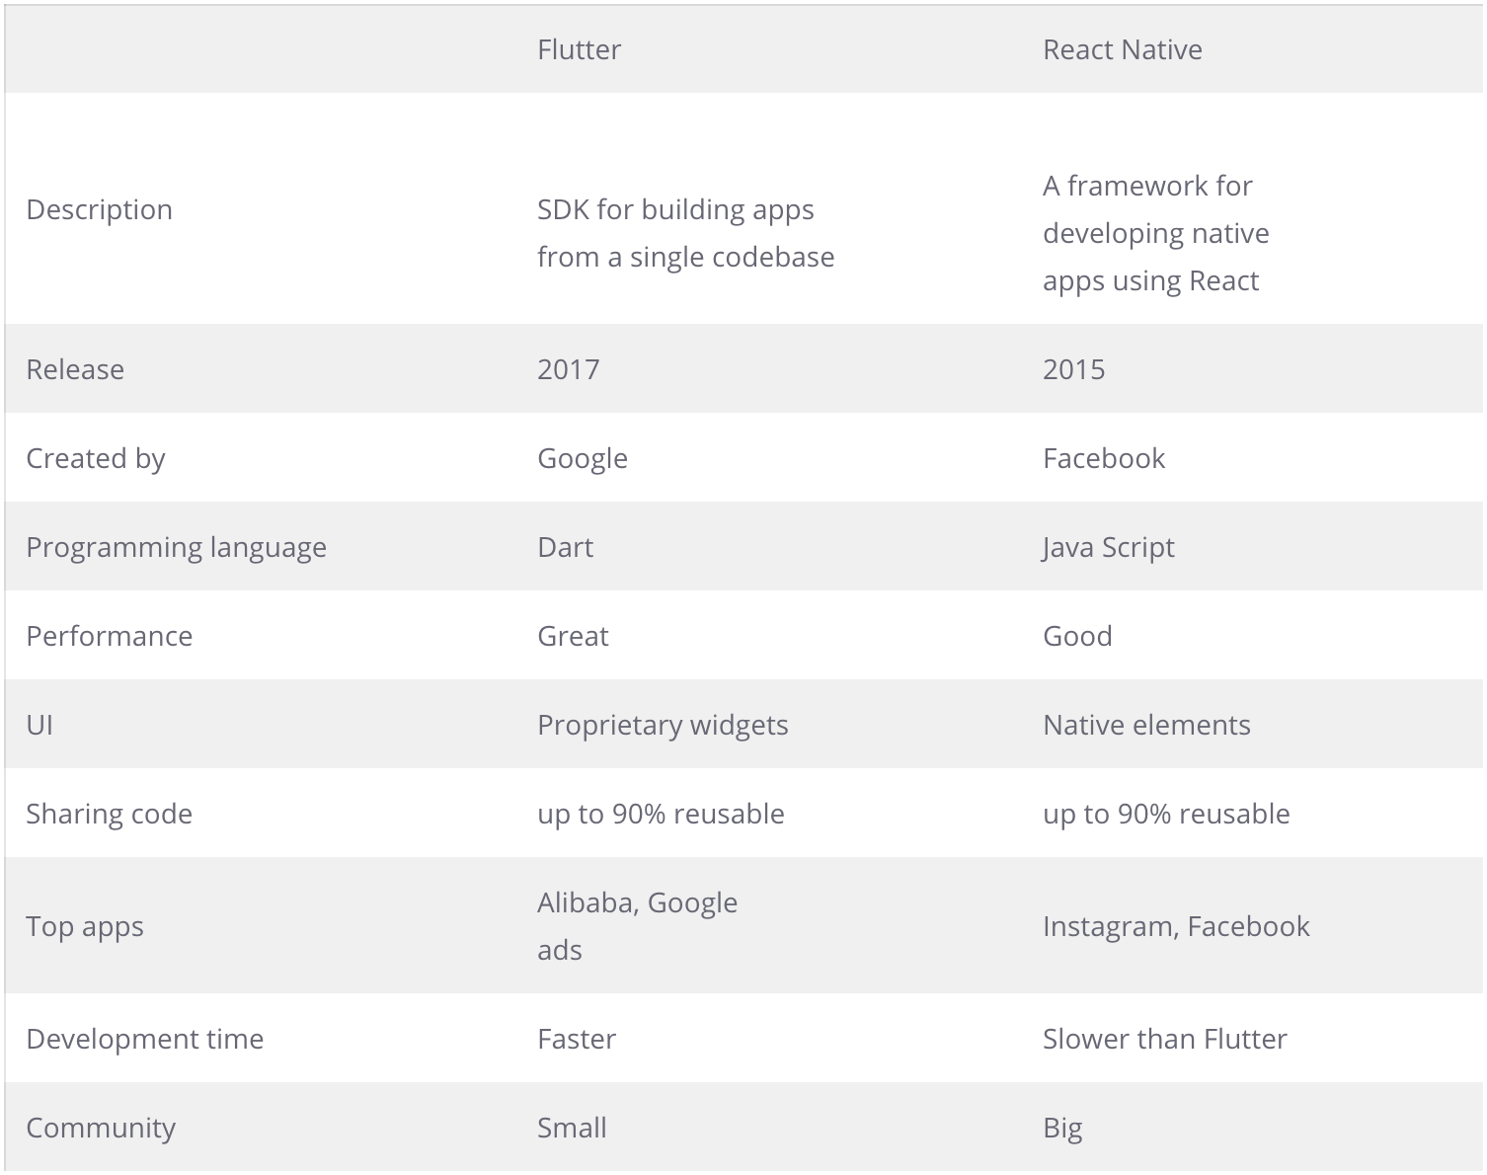
Introduce
Flutter
vs
React Native

Slide 8
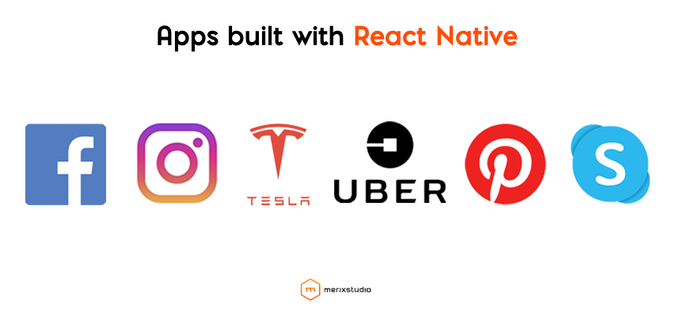
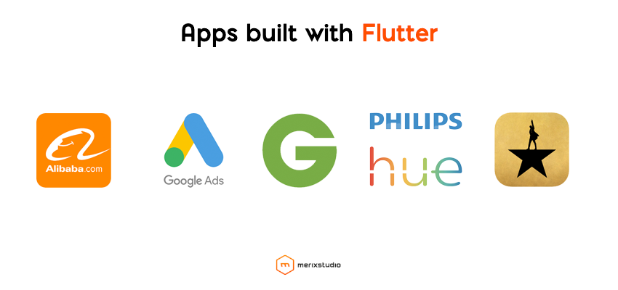
Introduce
Flutter vs React Native top apps

Slide 9
Introduce
Q & A FLUTTER AND REACT NATIVE ?
Q. Which Code Structure is the best to use?
React Native: Helps the developers to understand and write the code as Javascript follows the simple code structure.
Flutter: Difficult to understand as Dart doesn’t have separation of template, data files, and styles.
Winner: React Native
Q. Which framework helps with speedy development?
React Native: Uses the native elements & bridge hence requires separate optimization for each platform which makes the app development with RN longer.
Flutter: Development speed is much faster than RN and native development as flutter is widget-based.
Winner: Flutter
Q. Which has better documentation?
React Native: Chaotic & Unclear: The documentation of React Native is somewhat clumsy & disorganized/unorganized.
Flutter: Clear & Well Structured: Flutter is better at facilitating the documentation as it offers regimented and efficiently smooth documentation.
Winner: Flutter
Q. What about community support?
React Native: RN is quite stable from earlier and it also holds the support of a large and active community of contributors.
Flutter: Flutter is a newbie that has a smaller community than React but now flutter’s rate of growth increases swiftly, consequently it will catch up to React Native.
Winner: React Native
Q.How long is the learning curve?
React-Native: Easy to understand: For someone acquainted with React or Javascript, learning to code in React Native will be like a cakewalk.
Flutter: Quite steep: Dart is a natural fit for developers who know Java and C#.
Winner: React Native
Q. Which framework is ideal for development; Flutter or React native?
React Native: JavaScript is used as a bridge to communicate with native components, which results in inadequate performance.
Flutter: Streamlined process is used to communicate with native components so it doesn’t need a bridge to initiate interaction hence gives a better native performance.
Winner: Flutter

Slide 10
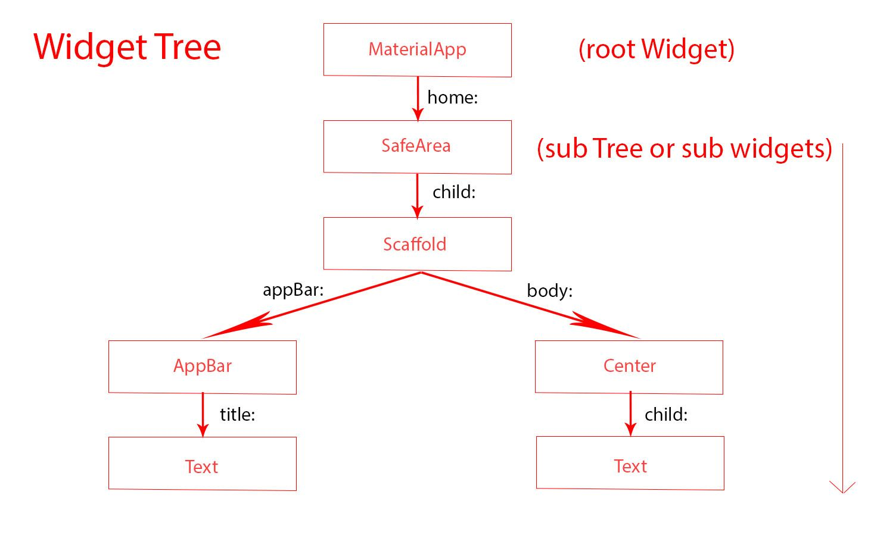
Everything is a WIDGET
SOME WIDGET
• Value Widgets : TextField, Icon, Image, FlatButton, ...
• Layout Widgets : Row, Column, GridView, ListView, ListTitle ...
• Animation Widgets : FadeInImage, AnimatedContainer, ….
• Navigator Widgets : AlertDialog, TabBar, BottomNavigationBar, ...
• Interaction Widgets : Dismissible, Draggable, GestureDetector, ...

Slide 11
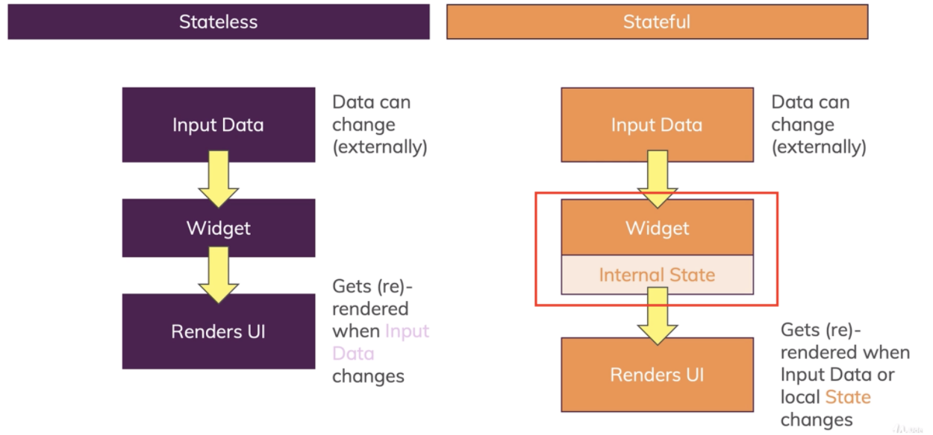
State, StatelessWidget, StatefulWidget

Slide 12
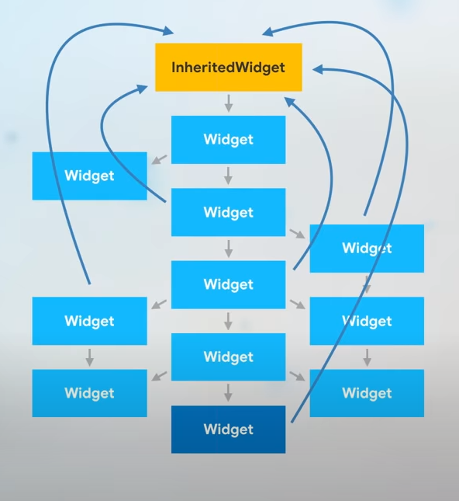
BuildContext, InheritedWidget

