Slide 1


BUILDING AN EMPLOYEE MANAGER WEBSITE USING REACTJS LIBRARY
INTERN
Pil Nguyen Tan
MENTOR
Quoc Phan Hoai

Slide 2
Requirements
Technologies
Implementation process
Conclusion
AGENDA

Slide 3
Requirements
Build an employee manager web UI with ReactJS
Responsive with multiple devices
Fetch and cache data by react-query
Manage the global state with Valtio
1

Slide 4








Technologies
ReactJS build a web UI
React-router-dom redirects the page
Styled-component style the components
Formik manages and validates the form
React-query fetches and caches the data
Valtio manages the global state
Json-server fake APIs
React-icons create icons
2

Slide 5
Implementation process
Initial project
and install frameworks
Apply real data and create global state
Build UI
and responsive
Refactor
and fix bug
Create a project with the npx and install frameworks related
Create components for UI. Use the styled-components to style
Use the react-query to fetch and cache data. Use valtio to create a global state
Refactor, clean code, and fix bugs
3

Slide 6
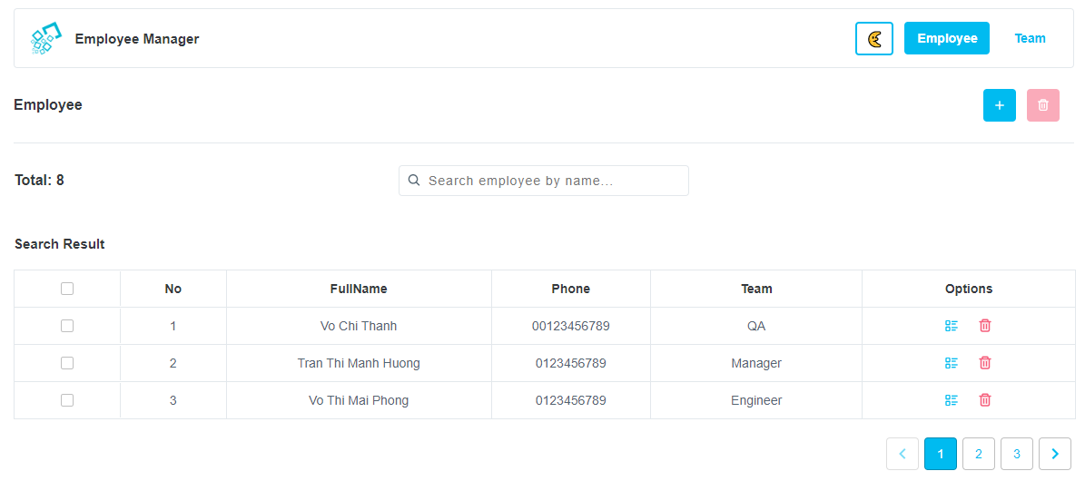
Implementation process
Add and delete employee selected
Change theme
Search employee by name
Select employee to delete
View detail and delete employee
Pagination employees
Employee page
4
Above is the UI of the employee page, we can search employees by name, and the result will pagination. We can create a new employee, delete employees by selected checkbox, can go to the employee detail.

Slide 7
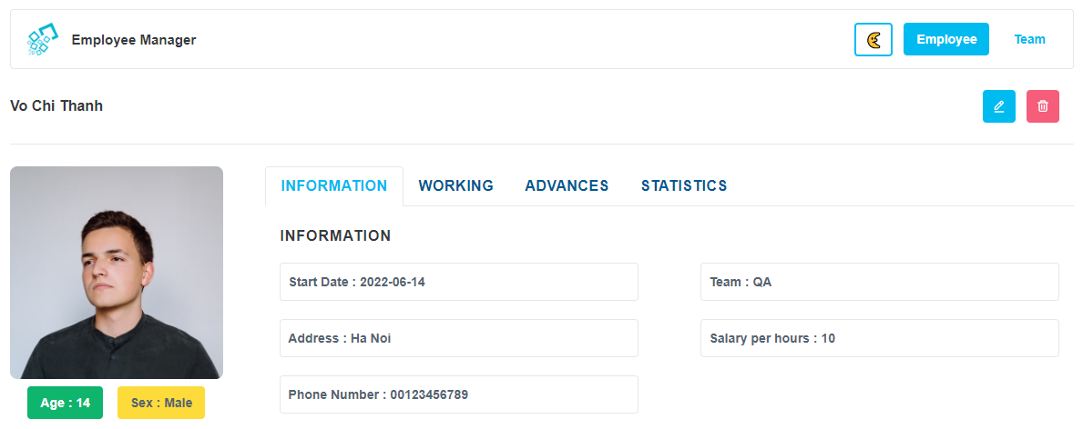
Implementation process
Edit and delete employee selected
Employee information detail
Employee detail page
5
Above is the UI of the employee detail, this page shows us the employee information detail such as avatar, age, name, and team…. We can edit employee information or delete this employee when we deleted the employee, the website will redirect to the home page.

Slide 8
Implementation process
Edit and delete employee selected
Employee detail page
5
Above is the UI of the employee detail, this page shows us the employee information detail such as avatar, age, name, and team…. We can edit employee information or delete this employee when we deleted the employee, the website will redirect to the home page.

Slide 9



