Slide 1


BUILDING AN EMPLOYEE MANAGE WEBSITE USING REACTJS LIBRARY
INTERN
Pil Nguyen Tan
MENTOR
Quoc Phan Hoai

Slide 2
Requirements
Technologies
Implementation process
Conclusion
AGENDA

Slide 3
Requirements
Build an employee manager web UI with ReactJS
Responsive with multiple devices
Fetch and cache data by react-query
Manage the global state with Valtio
1

Slide 4








Technologies
ReactJS build a web UI
React-router-dom redirects the page
Styled-component style the components
Formik manages and validates the form
React-query fetches and caches the data
Valtio manages the global state
Json-server fake APIs
React-icons create icons
2

Slide 5
Implementation process
Initial project
and install frameworks
Apply real data and create global state
Build UI
and responsive
Refactor
and fix bug
Create a project with the npx and install frameworks related
Create components for UI. Use the styled-components to style
Use the react-query to fetch and cache data. Use valtio to create a global state
Refactor, clean code, and fix bugs
3

Slide 6
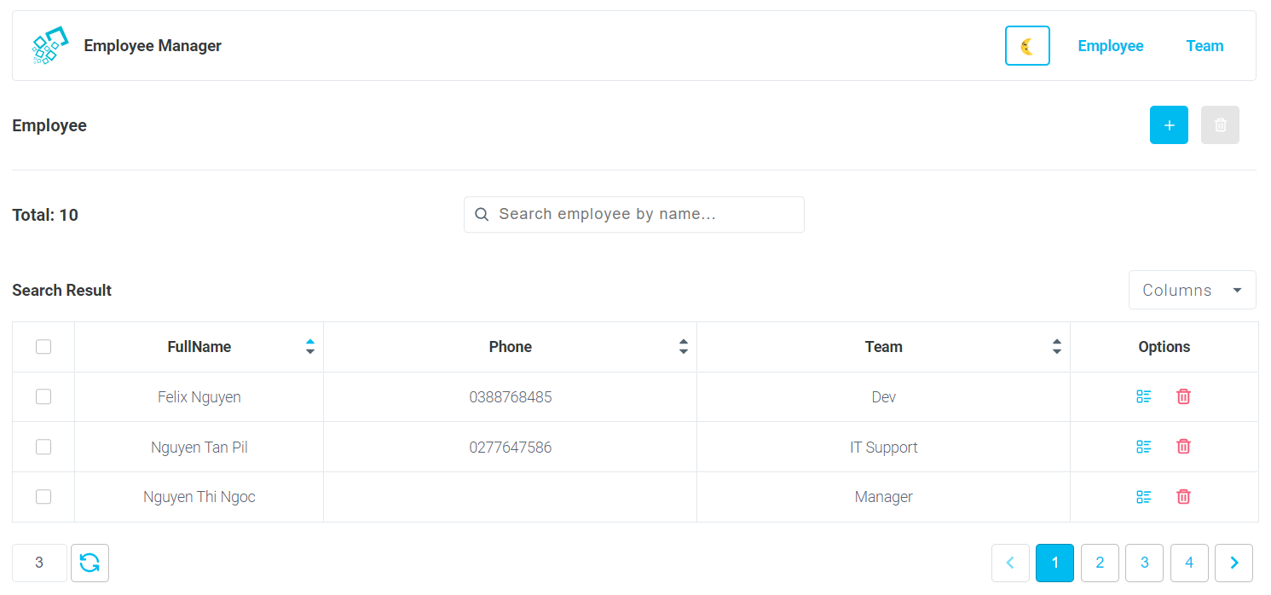
Implementation process
Add and delete employee selected
Change theme
Search employee by name
Select columns to display
Sort employees by column
Select employee to delete
View detail and delete employee
Pagination employees
Set employees per page
Employee page
4
Above is the UI of the employee page, we can search employees by name, and the result will pagination. We can create a new employee, delete employees by selected checkbox, can go to the employee detail.
We can set employees per page, select columns to display in UI, sort employee list by column(asc, desc).

Slide 7
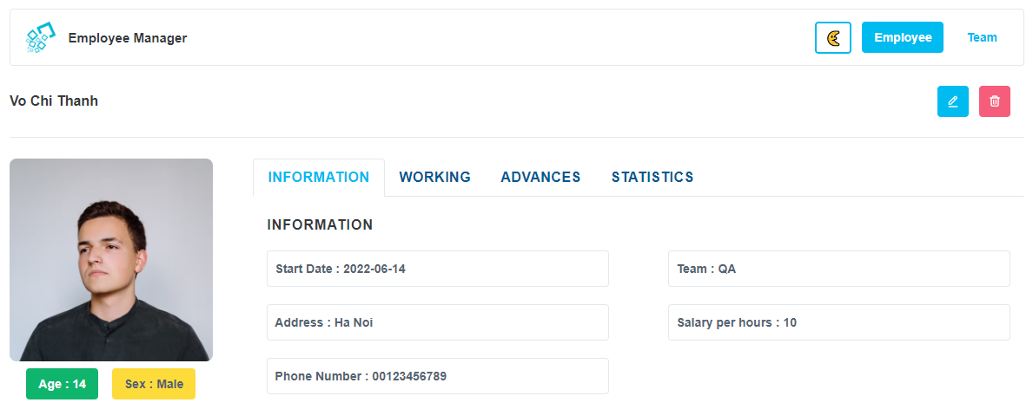
Implementation process
Edit and delete employee selected
Employee information detail
Employee detail page
5
Above is the UI of the employee detail, this page shows us the employee information detail such as avatar, age, name, avatar, and team…. We can edit employee information or delete this employee when we deleted the employee, the website will redirect to the home page.

Slide 8
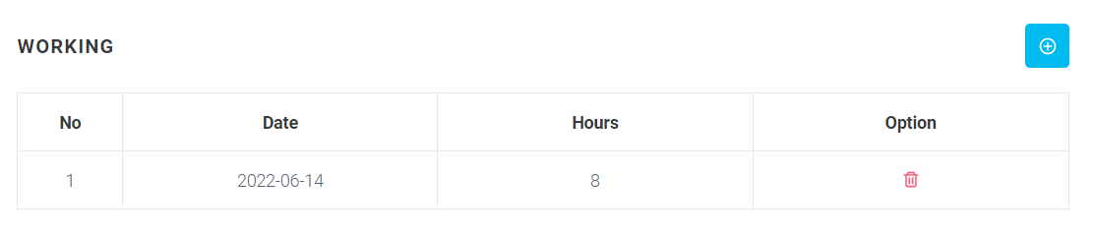
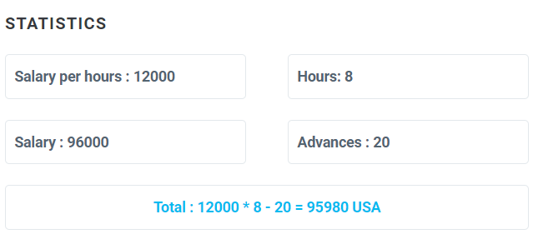
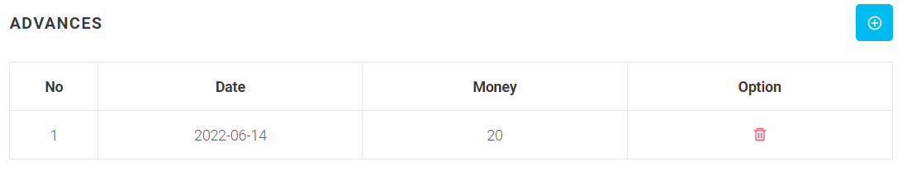
Implementation process
Add new working
Delete this working
Add new advance
The total salary of the employee
Delete this advance
Employee detail page
Above is the UI of the employee detail, we can add working and advances for employees, and after that website will calculate the total salary of that employee. We can delete working or advance.
6

Slide 9
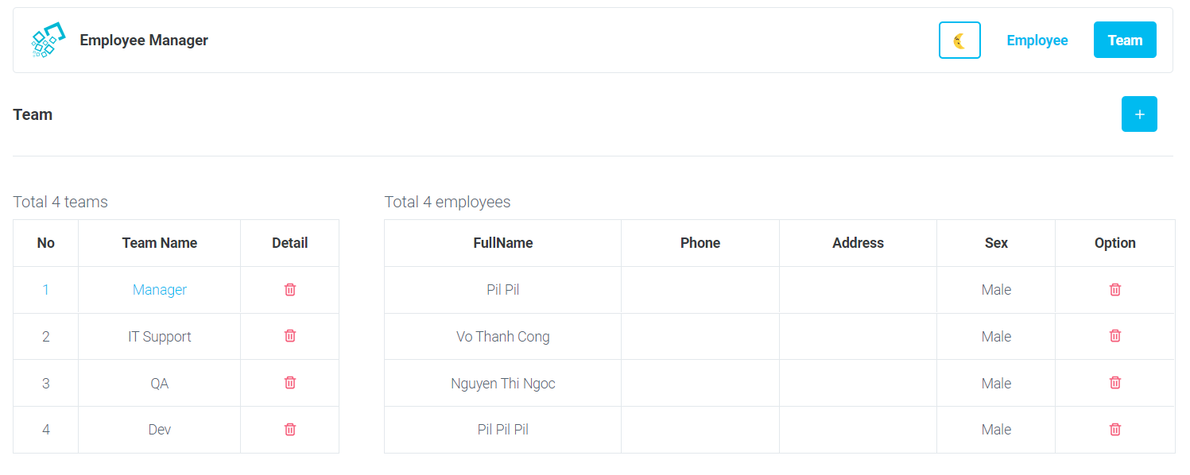
Implementation process
Add new team
Selected team
Delete this team
Delete this employee
The employees by the team selected
Team page
Above is the UI of the team page, we can choose a team the UI will render employees of that team. We can also add a new team or delete a team when that team has zero employees. We can delete the employee on this page.
7

Slide 10
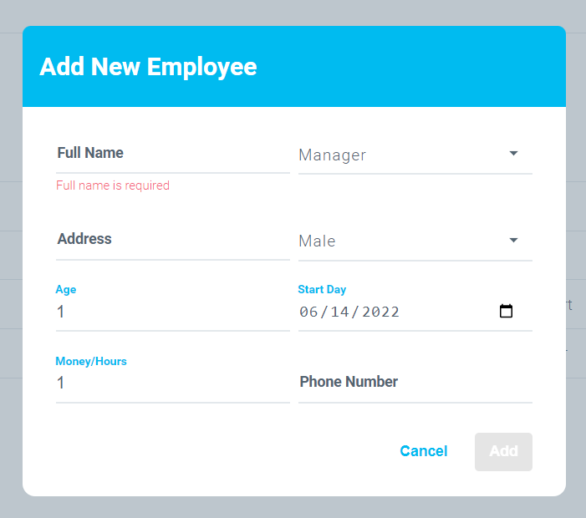
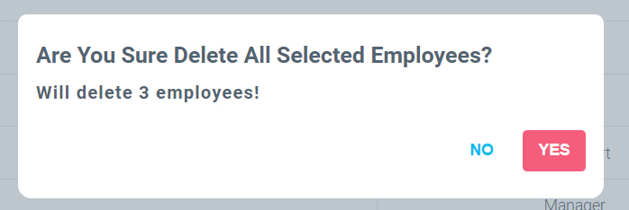
Implementation process
Add modal
Delete modal
With the add form we will enter a value in the input, the form only submits when the data is valid, if the data is required then it must be filled in the input. With the delete form, just confirm the deletion or cancel.
8

Slide 11
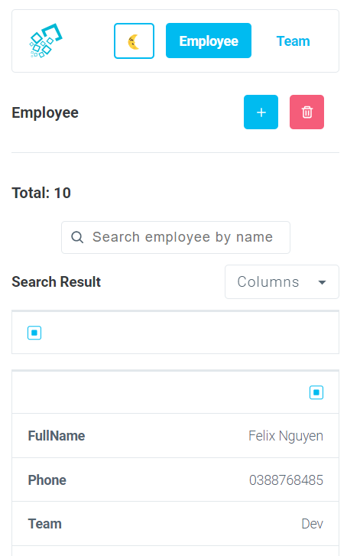
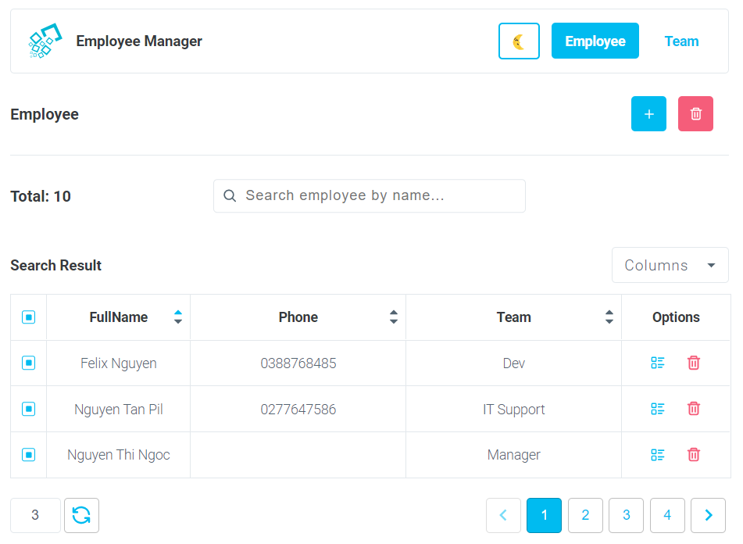
Implementation process
9
Mobile
Tablet and desktop
Responsive on multiple devices

Slide 12
CONCLUSION
Build a website using ReactJS library
Use the react-query to fetch and cache data efficiently
Use the valtio to manage global states
The website display good with many devices
Beautiful interface, easy to use
10

Slide 13



