Slide 1
Development Course 1: Customization Practice Answer
Practice List
Practice 1: “Inventory Count Adjustment” Screen Customization
Practice 2: “Item Detail Master” Screen Customization
Practice 3: “Company Lot List” Screen Customization
Notes:
www.mcframe.com
MCFrame Training
-<number>-

Slide 2
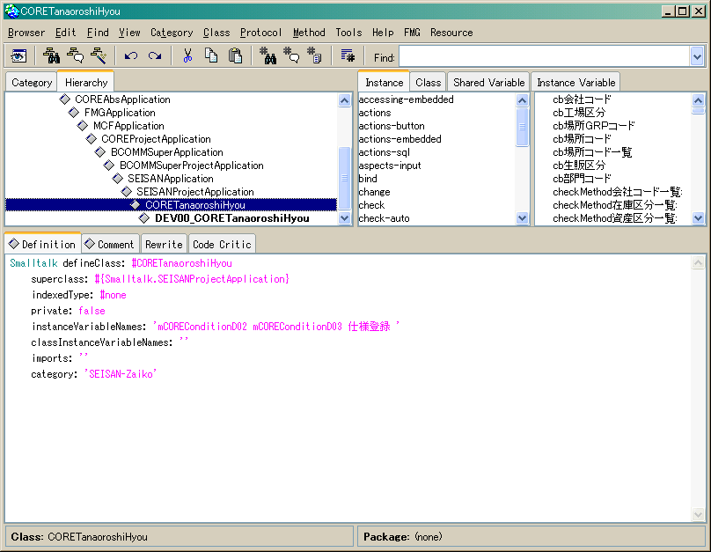
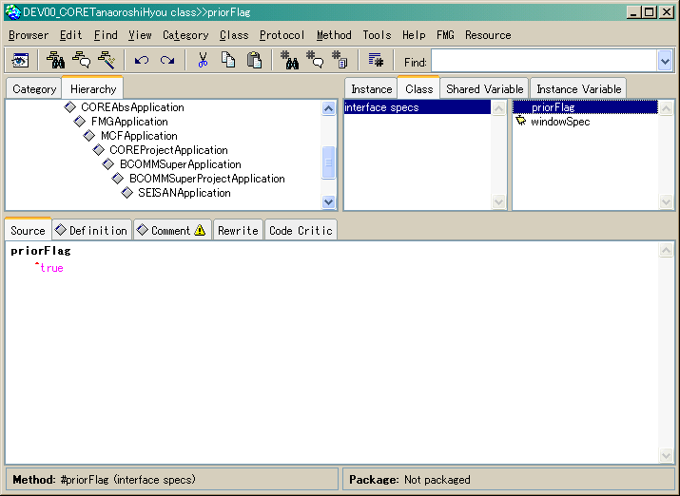
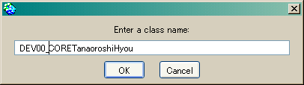
Development Course 1: Customization Practice Answer 1
Practice 1: “Inventory Count Adjustment” Screen Customization
Create a subclass
① Open Browser from “Inventory Count Adjustment” screen (CORETanaoroshiHyou).
② Right-click “Create Subclass” to create a subclass.
③ Create “priorFlag” method (class method).
②Create subclass
③Create priorFlag
Class method
Right-click
⇒ Create Subclass..
priorFlag
  ^true
Notes:
www.mcframe.com
-<number>-
MCFrame Training

Slide 3
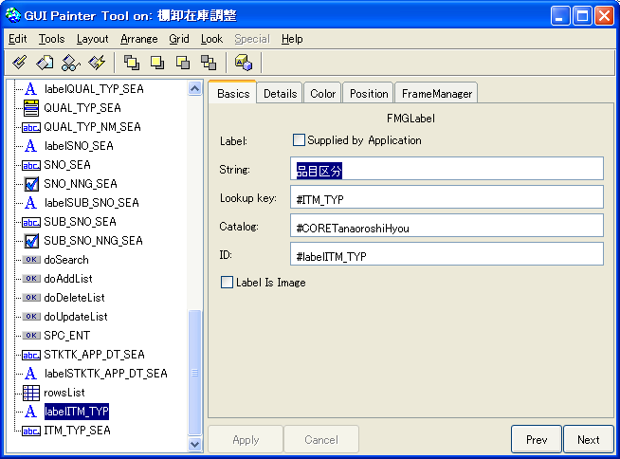
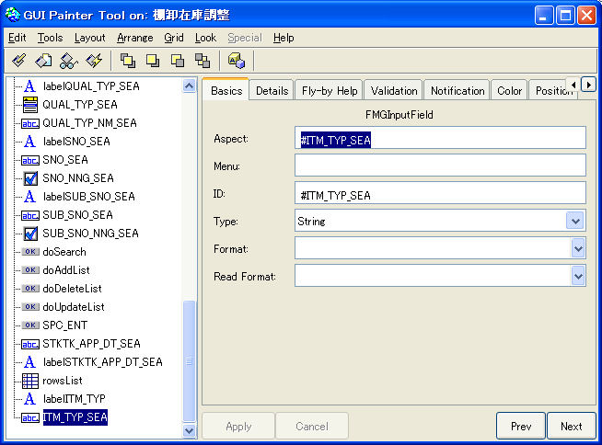
Development Course 1: Customization Practice Answer 1
Add “ITM_TYP (Item Type)” in search criteria.
① Open Canvas from the subclass created (Right-click on Browser⇒Canvas)
② Open Painter Tool, and create a label and an input field from Palette.
Label (FMGLabel)
Input Field (FMGInputField)
③ Select “ITM_TYP_SEA (Input field)” and perform “Define”.
Verifty TM_TYP_SEA and “Add Initialization” are checked in the list, and click “OK”.
④ Install and save “windowSpec”.
Notes:
www.mcframe.com
-<number>-
MCFrame Training

Slide 4
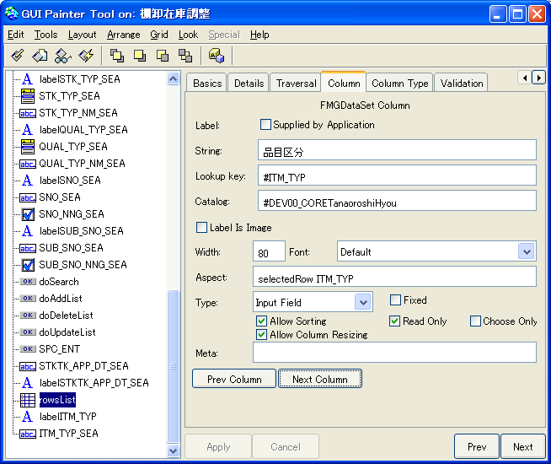

Development Course 1: Customization Practice Answer 1
Add “ITM_TYP (Item Type)” and “ITM_TYP_NM (Item Type Name)” in the list field.
① Open Canvas.
② Select the list, open Painter Tool, click twice “New Column” in “Basic” tab to add a column.
③ Select the list while pressing Ctrl key, and align the new column on the right side of Item Name.
④ Open Painter Tool while selecting the new column, setup properties in “Column” tab as below.
ITM_TYP (Item Type)
ITM_TYP_NM (Item Type Name)
⑤ Install and save “windowSpec”.
Notes:
www.mcframe.com
-<number>-
MCFrame Training

Slide 5
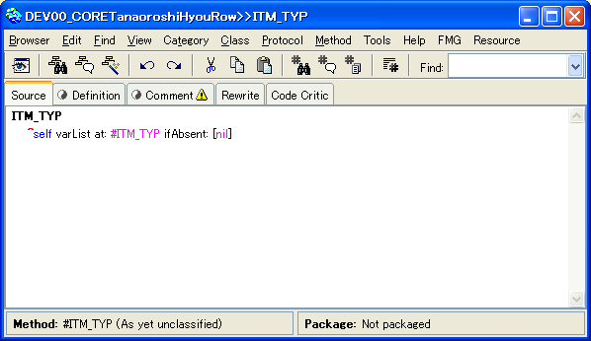
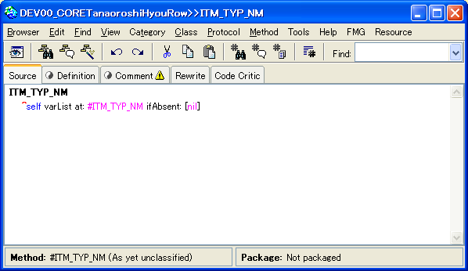
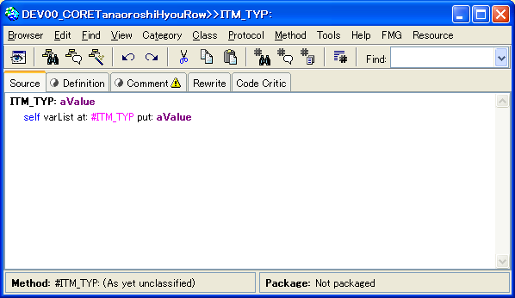
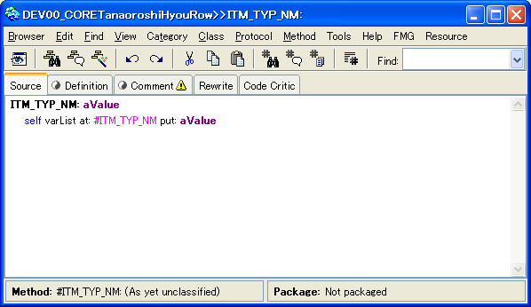
Development Course 1: Customization Practice Answer 1
⑥ Create a subclass from “Row” class.
⑦ Create “priorFlag” method.
⑧ Add accessor method.
ITM_TYP (Item Type)
ITM_TYP_NM (Item Type Name)
Notes:
www.mcframe.com
-<number>-
MCFrame Training

Slide 6
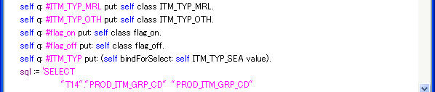
Development Course 1: Customization Practice Answer 1
Edit SQL Method.
*Change the section in red.
“STK_SEASql” method
Binding variable settings.
Notes:
www.mcframe.com
-<number>-
MCFrame Training

Slide 7
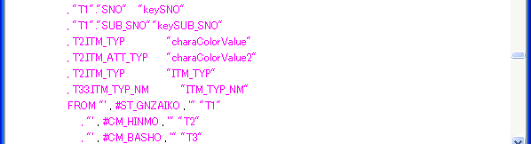
Development Course 1: Customization Practice Answer 1
Select Clause:
Notes:
www.mcframe.com
-<number>-
MCFrame Training

Slide 8
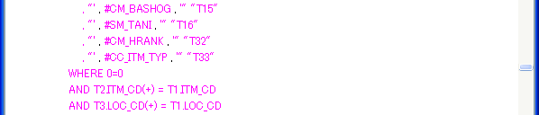
Development Course 1: Customization Practice Answer 1
From Clause:
Notes:
www.mcframe.com
-<number>-
MCFrame Training

Slide 9
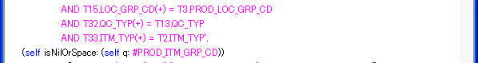
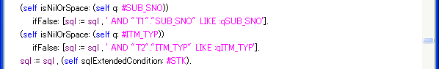
Development Course 1: Customization Practice Answer 1
Where Clause:
*Change “RACK_STK_SEASql” method similarly.
Notes:
www.mcframe.com
-<number>-
MCFrame Training

Slide 10
Development Course 1: Customization Practice Answer 2
Practice 2: “Item Detail Master” Screen Customization
Create a subclass
① Open Browser from “Item Detail Master” screen (CORE_M_HINMOS).
② Use “Create Subclass” to create a subclass.
③ Create “priorFlag” method (class method).
Notes:
www.mcframe.com
-<number>-
MCFrame Training

Slide 11
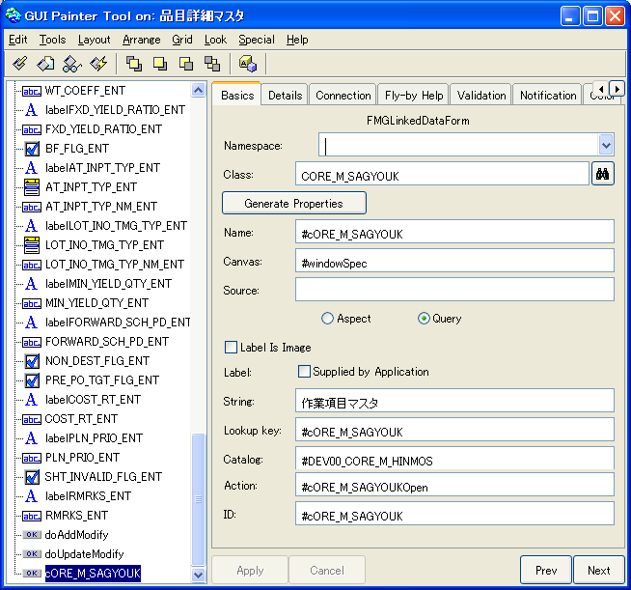
Development Course 1: Customization Practice Answer 2
Add Activity Item button.
① Open Painter Tool from Canvas, and create a new Data Integration Form from Palette.
Notes:
www.mcframe.com
-<number>-
MCFrame Training

Slide 12
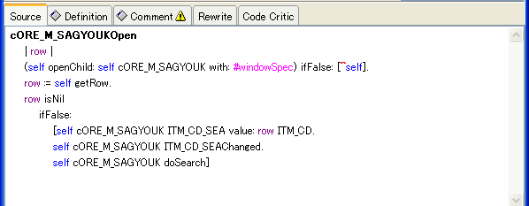
Development Course 1: Customization Practice Answer 2
② Select Data Integration Form, and perform “Define”.
Verify Item Category Master and “Add Initialization” are checked in the list, and click “OK”.
③ Install and save “windowSpec”.
④ Edit “cORE_M_SAGYOUKOpen” method.
Notes:
www.mcframe.com
-<number>-
MCFrame Training

Slide 13
Development Course 1: Customization Practice Answer 3
Practice 3: “Company Lot List” Screen Customization
Create a subclass.
① Open Browser from “Company Lot List” screen (COREJishaLotList).
② Use “Create Subclass” to create a subclass.
③ Create “priorFlag” method (class method).
Notes:
www.mcframe.com
-<number>-
MCFrame Training

Slide 14
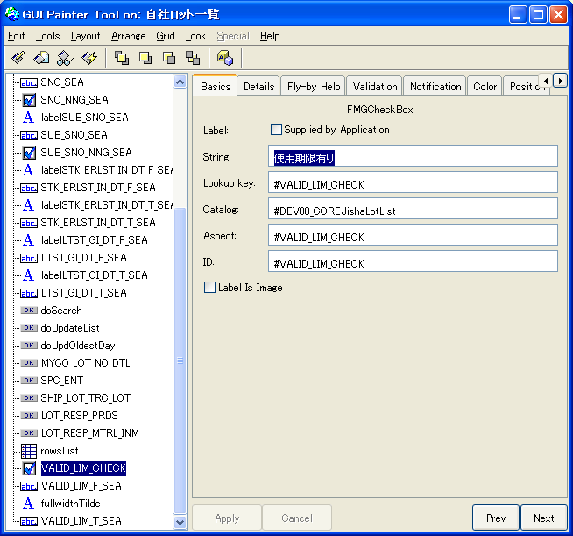
Development Course 1: Customization Practice Answer 3
Add “Effective Date (ON/OFF)” checkbox, and “Effective Date From/To”.
① Open Painter Tool, and create a new checkbox from Palette.
Notes:
www.mcframe.com
-<number>-
MCFrame Training

Slide 15
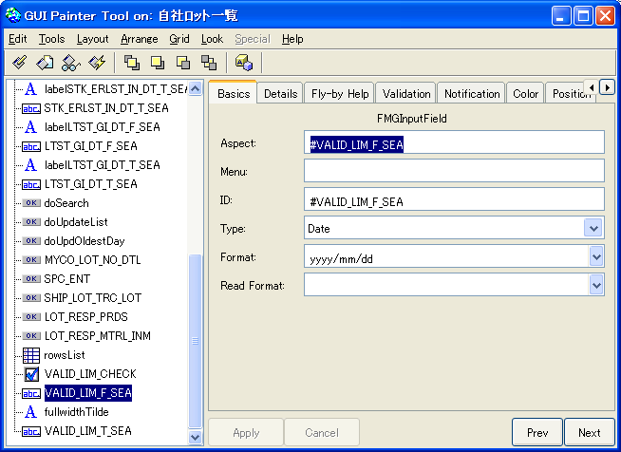
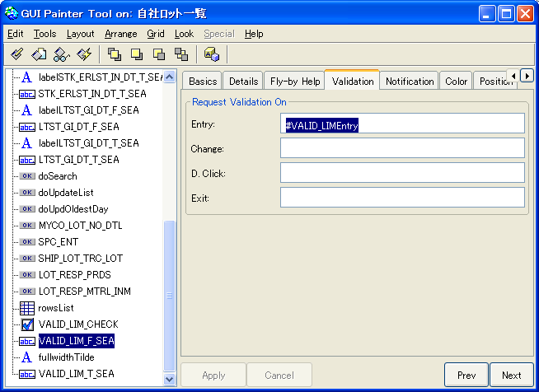
Development Course 1: Customization Practice Answer 3
② Add “Effective Date From/To” input fields.
Basics tab
Validation tab
③ Select the checkbox and the input fields, and perform “Define”.
④ Install, and save “windowSpec”.
Notes:
www.mcframe.com
-<number>-
MCFrame Training

Slide 16
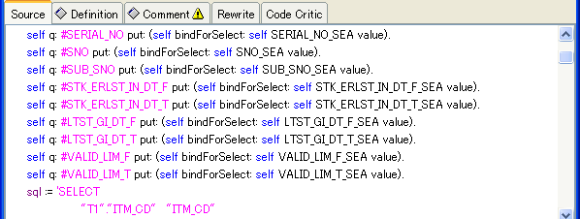
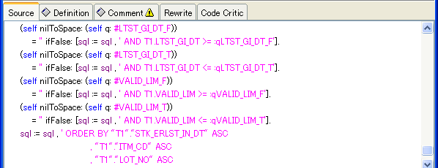

Development Course 1: Customization Practice Answer 3
Edit “selectSql”.
*Change the section in red.
Notes:
www.mcframe.com
-<number>-
MCFrame Training

Slide 17
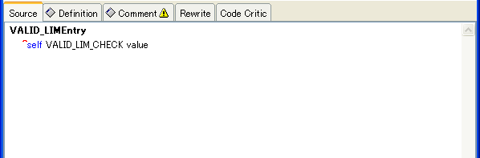
Development Course 1: Customization Practice Answer 3
Edit “entry” method.
Notes:
www.mcframe.com
-<number>-
MCFrame Training

