Slide 1
Development Course 1: Customization Practice
Practice List
Practice 1: “Inventory Count Adjustment” Screen Customization
Practice 2: “Item Detail Master” Screen Customization
Practice 3: “Company Lot List” Screen Customization
Notes:
www.mcframe.com
MCFrame Training
-<number>-

Slide 2
Development Course 1: Customization Practice 1
Practice 1: “Inventory Count Adjustment” Screen Customization
Practice Objectives
To make screen customizations using Visualworks.
  *FrameManager isn’t used.
To add search criteria.
To add list fields.
Screens and Classes
Screen:
  Inventory Count Adjustment Screen
Classes:
  CORETanaoroshiHyou (Screen class)
  CORETanaoroshiHyouRow (Row class)
Customization Requirements
Add “ITM_TYP (Item Type)” in search criteria.
Add “ITM_TYP (Item Type)” and “ITM_TYP_NM (Item Type Name)” in list fields.
Notes:
www.mcframe.com
-<number>-
MCFrame Training

Slide 3
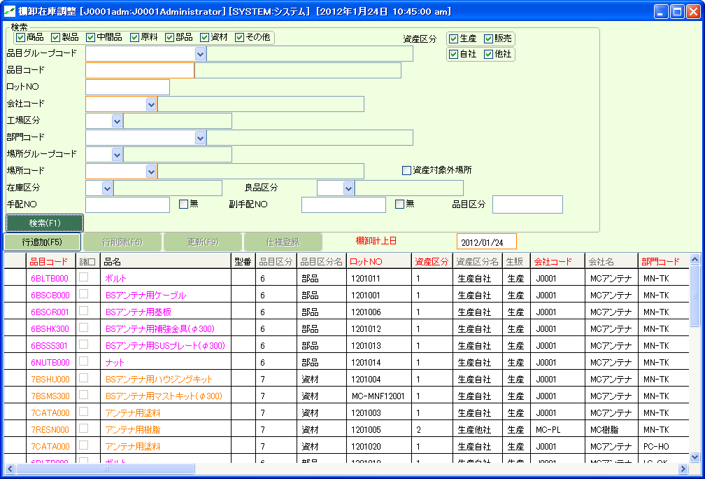
Development Course 1: Customization Practice 1
Completed Screen Image
Notes:
www.mcframe.com
-<number>-
MCFrame Training

Slide 4
Development Course 1: Customization Practice 1
Hint 1
◆ Create a subclass for customization.
Then, create “priorFlag” method which returns true.
◆ Table join criteria:
  CM_HINMO.ITM_TYP= CC_ITM_TYP. ITM_TYP
◆ Make customization one step at a time.
Start from adding a search criteria “ITM_TYP (Item Type)”.
◆ Setup properties using Painter Tool for the objects (label, input field, checkbox) added on Canvas.
Properties to setup are those in Basics and Details tabs.
Refer to other search criteria and list field properties for the properties you aren’t certain.
◆ Use Install to save Canvas layout.
◆ Perform Define for input fields and checkbox you added.
!!! Attention !!!
  Select only the new objects and perform Define.
  In case no objects are selected, all the objects will be initialized.
Notes:
www.mcframe.com
-<number>-
MCFrame Training

Slide 5
Development Course 1: Customization Practice 1
Hint 2
◆ Modify Row class to add a list field.
*Create a subclass from Row Class in this practice.
◆ When you create a new method using Browser, please copy a similar method to begin.
◆ There are 2 SQL methods (STK_SEASql, RACK_STK_SEASql) joined in this screen.
Apply changes to both of the methods.
Notes:
www.mcframe.com
-<number>-
MCFrame Training

Slide 6
Development Course 1: Customization Practice 2
Practice 2: “Item Detail Master” Screen Customization
Practice Objectives
To make screen customizations using Visualworks.
  *FrameManager isn’t used.
To retrieve a value from a list, and pass the value to the next screen.
Screens and Classes
Screen name (class name):
  Item Detail Master (CORE_M_HINMOS)
  Activity Item Master (CORE_M_SAGYOUK)
Customization Requirements
Add “Activity Item Master” button to open a child screen.
In case a row is selected in Item Detail Master list, selected row’s value is passed
to the next screen, and search will be performed.
In case no row is selected, it simply opens a child screen.
Notes:
www.mcframe.com
-<number>-
MCFrame Training

Slide 7
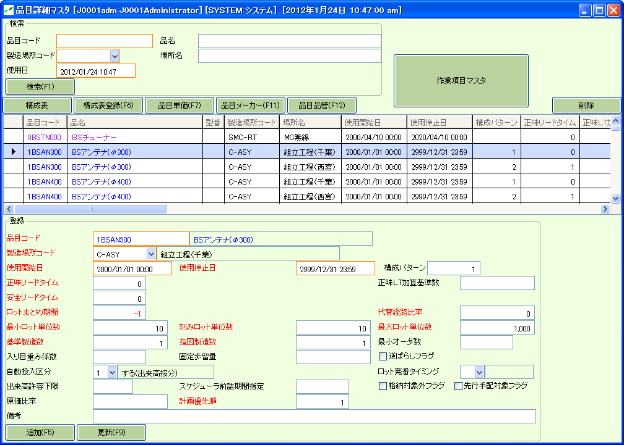
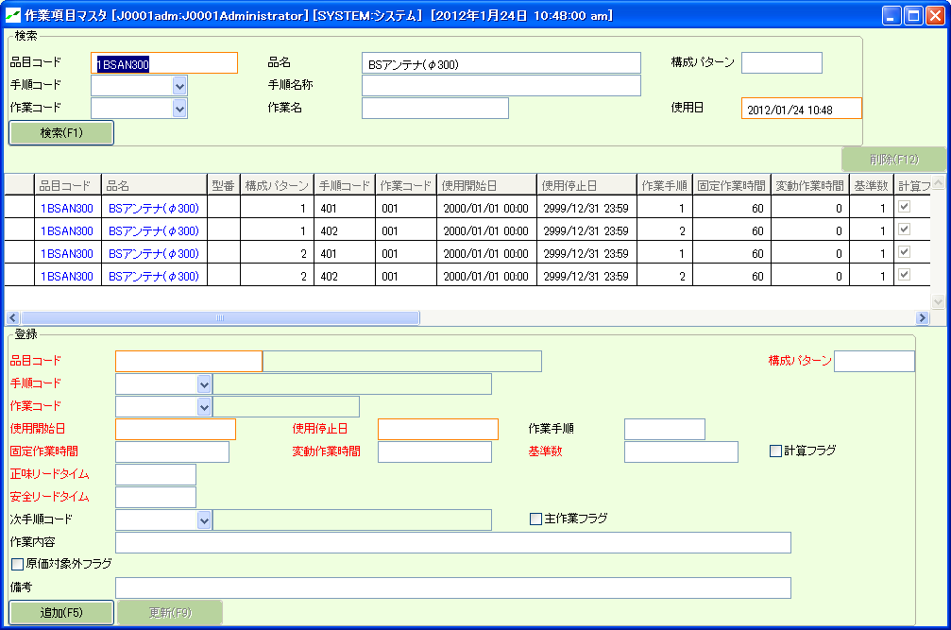
Development Course 1: Customization Practice 2
Completed Screen Image
Notes:
www.mcframe.com
-<number>-
MCFrame Training

Slide 8
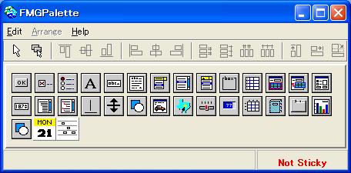
Development Course 1: Customization Practice 2
Hint
◆ Button to open a child screen is “FMGLinkedDataForm”.
It is easier to use “Generate Properties “ to perform auto-setup when you setup properties using Painter Tool.
◆ Refer to other button properties which perform screen transitions.
Notes:
www.mcframe.com
-<number>-
MCFrame Training

Slide 9
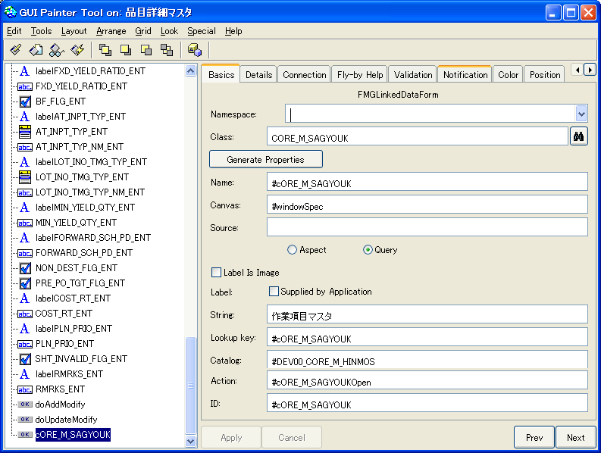
Development Course 1: Customization Practice 2
Hint
◆ Button to open a child screen is “FMGLinkedDataForm”.
It is easier to use “Generate Properties“ to perform auto-setup when you setup properties using Painter Tool.
◆Please add button with reference to other button properties which perform screen transitions and .
Notes:
www.mcframe.com
-<number>-
MCFrame Training

Slide 10
Development Course 1: Customization Practice 3
Practice 3: “Company Lot List” Screen Customization
Practice Objectives
To add search criteria.
To add input field constraint to the search criteria.
Screens and Classes
Screen name:
  Company Lot List Screen
Class name:
  COREJishaLotList (Screen class)
Customization Requirements
Add “Effective Date (ON/OFF)” and “Effective date from/to”.
“Effective date from/to” is enabled only when “Effective Date” is ON.
In case of OFF, restrict from entering a value.
Notes:
www.mcframe.com
-<number>-
MCFrame Training

Slide 11
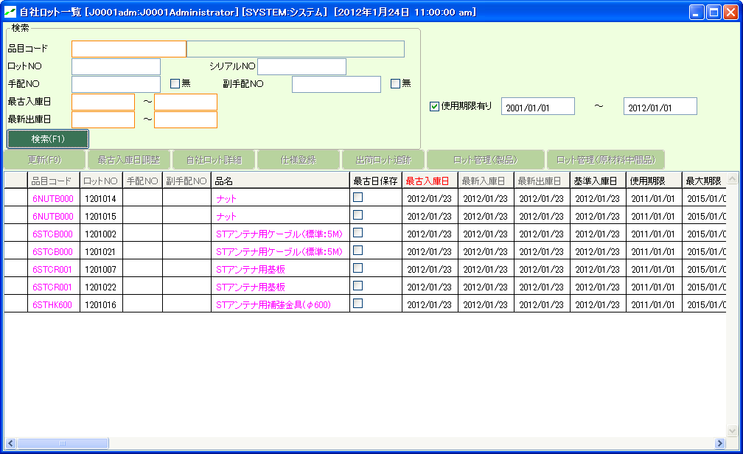
Development Course 1: Customization Practice 3
Completed Screen Image
Notes:
www.mcframe.com
-<number>-
MCFrame Training

Slide 12
Development Course 1: Customization Practice 3
Hint
◆ “FMGCheckBox “ in Palette can be used to the “Effective Date (ON/OFF)” checkbox.
Value for the checkbox is a Boolean type (checked＝true, unchecked＝false).
◆ Use “Entry” method to control enabling/disabling input fields.
Refer search criteria of “STK_ERLST_IN_DT_F_SEA (oldest receive date)” to define “Entry” method and set Canvas.
Notes:
www.mcframe.com
-<number>-
MCFrame Training

