Slide 1

WORLDWIDE STARBUCKS LOCATIONS
GROUP 10
THI KIM KHUE NGUYEN, MARCANTHONY SOLORZANO,
NOAH STEVENS,
GINA BUTLER

Slide 2
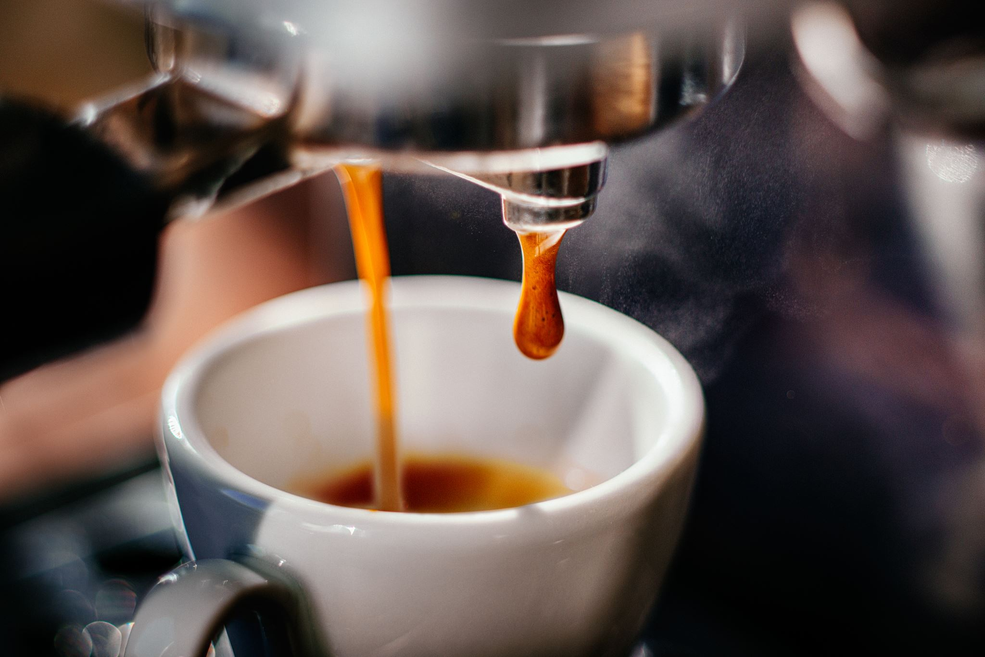
Topic of choice
We chose Starbucks coffee because we like coffee and have experienced Starbucks.
Also, we thought it would be interesting to explore how many Starbucks locations there are in various countries.

Slide 3

INSPIRATION
We were inspired by two datasets.
One was found on Kaggle.com: Starbucks Locations Worldwide 2021(https://www.kaggle.com/datasets/kukuroo3/starbucks-locations-worldwide-2021-version).
The other was found on nycdatascience.com blog: Starbucks Store Location Analysis (https://nycdatascience.com/blog/r/starbucks-store-location-analysis/?utm_source=chatgpt.com).

Slide 4

Questions Explored
What countries had the most Starbucks locations?
Whether there’s a trend, as far as how many Starbucks locations there are within a country?

Slide 5
Datasets
To answer our questions, we downloaded two datasets from Kaggle.com:
Country Mapping - ISO, Continent, Region (https://www.kaggle.com/datasets/andradaolteanu/country-mapping-iso-continent-region)
Starbucks Locations Worldwide 2023(https://www.kaggle.com/datasets/omarsobhy14/starbucks-store-location-2023)

Slide 6
Data Cleaning
We reviewed both datasets and decided on which columns to keep, drop, and convert data types.
Examples of what was done are reducing data down to only countries that are in English.
We did a LEFT JOIN to merge country and region data between the continent.csv and Starbucks.csv to keep the Starbucks.csv data.
Columns dropped were: "Store Name", "Brand", "Ownership Type", "Postcode", "alpha-2", "Phone Number", "Timezone", and "Street Address“.

Slide 7

VISUALIZATIONS
From the cleaned data we generated a bar chart of the locations within the U.S.A.
Also, we generated two Sunburst charts depicting the percentage of locations worldwide including the United States and one excluding the United States.

Slide 8
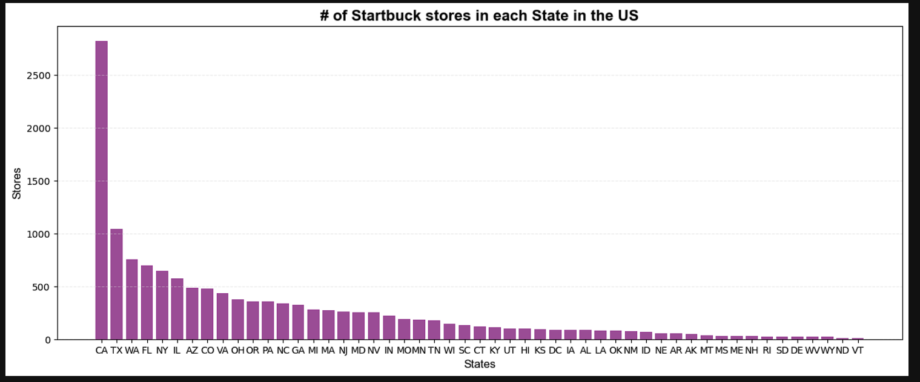
BAR CHART OF U.S.A. STARBUCKS

Slide 9
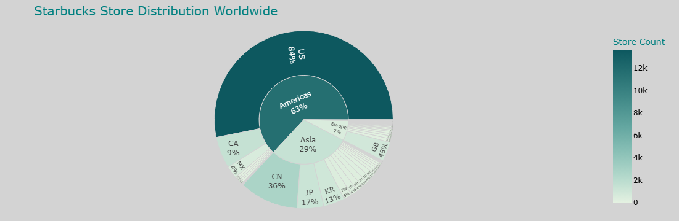
SUNBURST OF WORLDWIDE STARBUCKS

Slide 10

FLASK APP & HTML
We worked on the Flask App and HTML pages.

Slide 11
BIBLIOGRAPHY
Starbucks Locations Worldwide 2021(https://www.kaggle.com/datasets/kukuroo3/starbucks-locations-worldwide-2021-version).
nycdatascience.com blog: Starbucks Store Location Analysis (https://nycdatascience.com/blog/r/starbucks-store-location-analysis/?utm_source=chatgpt.com).
Country Mapping - ISO, Continent, Region (https://www.kaggle.com/datasets/andradaolteanu/country-mapping-iso-continent-region).
Starbucks Locations Worldwide 2023(https://www.kaggle.com/datasets/omarsobhy14/starbucks-store-location-2023).
ChatGPT (https://chatgpt.com/).

