Slide 1

From Education to Career:
AI-Based Career Recommendation System
26th Oct 2026
GP8001, Group E-2
HAN ZILIN
HE YANGFAN
NGUYEN THIEN AN
PARK SEUNGWOO (G2609551C)
LIM CHUAN ZHONG
LI ZHENYING

Slide 2
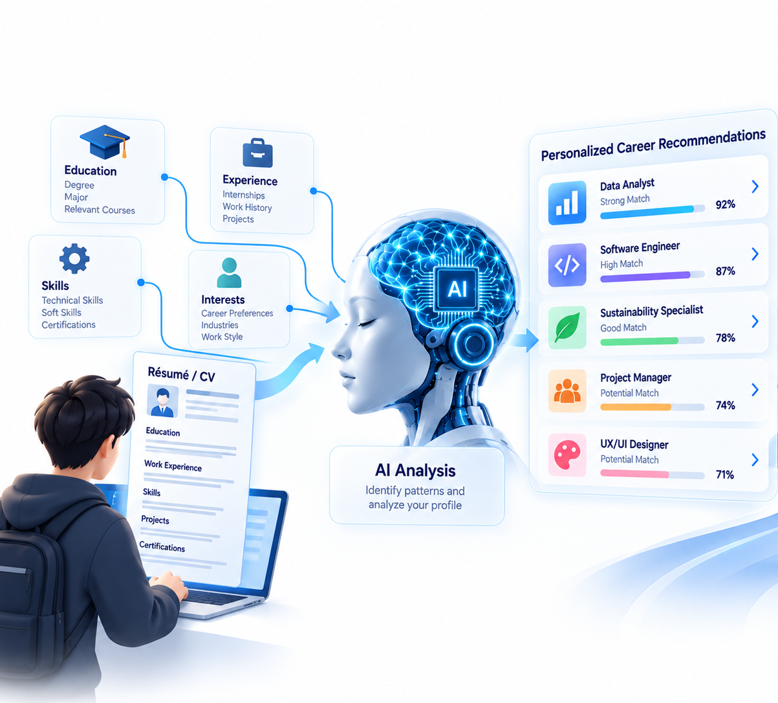
Table of contents
Introduction
Methodology
AI Application
Results
Discussion
Conclusion
01
02
03
04
05
06

Slide 3






01 Introduction
Introduction
Background
Methodology
AI Application
Results
Discussion
Conclusion

Slide 4
01 Introduction
Introduction
Literature Review
Methodology
AI Application
Results
Discussion
Conclusion

Slide 5
01 Introduction
Introduction
Aim and Objective
Methodology
AI Application
Results
Discussion
Conclusion

Slide 6
02 Methodology
Introduction
Project Overview
Methodology
AI Application
Results
Discussion
Conclusion

Slide 7
02 Methodology
Introduction
Build the Dataset
Methodology
AI Application
Results
Discussion
Conclusion

Slide 8
02 Methodology
Introduction
Prototype
Methodology
AI Application
Results
Discussion
Conclusion

Slide 9
03 AI Application
Introduction
Overview
Methodology
AI Application
Results
Discussion
Conclusion

Slide 10
03 AI Application
Introduction
Data Parameters
Methodology
AI Application
Results
Discussion
Conclusion

Slide 11
03 AI Application
Introduction
AI Models
Methodology
AI Application
Results
Discussion
Conclusion

Slide 12
03 AI Application
Introduction
AI Architecture
Methodology
AI Application
Results
Discussion
Conclusion

Slide 13
04 Results
Introduction
Comparison the models
Methodology
AI Application
Results
Discussion
Conclusion

Slide 14
04 Results
Introduction
Simulated Results
Methodology
AI Application
Results
Discussion
Conclusion

Slide 15
05 Discussion
Introduction
Limitations and Challenges
Methodology
AI Application
Results
Discussion
Conclusion

Slide 16
05 Discussion
Introduction
Ethics and Responsible
Methodology
AI Application
Results
Discussion
Conclusion

Slide 17
06 Conclusion
Introduction
Methodology
AI Application
Results
Discussion
Conclusion

Slide 18
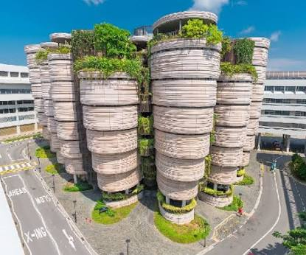

Thank you

