Slide 1
Tianic Project
Nguyễn Toàn Thắng
Dường Tùng Thiện
Hồ Minh Tiến
Đặng Thái Tú

Slide 2
Points to Discuss:
Agenda
Data summary
Univariate analysis
Class-wise Analysis
Demographic Analysis
Survival Factors Analysis
Time/Port-wise Analysis
Some Important Questions
Conclusion
Correlation Heatmap

Slide 3
Agenda
To discuss the analysis of Titanic dataset from 1912 sinking.
We'll do EDA in following ways:
Univariate
Class-wise, etc.

Slide 4
Data Summary
The dataset includes various columns of important variables for ticket booking. Some of them are:
Survived: 0 (died), 1 (survived).
Pclass: Ticket class (1=upper, 2=middle, 3=lower).
Sex: Male/Female.
Age: Passenger age.
SibSp: Siblings/spouses aboard.
Fare: Ticket fare.

Slide 5
Data Summary(contd)
Embarked: Port (C=Cherbourg, Q=Queenstown, S=Southampton).
Name: Full name of passenger, including title (Mr, Mrs,...).
Ticket: Passenger ticket number, which may include letters and numbers.
Cabin: The passenger's cabin number on the ship.
PassengerId: Unique identifier for each passenger.

Slide 6
Univariate Analysis
(1) Passenger age distribution?
(2) Male/female ratio?
(3) Which class has the highest fare distribution?
(4) Overall survival rate?

Slide 7
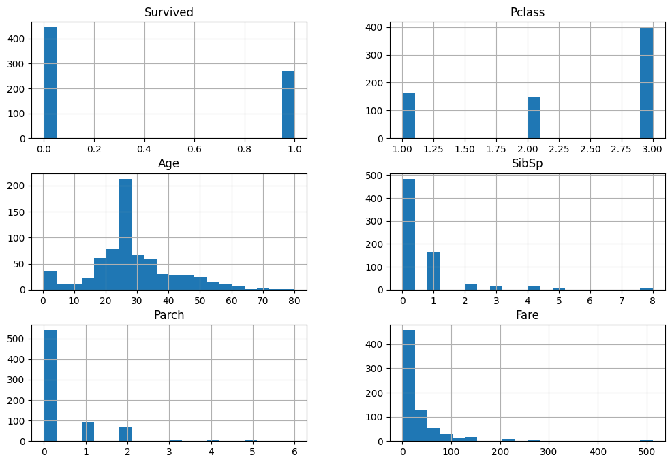

Slide 8
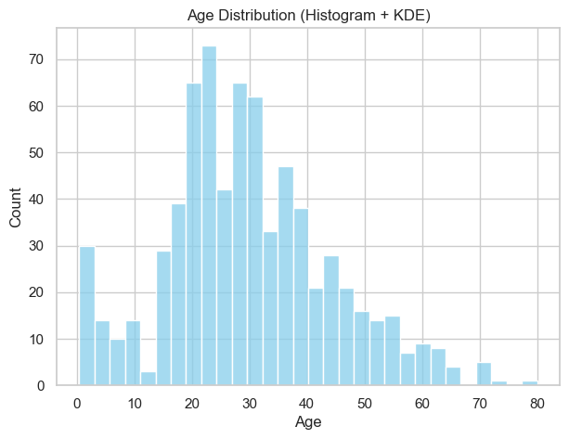
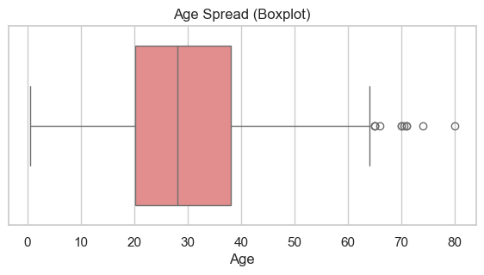
Ages range from 0 → 80+.
Most passengers are between 20–40 years old.
There are some children (~10% under 12 years old).

Slide 9
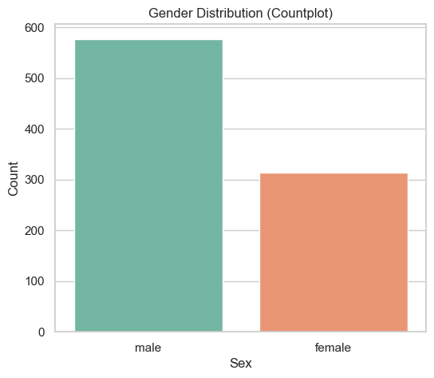
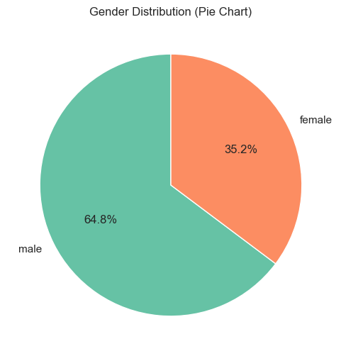
Males account for about 65%, females about 35%.
But females have a much higher survival rate.

Slide 10
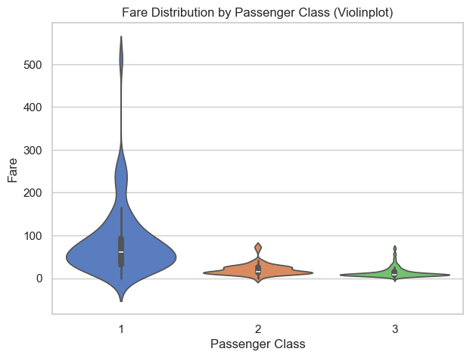
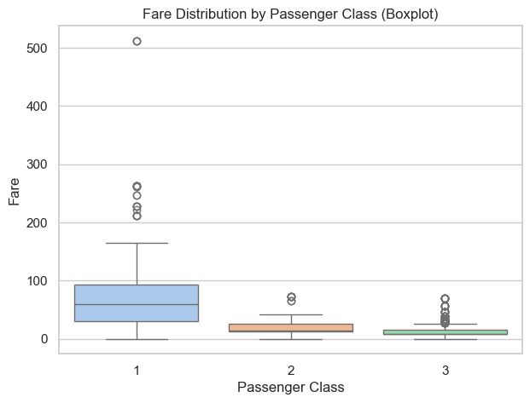
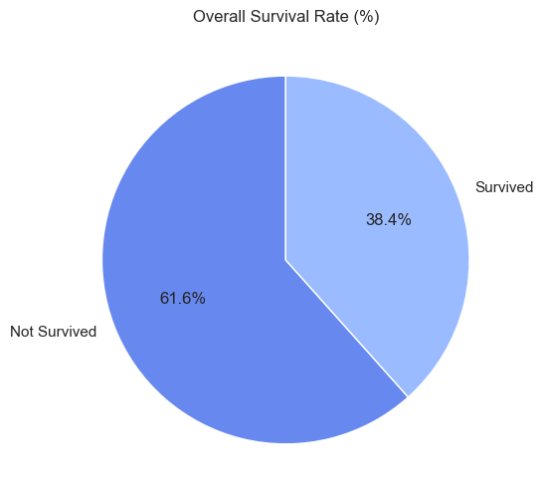
Class 1 has the highest and average Fare.
Class 3 has the lowest Fare, many cheap tickets.
A total of ~38% survived.
The majority (~62%) were non-survivors.

Slide 11
Group-wise Analysis
(1) % survived by class?
(2) Average age/fare by class?
(3) Which class has more families?

Slide 12
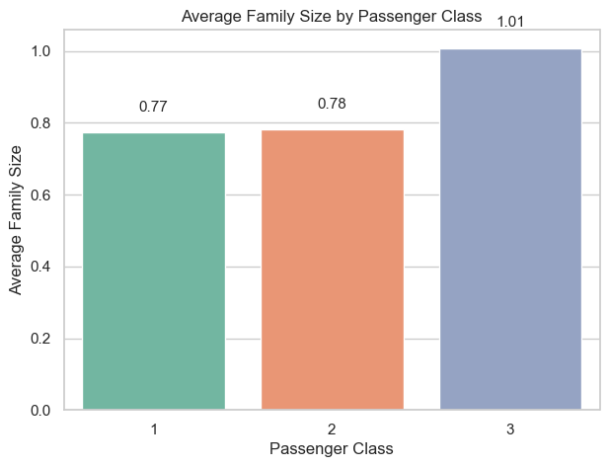
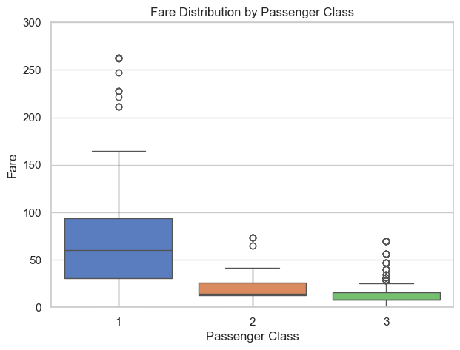
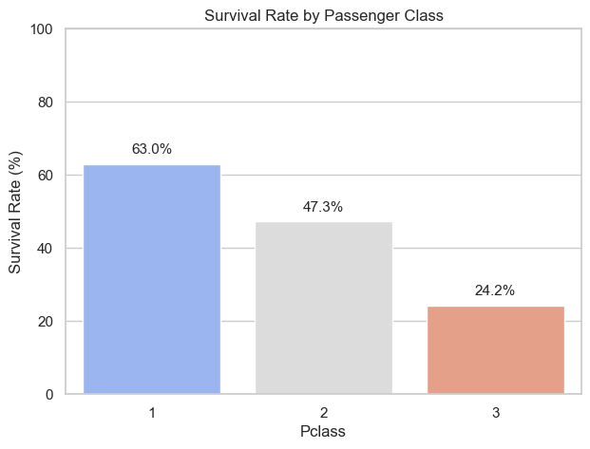
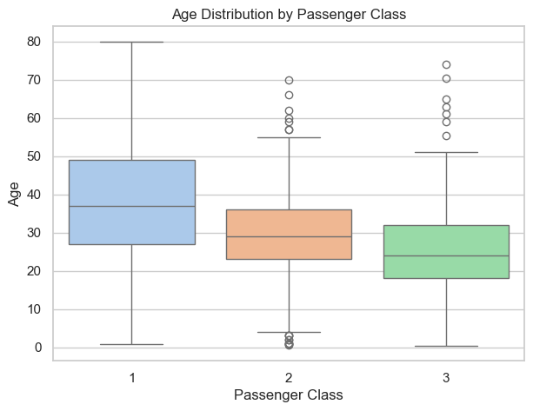
Class 1 survived 63%, class 3 only 24%..
Class 1 is richer (high fare)

Slide 13
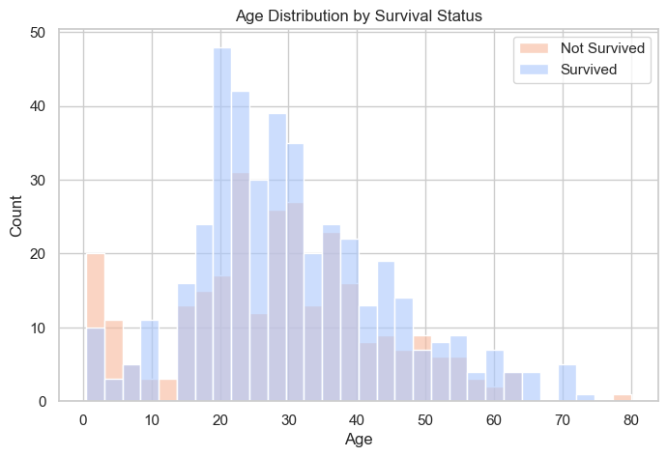
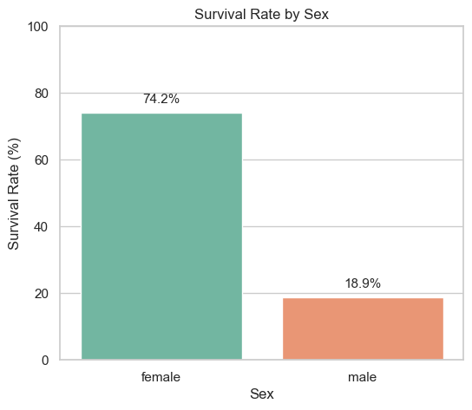
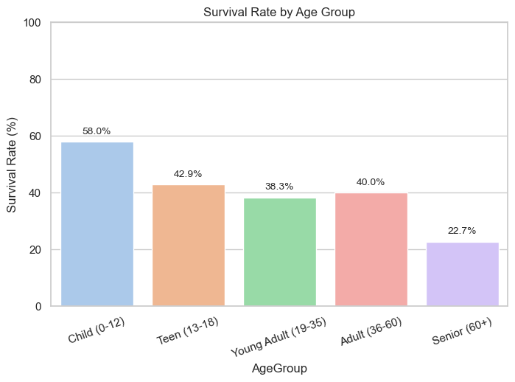
Survival by Sex (female 74% survived, male 19%).
Women and children first policy

Slide 14
Survival Factors Analysis
Questions:
(1) Sex affects survival?
(2) Does family size (SibSp+Parch) help survival?
(3) Is there an advantage to having a taller Fare?

Slide 15
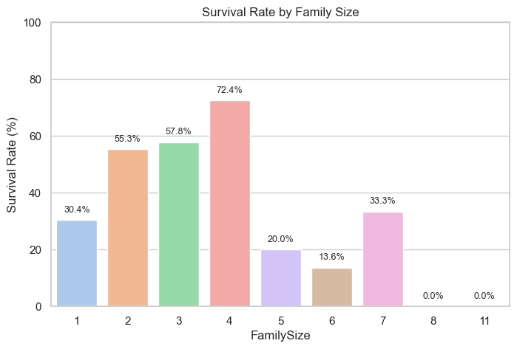
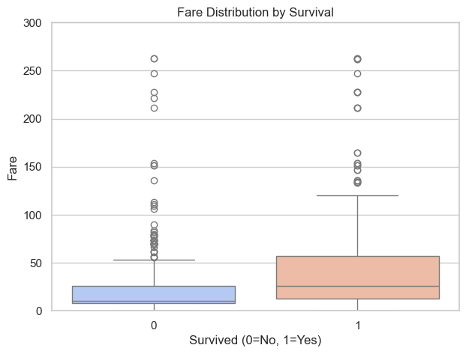
Female survival ~74%
Male only ~19%
Women first
Single travelers (FamilySize=1) or small families (2–4) have higher survival rates.
Big families are not always better – single or small families survive better

Slide 16
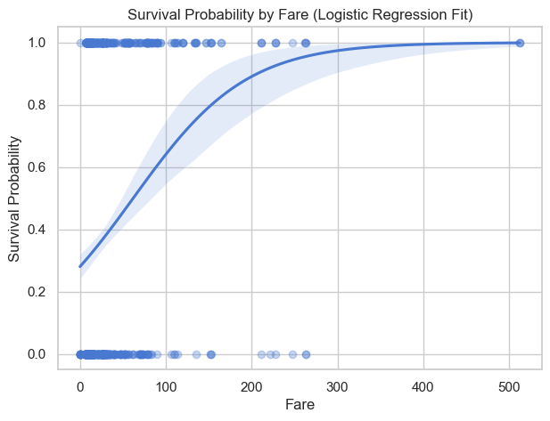
The surviving group has a higher average Fare (usually in the higher class).
The logistic regression line shows that the higher the Fare, the greater the probability of survival.
High fare correlates with survival – rich advantage

Slide 17
Time/Port-wise Và Other Analysis
Questions
(1) Survival by port? (C is higher than S/Q)
(2) Optimal family size?
(3) Effect of cabin?

Slide 18
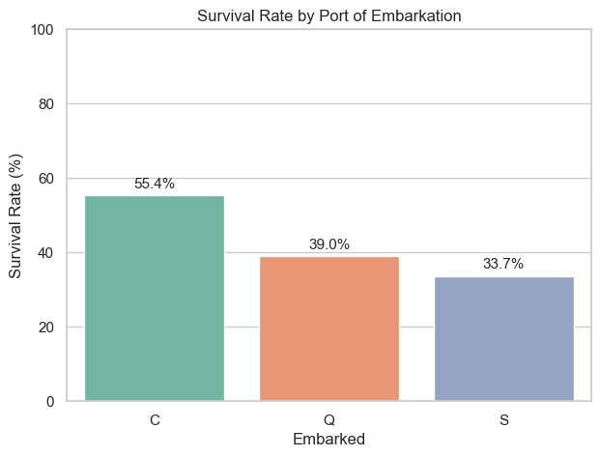
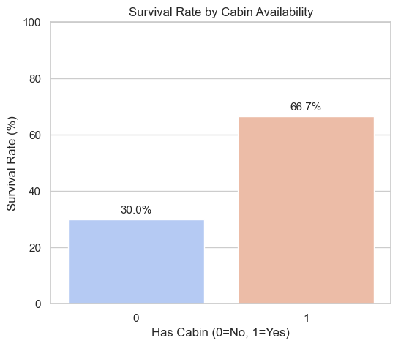
Survival is highest in Cherbourg (C) (~55%), S is lower (~34%), Q is lowest (~39%).
Passengers from Cherbourg (richer, higher ticket) survived higher
People with Cabin info (1) → survive better (richer, higher class).
Cabin data reflects wealth → higher chance of survival.

Slide 19

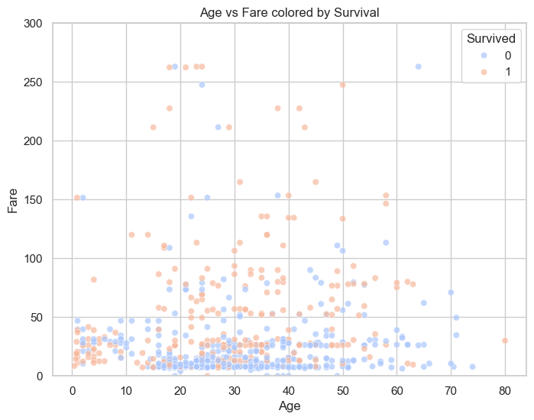
Optimal survival for small (2–4 people).Single (1) lower, Family >4 drops sharply.
Small family has the most benefits, large family has less opportunity.
High ticket group (Fare > 50) has many red points (Survived).Young people + high ticket = best survival.
High fare correlates to survival. Young age + wealth = advantage.

Slide 20
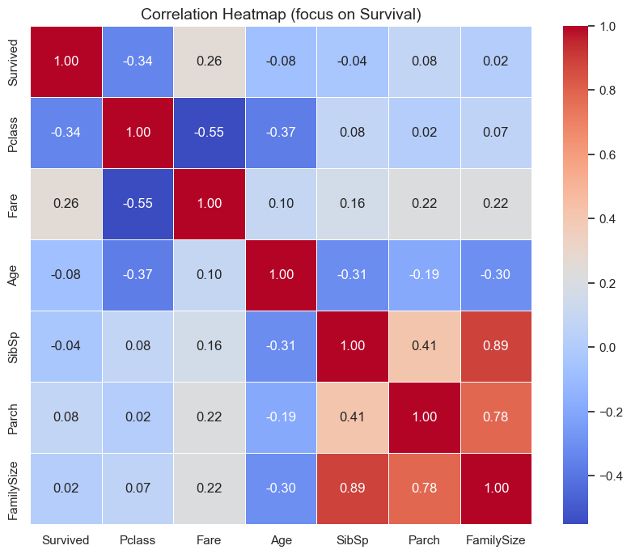
Correlation Heatmap
Survived vs Pclass = -0.3 → Higher class → higher chance of survival.
Survived vs Fare = +0.25 → More expensive ticket → higher chance of survival.
Survived vs Age ≈ -0.08 (older age, less likely to survive).
Survived vs FamilySize is close to 0, but U-shaped (small family is best).

Slide 21
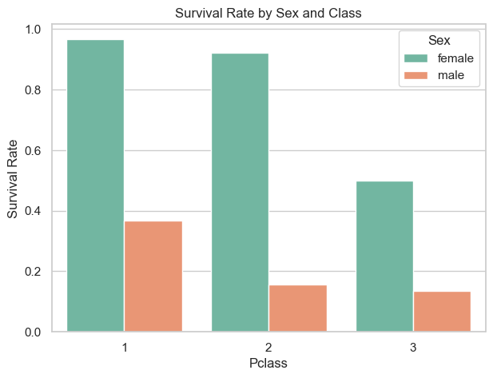
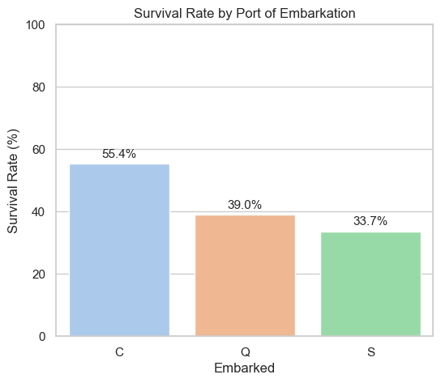
Optimal Insights
Sex: Female > Male (74% vs 19%).
Class: Class 1 > Class 3 (63% vs 24%).
Age: Younger (especially children) live better.
Port: C (Cherbourg) has the highest survival rate (~55%).

Slide 22
Conclusion
Key factors: Sex, Pclass, Age.
Women survived ~74%, men only ~19%.
Class 1 survived ~63%, Class 3 only ~24%.
Children and rich passengers (high Fare) have an advantage.
In disasters, prioritize vulnerable groups (women, children, elderly).
Ensure fairness in rescue efforts.
Through analysis, the most important factors affecting the probability of survival are gender, ticket class, and age. Women and children, especially those in high ticket classes, have a significantly higher chance of survival. Therefore, an important recommendation in disasters is to prioritize rescue for vulnerable groups.

Slide 23
Thank You

