Slide 1
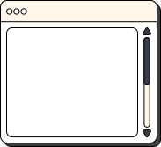


MATHS
Optimization in Deep Learning: Concepts & Convexity

Slide 2

TEAM MEMBER
Nguyễn Minh Tuấn - 2470574
Nguyễn Trần Phước - 2470576
Lê Trí Quyền - 2470740
Lê Quang Trung - 2470746
Trần Hoàng Nguyên - 2470739
THINK
PAIR
SHARE

Slide 3

TABLE CONTENT
Optimization & Deep learning
Optimization issues
Convexity: Convex Sets & Convex Functions
Key property & Constraint
Exercise

Slide 4

OPTIMIZATION
Minimize the loss function
Reduce the training error

Slide 5
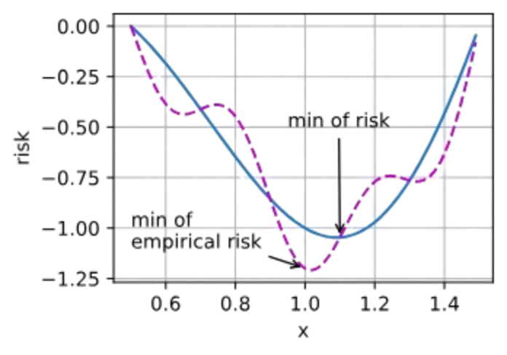
DEEP LEARNING
Finding a suitable model, given a finite amount of data
Reduce the generalization error

Slide 6

OPTIMIZATION ISSUES
LOCAL MINIMA
For any objective function f(x), if the value of f(x) at x is smaller than the values of f(x) at any other points in the vicinity of x, then f(x) could be a local minimum.
If the value of f(x) at x is the minimum of the objective function over the entire domain, then f(x) is the global minimum.

Slide 7
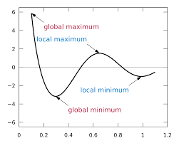
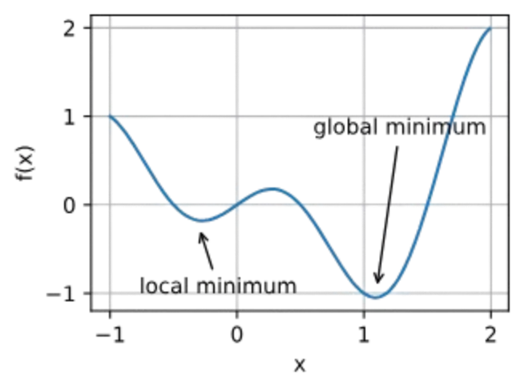
OPTIMIZATION ISSUES
LOCAL MINIMA
The optimization problems may have many local minima.

Slide 8
OPTIMIZATION ISSUES
SADDLE POINTS
A saddle point is any location where all gradients of a function vanish but which is neither a global nor a local minimum.
Consider the function f(x)=x^3. Its first and second derivative vanish for x=0. Optimization might stall at this point, even though it is not a minimum.

Slide 9
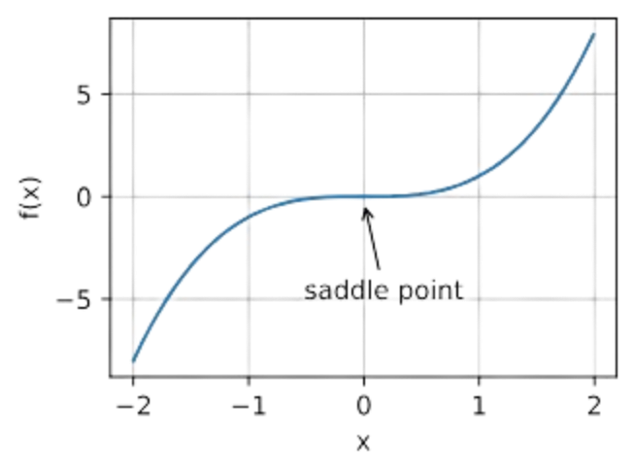
OPTIMIZATION ISSUES
SADDLE POINTS
The problem may have even more saddle points, as generally the problems are not convex.

Slide 10
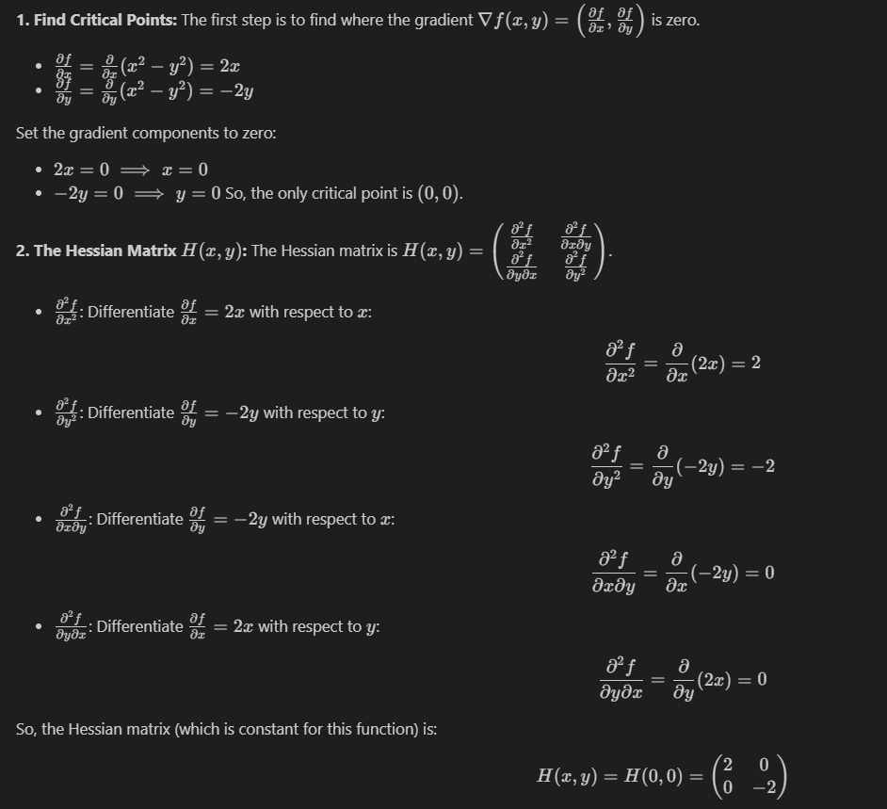
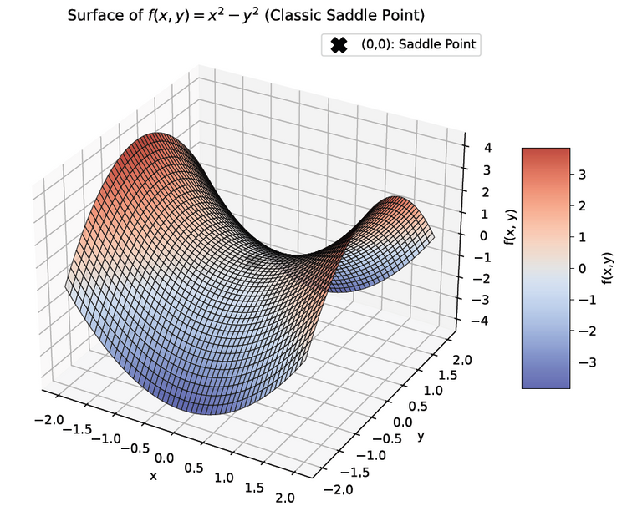
OPTIMIZATION ISSUES
SADDLE POINTS
Example: f(x,y) = x2 - y2

Slide 11
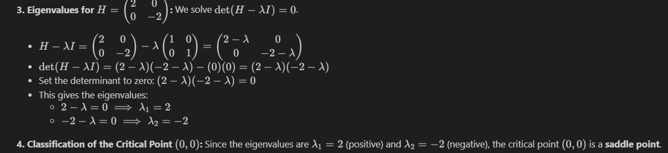
OPTIMIZATION ISSUES
SADDLE POINTS
Example: f(x) = x2 - y2

Slide 12
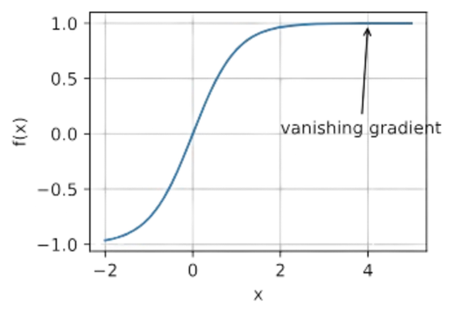
OPTIMIZATION ISSUES
VANISHING GRADIENTS
In a neural network, learning happens by adjusting the network's weights based on the error (or loss) calculated at the output. The backpropagation algorithm computes the gradient (which is essentially the derivative of the loss function with respect to each weight) and uses this gradient to update the weights. The vanishing gradient problem occurs when these gradients become extremely small as they are propagated backward from the output layers to the earlier layers of the network
For instance, assume that we want to minimize the function f(x)=tanh⁡(x) and we happen to get started at x=4. The gradient of f is close to nil. More specifically, f′(x)=1−tanh^2⁡(x) and thus f′(4)=0.0013.
Vanishing gradients can cause optimization to stall.

Slide 13
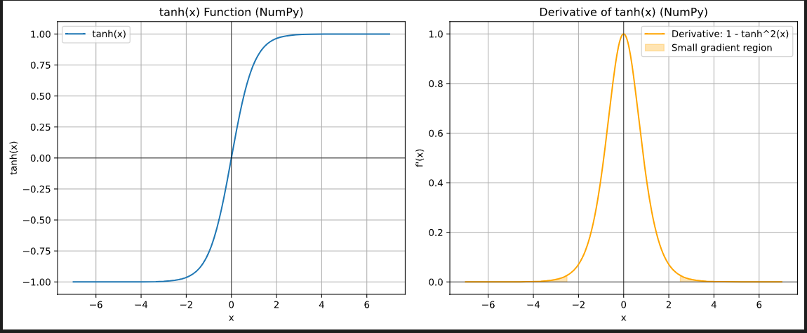
OPTIMIZATION ISSUES
VANISHING GRADIENTS

Slide 14
OPTIMIZATION ISSUES
VANISHING GRADIENTS
Slow Training: The most immediate effect is that the network trains very slowly, as the earlier layers are not updated effectively.
Poor Performance: If the early layers don't learn, the network cannot learn complex features and will likely perform poorly on the task it's being trained for.
Inability to Train Deep Networks: Vanishing gradients historically made it very difficult to train very deep neural networks effectively.

Slide 15
CONVEXITY
Convexity plays a vital role in the design of optimization algorithms.
This is largely due to the fact that it is much easier to analyze and test algorithms in such a context.

Slide 16

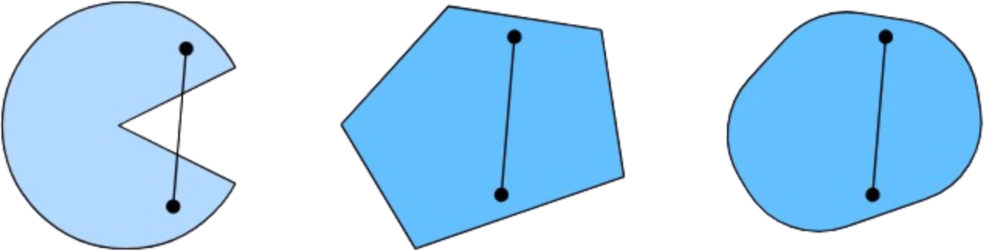
CONVEX SETS
Sets are the basis of convexity. Simply put, a set X in a vector space is convex if for any a,b∈X the line segment connecting a and b is also in X.
The first set is nonconvex and the other two are convex.

Slide 17
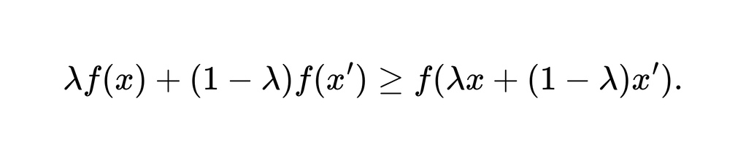
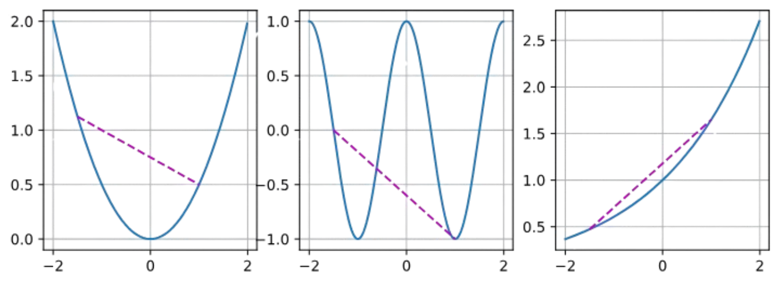
CONVEX FUNCTIONS
Now that we have convex sets we can introduce convex functions f. Given a convex set X, a function f:X→R is convex if for all x,x′∈X and for all λ∈[0,1] we have

Slide 18

JENSEN’S INEQUALITY
Given a convex function f, one of the most useful mathematical tools is Jensen’s inequality. It amounts to a generalization of the definition of convexity:

Slide 19

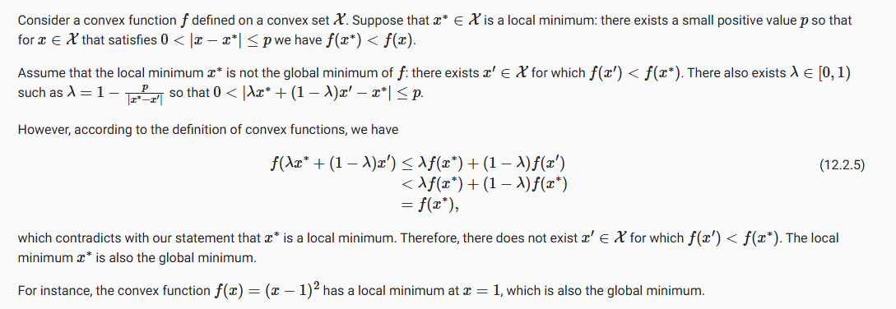
KEY PROPERTY
Local Minima Are Global Minima

Slide 20

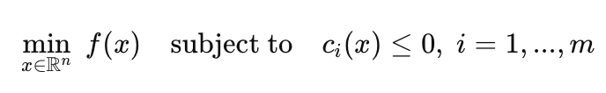
CONSTRAINT
Where:
f(x): objective functions
ci(x): constraint functions

Slide 21
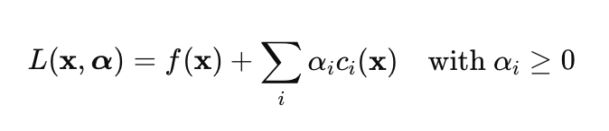
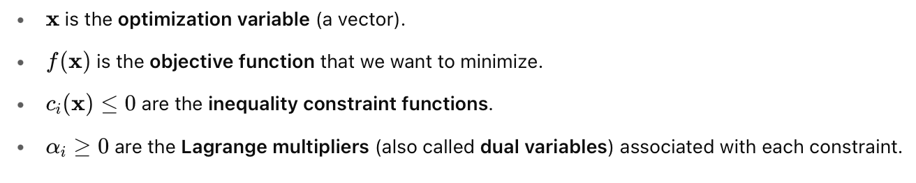
CONSTRAINT
Lagrangian

Slide 22
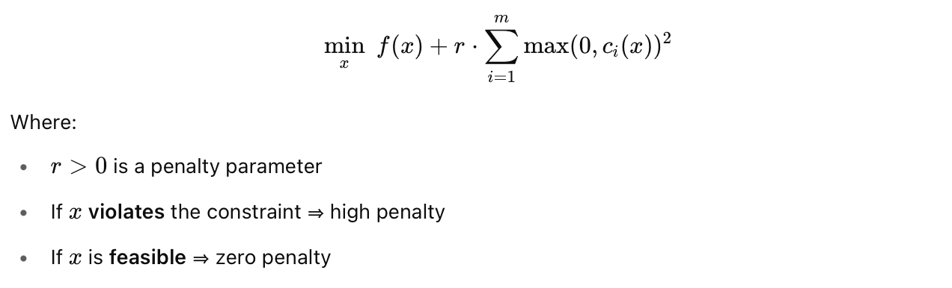
CONSTRAINT
Penalty

Slide 23


CONSTRAINT
Projections
Definition
Example: Gradient Clipping

Slide 24
EXERCISE 4: 12.1.3
Assume that you want to balance a (real) ball on a (real) saddle.
Why is this hard?
Can you exploit this effect also for optimization algorithms?
A saddle surface (z=x2−y2) curves:
Upward in one direction (e.g. along the x-axis),
Downward in another direction (e.g. along the y-axis).
So, placing a ball at the center of the saddle:
It rolls down along the downward-curved direction,
It’s trapped or balanced in the upward-curved direction.
=> Makes the saddle unstable

Slide 25
EXERCISE 4: 12.1.3
Since saddle points have negative curvature in some directions, we can:
Use second-order methods (e.g. Newton’s method) that detect negative curvature.
Add noise (as in SGD or Langevin dynamics) to escape flat saddle regions.
Use algorithms like Adam, RMSprop that adapt learning rates directionally.

Slide 26
EXERCISE 4: 12.1.3
Practical Strategies:
Momentum helps push through flat regions or escape slow convergence at saddles.
Hessian-vector products (used in trust-region or curvature-aware methods) can detect and escape saddles.

Slide 27
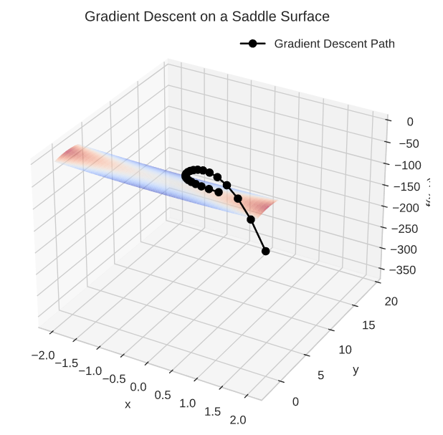
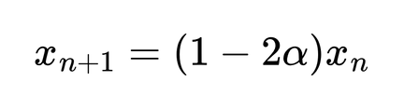
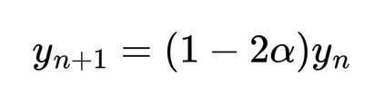



EXERCISE 4: 12.1.3
Because of the saddle shape, gradient descent does not converge to a minimum. Instead:
The x component decays toward zero, as
The y component diverges, growing exponentially, as
In this case, with , we have:
— decaying
— growing

Slide 28
EXERCISE 4: 12.1.3
A path that initially moves toward the saddle point along x, but then shoots off along the y-axis because of divergence.
This shows that gradient descent fails to converge on saddle points because they’re not minima, and small perturbations in the wrong direction (here, y-axis) get amplified.

Slide 29
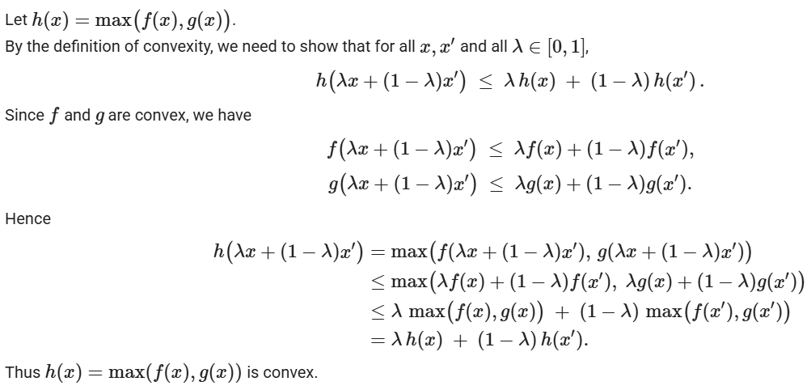
EXERCISE 3: 12.2.4
Given convex functions f and g, show that max(f,g) is convex, too. Prove that min(f,g) is not convex.

Slide 30
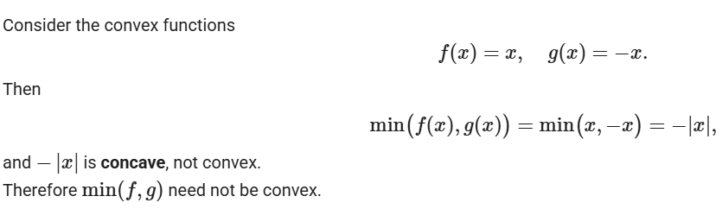
EXERCISE 3: 12.2.4
Given convex functions f and g, show that max(f,g) is convex, too. Prove that min(f,g) is not convex.

Slide 31
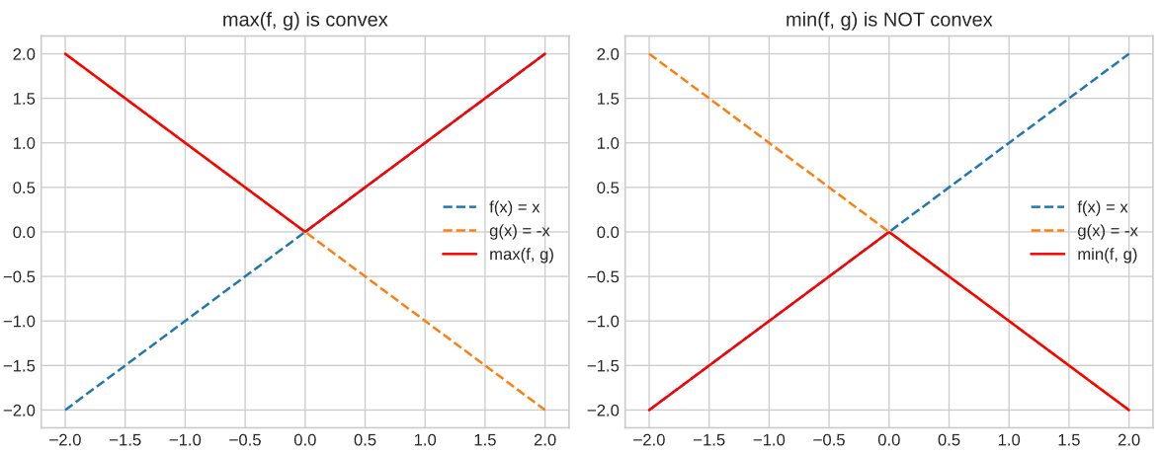
EXERCISE 3: 12.2.4
Given convex functions f and g, show that max(f,g) is convex, too. Prove that min(f,g) is not convex.

Slide 32
Q&A

Slide 33
THANK YOU

