Slide 1

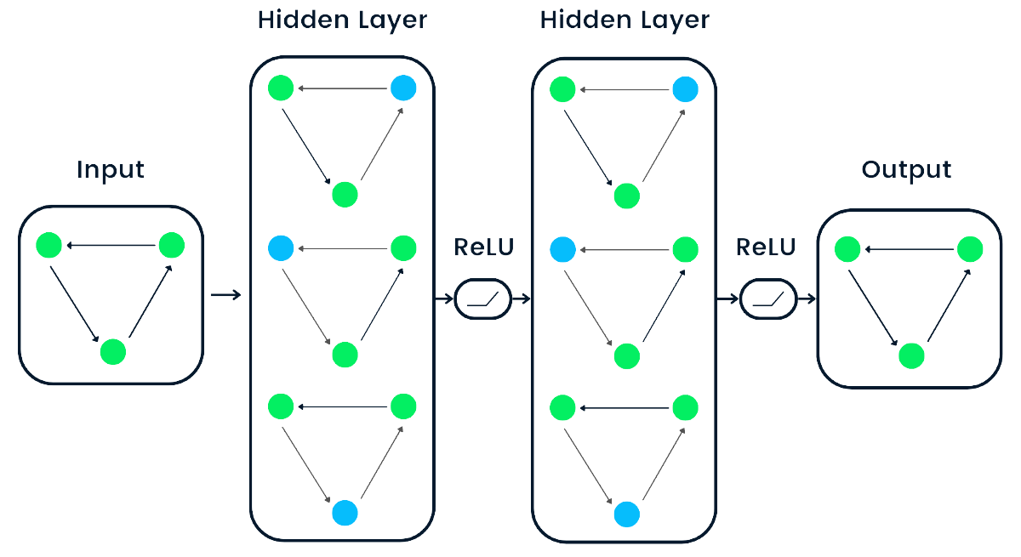
GRAPH NEURAL NETWORK
1

Slide 2
Member
Nguyen Thanh Binh - 20133025
Nguyen Nhat Trieu - 20133102
2

Slide 3
Table of Contents
Introduction to the topic
Introduction to the problem
Motivation
Expected results
Fundamental knowledge
Introduction to Graph Neural Network.
Some common architectures of GNN.
Applications, limitations, and future.
Application program
Introduction to the problem
Experiment
Conclusions
Conclusion
Limitations
Development direction
3

Slide 4
I. INTRODUCTION TO THE TOPIC
4

Slide 5
1. Introduction to the problem
Learn the basic knowledge about graph data and Graph Neural Network.
Explore the problem of link prediction and apply the knowledge of Graph Neural Network to solve the problem.
5

Slide 6
2. Motivation
The strong development of digital technology and artificial intelligence poses many challenges and new opportunities in processing and analyzing complex data types (especially graph data).
Graph Neural Network (GNN) is a powerful machine learning model in this field.
Understanding GNN and its applications can help us understand and leverage information from graph data, thereby supporting many current tasks.
6

Slide 7
3. Expected results
On a theoretical level:
Master the basic knowledge of graph data, analysis, and processing.
Master the basic knowledge revolving around Graph Neural Network.
On an application level:
Build a program that applies combined methods with Graph Neural Network to the "fb-pages-food" dataset to solve the link prediction problem.
7

Slide 8
II. FUNDAMENTAL KNOWLEDGE
8

Slide 9
1. Introduction to Graph Neural Network
Graph Neural Networks (GNNs) are a type of artificial neural network designed to perform processing and inference on various types of data represented in the form of graphs.
9

Slide 10

2. Some common architectures of GNN
2.1. Graph Convolution Network
Quy luật lan truyền:
Trong đó:
: Là ma trận kề được điều chỉnh (normalized adjacency matrix)
: Là ma trận đường chéo được điều chỉnh (normalized degree matrix)
: Là ma trận biểu diễn của các đặc trưng tại lớp l
: Là ma trận trọng số lớp l
10

Slide 11
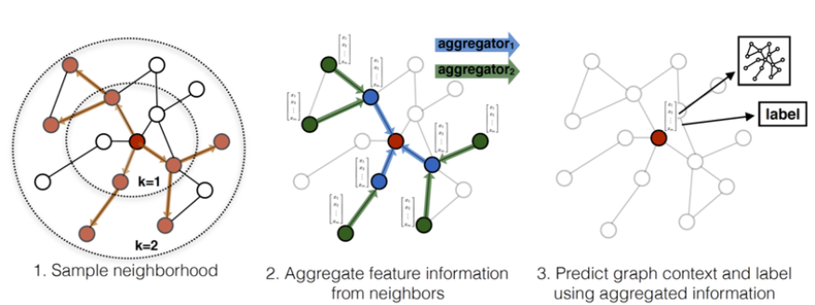
2. Some common architectures of GNN
2.2. GraphSage
Tổng quát:
Tận dụng một mẫu dữ liệu nhỏ từ các điểm lân cận để nhúng nút, thay vì xử lý toàn bộ đồ thị.
Có thể khái quát hóa các nút không nhìn thấy được.
Phù hợp giải cho các bài toán tổng quát hóa cao như bài toán về mạng xã hội, ....
11

Slide 12
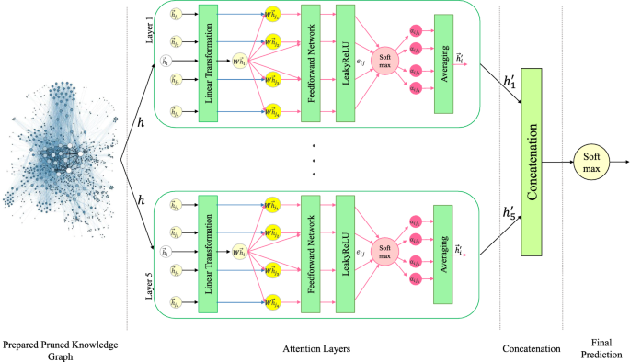
2. Some common architectures of GNN
2.2. Graph Attention Network (GAT)
It is a new architecture for graph data
Combining Graph Neural Network (GNN) and Attention layer.
GAT can be widely applied and effectively learned in many fields, but it is also computationally expensive and difficult to interpret the attention mechanism.
12

Slide 13
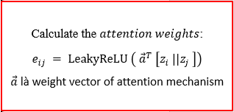
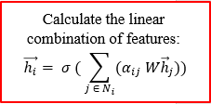

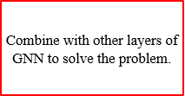


2. Some common architectures of GNN
2.2. Graph Attention Network (GAT)

Slide 14
3. Applications, limitations, and future
GNN is widely applied in many fields such as social networks, natural language processing, fraud detection, ...
However, GNN still faces many limitations such as high computation and storage costs, ...
In the future, GNN should enhance scalability, improve performance, ... by integrating with new models and mechanisms.
14

Slide 15
III. APPLICATION PROGRAM
15

Slide 16
1. Introduction to the problem
Predicting the existence of links between two nodes in the future is the task at hand.
Methods:
Traditional methods: heuristic method, feature-based method, content-based method
GNN-based methods:
Node-based methods (Graph AutoEncoder, ...)
Subgraph-based methods (SEAL Framework, Weisfeiler-Leman, ...)
The problem is applied in many fields. But also faces many challenges.
16

Slide 17
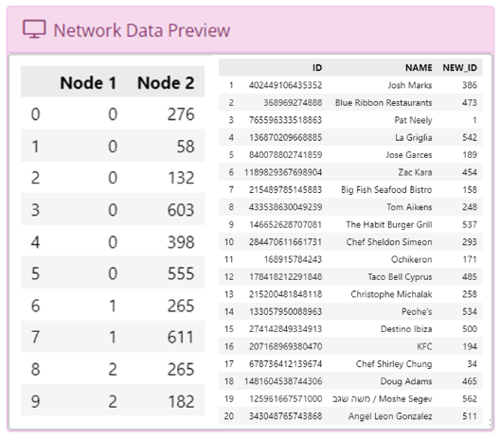
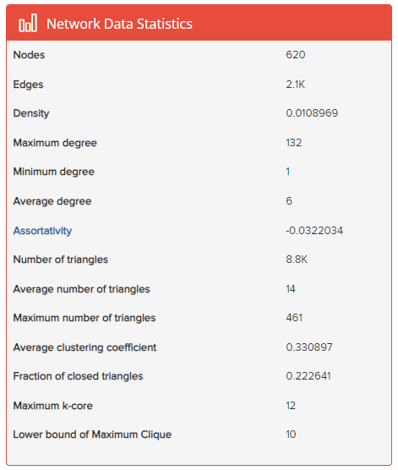
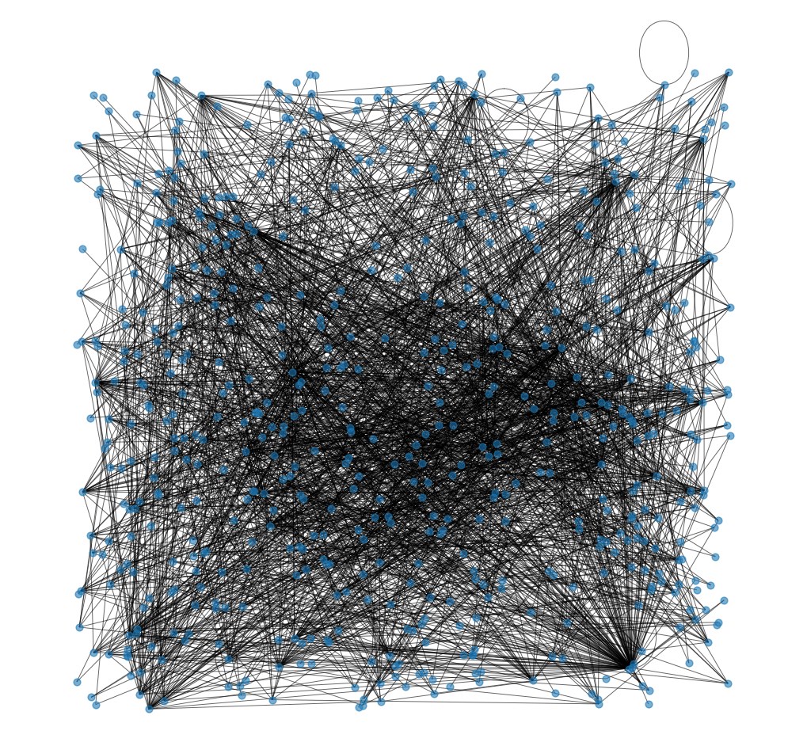

2. Experiment
2.1. Introduction to the environment and dataset
18

Slide 18
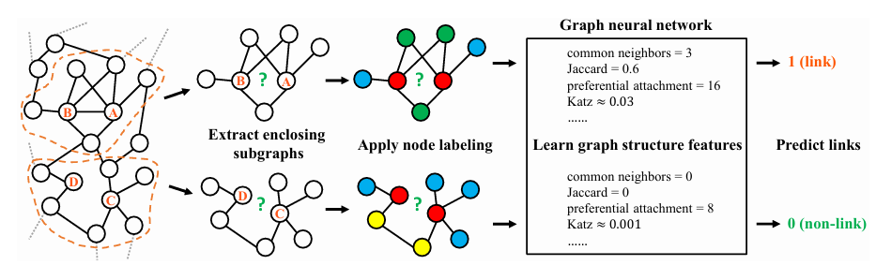
2. Experiment
2.1. SEAL Framework
(learning from Subgraphs, Embeddings, and Attributes for Link prediction)
19

Slide 19
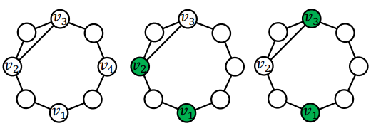
2. Experiment
2.2. Two-WL
Two-WL is a common technique used to extract information from graph structures.
Applying Two-WL in link prediction tasks improves prediction accuracy by utilizing the structural information of the graph.
20

Slide 20
2. Experiment
2.2. Two-WL
Steps to apply 2-WL to GNN for link prediction:
Step 1: Take the node features or node degrees as the initial input.
Step 2: Use 1-WL-GNN and clustering function to obtain the representation of the link.
Step 3: Use 2-WL-GNN to get the predicted score for each queried link.
20

Slide 21
2. Experiment
2.3. Evaluation and comments on the results
28

Slide 22
PHẦN 4: CONCLUTIONS
29

Slide 23
1. Conclution
The group has presented an overview of Graph Neural Network models and experimented with combining GNNs to predict deadlines accurately.
The results of the project have met some of the stated objectives.
30

Slide 24
2. Limitations
The group does not fully understand the deep structure and principles of GNNs and has not yet studied all the link prediction methods.
Experiments face difficulties in applying them to many large datasets, and the performance evaluation process is not entirely accurate until evaluated on many other factors.
31

Slide 25
3. Development direction
In the future, the program can be improved to run on larger datasets and integrate with data in data warehouses to build recommendation systems.
The theories and algorithms in the report can be applied to solve many problems in fields such as natural language processing and fraud detection..
32

Slide 26
THANK YOU FOR WATCHING !
33

