Slide 1

Introduction to Redux Redux, Redux Thunk and Redux Toolkit

Slide 2
Objectives
Discuss the features of the Flux architecture.
Explain the Redux approach to implementing a variant of the Flow architecture.
Install and Configure Redux.
Define Redux Toolkit
Split the reducer function into multiple simpler functions and combine the reducer functions
Use Redux Thunk middleware to return a function instead of an action
Use a logger middleware to print a log of actions initiated on the Redux store

Slide 3
Model-View-Controller Framework

Slide 4
Design Patterns
Well-documented solution to a recurring problem
Also referred to as an architectural pattern
Software design pattern
Reusable solution to commonly occurring problems
Gang of four: E. Gamma et al. Design Patterns: Elements of Reusable Object-Oriented Software, Addison-Wesley, 1994
https://en.wikipedia.org/wiki/Software_design_pattern

Slide 5
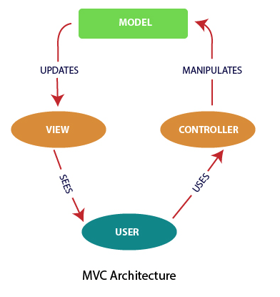
The Model-View-Controller (MVC) Architecture
Software engineering architecture pattern
Isolation of domain logic from user interface
Permits independent development, testing and maintenance (separation of concerns)

Slide 6
MVC Framework
Model
Manages the behavior and data of the application domain
Responds to requests for information about its state (usually from the view)
Responds to instructions to change state (usually from the controller)
In event-driven systems, the model notifies observers (usually views) when the information changes so that they can react

Slide 7
MVC Framework – cont’d
View
Renders the model into a form suitable for interaction, typically a user interface element
Multiple views can exist for a single model for different purposes
A viewport typically has a one to one correspondence with a display surface and knows how to render to it

Slide 8
MVC Framework – cont’d
Controller
Receives user input and initiates a response by making calls on model objects
A controller accepts input from the user and instructs the model and viewport to perform actions based on that input

Slide 9
The Flux Architecture

Slide 10
React and MVC
Initially React was viewed as the “V” in MVC
Not emphasized any more
Facebook found issues with using the standard MVC architecture pattern
Discarded in favor of the Flux architecture
Problems with cascading updates, decentralized mutations, race conditions

Slide 11
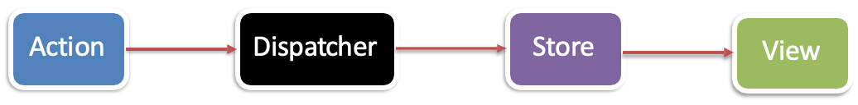
The Flux Architecture
Unidirectional Data Flow
Notes:
Actions: Represent the actions that users perform in the application or other events that the application generates. Actions are initiated by users or other components in the system and contain information about the action being performed.
Dispatcher: The intermediary component of the Flux architecture. The Dispatcher's responsibility is to receive actions and dispatch them to the corresponding stores. It ensures that actions are sent and processed in the correct order.
Stores: Contain the application's data and perform the business logic. Each store manages a separate portion of the application's data and provides methods to access and update the data. When the data in a store changes, it notifies other components through events.
Views: Represent the user interface and display data from the stores. Views receive data from stores and update the user interface based on that data. When users interact with the interface, views create actions and send them to the dispatcher to perform the corresponding actions.

Slide 12
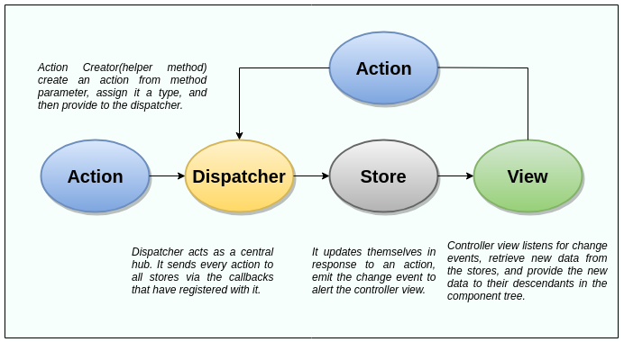
The Flux Architecture – cont’d
New actions propagated through the system in response to user interactions

Slide 13
Compare between Flux and MVC
 | Flux | MVC
Unidirectional data flow | Flux adheres to the principle of unidirectional data flow, where data can only be updated through actions and passed down to other components in a single direction | MVC does not enforce unidirectional data flow. State can be updated from both the Controller and Model, and the View can directly access the Model to display data
State management | Flux has one or multiple Stores to store application data. Stores are responsible for handling logic and providing data to Views. Stores are not tightly coupled to Views and can exist independently. | The Model is responsible for storing data and handling logic. The Controller serves as an intermediary between the Model and View, controlling the process of updating data and interactions between components
Action | actions are simple objects that describe events occurring in the application. Actions contain information about the type of action and corresponding data | actions are not explicitly defined as in Flux. Instead, user interactions and other events in the application are handled in the Controller and Model.
Component dependencies | Dispatcher is responsible for sending actions from View to Store. Stores do not depend on any other components and can exist independently. This ensures the independence and ease of testing of the components. | Controller depends on the Model and View to coordinate and update data. The Controller sends requests to the Model and updates the View to display new data. This dependency can increase the coupling between components and make testing more challenging

Slide 14
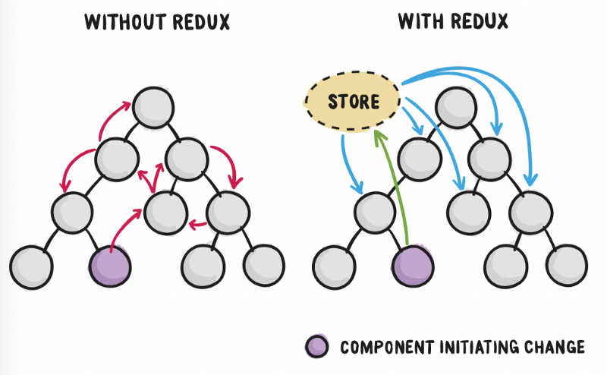
Introduction to Redux
What is Redux?
Predictable state container for JavaScript apps
Inspired by Flux architecture, Elm language, Immutable
Makes state mutations predictable

Slide 15
Main Principles of Redux
Single source of truth
Single state object tree within a single store
State is read-only (only getters, no setters)
Changes should only be done through actions
Changes are made with pure functions
Take previous state and action and return next state
No mutation of the previous state

Slide 16
What is Redux
Single store and single state tree enables powerful techniques:
Logging
API handling
Undo/redo
State persistence
“time-travel debugging”

Slide 17
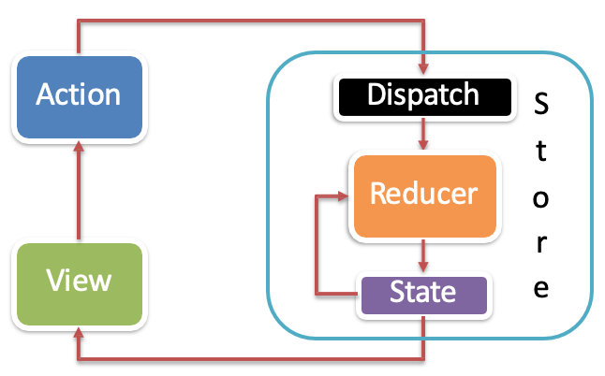
Redux Data Flow
State: stored in plain JS object
Action: plain JS object with a type field that specifies how to change something in the state
Reducer: pure functions that take the current state and action and return a new state
Update data immutably (do not modify inputs)
Uni-directional data flow

Slide 18
How to install redux
Redux: Application state management library helps maintain and update application state in the "store“.
npm i redux@4.2.1
React-Redux: Library combining React and Redux, providing connection between React component and Redux store. Provide hooks like useSelector and useDispatch to access state and send actions to the Redux store from components.
npm i react-redux@8.1.3
Redux Thunk: Redux middleware, allowing to handle asynchronous actions in Redux. Actions perform asynchronous tasks such as API calls, handle waiting tasks, and then dispatch subsequent actions.
npm i redux-thunk@2.4.2

Slide 19
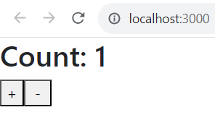
Redux Action
Actions are simply events. They are the way we send data from the app to the Redux store. These data can be from user vs app interaction, API calls or can also be from form submission.
//Action.js
import {increment, decrement} from './counterSlice';
export const incrementAsync = () => {
return (dispatch) => {
setTimeout(() => {
dispatch(increment());
}, 1000);
};
};
export const decrementAsync = () => {
return (dispatch) => {
setTimeout(() => {
dispatch(decrement());
}, 1000);
};
};

Slide 20
Redux Reducer
Reducers are primitive functions that take the current state of the app, perform an action, and return a new state.
These states are stored as objects and they define how an application's state changes in response to an action sent to the store.
//CounterSlice.js
import { createSlice } from "@reduxjs/toolkit";
const counterSlice = createSlice(
{
name: 'counter',
initialState: 0,
reducers:{
increment: (state)=>state+1,
decrement: (state)=>state-1,
},
}
)
export const {increment, decrement} = counterSlice.actions;
export default counterSlice.reducer
createSlice is not a direct replacement for createAction, is method for creating reducers and actions more automatically and conveniently.
createSlice is a function provided by the Redux Toolkit that combines both creating reducers and actions for a "slice" of application state.

Slide 21
Redux Store
Holds the current state value
Created using configureStore() from @reduxjs/toolkit
Instead of simply initializing a store, configureStore will default settings to allow the use of redux devtool to debug and monitor state updates as well as pre-set some middleware.
//Store.js
import { configureStore } from "@reduxjs/toolkit";
import counterReducer from "./counterSlice";
const store = configureStore({
reducer:
{
counter: counterReducer
}
});
export default store;

Slide 22
React with Redux
Use the react-redux package for bindings between React and Redux
Surround your App root with <Provider>
Takes the store as an attribute
Makes store accessible to all connected components
//App.js
import { Provider } from 'react-redux';
import store from './Redux/Store';
import Counter from './Counter';
const App = () => {
return (
<Provider store={store}>
<Counter />
</Provider>
);
}
export default App;

Slide 23
React with Redux – cont’d
//Counter.js
import React from 'react';
import { useSelector, useDispatch } from 'react-redux';
import { incrementAsync,decrementAsync } from './Redux/actions';
const Counter = () => {
const count = useSelector((state)=>state.counter);
const dispatch = useDispatch();
const handleIncrement = () => {
dispatch(incrementAsync());
};
const handleDecrement = () => {
dispatch(decrementAsync());
};
return (
<>
<h2>Count: {count}</h2>
<button onClick={handleIncrement}>+</button>
<button onClick={handleDecrement}>&nbsp;-&nbsp;</button>
</>
);
};
export default Counter;
useSelector and useDispatch from react-redux: These are hooks provided by the react-redux library that allow the component to interact with the Redux store.
useSelector hook is used to select a value from the Redux store. In this case, it selects the counter value from the state.
useDispatch hook is used to get the reference to the dispatch function, which is used to dispatch actions to the Redux store.

Slide 24
Exercise 24: Introduction to Redux
Install and configure Redux within your application
Configure your React application to make use of Redux

Slide 25
Redux Middleware and Redux Thunk

Slide 26
Redux Middleware
Provides the capability to run code after an action is dispatched, but before it reaches the reducer
Third-party extension point
e.g., logging, async API calls
Middleware:
Forms pipeline that wraps around the dispatch()
Pass actions onward
Restart the dispatch pipeline
Access the store state

Slide 27
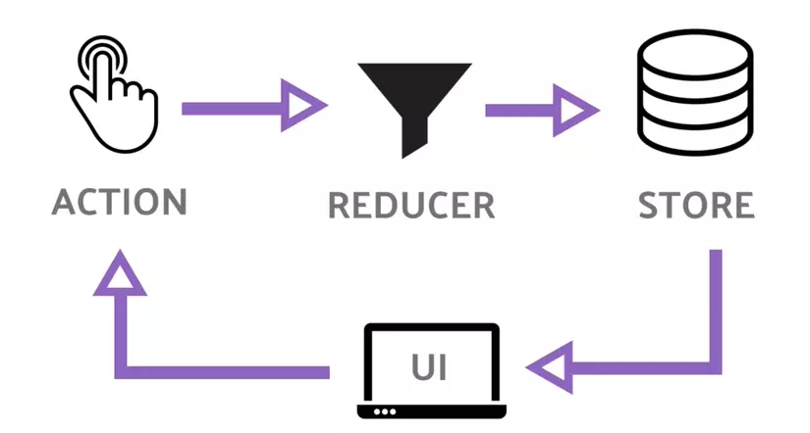

Slide 28
Redux Middleware
Middleware typically used for:
Inspecting the actions and the state,
Modify actions,
Dispatch other actions,
Stop actions from reaching the reducers, etc.
The applyMiddleware() function:
Sets up the middleware pipeline
Returns a “store enhancer” that is passed to configureStore()

Slide 29
What is redux-thunk?
Solution for asynchronous processing in redux activity stream (working with restful api)
How Redux Thunk works is as follows:
When an action is dispatched, Redux Thunk checks to see if the action is a function.
If must, Redux Thunk calls the function with the dispatch and getState parameters.
The called function can perform asynchronous operations, such as API calls, and can dispatch subsequent actions.
When the asynchronous task completes, the resulting action can be dispatched to update the Redux state.

Slide 30
Redux Thunk
Middleware that allows you to write action creators that return a function instead of an action
Can be used to delay the dispatch of an action, or
Dispatch only if a certain condition is met
Inner function receives the dispatch() and getState() store methods

Slide 31
// 1. Redux/fetchJobSlice
import { createSlice } from '@reduxjs/toolkit';
import axios from 'axios';
const fetchJobDetailStart = () => ({
type: 'FETCH_JOB_DETAIL_START',
});
const fetchJobDetailSuccess = (jobDetail) => ({
type: 'FETCH_JOB_DETAIL_SUCCESS',
payload: jobDetail,
});
const fetchJobDetailFailure = (error) => ({
type: 'FETCH_JOB_DETAIL_FAILURE',
payload: error,
});
export const fetchJobDetail = (jobId) => {
return async (dispatch) => {
dispatch(fetchJobDetailStart());
try {
const response = await axios.get(`https://my-json-server.typicode.com/typicode/demo/posts/${jobId}`);
const jobDetail = response.data;
dispatch(fetchJobDetailSuccess(jobDetail));
} catch (error) {
dispatch(fetchJobDetailFailure(error.message));
}
};
};
const jobSlice = createSlice({
name: 'jobs',
initialState: {
jobDetail: null,
loading: false,
error: null,
},
reducers: {},
extraReducers: (builder) => {
builder.addCase(fetchJobDetailStart().type, (state) => {
state.loading = true;
state.error = null;
})
.addCase(fetchJobDetailSuccess().type, (state, action) => {
state.loading = false;
state.jobDetail = action.payload;
})
.addCase(fetchJobDetailFailure().type, (state, action) => {
state.loading = false;
state.error = action.payload;
});
},
});
export default jobSlice.reducer;

Slide 32
Redux Thunk
// 3. Redux/fetchJobDetail
import React, { useEffect } from 'react';
import { useDispatch, useSelector } from 'react-redux';
import { fetchJobDetail } from './actions';
const JobDetail = ({ jobId }) => {
const dispatch = useDispatch();
const jobDetail = useSelector((state) => state.jobs.jobDetail);
const loading = useSelector((state) => state.jobs.loading);
const error = useSelector((state) => state.jobs.error);
useEffect(() => {
dispatch(fetchJobDetail(jobId));
}, [dispatch, jobId]);
if (loading) {
return <div>Loading...</div>;
}
if (error) {
return <div>Error: {error}</div>;
}
if (!jobDetail) {
return null;
}
return (
<div>
<h1>Job Detail</h1>
<p>{jobDetail.title}</p>
</div>
);
};
export default JobDetail;
// 2. Redux/store
import { configureStore } from "@reduxjs/toolkit";
import fetchReducer from "./fetchJobSlice";
const store = configureStore({
reducer:
{
jobs: fetchReducer
}
});
export default store;
// App
import { Provider } from 'react-redux';
import store from './Redux/store';
import JobDetail from './Redux/fetchJobDetail';
const App = () => {
return (
<Provider store={store}>
<JobDetail jobId={1} />
</Provider>
);
}
export default App;

Slide 33
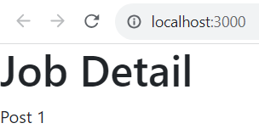
Redux Thunk
Useful for complex synchronous logic
Multiple dispatches
Conditional dispatches
Simple Async logic
Redux Saga: Uses ES6 generators to control pausable functions
Comples async logic
Ongoing “background thread” like processing behavior

Slide 34
Exercise 25: Redux Thunk
Use Redux Thunk middleware to return a function instead of an action
Use a logger to print a log of actions initiated on the Redux store.

Slide 35
Lab 6: Demo about Redux Toolkit, Redux Thunk

Slide 36
Summary
Concepts were introduced:
Discuss the features of the Flux architecture
Explain the Redux approach to implementing a variant of the Flow architecture
Install and Configure Redux
Define Redux Toolkit
Split the reducer function into multiple simpler functions and combine the reducer functions
Use Redux Thunk middleware to return a function instead of an action
Use a logger middleware to print a log of actions initiated on the Redux store

