Slide 1
E-Learning system
OBJECT ORIENTED ANALYSIS AND DESIGN COURSE
Instructor: Dr. Truong Ninh Thuan
Project team:
1.Nguyen Van Vu
2.Nguyen Huu Thuc
3.Nguyen Van Quan

Slide 2

Content
E-learning system requirements
E-learning system analysis
E-learning system designs

Slide 3
I. E-learning system requirements
Problem statement
Glossary
Supplementary specification
Use-case model

Slide 4
1. Problem statement
Booming of information technology in every terms of our normal life
Economics problem
Reusable and convenient.

Slide 5
2. Glossary
User
Instructor
Administrator
Guest
Course
Course certificate

Slide 6
3. Supplementary specification
Functionality
Usability
Reliability
Performance
Security

Slide 7
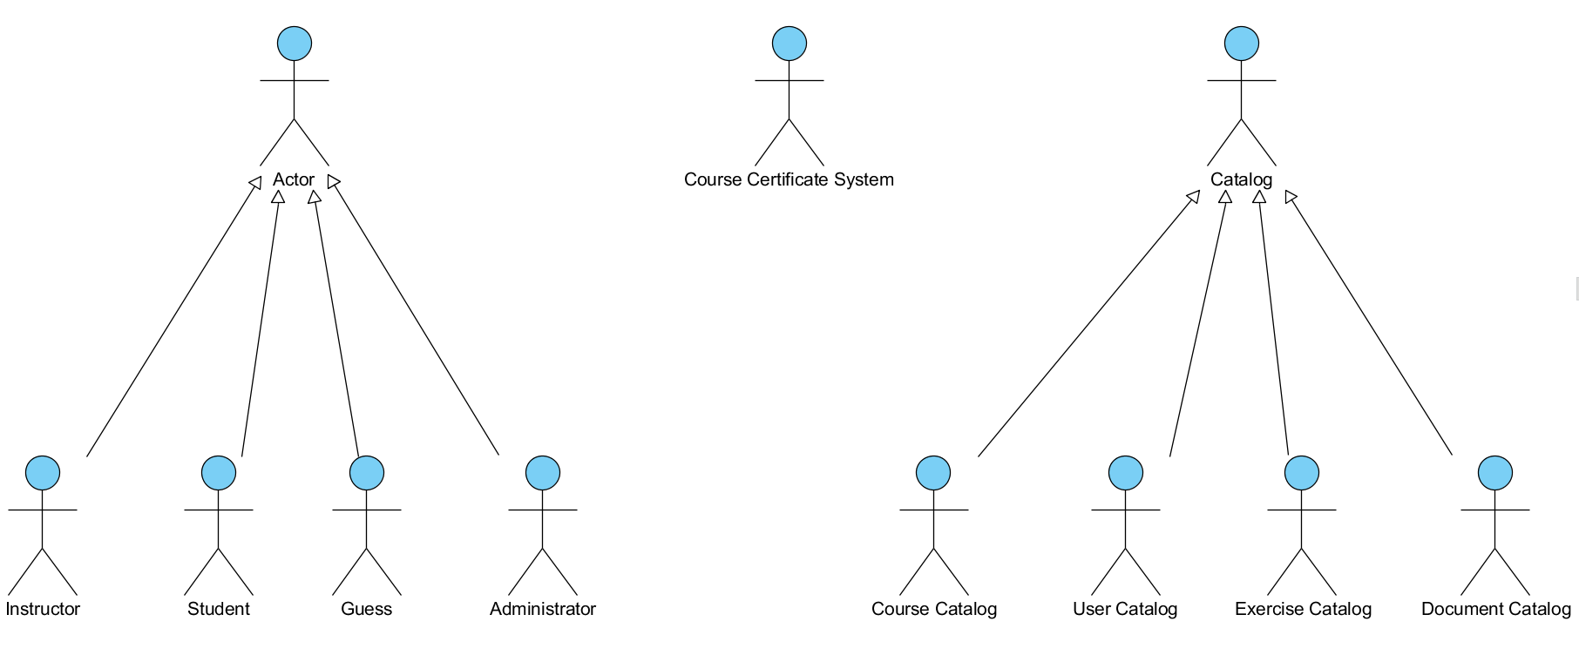
4. Use-case model

Slide 8
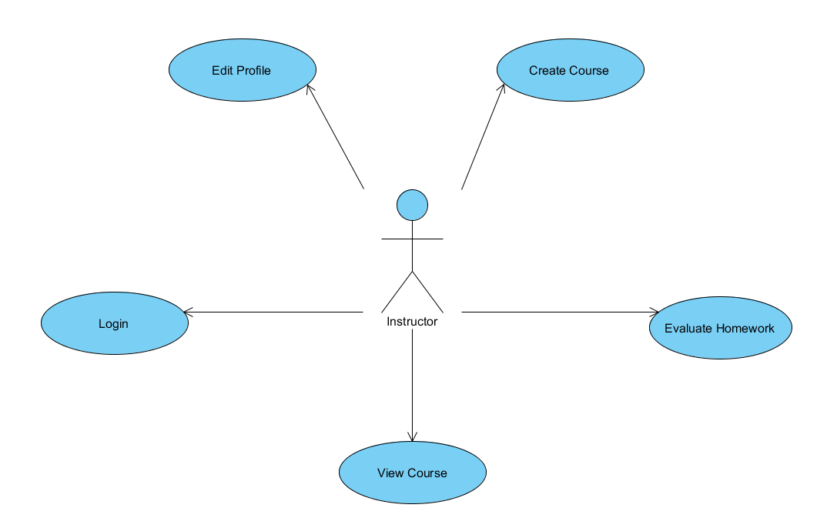
4. Use-case model

Slide 9
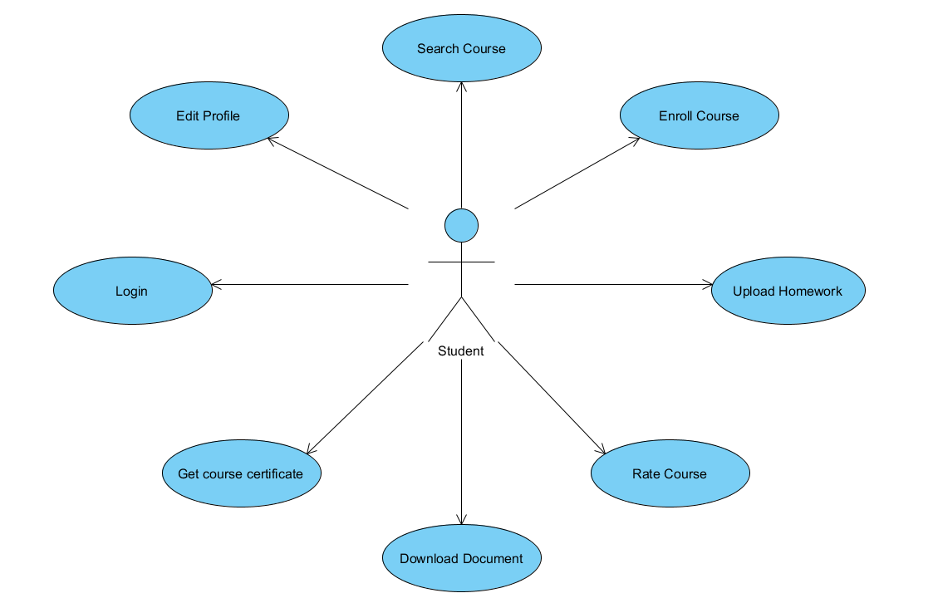
4. Use-case model

Slide 10
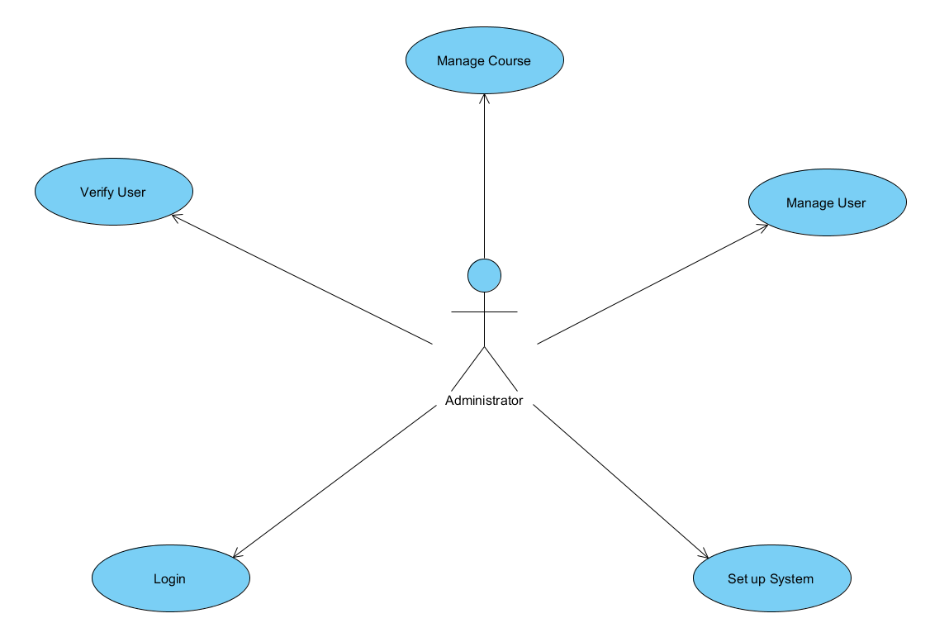
4. Use-case model

Slide 11
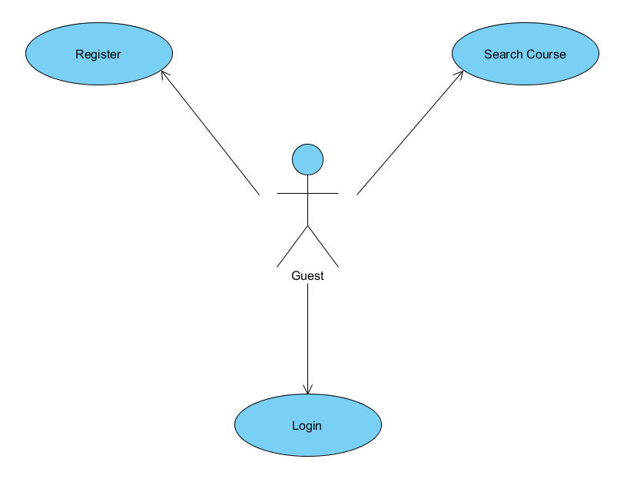
4. Use-case model

Slide 12
II. E-learning system analysis

