Slide 1
E-Learning system
OBJECT ORIENTED ANALYSIS AND DESIGN COURSE
Instructor: Dr. Truong Ninh Thuan
Project team:
1.Nguyen Van Vu
2.Nguyen Huu Thuc
3.Nguyen Van Quan

Slide 2

Content
E-learning system requirements
E-learning system analysis
E-learning system designs

Slide 3
I. E-learning system requirements
Problem statement
Glossary
Supplementary specification
Use-case model

Slide 4
1. Problem statement
Booming of information technology in every terms of our normal life
Economics problem
Reusable and convenient.

Slide 5
2. Glossary
User
Instructor
Administrator
Guest
Course
Course certificate

Slide 6
3. Supplementary specification
Functionality
Usability
Reliability
Performance
Security

Slide 7
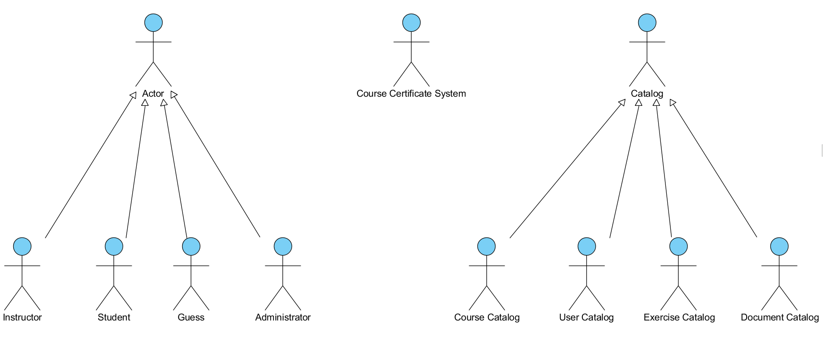
4. Use-case model

Slide 8
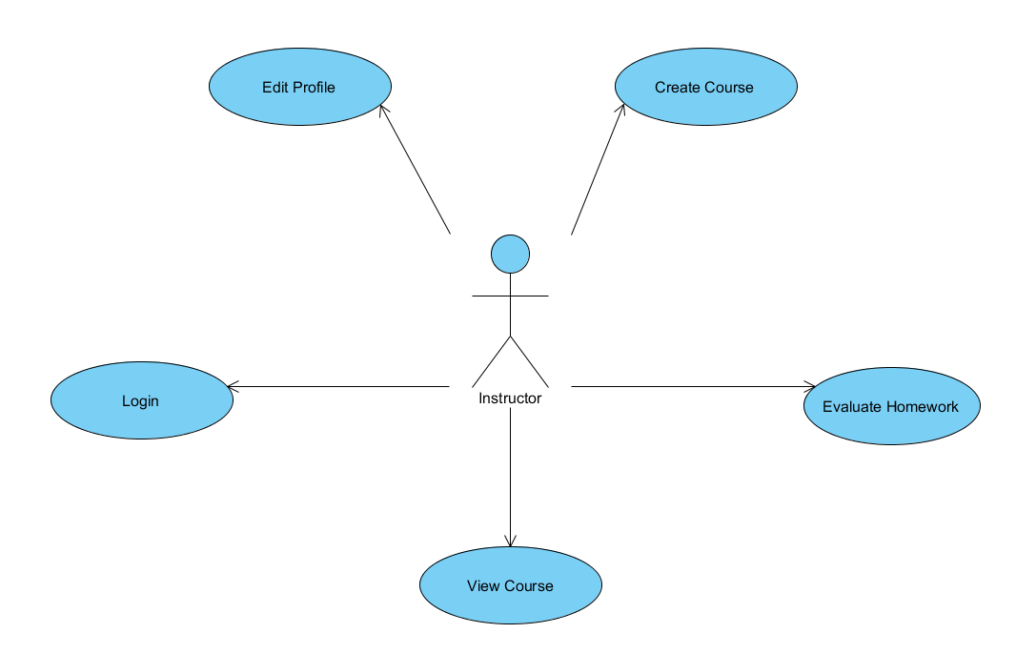
4. Use-case model

Slide 9
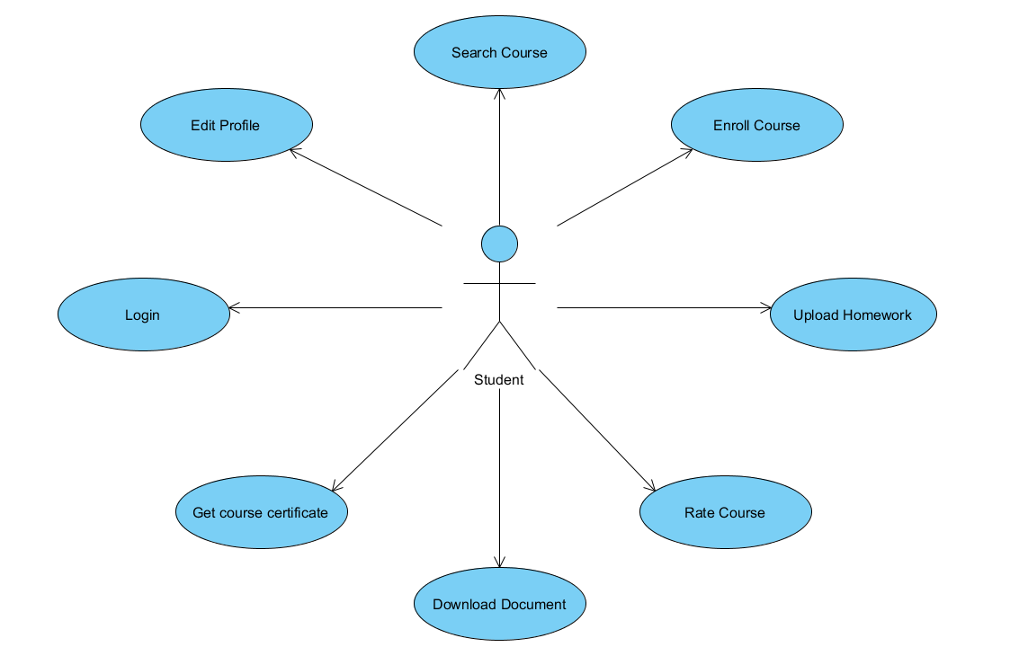
4. Use-case model

Slide 10
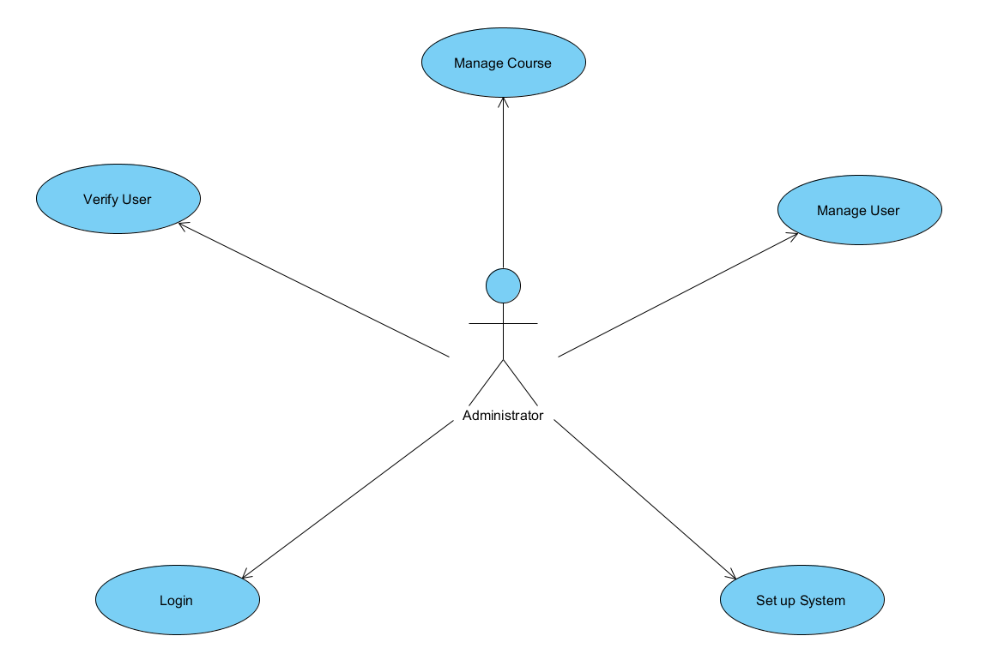
4. Use-case model

Slide 11
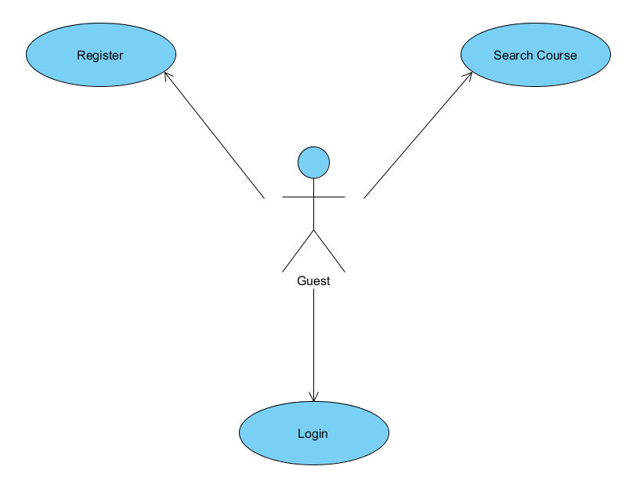
4. Use-case model

Slide 12
II. E-learning system analysis
Architectural analysis
Use case analysis

Slide 13
1. Architectural analysis
1.1. Key abstraction
1.2. Upper-Level Components and their dependencies

Slide 14
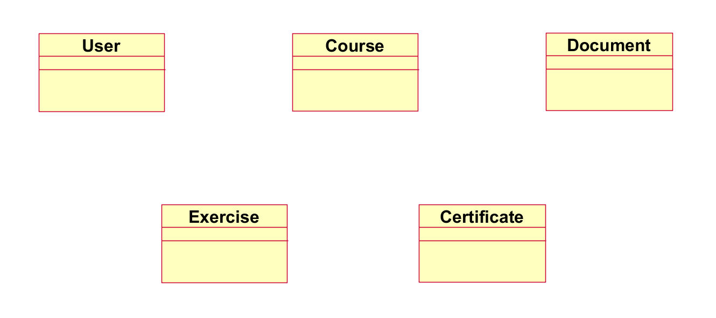
1.1. Key abstraction

Slide 15
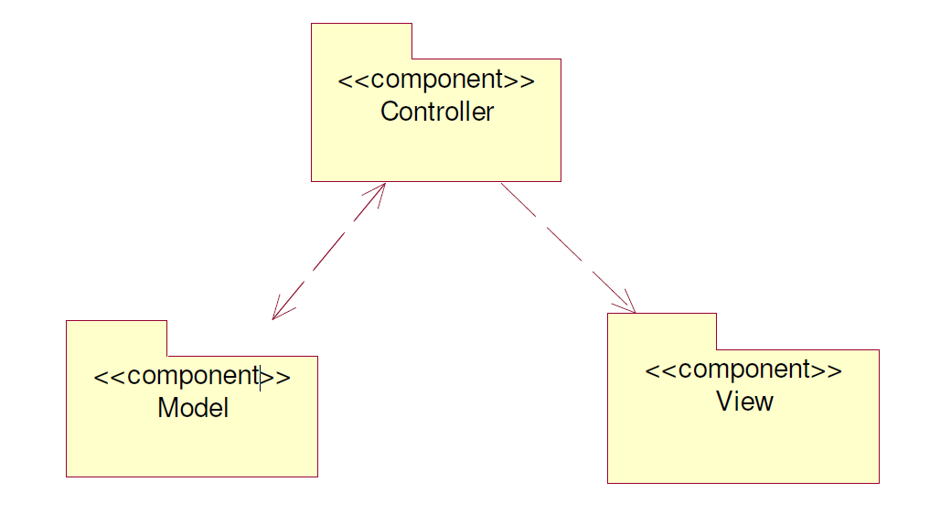
1.2. Upper-Level Components and their dependencies

Slide 16
2. Use-case analysis
2.1. Use case realization interaction diagram
2.2. Use case realization view of participating classes (VOPCs)

Slide 17
2.1. Use case realization interaction diagram
2.1.1 Log in 2.1.8 Course feedback
2.1.2 Change profile 2.1.9 Course creating
2.1.3 Course searching 2.1.10 Homework grading
2.1.4 Course enrolling 2.1.11 Register
2.1.5 Homework uploading 2.1.12 Register confirming
2.1.6 Tutorial uploading 2.1.13 User management
2.1.7 Student certificate confirming 2.1.14 Course management

Slide 18
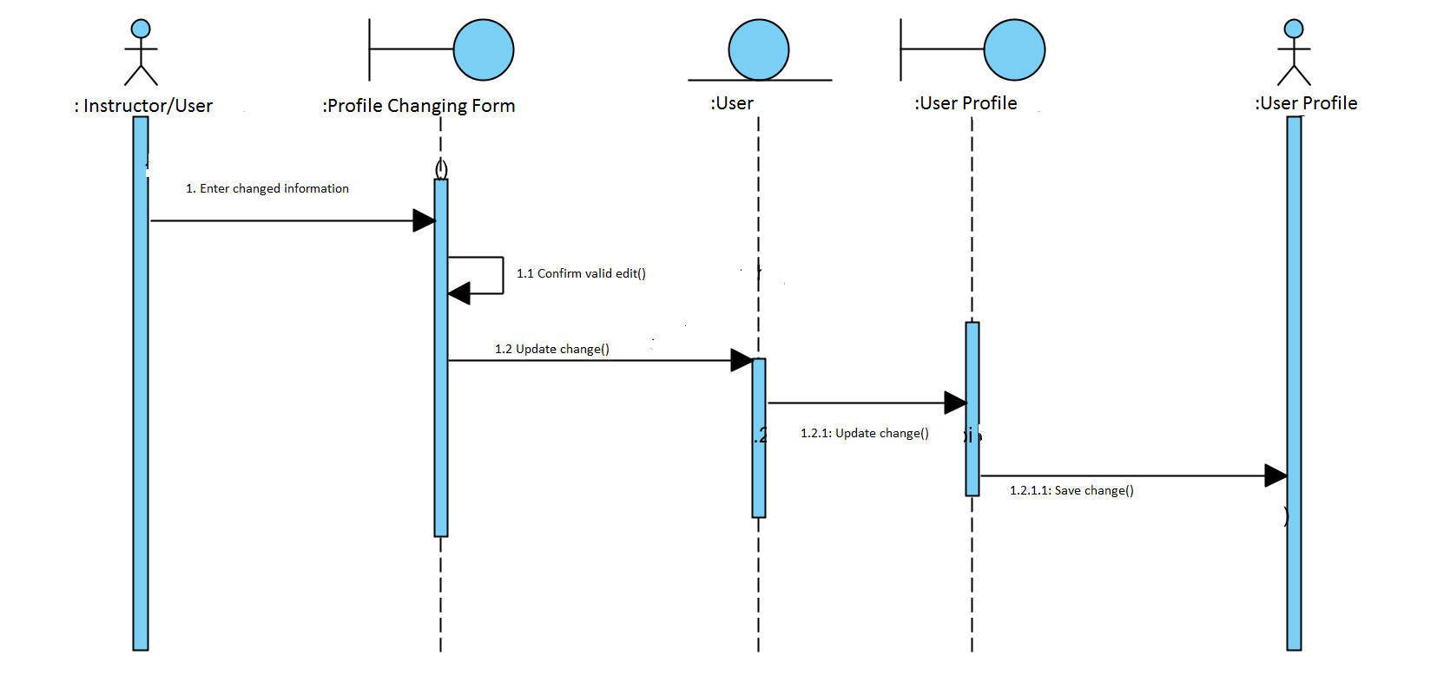
2.1.2 Change profile

Slide 19
2.2. Use case realization view of participating classes (VOPCs)
2.2.1 Log in 2.2.8 Course feedback
2.2.2 Change profile 2.2.9 Course creating
2.2.3 Course searching 2.2.10 Homework grading
2.2.4 Course enrolling 2.2.11 Register
2.2.5 Homework uploading 2.2.12 Register confirming
2.2.6 Tutorial uploading 2.2.13 User management
2.2.7 Student certificate confirming 2.2.14 Course management

Slide 20
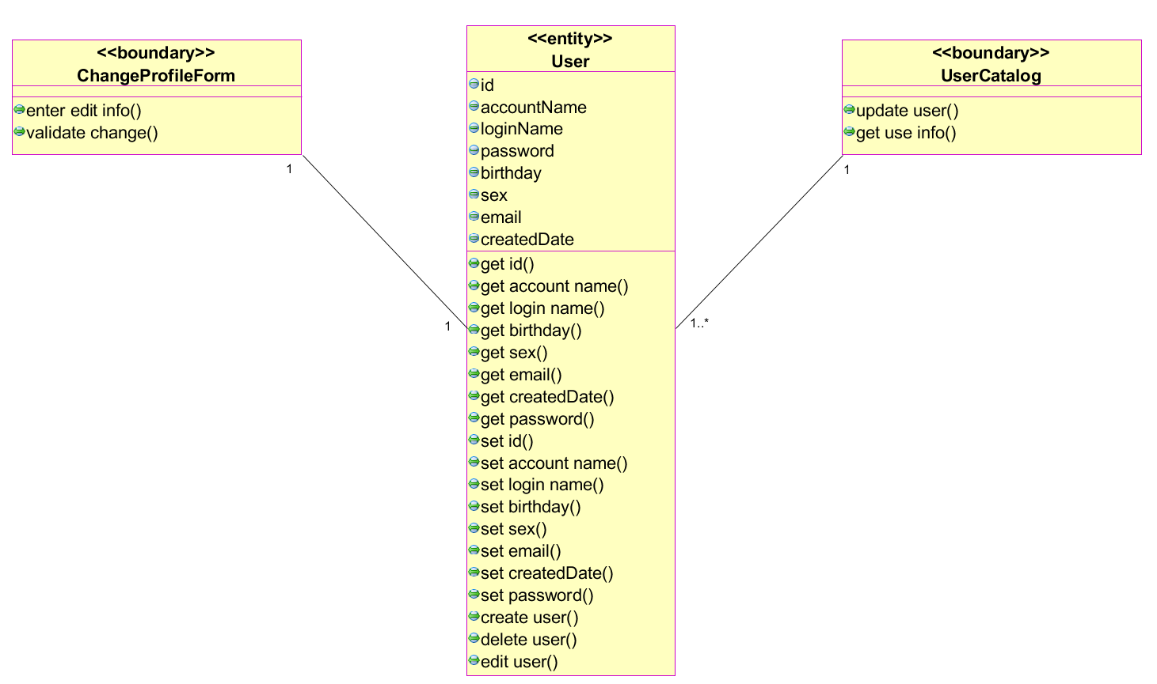
2.2.1 Change profile

