Slide 1

H.11 AI English Tutor
21CNTThuc - Xử lý ngôn ngữ tự nhiên ứng dụng Group 5 - Teach me 19127620 - Nguyễn Văn Vũ Tường 20127349 - Trần Quốc Thuận
Improve your English proficiency with AI

Slide 2
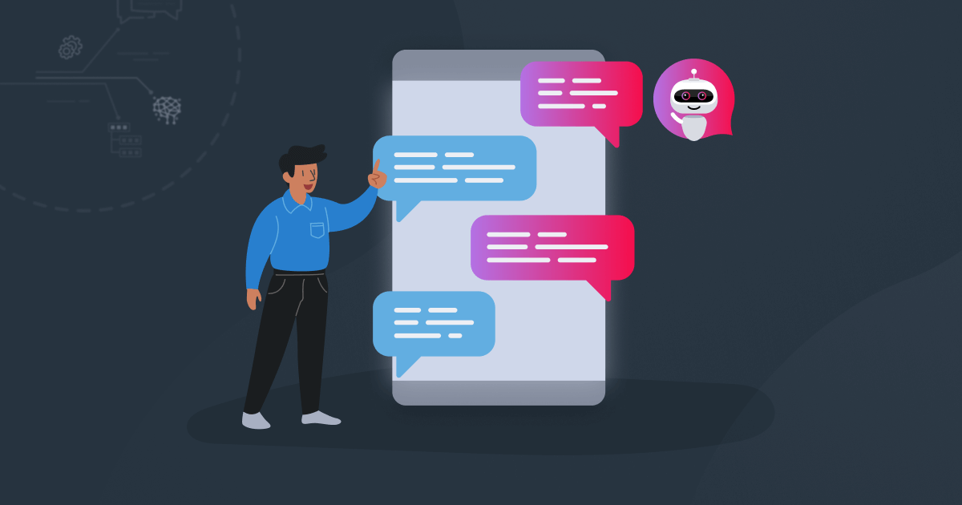
1. Introduction
Artificial Intelligence (AI) has revolutionized language learning by making it more interactive and personalized. This project showcases an AI-driven piece of software, designed to improve the English proficiency of its users.
This project uses the state-of-the-art natural language processing capabilities of OpenAI's GPT-3.5 Turbo large language model and combines it with ElevenLabs' high-quality text-to-speech technology. Everything is then presented in an intuitive and accessible user interface built using Streamlit.

Slide 3
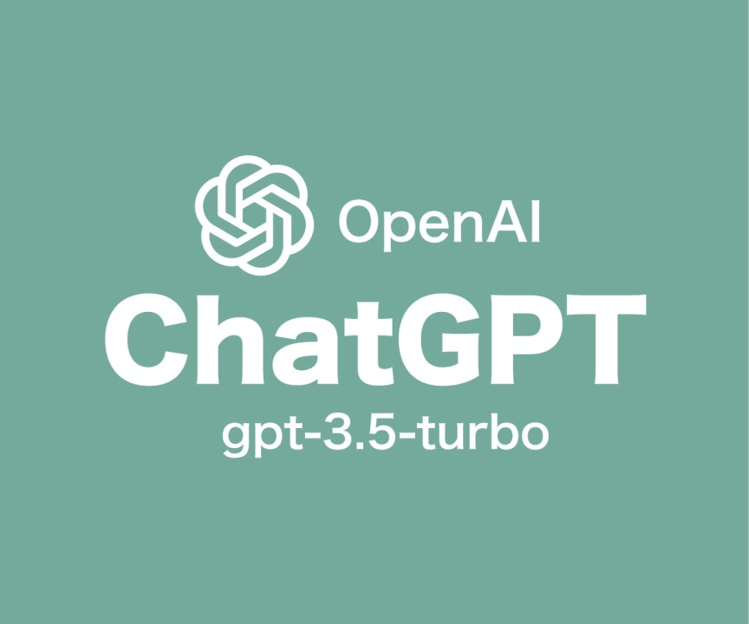
2. OpenAI’s GPT-3.5 Turbo
OpenAI's large language model serves as the core of our AI tutor. Through OpenAI's model, the tutor generates real-time responses to the user’s input. The tutor helps improve the user’s English proficiency by providing corrections and initiating dialogues for practice.

Slide 4
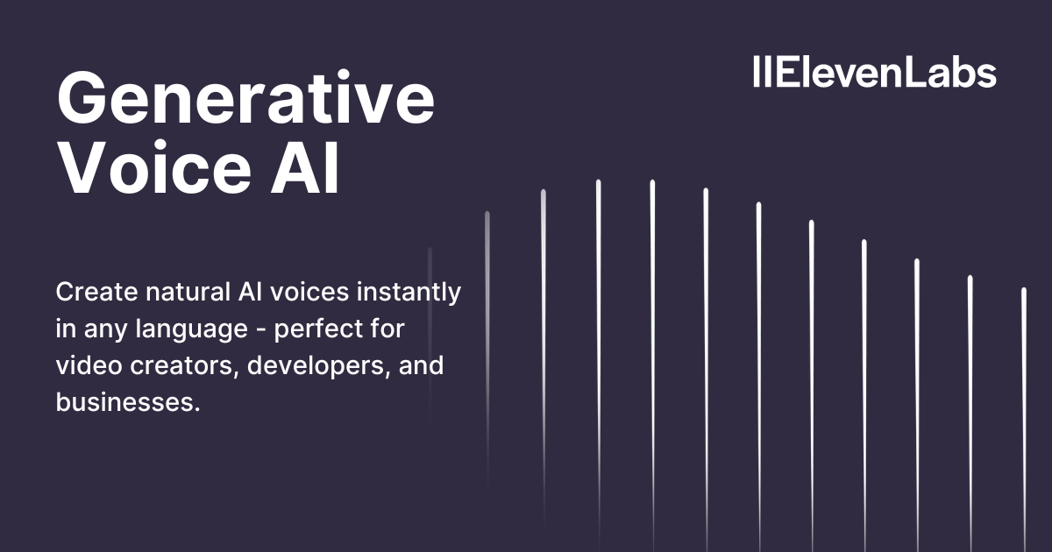
3. ElevenLabs’ Speech Synthesis
After a response is obtained from the language model, it is converted into audible speech using ElevenLabs' technology, providing auditory reinforcement for the learning experience. Users have the ability to select different voices for the output.
The inclusion of this technology helps create a more immersive language learning environment, combining text with audio.

Slide 5

4. Streamlit
Streamlit is a promising open-source Python library, which enables developers to build attractive user interfaces in no time.
Streamlit provides the user interface for our AI tutor. It lets users easily enter their input and interact with the tutor.

Slide 6

5. Google’s Colaboratory
Colaboratory (Colab) allows anyone to write and execute Python code through a web browser. Colab is entirely cloud-based, which means that we don't need to install anything on our computer. All the processing is done on Google's servers, which makes Colab easy to use on any device.
Colab provides a stable environment for the deployment of our project.

Slide 7
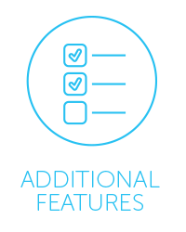
6. Additional features
This project can be further expanded with additional features.
For example:
Give a piece of advice on learning English.
Explain a mistake that people often make while using English.
Explain a word or phrase, then use it in a sentence.
Convey an idea in a different way.
Pronounce a sentence.
…

Slide 8

7. Limitations
The language model has certain limitations. While adept at generating responses based on vast data sets, it may provide inaccurate information or fail to grasp complex subject matter.
While assessing sentences and essays answering IELTS or TOEIC writing tests, the language model can’t seem to follow the rubrics of IELTS or TOEIC. Nor can it accurately assess the content and organization of the essays.

Slide 9
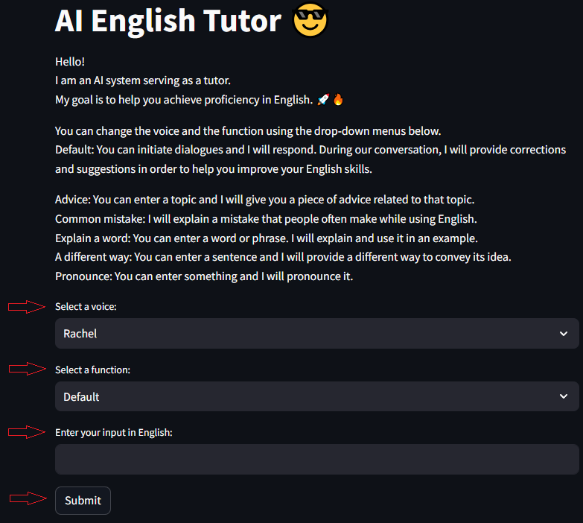
8. Demonstration
You can interact with the tutor using the drop-down menus, input field, and submit button.

Slide 10
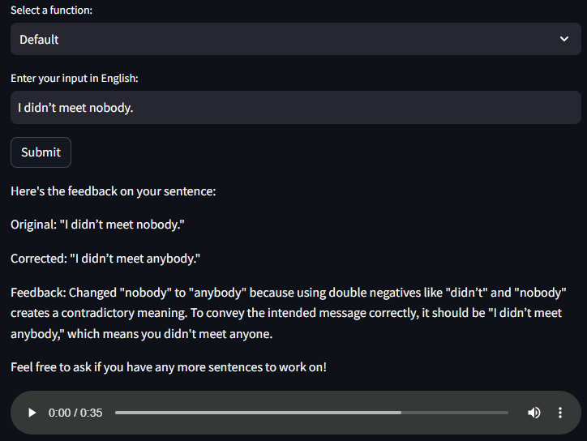
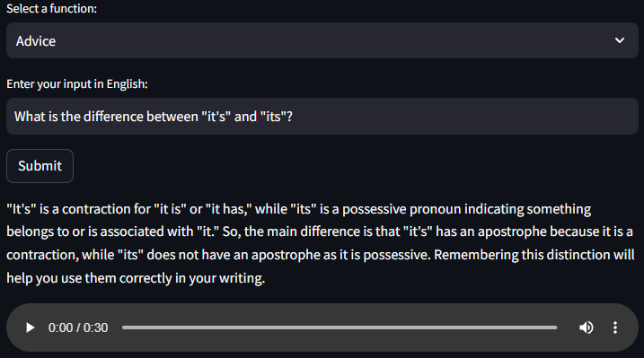
8. Demonstration
Here are a few examples:

Slide 11
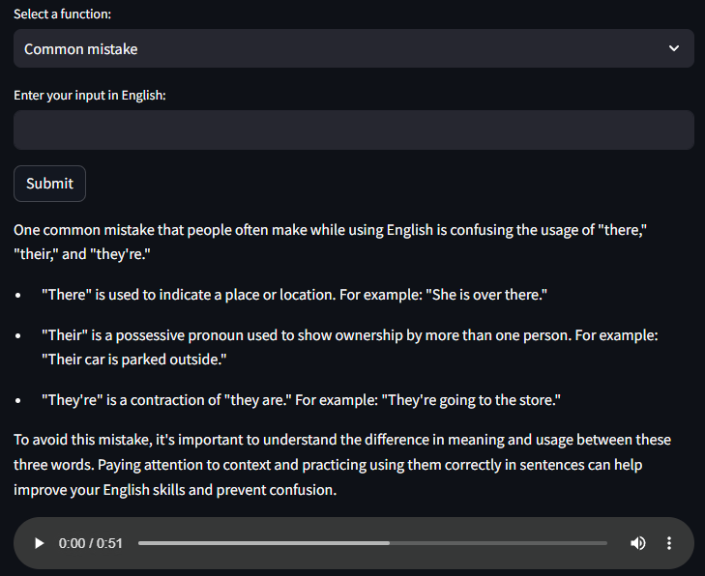
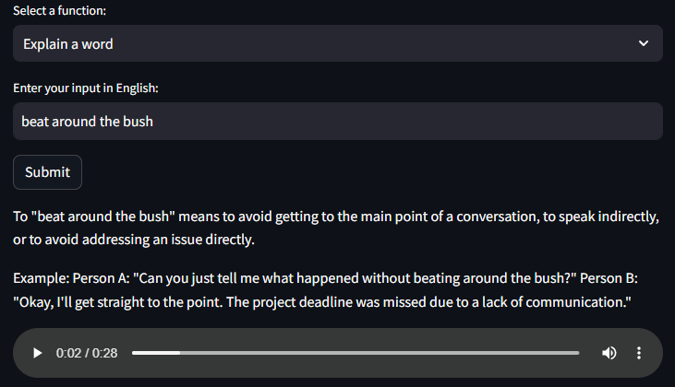
8. Demonstration
Here are a few examples:

Slide 12
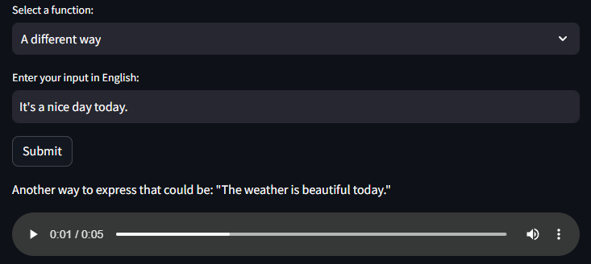
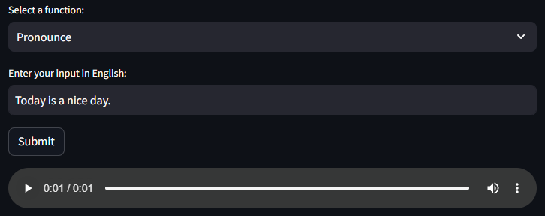

8. Demonstration
Here are a few examples:
You can find more examples and the instructions on how to run the tutor in the documentation file.

Slide 13

9. End of the presentation
This project serves as a showcase of how AI technologies can be integrated to create a comprehensive learning tool and how they can be made accessible through an intuitive user interface.
This project highlights the significant strides made in AI-powered education and the promising potential it holds for future learning methodologies.

